Slide 1


KadabrA
-Nidhi Sarode
-Rishi Nandedkar
-Ranga Chari .V

Slide 2
Problem Statement
Amazon faces the major issue of investing heavily in their warehouses in various states of USA which is proving to be an expensive deal to expedite the same day delivery process.
To provide the same day delivery service, building warehouses in all the required locations is not economical. So, the objective is to come up with an integrated approach that would make the current delivery process more efficient and extend the service to a larger number of customers for as many products as possible.

Slide 3
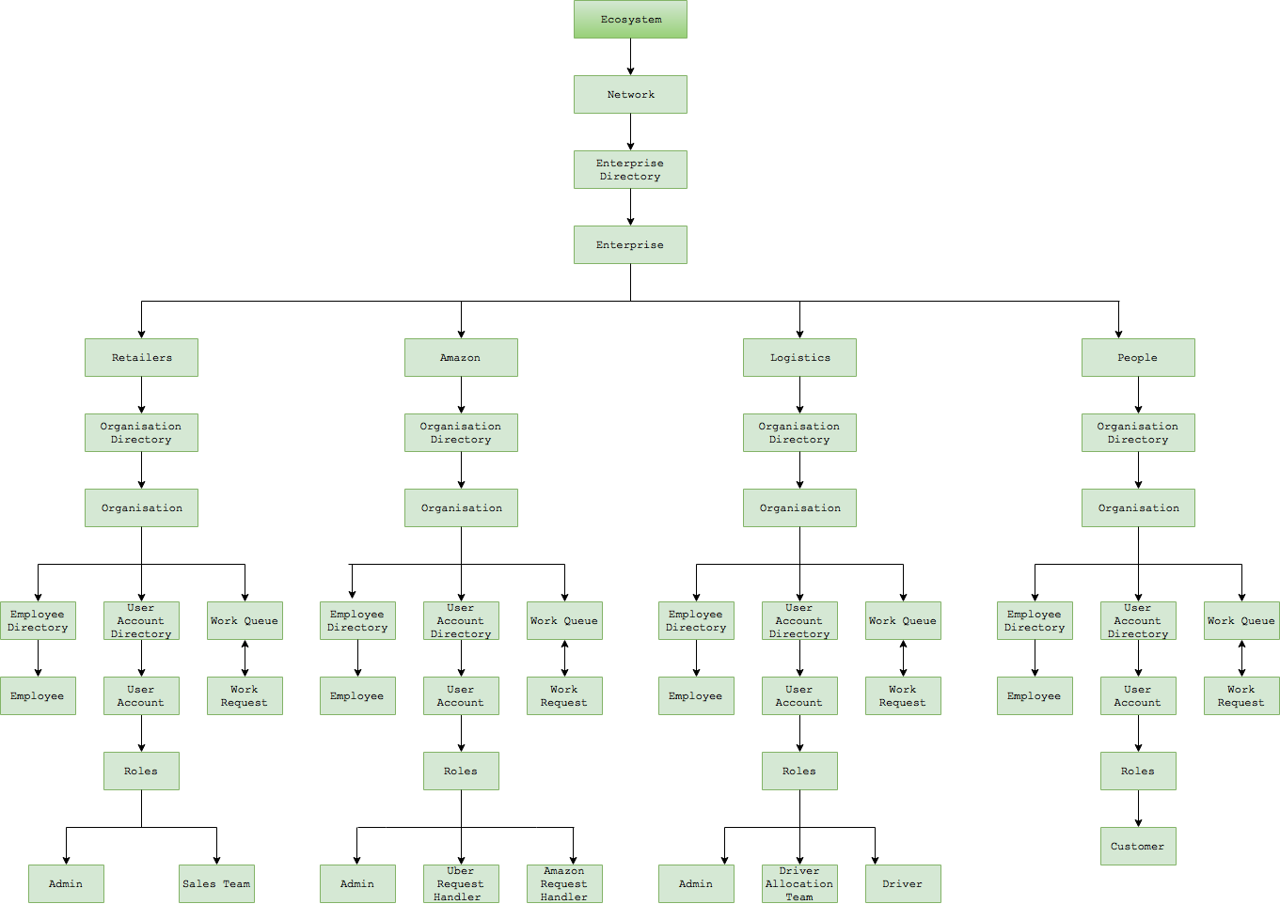
OBJECT MODEL :

Slide 4
Special Features
It is an implementation of the complete Ecosystem Model
The products gets segregated according to the category of the product and then provided to the enterprise
The revenue can be calculated by each city, by each area as per the retailers

Slide 5
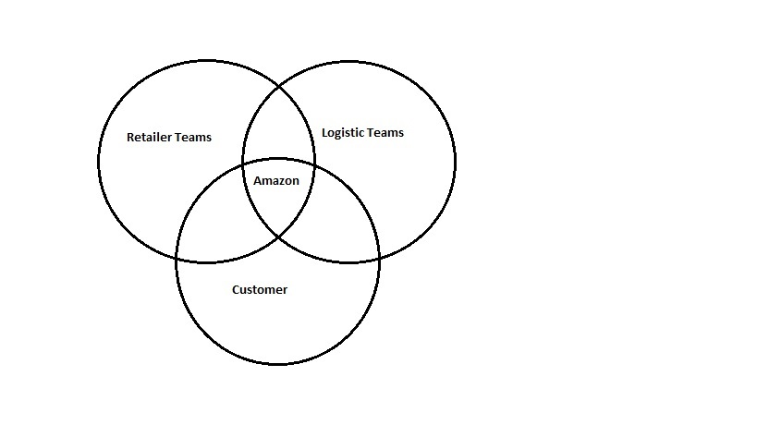
Key Roles
The Key Roles are the following:
Amazon
Retailers
Logistics
Customers

Slide 6
Workflow
Customer sign up
Order placement
Information sent to dashboard system like customer information, location, product type and retailer
Await confirmation from retailers and partner organization
Confirmed order which is put up is to be accepted by local logistics individuals/organizations
Order information sent to delivery executive and confirmation received after successful delivery

Slide 7
Order prerequisites for eligibility
Time of Order – Orders should be placed before 12:00 pm
Product Type – Products must be available with retailers and partner organizations
Customer Location – Customer must specify the area critical radius, as specified by retailers and logistics organizations

Slide 8
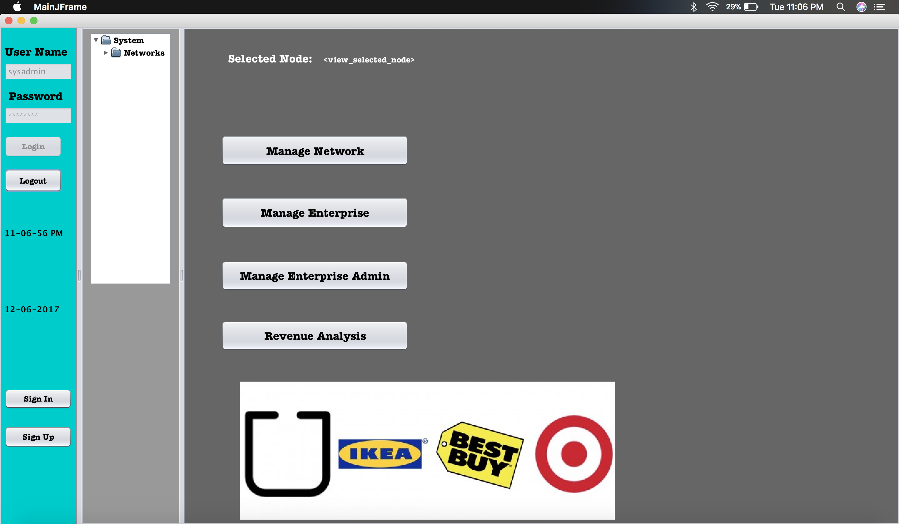
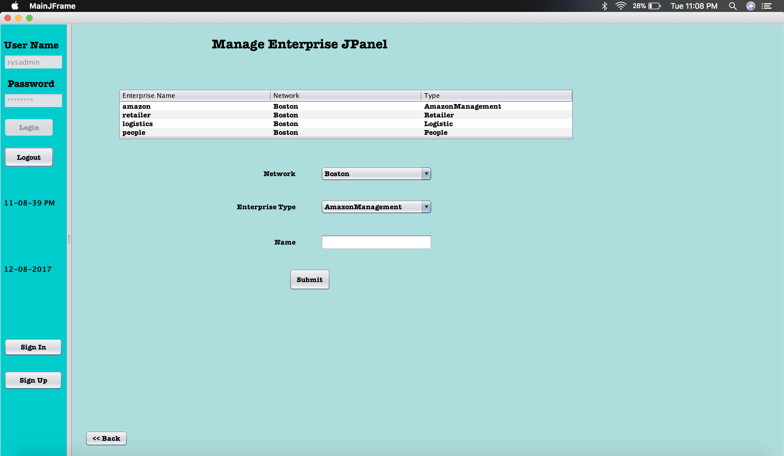
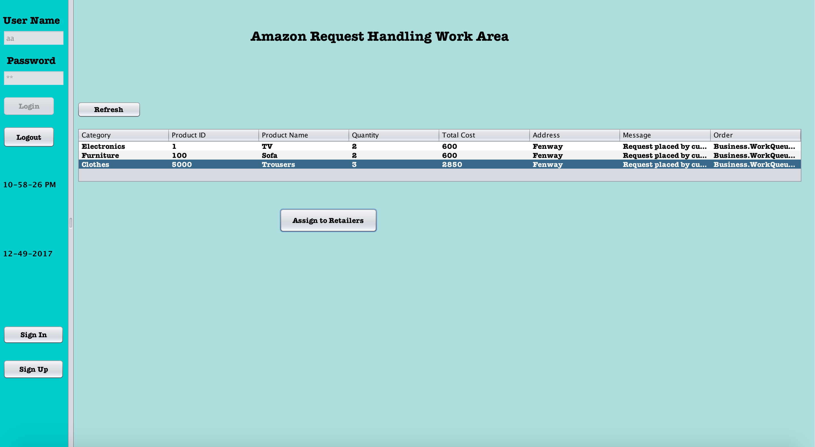
SCREEN SHOTS

Slide 9
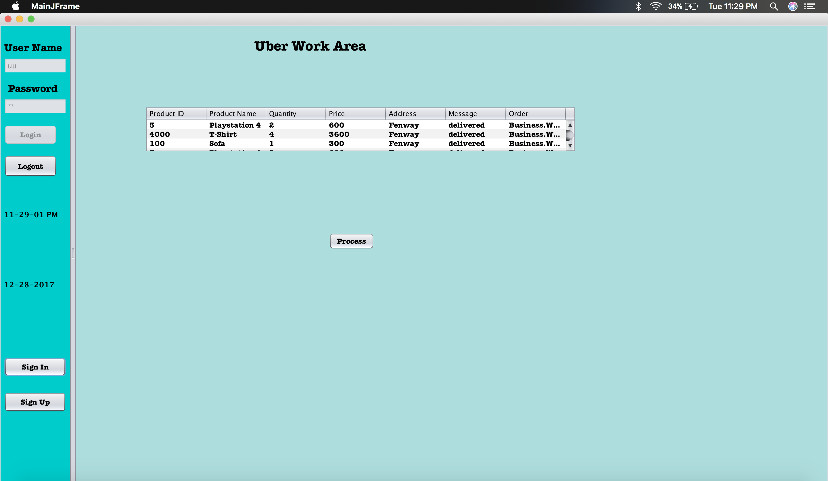
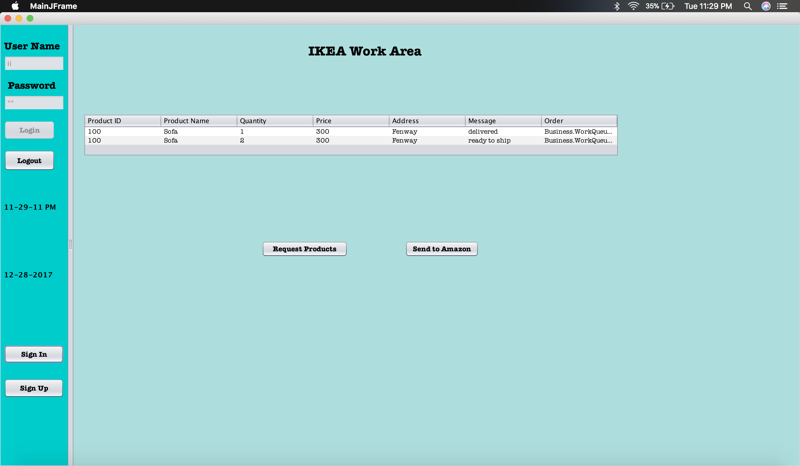
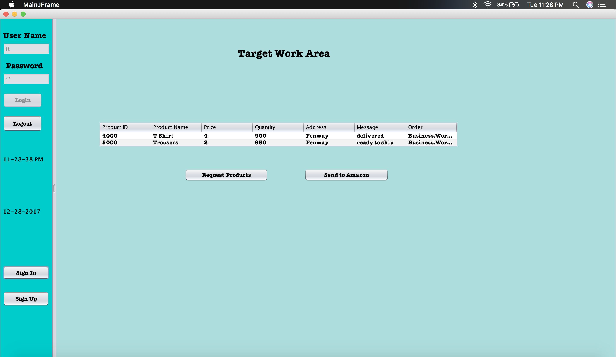
WORK AREAS:

Slide 10
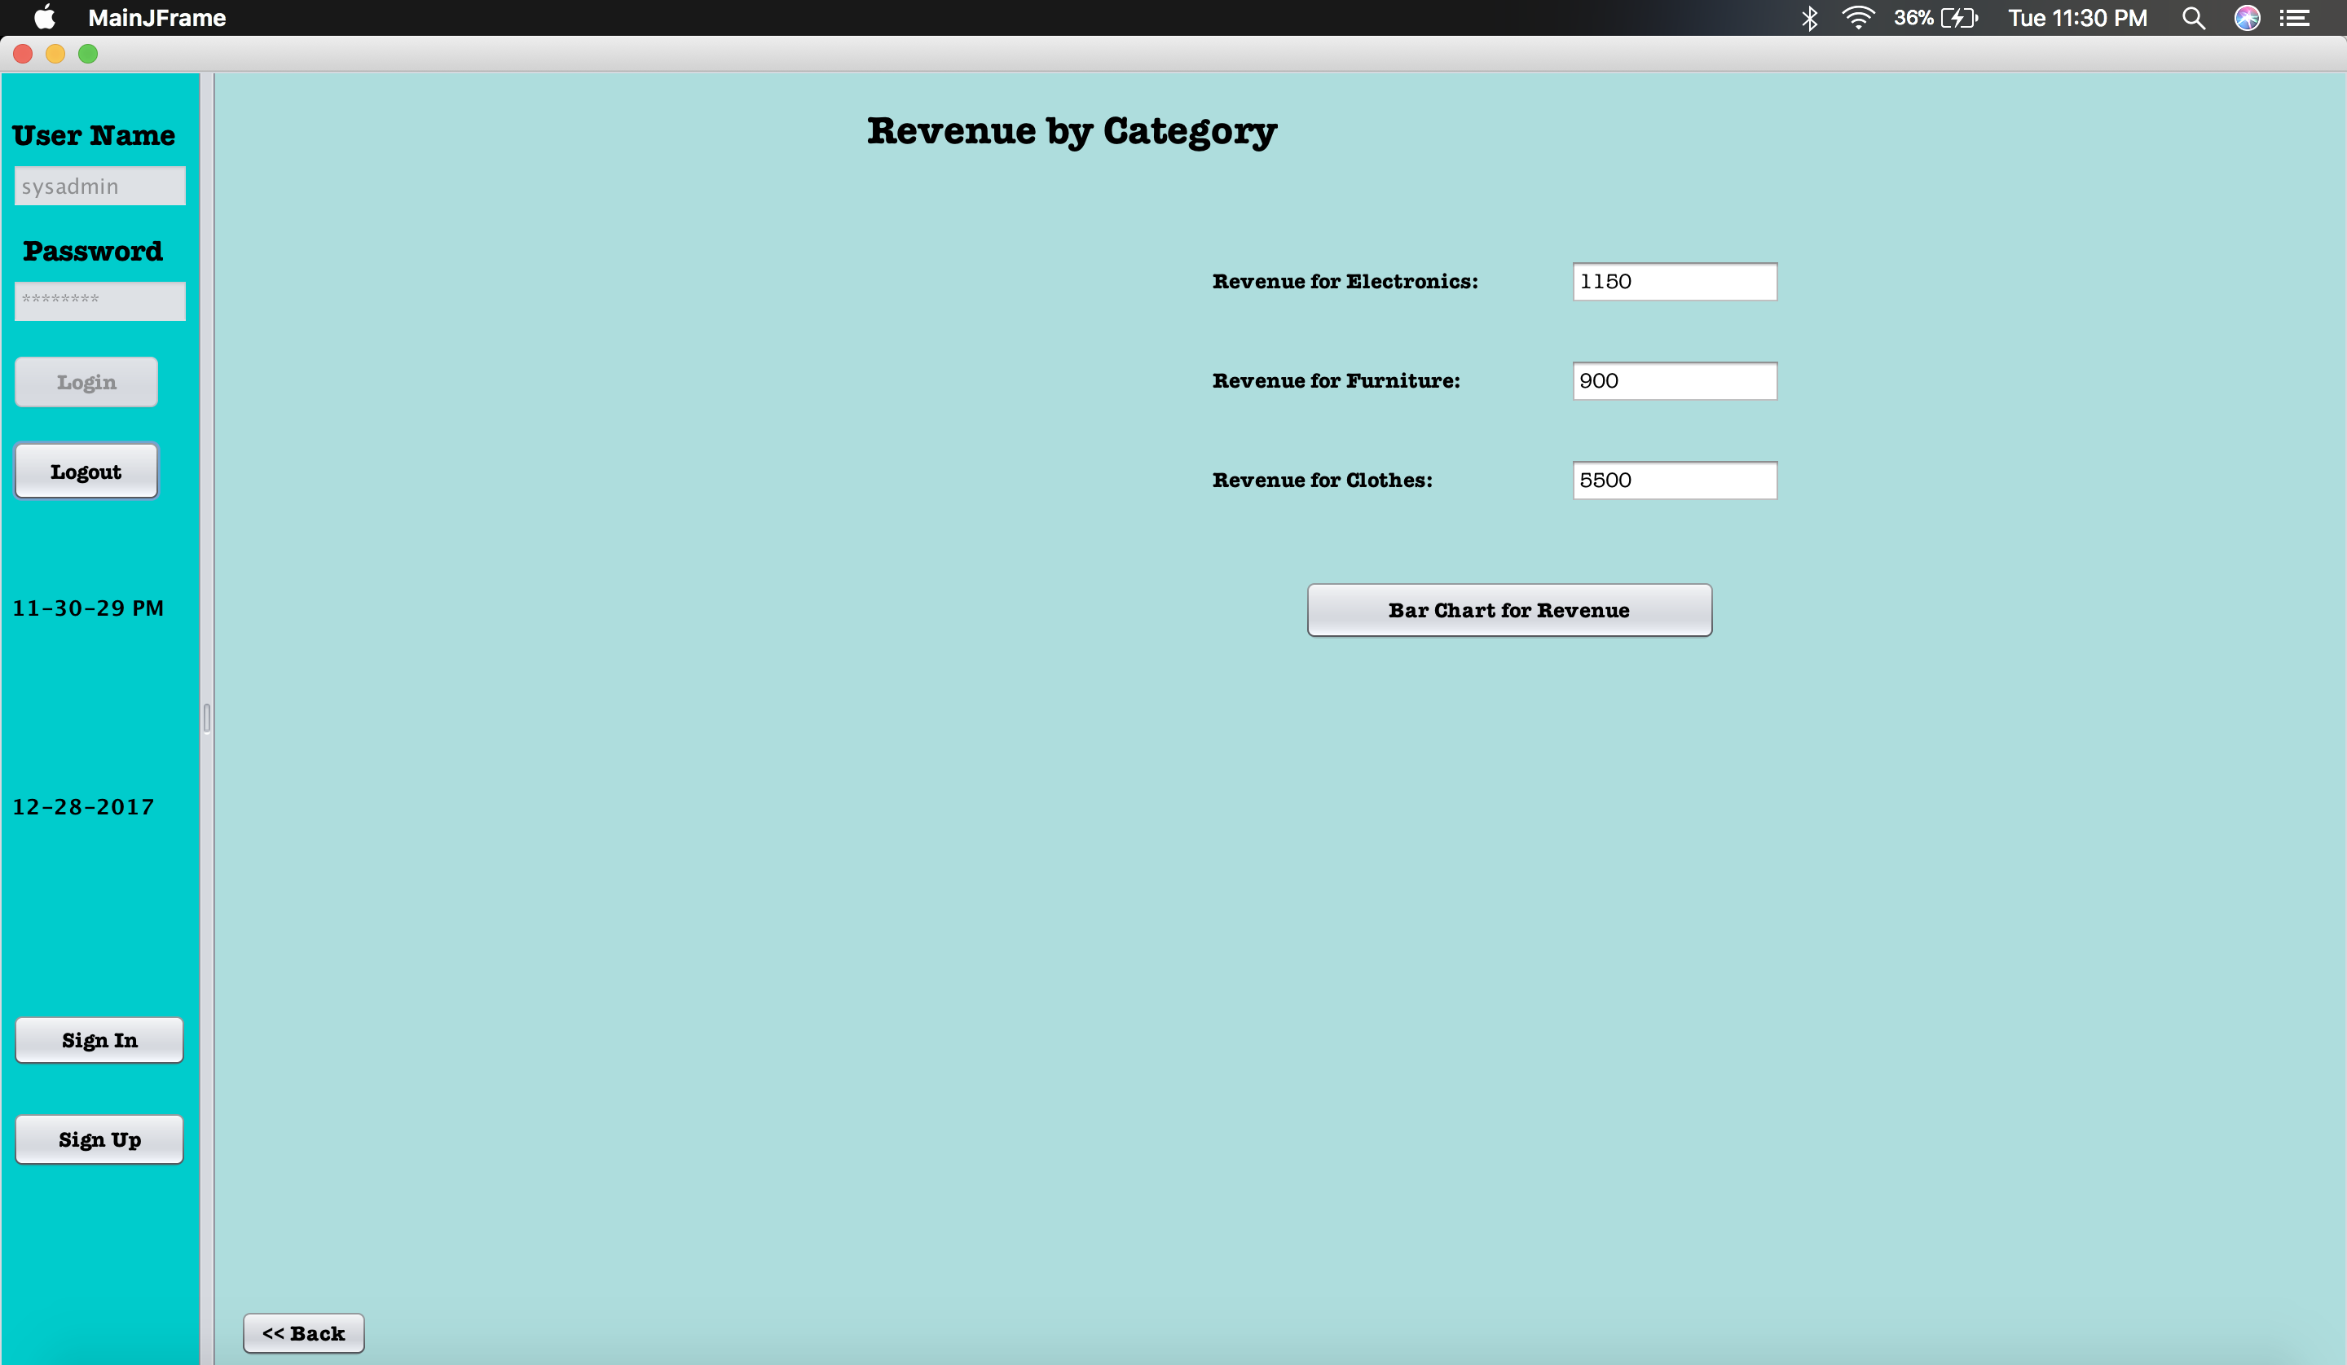
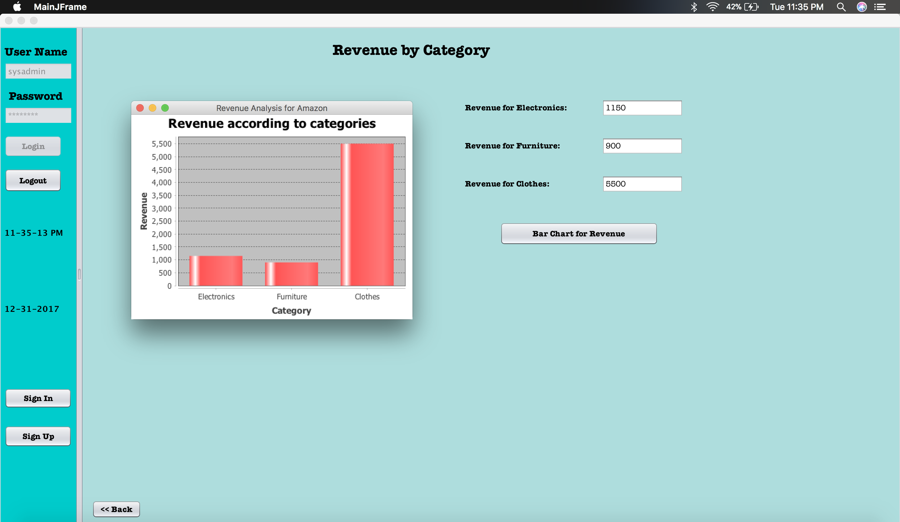
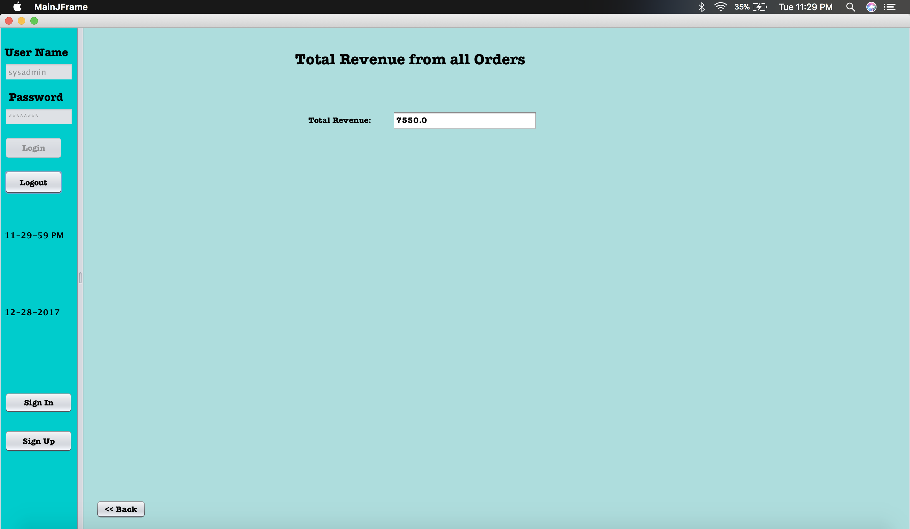
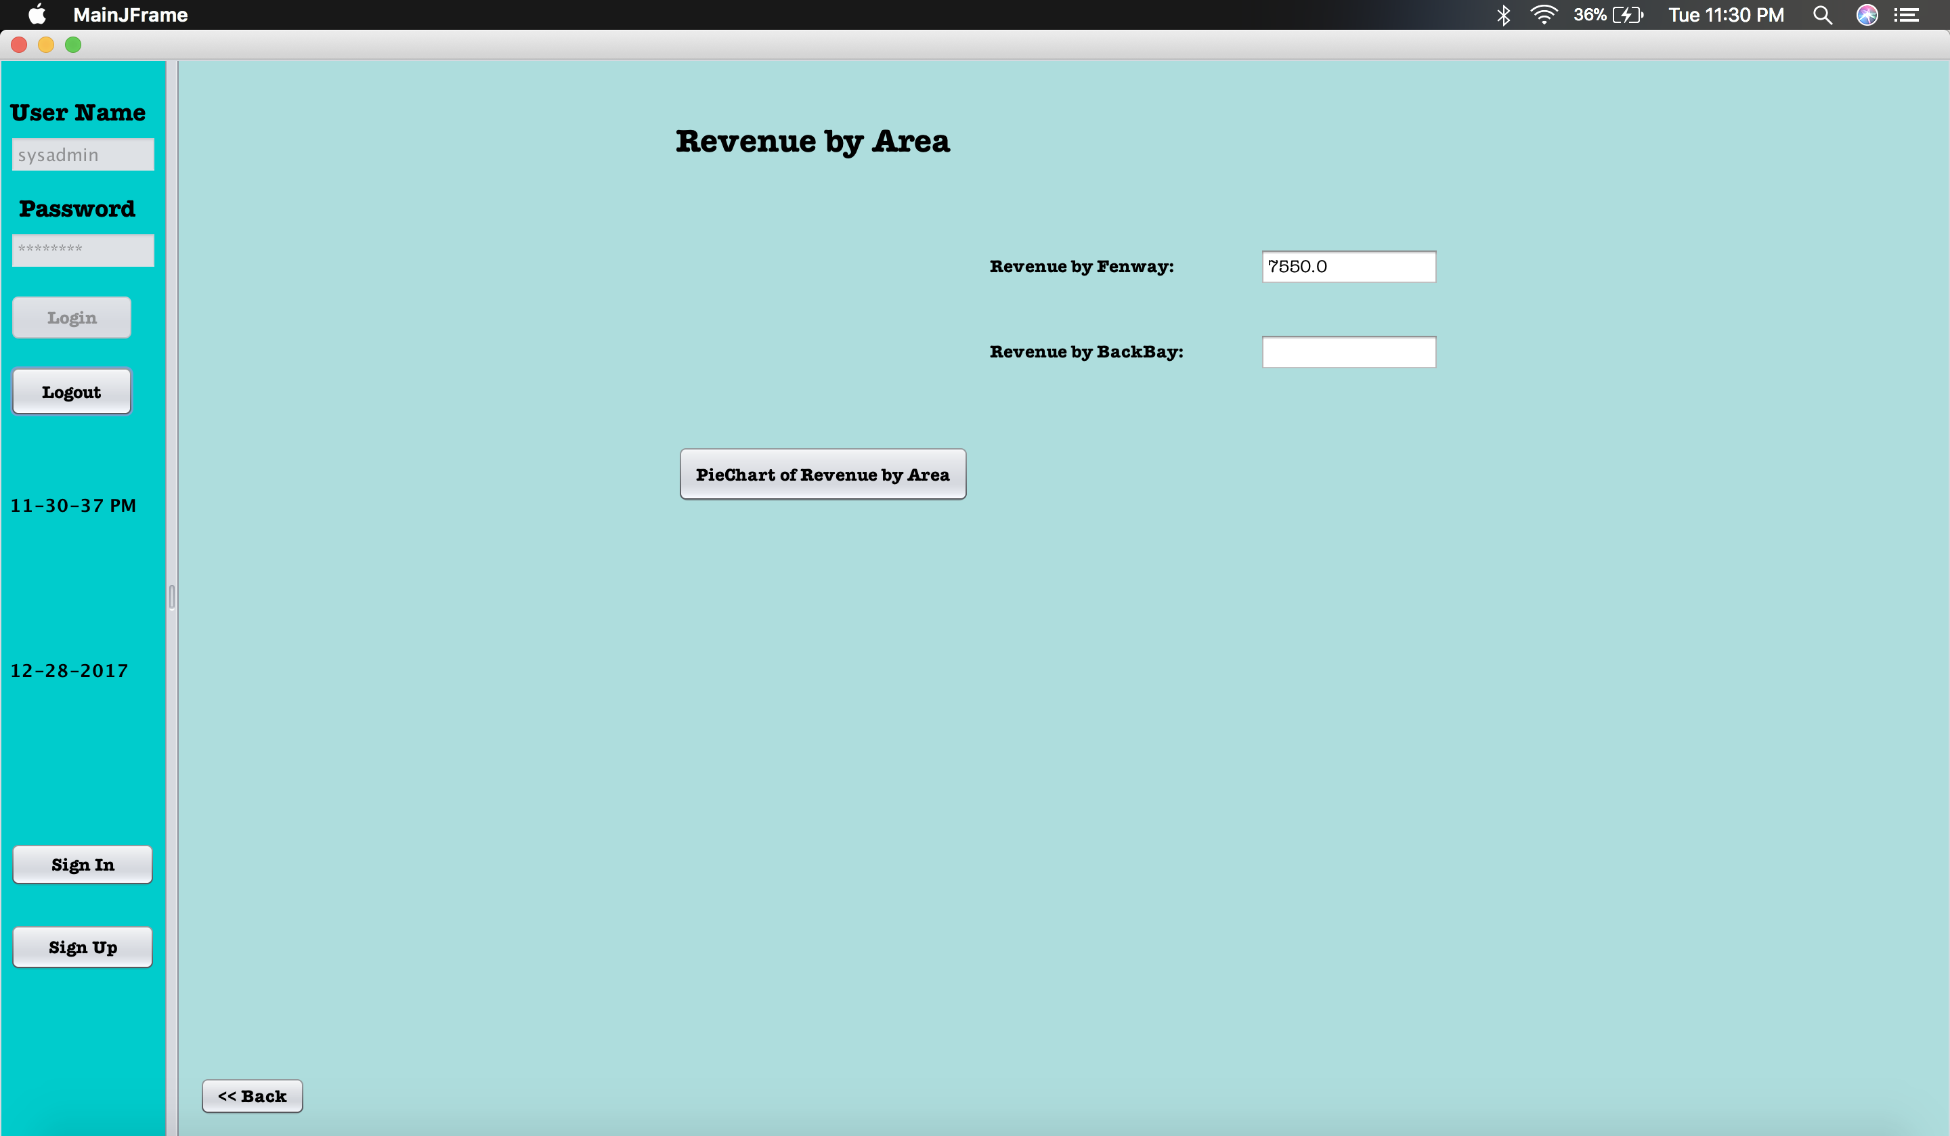
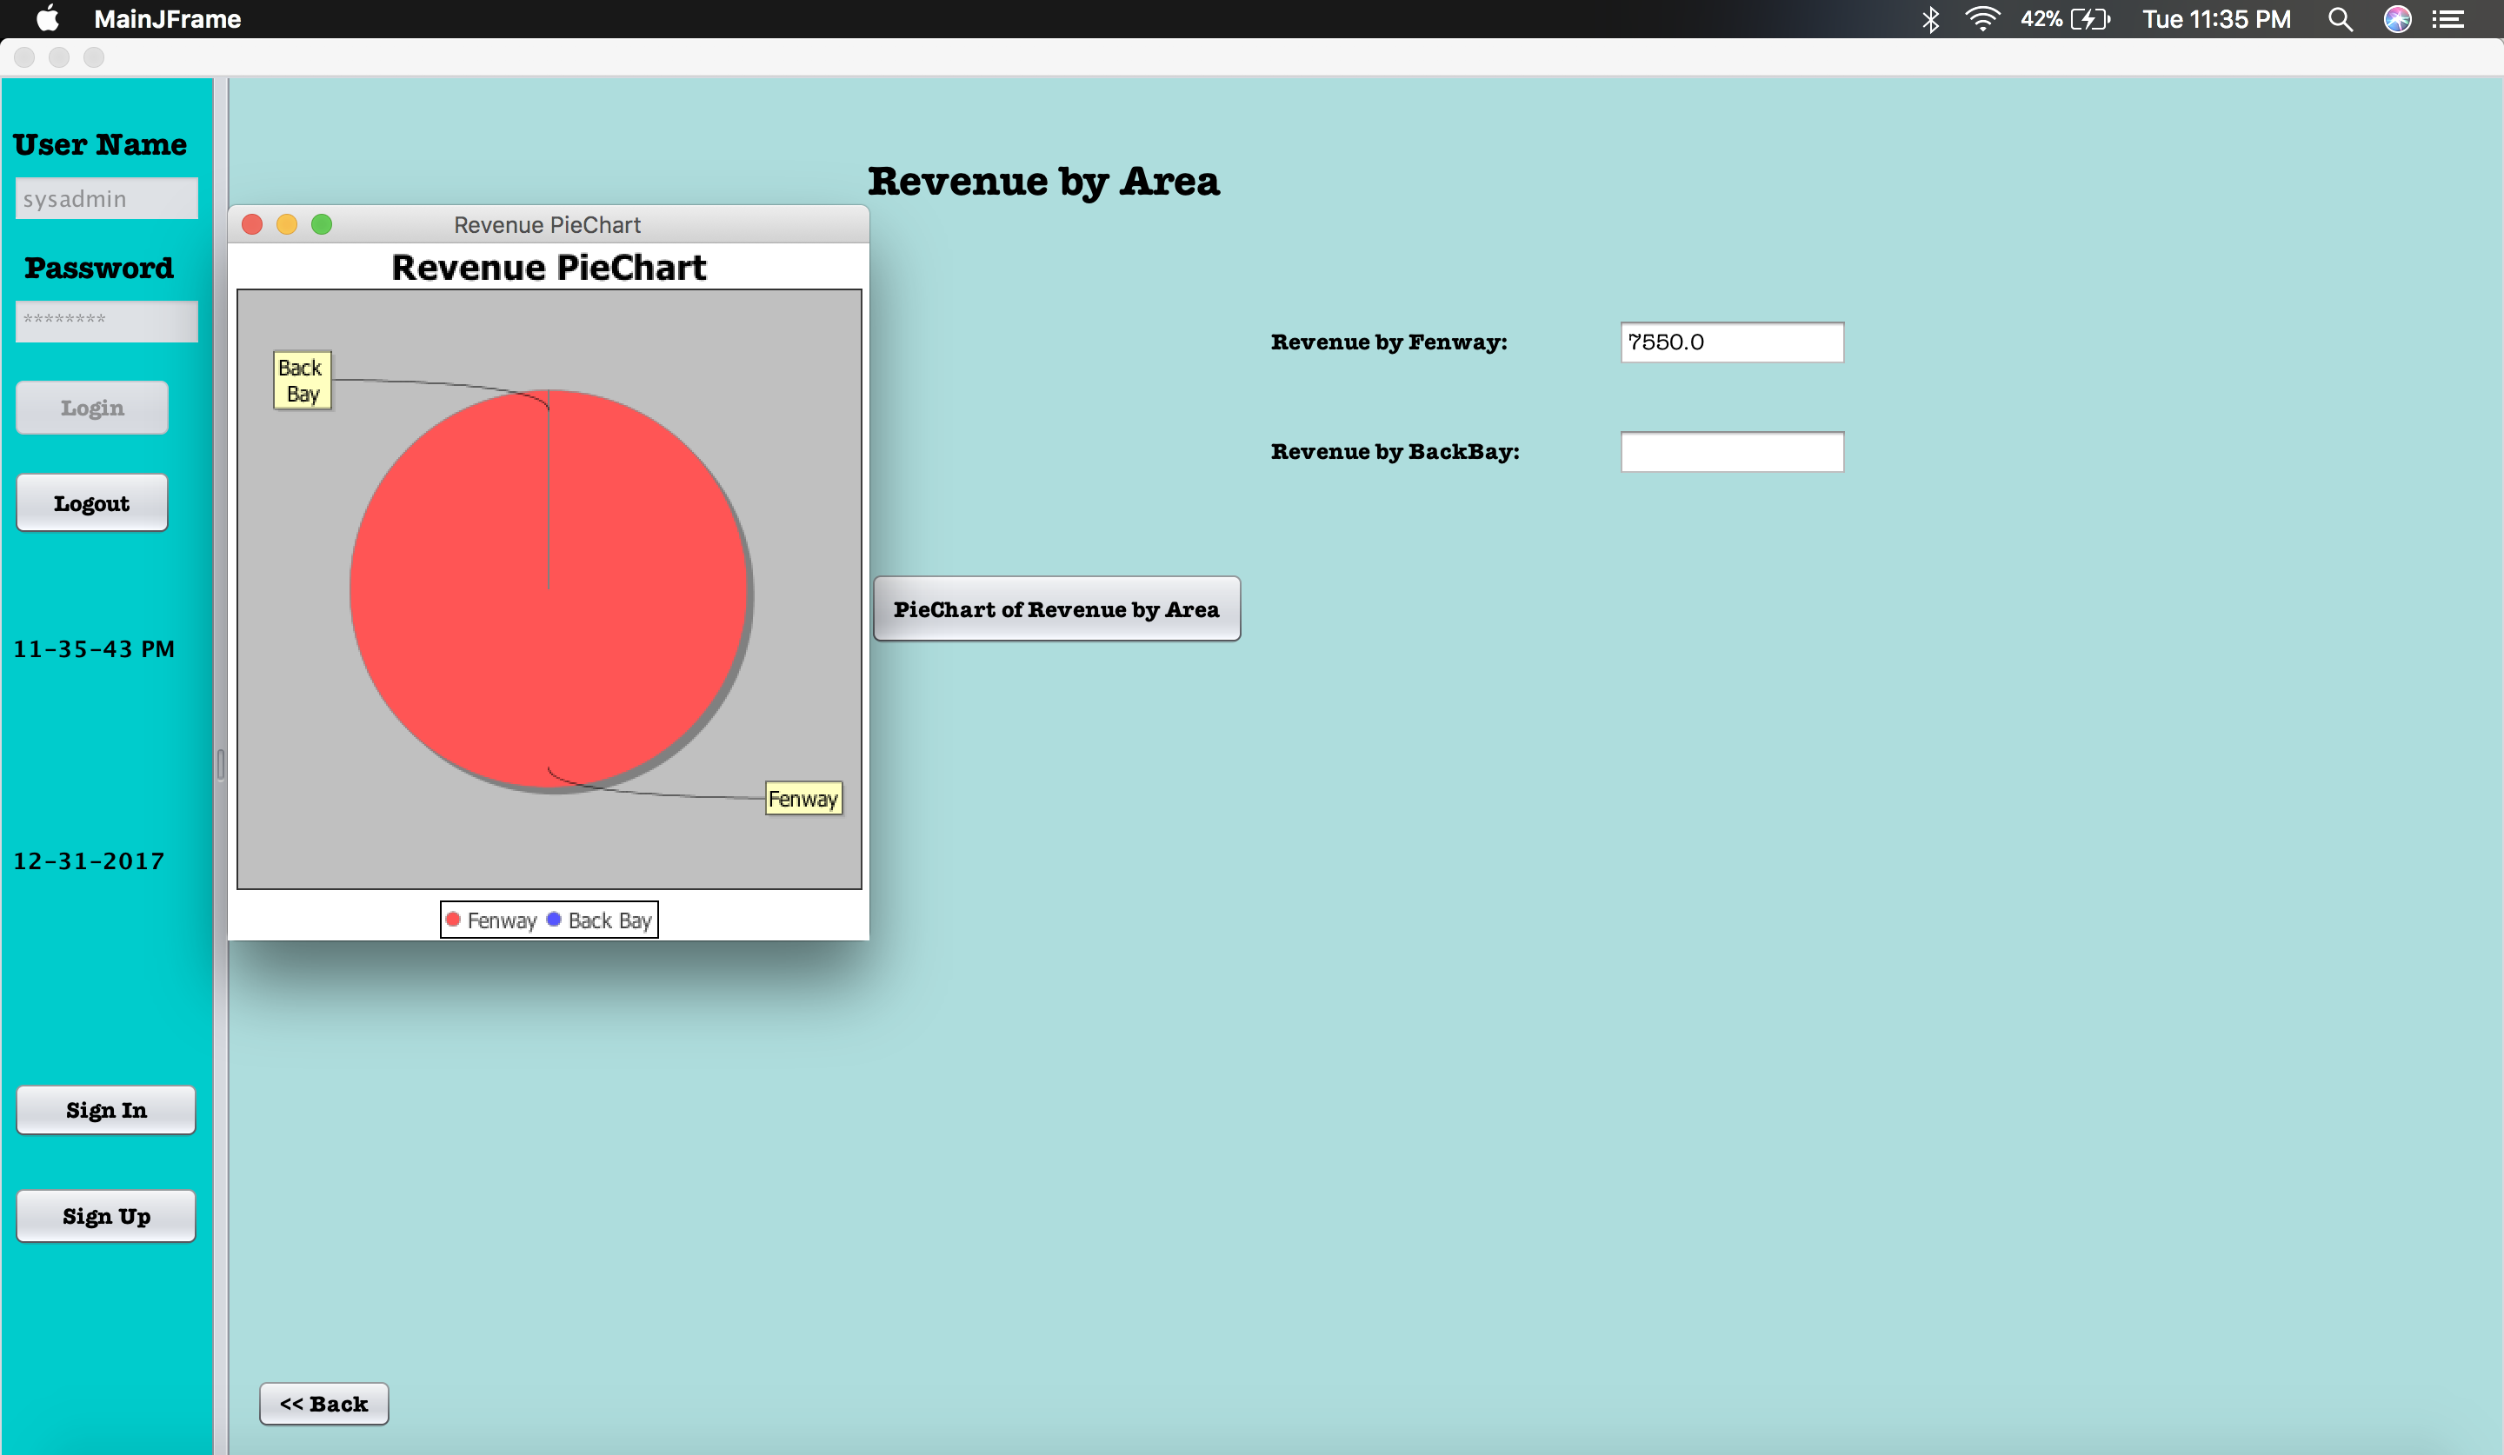
ANALYSIS:

Slide 11
Thank YOU
Divided by Organizations United by Purpose

