Slide 1
Mining of Web Server Logs Using Big Data Technologies
Internal Guide : Dr. Bipin Bihari Jayasingh (Prof. IT Dept)
Ashish R Francis – 11B81A1214
Karthik T – 11B81A1226
B R Rishinder Kumar– 11B81A1259

Slide 2
Introduction
In today’s Internet world, log file analysis is becoming a necessary task for analyzing the customer’s behavior in order to improve advertising and sales.
For datasets like environment, medical,banking system it is important to analyze the log data to get required knowledge from it.
Log files are getting generated very fast at the rate of 1-10 Mb/s per machine, a single data center can generate tens of terabytes of log data in a day.
These datasets are huge. In order to analyze such large datasets we need parallel processing system and reliable data storage mechanism.

Slide 3
The Hadoop framework provides reliable data storage by Hadoop Distributed File System and MapReduce model which is a parallel processing system for large datasets.
Hadoop distributed file system breaks up input data and sends fractions of the original data to several machines in hadoop cluster to hold blocks of data.
This mechanism helps to process log data in parallel using all the machines in the hadoop cluster and computes result efficiently.

Slide 4
Why do we need to analyse the logs ?
Number of visits and number of unique visitors
Visit duration and last visits
Authenticated users, and last authenticated visits
Days of week and rush hours
Domains/countries of host's visitors
Hosts list
Number of page views
Most viewed, entry, and exit pages
Detecting DDoS attacks

Slide 5
Why Hadoop ?
Conventional database solutions are not suitable for analyzing such log files because they are not capable of handling such a large volume of logs efficiently.
Andrew Pavlo and Erik Paulson in 2009 compared the SQL DBMS and Hadoop MapReduce and suggested that Hadoop MapReduce tunes up with the task faster and also load data faster than DBMS.
Also traditional DBMS cannot handle large datasets. This is where big data technologies come to the rescue.
Hadoop-MapReduce is applicable in many areas for Big Data analysis. As log files is one of the type of big data so Hadoop is the best suitable platform for storing log files and parallel implementation of MapReduce program for analyzing them.

Slide 6
Implementation of Log Processor
Log processor is implemented in 3 phases
Log pre-processing
Interacting with HDFS
Implementation of MapReduce programming

Slide 7
Log pre-processing
In any analytical tool, pre-processing is necessary, because Log file may contain noisy & ambiguous data which may affect result of analysis process.
Log pre-processing is an important step to filter and organize only appropriate information before applying MapReduce algorithm.
Three steps for Log pre-processing are:
Individual Field in the Log
Removing Redundant Log Entries
Cleaning

Slide 8
Interacting With HDFS
Hadoop Distributed File System holds a large log files in a redundant way across multiple machines to achieve high availability for parallel processing and durability during failures.
It is block-structured file system as it breaks up log files into small blocks of fixed size. Default size of block is 64 MB as given by Hadoop but we can also set block size of our choice.
These blocks are replicated over multiple machines across a Hadoop cluster. Replication factor is 3 so Hadoop replicates each block 3 times so even if in the failure of any node there should be no data loss.
Hadoop MapReduce jobs automatically draws their input log files from HDFS by setting the fs.default.name configuration option to point to the NameNode.

Slide 9
MapReduce
MapReduce is a simple programming model for parallel processing of large volume of data.
Fundamental concept of MapReduce is to transform lists of input data to lists of output data.
It happens many times that input data is not in readable format; it could be the difficult task to understand large input datasets. In that case, we need a model that can mold input data lists into readable, understandable output lists.
MapReduce does this conversion twice for the two major tasks: Map and Reduce just by dividing whole workload into number of tasks and distributing them over different machines in the Hadoop cluster
MapReduce is divided into two phases: Map phase and Reduce phase.

Slide 10
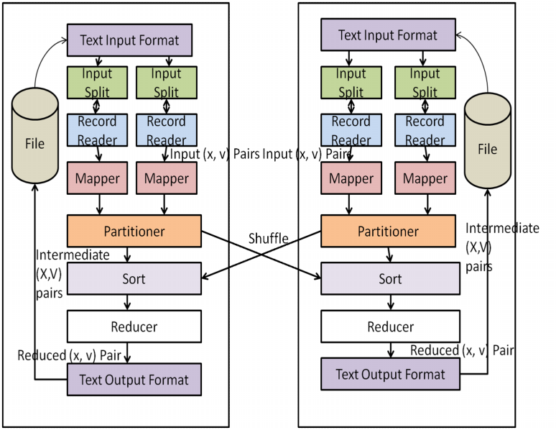
MapReduce Workflow

Slide 11
Map phase
Input to the MapReduce is log file, each record in log file is considered as an input to a Map task.
Map function takes a key-value pair as an input thus producing intermediate result in terms of key-value pair.
It takes each attribute in the record as a key and Maps each value in a record to its key generating intermediate output as key-value pair.
Map reads each log from simple text file, breaks each log into the sequence of keys (x1, x2, …., xn) and emits value for each key which is always 1. If key appears n times among all records then there will be n key-value pairs (x, 1) among its output.
Map: (x1, v1) [(x2, v2)]

Slide 12
Grouping
After all the Map tasks have completed successfully, the master controller merges the intermediate results file from each Map task that are destined for a particular Reduce task and feeds the merged file to that process as a sequence of key-value pairs.
That is, for each key x, the input to the Reduce task that handles key x is a pair of the form (x, [v1, v2, . . . , vn]), where (x,v1), (x, v2), . . . , (x, vn) are all the key-value pairs with key x coming from all the Map tasks.

Slide 13
Reduce phase
Reduce task takes key and its list of associated values as an input.
It combines values for input key by reducing list of values as single value which is the count of occurrences of each key in the log file, thus generating output in the form of key-value pair (x, sum).
Reduce: (x2, [v2]) (x3, v3)

Slide 14
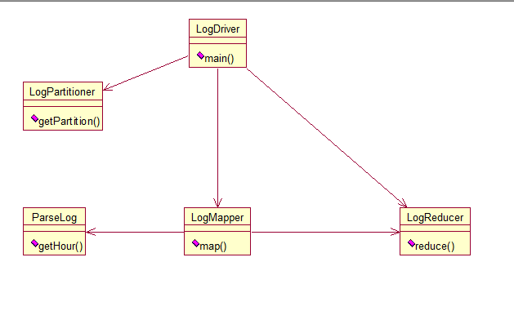
Class Diagram

Slide 15
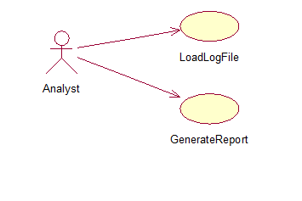
Use Case Diagram

Slide 16
System Requirements
Software Requirements
Ubuntu OS
Apache Hadoop 1.0.3
Java 1.6
Hardware Requirements
dua
l processor/dual core machines with 4-8GB of RAM

Slide 17
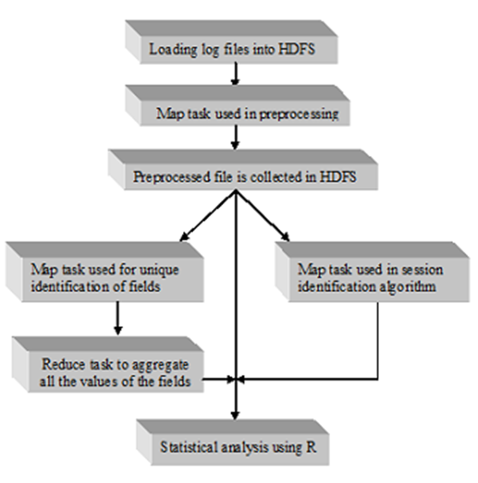
System Architecture

Slide 18
199.72.81.55 - - [01/Jul/1995:00:00:01 -0400]
"GET /history/apollo/ HTTP/1.0" 200 6245
The Remote IP address: This identifies who had visited the web site;
User Authentication: Username and password if the server requires user
authentication(generally empty and represented by a “-”);
The date and time of the request: This attribute is used to determine how long a visitor has spent on a given page;
The operation type (GET, POST, HEAD, etc.): The method used for information transfer is noted;

Slide 19
The requested resource name: The resource accessed by the user. It may be an
HTML page, a CGI program, or a script;
The protocol Version: HTTP protocol being used.
The request status: The HTTP status code returned to he client, e.g., 200 is “ok” and 404 are “not found”;
The requested page size: The content-length of the

Slide 20
Status codes of Hypertext Transfer Protocol
Code Description
101 Switching Protocols
200 OK
201 Created
202 Accepted
203 Non-Authoritative Information
204 No Content

Slide 21
205 Reset Content
206 Partial Content
300 Multiple Choices
302 Found
303 See Other
304 Not Modified
305 Use Proxy
306 (Unused)

Slide 22
307 Temporary Redirect
400 Bad Request
401 Unauthorized
402 Payment Required
403 Forbidden
404 Not Found
405 Method Not Allowed
406 Not Acceptable

Slide 23
407 Proxy Authentication Required
408 Request Timeout
409 Conflict
410 Gone
411 Length Required
412 Precondition Failed
413 Request Entity Too Large
414 Request-URI Too Long
415 Unsupported Media Type

Slide 24
416 Requested Range Not Satisfiable
417 Expectation Failed
500 Internal Server Error
501 Not Implemented
502 Bad Gateway
503 Service Unavailable
504 Gateway Timeout
505 HTTP Version Not Supported
101 Switching Protocols

