Slide 1
SUMMER TRAINING AT upGrad
Field of Training- Python for Data Science
Name-Rishindra Mani Katiyar
Registration no- 11715013
Course Code: CSE443

Slide 2
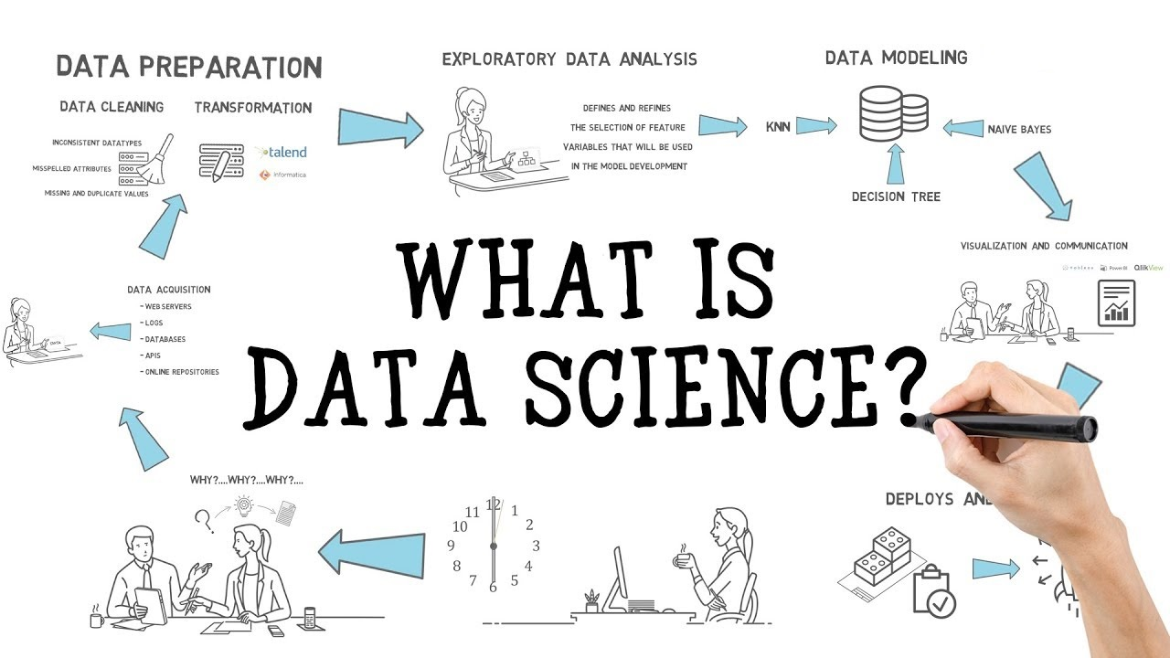

Slide 3
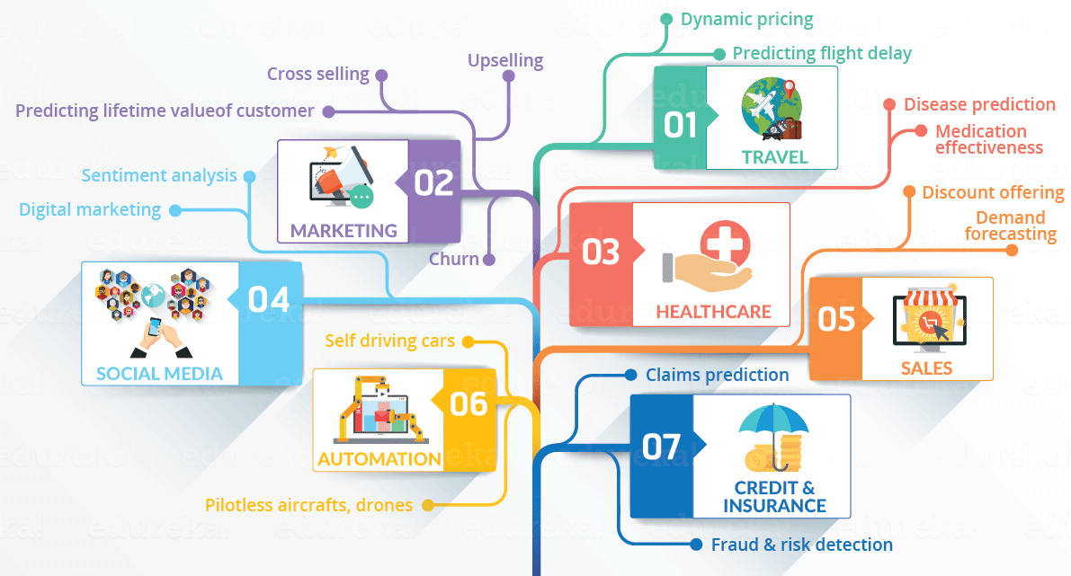
INTRODUCTION
Multidisciplinary blend of data inference, algorithm development, and technology.
Data science is the field of study that combines domain expertise, programming skills,
and knowledge of math and statistics to extract meaningful insights from data.
Data Science Domains

Slide 4
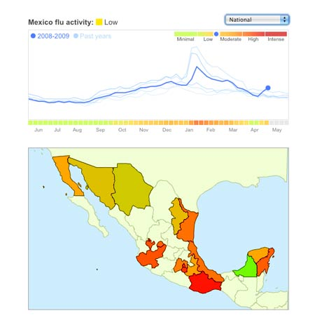
DATA SCIENCE: Why all the Excitement?
Exciting new effective
applications of data analytics
e.g.,
Google Flu Trends:
Detecting outbreaks
two weeks ahead
of CDC data
New models are estimating which cities are most at risk for spread of the Ebola virus.
Prediction model is built on
Various data sources,
types and analysis.
Notes:
CDC: Centers for Disease Control

Slide 5
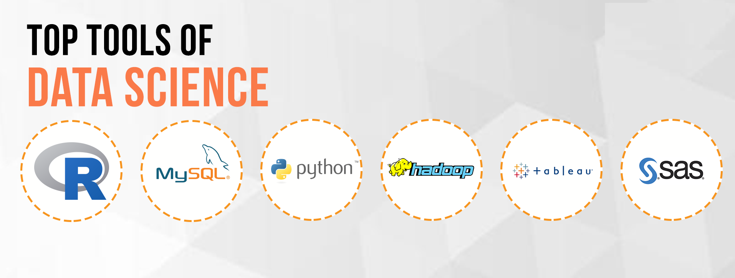
TOOLS for DATA SCIENCE

Slide 6

LIBRARIES used in PROJECT
Pandas is an open source python library that is built on top of NumPy. It allows you do fast analysis as well as data cleaning and preparation.
Pandas Data Structures:
1.Series: A Series is a one-dimensional array.
my_series = pd.Series(data, index)
2. Dataframe: A DataFrame is a two-dimensional data structure in which the data is aligned in a tabular form.
pd.DataFrame(data,index)
NumPy is a library written for scientific computing and data analysis. It stands for numerical python.
The most basic object in NumPy is the ndarray or n dimensional array or homogeneous array.

Slide 7
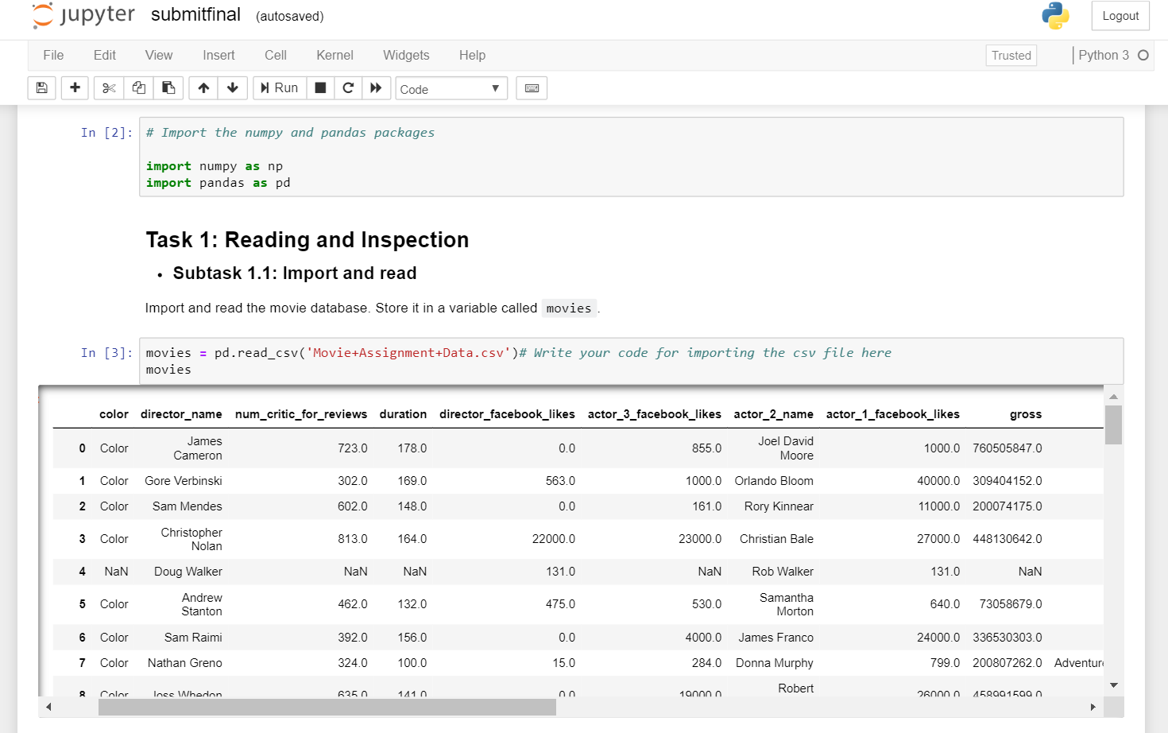
Project Demonstration
In this assignment, we try to find some interesting insights into movies released between 1916 and 2016, using Python and its available libraries. In this dataset, we will write Python code to explore the data and gain insights into the movies , actors, directors,gross,etc.

Slide 8
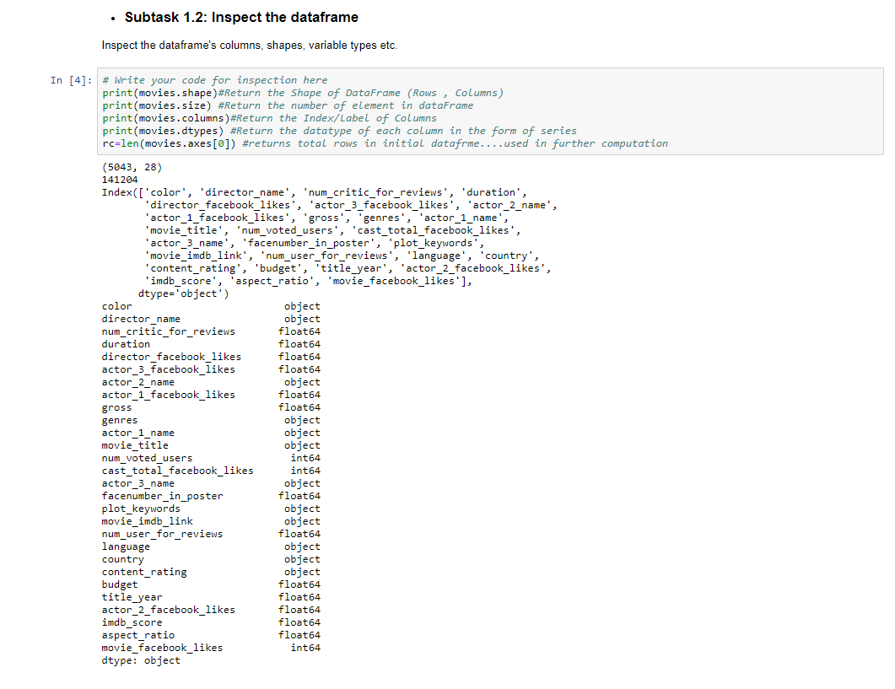
Inspecting Dataframe

Slide 9
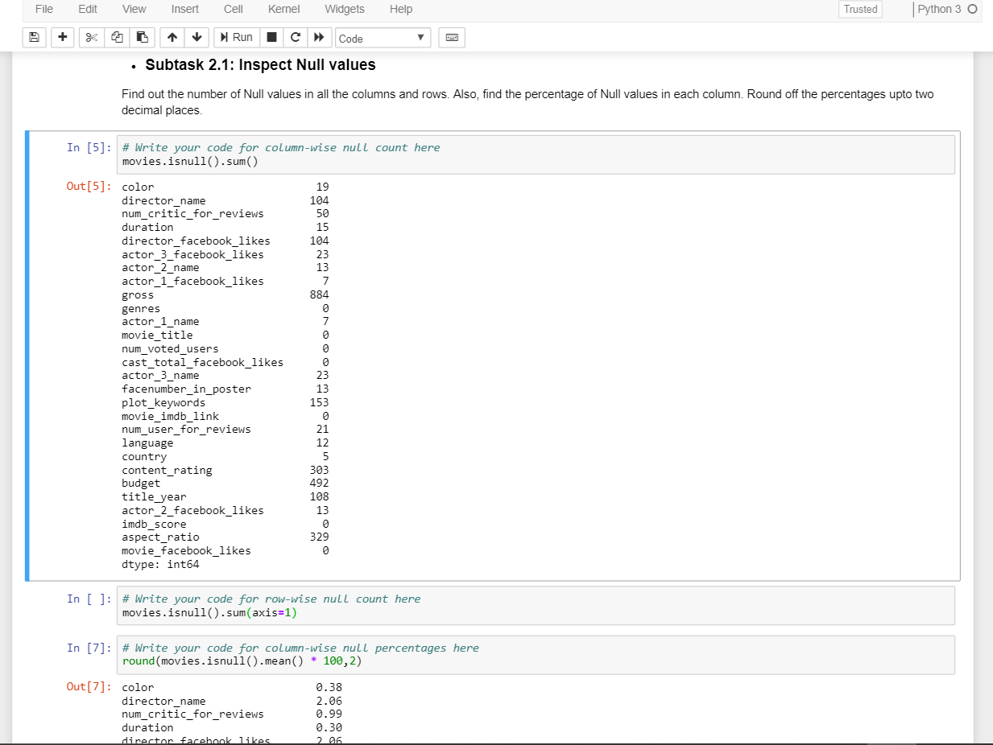
Inspecting Null Values

Slide 10
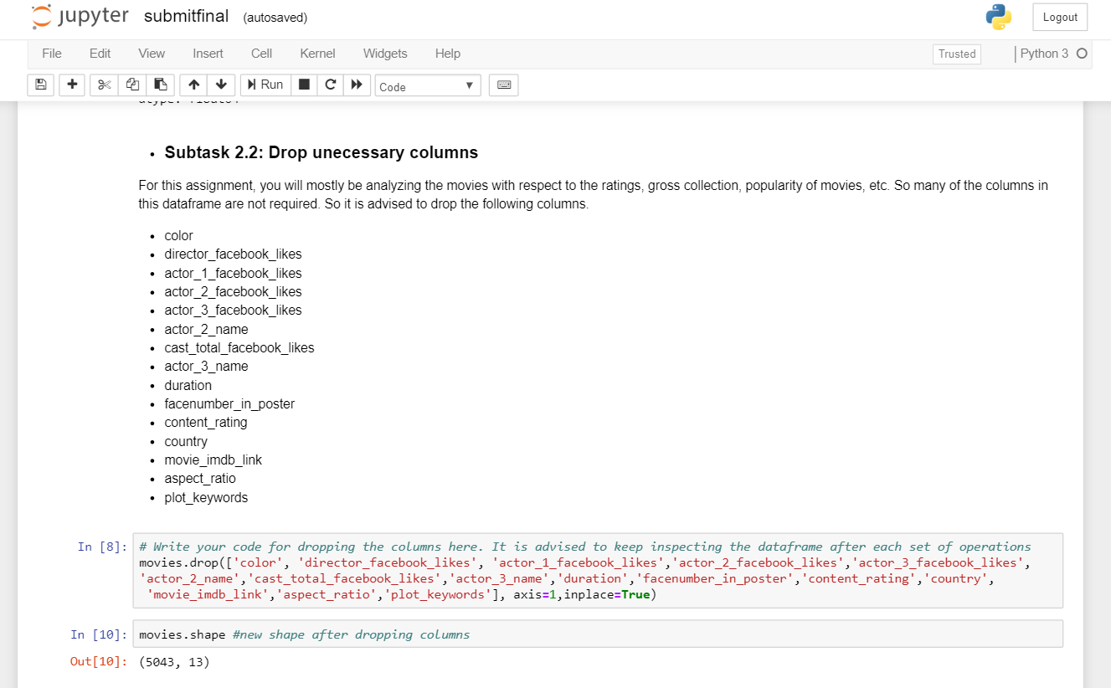
Dropping Unnecessary Columns

Slide 11
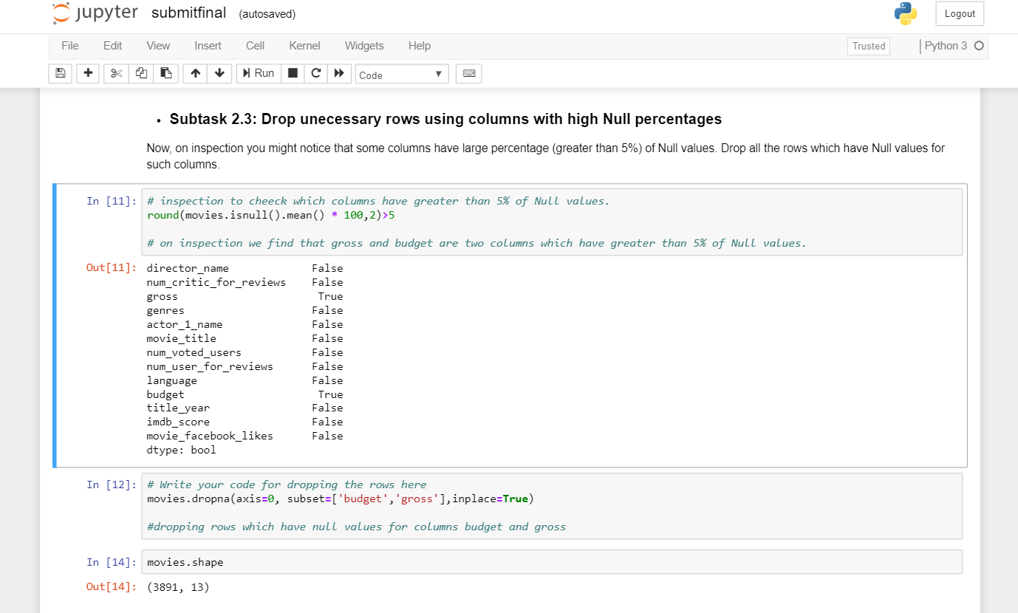
Dropping Rows using columns with high Null Percentages

Slide 12
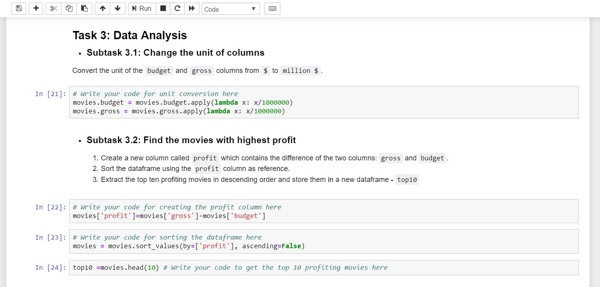
Changing Unit of Columns

Slide 13
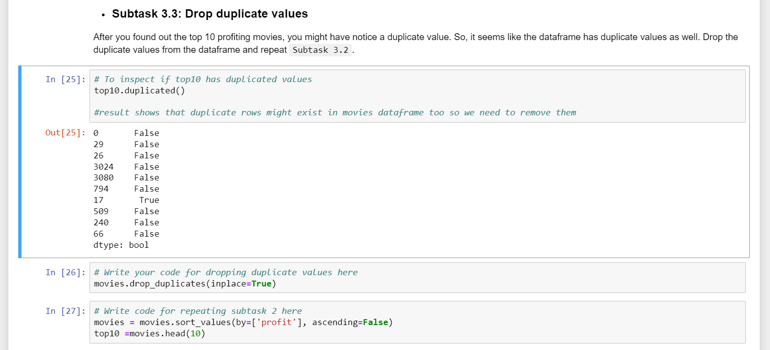
Dropping Duplicate Values

Slide 14
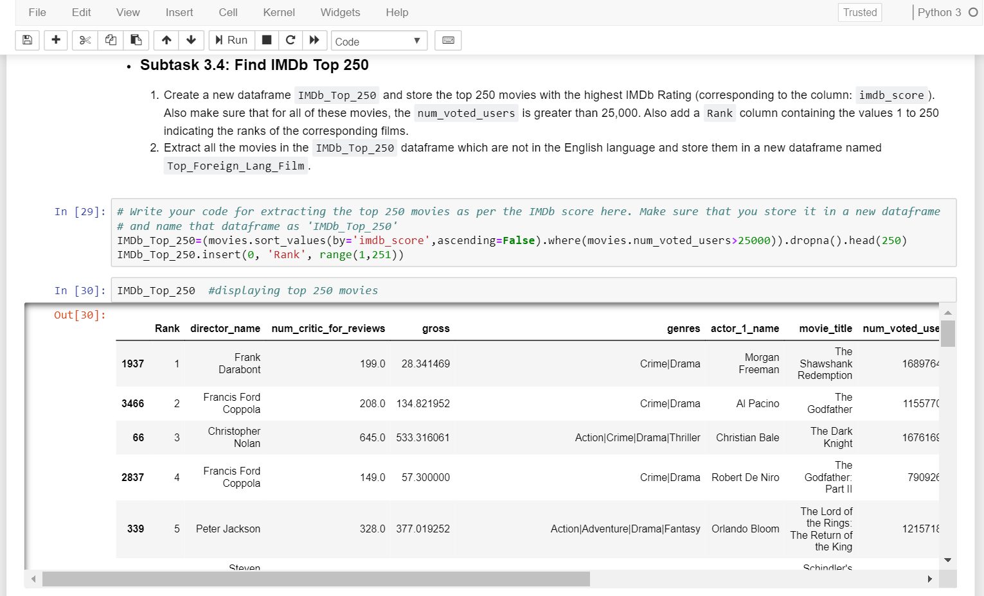
Top IMDb 250

Slide 15
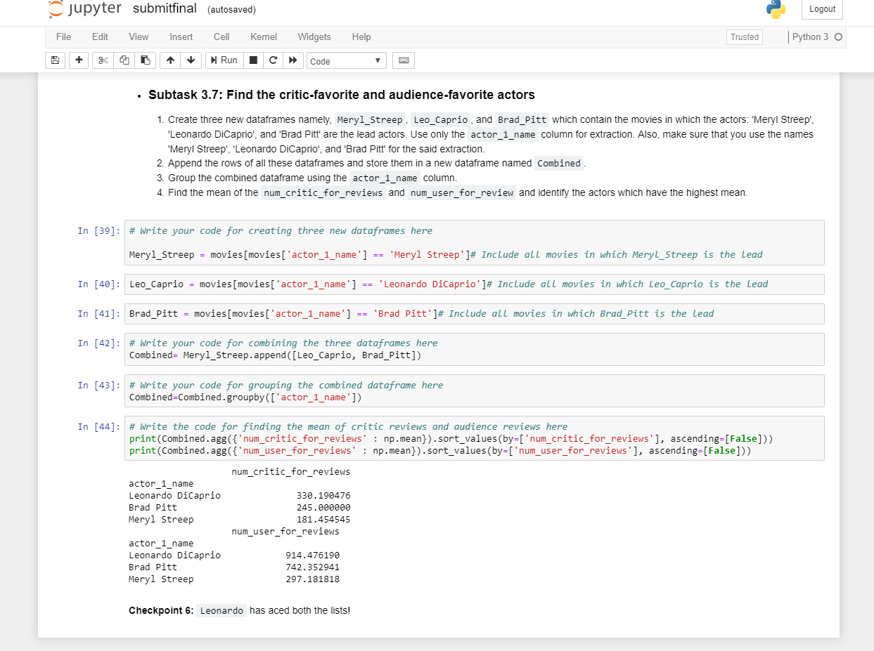
Finding Critic and Audience-Favorite Actors

Slide 16
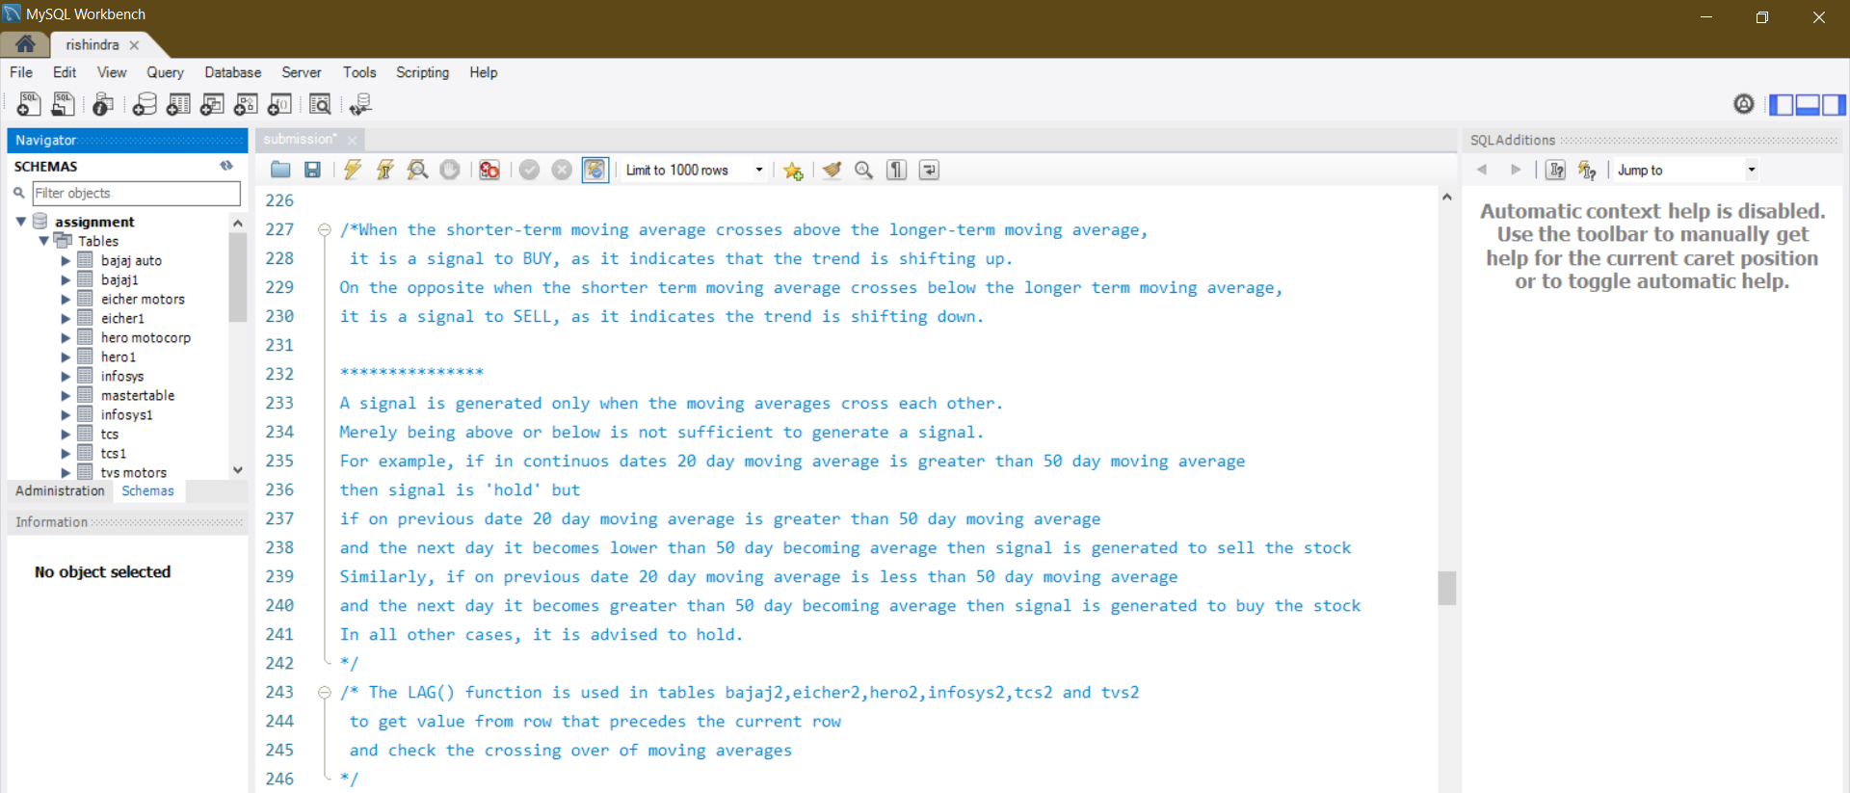
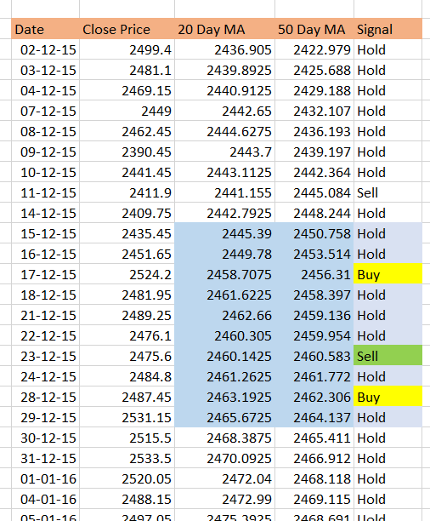
MOVING AVERAGE
The moving average (MA) is used to analyse data points by constantly updating the series of averages of different subsets of the full data set. Moving averages are great statistical tools that help traders in buying and selling of stocks.

Slide 17
THANK YOU

