Slide 1




AI POWERED CONVERSATIONAL SHOPPING AND HUMAN PLUS BOT HYBRID SUPPORT

Slide 2
Project Group Number: KC274
Project Name: AI Powered Conversational Shopping And Human Plus Bot Hybrid Support Team Members:
Project Link: https://github.com/rishindramani/CAPSTONE
Rishindra Mani Katiyar- 11715013
Shivmangal Singh Yadav- 11709300

Slide 3
SOLUTION APPROACH
A conversational solution approach for ordering and discovering products is a much better approach to understand the customer’s requirements. Here chatbots come in very handy. Chatbots bridge the gap between online and offline experiences. Moreover, chatbots can deliver same shopping experience to shoppers that they might expect from a brand either in-store or online. Therefore, making a chatbot was the first thing that struck our mind.
Next we thought of gamifying the ordering experience so that customer is engaged right till the end and is never exhausted of options while ordering products. Additionally, provide a hassle free checkout experience in the end.

Slide 4
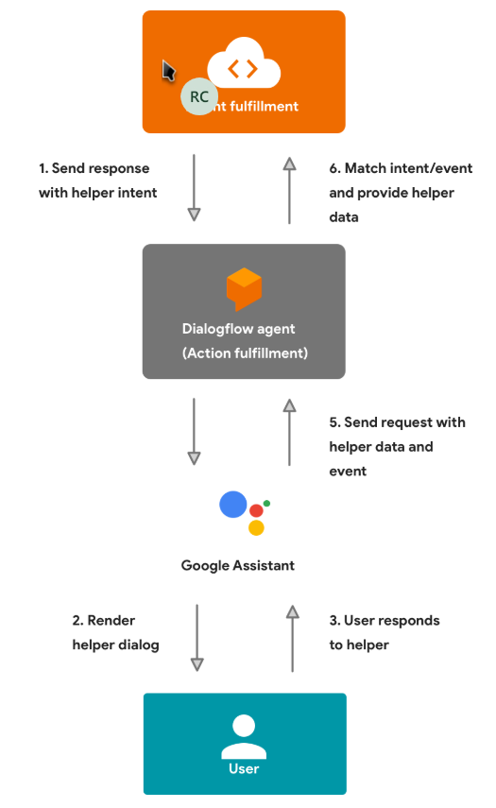

ARCHITECHTURE

Slide 5
Technology/Tool/Cloud Stack:
Node.js: Node.js is an open-source, cross-platform, JavaScript runtime environment that executes JavaScript code outside of a browser.
Dialogflow: Dialogflow is an end-to-end, build-once deploy-everywhere development suite for creating conversational interfaces for websites, popular messaging platforms and IoT devices.
Firebase: Firebase is a Google-backed application development software that enables developers to develop iOS, Android and Web apps.
Kommunicate: We have used Kommunicate to demonstrate website integration of our conversational solution, enabling proactive and personalized support for businesses. With Kommunicate, we can also manage customer conversations and provide support without altering the conversational flow of the solution.

Slide 6
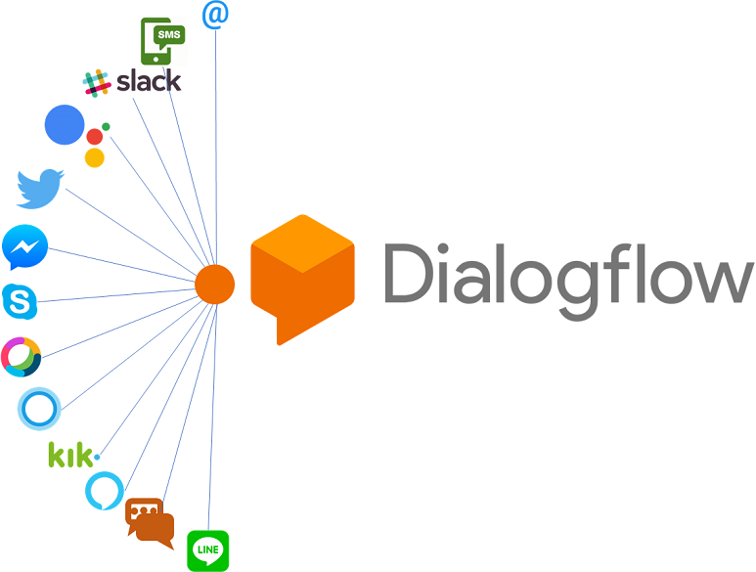
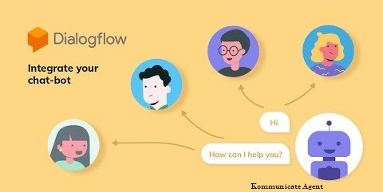
INTEGRATIONS

Slide 7
Challenges Faced:
Data: The biggest challenge we faced was unavailability of appropriate APIs that could be harnessed to make a more scalable solution. Therefore, we had no other choice but to scrape the data from a website and work on a limited dummy data rather than quality data.
Design: We had to brainstorm a lot initially on the design part of the chatbot. But finally we decided to leverage the actions on google platform and use google assistant theme to build the conversational solution.
Context Maintenance: Context maintenance was a bit tedious initially as the flow of the chatbot would break when adding new features to it. However, we fixed all the bugs and finally built an error free conversational solution.

Slide 8
Demo - Video/Solution URL
Project Video Link: https://vimeo.com/554934167
Google Assistant Demo Link: https://vimeo.com/554932525
Typical Website Integration for Conversational Solution Demonstration: https://team-code-paradox.github.io/hubdroid-web

Slide 9
Future Product Enhancements
Addition of images to product types and provide user with custom product filter option in order to display products according to user’s requirements
Implement order tracking system from the chat window itself
Display live-stock availability of products
Enhance Product Recommendations module
Alert price drops.
Trigger telephonic customer support call from chat on shopper’s demand
Download invoice right from the chat window
Redirect to appropriate payment services on checkout

Slide 10
THANK YOU

