Slide 1

Lowe’s Campus Hackathon

Slide 2
Team Name: Code Paradox
Theme Name: Build a conversational solution that enables customers to discover and order products. Team Members:
Rishindra Mani Katiyar
Harshit Agrawal
Rajdeep Roy Chowdhury

Slide 3
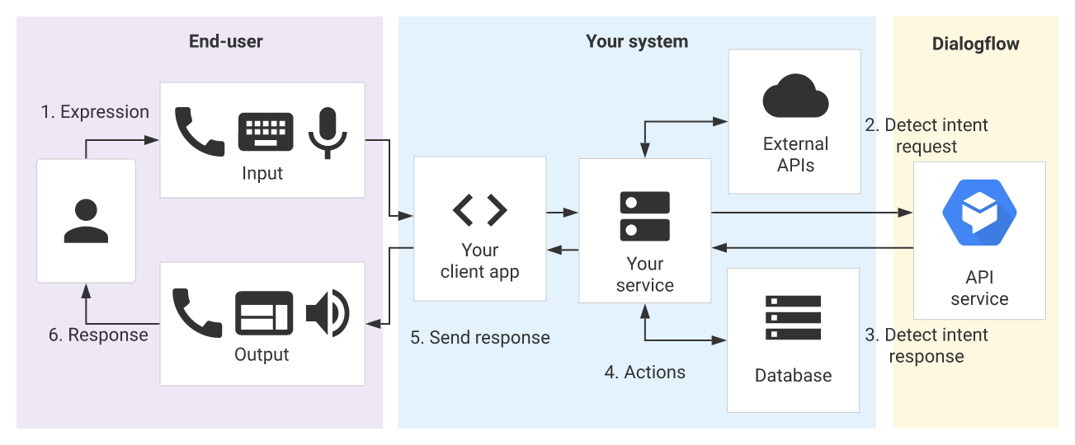
Architecture:
For now, end-user is google assistant client, our system is hosted in Firebase and Dialogflow for intent recognition.

Slide 4
Solution Approach
A conversational solution approach for ordering and discovering products is a much better approach to understand the customer’s requirements. Here chatbots come in very handy. Chatbots bridge the gap between online and offline experiences. Moreover, chatbots can deliver same shopping experience to shoppers that they might expect from a brand either in-store or online. Therefore, making a chatbot was the first thing that struck our mind.
Next we thought of gamifying the ordering experience so that customer is engaged right till the end and is never exhausted of options while ordering products. Additionally, provide a hassle free checkout experience in the end.

Slide 5
Technology/Tool/Cloud Stack:
Node.js: Node.js is an open-source, cross-platform, JavaScript runtime environment that executes JavaScript code outside of a browser.
Express.js: Express.js is a Node.js web application server framework, designed for building single-page, multi-page, and hybrid web applications. It is the de facto standard server framework for node.
Dialogflow: Dialogflow is an end-to-end, build-once deploy-everywhere development suite for creating conversational interfaces for websites, popular messaging platforms and IoT devices.
Firebase: Firebase is a Google-backed application development software that enables developers to develop iOS, Android and Web apps.

Slide 6
Hardware Specifications:
No specific Hardware required for the problem statement stated in the hackathon theme. Any display device which supports Google Assistant is enough for this prototype.
Support for other voice assistant platforms such as Alexa, Siri, Cortana, etc. will be given in enhanced version of the prototype.

Slide 7
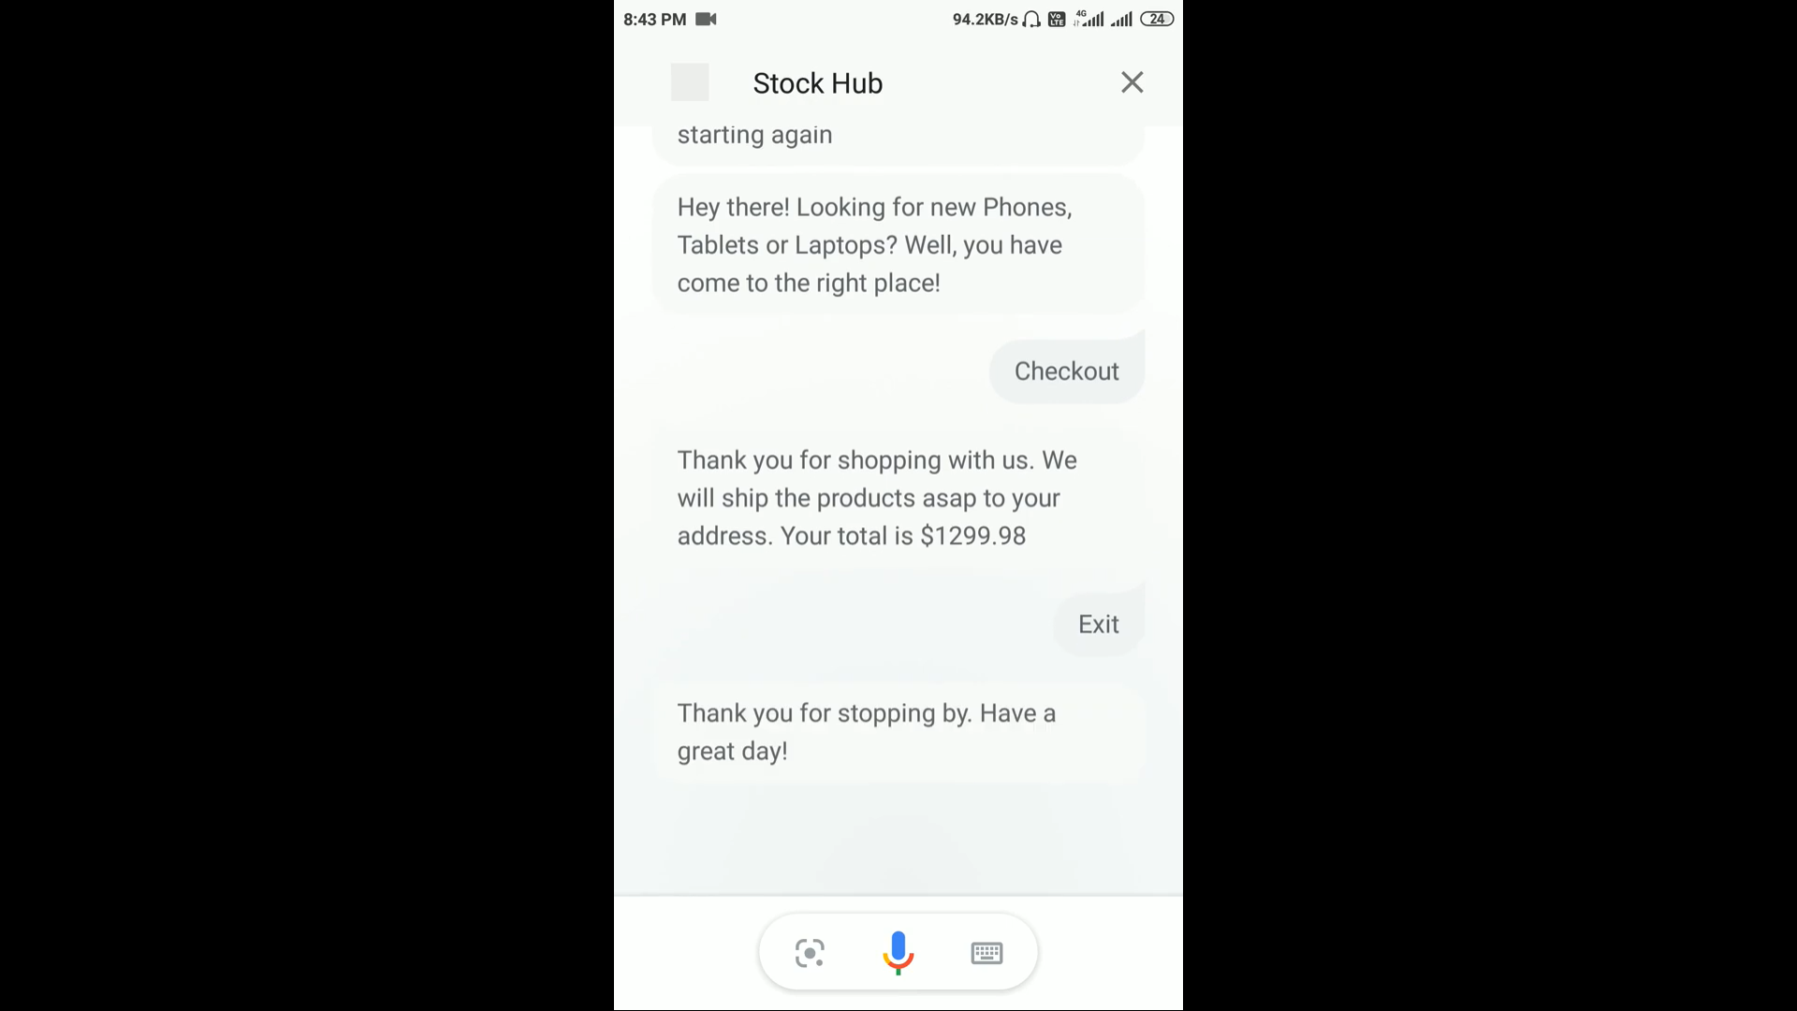
Demo - Video/Prototype (YouTube):
Video Link: https://youtu.be/uVOLpTEiFzo

Slide 8
Source code (zipped/ private GitHub Repository):
Source Code along with presentation has been uploaded in the zipped format on TechGig website.
Link to private GitHub repository (public after 16th March 2020) : https://github.com/rishindramani/Code-Paradox
A google drive link for the source code is listed below: http://bit.ly/2PwSiOt

Slide 9
Challenges Faced:
Data: The biggest challenge we faced was unavailability of appropriate APIs that could be harnessed to make a more scalable solution. Therefore, we had no other choice but to scrape the data from a website and work on a limited dummy data rather than quality data.
Design: We had to brainstorm a lot initially on the design part of the chatbot. But finally we decided to leverage the actions on google platform and use google assistant theme to build the conversational solution.
Context Maintenance: Context maintenance was a bit tedious initially as the flow of the chatbot would break when adding new features to it. However, we fixed all the bugs and finally built an error free conversational solution.

Slide 10
Future Product Enhancements
Addition of images to product types and provide user with custom product filter option in order to display products according to user’s requirements
Implement order tracking system from the chat window itself
Display live stock availability of products
Enhance Product Recommendations module
Alert price drops.
Trigger telephonic customer support call from chat on shopper’s demand
Download invoice right from the chat window
Redirect to appropriate payment services on checkout

Slide 11
THANK YOU

