Slide 1
UBER SUPPLY-DEMAND GAP CASE STUDY

Slide 2
Business Objectives
To identify the root cause of the problem (i.e. cancellation and non-availability of cars) and recommend ways to improve the situation
Reason for this issue for the supply-demand gap?

Slide 3
Time Slots for Analysis
Assumed Time Slots as mentioned below:
Early Morning : 12 AM - 5 AM
Morning : 5 AM - 10 Noon
Day : 10 AM - 5 PM
Evening : 5 PM - 10 PM
Night : 10 PM - Midnight

Slide 4
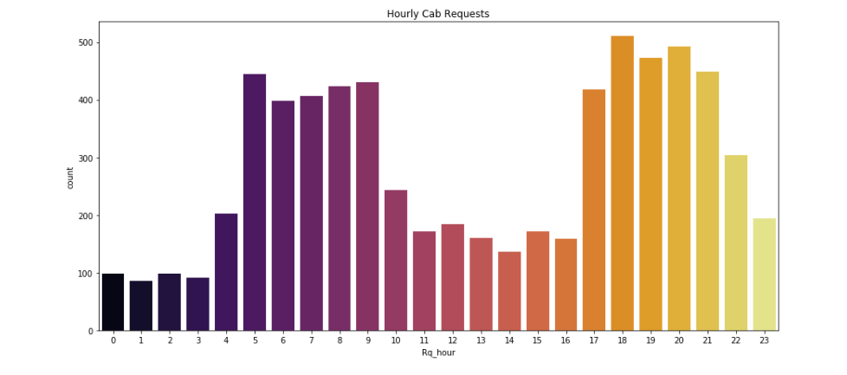
Identifying Requests

Slide 5
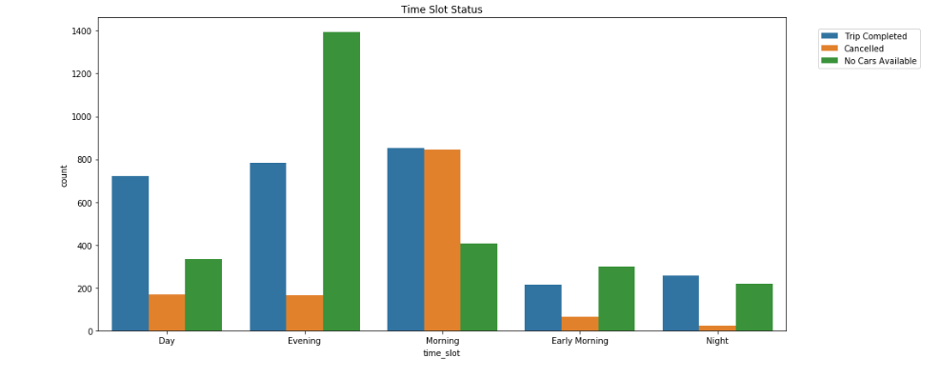
Identifying Problematic Types of Request Time Slots

Slide 6
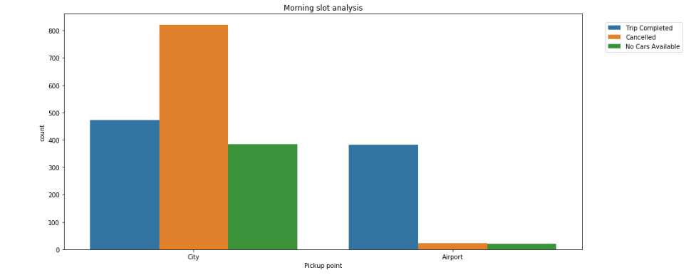
Morning Slot Analysis

Slide 7
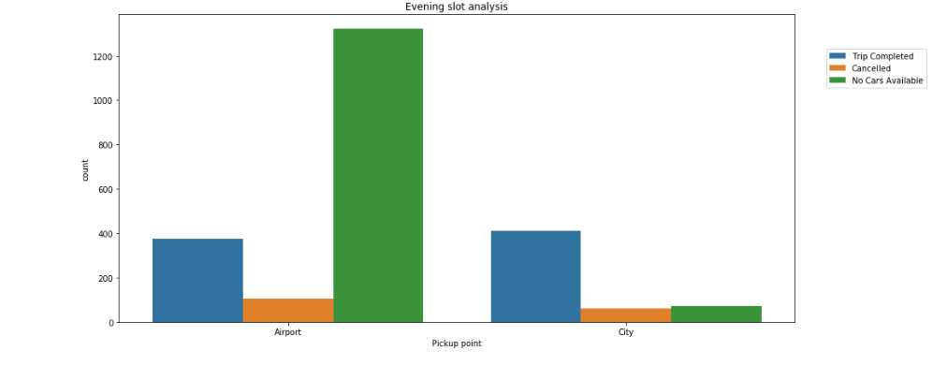
Evening Slot Analysis

Slide 8
Reasons for the Supply-Demand Gap
For trips originating from the Airport, most probable reasons for such a huge Non Availability of Cars during Evening and Night request time slots are:
For most of the driver partners this time period is the end of their working hours thus leading to non-availability of cars at the airport
Also since the frequency of flights landing after these time slots start reducing the wait period for the driver partner is increased for a passenger to board a trip from Airport thus they are reluctant to be at the airport at these time slots
For trips originating from the City, most probable reasons for such a huge Cancellation during Early Morning and Morning request time slots are:
Higher waiting period at the airport after these time slots
Chances of more trip completion and higher earnings if choosing a trip that is not bound for airport

Slide 9
Ways to resolve Supply-Demand Gap
Give incentive to the cab drivers to work at high demand hours by increasing rates from City to airport during Early morning hours and from Airport to City during evening and night hours.
2. Direct cabs from city towards the airport starting late afternoon.
3. Direct cabs towards the city from the airport to spuuly high demand at Early morning hours.
4. Evaluate reasons for high cancellations.

