Slide 1
Digital Portfolio
STUDENT NAME : SRI RISHIVANTH K
REGISTER No : 24131191802521042
NMID : asanm11911924ucsc042
DEPARTMENT : B.Sc.,Computer Science
COLLEGE :GOVT ARTS AND SCIENCE COLLEGE , THITTAGUDI

Slide 2
PROJECT TITLE
Creative Student portfolio using FWD

Slide 3
AGENDA
Problem statement
Project Overview
End Users
Tools and Technologies
Portfolio design and Layout
Features and functionality
Results and Screenshots
Conclusion
Githublink

Slide 4
PROJECT OVERVIEW
Portfolio contains About me , Projects , Skills , Contact and pictures

Slide 5
WHO ARE THE END USERS?
STUDENTS
JOB SEEKERS
PROFESSIONALS
SOFTWARE EMPLOYEE

Slide 6
TOOLS AND TECHNIQUES
HTML – Pages, Sections
CSS-LAYOUT – COLOURS ,FONT
JAVASCRIPT-INTERACTIVE NAVIGATION,FORM VALIDATION
VS CODE –IMPLEMENTATION CODE EDITOR ,GITHUB LINK

Slide 7
PORTFOLIO DESIGN AND LAYOUT
SECTION
HOME
PROJECETS
SKILLS
CONTACT
MOBILE / DESKTOP / TABLET

Slide 8
FEATURES AND FUNCTIONALITY
Navigation BAR with smoth scrolling
Image Details/ Hyperlinks
Interactive elements –Animations, Hover effects , Background colour change
Contact from validate

Slide 9
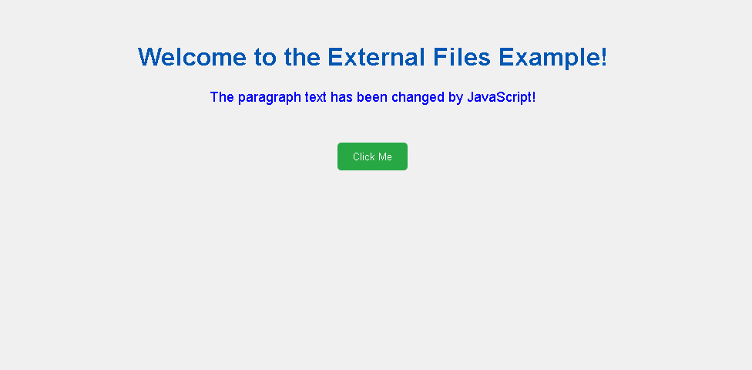
RESULTS AND SCREENSHOT

Slide 10
CONCLUSION
Easy to share With recruiters It makes Online presence

Slide 11
GITHUB LINK

