Slide 1
Personalized Fashion Recommendation System
CMPE_256 – Advanced Data Mining
Team Name -Spartan Squad
Members-
Rishi Patel
Rushabh Runwal
Aishly Manglani
Syeda Nida Khader

Slide 2
Project Overview
What is this Project About?
A system that provides personalized product recommendations for H&M customers.
Built using data from transactions, customers, and product metadata.
Features a content-based and collaborative filtering approach.
Includes a live interactive UI deployed on Hugging Face.

Slide 3
Dataset Description
articles.csv: Metadata for 105K+ products (e.g., product type, color).
customers.csv: Information about 1.3M customers (e.g., age, membership).
transactions_train.csv: Over 31M transactions (e.g., purchases, prices).
Images: 105K+ Product images corresponding to article IDs.
Link to dataset –
https://www.kaggle.com/competitions/h-and-m-personalized-fashion-recommendations/data

Slide 4
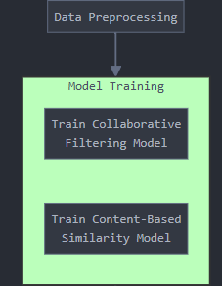
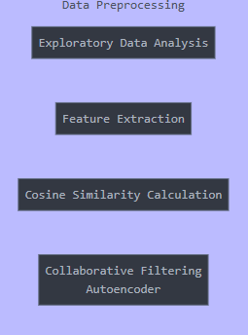
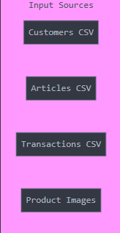
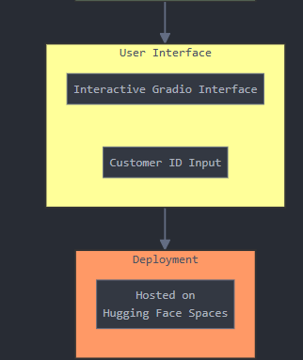
System Architecture

Slide 5
Workflow
Data Loading and Preprocessing
Recommendation Models → Interactive UI → Deployment
Read CSV files and product images.
Create a sparse matrix for collaborative filtering.
Extract features for content-based recommendations.
Content-Based: Find similar products based on features and purchase history.
Collaborative Filtering: Recommend based on similar customer behavior.
Input: Customer ID.
Output: Previously purchased products and recommended items.
Integration of models with Gradio.
Hosted and accessible on Hugging Face Spaces.

Slide 6
Demo
Gradio UI workflow:
Input: Customer ID
Example → 07b9c65c7f3f1b709c9163bcecf62ac438a5ab5e9b6e13214667e7229bc4294a
Output: Previously purchased products and recommendations.
Deployment link – https://huggingface.co/spaces/Rishi3499/DataMining

