Slide 1
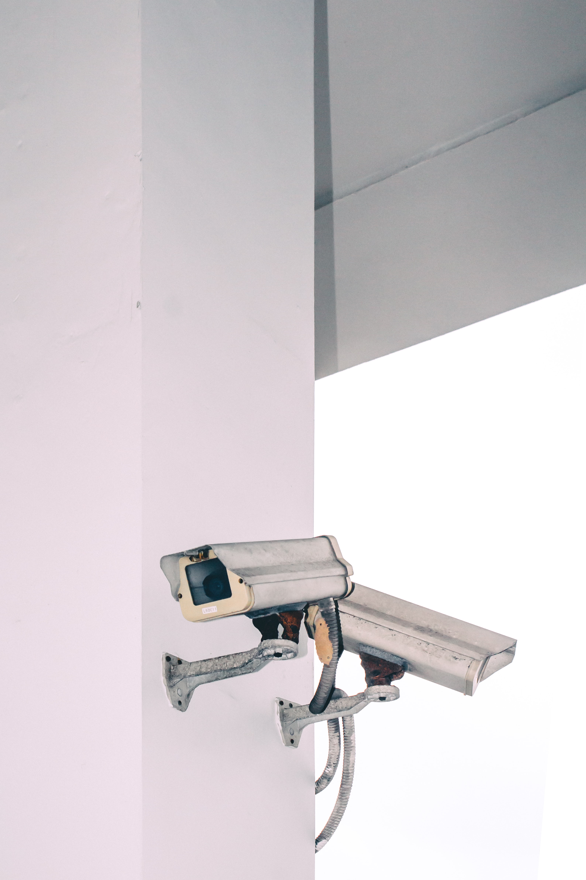
Securing the video feed of IP surveillance cameras
Rishi Pathak
170101054

Slide 2
Table of Contents
01
02
03
04
Introduction
Previous Work
IoT, IP Surviellance cameras and their problems
Discuss about existing work and their disadvantages
Algorithm
Work Done
Propose a new cost-efficient and flexible algorithm
Platforms explored and Test Bench used

Slide 3
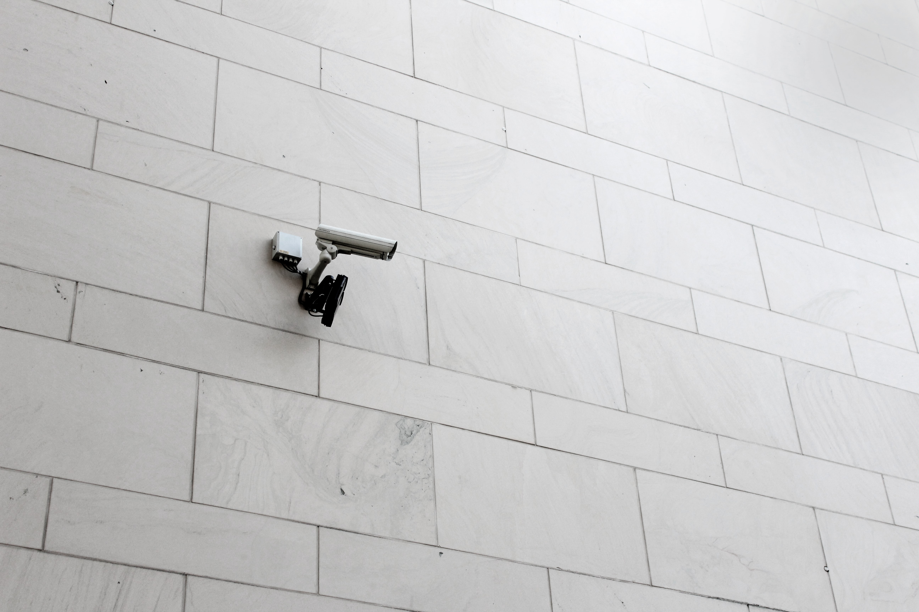
Introduction
The age of Internet of Things(IoT) is upon us. All the items around us are slowly getting smart attached to their name. This is because they now have ability to communicate some information over some internet/network.

Slide 4
IP Surveillance Camera
IP surveillance systems are made up of three modules-
Video Capture Units
Network Transmission
Central Control
Video Capture Units captures raw videos, compresses the data, encode them into popular formats like MPEG, H261 etc.
The network transition module sends this encoded video over LAN or the internet.
The central control module is the end module of the system where we can view or record the video stream.
There are two type of data transmissions in the system. Firstly, control commands from control center to video camera units and other one is video stream from cameras to the central control unit.
We are mostly concerned about the security of video stream. They carry a large amount of data and is time-sensetive.

Slide 5
Background
There was a huge DDoS attack against Dyn, which is a DNS provider in October 2016.
This attack broke a fairly large part of the Internet, causing hundreds of websites and services to go down. This was carried out by making the IP Surveillance Cameras as part of a botnet. The devices were made to do numerous DNS lookup requests and were infected by Mirai malware.
Another study studied about Motorola’s Focus 73 outdoor security camera and found that the pictures and videos that are taken by the camera can be redirected to a mobile application.
By interfering with device’s DNS settings, the attacker can cut off the alerts that the camera sends to the customer, as well as to see video clips that would be sent to a cloud storage service.
This is a large security concern and a breach of users’ privacy without their knowledge of the system compromise.

Slide 6
Previous Work
There are basically two types of methods proposed.
The Basic
Method
Selective
Encryption
The basic method treats the stream data as the regular IP data.
Encodes 100% of the video stream.
Doesn’t understands the encoding and compression of video stream.
They are usually very slow.
Monetorily less costly.
Not flexible.
More secure.
Selective encryption doesn’t treats the stream data as the regular IP data.
Selectively encodes the video stream.
Understands the encoding and compression of the video data.
Faster than the basic method.
Monetorily expensive.
Not flexible.
Not so secure and require a formal and strict cryptanalysis.

Slide 7
Selective Encryption
Header Encryption
Prediction based
DCT Coefficient
Encrypt all the headers of data stream
Reconstruction of headers is simple.
In the MPEG videos, encrypting the I frames would be sufficient.
Encryption not strong.
Frames represented in frequency than time.
Required deep parsing in stream at both sides.
Zig Zag scan
One time pad
Random corruption
Order in which DCT coefficients are scanned from can be permuted before encoding it.
Very unsecure.
Half bytes encrypted using DES, then these bytes are XORed with other half of bytes.
Good, same complexity
Random corruption of video stream approx. 1%
Leaves the content format incompatible.

Slide 8
Algorithm
We have seen the limitations of both the basic method and the selective encryption.
They suffer from security and performance problems. So to avoid this problem, I propose a more flexible and randomly adjustable algorithm by combining the two.
I will treat the data as regular IP data like in the basic method.
Then I will selectively add encryption to the video stream data without understanding the specific characteristics of the data.
For flexibility, I will give the control of degree of security to the users. They can set the percentage of encrypted video.
Before exacting the details of the algorithm, I want to introduce some terms.

Slide 9



Algorithm
CSPRNG
ChaCha20
Stream Cipher
CSPRNG is a pseudorandom number generator that is more secure and has properties which are suitable for use in cryptography.
A special design CSPRNG which is more secure than previously used pseudo random generators like RC4 which was found to be insecure
A stream cipher is a method of encrypting text in which a crypto key and algorithm are applied to each binary digit in a data stream, one bit at a time.

Slide 10
Algorithm
Now that we know about these terms. Let us start the algorithm.
There will be two ends of the whole algorithm: Camera end and User end.
The two ends will be connected through two TCP connections. One will be used for sending data and the other for sending instructions.
We will use a special design CSPRNG known as ChaCha20 for generating keystream.
We will use a stream cipher for combining the sequence generated by CSPRNG with our stream data, at some controllable time interval based on the user’s given degree of security. They will be combined using the XOR (exclusive OR) operation bit by bit.
ChaCha20 uses a 256-bit key, 32-bit initial counter, and 96-bit nonce to encrypt the stream data.
We will use the RSA cryptosystem for encrypting instructions and ChaCha20 requirements. RSA cryptosystem makes use of two keys, a public key used for encryption and a private key for decryption or vice versa. In our algorithm, both keys are generated at the user end. The public key is sent to the camera end, where it is used to encrypt the ChaCha20 key, nonce, and counter, which are later appended to the encrypted frame.

Slide 11
Algorithm
Decryption at the user end is done in the same method. First, we decrypt the key, nonce, and counter through the private key.
The ChaCha20 block function then uses these key, nonce, and counter to expand the key to keystream, which is then XORed with the encrypted frame data which CSPRNG generated to get back the original data.
So the data can be converted from no secrecy to encrypted form with a bit of performance overhead.
In the whole process, the private key remains at the user end and is never transmitted.
Therefore, this algorithm with high-speed and secure stream cipher and key encryption cryptosystem will provide enough flexibility, sufficient security, and real-time encryption to the users.
This is the main algorithm.

Slide 12
Algorithm
The problem we are solving consists of video streaming. Although we are using TCP, certain packets can still be lost on the way to the user. So we should also find a way to synchronize the data sender and receiver with each other.
ChaCha20 successively calls the block function, with the same key and nonce, and increasing counter parameters. Every keystream block is XORed with a data block of an equivalent length before going forward to make the successive block, saving some memory. There is no demand for the data to be an integral multiple of 512 bits. If there is further keystream after the last block, it is removed.
So when the packet is lost in the transmission, receiver detects it using the packet sequence number and then make for this loss by generating a keystream block of 512 bits. So the sender and receiver will remain synchronised.
Another important aspect of surveillance systems is key management. We suggest that we change the RSA keypair every fixed amount of time, say 5 minutes. The public key that we change after every interval can be sent to the camera end, and the private key remains at the user end.

Slide 13
Algorithm
01
02
03
04
05
ChaCha20
Encrypt key
Change the seed
Generate keystream using CSPRNG, ChaCha20
Encrypt key, nonce and counter using public key.
Change RSA keys after every fixed amount of time
Stream Cipher
Decryption
Use stream cipher to combine the keystream with video
Decryption is done at the user using ChaCha20 block fn.

Slide 14
The Solution
We implemented the above-proposed algorithm for testing its performance and feasibility.
The algorithm was coded in Java in Eclipse IDE for Java developers.
The project uses a JavaFX platform, an open-source, next-generation client application platform for developing the software interface. It has support for desktop computers and web browsers on Windows, macOS, and Linux.
It also uses OpenCV for capturing frames from the camera and other image processing functions proposed in the algorithm.
We developed two parts of the software: the camera end and the user end.
In the real world, both the software ends will be on different computers. The camera end will be on a chip/small-sized computer with no screen to display the interface.
There would be no screen for the camera end in the real world, so these controls or buttons do not need to be touched for changing the transmitted bytes. The camera interface can be completely controlled from the user end.

Slide 15
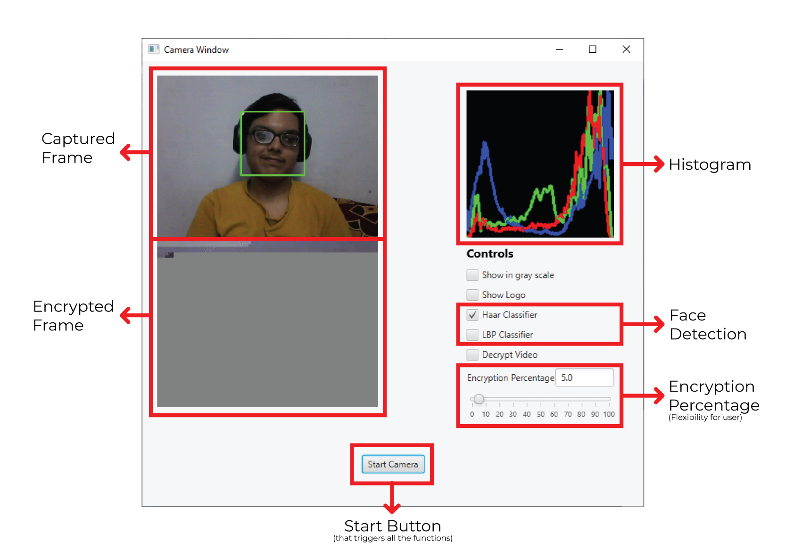
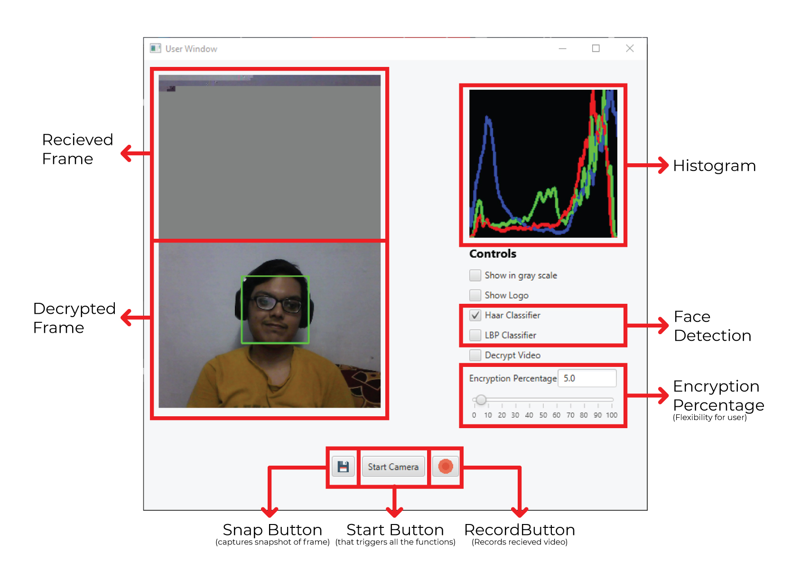
The Solution
Camera End
User End

Slide 16
Test Bench
We have used a laptop with a webcam/USB camera as a test bench for the experiment.
We have used the same laptop as the surveillance system’s control center to receive the data and view the video stream.
The system’s transmission module is mobile hotspot WiFi with TCP for the video streaming and sending the instructions.
The test bench’s hardware configuration for the experiment is Intel(R) Core(TM) i5-7200U CPU @ 2.50GHz 2.70 GHz with 8.00GB of installed RAM and Windows 10 as the operating system.
For the algorithm, we use a public encryption key of size 2048 bits for the RSA cryptosystem.
Our main encryption stream cipher ChaCha20 will use a 256-bit key and a 96-bit nonce.
The percentage of encryption is decided by the user and can range from 0 to 100%.

Slide 17
Results
We ran the solution program with the encryption percentage set as 100%.
We found virtually no lag between the frame captured by the camera and decrypted frame at the user end.
Both frames were running smoothly with no frame drops visible.
Even at 100% encryption, the algorithm runs very efficiently, and encryption and decryption complete within milliseconds.
While running the tests, we noticed that after pressing the start camera button at the user end, there is a delay of 2-3 seconds before the frames appear on the screen.
This may be due to long process that includes forming a TCP connection for instructions, generating the RSA key pair at the user end, and then sending the public key over the connection, before camera starts capturing and displays the frame on the screen after the algorithm’s first iteration completes.

Slide 18
Results
We did another experiment to find enough value of encryption percentage. The minimum encryption percentage such that video captured from the camera is scrambled enough that its content is not decipherable.
We encrypted the video such that the header information of individual frames remains unencrypted.
We found that as the encryption percentage values increased from 0% to 4%, the scrambledness of the video gradually increased, but few video frames were partially decipherable even at 4%.
However, as the encryption percentage increases to 5%, the encrypted video frames cannot be deciphered by the average human eye.
When the percentage increases to 10%, the encrypted frame becomes too encrypted and cannot be displayed by most decoding software.
This percent depends on how selective encryption is implemented and can change drastically based on it.

Slide 19
Results
Next, we also measured the time required by the ChaCha20 cipher and RSA cryptosystem in one iteration of the algorithm.
For encryption percentage set to 5%, we found that in the camera end, ChaCha20 cipher takes an average of 0.173 ms and a minimum of 0.037 ms for encrypting captured frame bits.
RSA takes an average of 0.415 ms and a minimum of 0.188 ms for decrypting instruction at the same end.
At the user end, things turn out a little different. ChaCha20 takes only 0.125 ms on average to decrypt the received byte array with a minimum of 0.035 ms.
However, the whole algorithm’s bottleneck is the RSA algorithm’s time to encrypt 130-byte instruction. RSA takes 8.213 ms on average, while the minimum time was 3.583 ms which is enormous compared to the time taken by ChaCha20.

Slide 20
Results
We also tried using different cameras for capturing. The above results were from the test bench machine’s webcam. We used Logitech C270 HD USB Camera to test and analyze if any difference comes in the time taken by ChaCha20 and RSA.
With encryption percentage set to 5%, the average time of ChaCha20 for encrypting frames was 0.109 ms while the min time was 0.036 ms.
In comparison, RSA took a minimum time of 0.186 ms and an average time of 0.399 ms for decrypting the instructions.
At the user end, ChaCha20, on average, took 0.118 ms with a min of 0.040 ms to decrypt the received frame.
The slowest one was RSA encryption here, too, with an average of 6.97 ms and a minimum of 3.581 ms.
We can see from the graph that the time taken by ChaCha20 and RSA is slightly lower for the USB camera.
We can also see that decryption takes slightly less time than encryption in ChaCha20, while this difference is enormous in RSA.

Slide 21
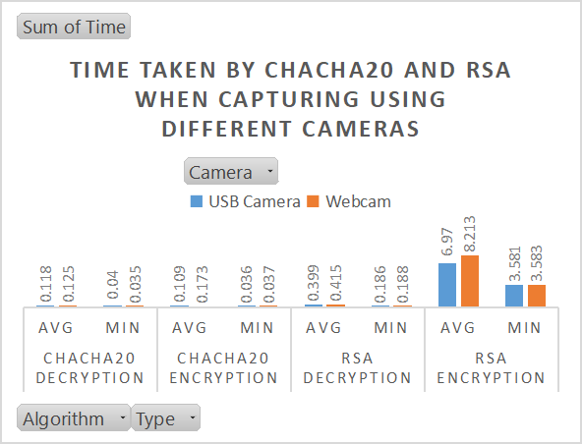
Results

Slide 22
Results
We also ran the tests with different encryption percentage values and found out how it affected the time taken by ChaCha20 and RSA to encrypt and decrypt data and instruction, respectively.
For this test, we ran the algorithm for approximately 1500 frames each time after setting the initial encryption percentage value.
The values of encryption percentage used for this test were 0, 1, 2, 3, 5, 10, 20, 30, 50, 75, 90 and 100.
From the graph,we can study the trends.
We can see that with an increase in encryption percentage, the time taken by ChaCha20 increases gradually for both encryption and decryption.
It is expected because, with an increase in encryption percentage, the number of bits ChaCha20 has to encrypt also increases proportionally, which gets reflected as the increase in time of encryption and decryption.
In contrast, for decryption, except for one time, RSA takes about the same amount of time every time. However, in the case of encryption of instruction at the user end, RSA’s time gradually decreases.

Slide 23
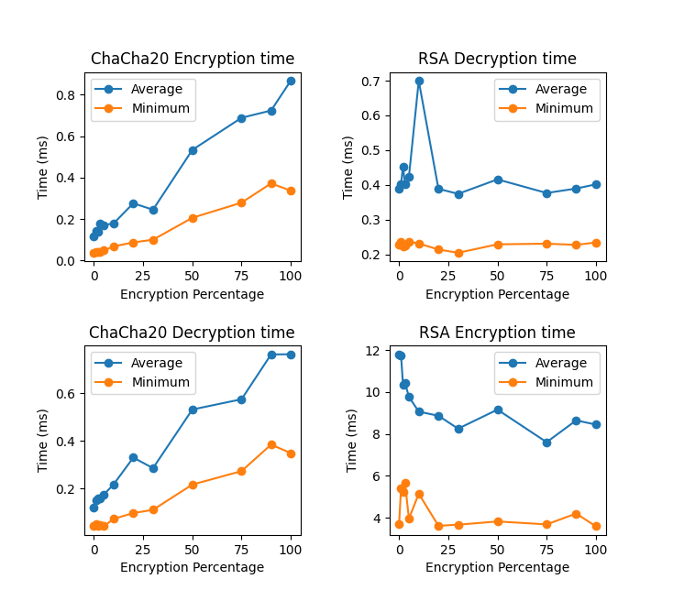
Results

Slide 24
Future Works
For this project’s future outlooks, we can choose a more efficient and secure asymmetric cryptosystem than RSA.
As seen in the results, RSA encryption takes the most time than other parts of the algorithm.
We can also investigate the security properties of our algorithm and check if it is compatible with IPSec.
Stronger cryptanalysis can be done on our approach to check its security strength.
We can also try to implement our approach on an embedded device that can be used practically in the industry.

Slide 25
Thanks

