Slide 1

Technology has the opportunity to completely disrupt conventional education system by democratizing learning

Slide 2
Module 4
Module 4: Under the Hood
$scope vs. scope
Controllers Hierarchy
Providers
Services
Factory
Dependency Injection
Module 5: $http and Server Interaction
$http service
$resource service
Copyright 2013-14

Slide 3
$scope vs. scope
Copyright 2013-14

Slide 4
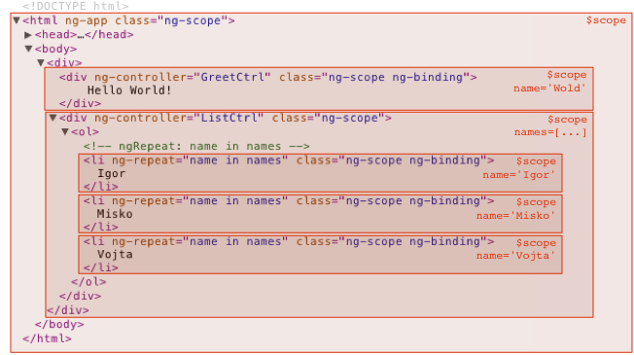
Controllers Hierarchy
Copyright 2013-14

Slide 5
Providers
Provider is the core type and all the other types are just syntactic sugar on top of it. It is the most verbose with the most abilities.
The Provider recipe is syntactically defined as a custom type that implements a $get method. This method is a factory function just like the one we use in the Factory recipe. In fact, if you define a Factory recipe, an empty Provider type with the $get method set to your factory function is automatically created under the hood.
You should use the Provider recipe only when you want to expose an API for application-wide configuration that must be made before the application starts. This is usually interesting only for reusable services whose behavior might need to vary slightly between applications.
Copyright 2013-14

Slide 6
Services
Angular services are substitutable objects that are wired together using dependency injection (DI). You can use services to organize and share code across your app.
Angular services are:
Lazily instantiated – Angular only instantiates a service when an application component depends on it.
Singletons – Each component dependent on a service gets a reference to the single instance generated by the service factory.
Copyright 2013-14

Slide 7
Services
Angular services are substitutable objects that are wired together using dependency injection (DI). You can use services to organize and share code across your app.
Angular services are:
Lazily instantiated – Angular only instantiates a service when an application component depends on it.
Singletons – Each component dependent on a service gets a reference to the single instance generated by the service factory.
Copyright 2013-14

Slide 8
Dependency Injection
Dependency Injection (DI) is a software design pattern that deals with how components get hold of their dependencies.
The Angular injector subsystem is in charge of creating components, resolving their dependencies, and providing them to other components as requested.
Using Dependency Injection:
DI is pervasive throughout Angular. You can use it when defining components or when providing run and config blocks for a module.
Components such as services, directives, filters, and animations are defined by an injectable factory method or constructor function. These components can be injected with "service" and "value" components as dependencies.
Controllers are defined by a constructor function, which can be injected with any of the "service" and "value" components as dependencies, but they can also be provided with special dependencies. See Controllers below for a list of these special dependencies.
The run method accepts a function, which can be injected with "service", "value" and "constant" components as dependencies. Note that you cannot inject "providers" into run blocks.
The config method accepts a function, which can be injected with "provider" and "constant" components as dependencies. Note that you cannot inject "service" or "value" components into configuration.
Copyright 2013-14

Slide 9
Dependency Injection
Dependency Annotation
Angular invokes certain functions (like service factories and controllers) via the injector. You need to annotate these functions so that the injector knows what services to inject into the function. Three ways of annotating your code with service name information:
Using the inline array annotation (preferred)
Using the $inject property annotation
Implicitly from the function parameter names (has caveats)
Inline Array Annotation:
This is the preferred way to annotate application components.
For example:
someModule.controller('MyController', ['$scope', 'greeter', function($scope, greeter) {
// ...
}]);
$inject Property Annotation:
To allow the minifiers to rename the function parameters and still be able to inject the right services, the function needs to be annotated with the $inject property. The $inject property is an array of service names to inject.
var MyController = function($scope, greeter) {
// ...
}
MyController.$inject = ['$scope', 'greeter'];
someModule.controller('MyController', MyController);
Copyright 2013-14

Slide 10
Dependency Injection
Implicit Annotation
If you plan to minify your code, your service names will get renamed and break your app.
The simplest way to get hold of the dependencies is to assume that the function parameter names are the names of the dependencies.
someModule.controller('MyController', function($scope, greeter) {
// ...
});
You can add an ng-strict-di directive on the same element as ng-app to opt into strict DI mode:
Copyright 2013-14

Slide 11
Module 5: $http and Server Interaction
$http service
$resource service
Copyright 2013-14

Slide 12
$http service
The $http service is a core Angular service that facilitates communication with the remote HTTP servers via the browser's XMLHttpRequest object or via JSONP.
The $http service is a function which takes a single argument — a configuration object — that is used to generate an HTTP request and returns a promise with two $http specific methods: success and error.
// Simple GET request example :
$http.get('/someUrl').
success(function(data, status, headers, config) {
// this callback will be called asynchronously
// when the response is available
}).
error(function(data, status, headers, config) {
// called asynchronously if an error occurs
// or server returns response with an error status.
});
// Simple POST request example (passing data) :
$http.post('/someUrl', {msg:'hello word!'}). success(function(data, status, headers, config) {
// this callback will be called asynchronously
// when the response is available
}). error(function(data, status, headers, config) {
// called asynchronously if an error occurs
// or server returns response with an error status.
});
Copyright 2013-14

Slide 13
$http service
A response status code between 200 and 299 is considered a success status and will result in the success callback being called. Note that if the response is a redirect, XMLHttpRequest will transparently follow it, meaning that the error callback will not be called for such responses.
Copyright 2013-14

Slide 14
$resource service
A factory which creates a resource object that lets you interact with RESTful server-side data sources.
The returned resource object has action methods which provide high-level behaviors without the need to interact with the low level $http service. $resource is a higher level service than $http.
Requires the ngResource module to be installed:
First include angular-resource.js in your HTML:
<script src="angular.js">
<script src="angular-resource.js">
Then load the module in your application by adding it as a dependent module:
angular.module('app', ['ngResource']);
Default actions in a resource: { 'get': {method:'GET'},
'save': {method:'POST'},
'query': {method:'GET', isArray:true},
'remove': {method:'DELETE'},
'delete': {method:'DELETE'} };
Copyright 2013-14

Slide 15

Any Questions
Copyright 2013-14

Slide 16
Feedback from learners
Body
Copyright 2013-14

Slide 17

Copyright 2013-14

