Slide 1
Exploratory Data Analysis

Slide 2
Inr Vs Creatinine
Creatinine Vs Inr
No stratification
R
=
0.13
,
p
=
2.6e-07
7.5
5.0
Inr
2.5
0.0
0.0
2.5
5.0
7.5
10.0
12.5
Creatinine

Slide 3
Inr
Element | Value
Variable | INR
Type | numeric
Missing Num | 0
Missing Pct | 0%
Unique Values | 50
Mean | 1.92
Median | 1.60
Mode | 1.3
Variance | 0.88
Std Deviation | 0.94
Range | 7.7
Min | 0.9
Max | 8.6
Iqr | 1.1
Skewness | 1.855
Kurtosis | 2.374

Slide 4
Inr Vs Sodium
Sodium Vs Inr
No stratification
R
=
−
0.13
,
p
=
1.7e-06
7.5
5.0
Inr
2.5
120
130
140
150
160
170
Sodium

Slide 5
Inr
Element | Value
Variable | INR
Type | numeric
Missing Num | 0
Missing Pct | 0%
Unique Values | 50
Mean | 1.92
Median | 1.60
Mode | 1.3
Variance | 0.88
Std Deviation | 0.94
Range | 7.7
Min | 0.9
Max | 8.6
Iqr | 1.1
Skewness | 1.855
Kurtosis | 2.374

Slide 6
Inr Vs Num_rnd1
Num Rnd1 Vs Inr
No stratification
R
=
−
0.013
,
p
=
0.63
7.5
Inr
5.0
2.5
2.5
5.0
7.5
10.0
Num Rnd1

Slide 7
Inr
Element | Value
Variable | INR
Type | numeric
Missing Num | 0
Missing Pct | 0%
Unique Values | 50
Mean | 1.92
Median | 1.60
Mode | 1.3
Variance | 0.88
Std Deviation | 0.94
Range | 7.7
Min | 0.9
Max | 8.6
Iqr | 1.1
Skewness | 1.855
Kurtosis | 2.374

Slide 8
Inr Vs Logical_rnd1
Logical Rnd1 Vs Inr
No stratification
7.5
Logical Rnd1
Inr
5.0
FALSE
TRUE
2.5
0.0
FALSE
TRUE
Logical Rnd1

Slide 9
Inr
Element | Value
Variable | INR
Type | numeric
Missing Num | 0
Missing Pct | 0%
Unique Values | 50
Mean | 1.92
Median | 1.60
Mode | 1.3
Variance | 0.88
Std Deviation | 0.94
Range | 7.7
Min | 0.9
Max | 8.6
Iqr | 1.1
Skewness | 1.855
Kurtosis | 2.374

Slide 10
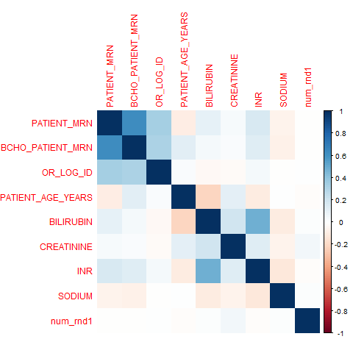
Correlation Matrix

