Slide 1
Exploratory Data Analysis

Slide 2
Creatinine
Q-Q Plot
No stratification
12
8
Sample
4
0
-2
0
2
Theoretical

Slide 3
Creatinine
Histogram
No stratification
1000
750
Count
500
250
0
0
5
10
Creatinine

Slide 4
Creatinine
Element | Value
Variable | CREATININE
Type | numeric
Missing Num | 0
Missing Pct | 0%
Unique Values | 347
Mean | 1.404
Median | 0.970
Mode | 0.76
Variance | 1.619
Std Deviation | 1.272
Range | 11.98
Min | 0.1
Max | 12.08
Iqr | 0.77
Skewness | 3.133
Kurtosis | 10.093

Slide 5
Inr
Q-Q Plot
No stratification
8
6
4
Sample
2
0
-2
0
2
Theoretical

Slide 6
Inr
Histogram
No stratification
600
400
Count
200
0
0.0
2.5
5.0
7.5
Inr

Slide 7
Inr
Element | Value
Variable | INR
Type | numeric
Missing Num | 0
Missing Pct | 0%
Unique Values | 50
Mean | 1.92
Median | 1.60
Mode | 1.3
Variance | 0.88
Std Deviation | 0.94
Range | 7.7
Min | 0.9
Max | 8.6
Iqr | 1.1
Skewness | 1.855
Kurtosis | 2.374

Slide 8
Sodium
Q-Q Plot
No stratification
170
160
150
Sample
140
130
120
-2
0
2
Theoretical

Slide 9
Sodium
Histogram
No stratification
600
Count
400
200
0
120
130
140
150
160
170
Sodium

Slide 10
Sodium
Element | Value
Variable | SODIUM
Type | numeric
Missing Num | 0
Missing Pct | 0%
Unique Values | 37
Mean | 136.0
Median | 137.0
Mode | 137
Variance | 21.5
Std Deviation | 4.6
Range | 51
Min | 119
Max | 170
Iqr | 5
Skewness | -0.176
Kurtosis | 0.223

Slide 11
Num_rnd1
Q-Q Plot
No stratification
15
10
Sample
5
0
-5
-2
0
2
Theoretical

Slide 12
Num_rnd1
Histogram
No stratification
150
100
Count
50
0
0.0
2.5
5.0
7.5
10.0
Num Rnd1

Slide 13
Num_rnd1
Element | Value
Variable | num_rnd1
Type | numeric
Missing Num | 0
Missing Pct | 0%
Unique Values | 91
Mean | 5.39
Median | 5.30
Mode | 3.2
Variance | 6.72
Std Deviation | 2.59
Range | 9
Min | 1
Max | 10
Iqr | 4.4
Skewness | 0.050
Kurtosis | -4.173

Slide 14
Logical_rnd1
Summary of logical_rnd1
No stratification
0.9
0.6
Count
0.3
0.0
FALSE
TRUE
Logical Rnd1

Slide 15
Logical_rnd1
Element | Value
Variable | logical_rnd1
Type | logical
Missing Num | 0
Missing Pct | 0%
Unique Values | 0
Mode | TRUE

Slide 16
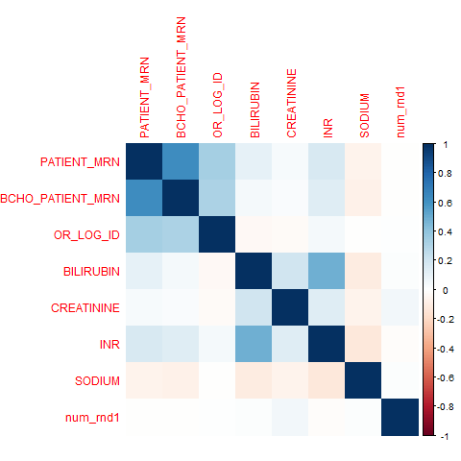
Correlation Matrix

