Slide 1
Internet of Things
Water Quality Monitoring For Fish Pond
Bahar Barzegar
Salam Rishiraj Singh
Ali Shahrzad
May -2021

Slide 2
Abstract
Water quality influences fish growth and survival rate. The purpose of this project is to monitor and control remotely water quality in real-time using IOT technology through sensors and actuators connected to the internet (or cloud service).
Objective
Our goal is to develop a small, relatively inexpensive, portable device that can be deployed in an Artificial fish pond located in remote fish farm for water quality monitoring that could potentially reduce time-consuming daily visits to the offshore fish cage.
Users
Fish farming operators

Slide 3
Questions
What is the problem and why do you need IoT?
The problem is to solve water quality monitoring of remote Fish Farms. Since the Fish farms are located miles away in the remote location, which daily monitoring in presence of operators will be expensive and time consuming. Scientists and operators need a way to observe water quality, fish feeding habit and growth on a regular basis without having to visit the artificial fish ponds themselves. Eventually the control of fish farm operations should be done remotely. Remote monitoring can be done using IoT that uses sensors and actuators connected to internet and we can monitor and control Fish ponds, using web-based applications serviced by cloud based IoT platform.

Slide 4
Key Functionalities
Real time data acquisition.
Plug and play IOT Device.
Decrease in time period for commute.
Monitor major environmental Component for fish pond.
User friendly dashboard for data overview.
Easy to take control of the actuators.

Slide 5
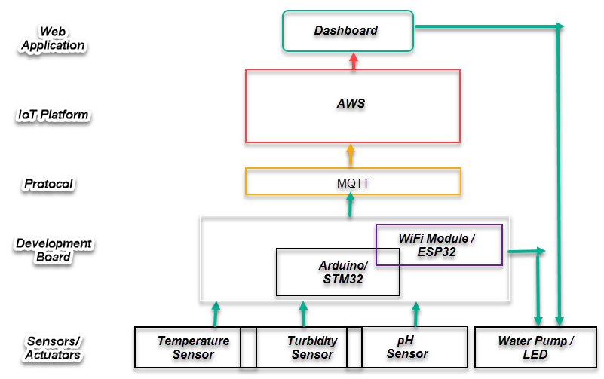
2. What are the connected components, the protocols to connect them and the overall IoT architecture?
Connected Components are illustrated in the following structure:

Slide 6
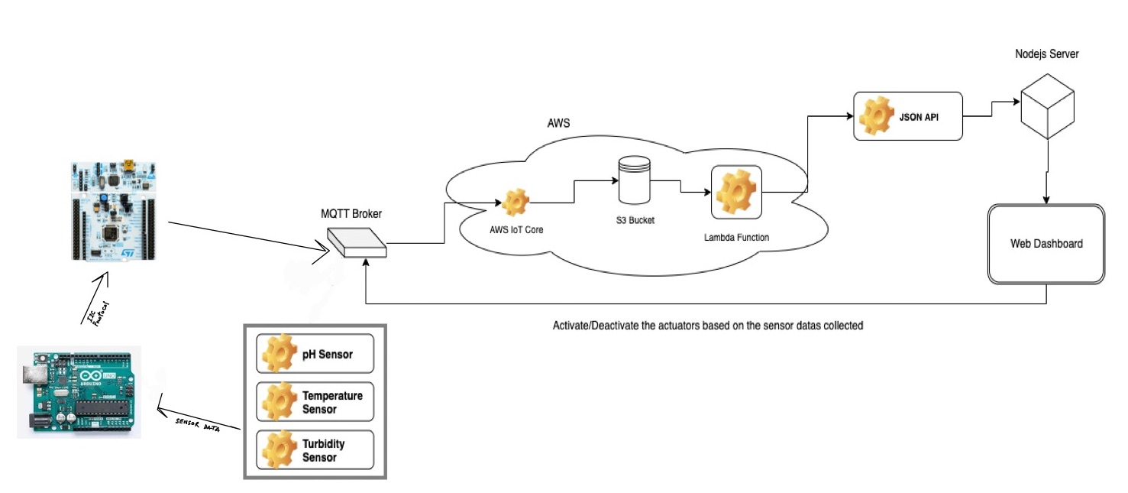
IoT Architecture

Slide 7
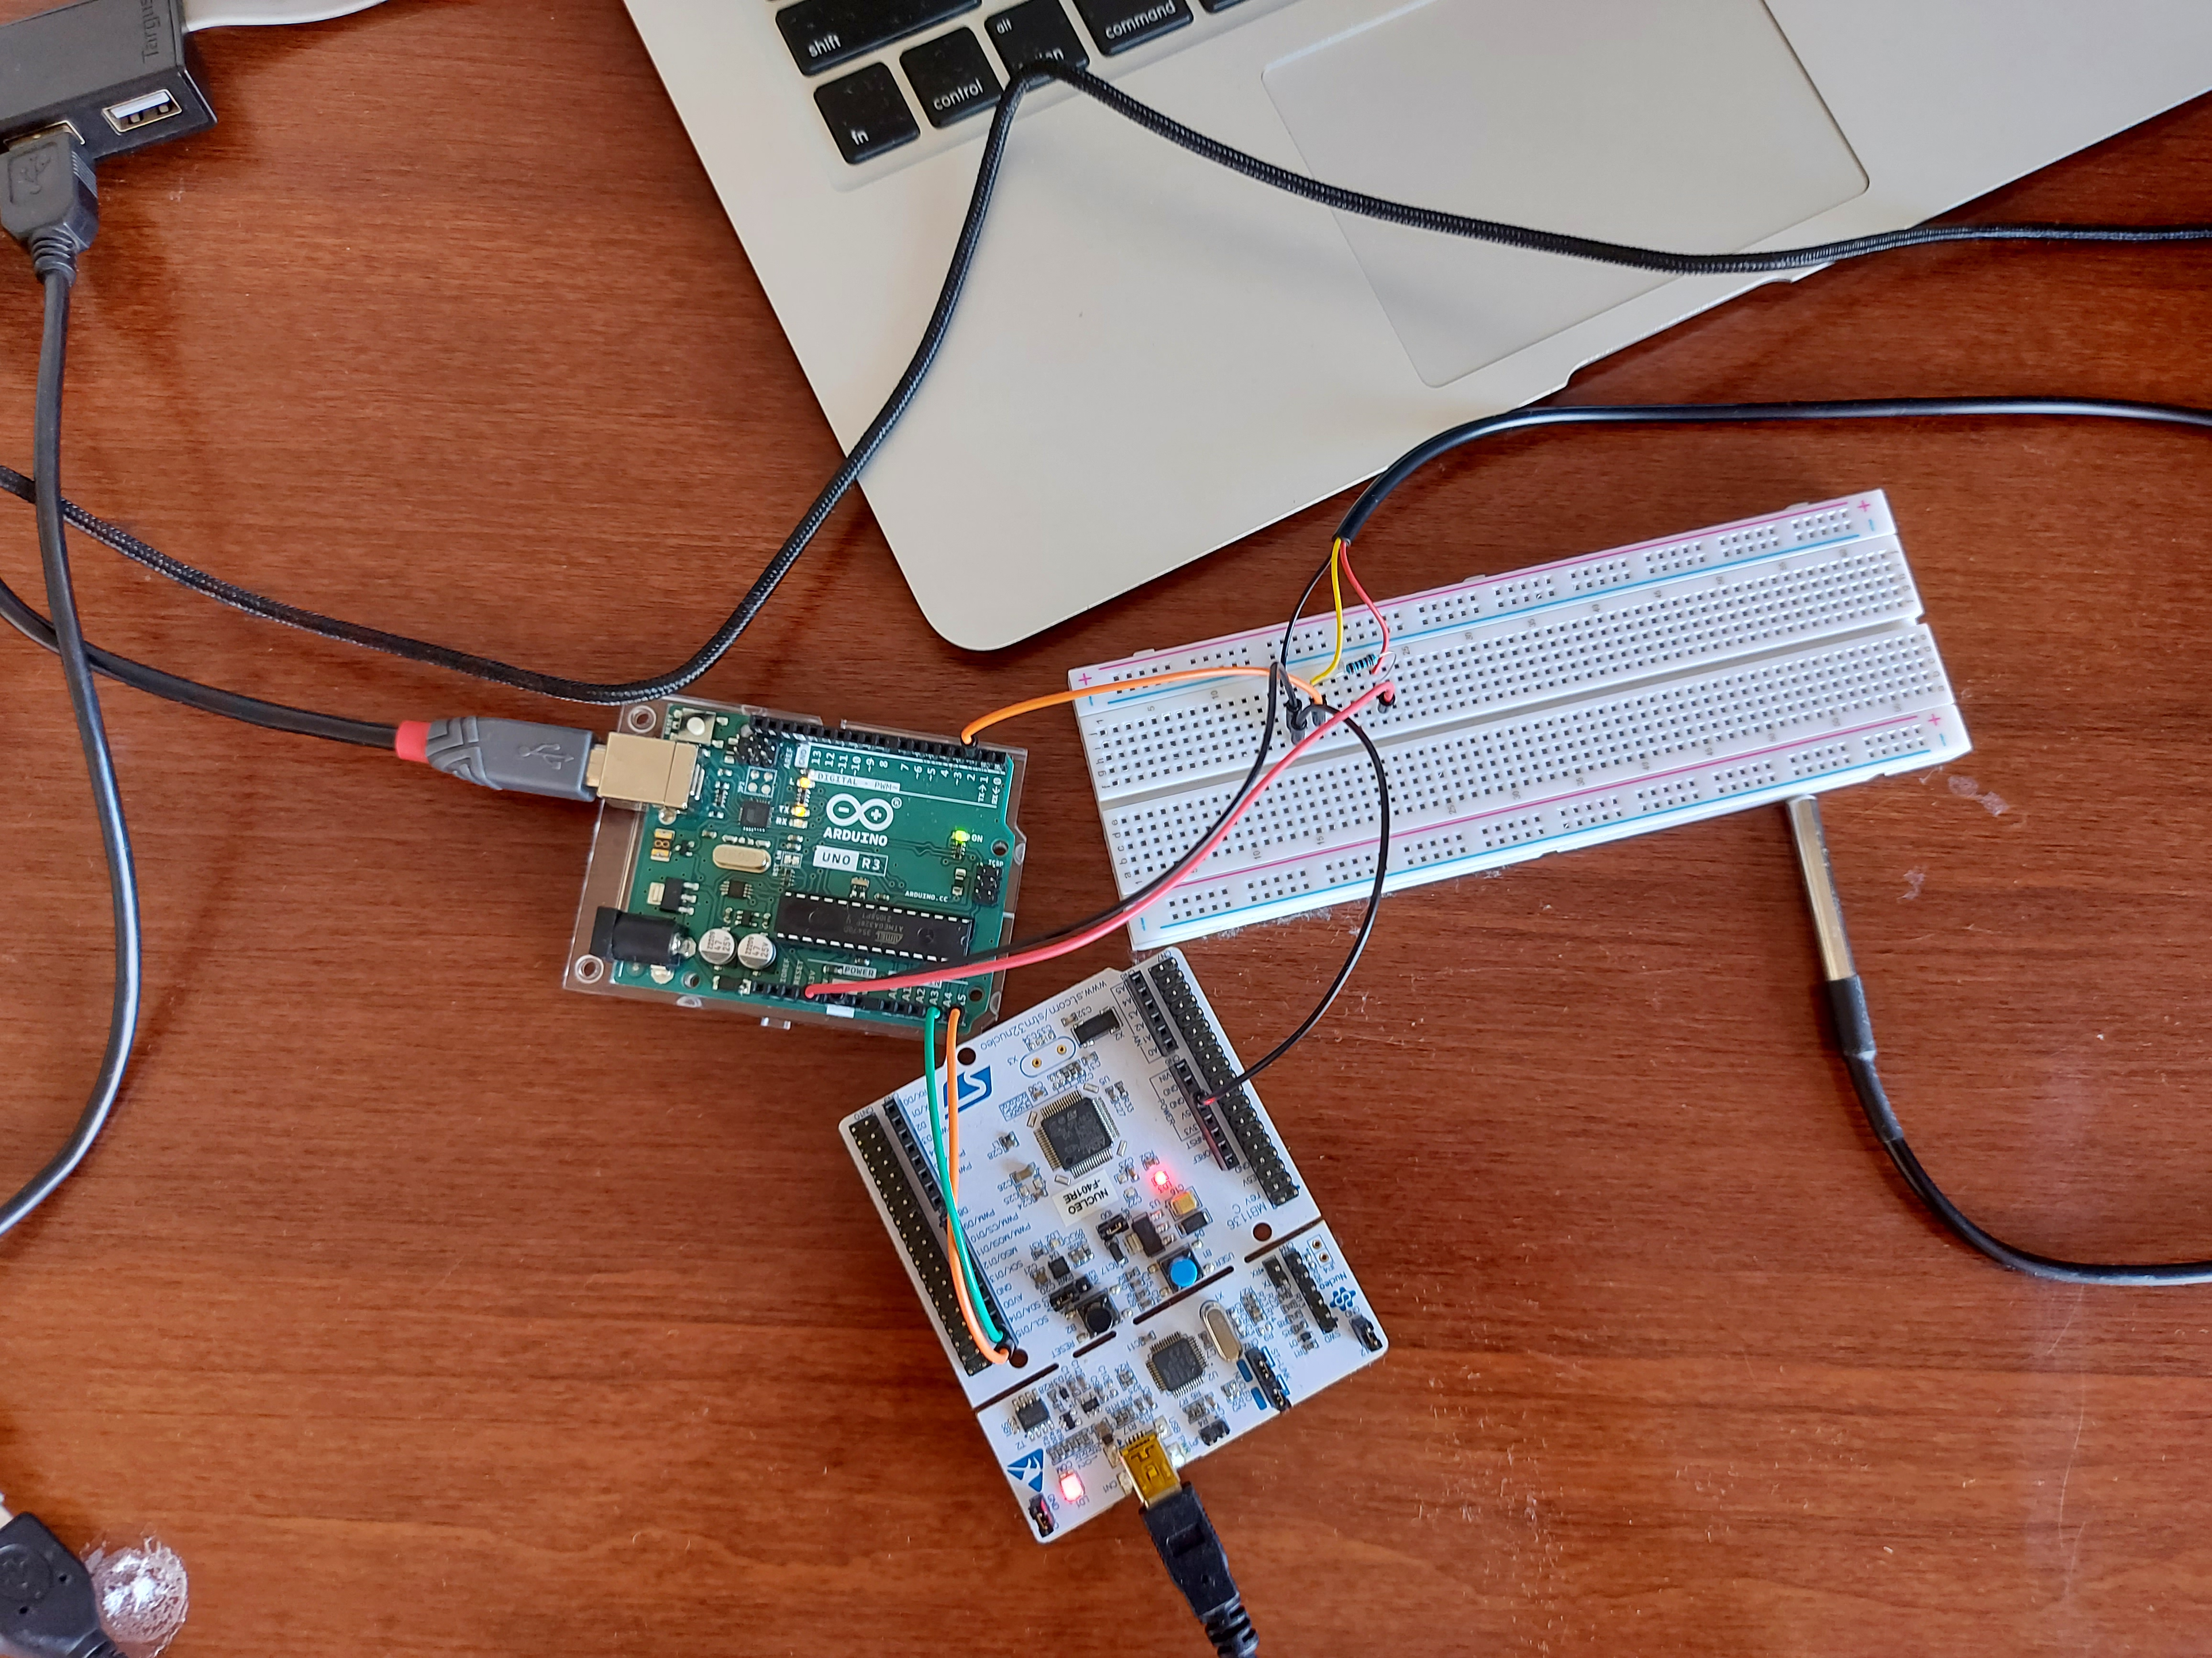
IoT Device

Slide 8
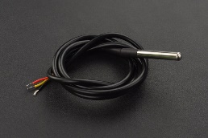
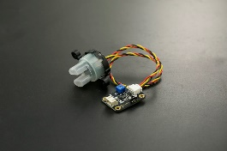
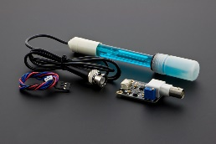
3. What data are collected and by which sensors?
Waterproof DS18B20 Digital temperature Sensor |  | Analog Data- (Celsius)
Analog Turbidity Sensor Presence of solid particles |  | Analog Data - (Volt)
Analog pH Sensor Acidity of water |  | Analog Data– Acidity(pH)

Slide 9
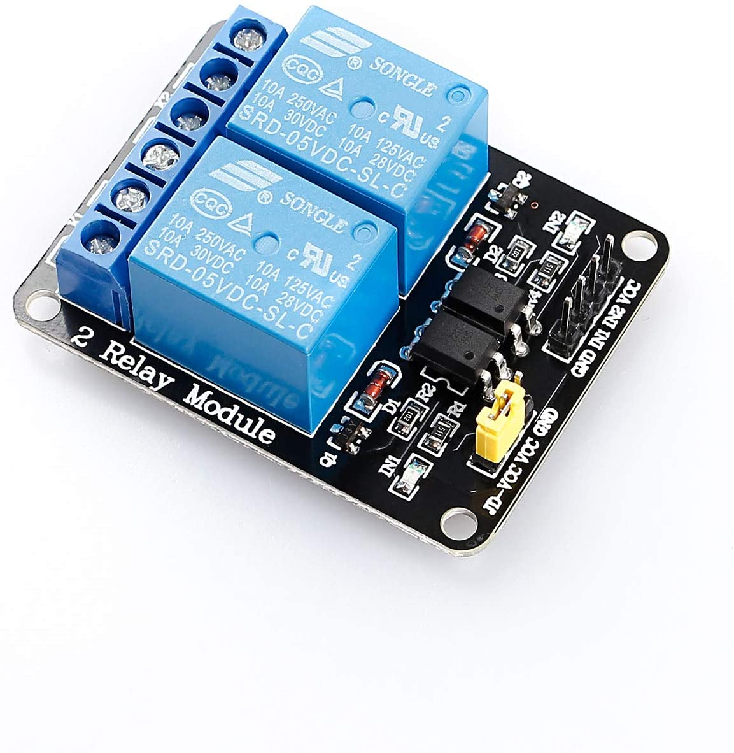
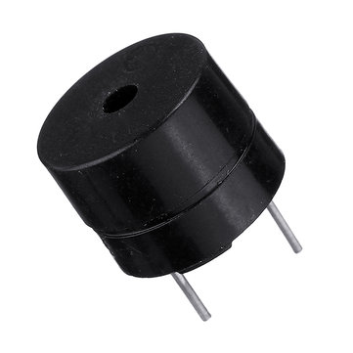
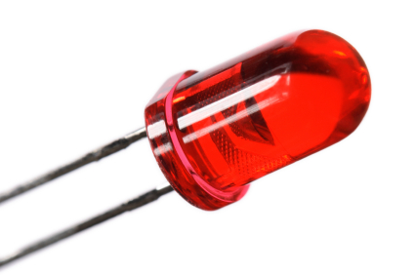
Actuators used.
Relay To control the water pump.
Active Buzzer To be used as a feedback for rise in the temperature.
LED To be used as feedback for the water impurity level.

Slide 10
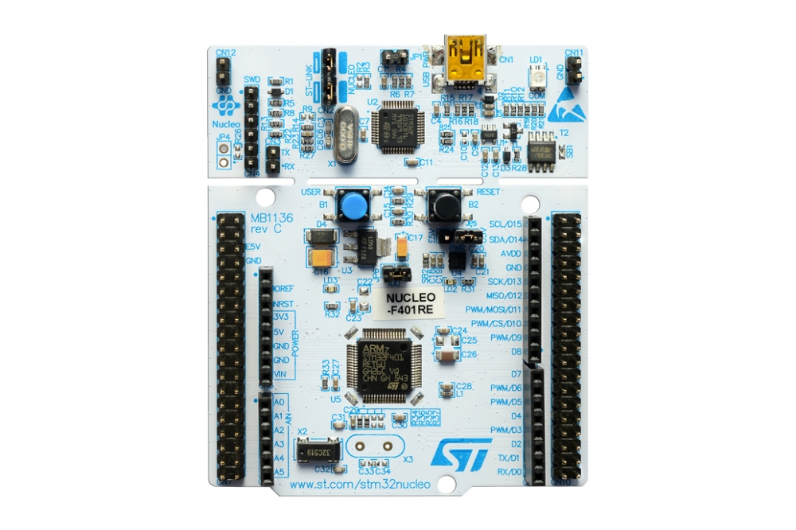
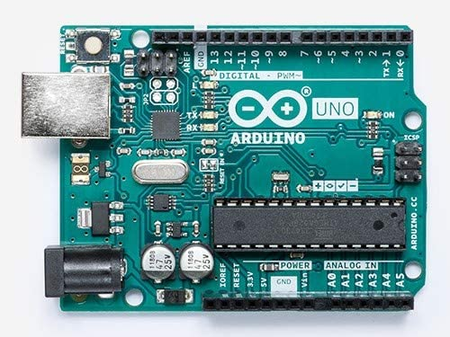


Water Quality Monitoring System Structure
SLAVE
MASTER
Sensors
NUCLEO F401RE
Arduino Uno

Slide 11
4. What kind of collective intelligence do you expect will emerge?
Our purpose is to replicate a similar environment as that of the offshore fish cage and present it to the Artificial fish pond in the remote fish farm with optimal condition to get better fish growth rate.

Slide 12
5. What are you going to learn and how will you act into the environment by what actuators?
We are going to monitor three important parameters of water in fish-living area to monitor and control the fish growth and prevent fish death.
In case of water impurity, which can be measured by pH and Turbidity sensors, we will start a water pump to add pure water to the Fish pond to make the water pure in comparison with previous state.
In case of water high temperature, we will turn on an LED to notify operators to start pump to add some cold water to the existing Fish pond.

Slide 13
6. How are you going to measure the effectiveness of your actions into the environment?
Water pollution is one of the biggest issue affecting the fish growth and survival rate. In order to guarantee clean water for fish ponds, it should be based on real-time monitoring. In this project, we present a design and development of a low cost system for monitoring of the water quality. The system measures physical and chemical parameters of the water. The parameters such as temperature, PH, turbidity of the water can be measured. These values will interpret by Data processing part of the system (Controller) and relevant actions will be applied to the environment through actuators at the right time. Therefore having a real time sensing and actuation will be effective and prevent fish death in our case.

Slide 14
7. What are the constraints? How often? Bandwidth? Latency? Energy? Duty Cycle?
In our proposed solution, mainly we are going to face power and network limitations. As we are using multiple sensors, actuators, Wi-Fi module and development board, we need a stable power connection, in case of using a battery, it can lead us for less power consumption. On the other hand, if we lose our network connection it can create a latency to update system instantly.
8. What is the plan and what are the metrics (quantitative, not qualitative) to evaluate the performance.
To measure the performance of our proposed system we are going to test our device and its components with exciting solutions which are already available in the market to verifies our result’s accuracy. Once our device will be fully functional we will run different scenarios to compare our device results with existing results to find out the performance . There are many tools available in the market to evaluate the IOT devices performance for example JTAG Dongle , Wireshark and Shodan etc. .

