Slide 1

Notes:
Cover. Introduce the team and the one-line idea: a digital-first journey that takes a small business from first hello to live services in one sitting.

Slide 2
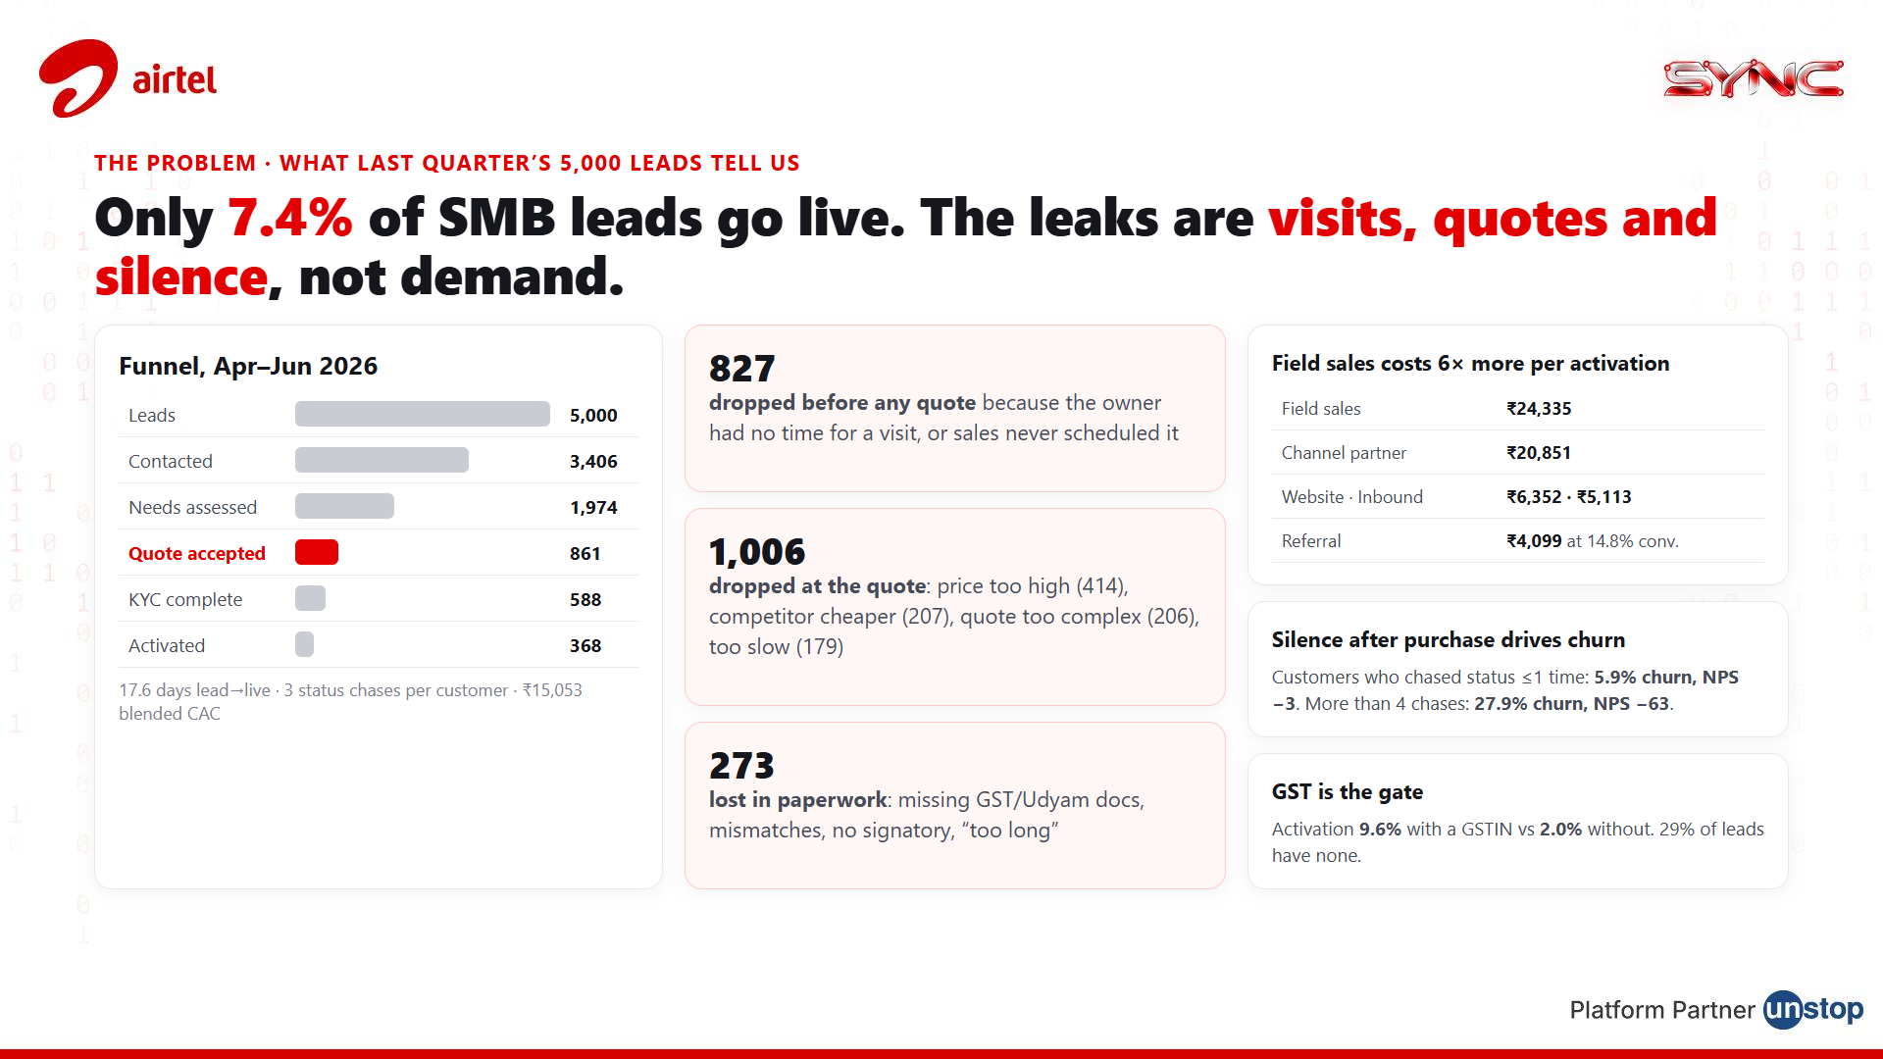
Notes:
Problem. Use the data: 7.4% activation. Three leaks: no-time-for-visit (827), quote stage (1,006 on price, complexity, speed), paperwork (273). Field sales costs 6x digital per activation. Status chases after purchase predict churn. GSTIN is the gate.

Slide 3
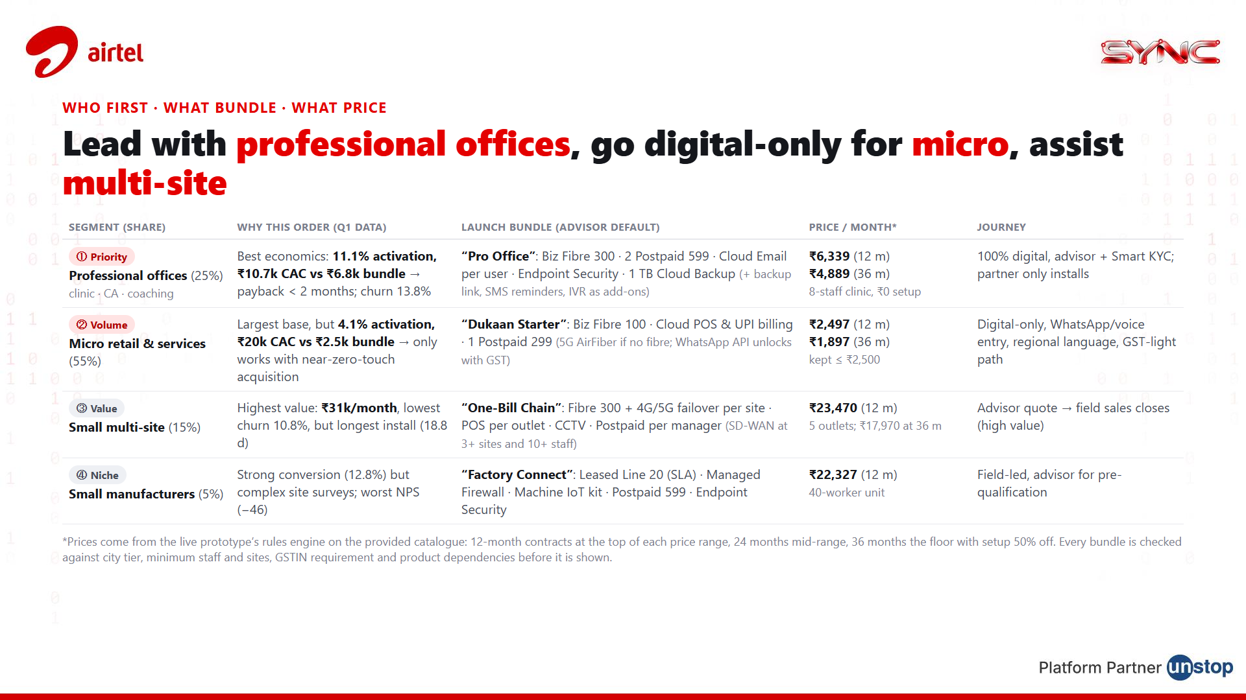
Notes:
Segments. Professional offices first because the economics are best (payback under 2 months). Micro is 55% of the base but only works zero-touch, so it gets a digital-only ₹2,497 bundle. Multi-site is high value, so the advisor qualifies and field sales closes. Prices are from the prototype rules engine.

Slide 4
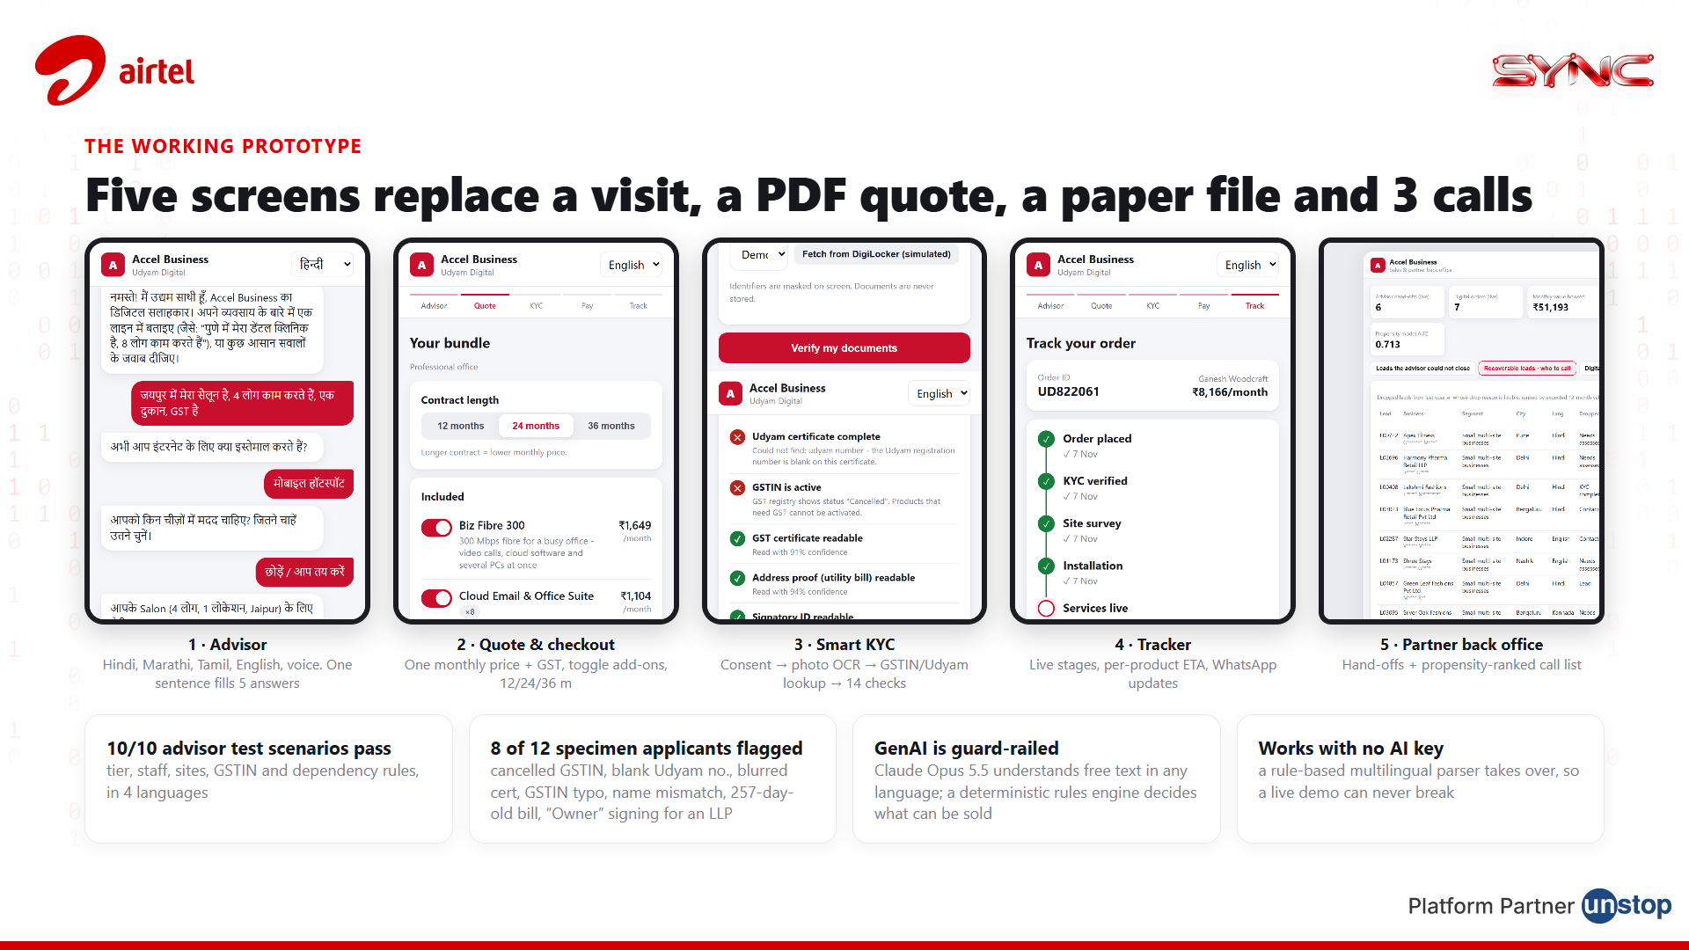
Notes:
Prototype. Walk through the five screens. Stress: the GenAI understands, the rules engine decides; 10 of 10 advisor scenarios pass; 8 of 12 specimen KYC applicants are flagged with the exact reason.

Slide 5
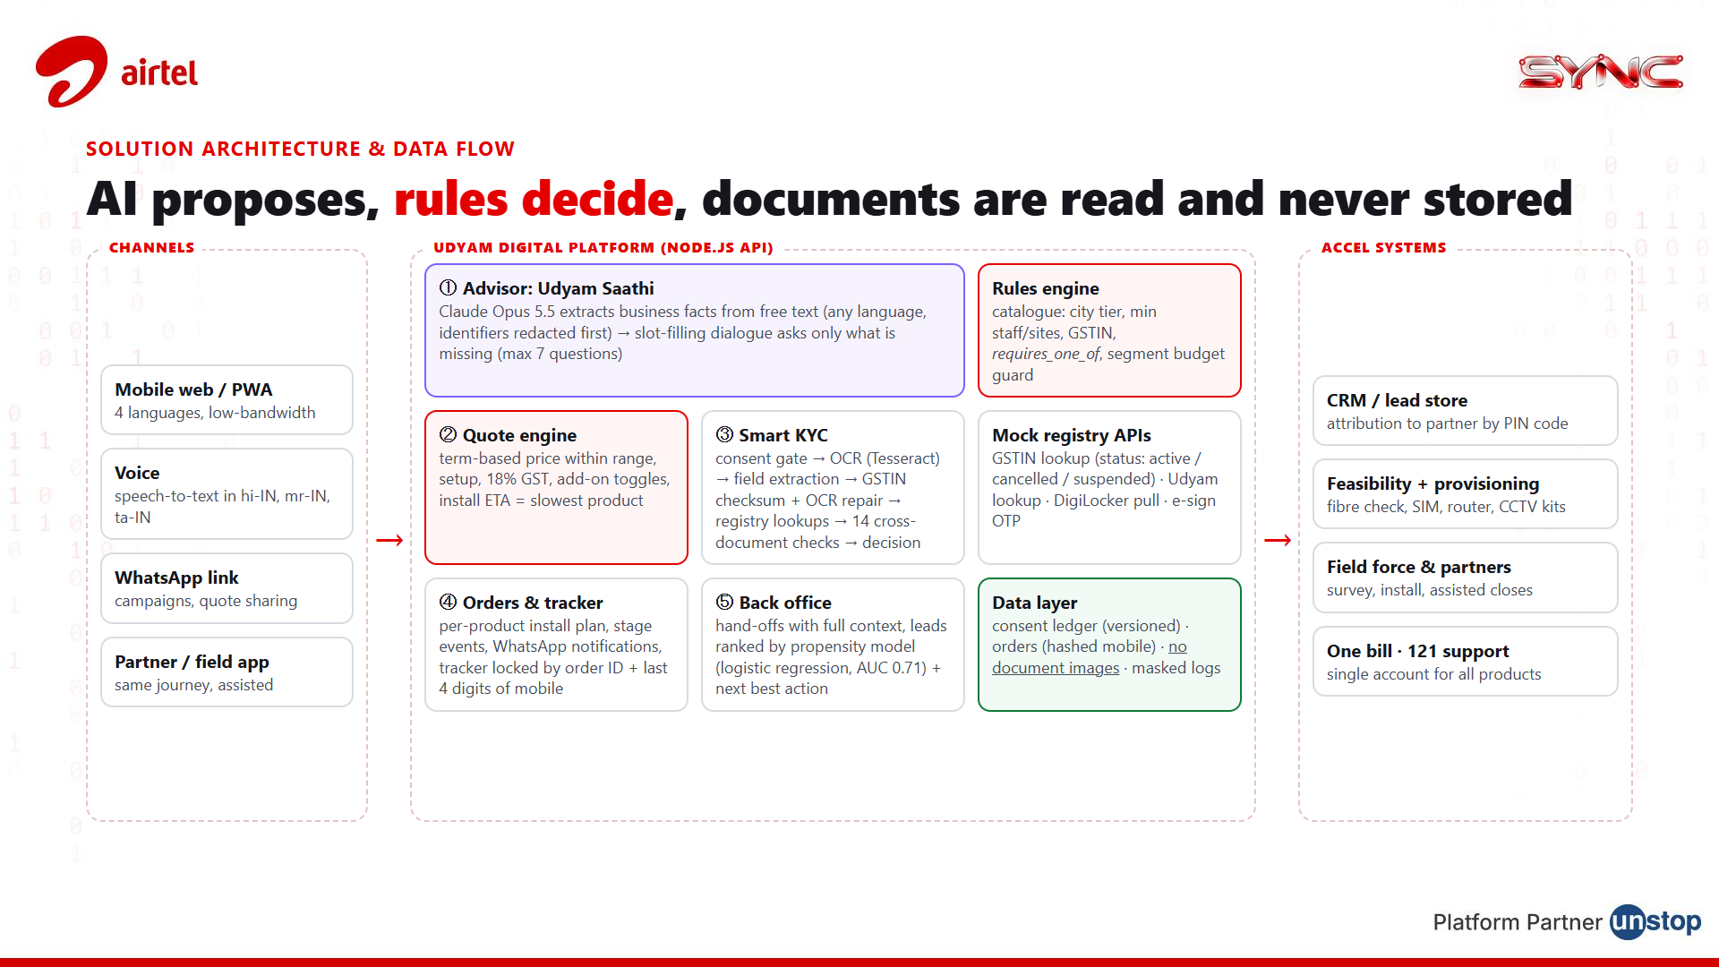
Notes:
Architecture. Channels on the left, the platform in the middle, Accel systems on the right. Purple = AI, red = deterministic rules, green = data layer with no document storage.

Slide 6
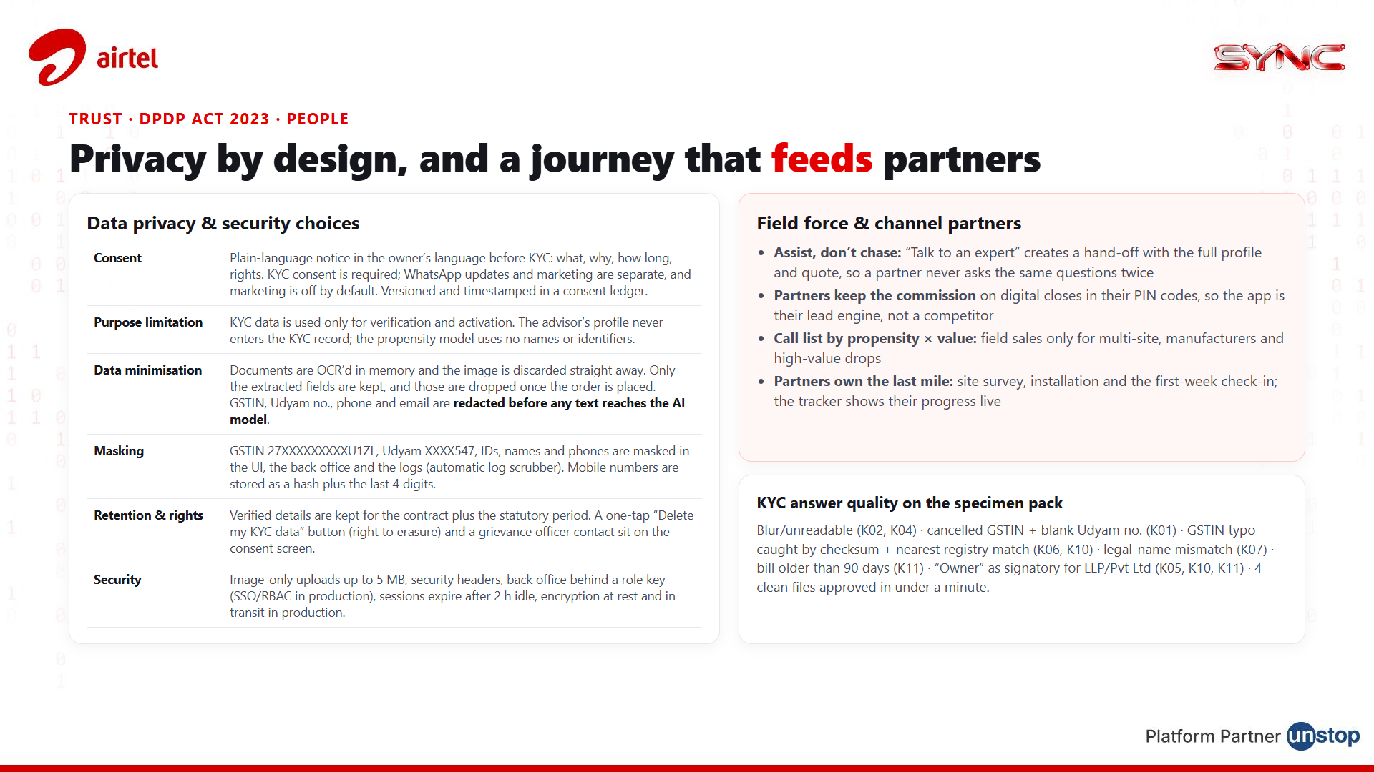
Notes:
Privacy and people. DPDP: consent, purpose limitation, minimisation, masking, retention, erasure. Partners get context-rich hand-offs, commission on digital closes in their PIN codes, and they own installation.

Slide 7
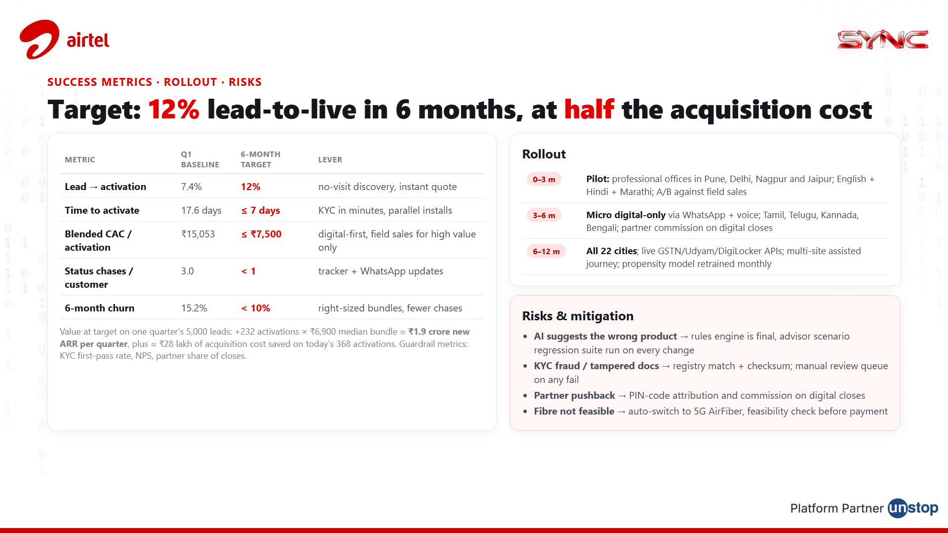
Notes:
Impact. Five metrics with baselines from the data and 6-month targets. Value: about ₹1.9 crore new ARR per quarter of leads. Phased rollout and the four main risks with mitigations.

