Slide 1
Mogambo Diners management system
Made by
Rishi Raj Dutta (001825928)

Slide 2
Scope of the project
Mogambo Diners is a mid tier multi cuisine restaurant that servers its customers with appetizing meals
It is a restaurant database management system that will hold the responsibility of maintaining records of all the employees, personal details and a record of all the various orders placed
The database system holds the catalog of all the various cuisines and deserts available according to season and information about its valuable customers

Slide 3
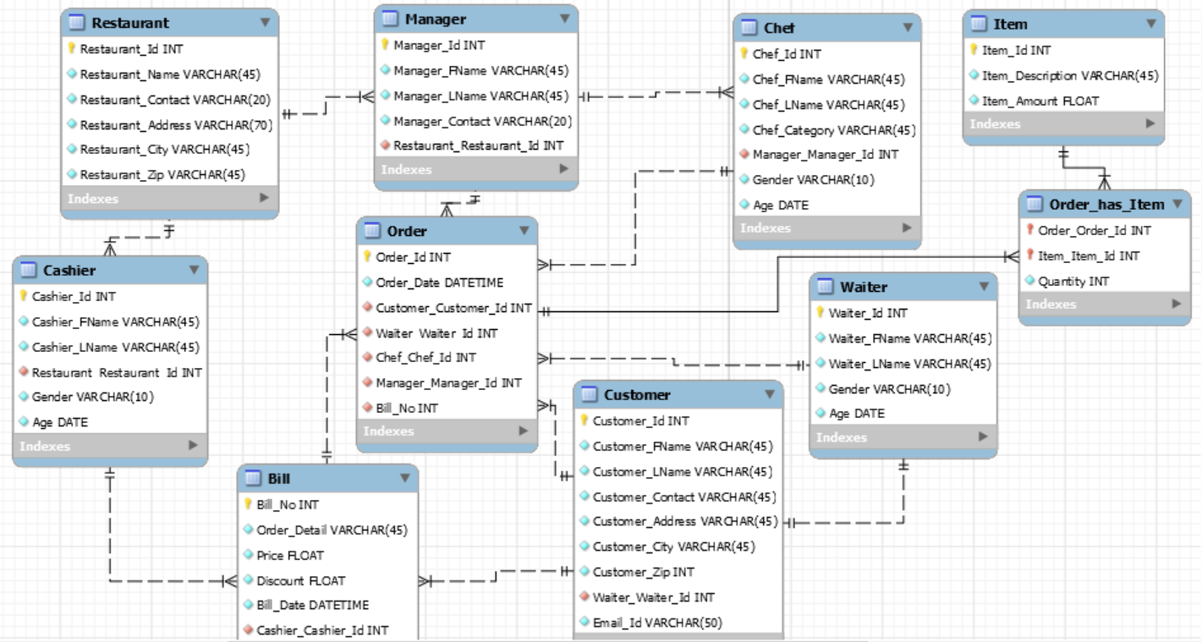
Entity relationship diagram

Slide 4
List of Entities
Restaurant
Manager
Customer
Order
Chef
Item
Waiter
Bill
Cashier

Slide 5
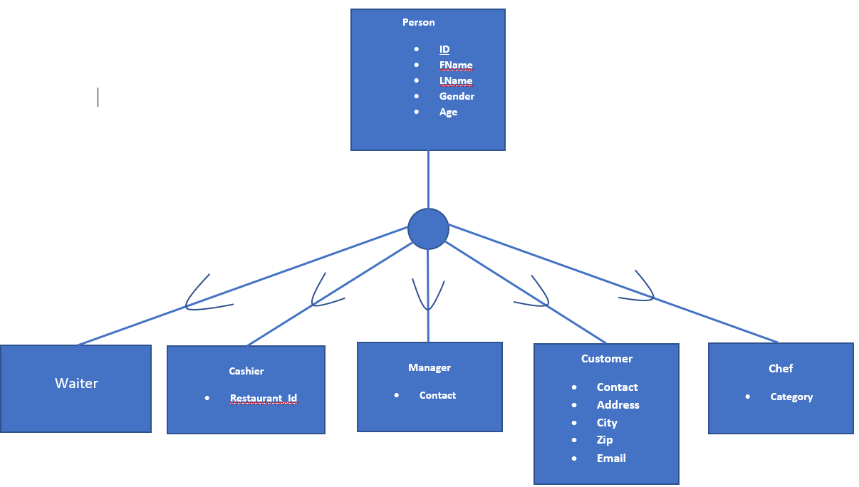
Identification of Entities and their subtypes
SUPERTYPE
SUBTYPE LEVEL

Slide 6
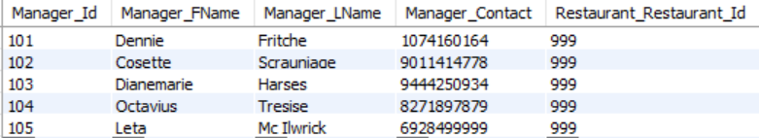
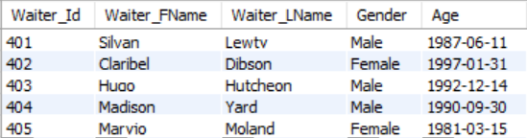
Relational Data Model
Restaurant Table
Manager Table
Waiter Table

Slide 7
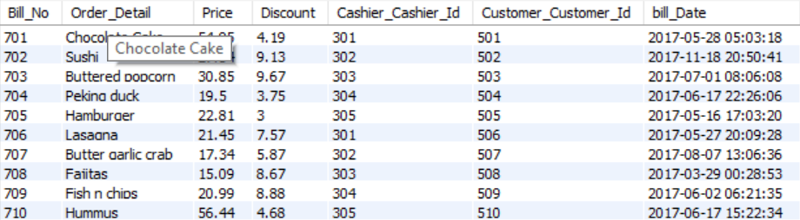
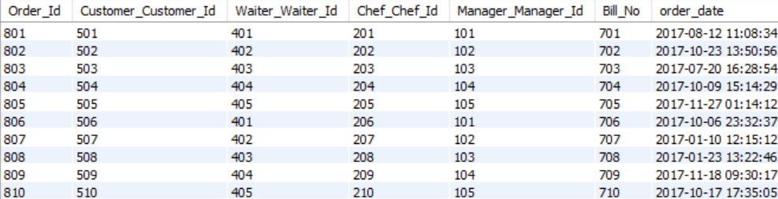
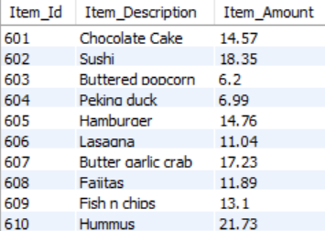
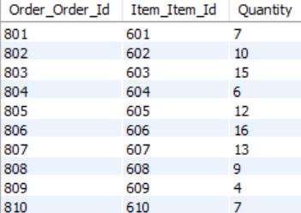
Bill Table
Order Table
Item Table > Order_has_Item(Bridge Table)

Slide 8
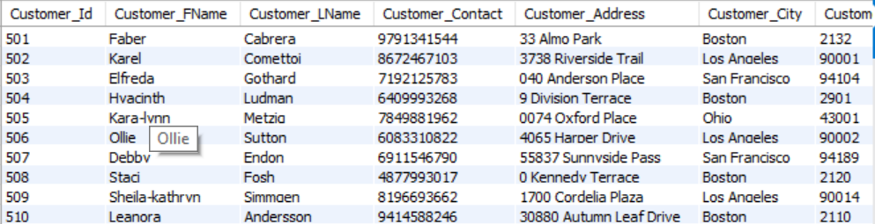
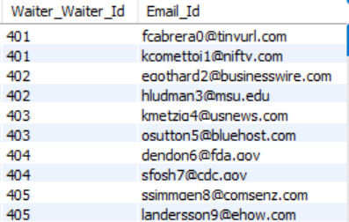
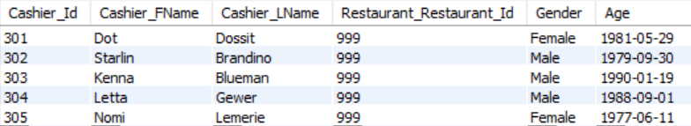
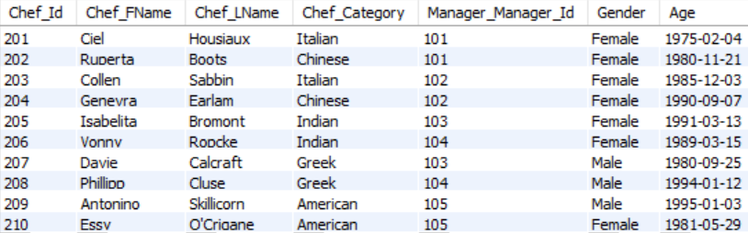
Customer Table
Cashier Table
Chef Table

Slide 9
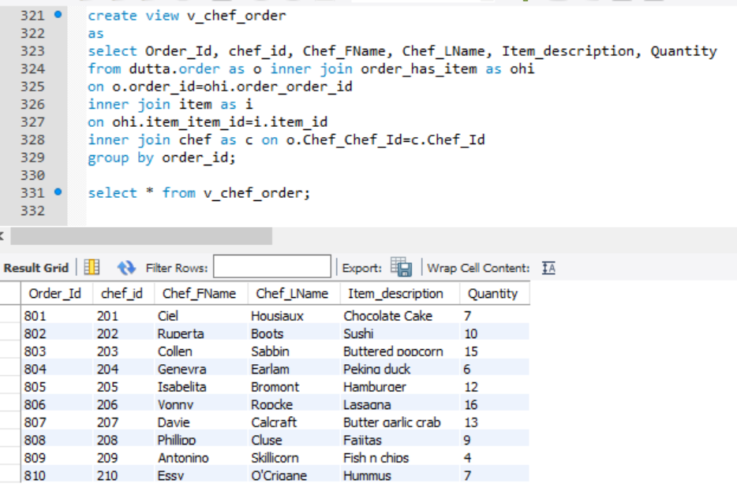
VIEW

Slide 10
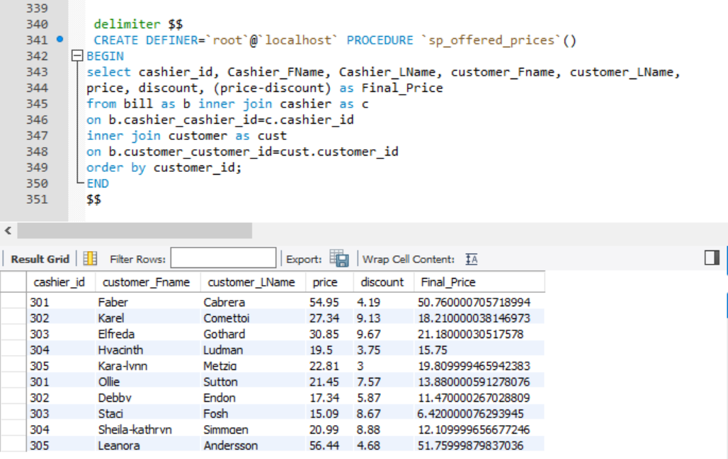
Stored procedure

Slide 11
THANK yOU

