Slide 1
MULTI-VENDOR E-COMMERCE MARKETPLACE
Vyapar Setu
Bridge of Commerce -- Connecting Sellers & Buyers
A Full-Stack Web Application
PHP 8.x
MySQL
Bootstrap 5
JavaScript
AJAX
Chart.js
Project By
Rishiraj Sharma, Rushikesh Sherkar,
Vishal Yadav

Slide 2
Introduction & Problem Statement
The Problem
Our Solution -- Vyapar Setu
Small vendors in India lack affordable e-commerce platforms to sell their products online
A multi-vendor marketplace where any vendor can register, list products, and sell to customers
Building an independent online store requires significant technical expertise and investment
Role-based dashboards for Customer, Vendor & Admin with intuitive interfaces
Customers struggle to discover local and regional sellers in a unified marketplace
"Vyapar Setu" means "Bridge of Commerce" -- seamlessly connecting sellers & buyers
No single platform connecting multiple vendors with buyers in an organized manner
5 product categories: Electronics, Fashion & Apparel, Spices & Organics, Home & Living, Beauty & Wellness

Slide 3
Project Objectives
01
Multi-Vendor Support
02
Secure Authentication
Enable multiple vendors to register, manage stores, and sell products from a single unified platform.
3-tier role-based access (Customer, Vendor, Admin) with bcrypt password hashing & session management.
03
Full E-Commerce Flow
04
Admin Governance
End-to-end shopping experience: browsing, cart, wishlist, checkout, order tracking, and payments.
Centralized admin panel for vendor approvals, product moderation, order oversight, and revenue analytics.
05
Responsive Design
06
Reviews & Ratings
Mobile-first responsive UI with Bootstrap 5 for seamless experience across desktop, tablet, and mobile.
Customer product reviews with 1-5 star ratings and vendor reply capability for community trust.

Slide 4
Technology Stack
Frontend
HTML5, CSS3, Bootstrap 5, JavaScript ES6, AJAX
Backend
PHP 8.x (Procedural + PDO Database Abstraction)
Database
MySQL / MariaDB via XAMPP (InnoDB Engine, Foreign Keys)
Server
Apache HTTP Server (XAMPP Stack)
Libraries
Chart.js (Analytics), Bootstrap Icons, Google Fonts (Inter)
Dev Tools
phpMyAdmin, Visual Studio Code, Git Version Control

Slide 5
System Architecture
3-Tier MVC-Inspired Architecture Pattern
Presentation Layer
Application Layer
Data Layer
HTML5 / CSS3 / Bootstrap 5
JavaScript / AJAX
Responsive UI & Dynamic DOM
PHP 8.x Business Logic
Routing, Sessions, Auth
db.php, functions.php, auth.php
MySQL / MariaDB (16 Tables)
PDO Prepared Statements
Foreign Key Constraints
Directories: admin/ | vendor/ | customer/ | api/ | ajax/ | includes/ | assets/ | uploads/

Slide 6
ER Diagram (Entity Relationship)
16 Database Tables with Foreign Key Relationships
Vendors
Users
Categories
PK: id FK: user_id
PK: id
PK: id
store_name, vendor_code
name, email, role
name, slug, icon
gstin, commission_rate
password_hash, status
parent_id (self-ref)
Reviews
Products
Product Images
PK: id
PK: id
PK: id FK: product_id
FK: product_id, user_id
FK: vendor_id, category_id
image_url, is_primary
rating, comment
title, price, stock
spotlight, rating
Cart
Payments
Orders
Order Items
PK: id FK: user_id
PK: id FK: order_id
PK: id FK: user_id
PK: id
session_id
transaction_id, amount
order_number, status
FK: order_id, product_id
total_amount
quantity, price
Users 1:N Vendors | Vendors 1:N Products | Products 1:N Images, Reviews | Users 1:N Orders 1:N OrderItems | Orders 1:1 Payments | + Wishlist, Notifications, Support, Logs, Brands

Slide 7
Database Schema
16 Normalized Tables -- MySQL / MariaDB with InnoDB Engine
Table Name
Key Columns
Group
users
id, name, email, phone, password_hash, role, avatar, status
Core
vendors
id, user_id(FK), vendor_code, store_name, gstin, category, status
Core
categories
id, name, slug, icon, parent_id(FK), description
Core
brands
id, name, slug, logo
Core
products
id, sku, vendor_id(FK), category_id(FK), title, price, stock, spotlight, rating
Commerce
product_images
id, product_id(FK), image_url, is_primary
Commerce
cart / cart_items
cart: user_id, session_id | items: product_id, quantity, price
Commerce
wishlist
id, user_id(FK), product_id(FK) -- UNIQUE constraint
Commerce
orders
id, order_number, user_id(FK), address, payment_method, total_amount, status
Transactions
order_items
id, order_id(FK), product_id(FK), vendor_id(FK), quantity, status
Transactions
payments
id, order_id(FK), transaction_id, amount, status
Transactions
reviews
id, product_id(FK), user_id(FK), rating(1-5), comment, vendor_response
Engagement
notifications
id, user_id(FK), title, message, is_read, type, link
Engagement
support_tickets
id, user_id(FK), ticket_no, subject, priority, status
Engagement
activity_logs
id, user_id(FK), action_description, ip_address
Engagement

Slide 8
User Roles & Authentication
Customer
Vendor
Admin
Browse products, add to cart & wishlist
Place orders & track deliveries
Write reviews & manage profile
Save multiple shipping addresses
Register store & list products
Manage inventory & pricing
Fulfill orders & update status
Reply to reviews, view analytics
Approve or reject vendor applications
Moderate products & reviews
Manage categories & users
View GMV reports & analytics
Security Features
bcrypt Password Hashing | PDO Prepared Statements (SQL Injection Prevention) | Session-based Auth with Role Middleware | XSS Sanitization | Email Verification

Slide 9
Functional Modules Overview
Customer Module
Vendor Module
Admin Module
Shopping Cart
Product CRUD
Vendor Approval
AJAX add/remove, quantity update
Add, edit, delete with images
Review & approve applications
Wishlist
Sales Analytics
Product Moderation
Save & manage favorite products
Revenue charts via Chart.js
Monitor all listings
Order Tracking
Order Fulfillment
User Management
Real-time status updates
Update order status workflow
Activate / Suspend accounts
Reviews & Ratings
Review Management
Categories
1-5 stars with comments
Read & reply to feedback
Parent-child hierarchy CRUD
Address Book
Store Profile
GMV Analytics
Multiple shipping addresses
Logo, banner, GSTIN, category
Revenue trend reports
Search & Filter
Earnings
Support Tickets
By category, price, rating
Track sales & commissions
Priority-based resolution

Slide 10
Product Catalog & Order Flow
Electronics
Fashion & Apparel
Spices & Organics
Home & Living
Beauty & Wellness
37 Items
34 Items
31 Items
30 Items
30 Items
Order Flow
1
2
3
4
5
6
7
Browse &
Add to Cart
Review Cart
& Checkout
Shipping
Details
Payment
Method
Order
Confirmed
Vendor
Fulfills
Shipped &
Delivered
Payment & Order Tracking
UPI / Razorpay (Simulated) | Cash on Delivery (COD)
Status Flow: Order Placed --> Processing --> Shipped --> Out for Delivery --> Delivered / Cancelled

Slide 11
Key Features Summary
Multi-vendor product listing with vendor-specific stores
Order lifecycle tracking with status notifications
3-tier role-based access control (Customer, Vendor, Admin)
Admin governance: vendor approvals, product moderation
Secure authentication with bcrypt hashing & sessions
Responsive Bootstrap 5 UI with modern clean design
AJAX-powered cart & wishlist with real-time badge updates
Sales analytics with Chart.js powered dashboards
Product spotlight badges (Bestseller / Featured / Regular)
Search, filter, sort across 162 products in 5 categories
Customer reviews & ratings with vendor response capability
Support ticket system with priority levels (Low to Urgent)
Multi-step checkout with UPI, Razorpay & COD options
Activity logging for complete security audit trail

Slide 12
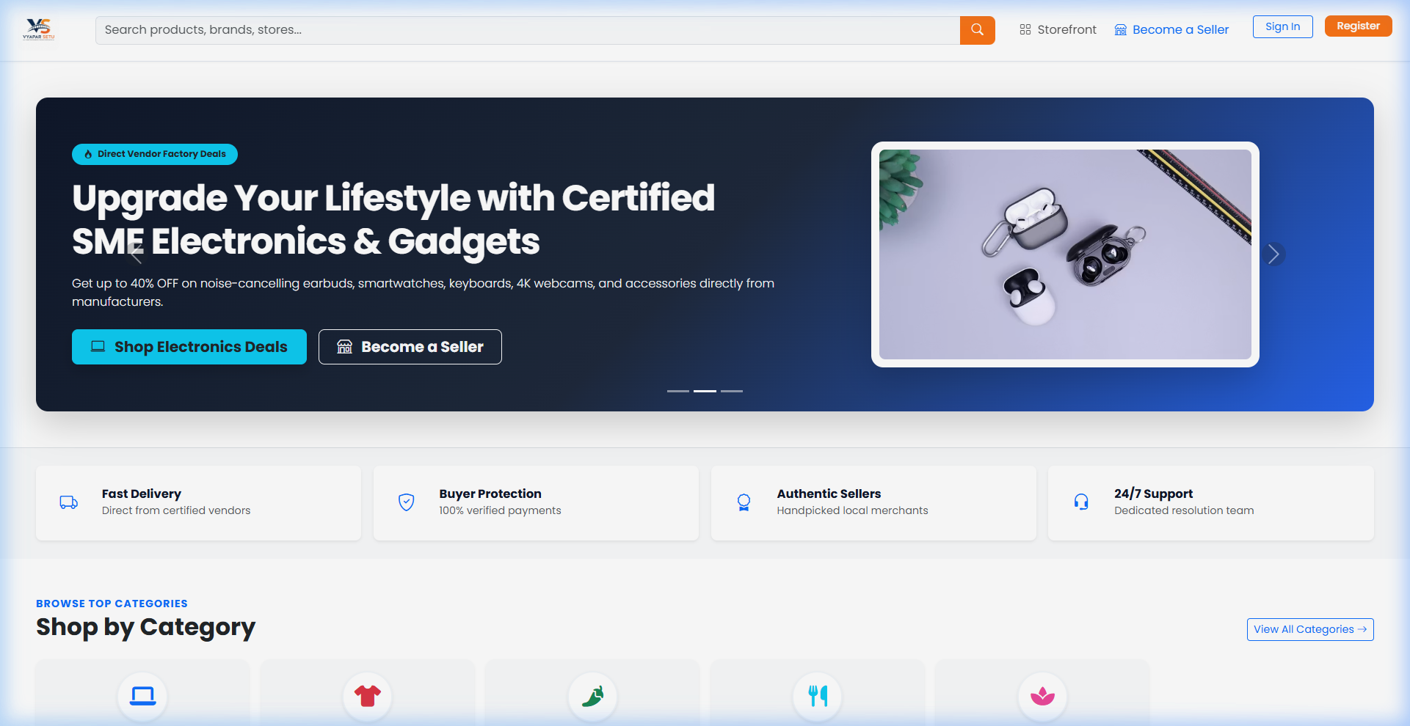
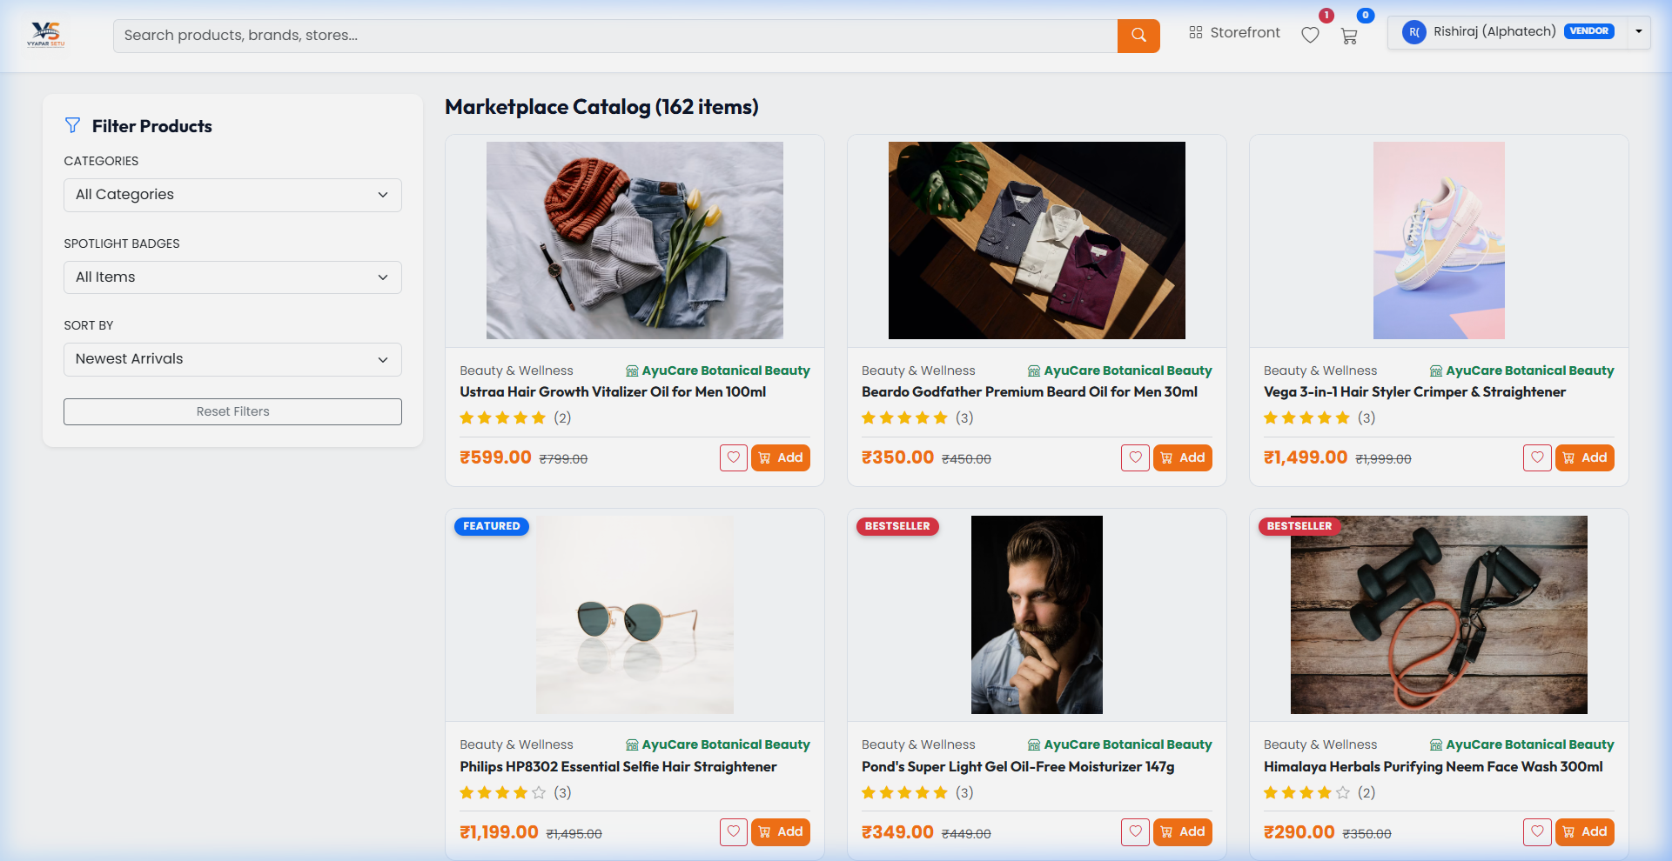
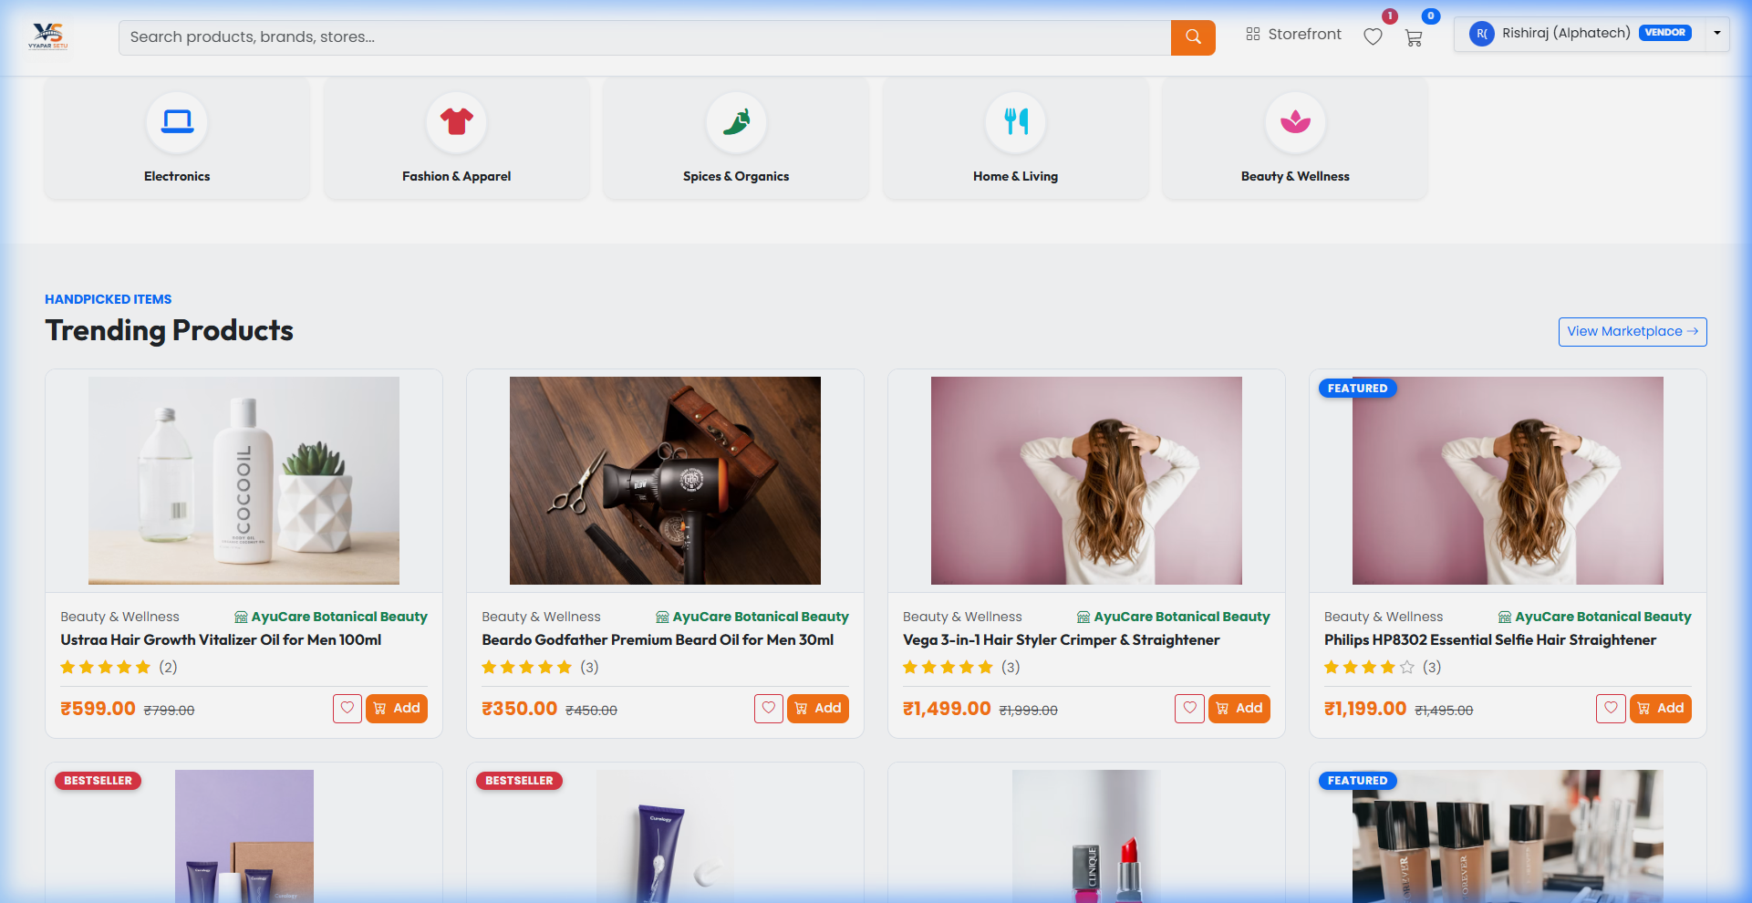
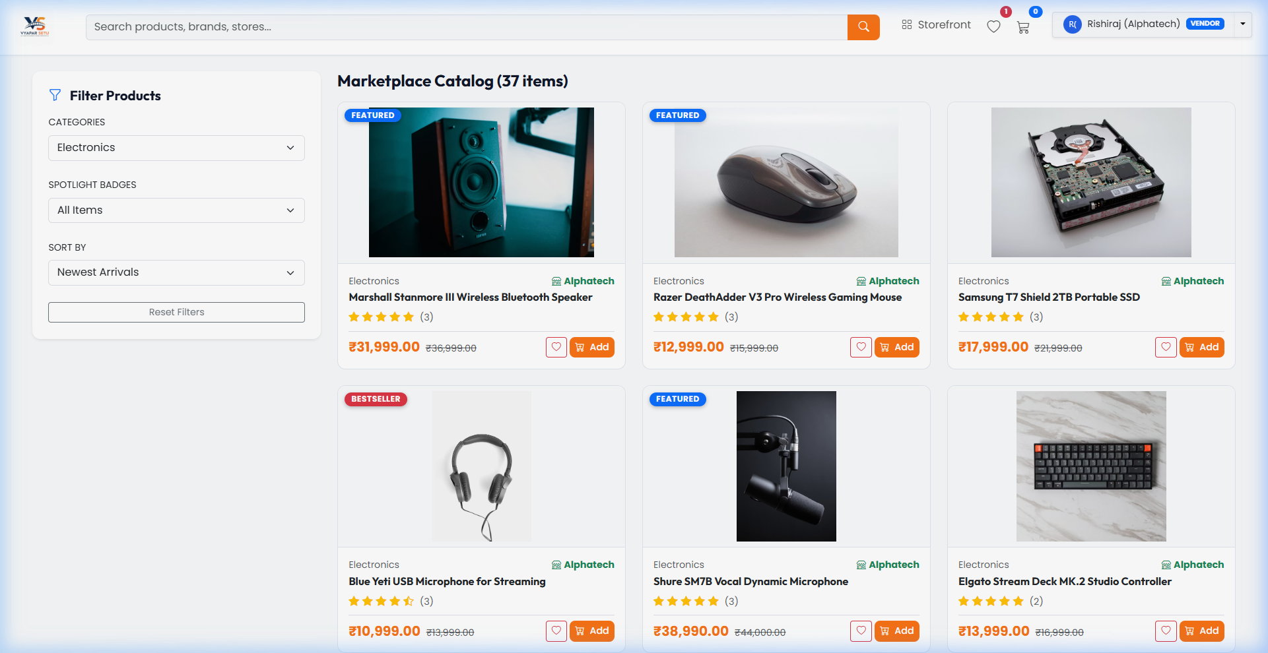
Screenshots: Homepage & Shop Catalog
Homepage -- Hero Banner & Categories
Shop Catalog -- 162 Products with Filters

Slide 13
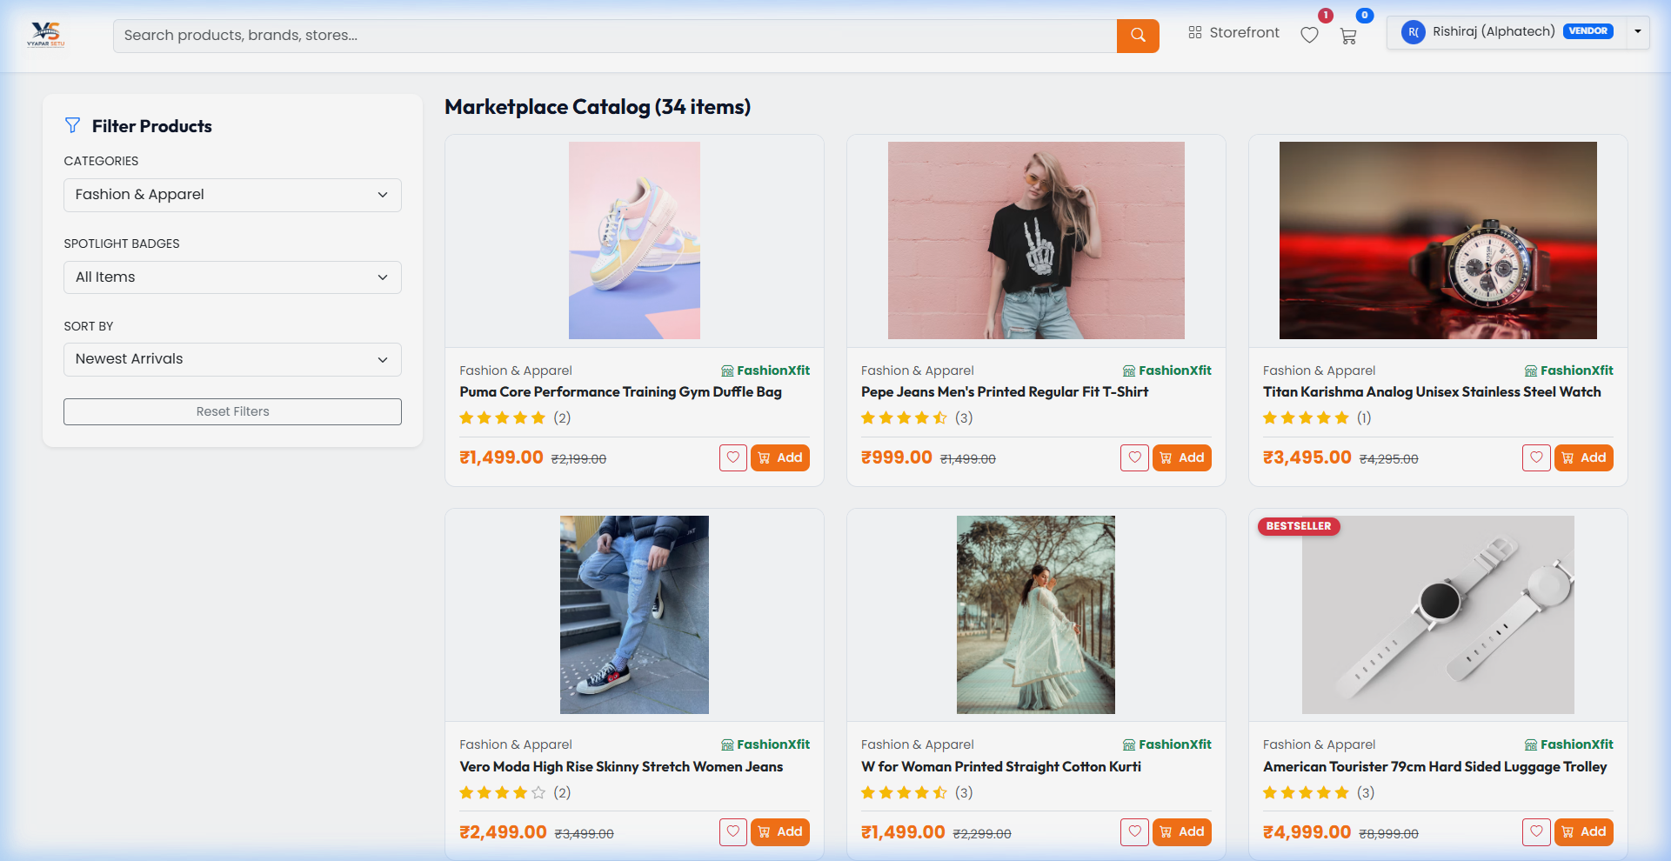
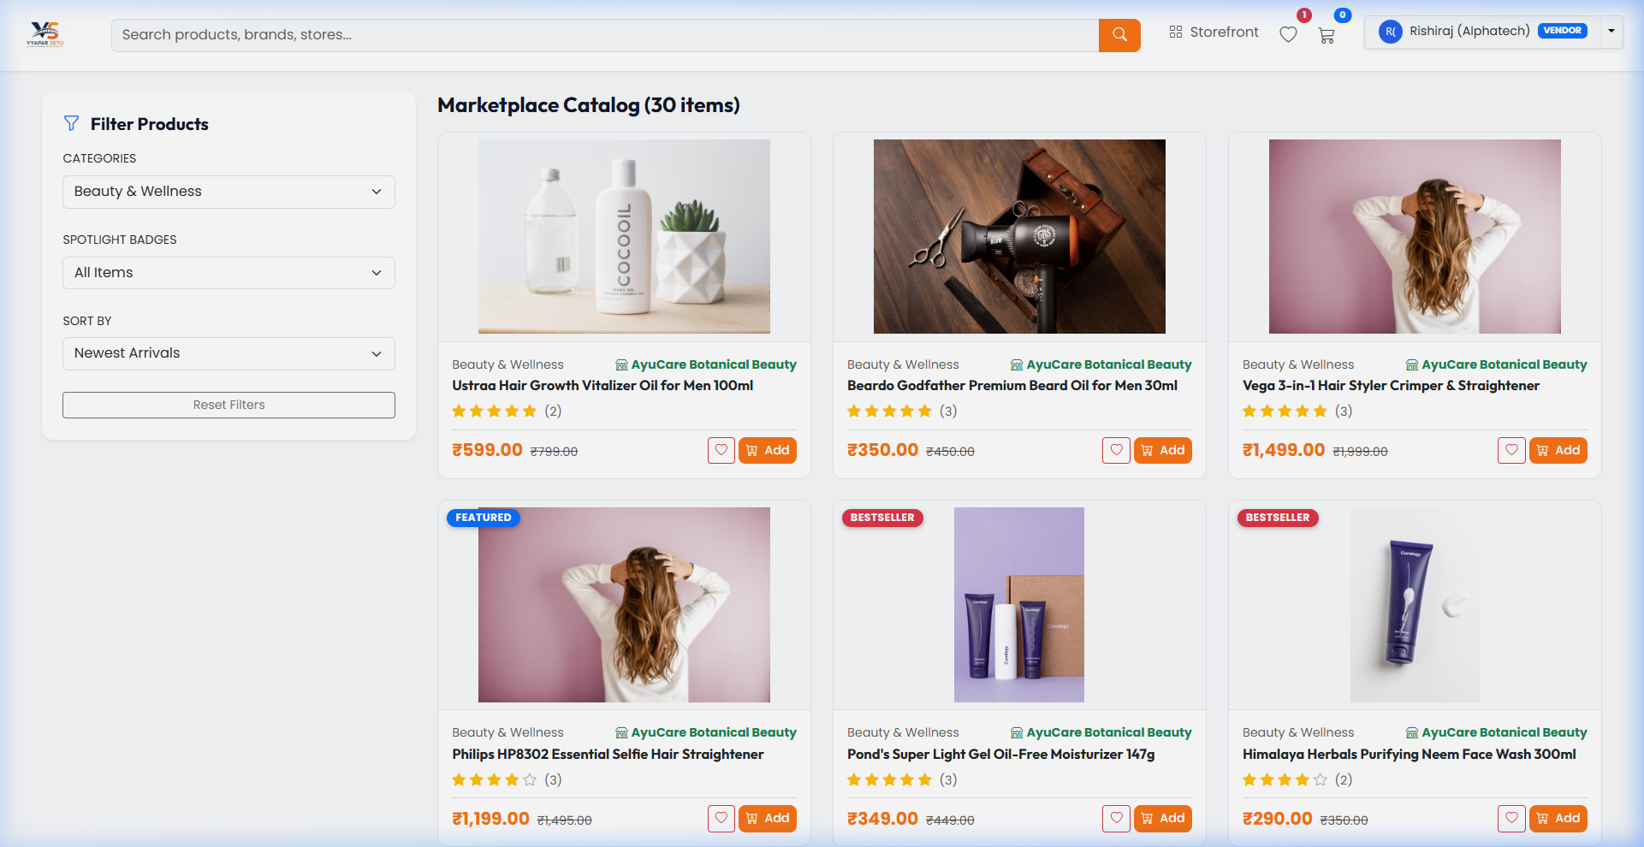
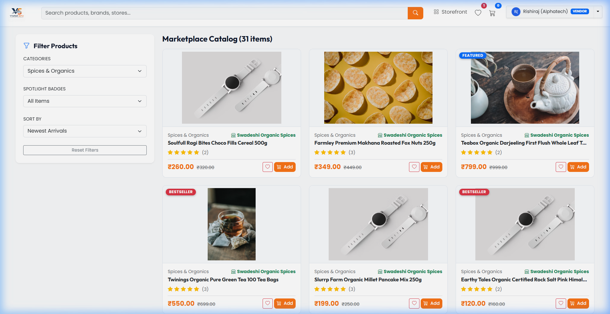
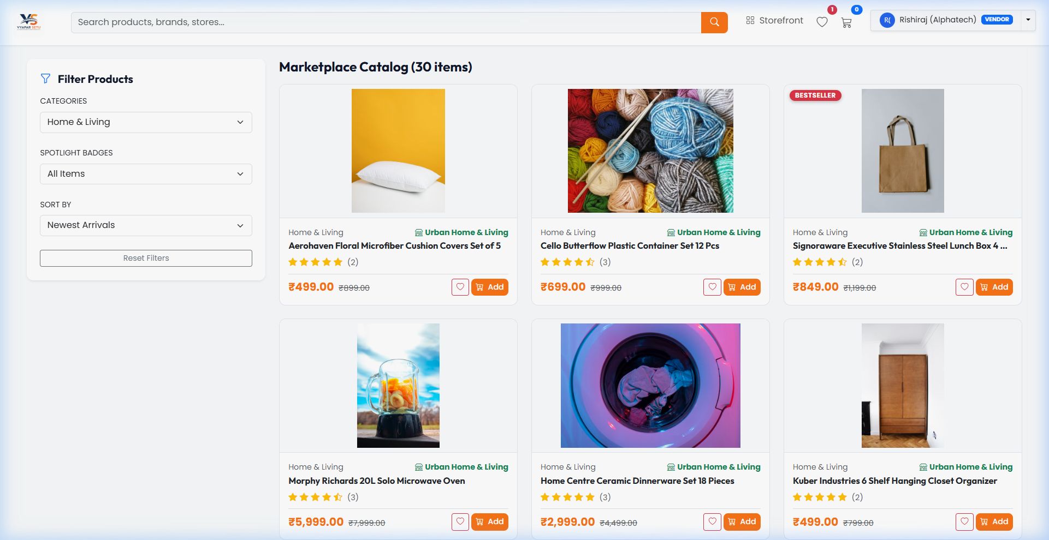
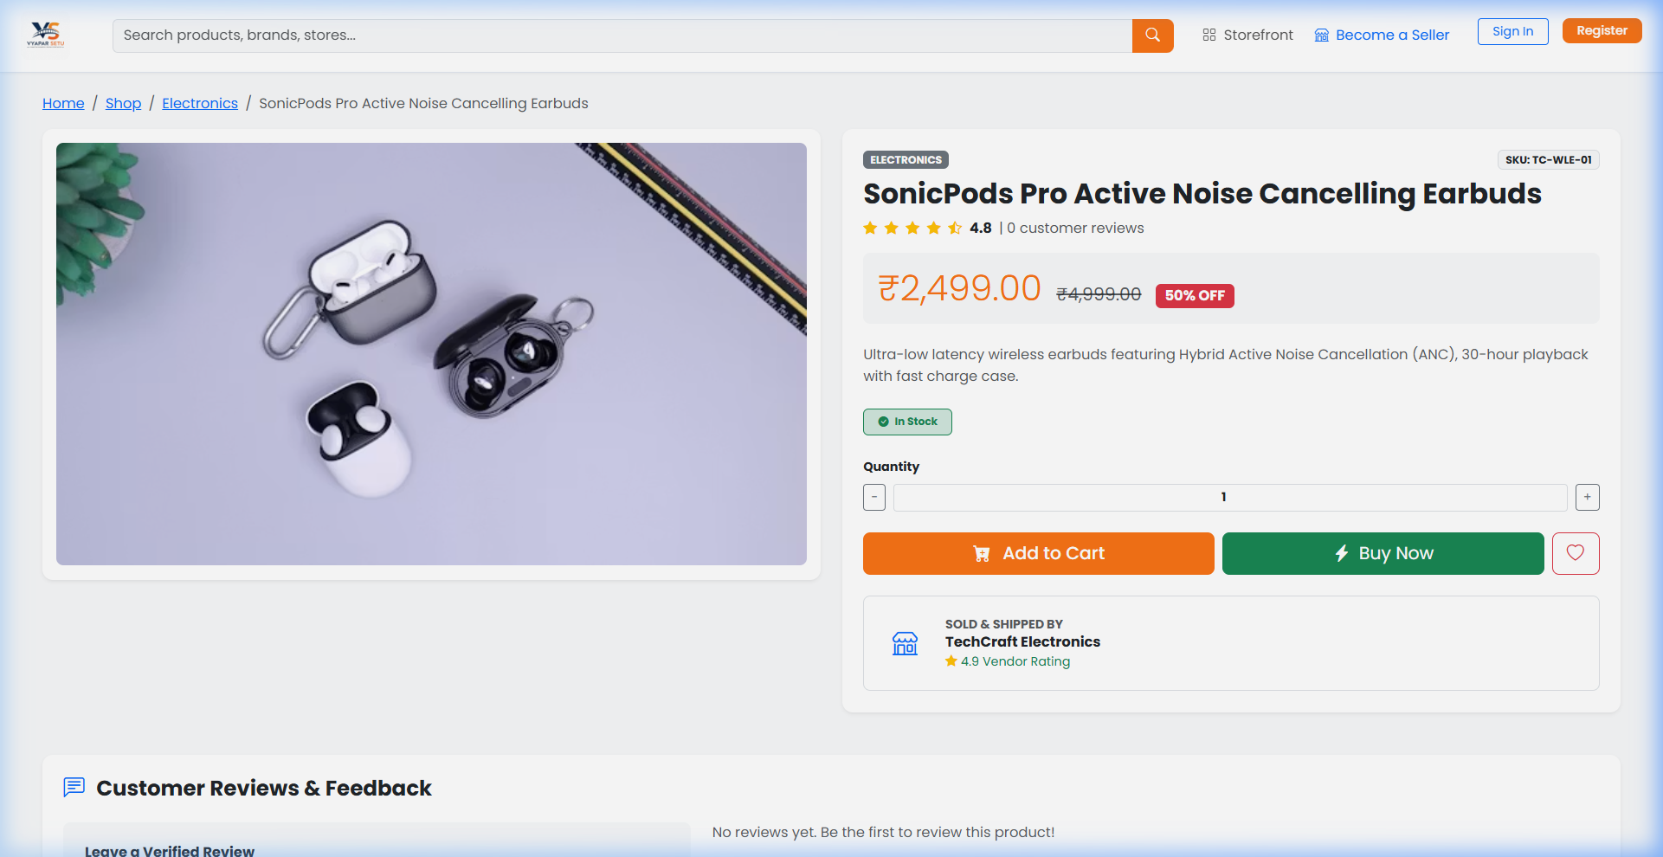
Screenshots: Category Browsing
Fashion & Apparel -- 34 Items
Beauty & Wellness -- 30 Items

Slide 14
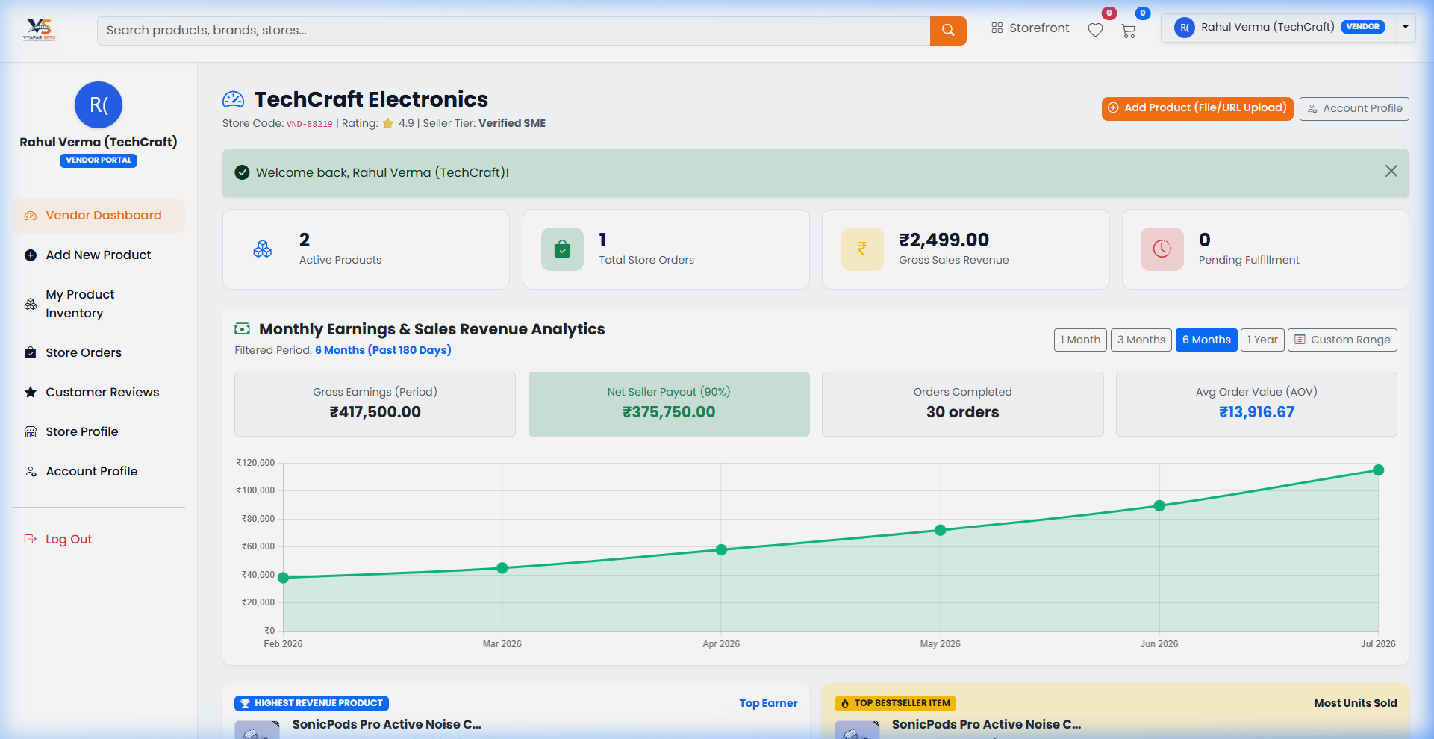
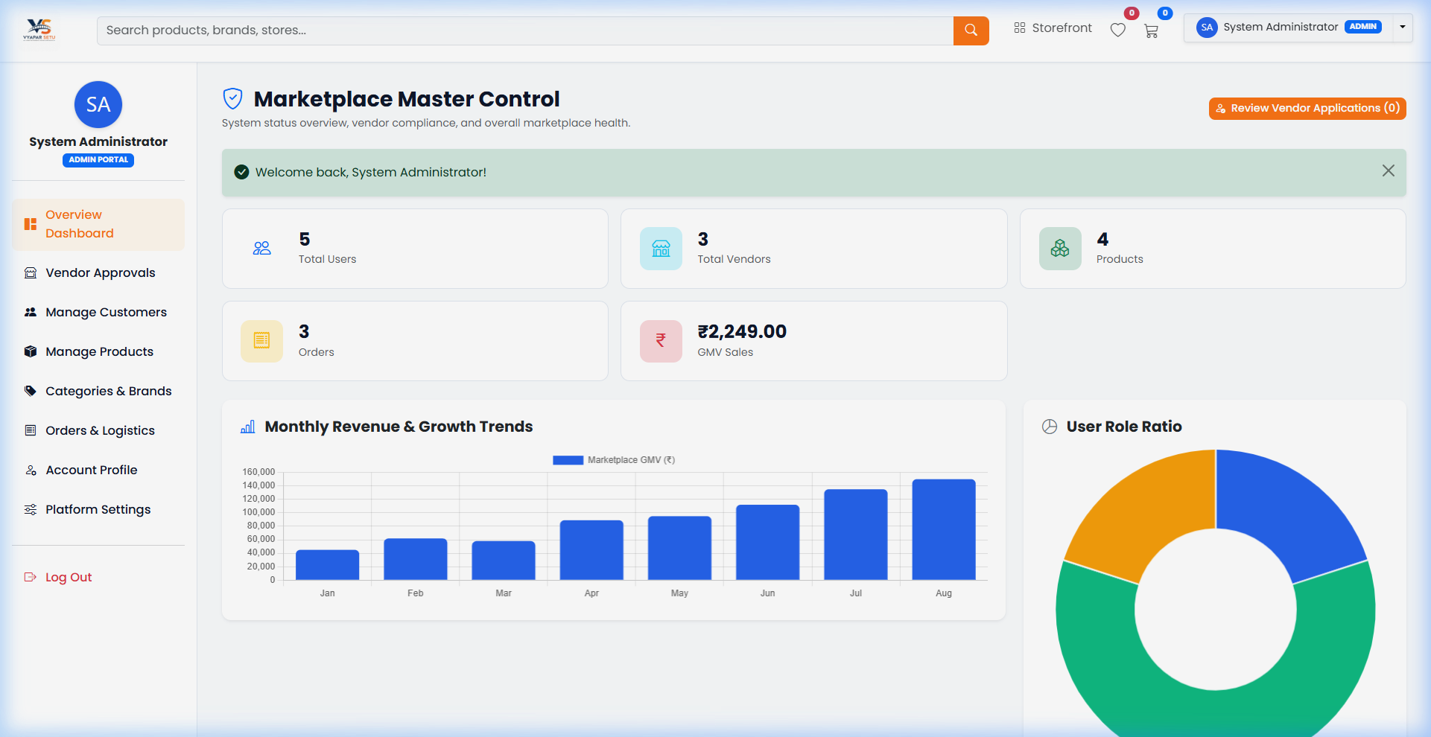
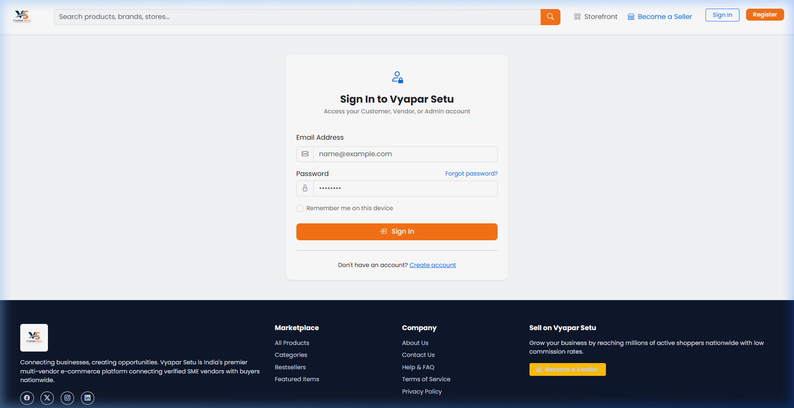
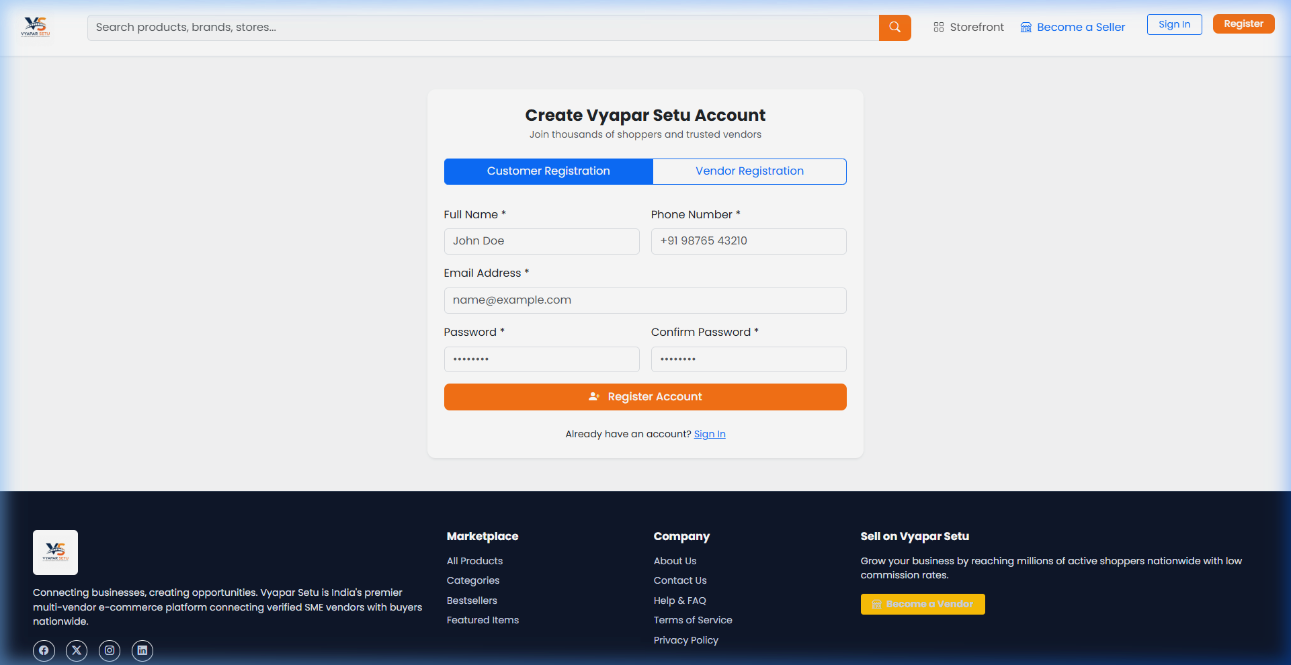
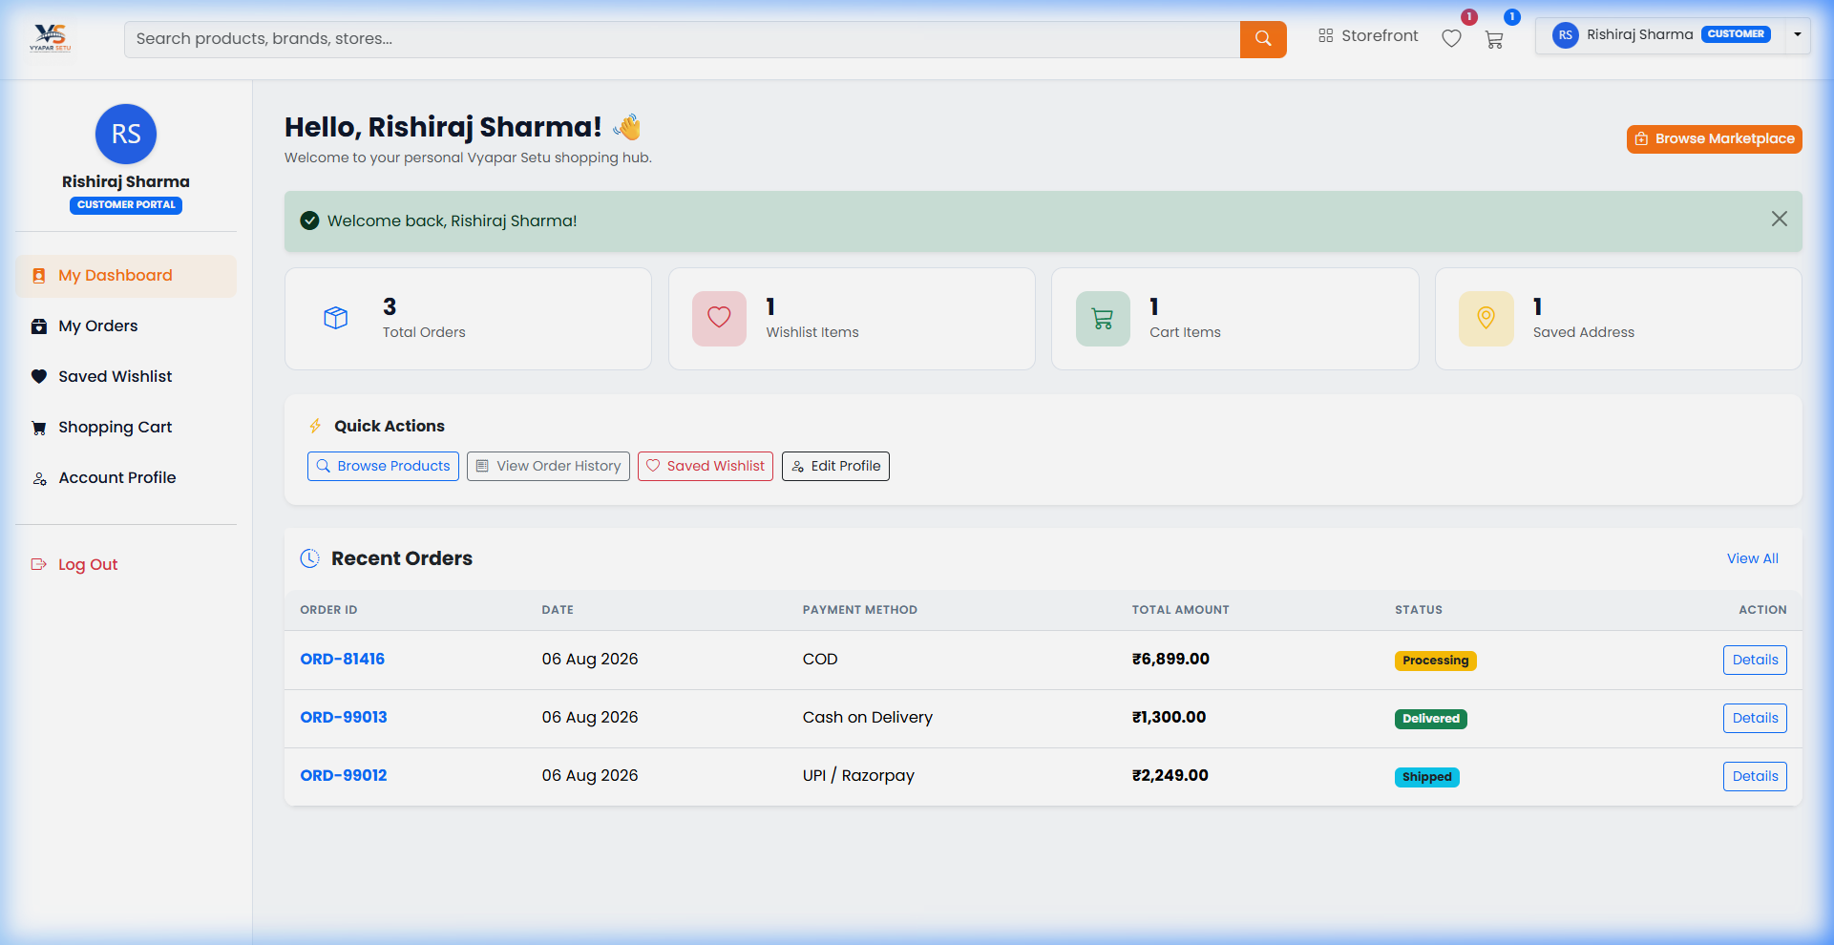
Screenshots: Dashboards & Authentication
Vendor Dashboard -- Store & Analytics
Admin Dashboard -- Governance Panel

Slide 15
Conclusion & Future Scope
Conclusion
Future Scope
Successfully built a full-stack multi-vendor marketplace
Live Razorpay / PayU payment gateway integration
162 products across 5 categories with reviews & ratings
Email & SMS notification system (OTP verification)
Complete CRUD operations for all three user roles
AI-powered product recommendation engine
Secure authentication & role-based authorization
Real-time chat between buyer & seller
Responsive design works on all devices
Progressive Web App (PWA) for mobile
Real-time AJAX interactions for seamless UX
Cloud deployment (AWS / DigitalOcean)
Thank You!
Vyapar Setu | Multi-Vendor E-Commerce Marketplace | Project By: Rakesh Sharma

