Slide 1
VYAPAR SETU
Multi-Vendor E-Commerce Marketplace Platform
A Full-Stack Web Application built with PHP | MySQL | Bootstrap 5 | JavaScript | AJAX
Project By: Rakesh Sharma
August 2026

Slide 2
Introduction & Problem Statement
The Problem
Our Solution -- Vyapar Setu
* Small vendors in India lack affordable e-commerce platforms
* Building an independent online store is expensive & complex
* Customers struggle to discover local / regional sellers
* No unified platform connecting buyers with multiple vendors
* A multi-vendor marketplace where any vendor can register, list products, and sell
* Role-based dashboards for Customer, Vendor & Admin
* "Vyapar Setu" = Bridge of Commerce -- connecting sellers & buyers
* 5 product categories: Electronics, Fashion, Spices, Home & Living, Beauty

Slide 3
Project Objectives
Multi-Vendor Support
Secure Role-Based Access
Enable multiple vendors to register, manage their stores, and sell products from a single platform.
Implement 3-tier authentication (Customer, Vendor, Admin) with bcrypt hashing and session management.
Full E-Commerce Flow
Admin Governance
Provide end-to-end shopping: browsing, cart, wishlist, checkout, order tracking, and payments.
Centralized admin panel for vendor approvals, product moderation, order oversight, and analytics.
Responsive Design
Reviews & Ratings
Mobile-first responsive UI built with Bootstrap 5 for seamless experience across all devices.
Allow customers to rate and review products; vendors can reply to customer feedback.

Slide 4
Technology Stack
Frontend
HTML5, CSS3, Bootstrap 5, JavaScript, AJAX
Backend
PHP 8.x (Procedural + PDO)
Database
MySQL / MariaDB (via XAMPP)
Server
Apache (XAMPP)
Libraries
Chart.js, Bootstrap Icons, Google Fonts
Tools
phpMyAdmin, VS Code, Git

Slide 5
System Architecture
3-Tier MVC-Inspired Architecture
Presentation Layer
Application Layer
Data Layer
HTML5 / CSS3 / Bootstrap 5 / JavaScript
Responsive UI, AJAX calls, Dynamic DOM
PHP 8.x -- Routing, Session, Auth, Logic
db.php, functions.php, auth.php, validation.php
MySQL / MariaDB Database (16 Tables)
PDO Prepared Statements, Foreign Keys
Directory: admin/ * vendor/ * customer/ * api/ * ajax/ * includes/ * assets/ * uploads/

Slide 6
ER Diagram (Entity Relationship)
Database Entity Relationships -- 16 Tables
Vendors
Users
Categories
PK: id FK: user_id
PK: id
PK: id
store_name, vendor_code
name, email, role
name, slug, icon
gstin, commission_rate
password_hash, status
parent_id (self-ref)
Reviews
Products
Product Images
PK: id
PK: id
PK: id FK: product_id
FK: product_id, user_id
FK: vendor_id, category_id
image_url, is_primary
rating, comment
title, price, stock
spotlight, rating
Cart
Payments
Orders
Order Items
PK: id FK: user_id
PK: id FK: order_id
PK: id FK: user_id
PK: id
session_id
transaction_id, amount
order_number, status
FK: order_id, product_id
total_amount, payment
quantity, price, status
Relationships: Users 1->N Vendors | Vendors 1->N Products | Products 1->N Images, Reviews | Users 1->N Orders 1->N OrderItems | + Cart, Wishlist, Notifications, Support, Logs, Brands

Slide 7
Database Schema
16 Normalized Tables -- MySQL / MariaDB with InnoDB
Table Name
Key Columns
Group
users
id, name, email, phone, password_hash, role, avatar, status
Core
vendors
id, user_id(FK), vendor_code, store_name, gstin, category, status
Core
categories
id, name, slug, icon, parent_id(FK->self), description
Core
brands
id, name, slug, logo
Core
products
id, sku, vendor_id(FK), category_id(FK), title, price, stock, spotlight, rating
Commerce
product_images
id, product_id(FK), image_url, is_primary
Commerce
cart / cart_items
cart: user_id, session_id | items: product_id, quantity, price
Commerce
wishlist
id, user_id(FK), product_id(FK) -- UNIQUE constraint
Commerce
orders
id, order_number, user_id(FK), address, payment_method, total_amount, status
Transactions
order_items
id, order_id(FK), product_id(FK), vendor_id(FK), quantity, status
Transactions
payments
id, order_id(FK), transaction_id, amount, status
Transactions
reviews
id, product_id(FK), user_id(FK), rating(1-5), comment, vendor_response
Engagement
notifications
id, user_id(FK), title, message, is_read, type, link
Engagement
support_tickets
id, user_id(FK), ticket_no, subject, priority, status
Engagement
activity_logs
id, user_id(FK), action_description, ip_address
Engagement

Slide 8
User Roles & Authentication
Customer
Vendor
Admin
Browse products, add to cart/wishlist,
place orders, track deliveries,
write reviews, manage profile
Register store, list products,
manage inventory & pricing,
fulfill orders, reply to reviews,
view sales analytics
Approve/reject vendors,
moderate products & reviews,
manage categories & banners,
view GMV reports & analytics
Security Features
bcrypt Password Hashing * PDO Prepared Statements * Session-based Auth * CSRF Protection * XSS Sanitization * Email Verification

Slide 9
Functional Modules Overview
Customer Module
Vendor Module
Admin Module
Shopping Cart -- AJAX add/remove, quantity update
Product CRUD -- Add, edit, delete with images
Vendor Approval -- Review & approve applications
Wishlist -- Save & manage favorite products
Sales Analytics -- Revenue charts (Chart.js)
Product Moderation -- Monitor all product listings
Order Tracking -- Real-time status updates
Order Fulfillment -- Update order status
User Management -- Activate / Suspend accounts
Reviews & Ratings -- 1-5 stars with comments
Review Management -- Read & reply to feedback
Category Management -- Parent-child hierarchy
Address Book -- Multiple shipping addresses
Store Profile -- Logo, banner, GSTIN, category
GMV Analytics -- Revenue trend reports
Search & Filter -- By category, price, rating
Earnings Dashboard -- Track sales & commissions
Support Tickets -- Priority-based resolution

Slide 10
Product Catalog & Order Flow
Electronics
Fashion
Spices & Organics
Home & Living
Beauty
37 Items
34 Items
31 Items
30 Items
30 Items
1
2
3
4
5
6
7
Browse &
Add to Cart
Review Cart
& Checkout
Enter Shipping
Details
Select Payment
Method
Order
Confirmed
Vendor
Fulfills
Shipped &
Delivered
Payment & Status
UPI / Razorpay (Simulated) | Cash on Delivery
Order Status Flow: Order Placed -> Processing -> Shipped -> Out for Delivery -> Delivered / Cancelled

Slide 11
Key Features Summary
Multi-vendor product listing with vendor-specific stores
Order lifecycle tracking with status notifications
3-tier role-based access control (Customer, Vendor, Admin)
Admin governance: vendor approvals, product moderation
Secure authentication with bcrypt hashing & sessions
Responsive Bootstrap 5 UI with modern design
AJAX-powered cart & wishlist with real-time badge updates
Sales analytics with Chart.js powered dashboards
Product spotlight badges (Bestseller / Featured / Regular)
Search, filter, sort across 162 products in 5 categories
Customer reviews & ratings with vendor response capability
Support ticket system with priority levels
Multi-step checkout with UPI, Razorpay & COD options
Activity logging for security audit trail

Slide 12
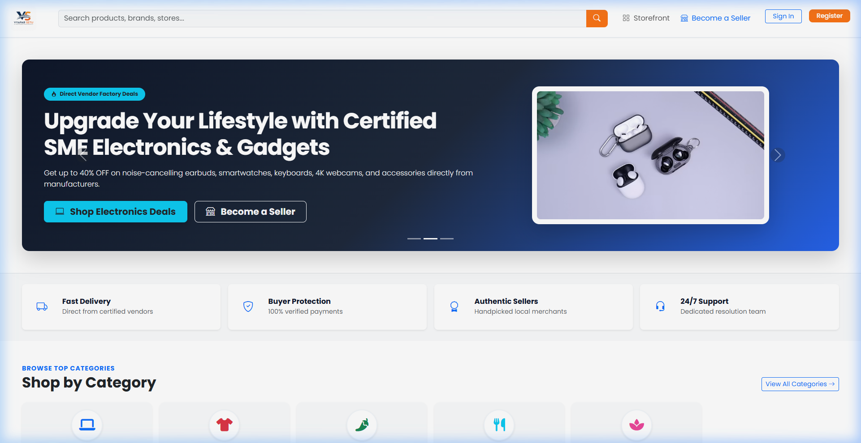
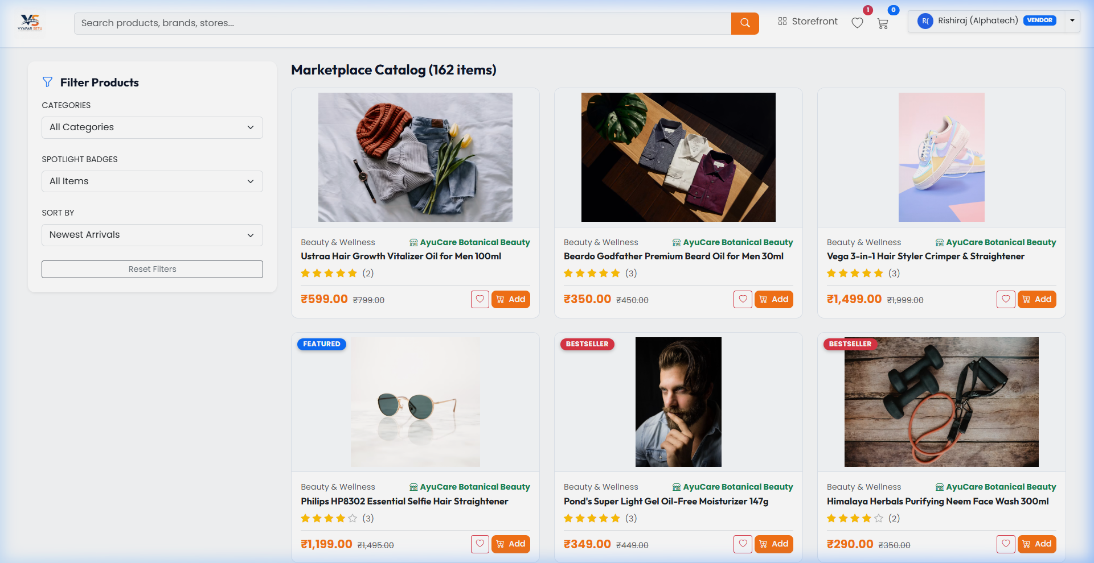
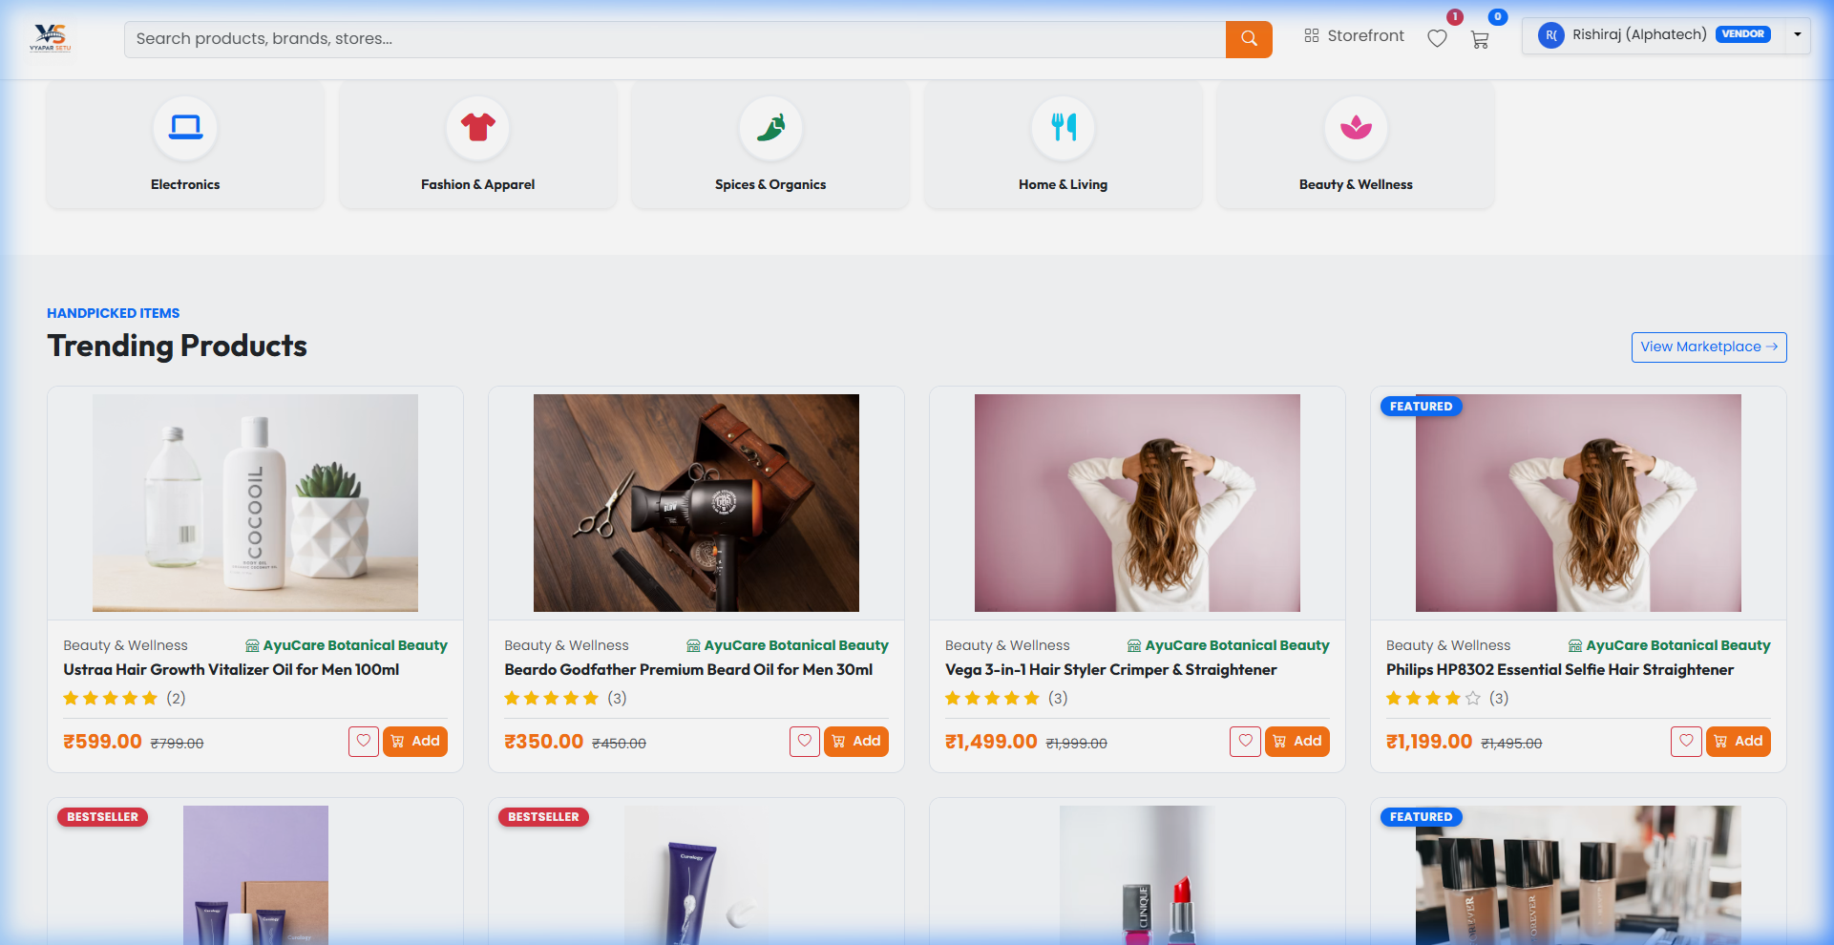
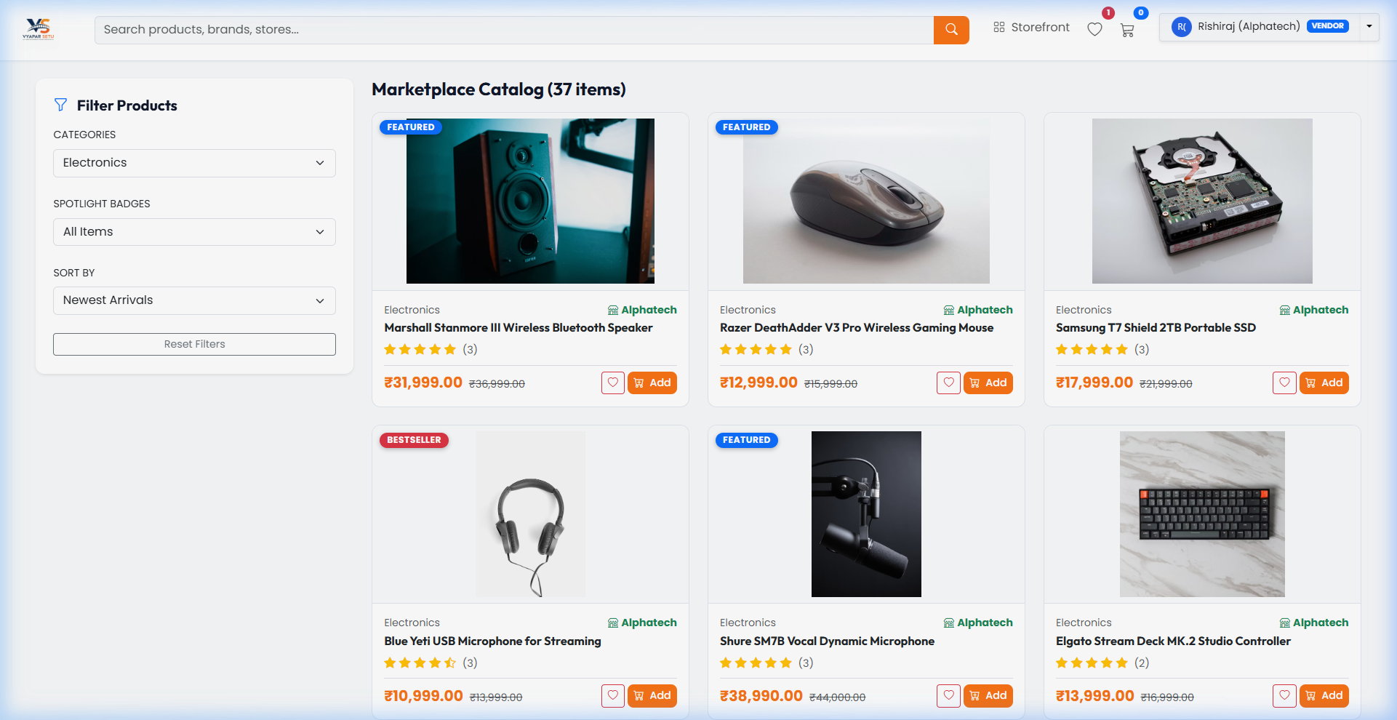
Screenshots: Homepage & Shop Catalog
Homepage -- Hero Banner, Categories, CTA Buttons
Shop Catalog -- 162 Products with Filters & Sorting

Slide 13
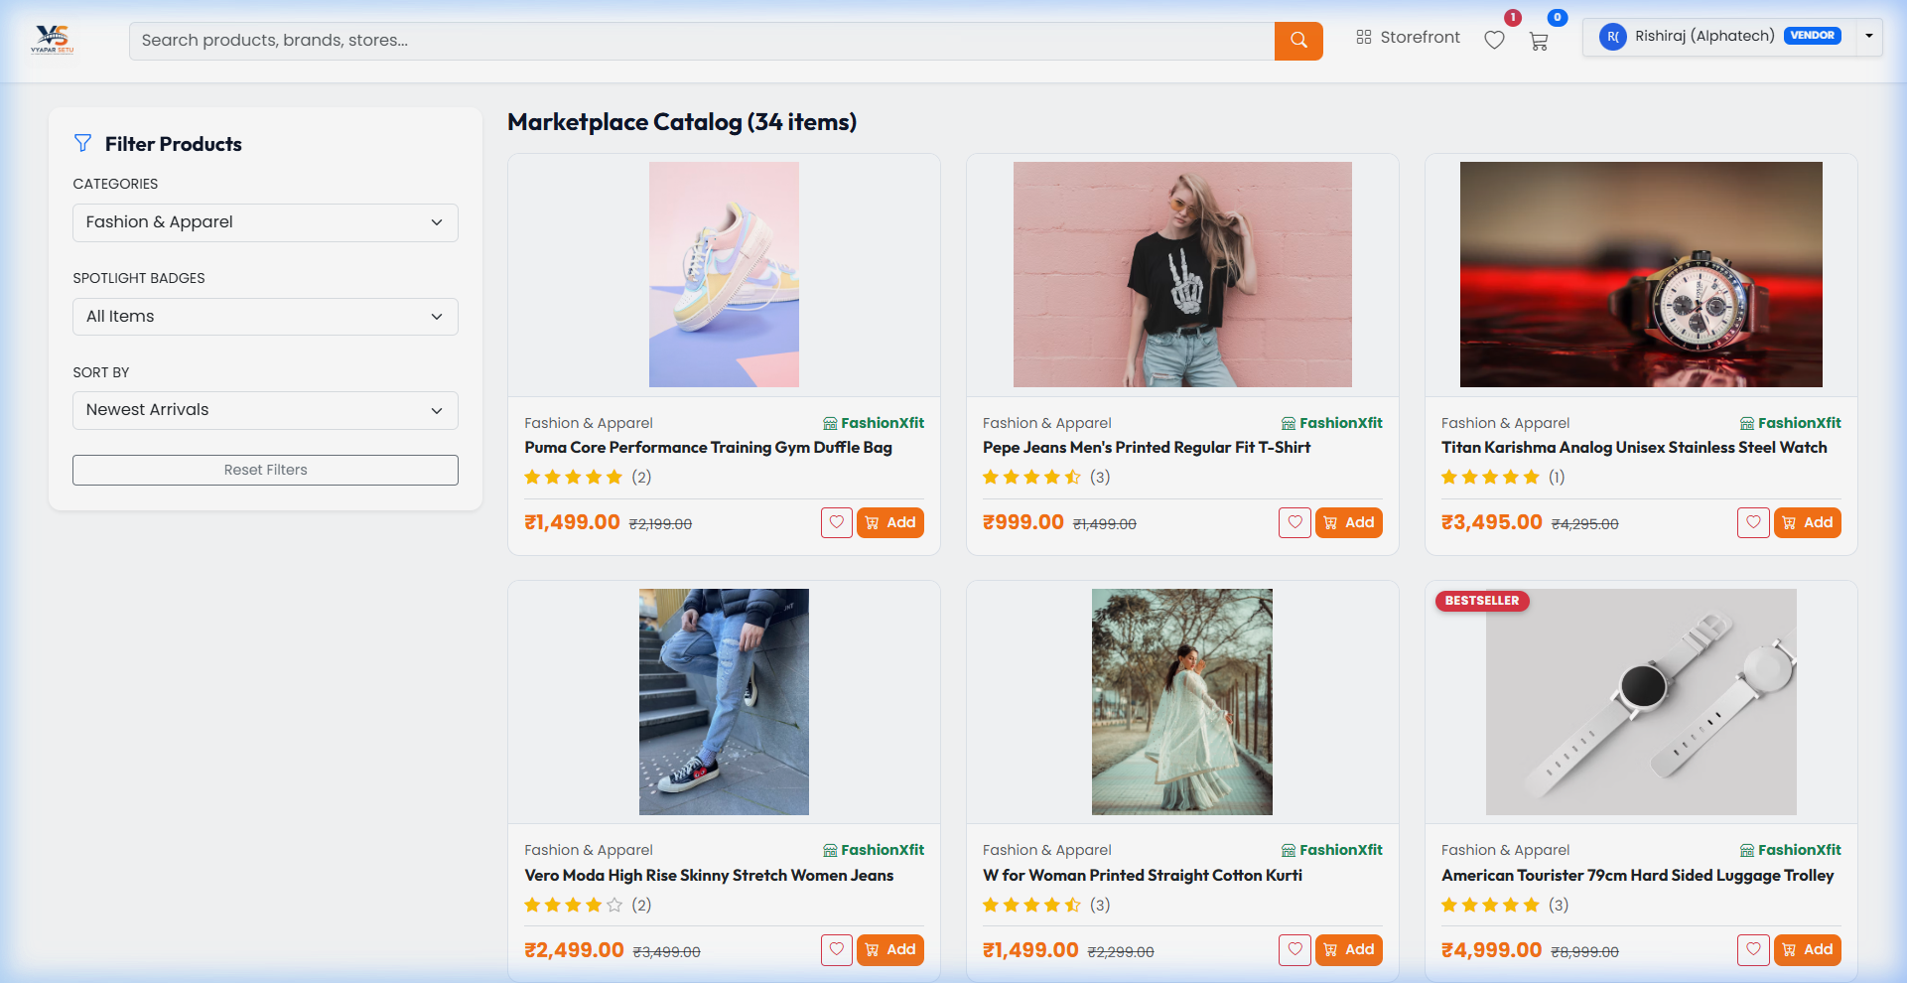
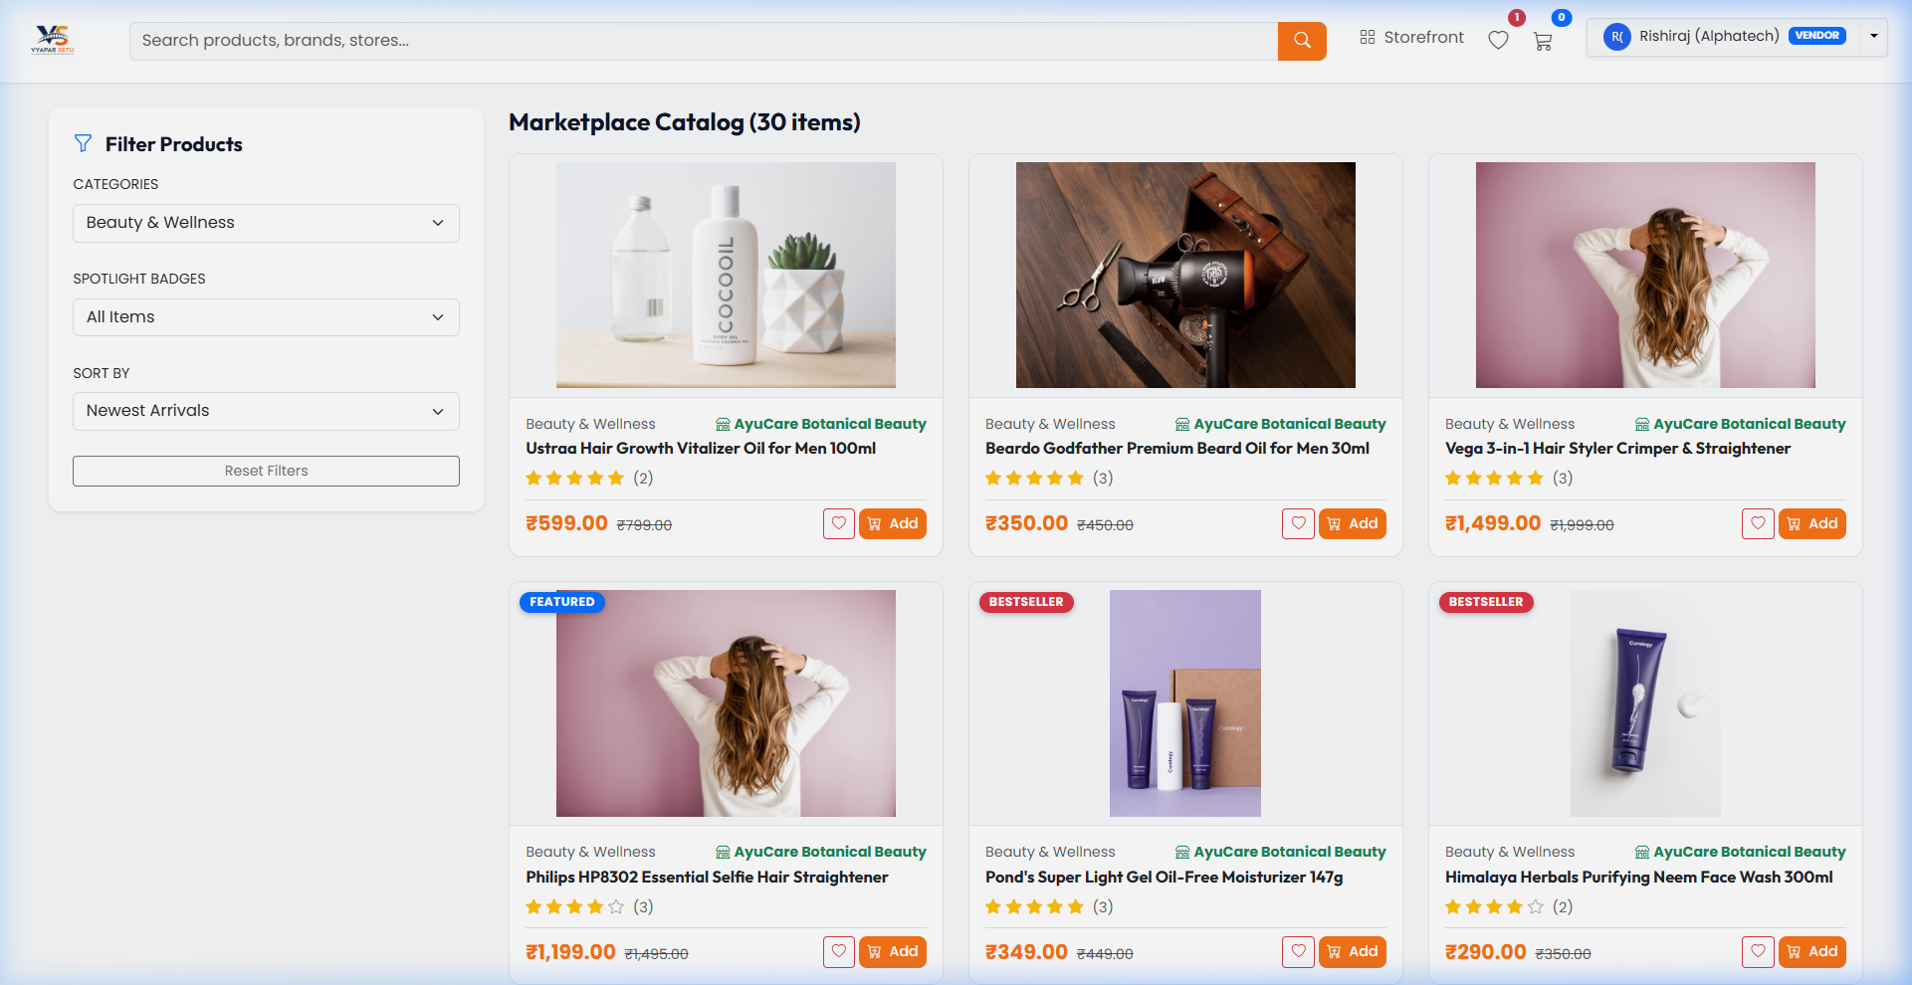
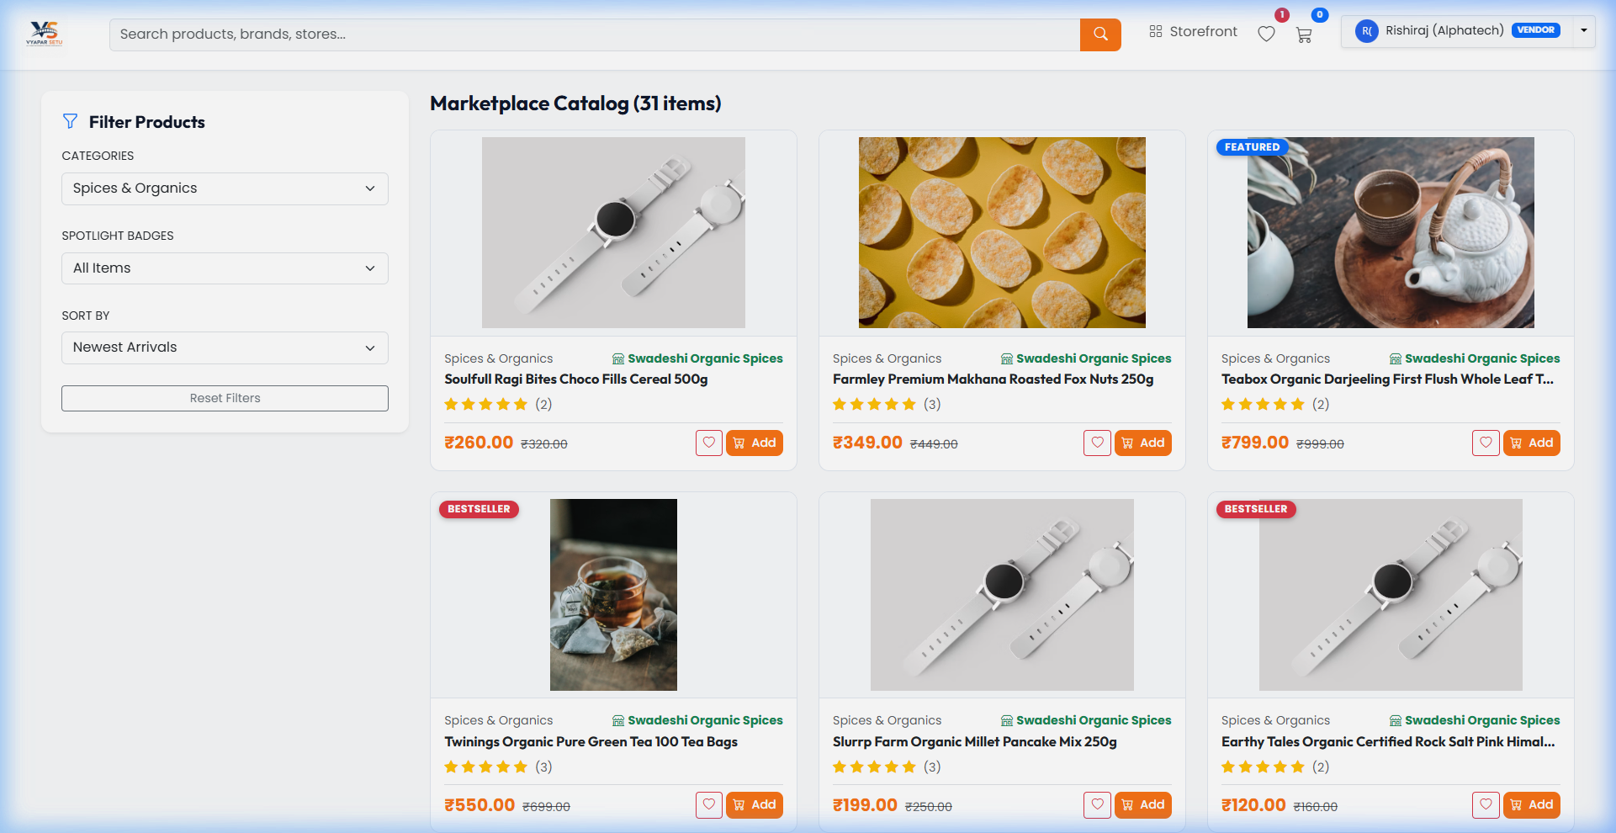
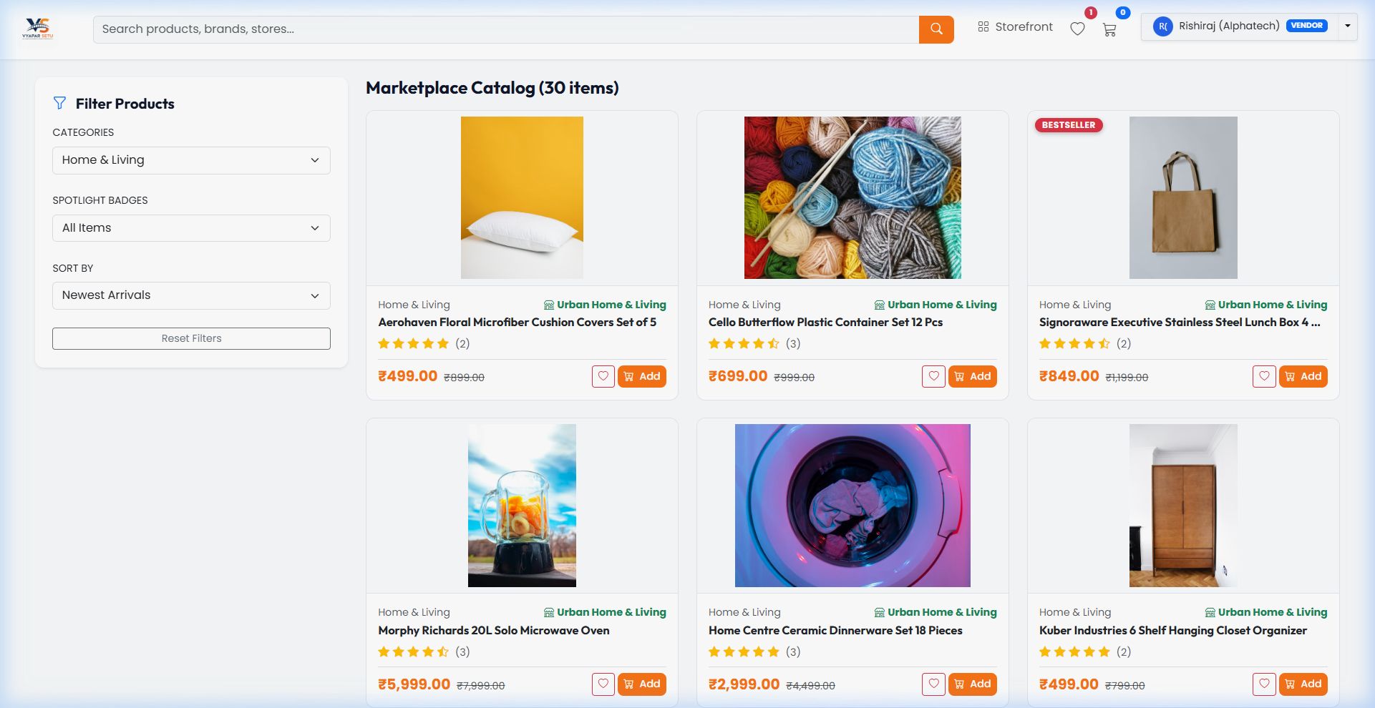
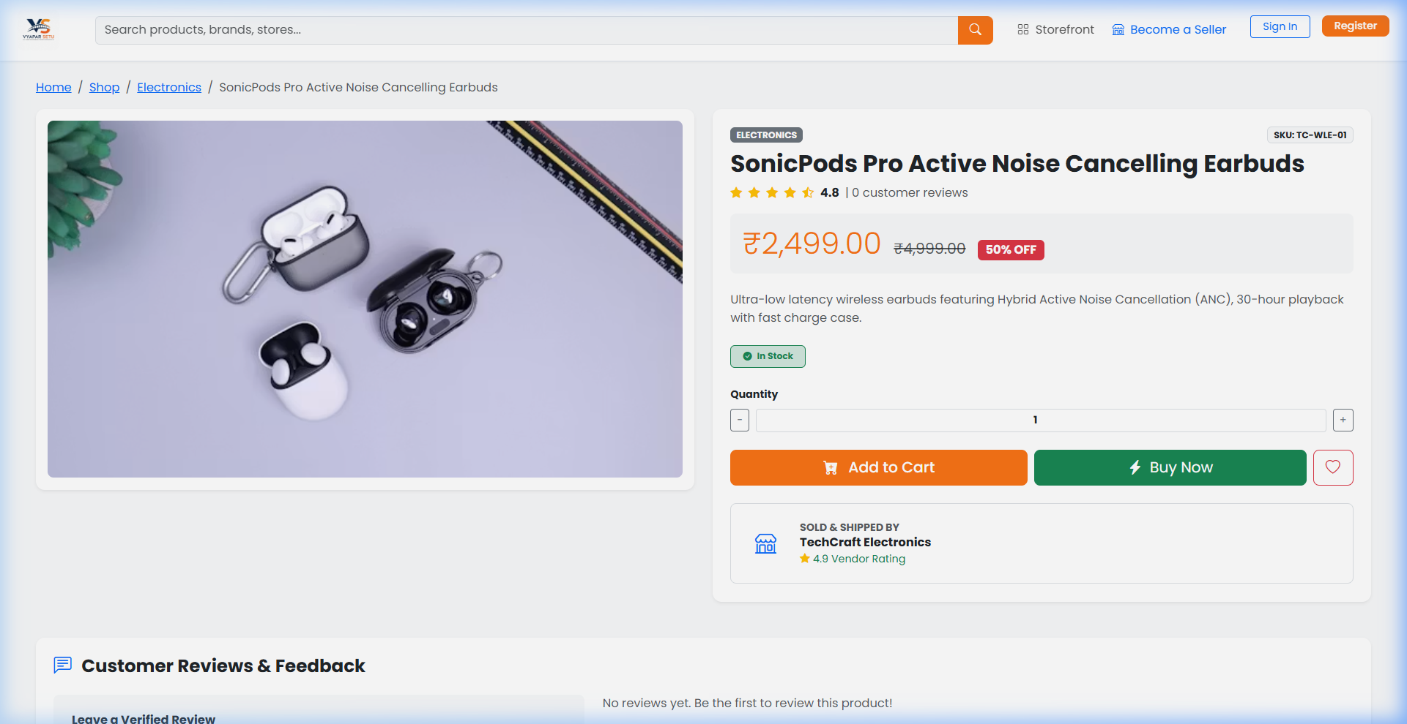
Screenshots: Category Browsing
Fashion & Apparel -- 34 Items
Beauty & Wellness -- 30 Items

Slide 14
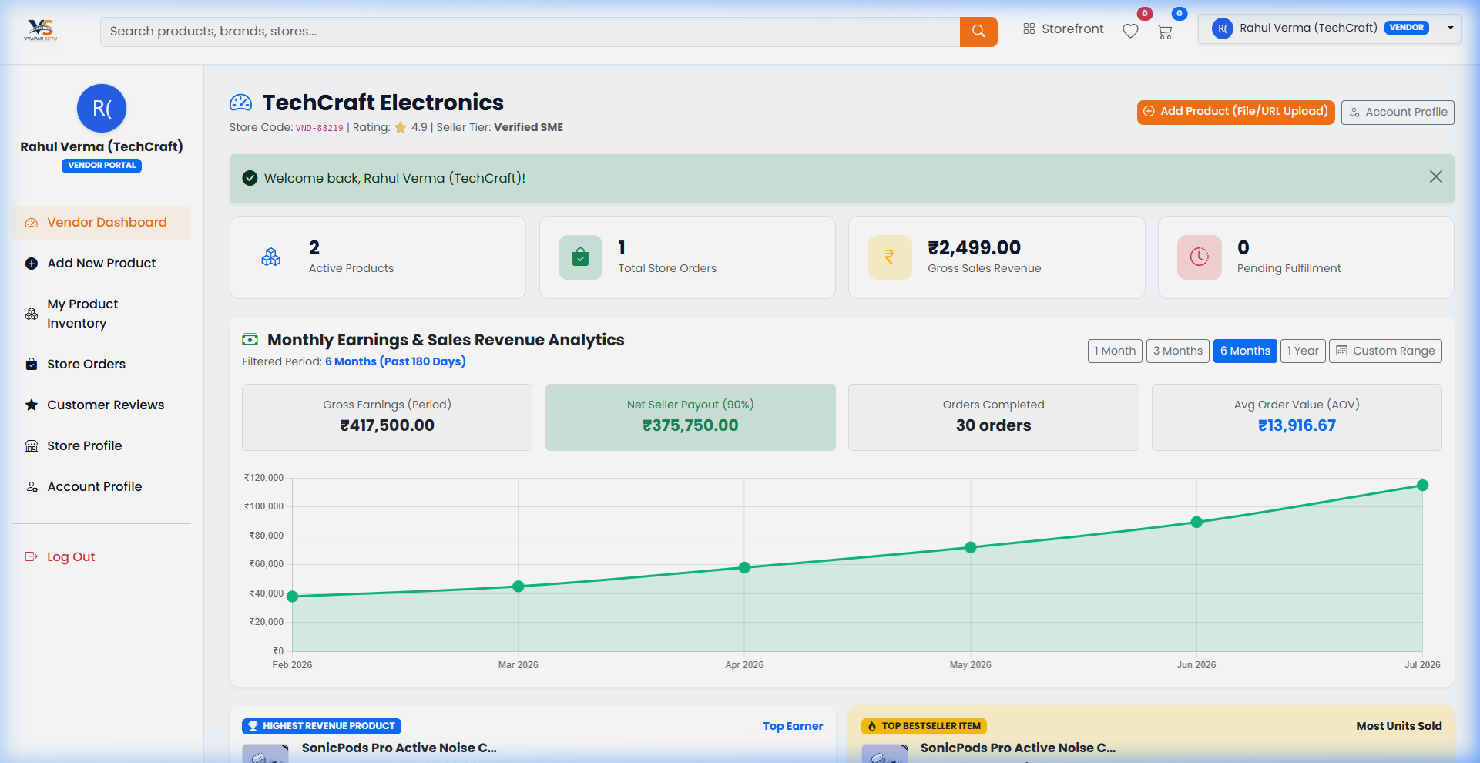
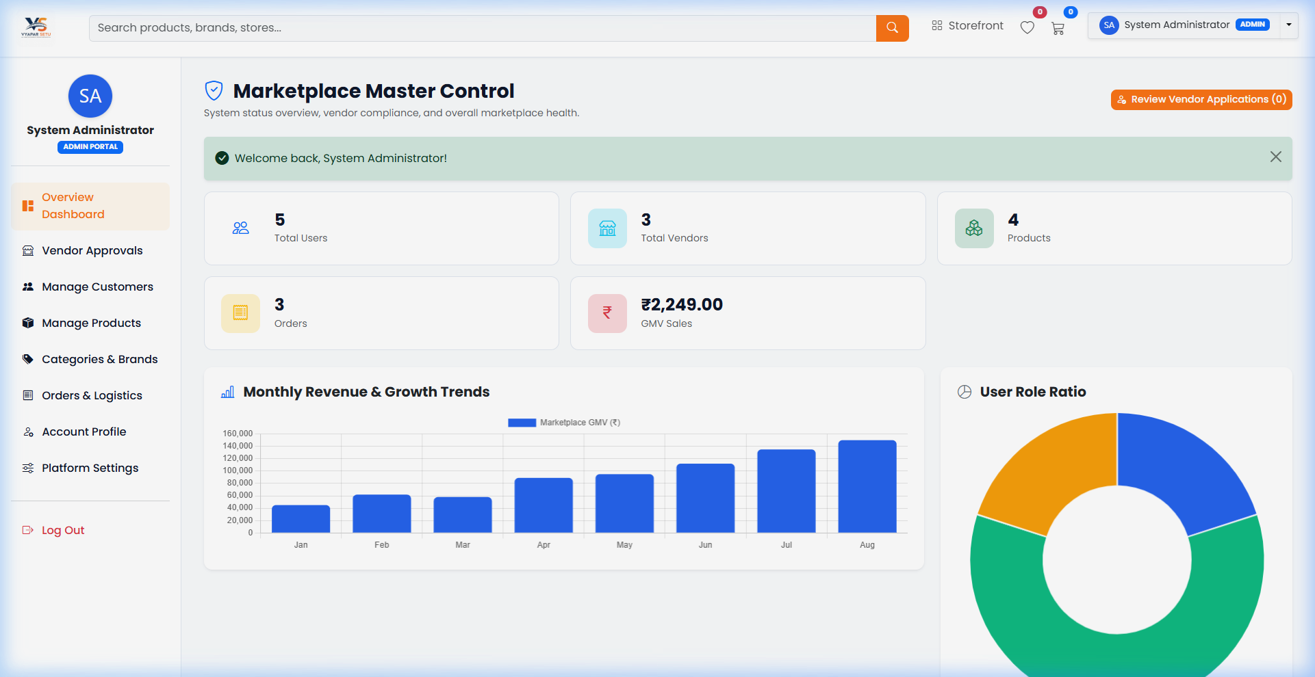
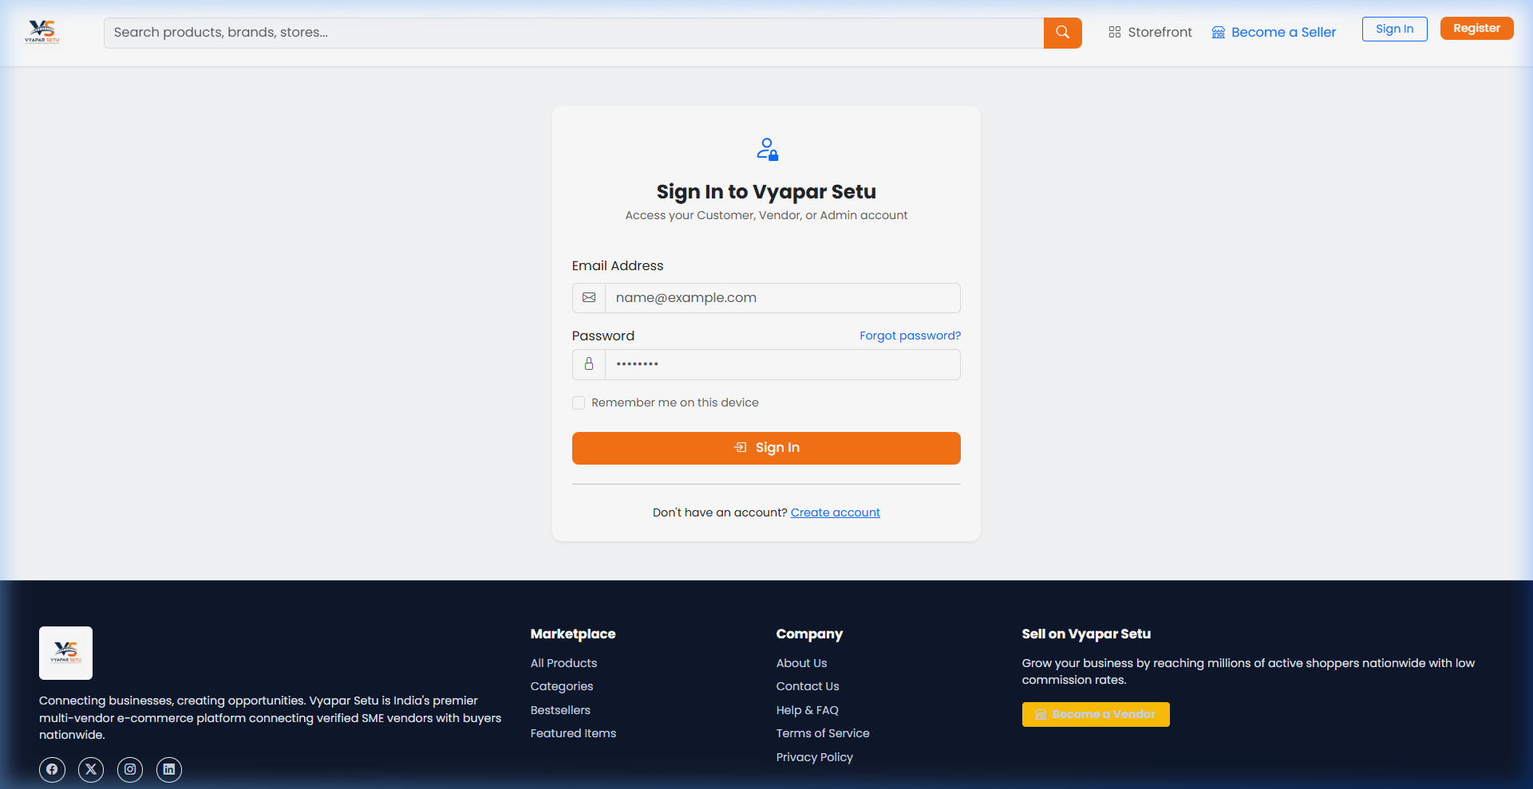
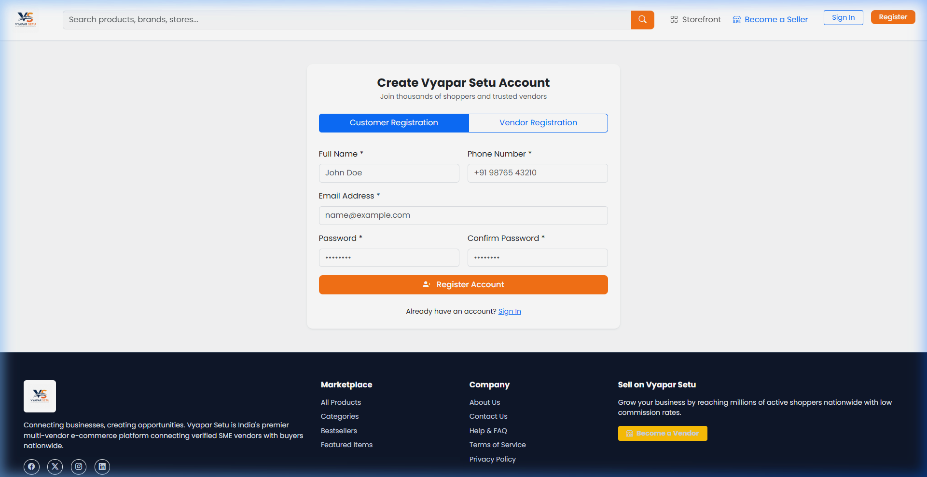
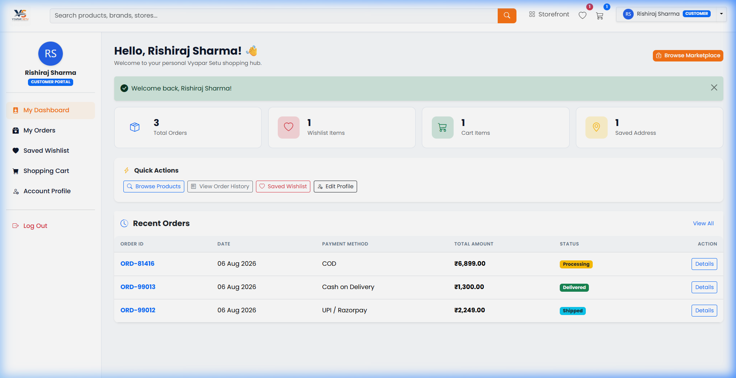
Screenshots: Dashboards & Authentication
Vendor Dashboard -- Store Management & Analytics
Admin Dashboard -- Governance & User Management

Slide 15
Conclusion & Future Scope
Conclusion
Future Scope
* Full-stack multi-vendor marketplace -- complete & functional
* 162 products across 5 categories with reviews & ratings
* Complete CRUD operations for all three user roles
* Secure authentication & role-based authorization
* Responsive design works on all devices
* Real-time AJAX interactions for seamless UX
* Live Razorpay / PayU payment gateway integration
* Email & SMS notification system (OTP verification)
* AI-powered product recommendation engine
* Real-time chat between buyer & seller
* Progressive Web App (PWA) for mobile
* Cloud deployment (AWS / DigitalOcean)
Thank You! -- Vyapar Setu | Project By: Rakesh Sharma

