Slide 1
Multi-Vendor E-Commerce Platform
Vyapar Setu
Connecting Indian SMEs & Customers on One Digital Marketplace
Academic / Project Presentation
PHP • MySQL • Bootstrap 5 • JavaScript • AJAX

Slide 2
About the Project
What is Vyapar Setu?
Vyapar Setu is a full-stack Multi-Vendor Marketplace web application.
It enables multiple independent sellers (SMEs) to list and sell products on a shared platform.
Customers can browse categories, compare prices, add to cart, and checkout securely.
Built for the Indian market — supports UPI, COD, GST-ready vendor onboarding, and regional categories.
Categories include Electronics, Fashion, Spices & Organics, Home & Living, Beauty & Wellness, and more.
Includes AI-powered chatbot assistance for product discovery and customer support.

Slide 3
Project Objectives
Goals & Problem Statement
Provide a scalable digital storefront for small and medium Indian businesses.
Offer role-based portals for Customers, Vendors, and Administrators.
Automate product listing, inventory tracking, order fulfillment, and payments.
Deliver a modern, mobile-responsive shopping experience with real-time cart updates.
Ensure secure authentication, SQL injection protection, and password hashing.
Support analytics dashboards for vendors and platform-wide GMV reporting for admins.

Slide 4
Technology Stack
Tools & frameworks used
Frontend
HTML5, CSS3, Bootstrap 5, JavaScript, AJAX, Chart.js
Backend
PHP 8+ with modular includes & REST-style API endpoints
Database
MySQL (primary) with PDO — SQLite fallback for portability
Security
password_hash(), prepared statements, role-based access control
Email / OTP
PHPMailer for password reset & OTP verification flows
Deployment
XAMPP (Apache + MySQL) on localhost / Windows environment

Slide 5
System Architecture
Three user roles & their capabilities
Customer
Vendor (SME)
Admin
• Register / login with email & OTP verification
• Browse shop, search, filter by category & price
• Cart, wishlist, multi-step checkout (UPI / COD)
• Order tracking, reviews, address management
• Dedicated vendor login & store dashboard
• Add / edit products with photo upload
• Manage inventory, orders, returns & coupons
• Sales analytics, earnings & withdrawal requests
• Platform governance & vendor approval workflow
• Manage users, categories, brands & products
• Order & payment oversight, banners & coupons
• GMV analytics, reports & system notifications

Slide 6
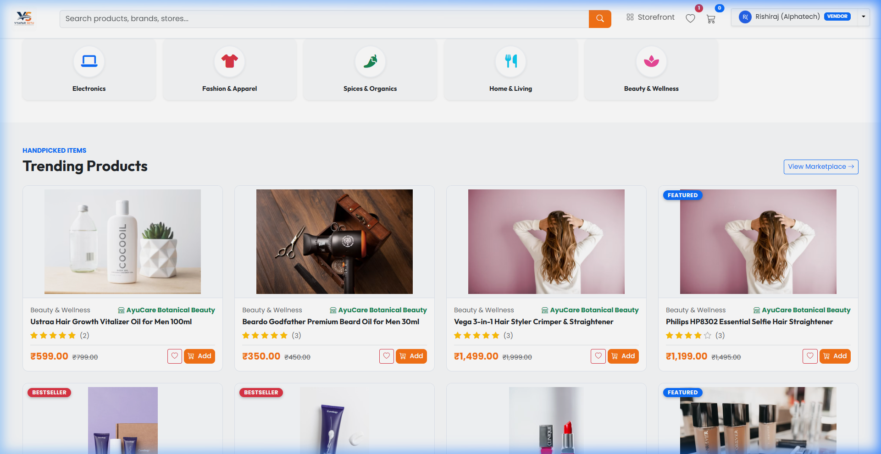
Storefront — Homepage
Hero carousel, categories & trending products
Independence Day sale hero carousel with promotional banners
Category grid with icons (Electronics, Fashion, Spices, etc.)
Trending & featured product cards with ratings & vendor info
Fully responsive navbar with search, cart badge & wishlist

Slide 7
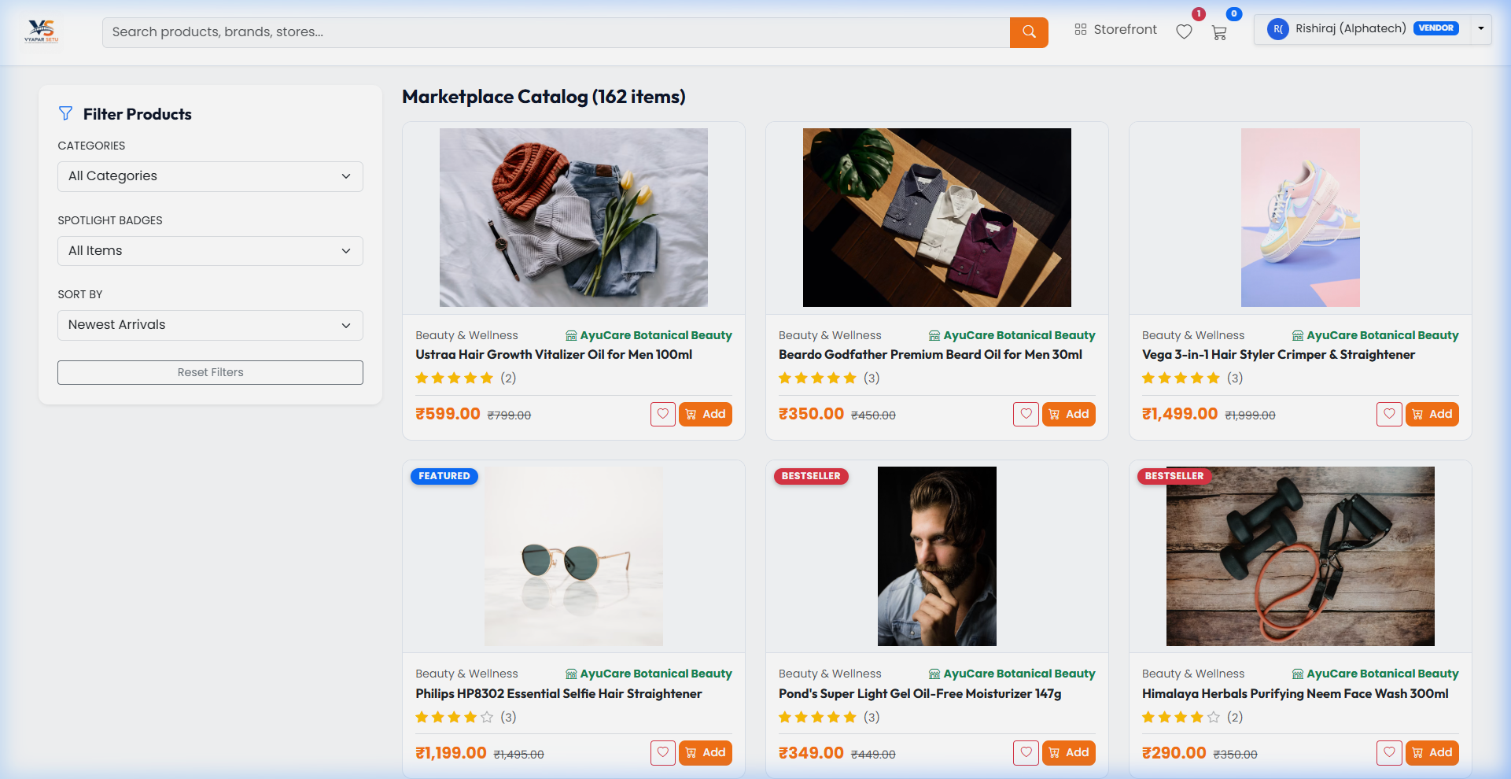
Product Catalog & Shop
Browse, filter & discover products
Dedicated shop page with grid/list product layout
Filter by category, price range & spotlight tags
Product detail pages with images, description & reviews
Add to cart & wishlist via AJAX — no page reload
8+ vendor stores across diverse Indian product categories

Slide 8
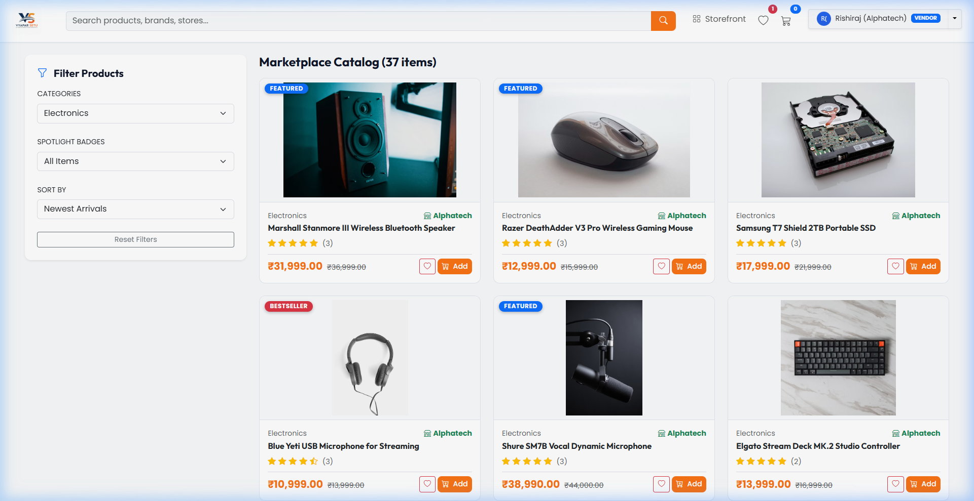
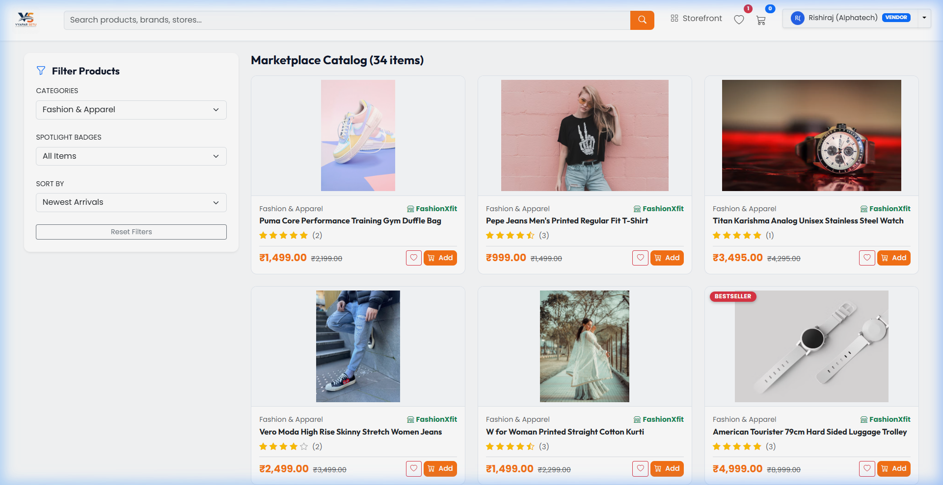
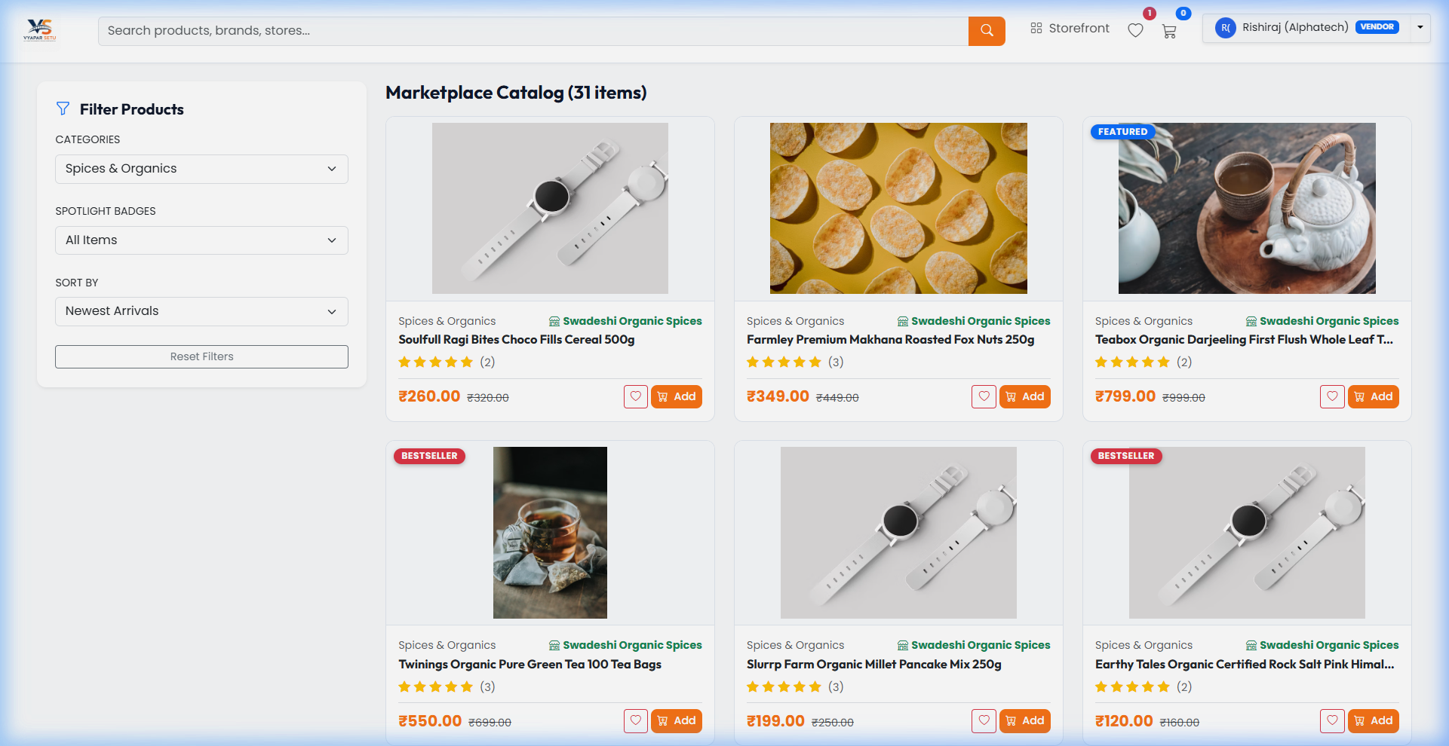
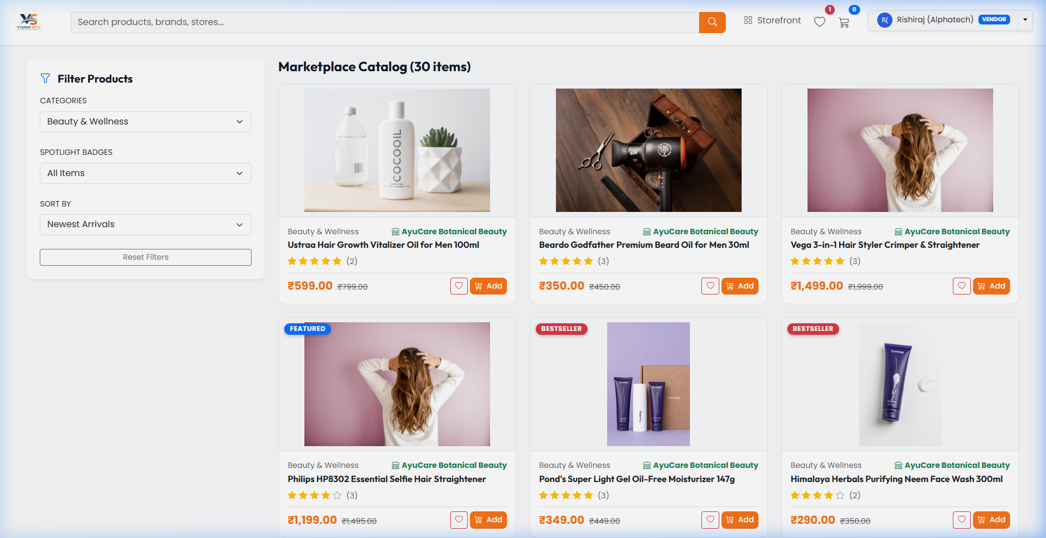
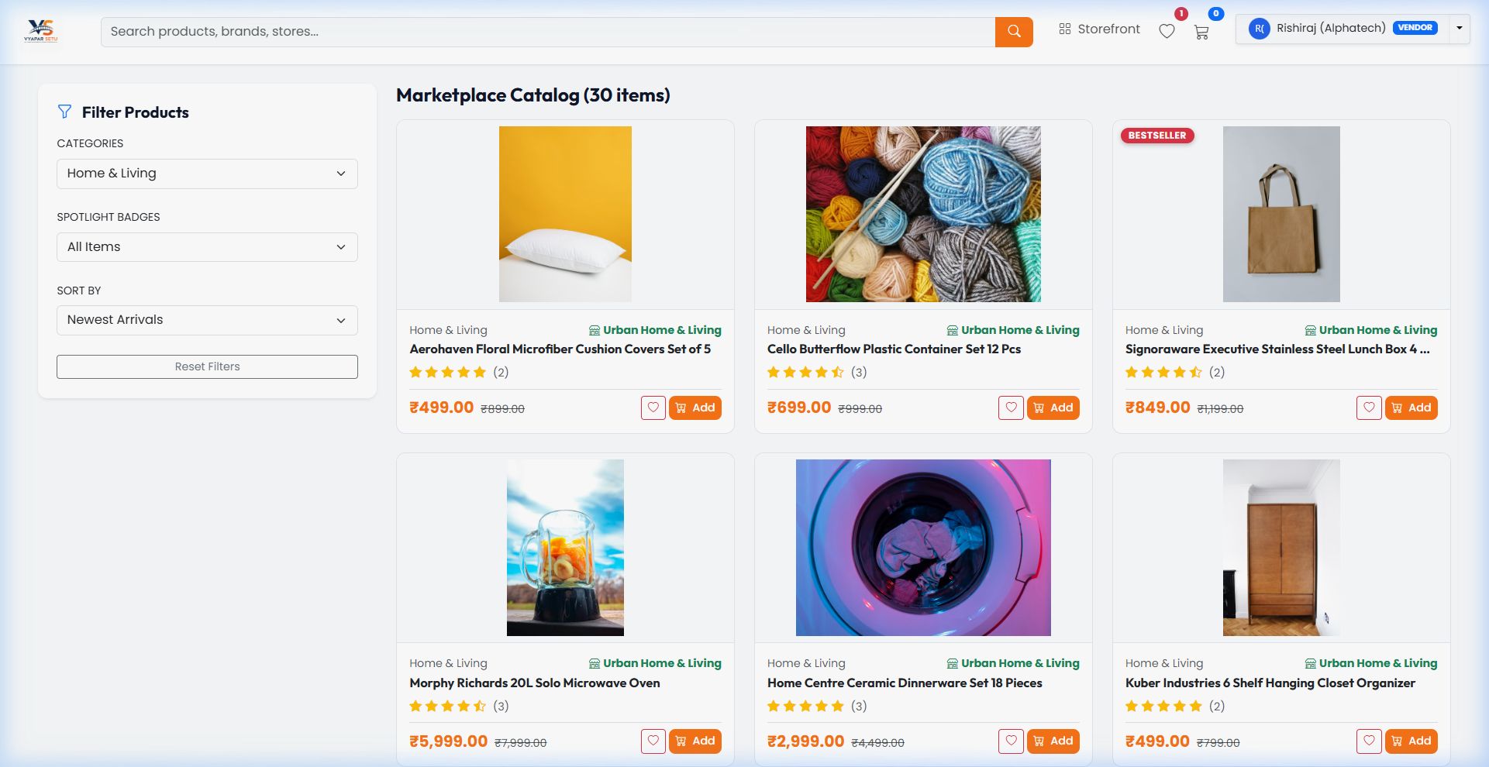
Product Categories
Diverse marketplace inventory
Electronics
Fashion
Spices & Organics
Beauty & Wellness
Home & Living

Slide 9
Customer Experience
Shopping journey end-to-end
Registration & Login
Email/password auth, OTP verification, forgot-password flow
Shopping Cart
Real-time cart badge, quantity updates, persistent session cart
Checkout & Payment
Multi-step checkout with Razorpay/UPI simulation & Cash on Delivery
Order Management
Order confirmation, tracking status, returns & review submission
AI Chatbot
Intelligent assistant for product recommendations & FAQs
Wishlist
Save favourite products and toggle via AJAX from any page

Slide 10
Vendor & Admin Portals
Business management dashboards
Vendor Dashboard
Admin Dashboard
• Add products with PC/mobile photo upload
• Inventory & stock management
• Process orders & handle returns
• Analytics charts & earnings reports
• Coupons, messages & customer reviews
• Approve / manage vendor accounts
• Moderate products, categories & brands
• Platform-wide orders & payment oversight
• Banner management & coupon control
• GMV analytics, reports & user management

Slide 11
Conclusion & Future Scope
✓ Vyapar Setu successfully demonstrates a complete multi-vendor e-commerce ecosystem.
✓ Scalable architecture supports growing vendor base and product catalog.
✓ Future enhancements: live payment gateway, mobile app, real-time notifications, ML recommendations.
✓ Ready for deployment on XAMPP with MySQL — import schema & sample data to get started.
Thank You!
Questions & Demo: http://localhost/Multi_Vendor_Marketplace_final

