Slide 1
INTERNSHIP FINAL YEAR PROJECT
Multi-Vendor
Marketplace System
🛒 📦 💳 🏪 🔍
Presented by
Rishiraj Sharma
Diploma in Computer Engineering
G. V. Acharya Polytechnic • Academic Year 2025–2026

Slide 2
Introduction
Understanding Multi-Vendor Marketplaces
📖
What is a Multi-Vendor Marketplace?
An e-commerce platform where multiple independent vendors list and sell products through one unified storefront, managed by a central administrator.
🛍️
Amazon
📦
Flipkart
🎨
Etsy
World's largest online marketplace
India's leading e-commerce platform
Handmade & vintage specialty goods
Key Benefits
✅ Wider product selection for customers
✅ Low startup cost for vendors
✅ Revenue through commissions for platform
✅ Centralized order & inventory management
2 / 18

Slide 3
Problem Statement
Challenges that inspired this project
🏪
Limited Online Presence
📊
No Centralized Management
Small businesses lack the technical resources and budget to build their own e-commerce platforms, restricting their growth potential.
Managing vendors, products, and orders across multiple disconnected systems creates inefficiency and data inconsistencies.
👥
Difficulty Reaching Customers
🔒
Security Concerns
Individual vendors struggle to attract traffic, build trust, and compete with established large-scale retailers online.
Absence of secure authentication, role-based access control, and proper data validation puts user data and transactions at risk.
3 / 18

Slide 4
Project Objectives
Goals driving the development
🎯
🔐
👤
Centralized Marketplace
Secure Authentication
Vendor Management
Build a unified platform connecting vendors and customers
Role-based login with password hashing & session management
Admin-approved vendor registration with store profiles
📦
🚚
📱
Product Management
Order Tracking
Responsive Design
Full CRUD with categories, images & inventory tracking
Real-time order status updates for all stakeholders
Mobile-first interface working on all screen sizes
4 / 18

Slide 5
System Users
Three key roles powering the marketplace
👤
🏪
🛡️
Customer
Vendor
Admin
▸ Browse & search products
▸ Register & manage store
▸ Approve / reject vendors
▸ Add to cart & wishlist
▸ Add / edit / delete products
▸ Manage all users & products
▸ Place & track orders
▸ Manage inventory & stock
▸ View platform analytics
▸ Write product reviews
▸ Process incoming orders
▸ Monitor orders & payments
▸ Manage profile
▸ View sales analytics
▸ System-wide oversight
5 / 18

Slide 6
System Architecture
High-level system design overview
PRESENTATION LAYER
👤
Customer Browser
🏪
Vendor Panel
🛡️
Admin Dashboard
▼ ▼ ▼
APPLICATION LAYER
⚙️ PHP Backend
⚙️ REST API
⚙️ Session Mgmt
⚙️ Auth & RBAC
▼ ▼ ▼
DATA LAYER
🗄️ MySQL Database
📁 File Storage
6 / 18

Slide 7
Technology Stack
Tools & technologies powering the system
🎨
⚙️
🛠️
Frontend
Backend
Dev Tools
HTML5
PHP 8.x
VS Code
Structure & semantics
Server-side logic
Code editor & IDE
CSS3
MySQL
Git & GitHub
Styling & animations
Relational database
Version control
JavaScript
XAMPP
Chrome DevTools
Client-side interactivity
Local development server
Debugging & testing
Bootstrap 5
Apache
phpMyAdmin
Responsive UI framework
Web server
Database management
7 / 18

Slide 8
Database Design
16 interconnected tables powering the platform
👤
Users
🏪
Vendors
📦
Products
id, name, email, role, password_hash, status
store_name, owner, gstin, status, commission_rate
title, price, stock, sku, category_id, vendor_id
📂
Categories
🛒
Cart & Items
❤️
Wishlist
name, slug, icon, parent_id, image
user_id, product_id, quantity, price
user_id, product_id, created_at
📋
Orders
💳
Payments
⭐
Reviews
order_number, status, total_amount, address
transaction_id, method, amount, status
rating, comment, vendor_response
8 / 18

Slide 9
Customer Module
End-to-end shopping experience
1
2
3
4
5
6
7
Register
→
Login
→
Browse
→
Wishlist
→
Cart
→
Checkout
→
Track
Create account with email
Secure session authentication
Search, filter & explore
Save favourite products
Add items & adjust qty
Enter shipping & place order
View order history & status
🔍 Advanced Search & Filters
📱 Fully Responsive Design
⭐ Product Reviews & Ratings
📜 Detailed Order History
Additional Customer Features
▸ Email verification on registration
▸ Password reset functionality
▸ Profile management with avatar
▸ Address book management
9 / 18

Slide 10
Vendor Module
Complete store management toolkit
📋
Registration
📊
Dashboard
📦
Product CRUD
Apply as vendor with store details, GSTIN, and business info. Admin approval required.
Real-time overview of sales, orders, revenue stats and key performance metrics.
Create, read, update & delete products with multiple images, categories & pricing.
📈
Inventory
🚚
Order Processing
💰
Sales Analytics
Track stock levels, set low-stock alerts, manage product availability.
View incoming orders, update order status, manage shipping and fulfillment.
Revenue trends, top-selling products, monthly performance reports.
10 / 18

Slide 11
Admin Module
Platform-wide control & oversight
👥
User Management
✅
Vendor Approval
📦
Product Oversight
View, activate, suspend or delete user accounts.
Review vendor applications, approve or reject stores.
Monitor all products, remove policy violations.
📊
Reports & Analytics
🛡️
Admin Dashboard
📋
Activity Logs
Revenue, orders, users platform-wide statistics.
Real-time overview of all platform activity.
Track all user actions for audit & compliance.
11 / 18

Slide 12
Application Workflow
End-to-end user journey
1
Register / Login
2
Browse Products
3
Add to Cart
4
Checkout & Pay
5
Order Confirmed
6
Vendor Processes
7
Shipped & Delivered
8
Admin Monitors
→
→
→
→
→
→
→
Customer Actions
System Actions
Vendor Actions
Admin Actions
Register → Browse → Cart → Checkout
Order Confirmed → Payment Processed
Receive Order → Process → Ship
Monitor → Report → Manage
Complete Lifecycle
From user registration to order delivery, every step is tracked, managed, and monitored through the integrated platform with real-time status updates.
12 / 18

Slide 13
Key Features
What makes this platform stand out
🏪
Multi-Vendor Support
📱
Responsive Design
🔐
Secure Authentication
🔍
Search & Filter
❤️
Wishlist Save Items
🛒
Shopping Cart
📦
Inventory Management
🚚
Order Tracking
📊
Sales Dashboard
13 / 18

Slide 14
Advantages
Why choose this marketplace platform
✨
Easy to Use
🏪
Helps Small Businesses
Intuitive interface designed for all user types — customers, vendors, and admins.
Ready-made platform for small businesses to reach customers without building their own.
😊
Better Customer Experience
📈
Scalable Architecture
Smooth browsing, wishlists, reviews, and streamlined checkout process.
Modular design supports growing number of vendors, products, and users.
🔒
Secure & Reliable
🎯
Centralized Management
Role-based access control, password hashing, and comprehensive input validation.
Single admin dashboard to monitor and control the entire platform operations.
14 / 18

Slide 15
Future Scope
Planned enhancements & roadmap
💳
Payment Gateway
Phase 1
📱
Mobile App
Phase 1
Razorpay / Stripe for online payments
Native Android/iOS app
🤖
AI Recommendations
Phase 2
🚛
Delivery Tracking
Phase 2
ML-powered product suggestions
Real-time map-based tracking
🎫
Coupons & Offers
Phase 3
📧
Email Notifications
Phase 3
Discount codes & flash sales
Automated order & promo emails
🌐
Multi-language
Phase 3
Hindi, Marathi & more
15 / 18

Slide 16
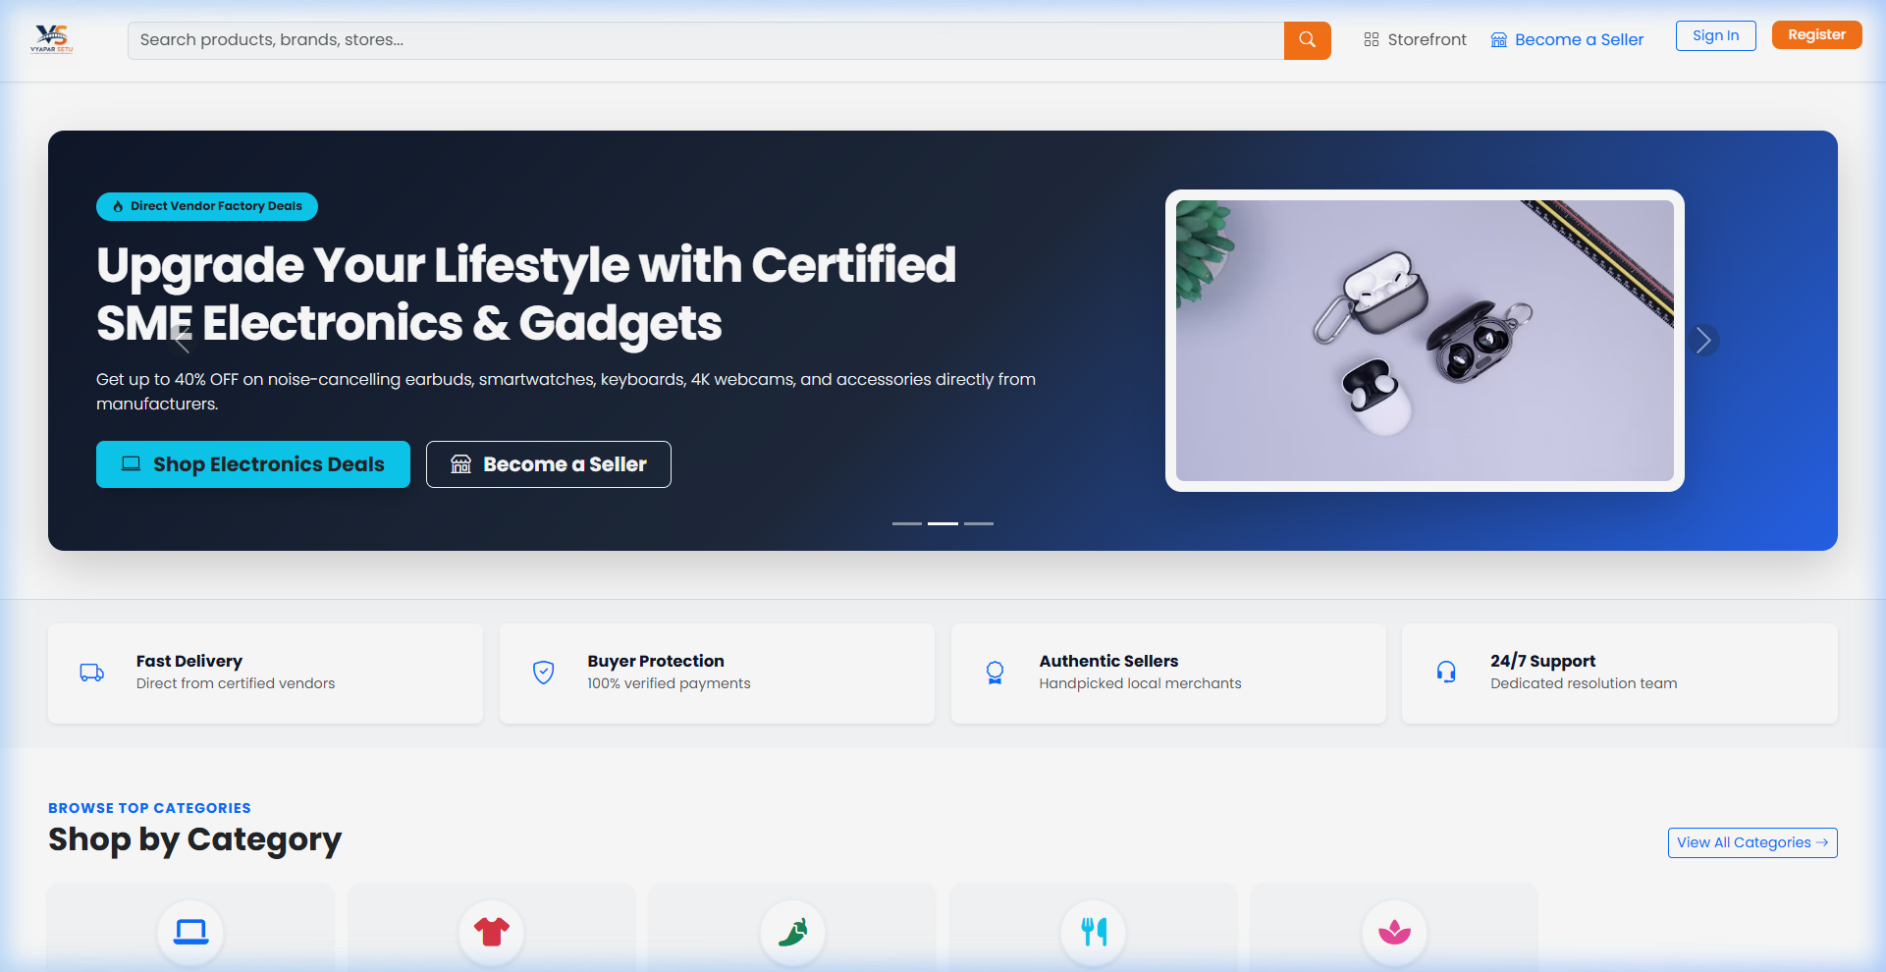
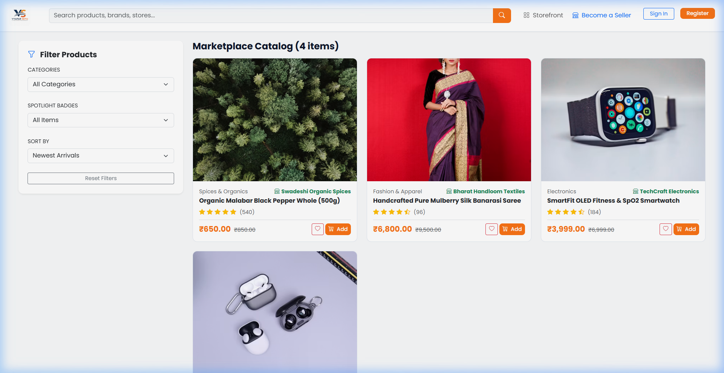
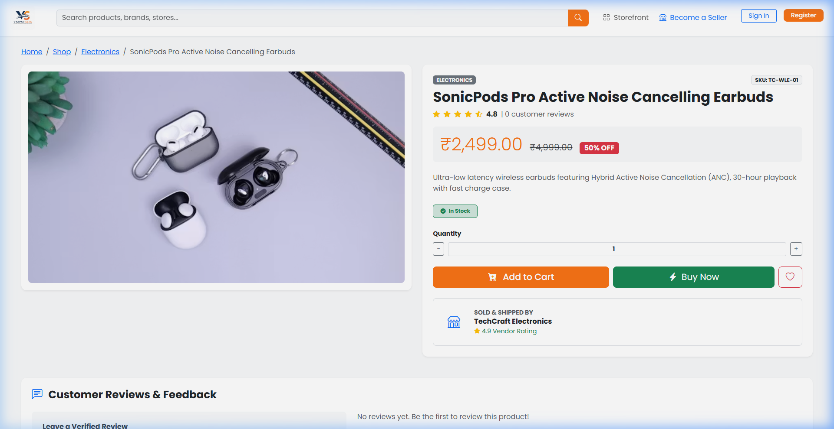
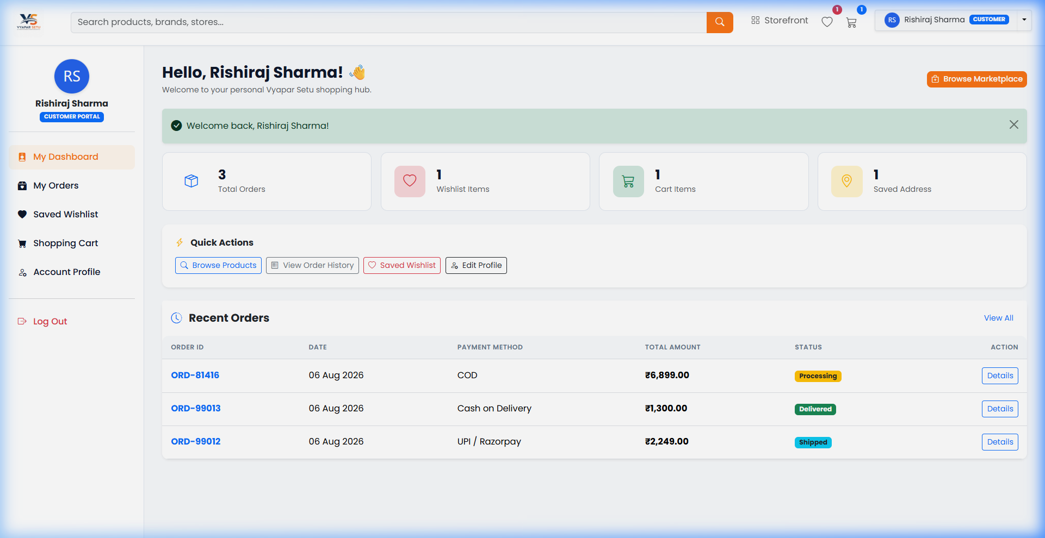
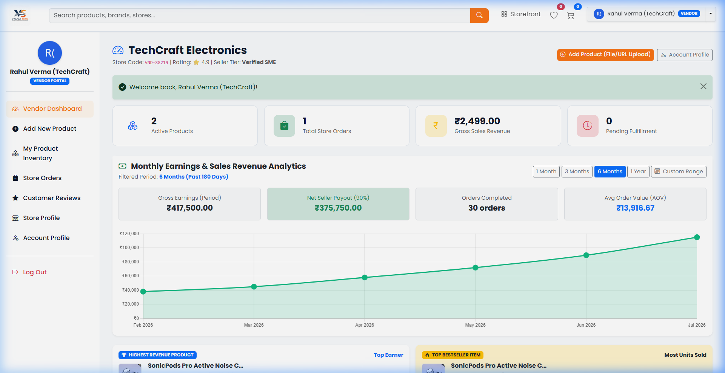
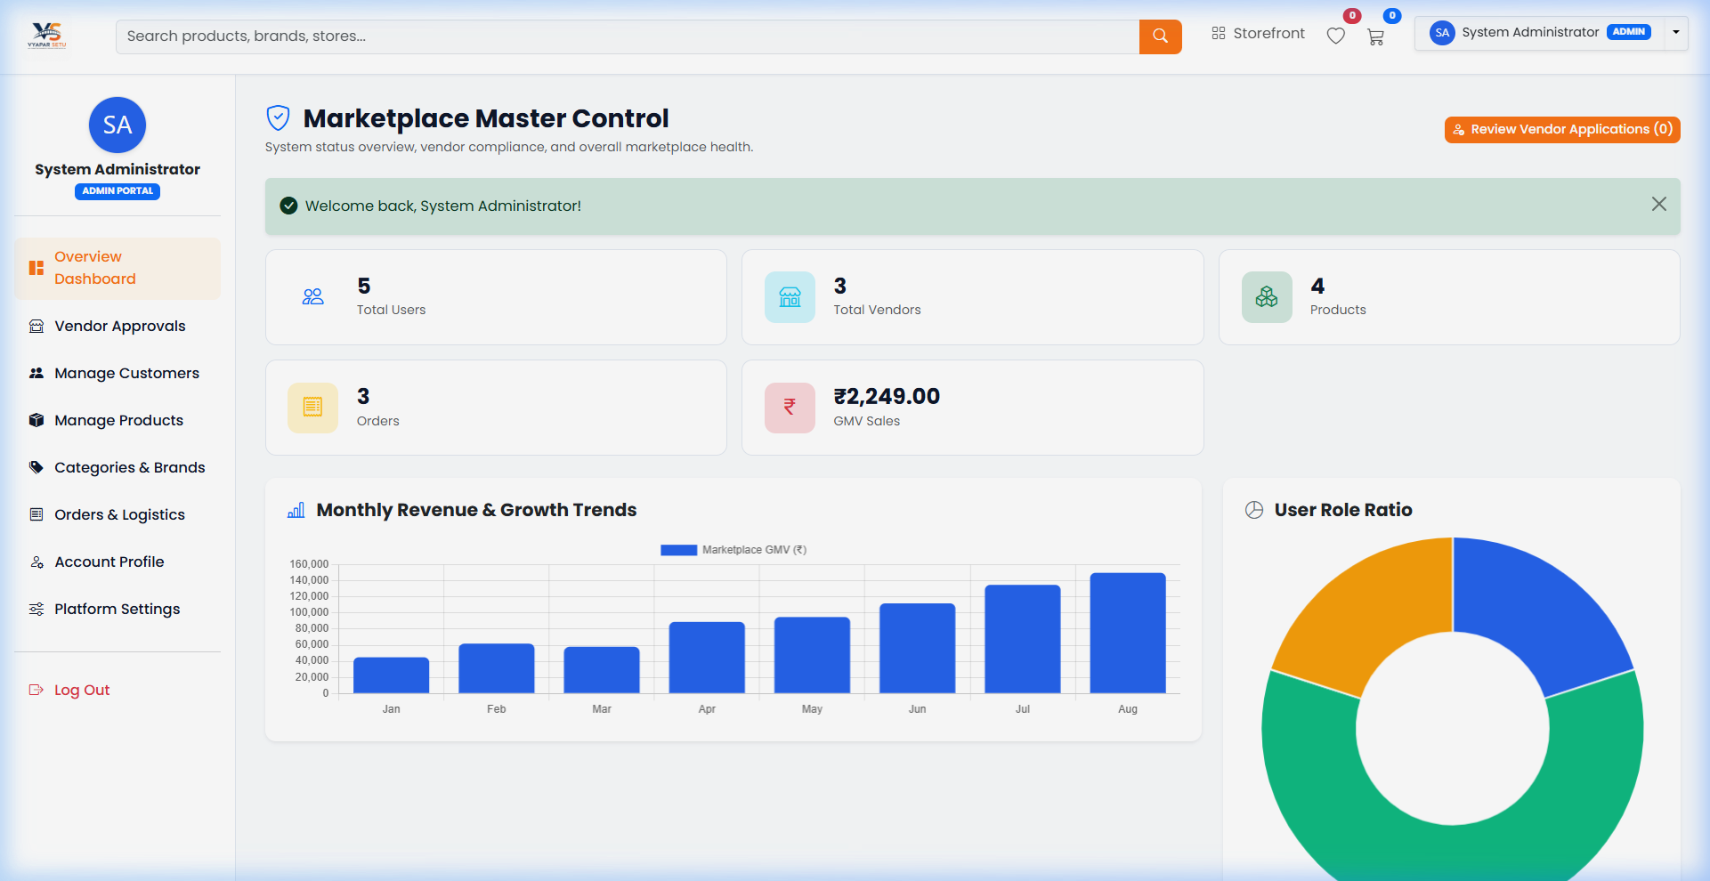
Screenshots
Live application interface
Home Page
Shop Page
Product Detail
Customer Dashboard
Vendor Dashboard
Admin Dashboard
16 / 18

Slide 17
Project Summary
Key takeaways & achievements
🏆
Key Achievements
💡
Skills Learned
• Built a complete multi-vendor marketplace
• Implemented 3 user roles with RBAC
• Designed 16-table relational database
• Created responsive UI with Bootstrap 5
• Full-stack web development (PHP + MySQL)
• Database design & normalization
• UI/UX design principles
• Version control with Git & GitHub
⚙️
Technologies Used
🎓
Internship Outcome
• HTML5, CSS3, JavaScript, Bootstrap 5
• PHP 8.x, MySQL / MariaDB
• XAMPP, VS Code, Chrome DevTools
• Git & GitHub for collaboration
• Successfully completed the project
• Gained real-world development experience
• Learned project management & planning
• Ready for deployment & future scaling
17 / 18

Slide 18
Thank You!
Questions & Answers
💬 📧 💻
Rishiraj Sharma
Diploma in Computer Engineering
G. V. Acharya Polytechnic
Multi-Vendor Marketplace System | 2025–2026

