Slide 1
🛒 MULTI-VENDOR MARKETPLACE SYSTEM
Multi-Vendor Marketplace System
Internship Final Year Project
Presented by Rishiraj Sharma
Diploma in Computer Engineering
G. V. Acharya Polytechnic
Academic Year 2025 – 2026

Slide 2
Introduction
Understanding Multi-Vendor Marketplaces
📖
What is a Multi-Vendor Marketplace?
A multi-vendor marketplace is an e-commerce platform where multiple independent vendors can list and sell their products through a single storefront, managed by a central admin.
🛍️
Amazon
📦
Flipkart
🎨
Etsy
Global leader with millions of vendors
India's largest online marketplace
Handmade & vintage specialty marketplace
Key Benefits
✅ Wider product selection for customers
✅ Low startup cost for vendors
✅ Revenue through commissions for admin
✅ Centralized order & inventory management
2 / 18

Slide 3
Problem Statement
Challenges that inspired this project
🏪
Limited Online Presence
📊
No Centralized Management
Small businesses lack the technical resources to build their own e-commerce platforms.
Managing vendors, products, and orders across multiple systems is inefficient.
👥
Customer Reach
🔒
Security Concerns
Individual vendors struggle to attract traffic and compete with large retailers.
Lack of secure authentication and payment handling puts users at risk.
3 / 18

Slide 4
Project Objectives
Goals driving the development
🎯
🔐
👤
Centralized Marketplace
Secure Authentication
Vendor Management
Build a unified platform for vendors and customers
Implement role-based login with password hashing
Admin-approved vendor registration & store management
📦
🚚
📱
Product Management
Order Tracking
Responsive Design
Full CRUD with categories, images, inventory tracking
Real-time order status updates for all stakeholders
Mobile-first, works on all screen sizes
4 / 18

Slide 5
System Users
Three key roles in the marketplace
👤
🏪
🛡️
Customer
Vendor
Admin
▸ Browse & search products
▸ Register & manage store
▸ Approve / reject vendors
▸ Add to cart & wishlist
▸ Add / edit / delete products
▸ Manage all users & products
▸ Place & track orders
▸ Manage inventory & stock
▸ View platform analytics
▸ Write product reviews
▸ Process incoming orders
▸ Monitor orders & payments
▸ Manage profile & addresses
▸ View sales analytics
▸ System-wide oversight
5 / 18

Slide 6
System Architecture
High-level system overview
PRESENTATION LAYER
👤
Customer Browser
🏪
Vendor Panel
🛡️
Admin Dashboard
▼ ▼ ▼
APPLICATION LAYER
⚙️ PHP Backend
⚙️ REST API
⚙️ Session Mgmt
⚙️ Auth & RBAC
▼ ▼ ▼
DATA LAYER
🗄️ MySQL Database
🗄️ File Storage
6 / 18

Slide 7
Technology Stack
Tools & technologies powering the system
🎨
⚙️
🛠️
Frontend
Backend
Dev Tools
HTML5
PHP
VS Code
Structure & semantics
Server-side logic
Code editor
CSS3
MySQL
Git & GitHub
Styling & animations
Relational database
Version control
JavaScript
XAMPP
Chrome DevTools
Client-side logic
Local dev server
Debugging
Bootstrap 5
Responsive framework
7 / 18

Slide 8
Database Design
16 interconnected tables powering the platform
👤
Users
🏪
Vendors
📦
Products
id, name, email, role, password_hash, status
store_name, owner, gstin, status, commission_rate
title, price, stock, sku, category_id, vendor_id
📂
Categories
🛒
Cart / Items
❤️
Wishlist
name, slug, icon, parent_id, image
user_id, product_id, quantity, price
user_id, product_id, created_at
📋
Orders
💳
Payments
⭐
Reviews
order_number, status, total_amount, address
transaction_id, method, amount, status
rating, comment, vendor_response
8 / 18

Slide 9
Customer Module
End-to-end shopping experience
1
2
3
4
5
6
7
Register
→
Login
→
Browse
→
Wishlist
→
Cart
→
Checkout
→
Track
Create account with email verification
Secure session-based authentication
Search, filter & explore products
Save favourite products for later
Add items, adjust quantities & total
Enter shipping info & place order
View order history & live status
🔍 Advanced search with filters
📱 Fully responsive mobile layout
⭐ Product reviews & ratings
📜 Detailed order history
9 / 18

Slide 10
Vendor Module
Complete store management toolkit
📋
Registration
📊
Dashboard
📦
Product CRUD
Apply as vendor with store details, await admin approval
Overview of sales, orders, revenue & analytics
Create, read, update & delete products with images
📈
Inventory
🚚
Orders
💰
Analytics
Track stock levels, low-stock alerts, bulk updates
View & process incoming orders, update status
Sales reports, revenue trends, top-selling products
10 / 18

Slide 11
Admin Module
Platform control & oversight
👥
User Management
✅
Vendor Approval
📦
Product Oversight
View, activate, suspend or delete user accounts
Review vendor applications, approve or reject
Monitor all products, remove violations
📊
Reports & Analytics
🛡️
Dashboard
📋
Activity Logs
Revenue, orders, users platform-wide stats
Real-time overview of all platform activity
Track all actions for audit & compliance
11 / 18

Slide 12
Application Workflow
End-to-end user journey flowchart
1
Register / Login
2
Browse Products
3
Add to Cart
4
Checkout & Pay
5
Order Confirmed
6
Vendor Processes
7
Shipped & Delivered
8
Admin Monitors
→
→
→
→
→
→
→
Customer Actions
System Actions
Vendor Actions
Admin Actions
Register → Browse → Cart → Checkout
Order Confirmed → Payment Processed
Receive Order → Process → Ship
Monitor → Report → Manage
12 / 18

Slide 13
Key Features
What makes this platform stand out
🏪
Multi-Vendor Support
📱
Responsive Design
🔐
Secure Authentication
🔍
Search & Filter
❤️
Wishlist
🛒
Shopping Cart
📦
Inventory Management
🚚
Order Tracking
📊
Sales Dashboard
13 / 18

Slide 14
Advantages
Why choose this marketplace platform
✨
Easy to Use
🏪
Helps Small Businesses
Intuitive interface designed for all user types — customers, vendors, and admins.
Provides a ready-made platform for small businesses to reach customers without building their own.
😊
Better Customer Experience
📈
Scalable Architecture
Smooth browsing, wishlists, reviews, and streamlined checkout process.
Modular design supports growing number of vendors, products, and users.
🔒
Secure & Reliable
🎯
Centralized Management
Role-based access control, password hashing, and input validation.
Single admin dashboard to monitor and control the entire platform.
14 / 18

Slide 15
Future Scope
Planned enhancements & roadmap
💳
Payment Gateway
📱
Mobile App
Integrate Razorpay / Stripe for online payments
Phase 1
Native Android/iOS app for on-the-go shopping
Phase 1
🤖
AI Recommendations
🚛
Delivery Tracking
ML-powered product suggestions based on user behavior
Phase 2
Real-time delivery tracking with map integration
Phase 2
🎫
Coupons & Offers
Multi-language
Email Notifications
🌐
Phase 3
📧
Phase 3
Phase 3
Discount codes, flash sales, and promotional campaigns
Support for Hindi, Marathi, and other languages
Automated emails for orders, shipping & promotions
15 / 18

Slide 16
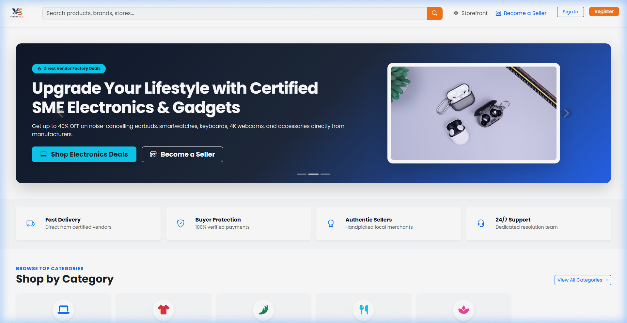
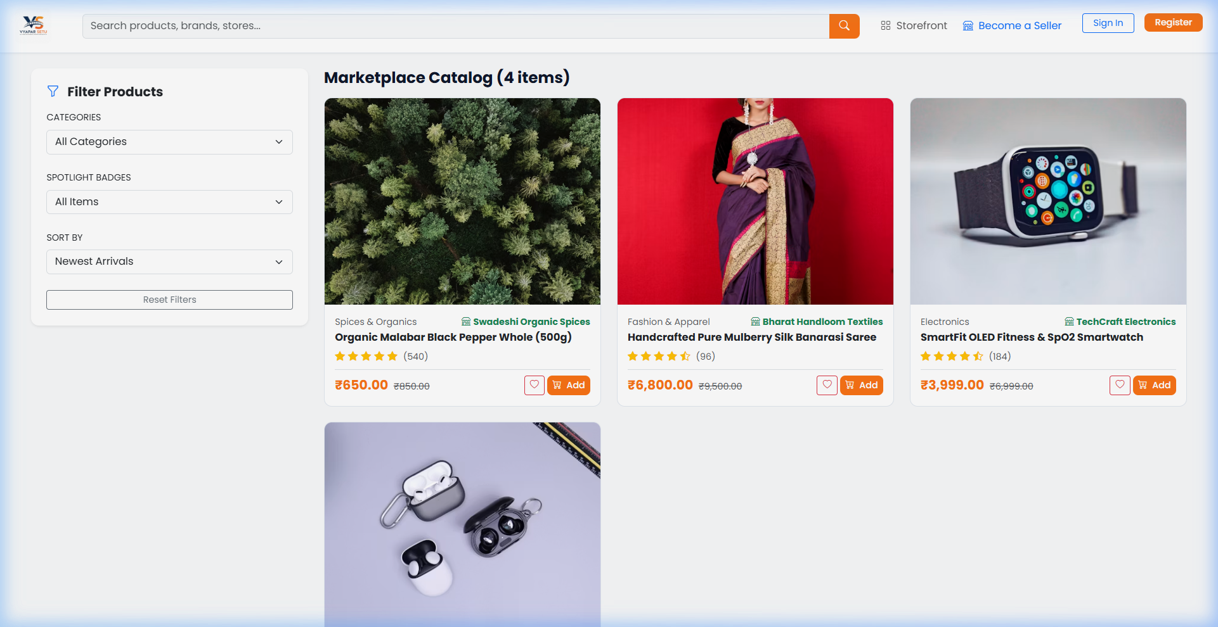
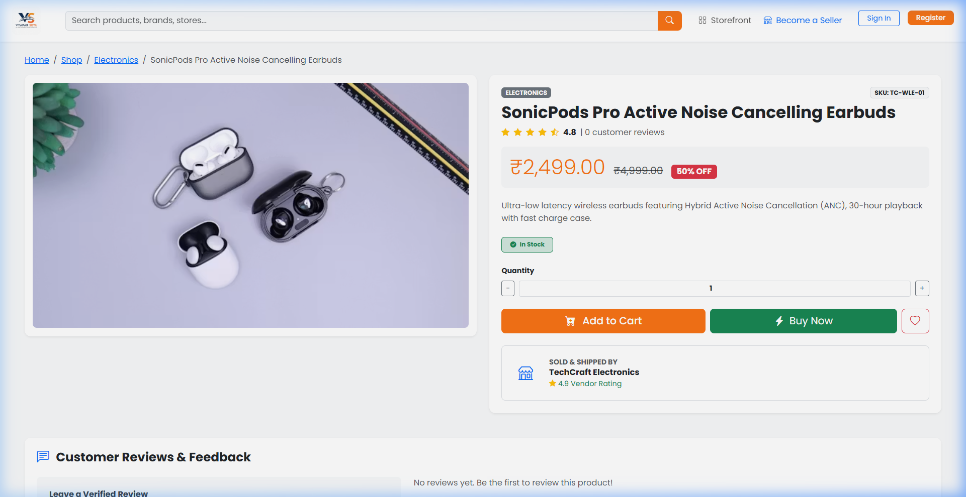
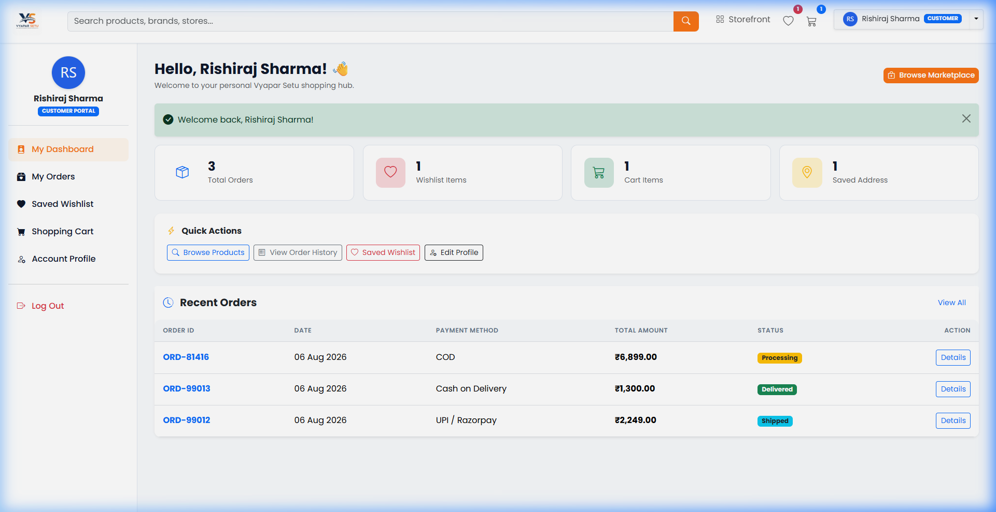
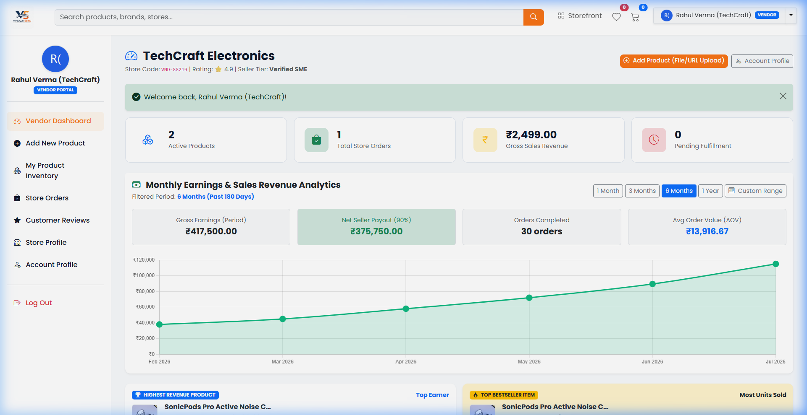
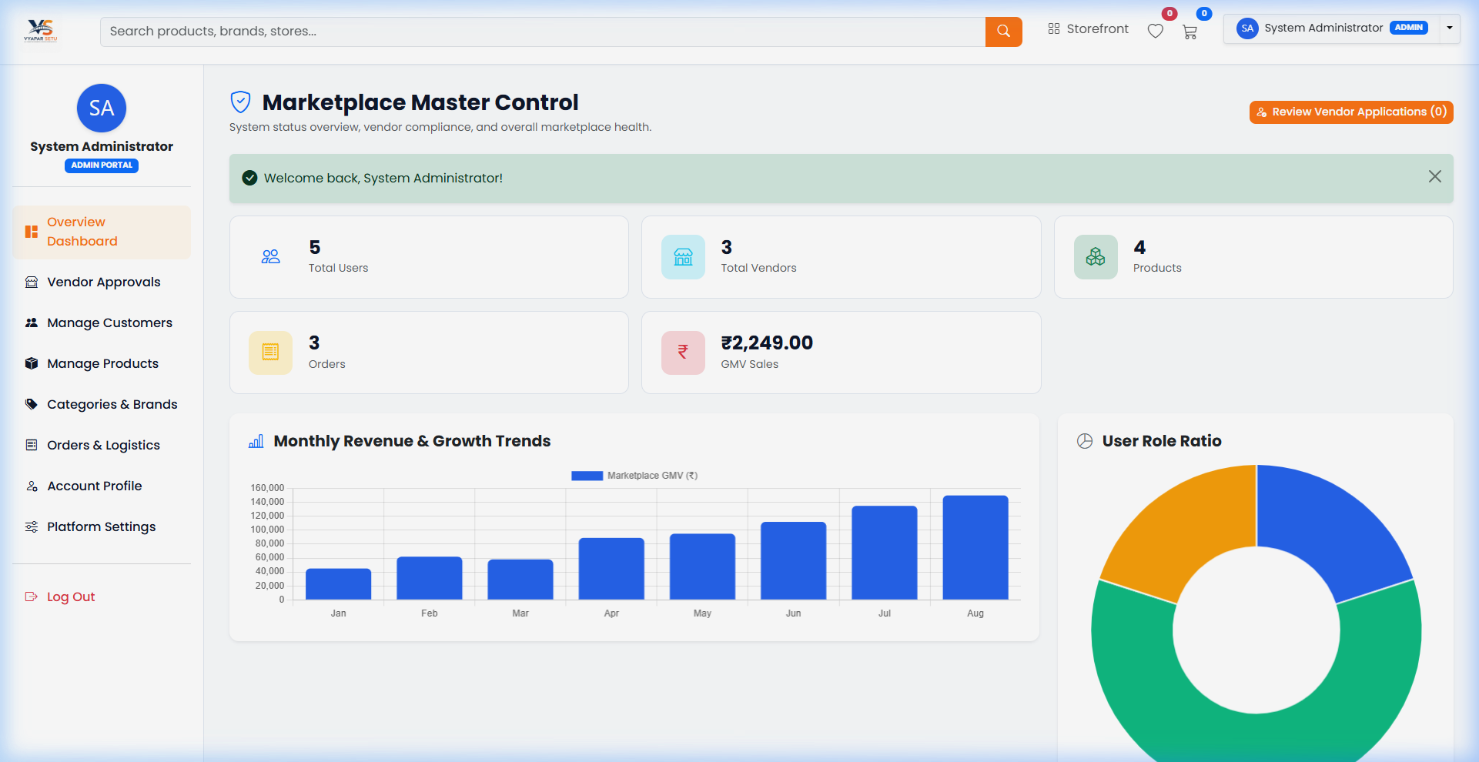
Screenshots
Live application screenshots
Home Page
Shop Page
Product Detail
Customer Dashboard
Vendor Dashboard
Admin Dashboard
16 / 18

Slide 17
Project Summary
Key takeaways & achievements
🏆
Key Achievements
💡
Skills Learned
• Built a full-stack multi-vendor marketplace
• Implemented 3 distinct user roles with RBAC
• Designed 16-table relational database schema
• Created responsive UI with Bootstrap 5
• Full-stack web development (PHP + MySQL)
• Database design & normalization
• UI/UX design principles
• Version control with Git & GitHub
⚙️
Technologies Used
🎓
Internship Outcome
• HTML5, CSS3, JavaScript, Bootstrap 5
• PHP 8.x, MySQL / MariaDB
• XAMPP, VS Code, Chrome DevTools
• Git & GitHub for collaboration
• Successfully completed the project
• Gained real-world development experience
• Learned project management & planning
• Ready for deployment & future scaling
17 / 18

Slide 18
Thank You!
Questions & Answers
Rishiraj Sharma
Diploma in Computer Engineering • G. V. Acharya Polytechnic
Multi-Vendor Marketplace System | 2025–2026

