Slide 1

Domain: Energy
Dataset Name: Data 1
Dataset Type: CSV Data
Dataset Size: 20K+ rows
Industrial Energy Combustion
Descriptive & Diagnostic Analysis

Slide 2


Project overview
This Project contains in-depth facility-level information on industrial combustion energy use in the United States.
Learning objectives
Keywords
It provides an essential resource for understanding consumption patterns across different sectors and industries which can serve as an informative baseline for efficient or renewable alternative plans of operation at these facilities.
Facility_id, Facility_name, Fuel_type, Unit_name, Unit_type, Latitude, Longitude, State, Zip, Primary_naics_code, Primary_naics_title, Cogeneration_unit_emiss_ind, Mecs_region, Mmbtu_total, Gwht_total, Grouping
Tools Used
EXCEL
Created a wireframe to get the blueprint of the functionality and the content.
MYSQL
Remove unwanted columns, null values and created view tables
POWERBI
Created a fully functional integrated dashboard as per business requirements
TABLEAU
Created a fully functional integrated dashboard as per business requirements

Slide 3


MMBtu_TOTAL for Ethane & Ethanol
This data shows Total Heat energy consumed for "Ethane" was higher than "Ethanol (100%)"
Ethane is more widely used in "South" and "Northeast" region and is accounted for 98.51% share MMBtu_Total between "Ethane" and "Ethanol (100%)"

Slide 4

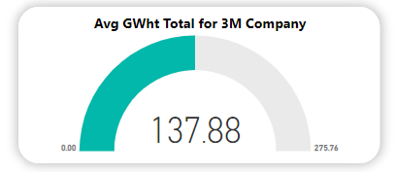
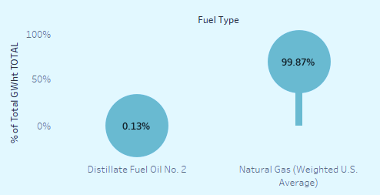

2. Average GWht_TOTAL for 3M Company Facility
The Gigawatt hours of electricity consumed by 3M Company Facility is lower compared to overall average i.e. 154 gwht.
Here we can see 3M company uses "Distillate Fuel oil" as Fuel which is used for "Plastics Material and Resin Manufacturing" has low energy combustion rate compared to other fuel.

Slide 5

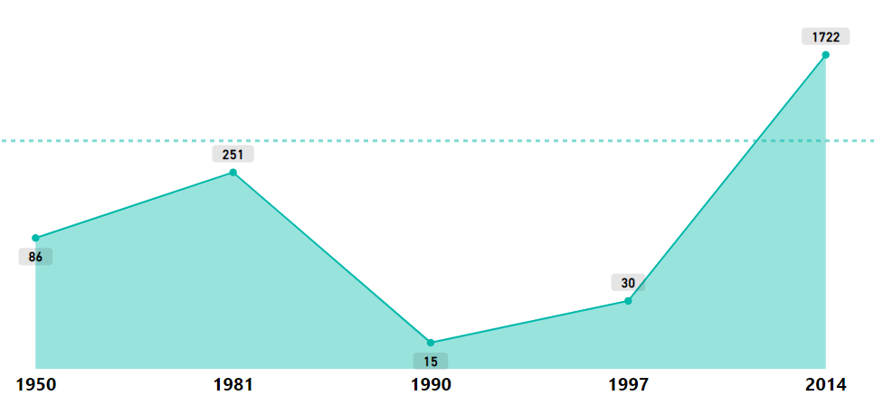
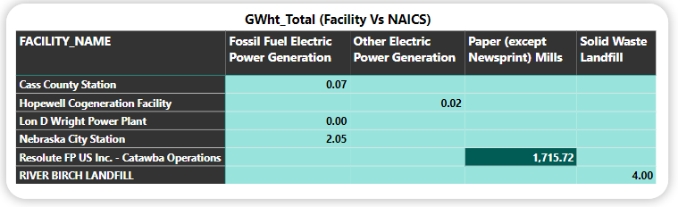

3. Unit Name trend (1950-2020) Vs GWht_TOTAL
In the latest year 2014 as per this data, the Electricity consumption was the at the highest compared to all the previous years
This matrix below illustrates with the introduction "Paper mills" industry by "Resolute FP US Inc. - Catawba Operations" Facility on 2014, we saw a significant rise in energy combustion.

Slide 6

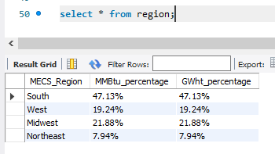
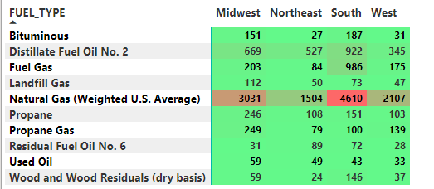

4. % Share of MMBtu_TOTAL & GWht_TOTAL for each MECS_Region
% Share of Energy Combustion is highest in South compared to any other regions.
These numbers prove the usage of fuel type like "natural gas" and "Fuel gas" is more in South region

Slide 7
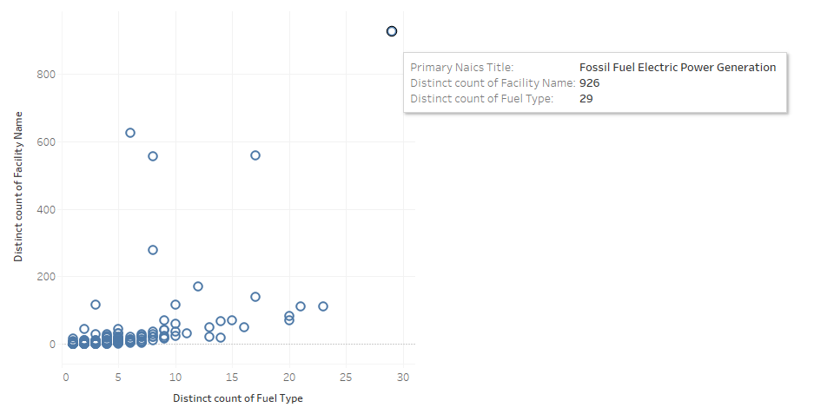
5. PRIMARY_NAICS_TITLE Vs Facility Name and Fuel Type Stats
﻿Across all 255 PRIMARY_NAICS_TITLE, There are total 5747 Facilities and 50 Fuel types.﻿
This chart illustrates “Fossil Fuel Electric Power Generation” is common in most facilities and as well as uses most types of fuel.

Slide 8

Thank You

