Slide 1

Equation Solver
By Rishi Rattanpal - 201634390
Statement of ethical compliance:
I state I will follow the University of Liverpool’s ethical guidance as detailed here https://student.csc.liv.ac.uk/internal/modules/comp390/2024-25/ethics.php
My project will be in the following data/human participant category, A2

Slide 2
Introduction
Overview?
Motivation?
Notes:
Overview:
The aim of my project is to make a web application that can act as an equation solver, that will assist users ranging from students to professionals in solving various types of problems
A user will be able to input their problem via text or a calculator interface in which my program will then be able to analyse and then solve it outputting the correct answer with working out, given the input is valid
Motivation:
There are both practical and academic uses for this
Academic:
aids students in learning maths by allowing them to verify if an answer is correct
Showing working out would also help them learn techniques to solve equations
Practical:
Equations are used in a wide range of fields such as engineering, AI, data science, economics and more to model relationships, processes, and phenomena
This tool allows them to utilise equations for quick and real answers
Personal:
I have always been interested in maths as well as compsci, this project allows me to link the two together

Slide 3
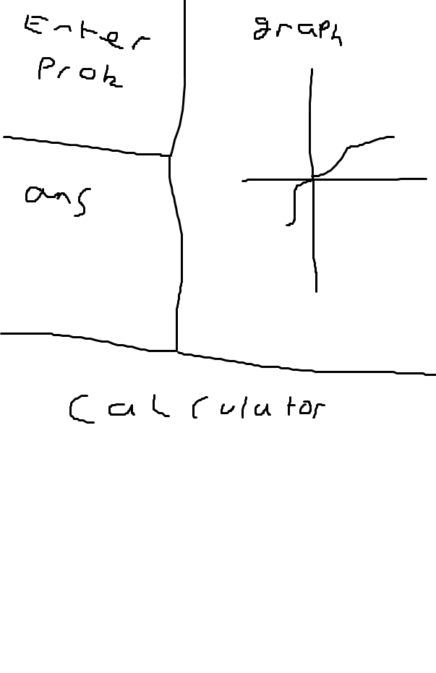
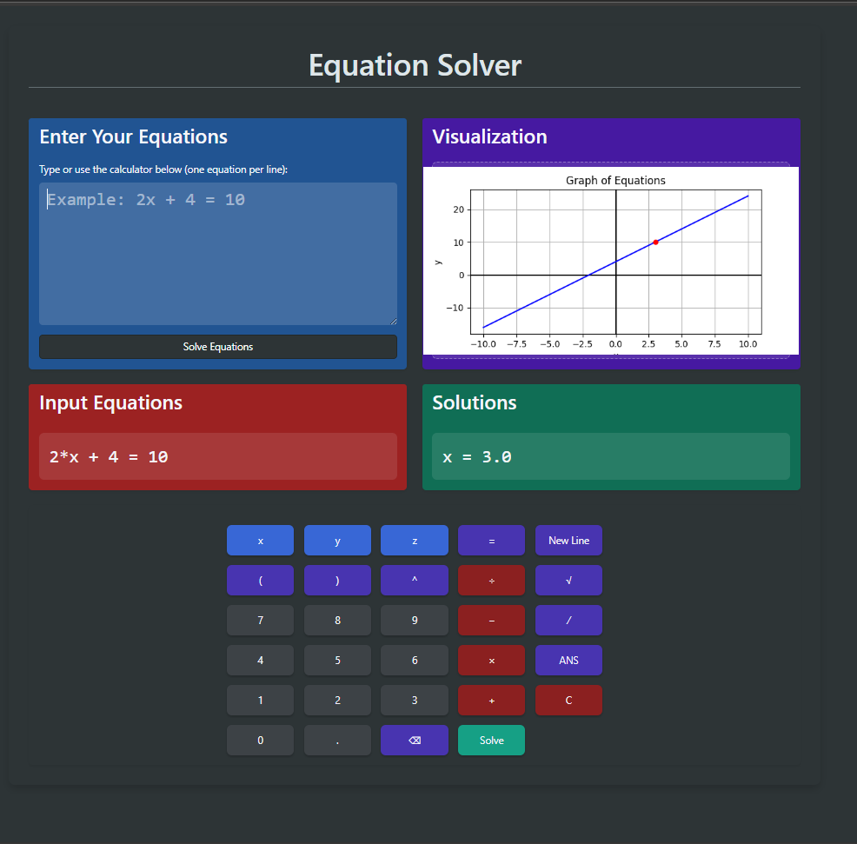
Original UI vs Final UI
Notes:
The content remains the same however as seen the layout is different but the core content remains the same

Slide 4
Key Features
Feature | Implemented | Improvements
Solves arithmetic | ✅ | Works perfect
Solves Linear | ✅ | Works perfect
Solves System of linear | ✅ | Works perfect
Solves nonlinear | ❌ | Implement
Solves inequalities | ❌ | Implement
Solves Quadratics | ✅ | Works perfect
Frontend for input/output | ✅ | Make more interactive
Graph for equations | ✅ | Support z, dynamically display
Working out shown | ❌ | Implement
Calculator Input | ✅ | Add more buttons
Formats input | ✅ | Add more edge cases
Error handling | ✅ | Display error more aesthetically
Notes:
Here is a table that shows the key features and what I have achieved so far and what I have left to implement

Slide 5
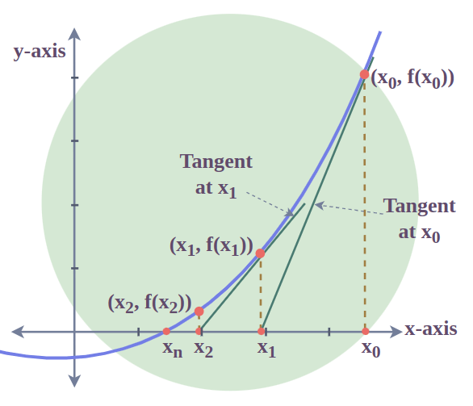
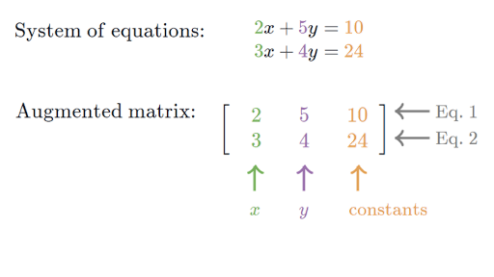
How systems are solved (Gaussian elimination)
Notes:
Equa

Slide 6
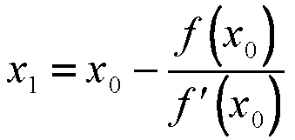
How high order polynomials are solved (newton rhapson)

