Slide 1

Equation Solver
By Rishi Rattanpal - 201634390
Statement of ethical compliance:
I state I will follow the University of Liverpool’s ethical guidance as detailed here https://student.csc.liv.ac.uk/internal/modules/comp390/2024-25/ethics.php
My project will be in the following data/human participant category, A2

Slide 2
Introduction
Overview?
Motivation?
Notes:
Overview:
The aim of my project is to make a web application that can act as an equation solver, that will assist users ranging from students to professionals in solving various types of problems
A user will be able to input their problem via text or a calculator interface in which my program will then be able to analyse and then solve it outputting the correct answer with working out, given the input is valid
Motivation:
There are both practical and academic uses for this
Academic:
aids students in learning maths by allowing them to verify if an answer is correct
Showing working out would also help them learn techniques to solve equations
Practical:
Equations are used in a wide range of fields such as engineering, AI, data science, economics and more to model relationships, processes, and phenomena
This tool allows them to utilise equations for quick and real answers
Personal:
I have always been interested in maths as well as compsci, this project allows me to link the two together

Slide 3
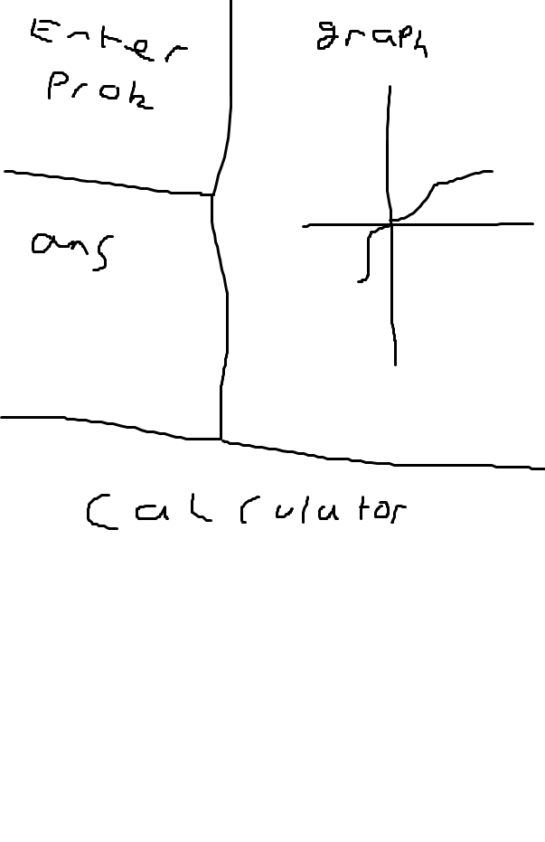
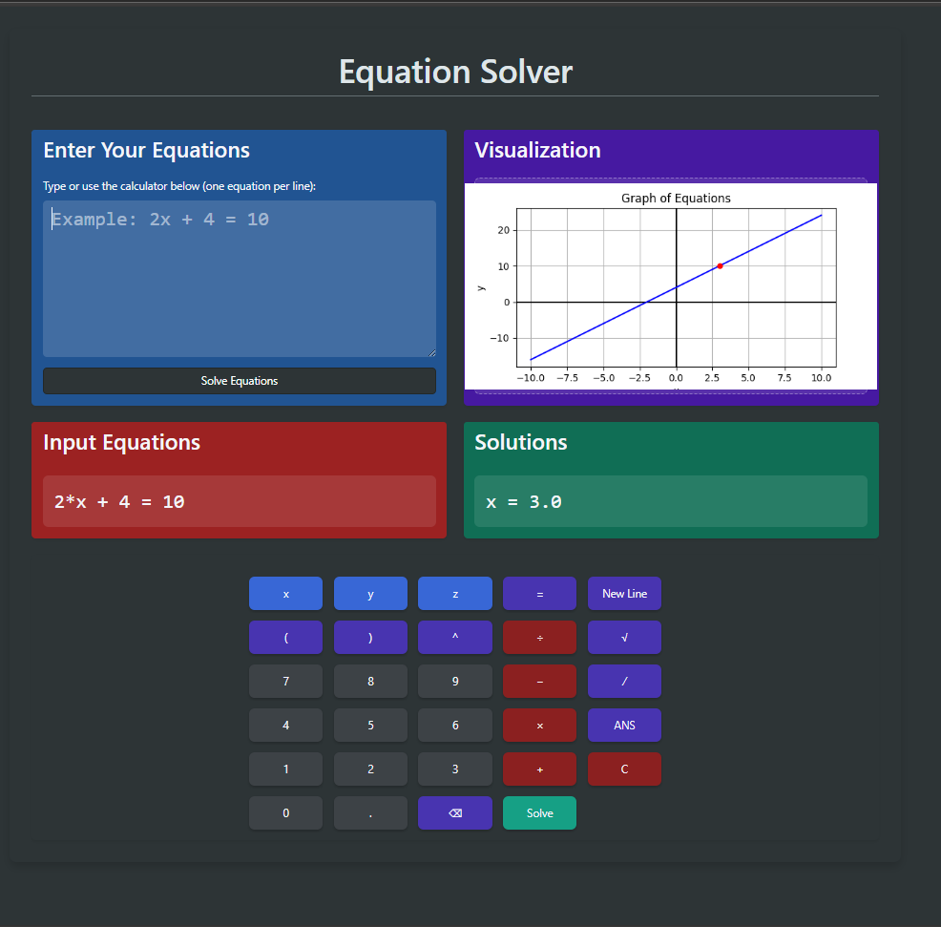
Original UI vs Final UI
Notes:
The content remains the same however as seen the layout is different but the core content remains the same

Slide 4
Key Features
Feature | Implemented | Improvements
Solves arithmetic | ✅ | Works perfect
Solves Linear | ✅ | Works perfect
Solves System of linear | ✅ | Works perfect
Solves nonlinear | ❌ | Future feature
Solves inequalities | ✅ | Quadratic formatting and graph support
Solves Quadratics | ✅ | Works perfect
Frontend for input/output | ✅ | Make more interactive
Graph for equations | ✅ | Support z and inequalities, dynamically display
Working out shown | ❌ | Future feature
Calculator Input | ✅ | Add more buttons
Formats input | ✅ | Add more edge cases
Error handling | ✅ | Display error more aesthetically
Sin, cos tan support | ❌ | Future feature
Notes:
Here is a table that shows the key features and what I have achieved so far and what I have left to implement
My future steps will be making sure this table is full of ticks

Slide 5
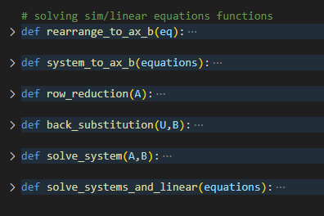
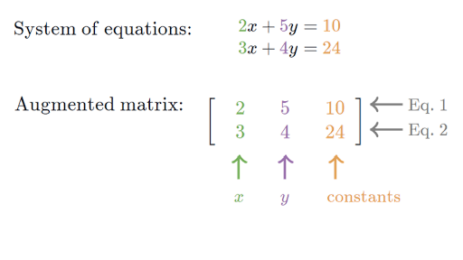
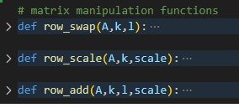
How systems are solved (Gaussian elimination)
Notes:
Next I will talk about a few features I am proud of and a high level explanation on how they work
I take my equation represented as a string and represent it as an augmented matrx
I then reduce the matrix to row echelon form
Once in row echelon form, I back substitute to get the other values
I also pre defined row manipulation functions for the matrix operations

Slide 6
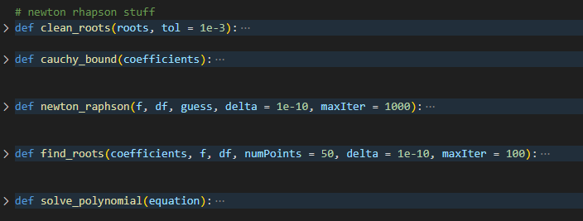
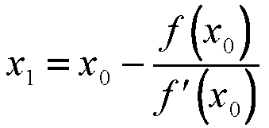
How high order polynomials are solved (newton rhapson)
Notes:
An iterative approach to find solutions to equations where it works by taking an initial guess and further refining it through more guesses
Each guess works by taking the current approximation and subtracting it by the function divided by it’s derivative and repeats until adjacent values are within a threshold
when translating into code there are a couple I need to implementof extra steps

Slide 7
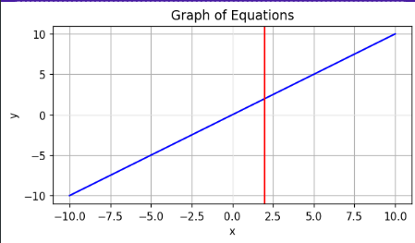
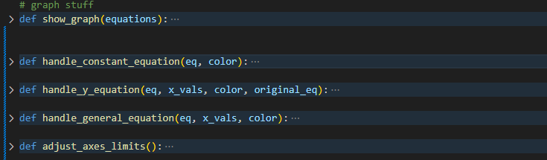
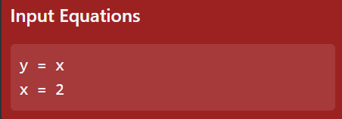
How graphs work
Notes:
I leverage matplotlib.pyplot for this
I account for explicit, implicit and constant functions
and then draw the corresponding graph onto an axis
Once the graph is drawn, I save the plot as an image and transfer to the frontend

Slide 8
Project demonstration
Show development environment:
Front/backend
Show test cases and error handling:
Linear
Systems
Quadratics
Notes:
Slow development environment:
Show app.py – this connects my frontend to my backend and transfers data between them
Show html file – this is a blueprint of the content I want to show, styled with bootstrap
Show css file – this makes my html more aesthetic
Show .js file – this makes my html more interactive
TEST CASES:
---------
SOFTWARE DEMONSTRATION
show error handling:
- no input
- incorrect input
show basic arithmetic:
2+2 = 4
show linear equations
2x + 23 = 43
x=10
show sim equations:
x = 0.5 * y
y = 0.5 * x + 3
x = 2.00
y = 4.00
x - y + z = 3
2x + y + 8z = 18
4x + 2y - 3z = -2
x=1.00
y=2.00
z=2.00
x + y = 2
x + y = 5
no solution
x + y = 2
2x + 2y = 4
x = 2
y = 0
(infinite sols)
show quadratics:
x^2 + 2x + 1 = 0
x = -1
(one root)
x^2 + 4x + 2 = 0
x = -0.586, 3.414
(two roots)
show polynomials:
x**3 - 6*x**2 + 11x - 6 = 0
x = 1, 2, 3
x**5 - 3*x**4 + x**3 - x**2 + 2*x - 2 = 0
x = 2.703, 0.6973+0.5421i, 0.6973−0.5421i, −0.5489+0.8044i, −0.5489−0.8044i

