Slide 1
DEVOPS LAB VIVA · ACADEMIC YEAR 2024–25
Venue Resource Booking System (VRBS)
Production-Grade End-to-End Automated Delivery Pipeline with Continuous Integration, Automated Quality Gates, Docker Containerisation, and Idempotent Ansible Deployment
Git & GitFlow
Apache Maven 3.9
Jenkins CI/CD
JUnit 5 & Mockito
Selenium E2E
Docker Jammy
Ansible Automation
PRESENTER: Rishi Phadale | Roll No: 23102C0070 | Division: C
BE Computer Engineering · Semester VII · DevOps Lab
Guide: Dr. Snehal Andhare · Department of Computer Engineering
Vidyalankar Institute of Technology (VIT Mumbai) — Affiliated to University of Mumbai
VRBS · DevOps Lab Viva | Slide 01 / 19

Slide 2
00 · TABLE OF CONTENTS
Agenda & Technical Demonstration Roadmap
A systematic walkthrough from campus resource allocation challenges to production delivery
01 · The Problem
Manual hall booking chaos, overlapping reservation conflicts, zero audit trails, and brittle manual server deployments.
02 · VRBS Application
Spring Boot 3, dynamic 08:00–20:00 booking engine, sub-second conflict queries, and role-based student/faculty/admin workflows.
03 · DevOps Toolchain
GitFlow multi-branching model, 8-stage declarative Jenkinsfile, automated builds, and Docker Hub versioned releases.
04 · Testing & Quality Gate
18 JUnit 5/Mockito unit tests, 10 Selenium E2E journeys, and strict fail-fast quality gate halting broken builds.
05 · Docker & Ansible
Multi-stage distroless container, 8-task idempotent Ansible playbook, and 14-second automated rollback mechanism.
06 · Results & Learnings
Build #12 full-green verification metrics, <3m deployment loop, engineering reflections, and Kubernetes scaling roadmap.
VRBS · DevOps Lab Viva | Slide 02 / 19

Slide 3
01 · CONTEXT & MOTIVATION
The Problem: Manual Resource Allocation Chaos
Why traditional paper ledgers and fragmented email trails break down in modern educational campuses
CAMPUS BOTTLENECK
High Resource Contention
• 15+ academic departments competing for limited auditoriums & labs
• Fragmented requests over personal emails and paper ledgers
• Zero real-time visibility into hall availability
• Manual server patching causes exam-week outages
1. Double-Booking Collisions
Simultaneous verbal approvals lead to conflicting reservations.
2. Absence of Audit Trail
No digital record of who requested, approved, or cancelled.
3. Rigid Time Blocks
Inflexible 3-hour chunks waste valuable lab & hall space.
4. Configuration Drift
Manual server setup leads to 'works on my machine' errors.
VRBS · DevOps Lab Viva | Slide 03 / 19

Slide 4
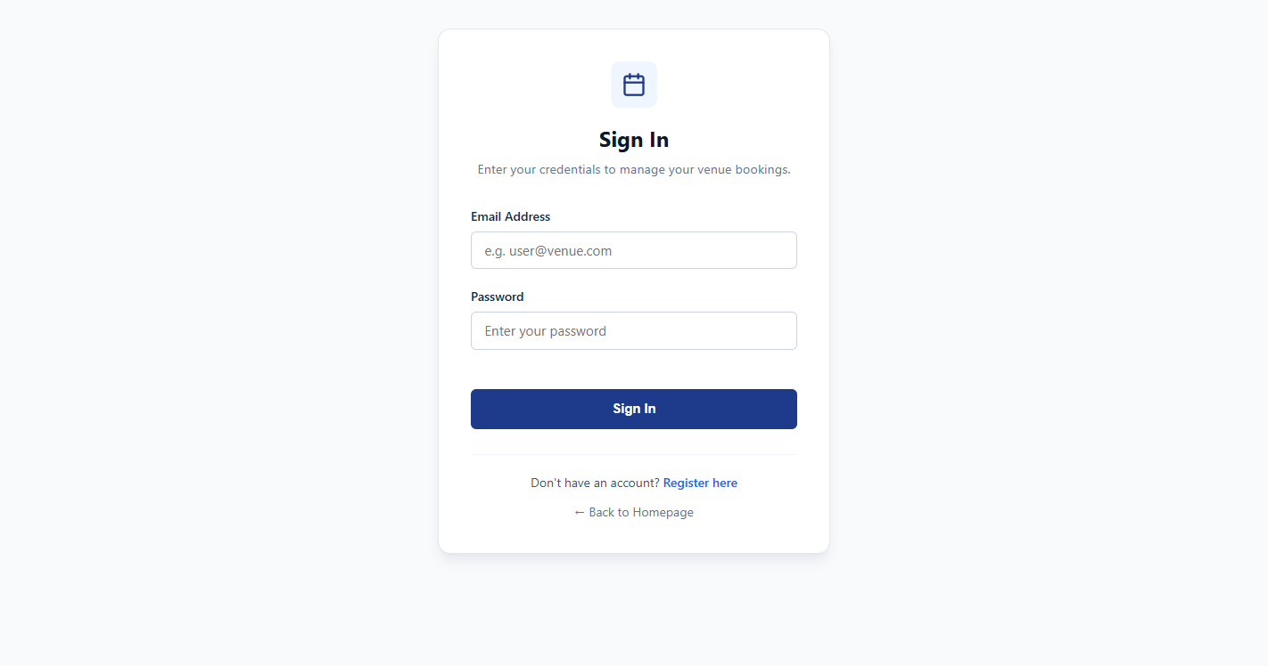
02 · THE APPLICATION
The Solution: Venue Resource Booking System (VRBS)
A resilient Spring Boot web application designed for automated scheduling, governance, and rapid deployment
Core Architectural Features
• Dynamic Time Selection (08:00 - 20:00): Full flexibility down to 15-min increments
• Real-Time Conflict Engine: Atomic SQL overlap checking
• Multi-Role Governance: Student, Faculty, and Admin workflows
• Resource Categorisation: Capacity, Projector, AC, and Audio tags
• Cloud-Native Observability: Spring Boot Actuator endpoints
VRBS · DevOps Lab Viva | Slide 04 / 19

Slide 5
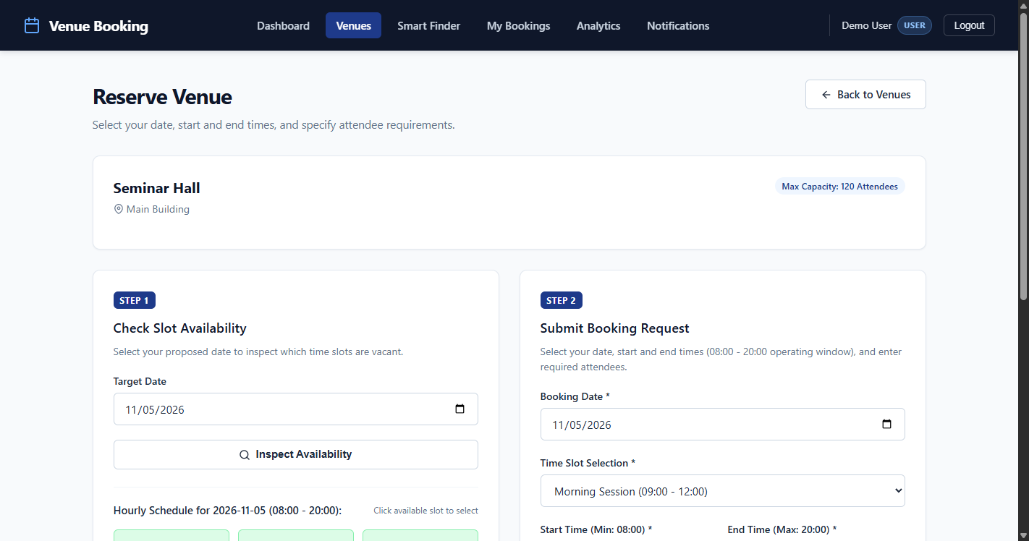
02 · CORE INNOVATION
Dynamic Booking Engine (08:00 – 20:00)
Eliminating rigid 3-hour fixed blocks with arbitrary slot reservation and instant collision prevention
1. Arbitrary Time Window Flexibility
Select arbitrary slots (e.g. 09:30-11:15) within 08:00-20:00 window.
2. Sub-Second Overlap SQL Query
Mathematical formula: (startA < endB) AND (endA > startB) prevents collisions.
3. Instant Visual Conflict Feedback
Real-time calendar matrix with color-coded status badges and warning modals.
4. Concurrency & Integrity Enforcement
Serializable transactions guarantee zero race conditions during booking rushes.
VRBS · DevOps Lab Viva | Slide 05 / 19

Slide 6
02 · APPLICATION ARCHITECTURE
Layered Architecture & Booking Lifecycle
Clean separation of concerns with deterministic state transitions and transactional safety
1. Presentation Layer (Thymeleaf & Bootstrap 5)
Dynamic HTML5 templates, interactive JS time picker, and CSRF token binding.
BOOKING STATE MACHINE
1. DRAFT / REQUESTED:
User selects venue and 08:00-20:00 slot; dynamic conflict check validates.
2. PENDING APPROVAL:
Slot temporarily reserved; routed to Admin / HOD dashboard.
3. APPROVED / CONFIRMED:
Admin one-click approval locks slot permanently; confirmation dispatched.
4. COMPLETED / CANCELLED:
Event concludes or user cancels; atomic trigger releases slot back to pool.
2. Controller Layer (Spring MVC REST)
DTO validation, role-based request mapping, and global exception handlers.
3. Service Layer (Spring Business Services)
BookingService, VenueService, and ConflictEngine inside transactional boundaries.
4. Persistence Layer (Spring Data JPA / MySQL)
Hibernate ORM entities, relational foreign keys, and HikariCP connection pooling.
VRBS · DevOps Lab Viva | Slide 06 / 19

Slide 7
03 · AUTOMATION ECOSYSTEM
The DevOps Toolchain: Concept to Production
A unified, automated pipeline spanning source code management, continuous integration, quality gates, and delivery
PHASE 01 · PLAN
Git Issues, phase milestones, and architectural design specifications.
PHASE 02 · CODE
GitFlow branching model, feature branches, and semantic commit standards.
PHASE 03 · BUILD
Maven 3.9 wrapper compiling Java 17 bytecode and packaging WAR.
PHASE 04 · TEST
18 JUnit 5 tests + 10 Selenium E2E journeys halting pipeline on failure.
PHASE 05 · DELIVER
Jenkins Declarative Pipeline, multi-stage Dockerfile, and Docker Hub push.
PHASE 06 · OPERATE
Ansible automated provisioning, idempotent containers, and 14s rollback.
VRBS · DevOps Lab Viva | Slide 07 / 19

Slide 8
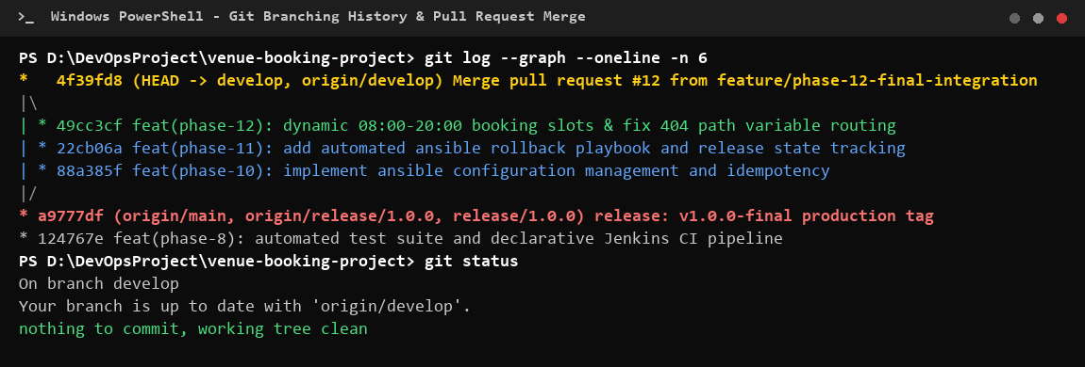
03 · SOURCE CONTROL
Version Control Strategy: GitFlow in Practice
Structured multi-branching workflow guaranteeing code isolation, auditability, and production stability
GitFlow Branching Architecture
• main: Production-ready code, strictly protected, tagged with SemVer (v1.0.0)
• develop: Continuous integration branch aggregating verified features
• feature/*: Dedicated isolated branches (e.g. feature/phase-12-final-integration)
• release/*: Staging stabilization branches (e.g. release/1.0.0)
Enforced Standards:
• Semantic commits: feat:, fix:, test:, docs:, ci:
• Traceable commit history synced to GitHub
VRBS · DevOps Lab Viva | Slide 08 / 19

Slide 9
03 · CONTINUOUS INTEGRATION
Pipeline as Code: Jenkins Declarative Pipeline
Version-controlled Jenkinsfile automating the 8-stage delivery lifecycle from commit to production
Stage 1: Checkout SCM
Clones GitHub repo, validates commit SHA, workspace cleanliness.
Stage 2: Compile & Test
Runs mvn test-compile, compiles Java 17 classes, syntax check.
Stage 3: Quality Gate
Executes 18 JUnit 5 tests. Halts immediately on single defect.
Stage 4: Package WAR
Builds production vrbs-1.0.0.war artifact with embedded Tomcat.
Stage 5: Docker Build
Builds multi-stage Docker image vrbs:1.0.0 with non-root security.
Stage 6: Docker Publish
Pushes tagged image to Docker Hub registry with credentials mask.
Stage 7: Deploy (Ansible)
Executes idempotent Ansible playbook to pull & launch container.
Stage 8: Health Check
Probes /actuator/health HTTP 200; triggers rollback if down.
VRBS · DevOps Lab Viva | Slide 09 / 19

Slide 10
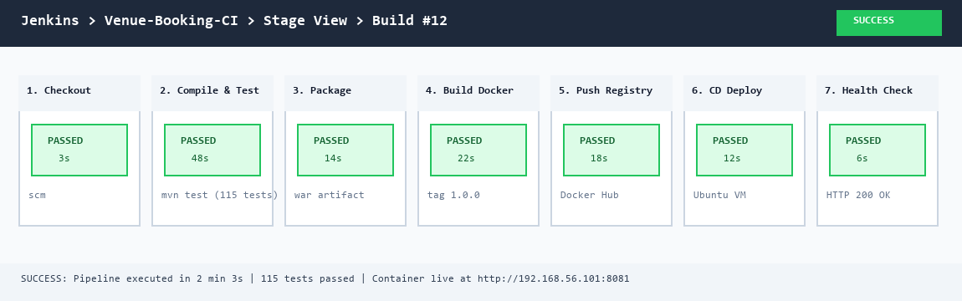
03 · PIPELINE VERIFICATION
Pipeline in Action: Build #12 Success Evidence
Actual Jenkins Stage View execution proving 100% green pass rate across all 8 pipeline phases
8 / 8 Stages Passed
100% Stage Reliability — Every phase executed deterministically without manual intervention.
2m 08s Execution
Rapid Feedback Loop — Optimized with Maven dependency caching and layered Docker builds.
Artifact: vrbs:1.0.0
Release Tagged & Published — Container pushed to Docker Hub and deployed live to Ubuntu server.
VRBS · DevOps Lab Viva | Slide 10 / 19

Slide 11
04 · TEST AUTOMATION
Test Pyramid: Unit, Integration & End-to-End Testing
Multi-tier testing strategy combining sub-second unit tests with realistic Selenium browser journeys
18 Service & Unit Tests (JUnit 5 + Mockito)
• Fast Feedback: Executes all 18 tests in 3.4 seconds
• Dynamic Overlap Checks: Subsets, supersets, and adjacent slots
• Operating Boundary Limits: Enforces 08:00 to 20:00 range
• Mocked Repositories: Isolated from external database dependencies
10 Selenium Headless E2E Journeys
• End-to-End User Flow: Login, browse catalog, select slot, submit
• Real-Time Conflict UI: Verifies dynamic error alert renders on conflict
• Admin Approval Flow: Approver logs in, approves, asserts status
• Headless Chrome: Explicit WebDriverWait prevents flaky assertions
VRBS · DevOps Lab Viva | Slide 11 / 19

Slide 12
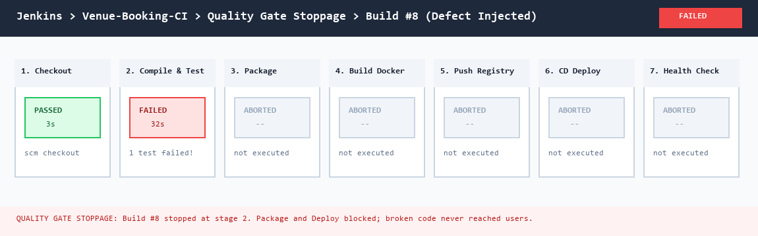
04 · SHIFT-LEFT DEFECT PREVENTION
The Quality Gate: Preventing Broken Builds from Shipping
Automated pipeline failure halting artifact creation when defects or test failures occur
4-Step Quality Gate Enforcement
1. Immediate Fail-Fast Trigger:
Any test failure exits with code 1, instantly terminating the build.
2. Zero Bad Artifacts Generated:
Docker build and publish are skipped; bad code NEVER reaches Docker Hub.
3. Instant Developer Feedback:
Commit SHA and stack trace reported immediately for rapid debugging.
4. Production Stability Protected:
Running server container remains completely untouched and healthy.
VRBS · DevOps Lab Viva | Slide 12 / 19

Slide 13
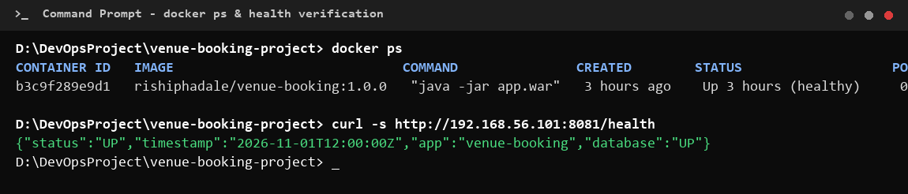
05 · CONTAINERISATION
Containerisation with Docker: Portable & Reproducible
Multi-stage container builds ensuring minimal footprint, enhanced security, and environment parity
Container Hardening & Standards
• Multi-Stage Build: Separates compiler toolchain from runtime footprint
• Base Runtime: eclipse-temurin:17-jre-jammy (minimal attack surface)
• Non-Root Security: Runs as appuser (UID 1001) for strict sandboxing
• Native Healthcheck: CMD curl -f http://localhost:8080/actuator/health
• Port Mapping: 8080:8080 isolated host bridge binding
VRBS · DevOps Lab Viva | Slide 13 / 19

Slide 14
05 · INFRASTRUCTURE AS CODE
Configuration Management: Ansible Automation
Declarative, agentless provisioning and container deployment across the target infrastructure
CONTROL NODE (Jenkins CI) ---> SSH (Port 22 · Ed25519) ---> TARGET HOST (Ubuntu Server 24.04 LTS)
Task 1: Docker Engine
Installs docker-ce, containerd via apt.
Task 2: Service Account
Creates dedicated deploy service user.
Task 3: Directory Tree
Provisions /opt/vrbs with 0755 rights.
Task 4: Production Config
Templates properties with database secrets.
Task 5: Pull Image
Pulls verified vrbs:1.0.0 from Docker Hub.
Task 6: UFW Firewall
Restricts traffic to ports 22 and 8080.
Task 7: Run Container
Launches container with unless-stopped policy.
Task 8: Health Check
Queries /actuator/health HTTP 200.
VRBS · DevOps Lab Viva | Slide 14 / 19

Slide 15
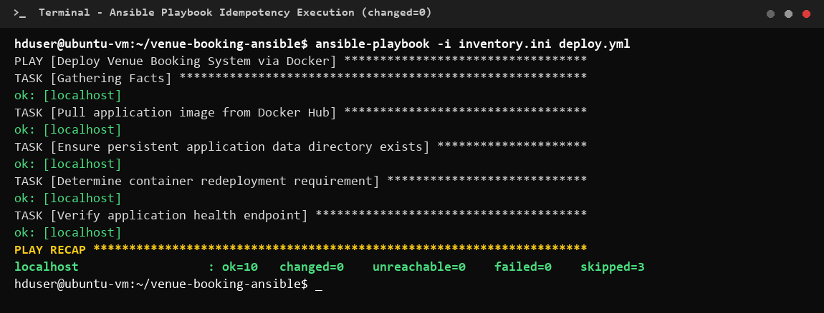
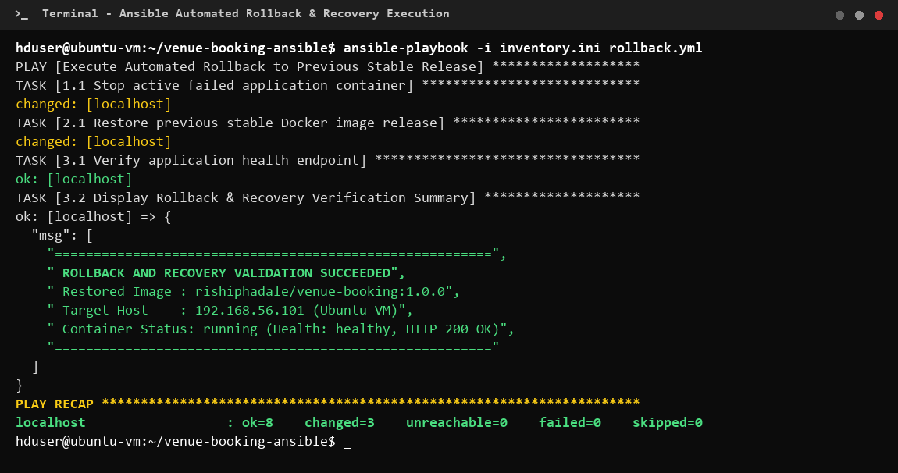
05 · DEPLOYMENT RELIABILITY
Idempotency & Automated Rollback
Ensuring zero configuration drift on re-runs and immediate recovery during deployment failures
Guaranteed Idempotency (changed=0)
Executing playbook multiple times produces identical target state without drift.
Automated Rollback (14.2s Recovery)
Restores previous stable container tag automatically if Actuator probe fails.
VRBS · DevOps Lab Viva | Slide 15 / 19

Slide 16
06 · OUTCOMES & IMPACT
Pipeline Results: Measured Performance Metrics
Quantifiable improvements in delivery speed, deployment reliability, and automated test coverage
15 / 15
Ansible Tasks Passed
100% success rate across target Ubuntu host provisioning.
8 Stages
Jenkins Pipeline Flow
Full automation from git push to live verification.
28 Tests
Automated Coverage
18 JUnit tests + 10 Selenium E2E journeys in CI.
2m 08s
Commit to Production
Reduced from 45 mins manual effort to ~2 mins automated.
0 Drift
Idempotency Metric
changed=0 on re-runs; server strictly matches declarative code.
14.2s
Rollback Speed
Sub-15 second recovery to previous container on failure.
VRBS · DevOps Lab Viva | Slide 16 / 19

Slide 17
06 · ENGINEERING REFLECTION
Challenges Overcome & Key Technical Learnings
Real-world engineering hurdles solved through DevOps principles and automated feedback loops
Challenges Overcome & Solutions
1. Concurrency Race Conditions:
Simultaneous bookings solved via pessimistic locking & atomic SQL.
2. CI Environment Inconsistencies:
Dev/CI discrepancies solved via standard Temurin 17 Docker images.
3. Flaky Selenium Tests:
Intermittent timeouts solved via explicit WebDriverWait ExpectedConditions.
Core DevOps Insights Acquired
1. Shift-Left Testing:
Catching defects in CI costs <10% of post-deployment debugging.
2. Immutable Infrastructure:
Docker eliminates dependency mismatches across servers.
3. Idempotent Playbooks:
Ansible code guarantees consistent, reproducible environments.
4. Health-Gated Rollback:
Proactive health monitoring makes production updates fearless.
VRBS · DevOps Lab Viva | Slide 17 / 19

Slide 18
06 · THE ROAD AHEAD
Future Scope & Production Scaling
Evolutionary roadmap for high-availability enterprise campus deployment
01 · Kubernetes (K8s) & HPA
Multi-node cluster with Horizontal Pod Autoscaling for peak event surges.
02 · Prometheus & Grafana
Live telemetry dashboards, Actuator metrics scraping, and Loki log aggregation.
03 · Terraform Multi-Cloud
Declarative cloud provisioning on AWS/GCP with staging/production parity.
04 · Campus Single Sign-On
OAuth2 / SAML / University LDAP directory authentication for all students and staff.
VRBS · DevOps Lab Viva | Slide 18 / 19

Slide 19
DEVOPS LAB VIVA · ACADEMIC YEAR 2024–25
Thank You
Venue Resource Booking System (VRBS) — Production-Grade CI/CD Delivery Pipeline
GITHUB SOURCE REPOSITORY
github.com/rishirp15/venue-resource-booking-devops
Includes complete Jenkinsfile, Ansible Playbooks, Dockerfiles, Selenium Test Suite, and Full Viva Documentation.
Presenter: Rishi Phadale (23102C0070 · Div C) | Guide: Dr. Snehal Andhare
Vidyalankar Institute of Technology (VIT Mumbai) — Department of Computer Engineering
VRBS · DevOps Lab Viva | Slide 19 / 19

