Slide 1

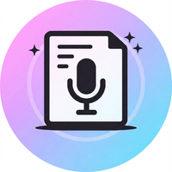

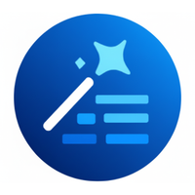

Released AI Tools
Released
Released
Released
KDN Tasks
Meeting Intelligence
MetaPrompt
Drafts clear, actionable email instructions for KDN offshore execution teams. Handles any task—from IS/BS roll-forwards and AR/AP schedules to GL breakdowns and QoE support work.
Transforms meeting transcripts into comprehensive, template-structured notes for FDD and General Business meetings. All content is transcript-grounded with zero invention.
Optimizes user tasks into refined AI prompts using structured templates, ensuring consistent quality for downstream model execution.
Released
Released
TS Copywriter
Lingo
Rewrites, drafts, and polishes financial due diligence report content with Big 4 partner-level expertise, applying strict style guidelines and data-anchored language.
Automatically extracts abbreviations from documents and generates professional, KPMG-branded glossary slides. Upload any PowerPoint or PDF for instant glossary creation.

Slide 2





AI Tools Roadmap
In Development
In Development
In Development
In Development
TS Letters
SPA Assistant
FDD Researcher
Automates generation of Transaction Services due diligence letters (Client Release, Third Party Access, Factual Accuracy) by filling DOCX templates with deal-specific data.
AI assistant for Sale and Purchase Agreement analysis and support.
Pre-data-room kickoff brief generator that creates comprehensive business overviews of the target company, with industry-specific playbooks and data request templates.
Planned
Planned
Planned
Databook Associate
Quality Control Assistant
Generates Excel schedules in Transaction Services according to KPMG brand standards. Processes a variety of data room schedules including leases, trial balances, aging schedules, and GL breakdowns.
Performs QC analysis on Transaction Services databooks and reports through automated consistency checks across deliverables.

