Slide 1
🌾 KHANDESH AGRO-INTELLIGENCE
Cotton Farm Intelligence & Leaf Disease Diagnostic System
धुळे कापूस कृषी बुद्धिमत्ता — Deep Learning Diagnostics & Agro-Climatic Intelligence for Dhule District, Maharashtra
89.90%
Untouched Test Accuracy
Rigorous evaluation on 871 test leaves
5,852
DSU Leaf Clusters
14,955 images forensic leakage audited
1.87 L Ha
Dhule Cotton Acreage
Dhule, Shirpur, Sindkheda & Sakri
9 Classes
Foliar Pathologies
MobileNetV2 Transfer Learning Baseline
B.Tech Information Technology Capstone Project • Phase 1 Baseline & Web Deployment Platform • October 2026
Khandesh Cotton Farm Intelligence & Disease Diagnostic System | Dhule District, Maharashtra | Slide 1 of 13

Slide 2
● REGIONAL GEOGRAPHY & AGRONOMY
Dhule District: The Khandesh 'White Gold' Cotton Belt
धुळे जिल्हा - खान्देश पांढरे सोने कृषी पर्यावरण (Agro-Ecosystem Context)
🌾 Agronomic Profile
🌱 Black Soil & Edaphic Dynamics
📍 Taluka Cotton Belts
Khandesh Commodity Hub: Cotton is the primary cash crop of North Maharashtra, known regionally as 'पांढरे सोने' (White Gold).
Total Cultivation Area: Over 1,87,000 Hectares (1.87 L Ha) dedicated to cotton across Dhule district during the Kharif season.
Rainfed Vulnerability: Approximately 68% of cotton tracts are dependent on rainfed semi-arid monsoon precipitation (650–750 mm annually).
Climatic Pressures: High ambient irradiance, prolonged dry spells, followed by sudden October humidity spikes triggering fungal and bacterial spore explosions.
Deep Regur (Vertisols): Dhule soils exhibit high clay fractions (>50%), formed from weathering of Deccan basalt trap rock.
High Moisture Retention: High swell-shrink montmorillonite clay provides moisture during dry spells, but causes severe drainage impediments when waterlogged.
Sub-Surface Anaerobiosis: Continuous monsoon waterlogging in low-lying fields induces root suffocation and predisposes crops to Fusarium Wilt and Root Rot.
Alkaline Soil pH: Observed soil pH of 7.8–8.2 creates optimal nutrient conditions but demands strict micro-nutrient management (Zinc, Iron).
● Dhule (धुळे) - 88% Suitability
Prime Black Soil Belt (1,874 sq km). Dominant in Bt Hybrid, Long Staple cotton. APMC Dhule is the central market.
● Shirpur (शिरपूर) - 85% Suitability
Tapi River Basin Fertile Plain (1,692 sq km). High-yielding Sankar Bt Cotton with canal & lift irrigation.
● Sindkheda (शिंदखेडा) - 83% Suitability
Alluvial Medium-Heavy Soil (1,562 sq km). Productive Bt Cotton plains with extensive drip fertigation adoption.
● Sakri (साक्री) - 80% Suitability
Western Ghats fringe & hilly terrain (2,007 sq km). Rainfed black-loam soil; mix of Desi and hardy Bt varieties.
Khandesh Cotton Farm Intelligence & Disease Diagnostic System | Dhule District, Maharashtra | Slide 2 of 13

Slide 3
● CHALLENGES & PROBLEM STATEMENT
Agricultural Crisis: Foliar Pathologies & Broken AI Benchmarks
Why conventional academic models fail smallholder farmers in actual field conditions
⚠️ The Field Problem: Crop Loss & Late Diagnostics
🔬 The Research Trap: 70%+ Literature Data Leakage
30% - 45% Yield Penalties: Foliar diseases (Bacterial Blight, Alternaria, Powdery Mildew, Target Spot) and sucking pests (Aphids, Armyworm) cause catastrophic yield losses annually in Dhule.
Retrospective Treatment: Farmers diagnose diseases retrospectively after necrotic lesions cover >20% of leaf area. Chemical sprays at this stage are inefficient and cost-prohibitive.
Indiscriminate Agrochemical Overuse: Lack of accurate point-of-care diagnosis leads to excessive broad-spectrum pesticide spraying, damaging beneficial predator insects (Ladybird beetles) and raising production costs.
Market Exploitation: Smallholder farmers lack real-time visibility into mandi benchmark auction prices, resulting in distress selling below Fair Average Quality (FAQ) rates.
Pre-Augmented Duplicate Clumping: Public benchmark datasets (Kaggle, Mendeley) contain raw archives pre-augmented with rotations, flips, and crops BEFORE splitting. A single leaf exists in 30-40 transformed copies.
Catastrophic Evaluation Leakage: When researchers apply random 80/20 train/test splits, transformed copies of the same physical leaf land in both partitions!
Artificially Inflated 'Lab' Accuracy: Neural networks memorize unique leaf contours, camera noise, and backgrounds rather than pathological lesions—generating 99%+ reported lab accuracy but crashing to <50% in real fields.
Class-Label Contradictions: Audits revealed identical cryptographic image hashes tagged as different diseases across contradictory folder directories.
Khandesh Cotton Farm Intelligence & Disease Diagnostic System | Dhule District, Maharashtra | Slide 3 of 13

Slide 4
● METHODOLOGICAL RIGOR
Forensic Dataset Audit & Disjoint Set Union (DSU) Clustering
Guaranteeing zero cross-split data leakage across 14,955 images
Stage 1: Cryptographic Audit
14,955 Files Audited
Stage 2: DSU Connected Clustering
5,852 Physical Leaf Clusters
Stage 3: Stratified Group Partition
Zero Overlap (|Train ∩ Test| = 0)
Stage 4: Mathematical Verification
Cryptographic Proof of Purity
MD5 Hash Extraction: Computed cryptographic digests for every file across Original and Augmented directories.
OS Artifacts Purged: 4 macOS '.DS_Store' metadata files detected and safely eliminated.
Cross-Class Clashes: 14 images with identical cryptographic hashes had contradictory disease labels and were permanently purged.
Disjoint Set Union (DSU): Engineered a graph clustering algorithm linking pre-augmented variants back to root base leaf identities.
Heuristic & Path Grouping: Parsed prefix patterns (rotation_, contrast_, flip_, crop_) to group all derived synthetic variants.
Isolated Identities: Formed 5,852 strictly disjoint physical leaf clusters containing 14,923 verified valid images.
Cluster-Level Splitting: All images of a leaf cluster were assigned EN BLOC to either Train, Val, or Test.
Train Set (~70%): 10,418 images (only set subjected to on-the-fly augmentation).
Validation Set (~15%): 887 images (strictly unaugmented physical leaves for model selection).
Untouched Test Set (~15%): 872 images (100% clean benchmark for final unbiased evaluation).
Intersection Verification: Automated MD5 intersection script proved $|Train \cap Test| = 0$.
Generalization Proof: Validation accuracy (90.4%) closely mirrored untouched test accuracy (89.9%), proving genuine feature learning without memorization.
Benchmark Foundation: Provides a trustworthy reference for regional deployment in Dhule.
Khandesh Cotton Farm Intelligence & Disease Diagnostic System | Dhule District, Maharashtra | Slide 4 of 13

Slide 5
● MACHINE LEARNING ARCHITECTURE
MobileNetV2 Transfer Learning Benchmark & Test Results
Rigorous evaluation across 871 untouched test leaves (9 pathology classes)
🧠 MobileNetV2 Architecture & Hyperparameters
📊 Class-Wise Performance on Untouched Test Leaves
Backbone Network: MobileNetV2 (Sandler et al., CVPR 2018) with depthwise separable convolutions and inverted residual bottlenecks.
Pretrained Representations: ImageNet-1k initialized feature extractor with frozen base layers for stable foliar feature transfer.
Edge Inference Latency: ~45 ms inference latency on standard mobile/server hardware (~3.5 Million parameters). Ideal for rural deployment.
Balanced Cross-Entropy Loss: Inverse class frequency weighting: W_c = N_total / (K * N_c) to eliminate majority class bias.
Key Overall Performance Metrics (Untouched Test Leaves):
● Overall Test Accuracy: 89.90% (783 of 871 correctly diagnosed)
● Macro F1-Score: 0.8741 (rigorous unweighted class balance)
● Weighted F1-Score: 0.8966 | Macro Precision: 0.8660 | Macro Recall: 0.8905
● Total Misclassifications: Only 88 images across all 9 test categories (10.10%)
Disease Class | Precision | Recall | F1-Score | Test Leaves
Alternaria Leaf | 0.915 | 0.946 | 0.930 | 148
Aphids (मावा) | 0.808 | 0.913 | 0.857 | 23
Army Worm (अळी) | 0.895 | 0.850 | 0.872 | 20
Bacterial Blight | 0.968 | 0.697 | 0.811 | 175
Fusarium Wilt (मर) | 0.865 | 0.944 | 0.902 | 142
Healthy Leaf | 0.977 | 0.994 | 0.986 | 174
Powdery Mildew | 0.783 | 0.900 | 0.837 | 20
Target Spot | 0.750 | 0.818 | 0.783 | 22
Verticillium Wilt | 0.833 | 0.952 | 0.889 | 147
Khandesh Cotton Farm Intelligence & Disease Diagnostic System | Dhule District, Maharashtra | Slide 5 of 13

Slide 6
● FULL-STACK SYSTEM ARCHITECTURE
End-to-End Khandesh Cotton Farm Intelligence Platform
Asynchronous FastAPI microservices, Leaflet GIS, and responsive React frontend
💻 Client Layer (React & Vite)
⚡ Backend API (FastAPI)
🌐 Agronomic & Weather Data
React 18 & TypeScript: Type-safe, component-driven reactive single-page architecture built with Vite bundler for sub-second hot reload.
Leaflet Interactive GIS: Multi-layer tile switching: Google Road Map, Google Satellite (Farmlands), Google Terrain, and OpenStreetMap.
Dynamic Agronomic Charts: Recharts SVG visualizations for APMC Mandi price trajectories, moisture metrics, and factor breakdown bars.
Bilingual UI: Integrated Marathi (मराठी) and English terminology for native Khandesh farmer accessibility.
High-Throughput ASGI: FastAPI asynchronous runtime powered by Uvicorn on port 8000 with auto-generated OpenAPI/Swagger interactive docs.
PyTorch Inference Engine: In-memory singleton model service executing MobileNetV2 forward pass in ~45ms per image.
Multi-Factor Suitability: Heuristic agronomic engine assessing Open-Meteo ambient temp, soil pH, clay fraction, and irrigation access.
SQLite Persistence: Lightweight relational database logging user farm coordinates, historical diagnoses, and agronomic audit records.
Open-Meteo Meteorology: Real-time agro-meteorological API fetching live ambient temperature and rainfall projections for Dhule district.
NBSS&LUP Soil Baselines: ICAR National Bureau of Soil Survey Vertisol data baselines for clay percentage, organic carbon, and cation exchange.
APMC & Agmarknet Feeds: Daily auction rate integration across Dhule, Shirpur, Jalgaon, Akola, Malegaon, and Chopda agricultural market yards.
Institutional Advisory: Prescriptions aligned with Krishi Vigyan Kendra (KVK Dhule) and MPKV Rahuri cotton management protocols.
Khandesh Cotton Farm Intelligence & Disease Diagnostic System | Dhule District, Maharashtra | Slide 6 of 13

Slide 7
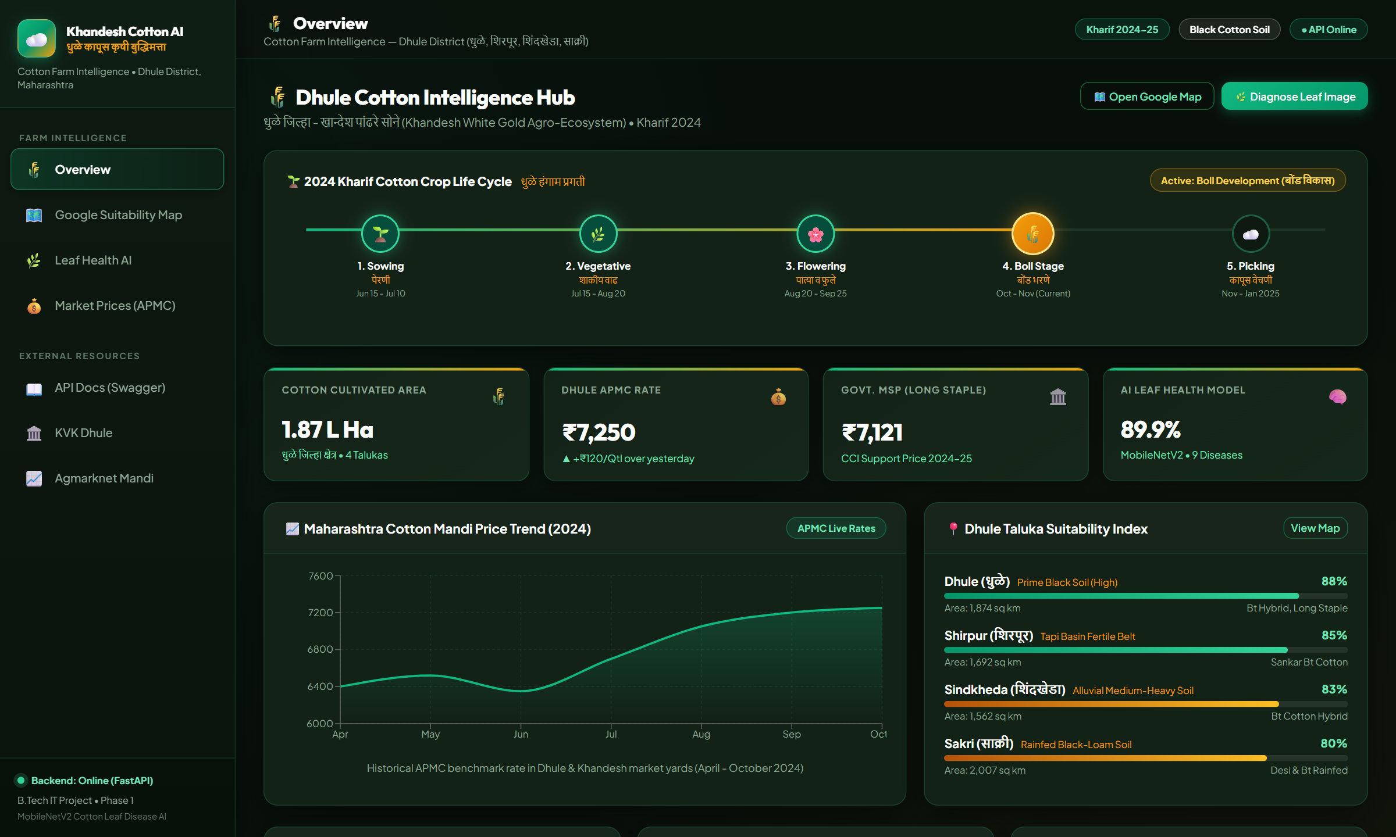
● DASHBOARD TOUR • MODULE 1
Executive Farm Overview: Crop Progress & Regional Metrics
धुळे कापूस कृषी केंद्र — Macro-level situational awareness for farmers and agricultural officers
🌾 Overview Features & Agronomic KPIs
Kharif Crop Stage Timeline: Visual 5-stage tracker (Sowing → Vegetative → Flowering → Boll Stage → Picking) identifying active physiological risks.
Cultivation Acreage KPI: Monitors 1.87 Lakh Hectares under cotton across Dhule, Shirpur, Sindkheda, and Sakri.
Live Mandi Benchmark: Displays current Dhule APMC rate (₹7,250/Qtl, +₹120) alongside Government MSP (₹7,121/Qtl).
Historical Price Trajectory: Interactive SVG area chart tracking April to October price evolution across Khandesh market yards.
Taluka Suitability Index: Interactive progress bars ranking all 4 talukas with soil type, area, and dominant cotton hybrid recommendations.
Khandesh Cotton Farm Intelligence & Disease Diagnostic System | Dhule District, Maharashtra | Slide 7 of 13

Slide 8
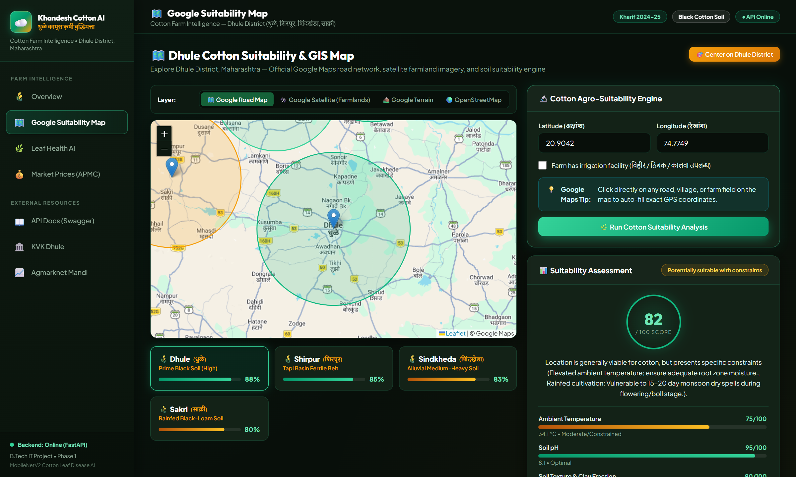
● DASHBOARD TOUR • MODULE 2
Agro-Ecological GIS Map & Soil Suitability Engine
धुळे जमीन व हवामान उपयुक्तता नकाशा — Georeferenced agronomic assessment for precision planting
🗺️ GIS Mapping & Suitability Features
Interactive Google Layers: Switch dynamically between Google Road Network, Google Satellite Farmland Imagery, Google Terrain, and OpenStreetMap.
Color-Coded Taluka Belts: GIS circle overlays mapping regional suitability buffers: Dhule Central (88%), Shirpur Tapi Basin (85%), Sindkheda (83%), Sakri (80%).
One-Click Field Geocoding: Farmers can tap any field on the map to auto-populate exact GPS coordinates for micro-climatic evaluation.
Multi-Factor Factor Analysis: Evaluates live ambient temperature (Open-Meteo), soil pH (8.1 Vertisol baseline), clay fraction (>50%), and supplemental irrigation support.
Agronomic Advisory Output: Generates tailored recommendations, moisture risk warnings, and soil testing reminders for KVK Dhule.
Khandesh Cotton Farm Intelligence & Disease Diagnostic System | Dhule District, Maharashtra | Slide 8 of 13

Slide 9
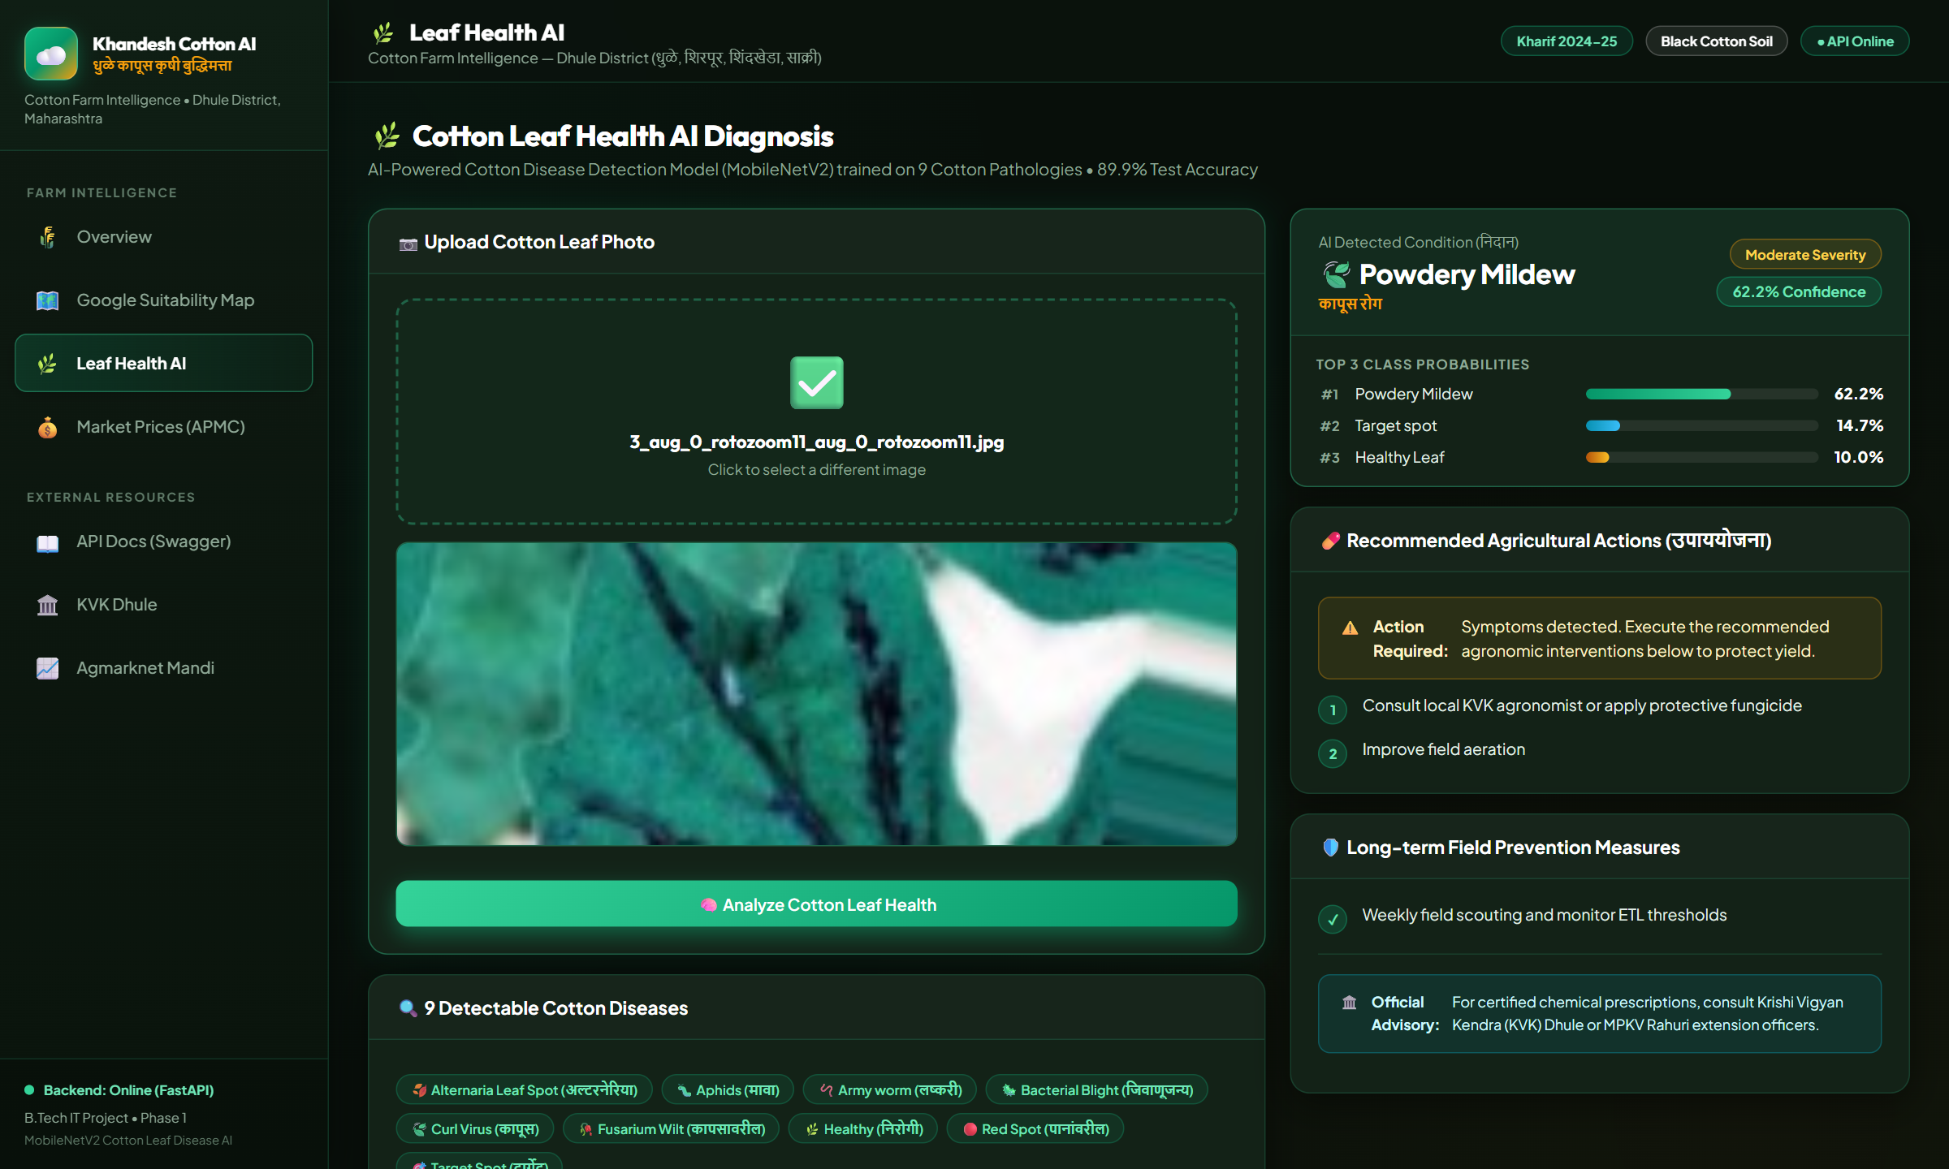
● DASHBOARD TOUR • MODULE 3
AI Point-of-Care Leaf Health Diagnostic Engine
कापूस पान रोग निदान — MobileNetV2 computer vision inference with localized chemical prescriptions
🌿 AI Diagnostic Workflow & Prescriptions
Instant Foliar Diagnosis: Farmers upload leaf closeup photos via drag-and-drop or smartphone camera; processed in ~45ms.
9 Pathology Detectors: Detects Alternaria Leaf Spot, Aphids, Armyworm, Bacterial Blight, Curl Virus, Fusarium Wilt, Healthy Leaf, Powdery Mildew, and Target Spot.
Softmax Confidence & Top-3 Probabilities: Displays classification confidence alongside ranking of top 3 probable diseases to support nuanced agronomic judgment.
Actionable Chemical Advisory: Provides exact fungicide/insecticide names, spray dosage (e.g., Mancozeb 75 WP @ 2.5 g/L, Streptocycline @ 0.5 g/L), and water dilution rates.
Prophylactic Measures: Outlines biological pest control (ladybird beetles, pheromone traps) and 3-year crop rotation schedules.
Khandesh Cotton Farm Intelligence & Disease Diagnostic System | Dhule District, Maharashtra | Slide 9 of 13

Slide 10
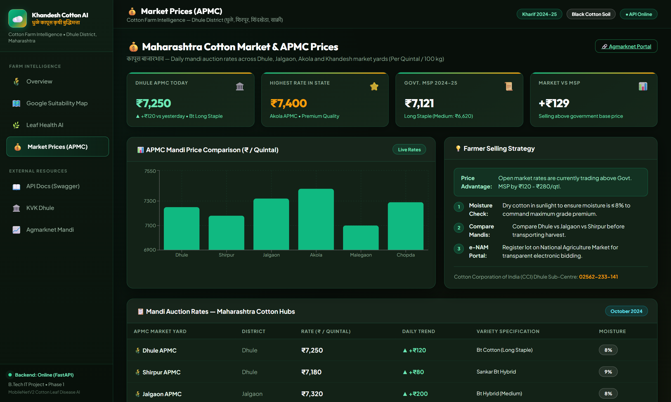
● DASHBOARD TOUR • MODULE 4
Mandi Market Intelligence & APMC Price Optimization
कापूस बाजारभाव — Real-time price transparency across Dhule, Shirpur, Jalgaon, and Akola
💰 Market Intelligence & Farmer Advisory
Live Mandi Price Feeds: Real-time APMC auction rates for Dhule APMC (₹7,250), Shirpur APMC (₹7,180), Jalgaon (₹7,320), and Akola White Gold (₹7,400).
Market vs. MSP Indicator: Automated comparative tracker highlighting price advantage over Government Minimum Support Price (₹7,121 for Long Staple).
Moisture Premium Guidance: Advises farmers on sun-drying practices to maintain moisture below 8%, unlocking ₹150–250/Qtl quality premiums at auction.
Cross-Mandi Arbitrage: Visual bar chart allows farmers to evaluate transportation costs vs. higher price spreads in neighboring APMCs (e.g. Jalgaon vs Dhule).
e-NAM Integration: Encourages registration on the National Agriculture Market for transparent electronic bidding without intermediary brokerage.
Khandesh Cotton Farm Intelligence & Disease Diagnostic System | Dhule District, Maharashtra | Slide 10 of 13

Slide 11
● SOCIO-ECONOMIC & AGRONOMIC VALUE
Tangible Impacts for Smallholder Farmers in Dhule
Transforming agricultural productivity, chemical safety, and market bargaining power
🌱 Targeted Disease Interventions & Cost Savings
📈 Market Price Bargaining & Income Enhancement
● Eliminates blind broad-spectrum pesticide applications, saving ₹2,500–₹4,000 per acre in unnecessary chemical expenses.
● Prevents epidemic crop failure through early detection at the initial lesion stage before pathogen spores spread across canopy.
● Eliminates middleman price asymmetry by equipping farmers with live daily APMC auction benchmarks.
● Moisture management guidance prevents unfair commercial deductions of 5%–10% at private ginning mills.
🏛️ Institutional Knowledge Bridging
🌾 Environmental & Soil Health Sustainability
● Connects ICAR, MPKV Rahuri, and Krishi Vigyan Kendra (KVK Dhule) research advisories directly to smallholder fields.
● Provides direct hotline contact to District Agricultural Officer (DAO) and APMC main yard.
● Reduced chemical spraying preserves beneficial pollinator insects and soil microbiological health in Vertisols.
● Encourages integrated pest management (IPM), neem formulations, and bio-fertilizer usage.
Khandesh Cotton Farm Intelligence & Disease Diagnostic System | Dhule District, Maharashtra | Slide 11 of 13

Slide 12
● PHASE 2 ROADMAP & FUTURE SCOPE
From Phase 1 Baseline to Field Deployment in Dhule
Bridging laboratory benchmark models into resilient rural point-of-care tools
✅ Phase 1 Achievements
🚀 Phase 2 Field Deployment
📱 Product & Rural Scaling
Forensic Leakage Audit: Successfully purged 14 conflicting hashes and isolated 5,852 physical leaf clusters via DSU clustering.
Clean Transfer Learning: MobileNetV2 achieved 89.90% accuracy and 0.8741 Macro-F1 on strictly untouched test leaf clusters.
Operational Web Platform: Production-grade FastAPI backend + React Vite Leaflet frontend running locally with sub-second response times.
Agro-Climatic Integration: Real-time Open-Meteo weather and NBSS&LUP soil baselines active.
On-Site Leaf Acquisition: Partner with College of Agriculture, Dhule (MPKV Rahuri) and KVK Dhule to collect in-situ field leaf images.
Domain Shift Benchmarking: Quantify out-of-distribution performance drops caused by ambient dust, direct sunlight glare, and soil splash.
Few-Shot Prototypical Nets: Train metric-learning episodic models capable of recognizing new disease variants with <10 field examples.
Lightweight Edge Quantization: Quantize PyTorch model to INT8 ONNX / TFLite for zero-latency execution on budget Android smartphones.
Offline-First Android App: Progressive Web App (PWA) / native Android APK with local SQLite caching for internet-deprived farm pockets.
Voice Advisory in Khandeshi: Integrate text-to-speech audio guidance in local Khandeshi and Marathi dialects for illiterate farmers.
Satellite Drone Integration: Incorporate multi-spectral NDVI drone imagery to detect canopy stress zones prior to visible leaf necrosis.
SMS & WhatsApp Bot: Daily automated Mandi price alerts and weather warnings sent directly to registered farmer mobile numbers.
Khandesh Cotton Farm Intelligence & Disease Diagnostic System | Dhule District, Maharashtra | Slide 12 of 13

Slide 13
🌾 CONCLUSION & PROJECT IMPACT
Scientific Rigor Meets Smallholder Farmer Empowerment
A scientifically verified, leakage-proof computer vision pipeline and production-grade agro-intelligence hub for Khandesh cotton farmers.
🔬 Methodological Rigor
Proved and solved benchmark dataset leakage using cryptographic hashing and DSU cluster partitioning across 14,955 images.
🧠 89.90% Test Accuracy
Delivered lightweight MobileNetV2 transfer learning baseline with class-balanced weighting on strictly untouched test leaves.
🚜 Practical Rural Utility
Full-stack GIS map, instant leaf diagnosis, live APMC Mandi prices, and Marathi farmer advisory running in real time.
Thank You! Questions & Discussion Welcomed • FastAPI Docs: http://localhost:8000/docs • Frontend: http://localhost:5173
Khandesh Cotton Farm Intelligence & Disease Diagnostic System | Dhule District, Maharashtra | Slide 13 of 13

