Slide 1
Hackathon Project presentation
by team Devomakes
Team code P5H2023662422
Hackathon 2023 | 08/11/2023

Slide 2
Our team devomakes
Rishi kumar singh
Alok kumar jha
Nitish raj
Developer
Developer
Data analyst

Slide 3
Our Problem Statement
p
Peter
Is a target user
who needs to
find a PG , HOSTEL or a APARTMENT to rent,
but
he is worried because it is very difficult to find it door to door home like stay in random streets in city for new comers .

Slide 4
Why this problem ?
Physically going door to door and finding room is so time taking.
No proper information about the facilities.
No collective list of available options and vacant beds or rooms.

Slide 5
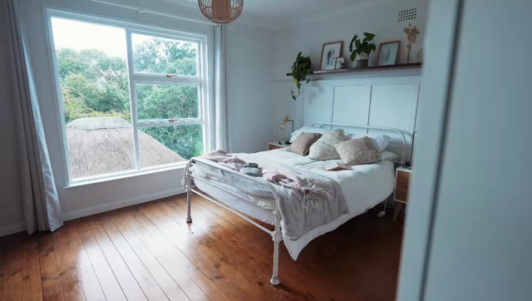
Potential solutions !
Our project Aims to create an easy-to-use Website to find and rent lodges, pg or apartments.
Target Users
Working Professionals
Bachelors

Slide 6
Advance filters for personalized choices
Availability of
No of vacant rooms and beds
In App messaging
Features of our website
Rating and review system
Secure payment gateway
Brokerage free deals and discounts
24/7 available at your service

Slide 7

Seamless stays – Your Lodge and hostel booking solution
More Reliable, Flexible & Efficient.
A rating and review system, and efficient in-app messaging for queries.
Feedback and Instant Booking or Rentals.

Slide 8
Future Scope
Expansion to more locations
We will include AI and ML for better user experience
We will enhance security measures

Slide 9

Thanks!

