Slide 1

Swami Keshvanand Institute of Technology, Management & Gramothan Ramnagaria, Jagatpura, Jaipur Department of Computer Science & Engineering Minor Project-Odd Semester (2022-23) Online Telephone & Newspaper Billing System
Project Members: Faculty Mentor: Lab Coordinator:
Rishi Singhal 19ESKCS800 Ms. Priyanka Bhardwaj Ms. Anjana Sangwan
Ronit Jain 19ESKCS809
Shobhit Jain 19ESKCS822

Slide 2
Content
Introduction
Purpose of Project
Existing System
Proposed System
Scope
Requirement Specification
Technology/Platform Used
System Architecture
Modules
UML Diagram
Database Tables
Integration and Testing
Output Screens
Conclusion
Benefits
References

Slide 3
Introduction
The Telephone & Newspaper Billing System will assist in managing the operations related to billings with more accuracy and efficiency.
Online billing systems are better replacements for the redundant manual billing systems which lacked efficacy in generating and managing telephone bills.
So for this, We are designing an online telephone & newspaper billing system project in HTML, CSS, JS/ReactJS, spring boot and MySQL, which consist of two main components i.e. admin and user.
Security measure will be adopted by maintaining the login of username and the password.
“Online Telephone & Newspaper Billing System ” is developed as per seeing the increasing requirement to speed up the work and incorporate a new work culture.

Slide 4
Purpose of Project
The purpose of the project is to present the requirement of the Computerization of Billing System.
The project calculates the telephone and newspaper bills automatically.
It does almost every work which is related to automatic telephone and newspaper billing connection system via- new connection , customer record modification, viewing customer records & all works related to rate of bills, meter readings in addition to bill calculation and bill generation.
Thus a new software has been proposed to reduce manual work, improving work efficiency, saving time and to provide greater flexibility and user-friendliness as the system previously followed was totally manual one with lots of errors.

Slide 5
Existing System
The existing system was a manual one. Whatever be the process involved in the system were done through register (files) . There were lots of complexities involved in the system. When any customer takes new connections then separate files were maintained.
Drawbacks of existing system:
• The existing system is totally manual thus there are chances of error in processing. • The basic and major drawbacks in the existing system are the speed of retrieval of data from files, which leads to delay. • Maintenance of data is very cumbersome and laborious job. • The manual jobs such as calculation are more error prone. • There are plenty of chances of duplicity of data and information. • Updating is very tedious job. • There is no central database from where one can get different statistical data at one place.

Slide 6
Proposed System
Information retrieval will become easy.
Maintenance of database as well as overall project will become easy.
Security measure will be adopted, by maintaining the login of username and the password.
It provide the user-friendliness in all possible ways and greater flexibility.
It reduces the delay in processing time and bill generation.

Slide 7
Scope
The project will save the time of customers by providing the facility of payment of their bill from anywhere and anytime.
It can also be used to save the time of organization by updating bill online .
There is no need to maintain files and registers.
By using this project there is less chance of errors and mistakes because there is less manually work in compare to existed system.
Bill payment reminder, forgot password, prepaid telecom plans, payment safety feature and many other advance features can be implemented using this project in future

Slide 8
Requirement Specification
System Interfaces Minimum Requirement : Client Side - Any open source OS Server Side - Any Windows based OS
User Interface
Minimum requirements : Processor - SSE3 Capable Intel Pentium 4 RAM - 4GB Disk Space - 10GB Recommended requirements : All Intel or AMD - 2.5GHz RAM - 8GB Disk Space - 5GB

Slide 9
Requirement Specification
Hardware Interfaces Minimum Requirements : Processor - x86-64bit CPU RAM - 4GB Disk Space - 5GB Recommended Requirements: Processor - All Intel or AMD - 2.5GHz RAM - 8GB Disk Space - 5GB
Software Interfaces Client on Intranet - User Interface, Windows OS Development end - Eclipse IDE, MySQL, Windows OS
Communications Interfaces Client (User) on Intranet will be using TCP/IP Protocol

Slide 10


Introduction Of Technology Used In Project
HTML: Hyper Text Markup Language
CSS: Cascading Style Sheets.
JavaScript: Programming language for web
Database Platform : MySQL
SpringBoot : An open source Java-based framework

Slide 11



Tools Used-
Ecllipse IDE 4.12
VS Code 1.71
Postman 9.21.2
Apache Tomcat (Internal) 9.0.60
Spring boot 2.6.6
MySQL Workbench 8.0 CE

Slide 12
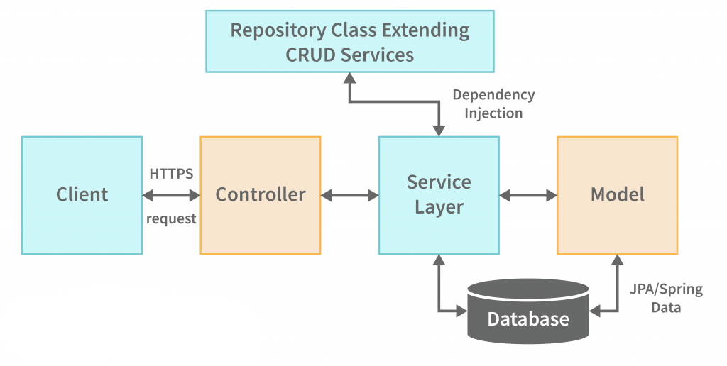
System Architecture

Slide 13
Modules

Slide 14
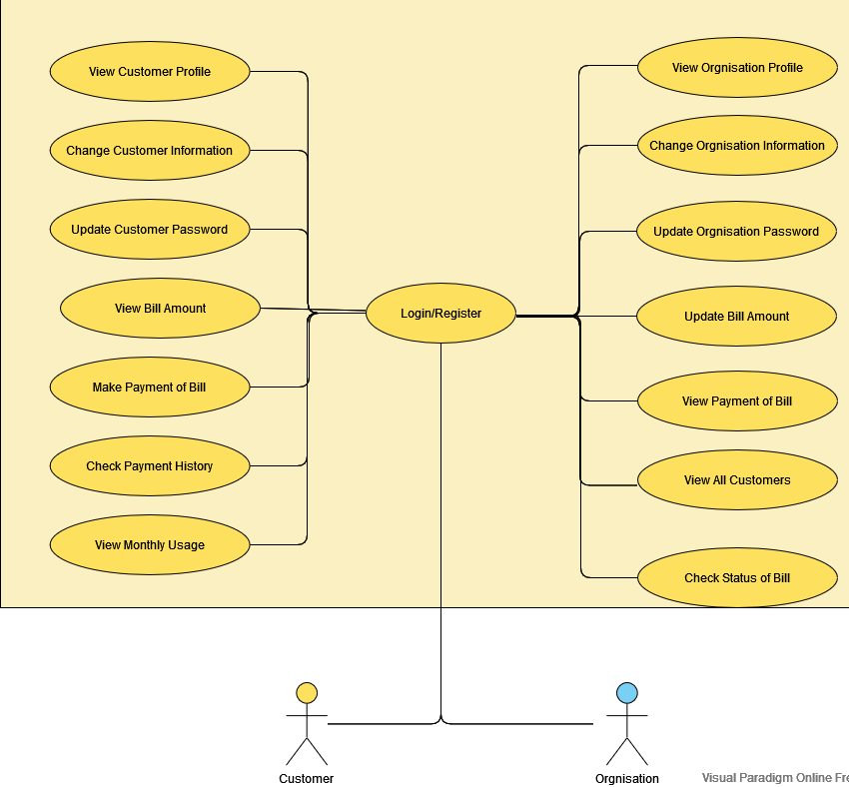
UML Diagram

Slide 15
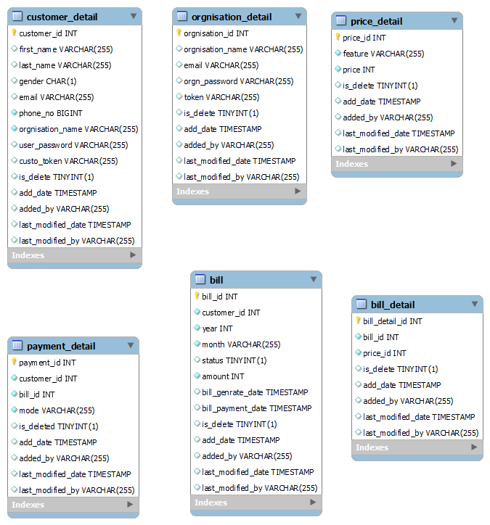
Database Tables

Slide 16
Integration and Testing

Slide 17
Output Screens

Slide 18
Conclusion
To overcome the drawbacks and complexities of the existing system, this Telephone and Newspaper Billing System Project in Java platform was proposed.
It eliminates the need of registers and files in many cases as the proposed system is fully computerized.
It is quick, user-friendly and accurate, and does not create complications in billing and management process .
After entering into the project, user is left with several options via –
a) The customer can easily register on the application.
b) The organization can view the existing lists of customers, which already have registered with that organization.
c) The customer can see the bills and bill details and check status of bills . It is a computerized system, which can be used very easily & effectively by organizations and customers of the telephone billing system.

Slide 19
Benefits

Slide 20
References
Object Oriented Modeling and Design with UML-Michael Blaha, James Rambaugh.
Software Engineering, Seventh Edition, Ian Sommerville.
Spring Boot Reference Document docs.spring.io
Java - www.sun.com
Wikipedia - www.wikipedia.com
Database Management Systems - Navathe.
Complete Reference - J2EE - Keogh.

