Slide 1
STORE SALES PREDICTION PROJECT
By Rishita Chouhan
DSFT-8

Slide 2
Table of Contents
01
03
05
02
04
06
Business Problem
Data Exploration
Model Evaluation
Project brief
Understanding features
Highlighting performance parameters used
Solution Agenda
Models Used
Conclusion
Outlining the project stages
All regression models used to predict sales
Optimal regression model and why

Slide 3
PROBLEM STATEMENT
The success of any retail store depends upon its sales.
In a fast paced market, it is imperative to understand trends such as fast or slow moving products, impact of store type, and more.
In order to strategize their business models, store owners rely heavily on past data to predict future sales, this is where the value of regression modeling can be utilized.
PROJECT
OBJECTIVE
Building a supervised learning regression model to predict the sales of the store.
PROJECT
GOALS
Making data-driven decisions towards realistic goals
Improving customer care services and retention schemes
Improved inventory management
Maximising profits in high sales areas
Applying discounts in low sales areas

Slide 4
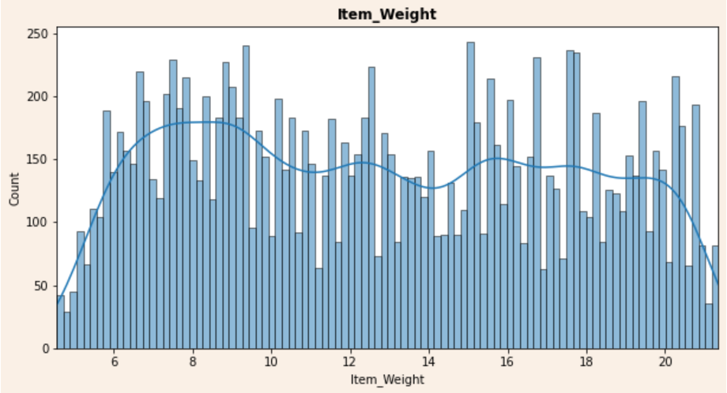
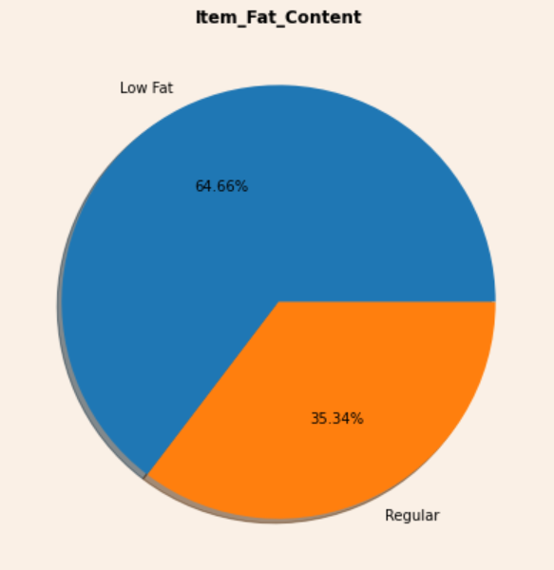
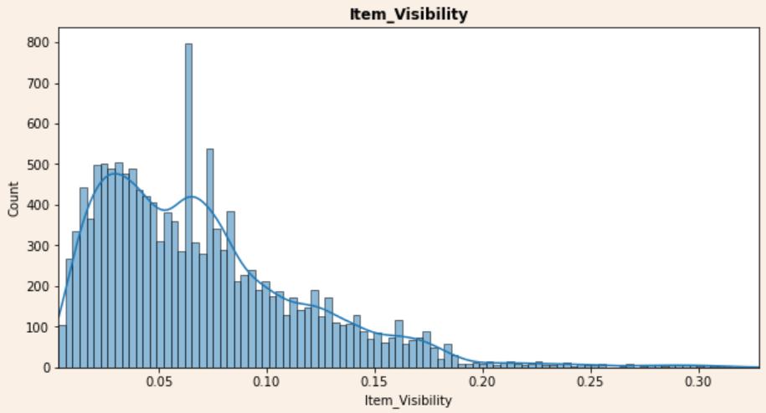
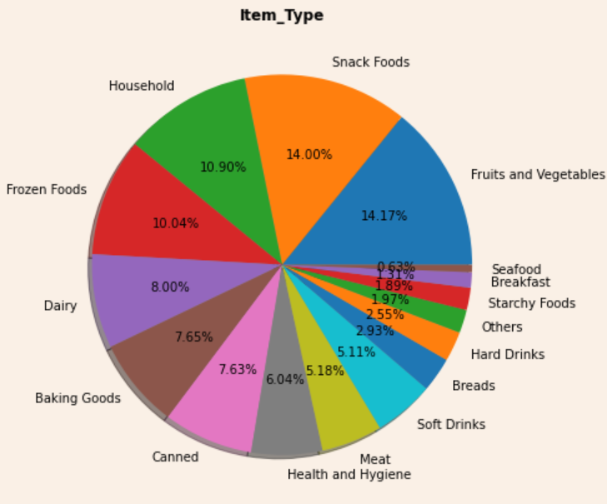
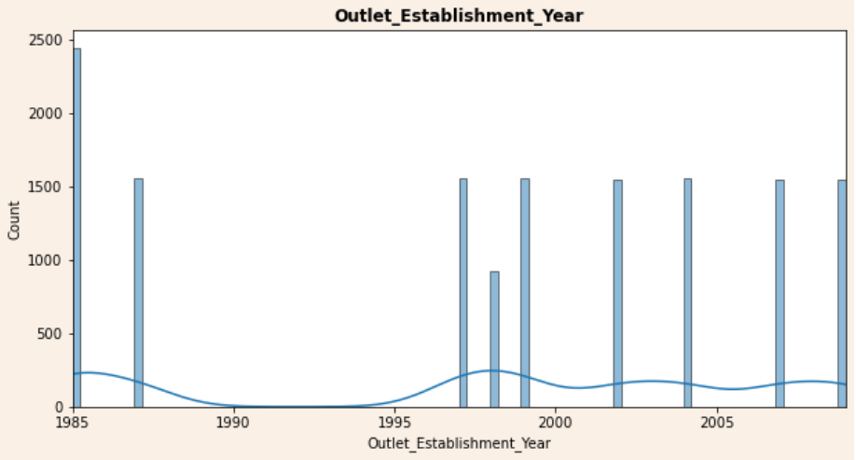
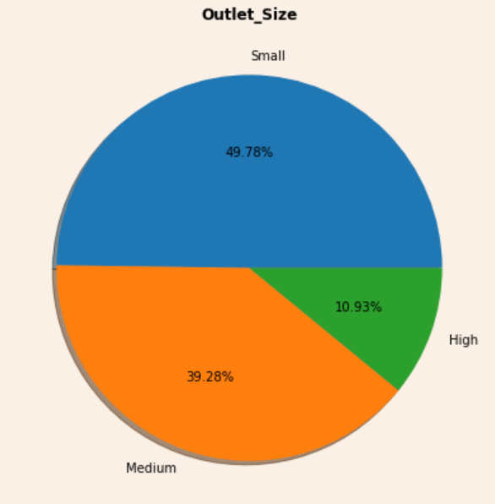
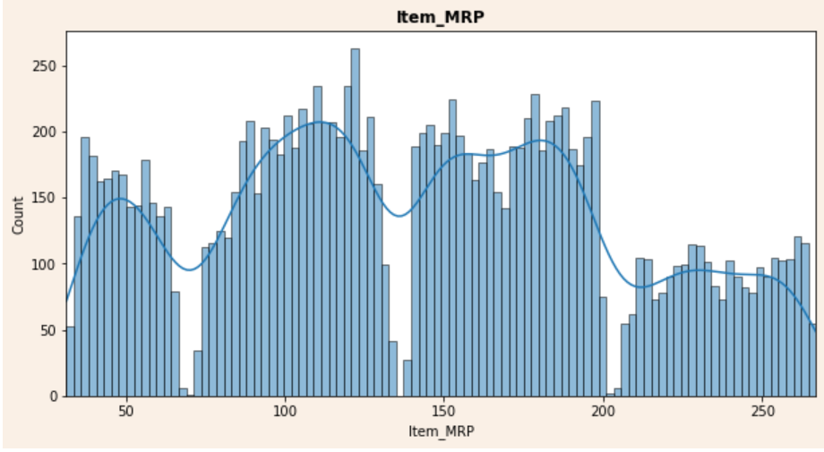
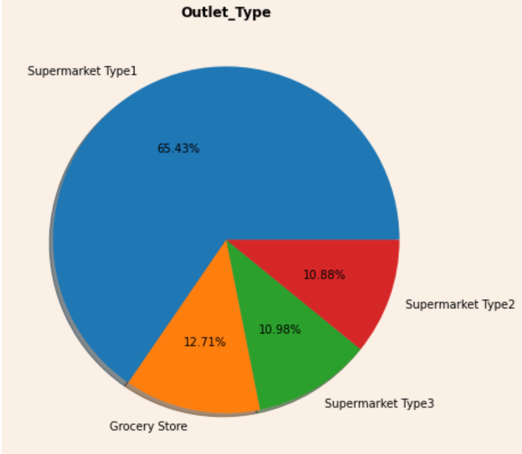
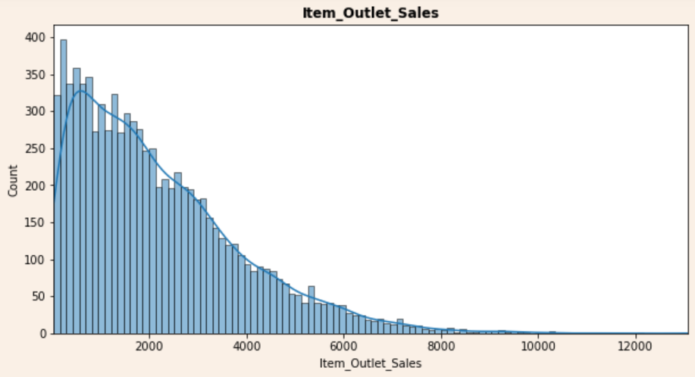
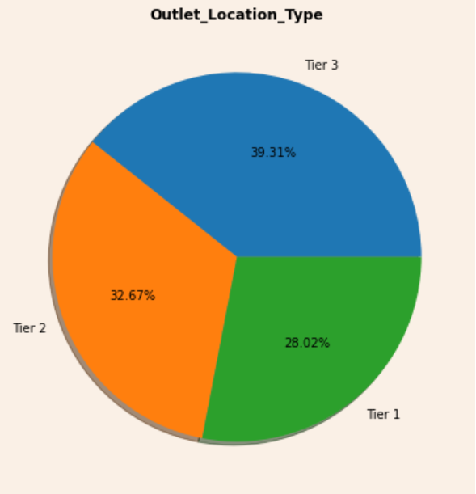
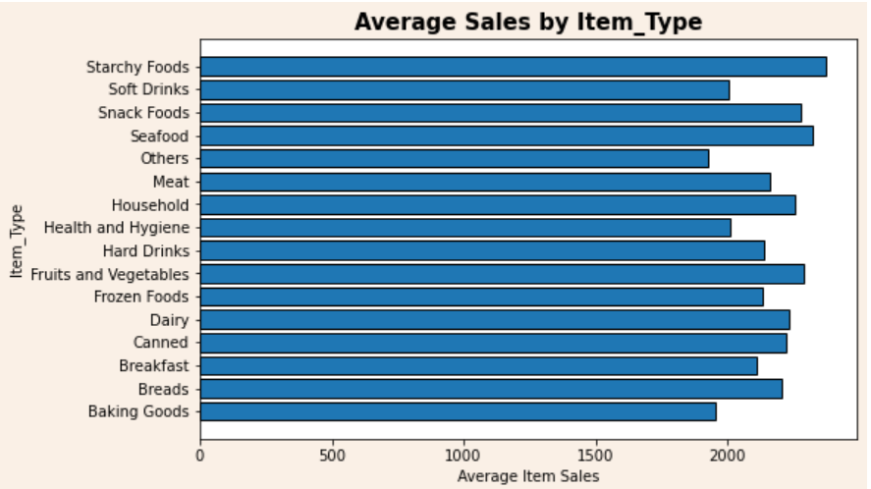
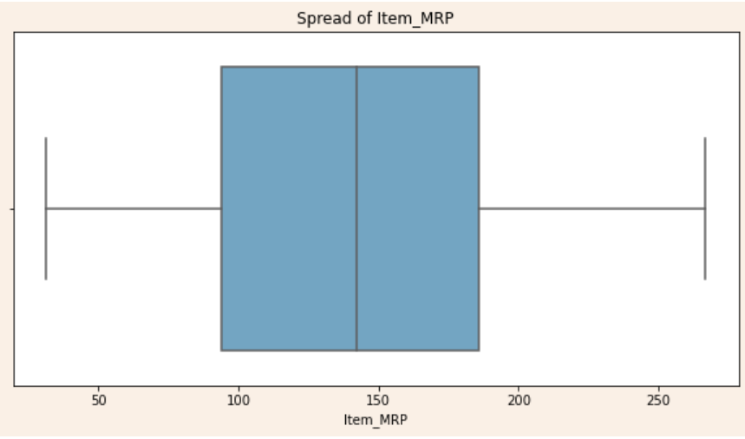
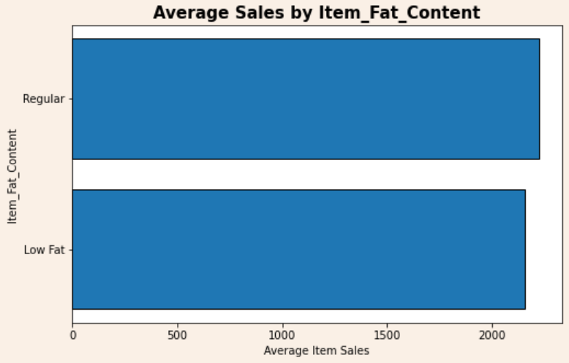
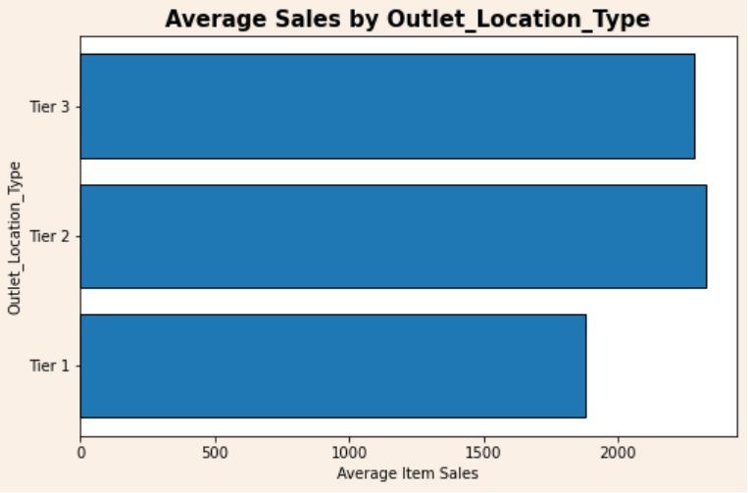
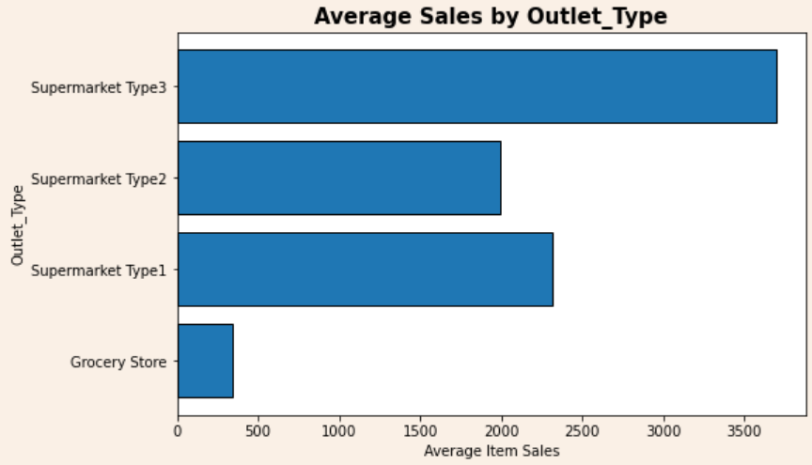
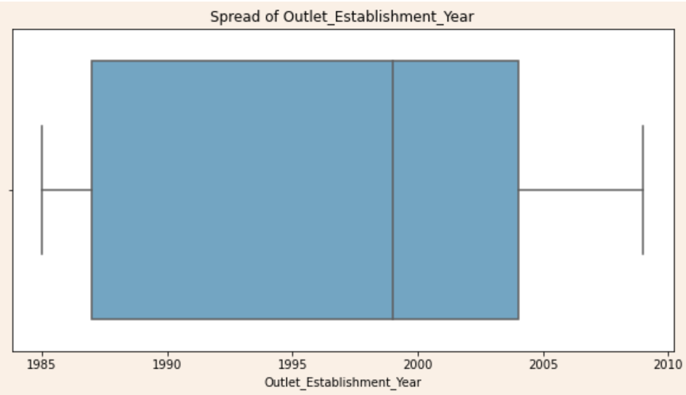
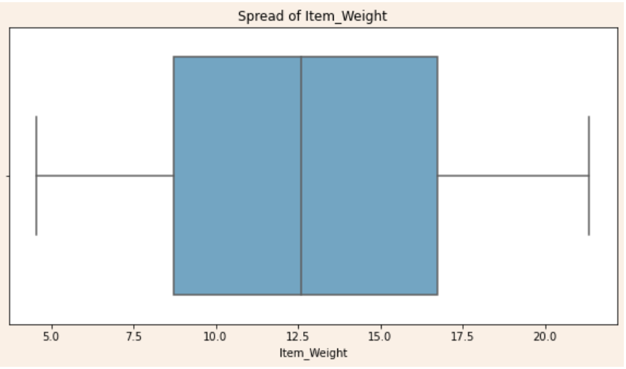
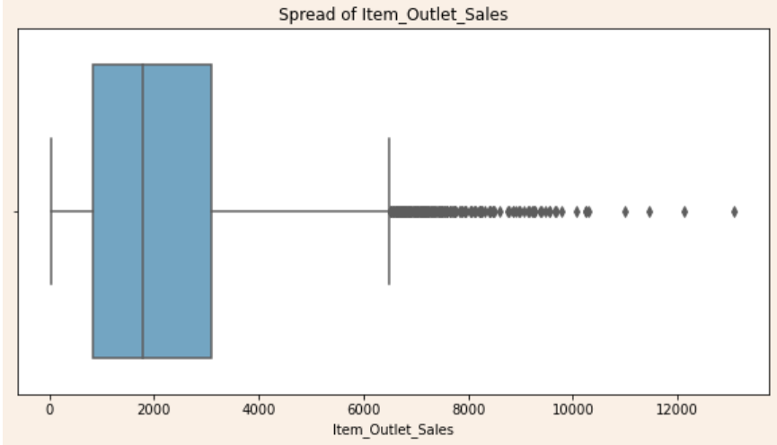
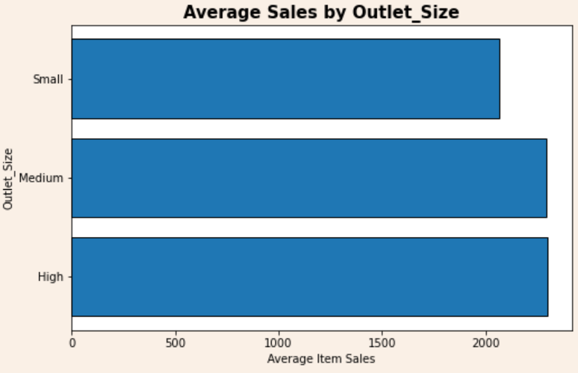
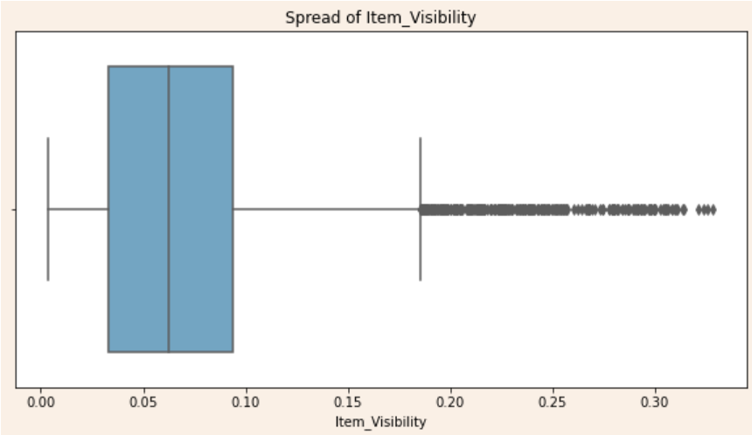
Data Features
Description: Weight of the product
Item weights are approximately evenly distributed across the feature range, while there is slightly higher density between 6 to 10.
Description: The year when the store was opened
The maximum number of outlets were established in 1985 (2439), while on average, 1500 outlets were established in other years.
Description: How visible is the product in the store
item_visibility is 0.07 on average and is right skewed implyng the existence of outliers
Description: Location type where the store is located Outlet locations are approximately evenly distributed, with the Tier 3 outlets having the greatest share in our dataset (39%). Items in Tier 1 areas contribute the least to sales.
Description: The store sales
On average, item sales are 2181. From the graphs, it is inferred that this feature is right skewed and contains outliers.
Description: Total fat content in the product
More than 60% of items are in the low fat category, while item sales are higher for items with regular fat content
Description: Product cost
Item MRP forms 4 high-density distributions, with an average MRP of 141. The data is also approximately normally distributed.
Description: The type of store Most outlets are of supermarket Type 1 (~65%). Supermarket Type 3 outlets contribute most to sales while grocery stores contribute the least.
.
Description: Store size type
Nearly 50% of all items sold in our dataset came from a small outlet, however these outlets contribute the least to item sales.
Description: Product category of the selected product
'Snack foods' and 'fruits and vegetable' item types have a higher share in our dataset, while item sales are highest for starchy Foods.
NUMERICAL
CATEGORICAL
Item_Weight
Item_Fat_Content
Item_Visibility
Item_Type
Item_MRP
Outlet_Size
Outlet_Establishment_Year
Outlet_Location_Type
Item_Outlet_Sales
Outlet_Type
About
14,204
Records
12
features
Business
Model
Type
Supervised learning Regressor
Target
Feature
Item_Outlet_Sales

Slide 5
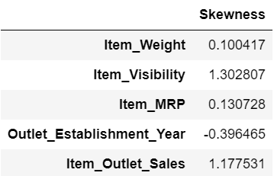
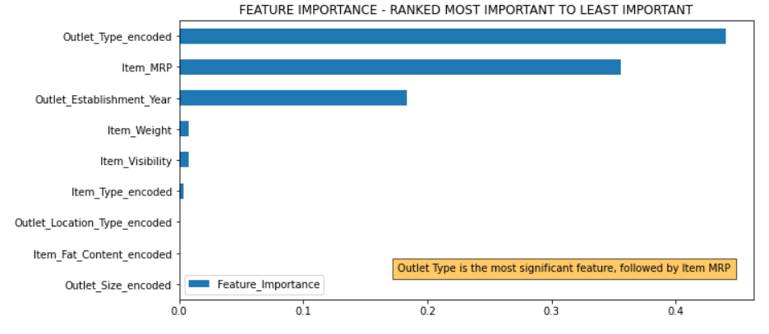
Data Preprocessing: Cleaning data to improve data quality and optimise modelling results
Key Insights
Check for duplicate records
Missing Value Treatment
Feature scaling
Check for Outliers
1. ‘Item_Outlet_Sales’ and ‘Item_Visibility’ contain outliers
2. 'Item_Identifier’ & 'Outlet_Identifier’ dropped due to irrelevancy.
3. All 5 categorical columns encoded.
4. Dataset contains no duplicated records.
5. All 5681 missing records in item sales, replaced by the mean of respective outlet types.
Partitioning Target and independent features
Feature encoding
Correlation heatmap for feature selection

Slide 6
Models Used We will evaluate the following regressors:
Linear Regression
Decision Tree Regressor
SVR
ENSEMBLE TECHNIQUES
Model pipeline Steps
i. Apply single step pipelines to tuned Regressors ii. Fit each pipeline with training data iii. Evaluate train accuracy of each model iv. Predict the test data for each model v. Evaluate the performance of test data using R-squared score, RMSE, MSE
AdaBoost
Regressor
Stacking
Regressor
XG Boost
Regressor
Radom Forest
Regressor

Slide 7
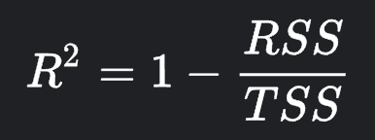
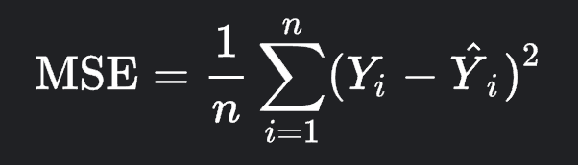

Evaluation Metrics Determining the model’s goodness of fit and prediction errors.
METRIC | DEFINITION | USE | GOOD MODEL | FORMULA
1. R-squared | Measures how well data fits the regression model | Compare train and test scores to check for overfitting | Higher R2 score is preferred. Train and test scores should be similar
2. Mean Squared Error | This cost function measures the squared sum of difference between actual and predicted values | Check how close predictions are to actual values | Lower MSE indicates better estimator.
3. Root Mean Squared Error | A popular measure of calculating error of predictions | Closeness of prediction conveyed in same units as target variable (not squared units) | Lower RMSE indicates better estimator.
√

Slide 8
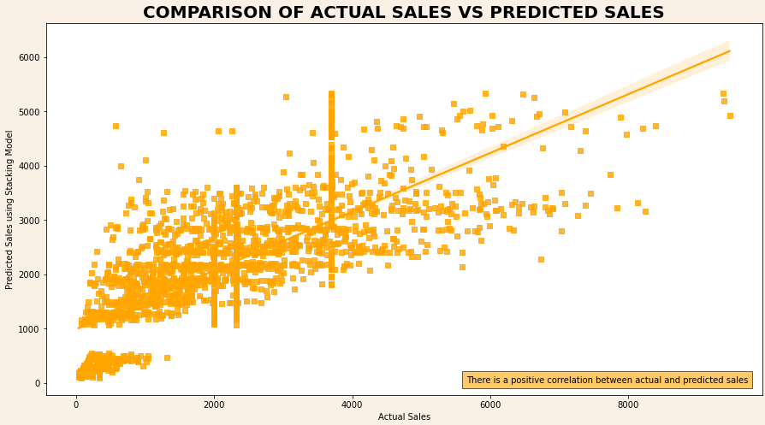
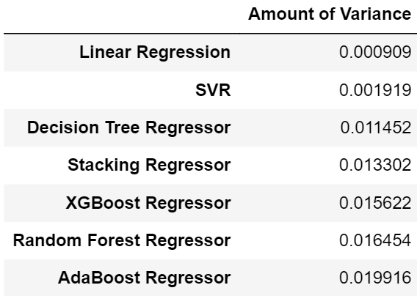
Model Comparison
Model with highest Accuracy
Model with lowest MSE
Estimator | Train Accuracy | Test Accuracy | MSE | RMSE
Linear Regression | 0.421 | 0.422 | 1146405.176 | 1070.703
Decision Tree Regressor | 0.533 | 0.522 | 949129.770 | 974.233
Random Forest Regressor | 0.544 | 0.528 | 936975.864 | 967.975
SVR | 0.111 | 0.113 | 1760938.707 | 1327.004
XGBoost | 0.540 | 0.525 | 943101.940 | 971.134
AdaBoost | 0.320 | 0.297 | 1394753.223 | 1180.997
Stacking | 0.542 | 0.529 | 934840.767 | 966.872
Stacking Regressor
Stacking Regressor
Model with Lowest Variance
Model with lowest RMSE
Linear Regression
Stacking Regressor

Slide 9
Conclusion – Technical Orientation From this in-depth analysis, I can conclude the following:
It is clear that the Support Vector Regressor is not a suitable model for our problem, as it is computationally costly and does not work well with mid to large datasets.
For a good performing model we want minimum MSE and RMSE, this is lowest in the Stacking regressor and closely followed by the random forest regressor.
In terms of highest r2 score, again we see that the stacking regressor has the highest score and random forest regressor is a very close second.
Since the difference between train and test scores is marginally lower in stacking regressor, it makes the stacking regressor slightly more reliable for predicting unseen data.

Slide 10
Business Conclusion
1.The Data Science team would obtain best results using the Stacking regressor model, available here.
2. The client should give highest importance to the following features in their stores, based on its influence on predicting sales:
Outlet Type: Outlet Items belonging to outlets of Supermarket Type 3 tend to generate highest sales.
Item MRP: Items that cost more produce higher sales
Outlet Size: Item sales are higher in medium and large outlets.
Outlet Location Type: Items in Tier 2 outlet locations generate more sales.
Based on the indicators provided above, the sales, marketing and project management team can formulate strategies to:
Create online visibility to help in outlet scaling in locations with higher demand via e-tail stores.
Improve inventory management across all outlets.
Increase discounts and promotions for stores with consistently higher sales.
Implement customer retention schemes in low-demand locations.

Slide 11
Thank you!
Have more questions?
Connect with me:
rishitachouhan@icloud.com

