Slide 1
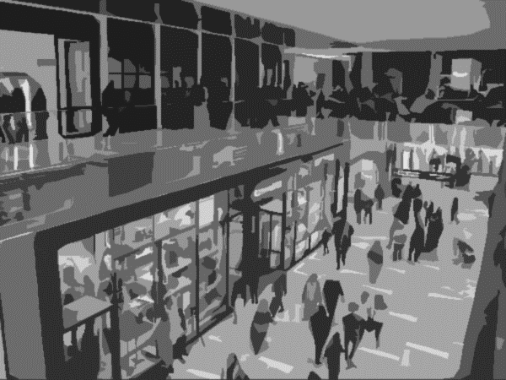
Mall Customer Segregation Project
Project by Rishita Chouhan
Notes:
Photo by power point stock photo

Slide 2
TABLE OF CONTENTS
1
2
3
4
5
Model Building& Evaluation
Business
Problem
Solution Agenda
Dataset
Exploration
Business
Conclusion
Project Brief
Project Objective
Project Goals
Highlighting ML Clustering models to tackle the problem
& Choosing the optimal model
Outlining the stages undertaken in this project
Key inferences tailored to client needs.
In-depth analysis of dataset features
2

Slide 3
PROJECT OVERVIEW
PROBLEM STATEMENT
Higher Customer Satisfaction & brand loyalty
Cost & Time Efficiency
Customer segmentation is the process of separating customers into groups based on certain traits or spending behaviors.
Why is clustering needed?
It creates a WIN-WIN situation for customers and stores.
Stores can identify the right customers for particular products, offers, and services– which is beneficial for customers. This translates into higher revenue and customer demand for stores.
To create & provide market opportunities
Effective Market Campaigning
PROJECT GOALS
PROJECT OBJECTIVE
To create Customer clusters to identify the different types of customers
This is achieved through unsupervised clustering algorithms in Machine Learning
Knowing customers better
Increase competitiveness & profit

Slide 4

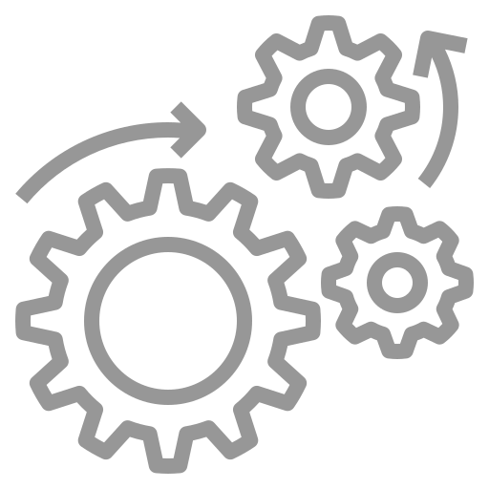
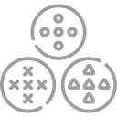

SOLUTION AGENDA
Data Exploration & Analysis
Including profile report generation, univariate and bivariate
analysis
Data Preprocessing
Missing Value Treatment, feature encoding, data scaling, correlation heatmap
Model Building – Single & Multiple Features Considered
Clustering algorithms used: KMeans, Hierarchical, DBSCAN Clustering
Model Prediction App
Predicting the segment a customer falls in, based on their customerID, age, gender, annual income (k$) and spending score.

Slide 5
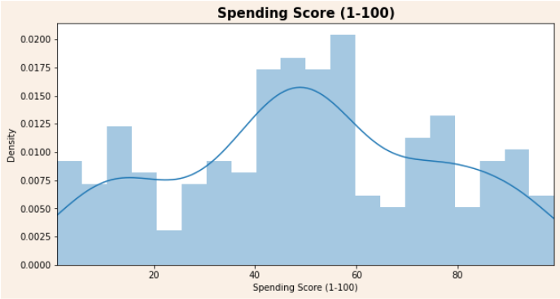
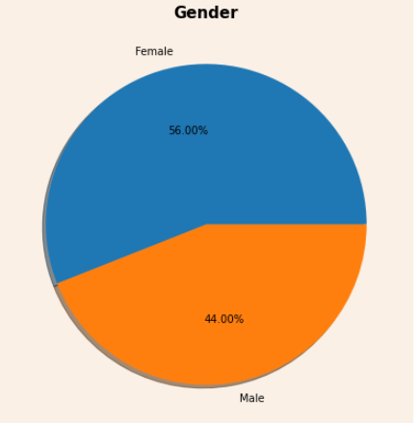
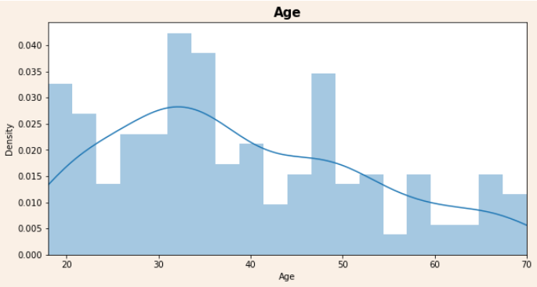
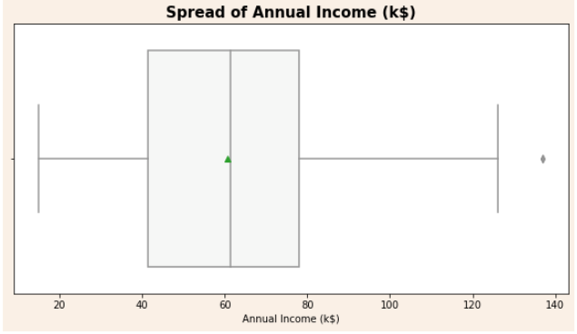
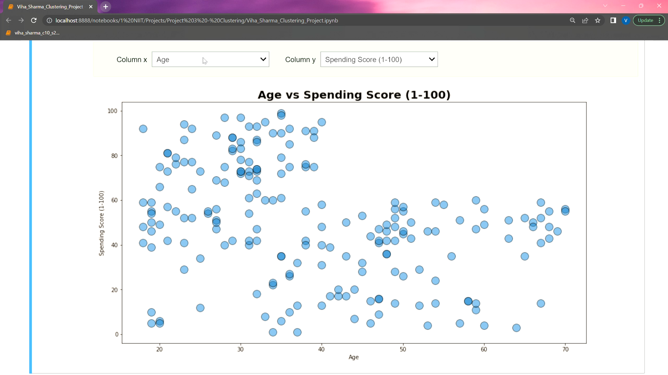
EXPLORATORY DATA ANALYSIS
1. Age : Age of the customer There is a high number of customers between the age of 25 to 40 years. This data is right skewed, implying a possibility of outliers
200
Records
5 Features
(1 categorical)
Important Feature
Spending Score (1-100)
Business Model
Clustering Algorithm
2. Gender : Gender of the customer More than half the customers are female.
3. Annual Income (k$) : Annual income of the customer (in thousands) Ranges from $ 26k to 137k, with customers earning $60k on average. There is one outlier in this feature.
4. Spending Score (1-100) : Score given to customers by mall authorities based on purchasing activities & behavior There is a higher number of customers who have a score between 30 to 70.

Slide 6


CUSTOMER SEGMENTATION
Will not overspend if income is low.
Persons with low annual income (k$) and la ow spending score.
Sensible Customers
Tends to overspend despite not having the income to support it .
Persons with low annual income (k$) and a high spending score.
Careless Customers
Will aim to spend the least at the mall despite having higher income.
Persons with high annual income (k$) and a low spending score.
Parsimonious Customers
Will not overspend or underspend.
Customers with an average income and average spending score.
Standard Customers
This customer has the income to support their heavy spending.
Customers with high income and high spending score.
Target Customers

Slide 7
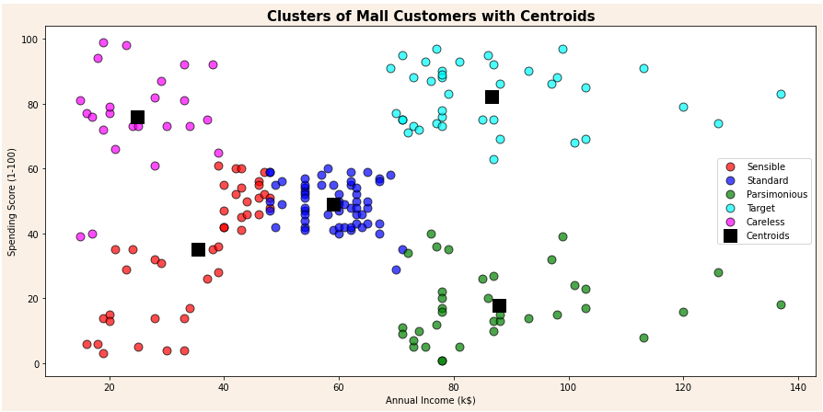
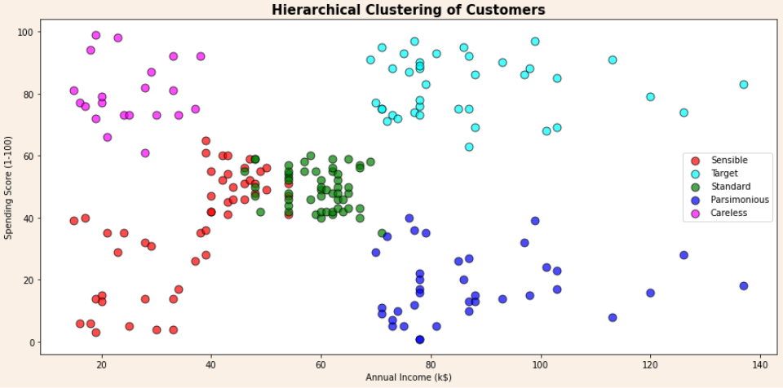
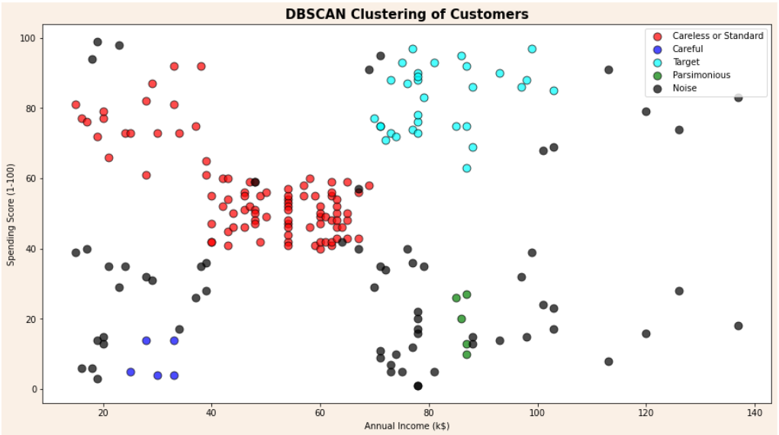
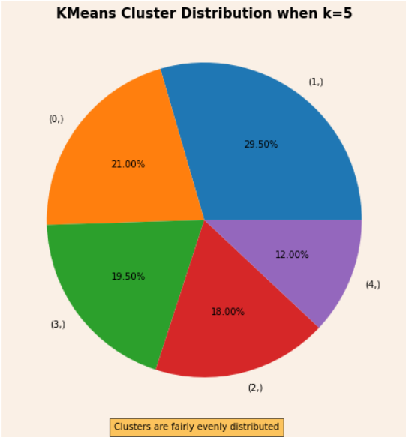
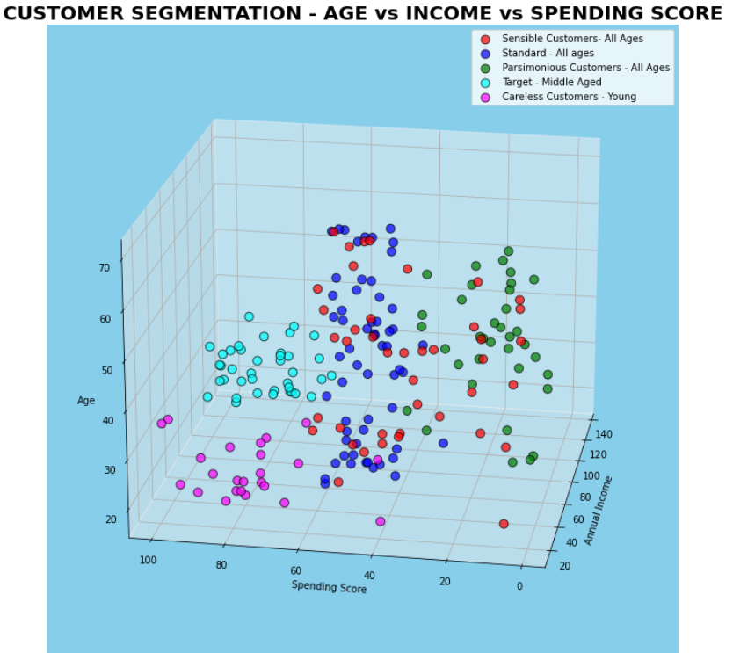
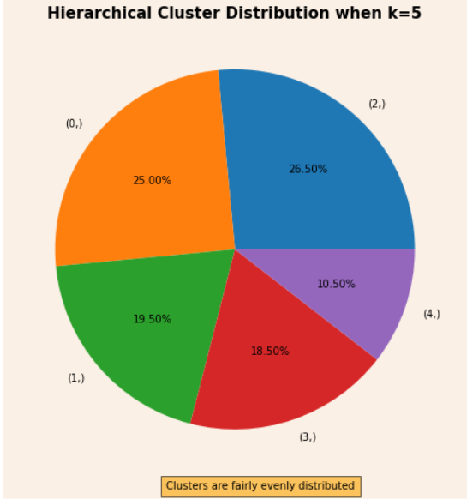
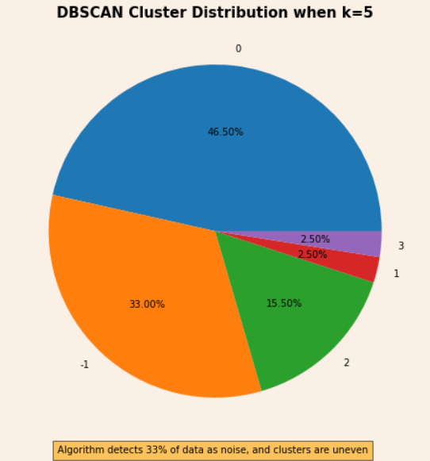
CLUSTERING TECHNIQUES USED
All columns
(Entire dataset fit for clustering)
K = 5
Silhouette Score = 0.43
Diving data into clusters using down to top approach along with dendrogram graph.
Partitioning data into non-hierarchical groups using centroid-based method.
Connects highly-dense areas into clusters based on minimum samples and epsilon-neighborhood distance. Able to handle outliers (noise).
KMeans Clustering
Agglomerative Clustering
DBSCAN Clustering
As DBSCAN can detect outliers, it leads to messy and improper clustering. Thus it is not a good model to forecast sales.
Notes:
Photo by power point stock photo

Slide 8
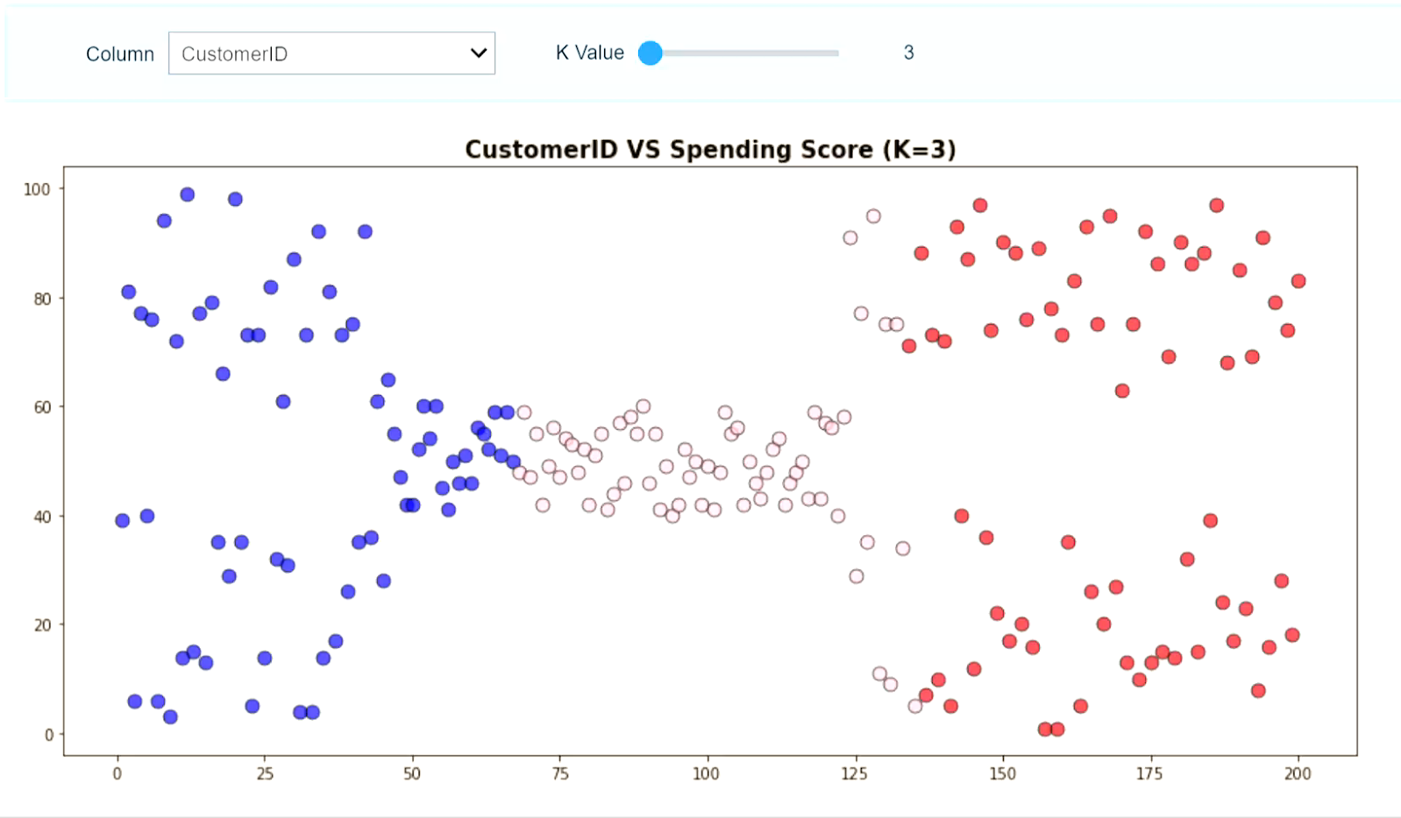
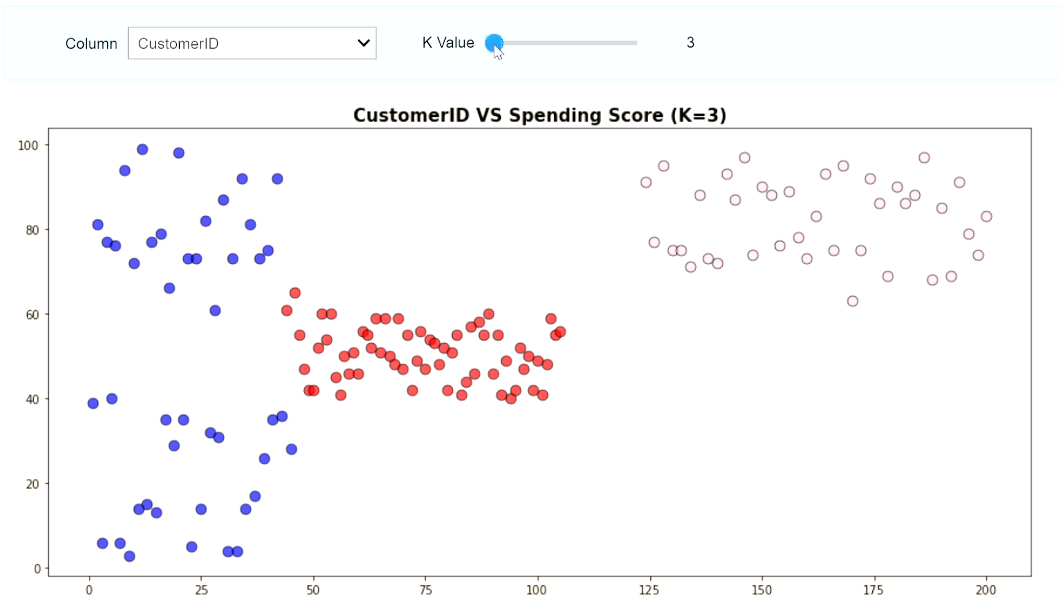
CLUSTERING TECHNIQUES USED
Specific columns fit for clustering
Kmeans Clustering
Agglomerative Clustering
In terms of CustomerID, Kmeans has better clusters.
In terms of annual income, both algorithms can detect the clusters fairly well.
We will use the Kmeans model to make predictions of the segment a customer belongs to.
Notes:
Photo by power point stock photo

Slide 9
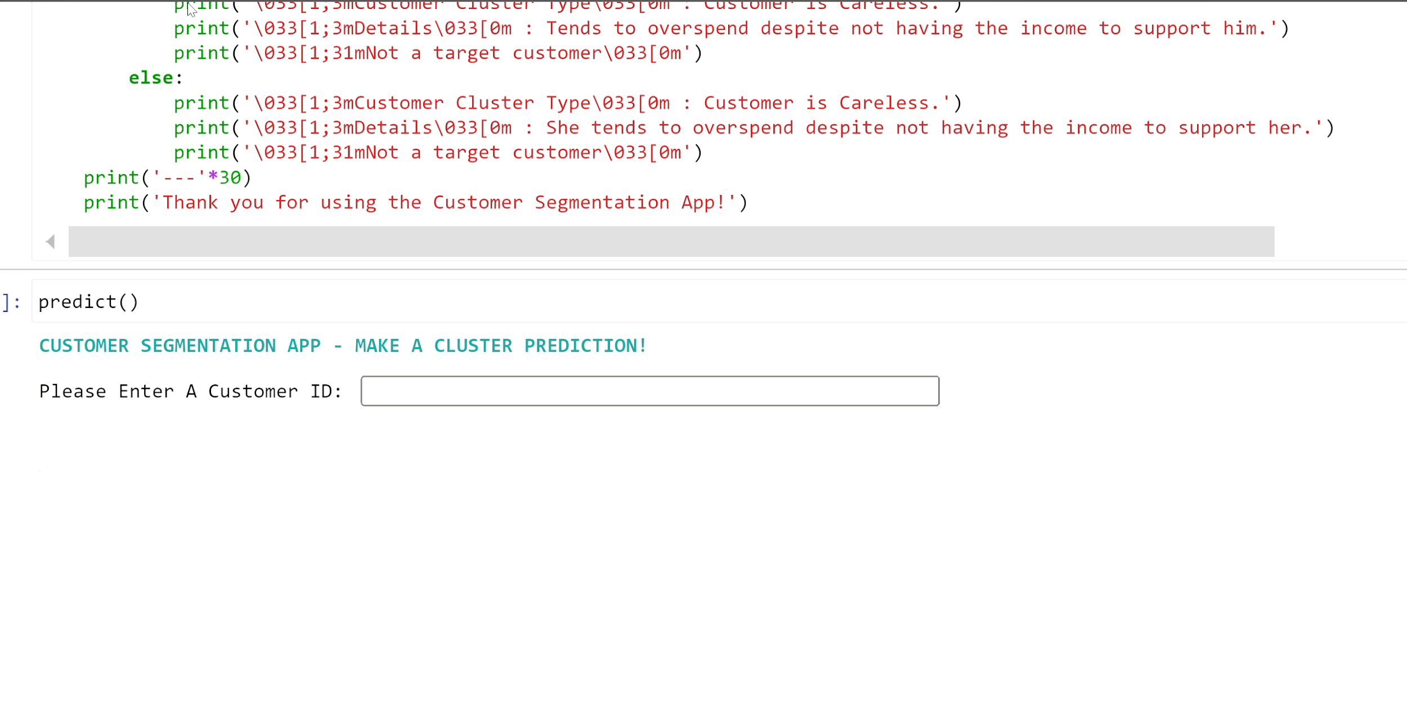
CUSTOMER SEGMENTATION APP
How it works
This automated Customer segmenting process uses KMeans clustering.
The user can enter details of the customer such as:
Customer ID (1-200)
Gender(Male=1,Female=0)
Age (18 to 70 years)
Annual Income ($26k -$137k)
Spending Score (1-100)
After this, the algorithm returns the personalized segment report for that customer.

Slide 10
BUSINESS INSIGHTS
Target Customer Features
Middle to old age customers
High spending score
High annual income
Clustering has allowed us to segregate footfall in the mall into sensible, careless, standard, parsimonious and target customers.
It must be noted that younger customers are more likely to overspend and thus, will not translate into long-term customers for the store. However, they can be attracted for short term gains using season-end discounts and offers.
The Mall management should focus on target employees to increase their profit and also better cater to their most valued customers, converting them into long term buyers.
Furthermore, the stores can strategize schemes and promo codes to attract customers with low spending scores.

Slide 11
Thank You
Have more questions?
Reach out to me:
rishitachouhan@icloud.com
RRR
R
R
Notes:
Photo by Alvaro Reyes on Unsplash

