Slide 1
CASE STUDY
How Does a Bike-Share Navigate Speedy Success?

Slide 2
Problem Statement
In this case study, I am assuming the position of ‘Jr. Data Analyst’ at Cyclistic, a bike-share company based in Chicago. Cyclistic offers over 6000 bikes at 800+ docking stations spread around Chicago. At the moment they offer classic bikes and electric bikes for use and they have two customer segments: Casuals and Members.
The finance department at Cyclistic has determined that Members are the more profitable customer segment and have tasked the marketing department with creating a campaign aimed at converting Casuals to Annual Members. To help them complete this business task, the marketing team has assigned me with answering the following question “How do annual members and casual riders use Cyclistic bikes differently?”
To answer this question I will be analyzing historical Cyclistic bike trip data for all 12 months in 2021

Slide 3
MY APPROACH
To combine the data for 12 months I used SQL on Google’s BigQuery platform, by using the concept of nested query and UNION ALL clause.
The primary key here is ride_id.
For cleaning the data I majorly removed trips where end or start station was null.
Removed cells having latitude or longitude as null.
Removed leading and trailing spaces by using TRIM.

Slide 4
Now, before analysing the data in Tableau I calculated certain terms such as :
Type of ride
Rides per month
Rides per day
Rides per hour
Average length of ride per day …. and other parameters.

Slide 5
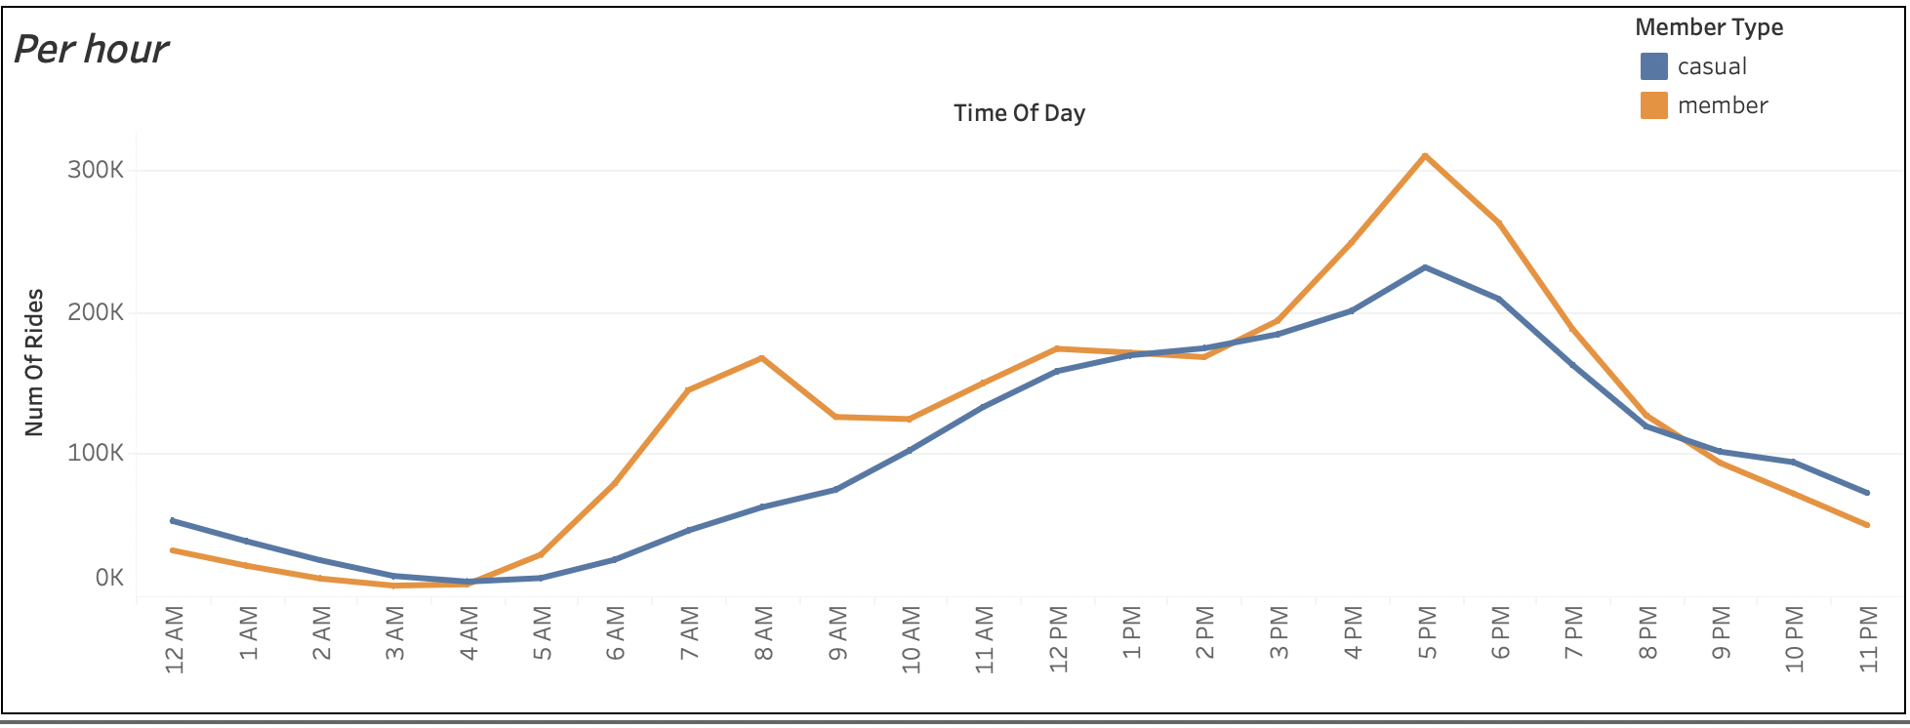

Slide 6
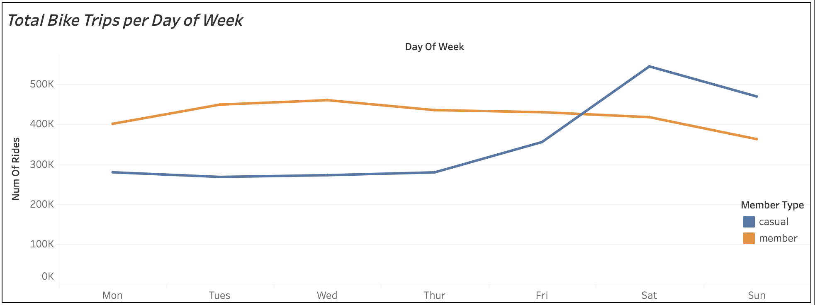

Slide 7
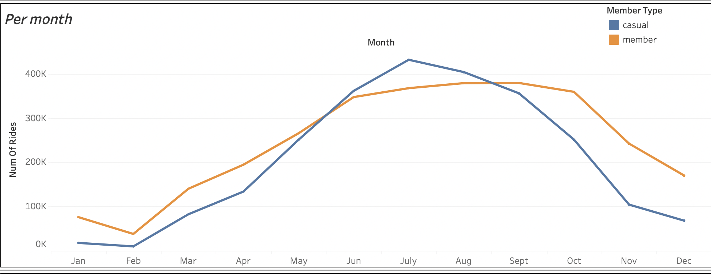

Slide 8
INFERENCES
Casual Member Trends:
Prefer riding bikes from late spring to the end of summer.
Avoid biking during winter months (Jan/Feb) due to weather conditions.
Annual Member Trends:
Favor spring/summer months for riding, with consistent ridership throughout the year.
Peak ridership between 6am-8am and 4pm-6pm, dropping after 7pm.
Annual Members' Usage Patterns:
Peak ridership during typical work commute hours (8am/5pm).
Sustained ridership levels outside work hours suggest commuting use.
Less pronounced drop in winter months compared to casual members.
Casual Members' Usage Patterns:
Even ridership distribution during the day, no sharp spikes.
Hypothesis: Casual members likely use bikes for leisure rather than commuting.
Weekday vs. Weekend Comparison:
Annual member ridership remains steady over the workweek and drops slightly on weekends.
Casual ridership is lower during the week and significantly rises during the weekend.

Slide 9
Conclusion
In summary, casual members tend to enjoy seasonal rides from late spring to summer, while annual members show consistent commuting patterns, riding during peak hours and even in colder months, indicating utilitarian usage. These insights can guide targeted strategies for enhancing user experiences and services.
SKILLS USED IN SOLVING THE PROBLEM :
Structured query language
Tableau
Excel/google sheets
Keynote

