Slide 1
OBE Implementation
Module-5: Department
Submitted By : TEAM ARKA
ch.Harini(AP23110011191)
G.Hema Sri(AP23110011197)
K.Rishita(AP23110011202)
SK.Shabana Sultana(AP23110011204)
Kalyan Ram(AP23110011184)
Eswar(AP23110011187)
CSE | 3rd Semester | Regulation

Slide 2
Introduction to Project
Our Department Management System is a C program designed to manage departmental data within an educational institution. It allows users to create, view, update, delete, and search department records, with data stored in a file for persistence. The program supports sorting by department code, name, or email, using insertion and selection sort algorithms, and provides both linear and binary search functionalities. A menu-driven interface makes it easy to perform these operations, showcasing essential concepts in file handling and algorithm comparisons.

Slide 3
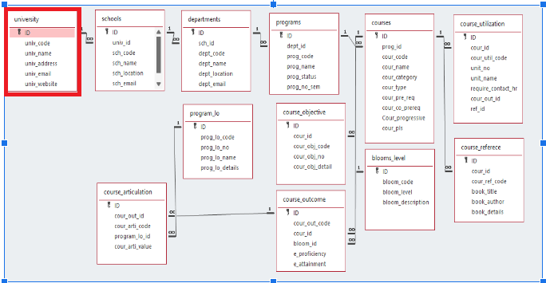
Architecture Diagram

Slide 4
Module Description : Department
The Department Management System is a C program for efficiently handling department records. Key modules include creating, updating, retrieving, and deleting records, with data stored in files for persistence. Sorting and searching modules optimize access to information, and complexity analysis highlights the efficiency of operations. This system provides a structured way to manage department data in educational or organizational settings.

Slide 5
Department Setting:Field/table details
Field Name | Data type
id | integer
sch_id | integer
dept_code | String
dept_name | String
dept_location | String
dept_email | String

Slide 6
Department:Programming Details
File name:arka_department
Function/method name
Create:arka_department_create
Update:arka_department_update
Retrieve:arka_department_retrive
Delete:arka_department_delete
Sorting:arka_department_insertion_sorting(int sort_option)
Searching:arka_department_linear_searching
Storing:arka_department_storing

Slide 7
Department :Programming Details
Comparison(both searching and Sorting):
For
Searching-arka_department_Compare_Search_algorithm_linear
For
Sorting-arka_department_Compare_sorting_algorithm_insertion
Time Complexity(both searching and Sorting):
For Searching-arka_department_complexity_Searching
For Sorting-arka_department_compexity_sorting

Slide 8
Department:Programming Details
Algorithm Details(pseudocode or steps)(both searching and Sorting):
For Searching-arka_department_linear_search_details
For Sorting-arka_department_insertion_sorting_details
File name(for storing the details)
File name to be used is:-department_data.txt

Slide 9
Department : Sorting Algorithm used
Sorting Algorithm Name: Insertion Sort
Algorithm:
Step 1:Initialize: Start a loop with i from 1 to department_count - 1.
Set Current Element.
Set current to departments[i].
Initialize j to i - 1.
Step 2:Shift Elements:
While j >= 0 and departments[j].dept_code is greater than current.dept_code:
Shift departments[j] to the right by setting departments[j + 1] = departments[j].
Decrement j by 1 to continue comparing with previous elements.
Step 3:Place Current Element:
Place current at the correct position by setting departments[j + 1] = current.
Step 4:Repeat: Continue steps 2 to 4 for each element until the end of the array.
Step 5:Result: The department’s array is now sorted by dept_code in ascending order.

Slide 10
Department : Comparison of Sorting Algorithm
Sorting Algorithm Name: Selection Sort
Algorithm:
Step 1:Initialize Outer Loop:
For each i from 0 to department_count - 2, do the following:
Step 2: Set Minimum Index:
Set min_index to i (assuming the current position has the smallest
dept_code initially).
Step 3: Inner Loop to Find Minimum:
For each j from i + 1 to department_count - 1:
If departments[j].dept_code is less than departments
[min_index].dept_code, update min_index to j (indicating a new minimum).
Step 4: Swap if Necessary:
If min_index is not equal to i, swap departments[i] and
departments[min_index] to place the minimum element in its sorted position.
Step 5: Repeat:
Repeat steps 2 to 4 for each i until department_count - 2.
Step 6: Result:
The departments array is now sorted by dept_code in ascending order.

Slide 11
Department : Time Complexity of Sorting Algorithm
Algorithm Name | Time Complexity | Compared Algorithm | Time Complexity
Insertion Sort | Best Case : O(n) Average Case : O(n^2) Worst Case : O(n^2) | Selection Sort | Best Case : O(n^2) Average Case : O(n^2) Worst Case : O(n^2)

Slide 12
Department : Searching Algorithm used
Algorithm Name: Linear Search
Algorithm:
Step 1: For each department in the departments array:
If department.dept_code matches search_code:
Print the department details.
Return "Department Found."
Step 2: If the end of the departments array is reached without finding a match:
Print "Department not found."

Slide 13
Department: Comparison of Searching Algorithm
Algorithm Name: Binary Search
Algorithm:
Step 1: Initialize left to 0 and right to department_count - 1.
Step 2. While left is less than or equal to right:
a. Set middle to (left + right) / 2.
b. If departments[middle].dept_code matches search_code:
- Print the department details.
- Return "Department Found."
c. If departments[middle].dept_code is less than search_code:
- Set left to middle + 1.
d. Else (if departments[middle].dept_code is greater than search_code):
- Set right to middle - 1.
Step 3. If no match is found after exiting the loop:
- Print "Department not found."

Slide 14
Department: Time Complexity of Searching Algorithm
Algorithm Name | Time Complexity | Compared Algorithm | Time Complexity
Linear Search | Best Case : O(1) Average Case : O(n) Worst Case : O(n) | Binary Search | Best Case : O(1) Average Case : O(log n) Worst Case : O(log n)

Slide 15
Sample Source Code
#include <stdio.h>
#include <stdlib.h>
#include <string.h>
#define MAX 100
typedef struct {
int id;
int school_id;
char dept_code[10];
char dept_name[50];
char dept_location[50];
char dept_email[50];
} Department;
Department departments[MAX];
int department_count = 0;
const char* FILE_NAME = "department_data.txt";
// Function declarations
void arka_department_create();
void arka_department_update();
void arka_department_retrieve();
void arka_department_delete();
void arka_department_storing();
void arka_department_insertion_sorting(int sort_option);
void arka_department_linear_searching();
void arka_department_Compare_Search_algorithm_linear();
void arka_department_Compare_Sorting_algorithm_insertion(int sort_option);
void arka_department_complexity_searching();
void arka_department_complexity_sorting();
void arka_department_linear_search_details();
void arka_department_insertion_sorting_details();

Slide 16
void load_from_file() {
FILE *file = fopen(FILE_NAME, "r");
if (file == NULL) {
return; // No file exists yet, no data to load
}
department_count = 0;
while (fscanf(file, "%d %d %s %s %s %s\n",
&departments[department_count].id,
&departments[department_count].school_id,
departments[department_count].dept_code,
departments[department_count].dept_name,
departments[department_count].dept_location,
departments[department_count].dept_email) != EOF) {
department_count++;
}
fclose(file);
}
void arka_department_storing() {
FILE *file = fopen(FILE_NAME, "w");
if (file == NULL) {
printf("Error opening file for writing!\n");
return;
}
for (int i = 0; i < department_count; i++) {
fprintf(file, "%d %d %s %s %s %s\n", departments[i].id, departments[i].school_id,
departments[i].dept_code, departments[i].dept_name,
departments[i].dept_location, departments[i].dept_email);
}
fclose(file);
}

Slide 17
void arka_department_create() {
if (department_count >= MAX) {
printf("Department list is full!\n");
return;
}
Department d;
printf("Enter Department ID: ");
scanf("%d", &d.id);
printf("Enter School ID: ");
scanf("%d", &d.school_id);
printf("Enter Department Code: ");
scanf("%s", d.dept_code);
printf("Enter Department Name: ");
scanf("%s", d.dept_name);
printf("Enter Department Location: ");
scanf("%s", d.dept_location);
printf("Enter Department Email: ");
scanf("%s", d.dept_email);
departments[department_count++] = d;
arka_department_storing();
printf("Department created successfully!\n");
}
void arka_department_update() {
int id;
printf("Enter Department ID to update: ");
scanf("%d", &id);

Slide 18
for (int i = 0; i < department_count; i++) {
if (departments[i].id == id) {
printf("Enter new School ID: ");
scanf("%d", &departments[i].school_id);
printf("Enter new Department Code: ");
scanf("%s", departments[i].dept_code);
printf("Enter new Department Name: ");
scanf("%s", departments[i].dept_name);
printf("Enter new Department Location: ");
scanf("%s", departments[i].dept_location);
printf("Enter new Department Email: ");
scanf("%s", departments[i].dept_email);
arka_department_storing();
printf("Department updated successfully!\n");
return;
}
}
printf("Department with ID %d not found.\n", id);
}
void arka_department_retrieve() {
printf("\nList of Departments:\n");
for (int i = 0; i < department_count; i++) {
printf("ID: %d\nSchool ID: %d\nCode: %s\nName: %s\nLocation: %s\nEmail: %s\n\n",
departments[i].id, departments[i].school_id,
departments[i].dept_code, departments[i].dept_name,
departments[i].dept_location, departments[i].dept_email);
}
}
void arka_department_delete() {
int id;
printf("Enter Department ID to delete: ");
scanf("%d", &id);

Slide 19
for (int i = 0; i < department_count; i++) {
if (departments[i].id == id) {
for (int j = i; j < department_count - 1; j++) {
departments[j] = departments[j + 1];
}
department_count--;
arka_department_storing();
printf("Department deleted successfully!\n");
return;
}
}
printf("Department with ID %d not found.\n", id);
}
void arka_department_linear_searching() {
int option;
char search_term[50];
printf("Search by:\n1. Department Code\n2. Department Name\nEnter choice: ");
scanf("%d", &option);
switch (option) {
case 1:
printf("Enter Department Code to search: ");
scanf("%s", search_term);
for (int i = 0; i < department_count; i++) {
if (strcmp(departments[i].dept_code, search_term) == 0) {
printf("\nDepartment Found:\n");
printf("ID: %d\n", departments[i].id);
printf("School ID: %d\n", departments[i].school_id);
printf("Code: %s\n", departments[i].dept_code);
printf("Name: %s\n", departments[i].dept_name);
printf("Location: %s\n", departments[i].dept_location);
printf("Email: %s\n\n", departments[i].dept_email);
return;
}

Slide 20
}
printf("Department with code '%s' not found.\n", search_term);
break;
case 2:
printf("Enter Department Name to search: ");
scanf("%s", search_term);
for (int i = 0; i < department_count; i++) {
if (strcmp(departments[i].dept_name, search_term) == 0) {
printf("\nDepartment Found:\n");
printf("ID: %d\n", departments[i].id);
printf("School ID: %d\n", departments[i].school_id);
printf("Code: %s\n", departments[i].dept_code);
printf("Name: %s\n", departments[i].dept_name);
printf("Location: %s\n", departments[i].dept_location);
printf("Email: %s\n\n", departments[i].dept_email);
return;
}
}
printf("Department with name '%s' not found.\n", search_term);
break;
default:
printf("Invalid search option!\n");
}
}

Slide 21
void arka_department_insertion_sorting(int sort_option) {
for (int i = 1; i < department_count; i++) {
Department key = departments[i];
int j = i - 1;
while (j >= 0) {
int compare = 0;
switch (sort_option) {
case 1:
compare = strcmp(departments[j].dept_code, key.dept_code);
break;
case 2:
compare = strcmp(departments[j].dept_name, key.dept_name);
break;
case 3:
compare = strcmp(departments[j].dept_email, key.dept_email);
break;
}
if (compare > 0) {
departments[j + 1] = departments[j];
j--;
} else {
break;
}
}
departments[j + 1] = key;
}

Slide 22
printf("Departments sorted!\n");
arka_department_retrieve();
}
void arka_department_Compare_Search_algorithm_linear() {
for (int i = 1; i < department_count; i++) {
Department key = departments[i];
int j = i - 1;
while (j >= 0) {
int compare = 0;
compare = strcmp(departments[j].dept_code, key.dept_code);
if (compare > 0) {
departments[j + 1] = departments[j];
j--;
} else {
break;
}
}
departments[j + 1] = key;
}
char search_code[10];
printf("Enter Department Code to search: ");
scanf("%s", search_code);

Slide 23
int left = 0, right = department_count - 1;
while (left <= right) {
int mid = left + (right - left) / 2;
int compare = strcmp(departments[mid].dept_code, search_code);
if (compare == 0) {
// Department found
printf("\nDepartment Found:\n");
printf("ID: %d\n", departments[mid].id);
printf("School ID: %d\n", departments[mid].school_id);
printf("Code: %s\n", departments[mid].dept_code);
printf("Name: %s\n", departments[mid].dept_name);
printf("Location: %s\n", departments[mid].dept_location);
printf("Email: %s\n\n", departments[mid].dept_email);
return;
} else if (compare < 0) {
left = mid + 1; // Search in the right half
} else {
right = mid - 1; // Search in the left half
}
}
printf("Department with code '%s' not found.\n", search_code);
}

Slide 24
void arka_department_Compare_Sorting_algorithm_insertion(int sort_option) {
//Comparing by selection sorting
for (int i = 0; i < department_count - 1; i++) {
int min_idx = i;
for (int j = i + 1; j < department_count; j++) {
int compare = 0;
switch (sort_option) {
case 1: // Sort by dept_code
compare = strcmp(departments[j].dept_code, departments[min_idx].dept_code);
break;
case 2: // Sort by dept_name
compare = strcmp(departments[j].dept_name, departments[min_idx].dept_name);
break;
case 3: // Sort by dept_email
compare = strcmp(departments[j].dept_email, departments[min_idx].dept_email);
break;
}
if (compare < 0) {
min_idx = j;
}
}
// Swap the found minimum element with the first element
if (min_idx != i) {
Department temp = departments[i];
departments[i] = departments[min_idx];
departments[min_idx] = temp;
}
}

Slide 25
printf("Departments sorted!\n");
arka_department_retrieve();
}
void arka_department_complexity_sorting() {
printf("Time Complexity Analysis:\n");
printf("Insertion Sort: O(n^2)\n");
printf("Selection Sort: O(n^2)\n");
}
void arka_department_complexity_searching() {
printf("Time Complexity Analysis:\n");
printf("Linear Search: O(n)\n");
printf("Binary Search: O(log n)\n");
}
void arka_department_linear_search_details() {
printf("Pseudocode for Linear Search:\n");
printf("For each department in departments:\n");
printf("1. If department.dept_code matches the search_code:\n");
printf("- Print the department details.\n - Return Department Found.\n");
printf("2. If the end of the departments array is reached without finding a match:\n");
printf("- Print Department not found.\n\n");
printf("Pseudocode for Binary Search:\n");
printf("1. Initialize left to 0 and right to department_count - 1.\n");
printf("2. While left is less than or equal to right:\n");
printf(" a. Set middle to (left + right) / 2.\n");
printf(" b. If departments[middle].dept_code matches search_code:\n");
printf(" - Print the department details.\n");
printf(" - Return \"Department Found.\"\n");
printf(" c. If departments[middle].dept_code is less than search_code:\n");
printf(" - Set left to middle + 1.\n");
printf(" d. Else (if departments[middle].dept_code is greater than search_code):\n");
printf(" - Set right to middle - 1.\n");
printf("3. If no match is found after exiting the loop:\n");
printf(" - Print \"Department not found.\"\n");
}

Slide 26
void arka_department_insertion_sorting_details() {
printf("Pseudocode for Insertion Sort:\n");
printf("1. For i from 1 to department_count - 1:\n");
printf(" a. Set current to departments[i].\n");
printf(" b. Set j to i - 1.\n");
printf(" c. While j >= 0 and departments[j].dept_code is greater than current.dept_code:\n");
printf(" - Shift departments[j] to departments[j + 1].\n");
printf(" - Decrement j by 1.\n");
printf(" d. Place current at departments[j + 1].\n");
printf("2. The departments array is now sorted by dept_code.\n");
printf("Pseudocode for Selection Sort:\n");
printf("1. For i from 0 to department_count - 2:\n");
printf(" a. Set min_index to i.\n");
printf(" b. For j from i + 1 to department_count - 1:\n");
printf(" - If departments[j].dept_code is less than departments[min_index].dept_code:\n");
printf(" - Set min_index to j.\n");
printf(" c. If min_index is not i:\n");
printf(" - Swap departments[i] with departments[min_index].\n");
printf("2. The departments array is now sorted by dept_code.\n");
}
int main() {
load_from_file();
printf("*DEPARTMENT MANAGEMENT*\n");
printf("Choose your option\n");
while(1) {
printf("1. Create New department\n");
printf("2. Update department\n");
printf("3. Retrieve department details\n");
printf("4. Delete department details\n");
printf("5. Sort departments by dept_code, dept_name, dept_email\n");
printf("6. Search departments by dept_code or dept_name\n");
printf("7. Store department details\n");

Slide 27
printf("8. Comparison of search algorithms (binary search)\n");
printf("9. Comparison of sorting algorithms (selection sort)\n");
printf("10. Time Complexity of sorting algorithms\n");
printf("11. Time Complexity of searching algorithms\n");
printf("12. Display linear search algorithm details\n");
printf("13. Display sorting algorithm details\n");
printf("14. Exit application\n");
printf("Please select the option: ");
int option;
scanf("%d", &option);
switch (option) {
case 1:
arka_department_create();
break;
case 2:
arka_department_update();
break;
case 3:
arka_department_retrieve();
break;
case 4:
arka_department_delete();
break;
case 5:
printf("Enter sorting option:\n1. By Department Code\n2. By Department Name\n3. By Department Email\n");
int sort_option;
scanf("%d", &sort_option);
arka_department_insertion_sorting(sort_option);
break;

Slide 28
case 6:
arka_department_linear_searching();
break;
case 7:
arka_department_storing();
break;
case 8:
arka_department_Compare_Search_algorithm_linear();
break;
case 9:
arka_department_Compare_Sorting_algorithm_insertion(1);
break;
case 10:
arka_department_complexity_sorting();
break;
case 11:
arka_department_complexity_searching();
break;
case 12:
arka_department_linear_search_details();
break;
case 13:
arka_department_insertion_sorting_details();
break;
case 14:
exit(0); // Exit the program
default:
printf("Please select a valid option.\n");
}
}
return 0;
}

Slide 29
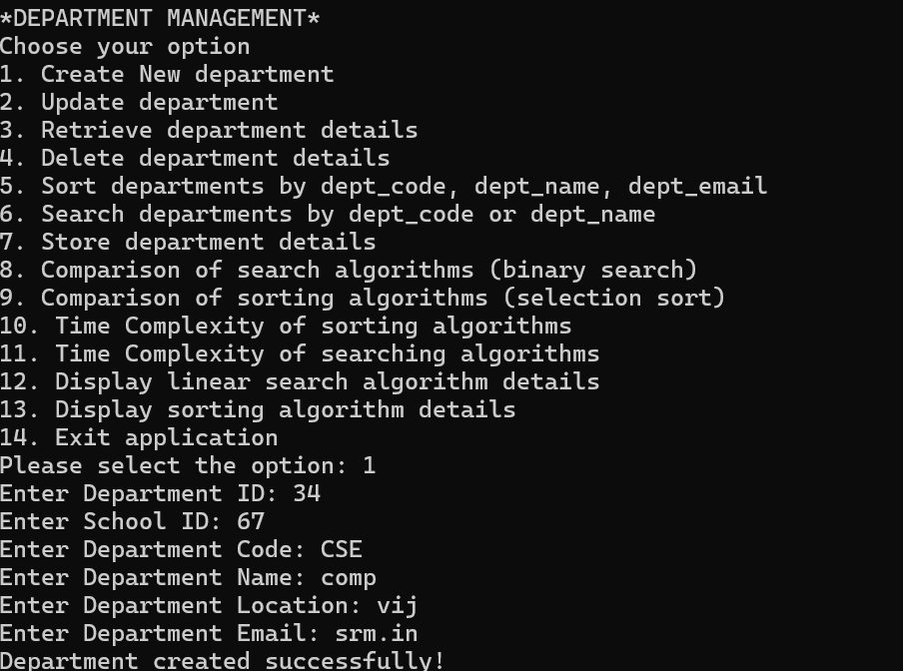
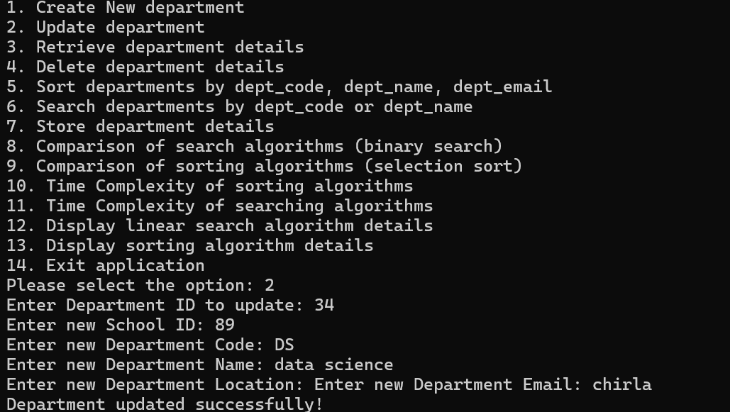
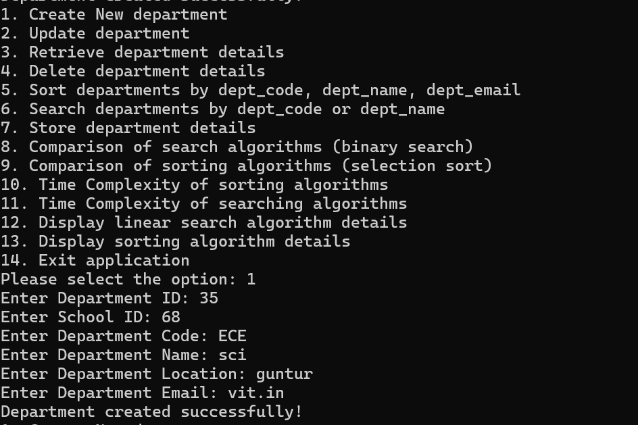
Sample Screen Shots
1. Create 2.Update

Slide 30
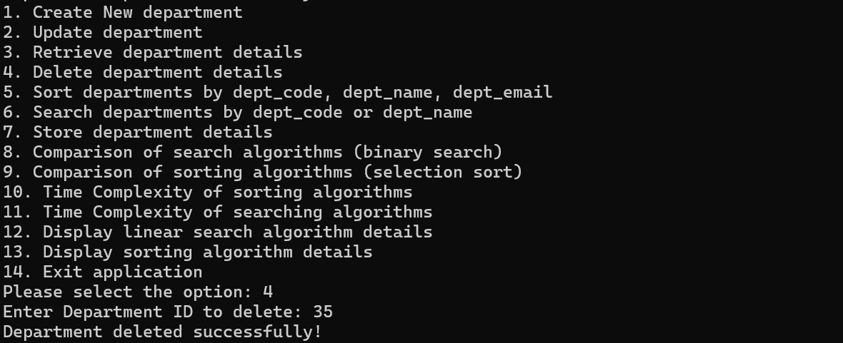
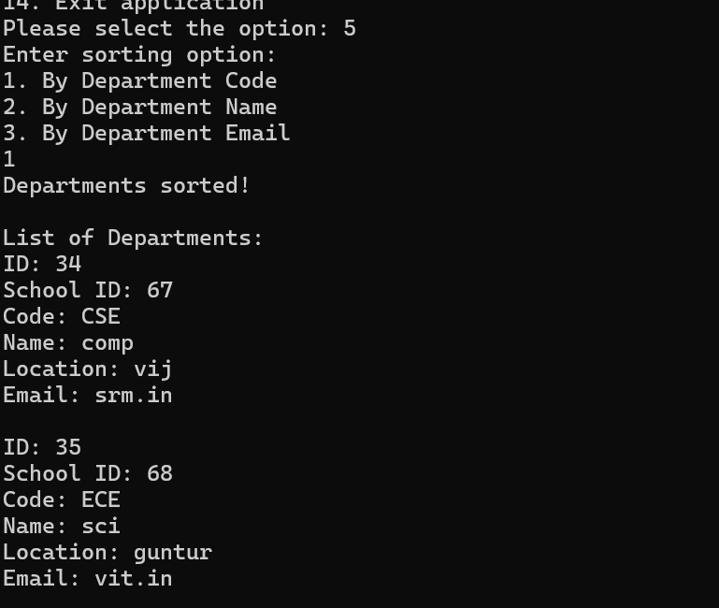
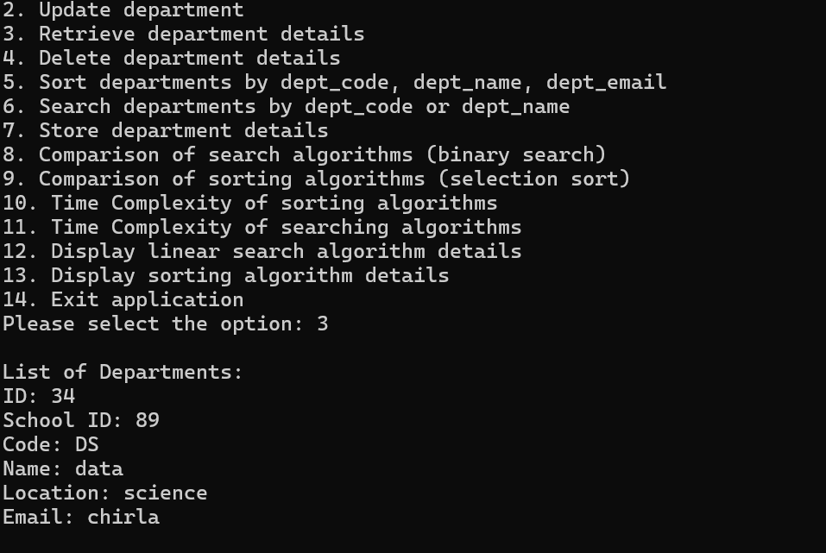
3. Delete
5. Sorting
4. Retrieve

Slide 31
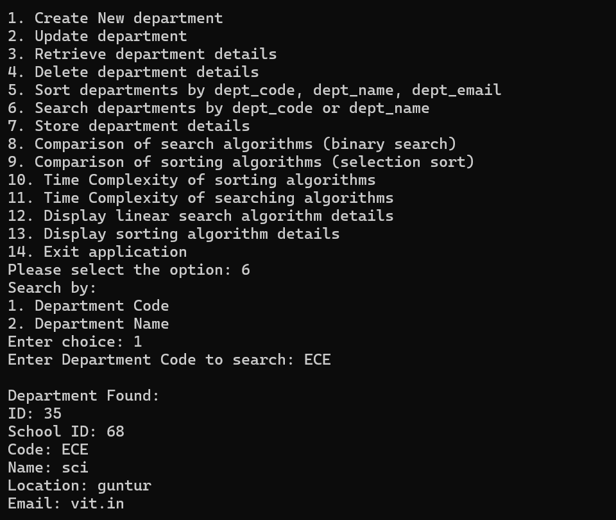
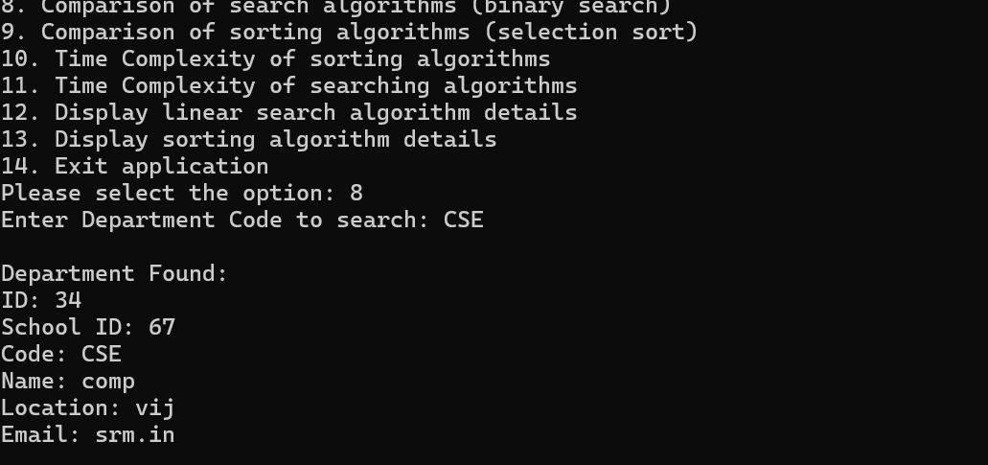
6. Searching
7. Using Binary Search

Slide 32
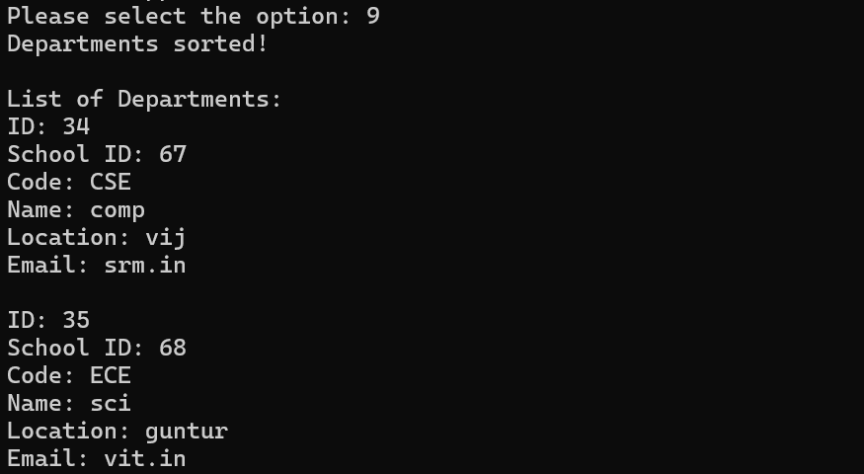
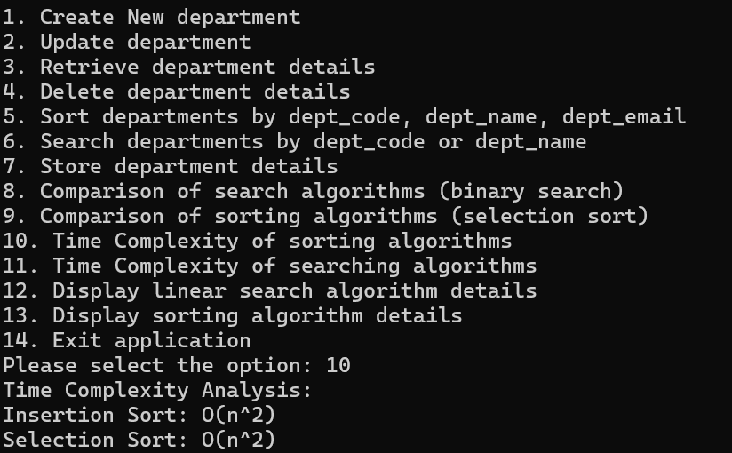
8. Using Selection Sort
9.Time Complexity of Sorting algorithm

Slide 33
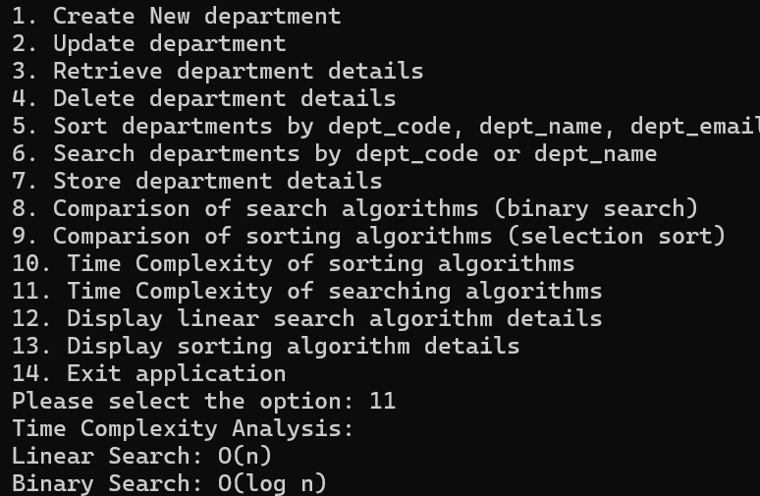
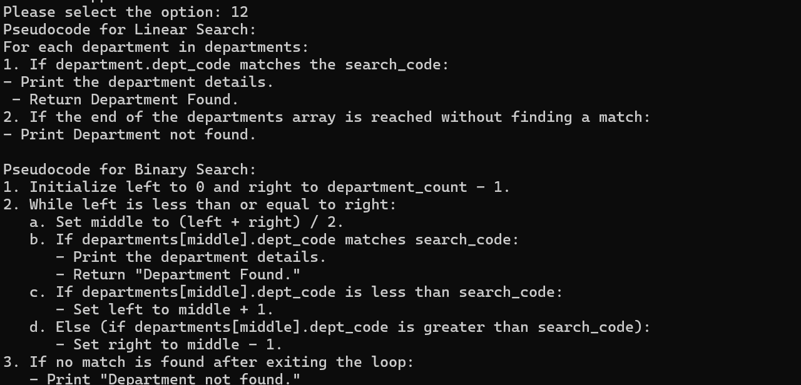
10. Time Complexity of Searching
11. Display Searching Details

Slide 34
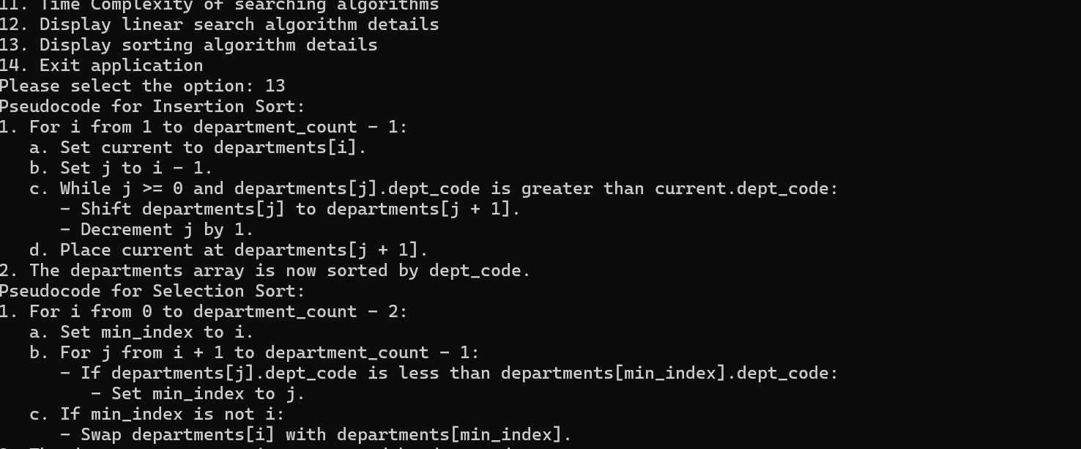
12. Display Sorting Details

Slide 35
Conclusion
Our Project Module manages CRUD Operations with insertion sort for Sorting and Linear Search for Searching. This project implemented Insertion Sort to sort departments by their department codes. Despite its O(n²) time complexity, Insertion Sort proved to be efficient for small datasets, especially when the data is partially sorted. We also used Linear Search to find specific departments, which is a simple and effective algorithm for unsorted data with a time complexity of O(n).

Slide 36
Thank You

