Slide 1



When ₹500 feels like a risk, people gamble with their health.
THE PROBLEM
Low-income families skip early diagnosis — and minor illnesses become emergencies.
500M
Indians lack access to affordable healthcare
₹300–800
Average doctor consultation fee
65%
Of rural Indians delay doctor visits due to cost

Slide 2

Why Existing Solutions Fall Short
Current options create more confusion than clarity
Google Search
Practo / 1mg
Going to a Doctor
Gives 10 different answers but no decision. Creates anxiety rather than clarity for the user.
Shows all doctors, not the right doctor. No triage system.
Assumes you already know exactly what's wrong.
Costs ₹300–₹800 even for a 5- minute consultation. Often inaccessible for daily wage earners.
Information Overload
Lack of Guidance
High Financial Barrier
None of these tell you what you actually need to know first — is this serious or not?

Slide 3

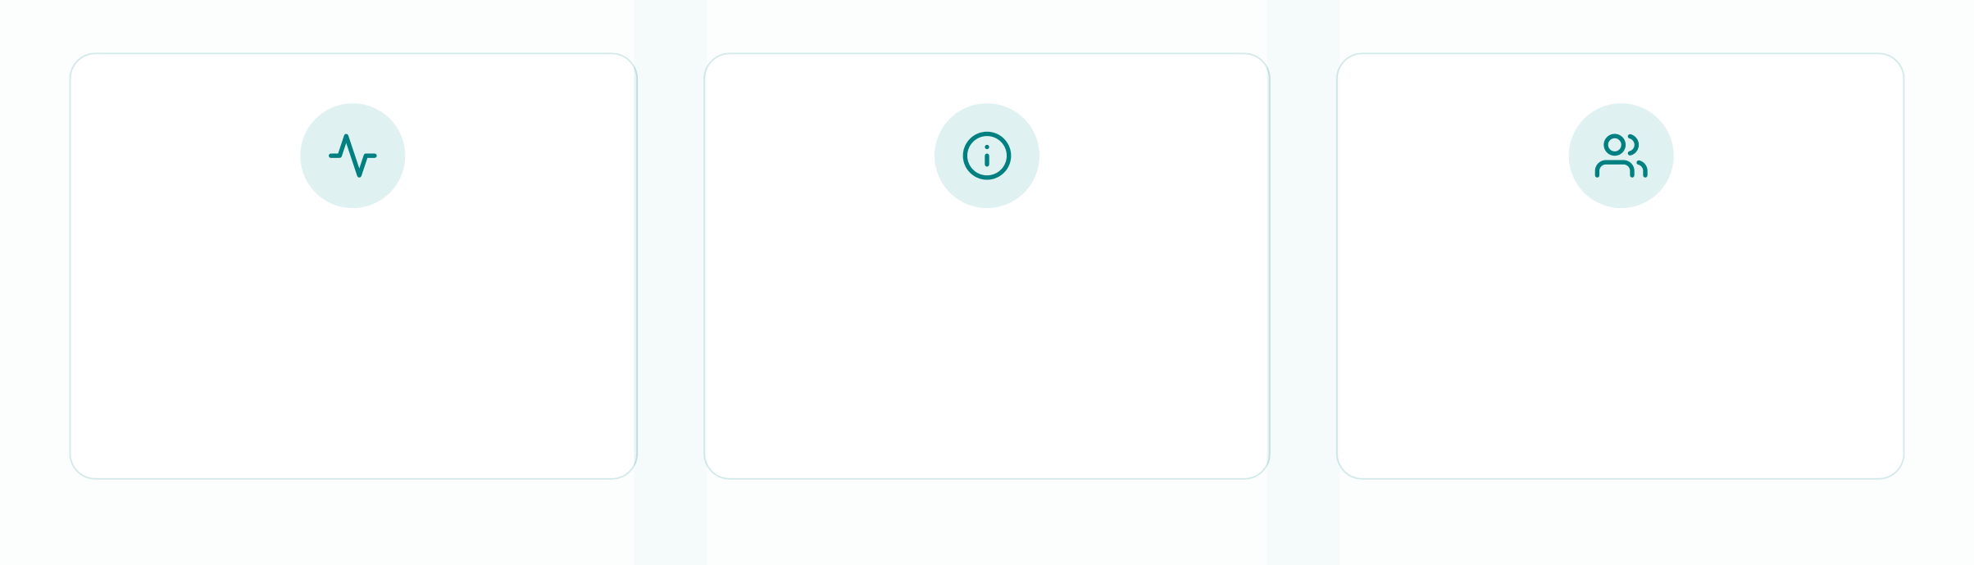
Aarogya AI
India's first two-sided health intelligence platform — built for the last mile.
Symptom Triage
Tell us how you feel. We tell you if you need a doctor.
Doctor Discovery
Find the right specialist nearby — sorted by distance, price, and rating.
Community Health
Aggregated anonymous data alerts ASHA workers about disease outbreaks.
Built on RapidMiner AI Studio + Mendix. Powered by real India health data.

Slide 4
How Aarogya AI Works
Data Input
User enters symptoms, age, duration
RapidMiner AI
Engine
Feature engineering & symptom clustering
Disease prediction model (Random Forest)
Geographic pattern detection
Mendix App Layer
Patient triage app
ASHA worker dashboard
District health map for NGOs
Outcomes
See a doctor today
Home care for 3 days
Outbreak early warning

Slide 5
Technology & Data
TECH STACK
DATASETS
RapidMiner AI Studio
Data preprocessing, feature engineering, predictive modeling, pattern detection
Disease Symptom Prediction (Pranay Patil, Kaggle)
41 diseases, 132 symptoms — maps symptom combinations to disease predictions
61,134 downloads — proven, widely validated
Mendix Studio Pro
Application interface, patient dashboard, ASHA worker portal, health map visualization
Doctor Specialty Recommendation (Ebrahim Elgazar)
Maps predicted diseases to the correct doctor specialization automatically
End-to-end pipeline: Symptoms → Disease → Right Doctor → Nearest Clinic

Slide 6
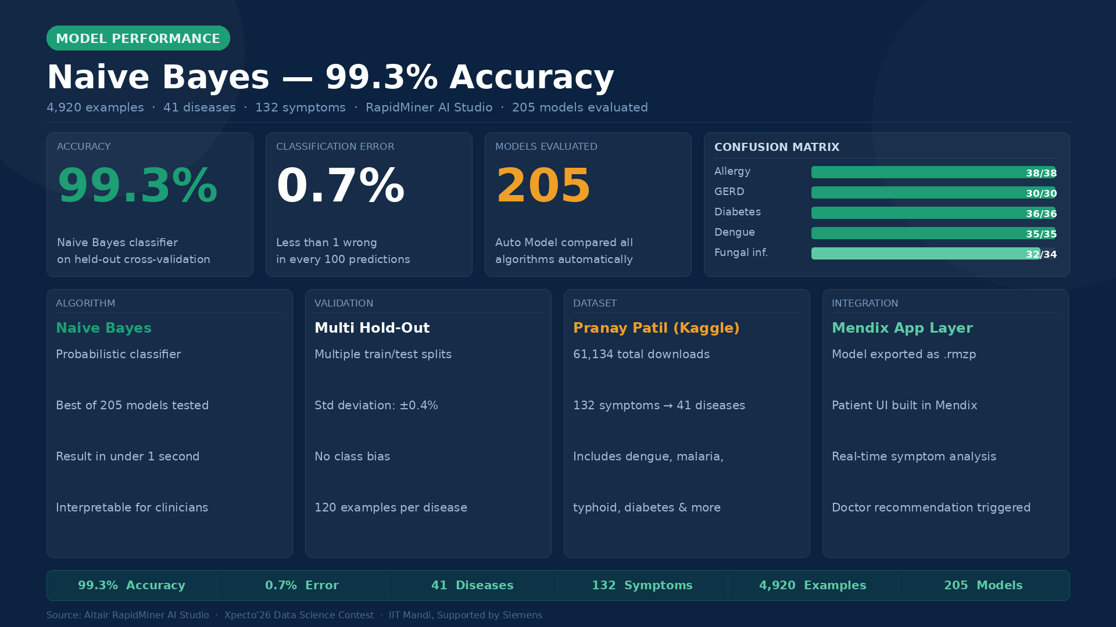

Slide 7
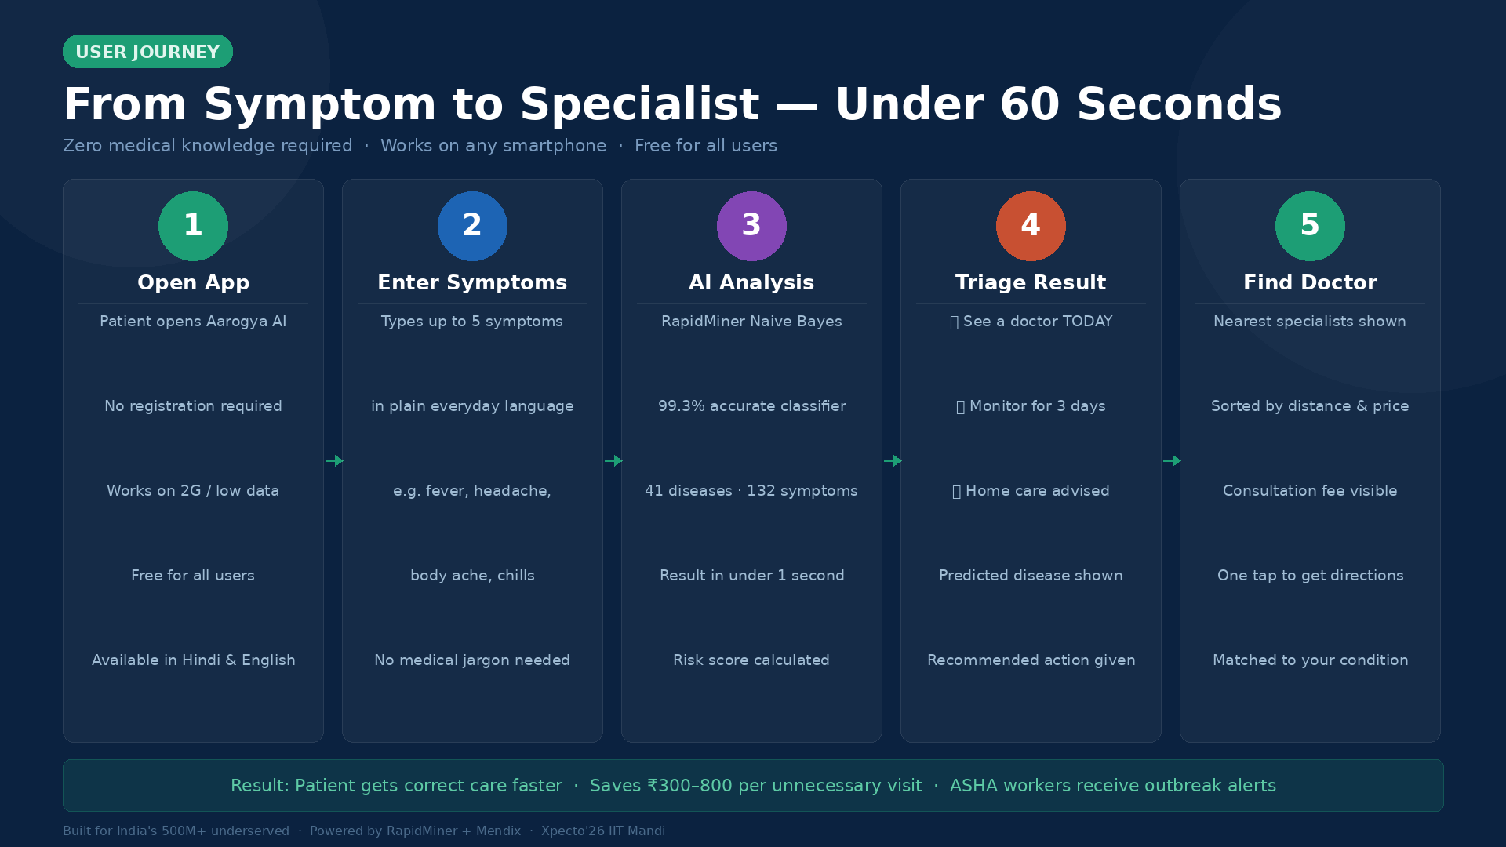

Slide 8
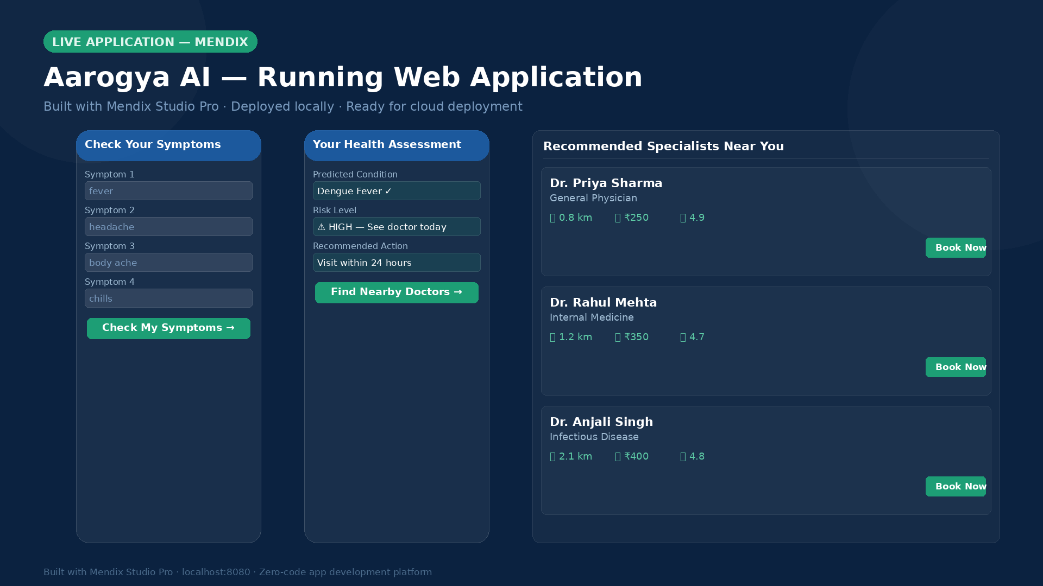

Slide 9
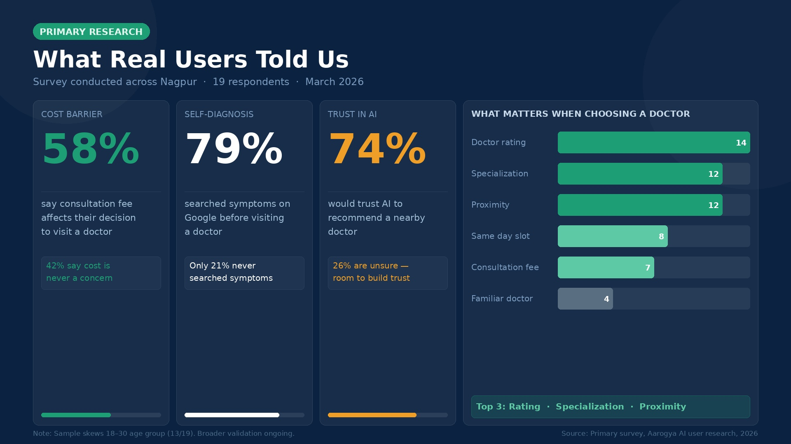

Slide 10
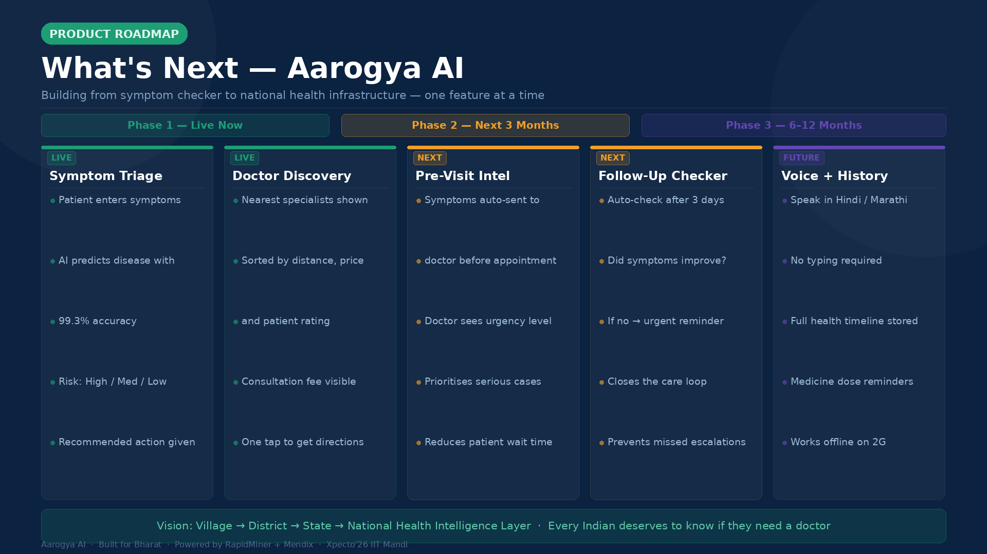

Slide 11
The Impact Aarogya AI Can Create
IMMEDIATE IMPACT
COMMUNITY IMPACT
ECONOMIC IMPACT
Reduce unnecessary doctor visits by 40% for non-serious conditions
Early outbreak detection for 500+ villages through anonymous symptom aggregation
Save low-income families ₹2,000–
₹5,000 annually in unnecessary consultation fees
"From a symptom checker to a national health intelligence layer — Aarogya AI scales from village to district to state."
BUILT FOR BHARAT. POWERED BY AI. SUPPORTED BY RAPIDMINER + MENDIX.

