Slide 1

BCSE306L – Artificial Intelligence · Slot C1 + TC1
CineMind AI
A local-first, explainable AI assistant for video pre-editing
Rishith Raj G (24BCE0175) · Hrishikesh Acharya (24BDS0231) · Krish Singh (24BDS0235)
School of Computer Science and Engineering · VIT · October 2026

Slide 2
The problem
A shoot produces hundreds of clips: repeated takes, mixed frame rates, soft or badly exposed shots, speech in several languages
Before editing starts, someone must watch, log, discard, find each line's best take and build a first assembly: hours of manual work
Existing AI help is fragmented: Premiere text editing, Resolve 20 IntelliScript (paid Studio), search plug-ins; often cloud-based and unexplained
Research models solve single tasks (shots, scenes, cut plausibility, moment retrieval) on edited films, on GPUs
Goal: organise, search, rank and assemble raw footage on the filmmaker's own laptop, and explain every decision
CineMind AI · BCSE306L · 2

Slide 3
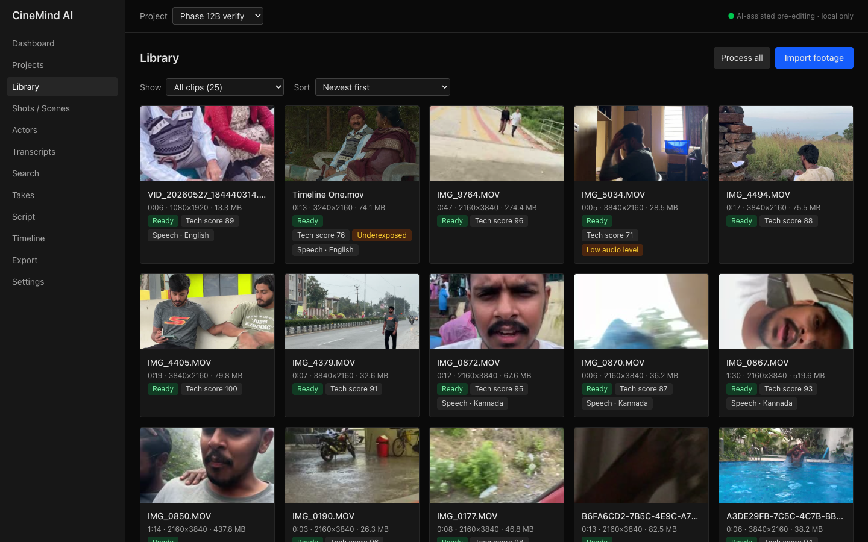
Objectives and principles
Turn an unorganised footage folder into a searchable, ranked library and an editable AI-assisted rough cut
Export to DaVinci Resolve (FCP7 XML), EDL and OpenTimelineIO, so the human editor finishes the film
Local-first: no cloud, no paid APIs, no internet while processing; runs on CPU (Apple M1, 8 GB)
Non-destructive: source footage is never modified
Explainable and honest: every tag, rank and cut stores its inputs; every reported number comes from an evaluation script
CineMind AI · BCSE306L · 3

Slide 4
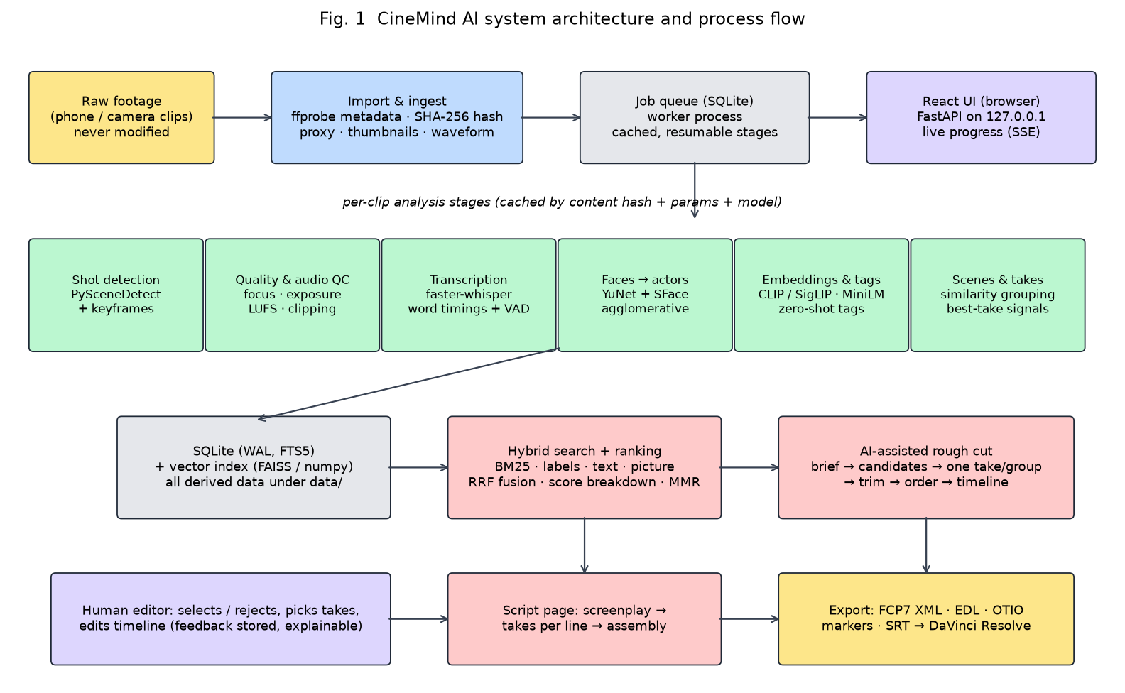
System architecture
CineMind AI · BCSE306L · 4

Slide 5
AI pipeline: existing models + our logic
Stage | Model / library | Our contribution
Shots & keyframes | PySceneDetect (adaptive) | sharpest keyframes, false-cut reporting
Technical quality | OpenCV, EBU R128 | re-blur focus measure, calibrated flags
Transcription | faster-whisper (Whisper small) | uncertainty marking, per-project languages
Faces → actors | YuNet + SFace | quality filter, tracking, constrained clustering
Embeddings & tags | OpenCLIP / SigLIP, MiniLM | thresholds calibrated to 0.9 precision
Search & ranking | SQLite FTS5 (BM25), FAISS | RRF fusion, explained weighted rank, MMR
Takes, script, rough cut | difflib, OpenTimelineIO | best-take signals, alignment, brief → timeline
CineMind AI · BCSE306L · 5

Slide 6
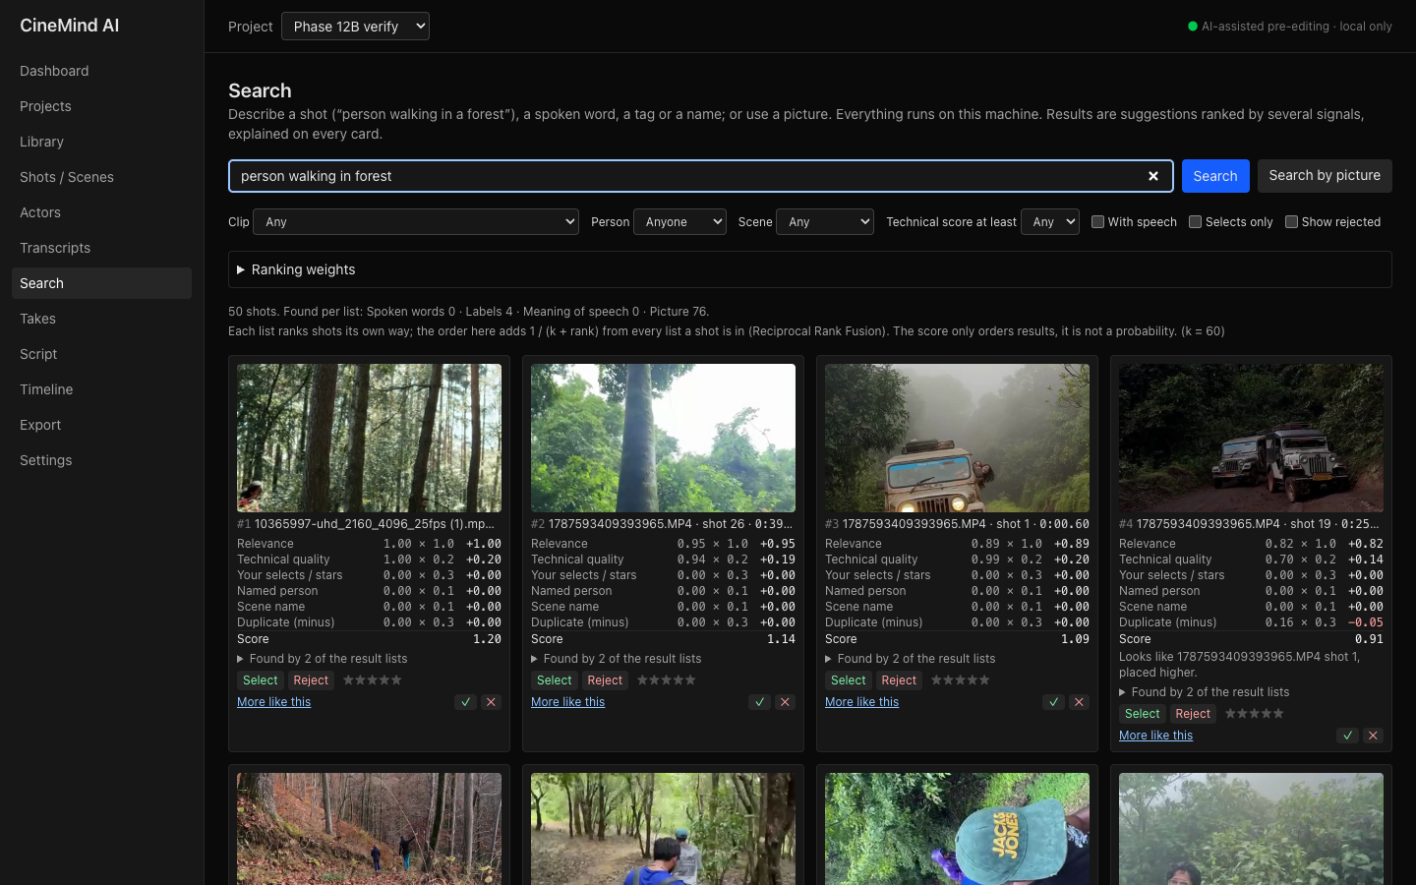
Explainable hybrid search and ranking
Four lists: spoken words (BM25), labels, meaning of speech, picture
Reciprocal Rank Fusion: score = Σ 1 / (60 + rank)
Weighted rank: relevance, quality, selects, person, scene − duplicate penalty (MMR)
Every card shows value × weight = contribution; what-if sliders
Search by reference picture ('more like this')
CineMind AI · BCSE306L · 6

Slide 7
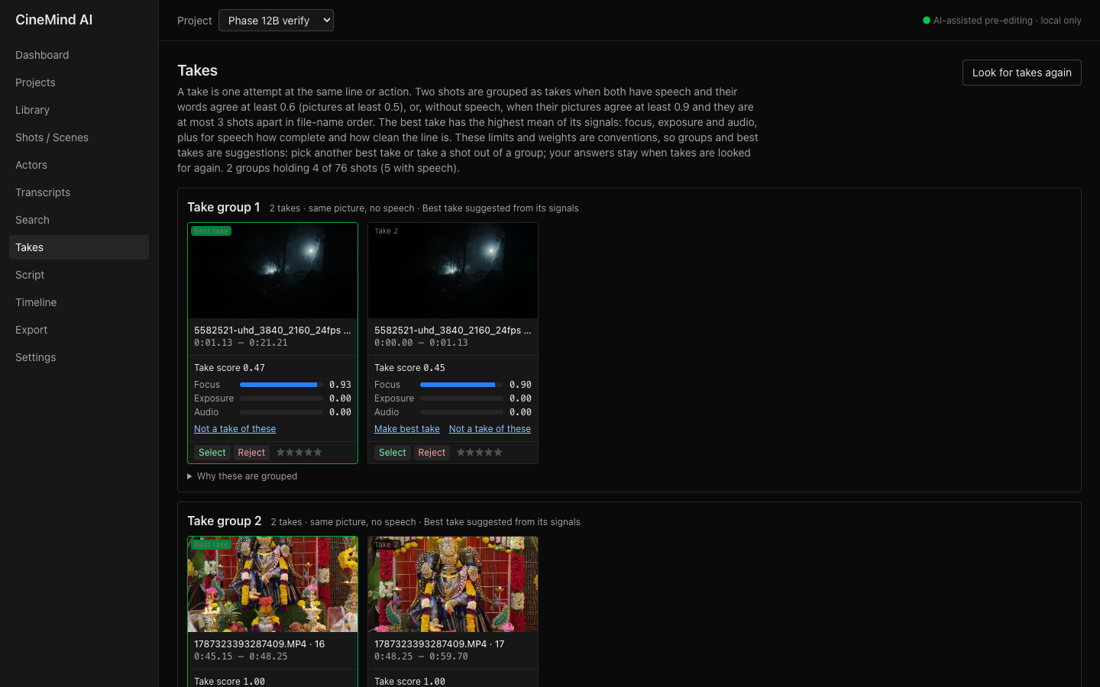
Takes and script alignment
Take groups: same words (≥ 0.6) or same picture (≥ 0.9) nearby; average linkage
Best take = focus, exposure, audio, completeness, clean delivery (flubs, fillers, cut-off)
Editor can overrule; corrections survive re-processing
Script page: each screenplay line → up to 5 takes; never-filmed lines rejected → script-ordered assembly
CineMind AI · BCSE306L · 7

Slide 8
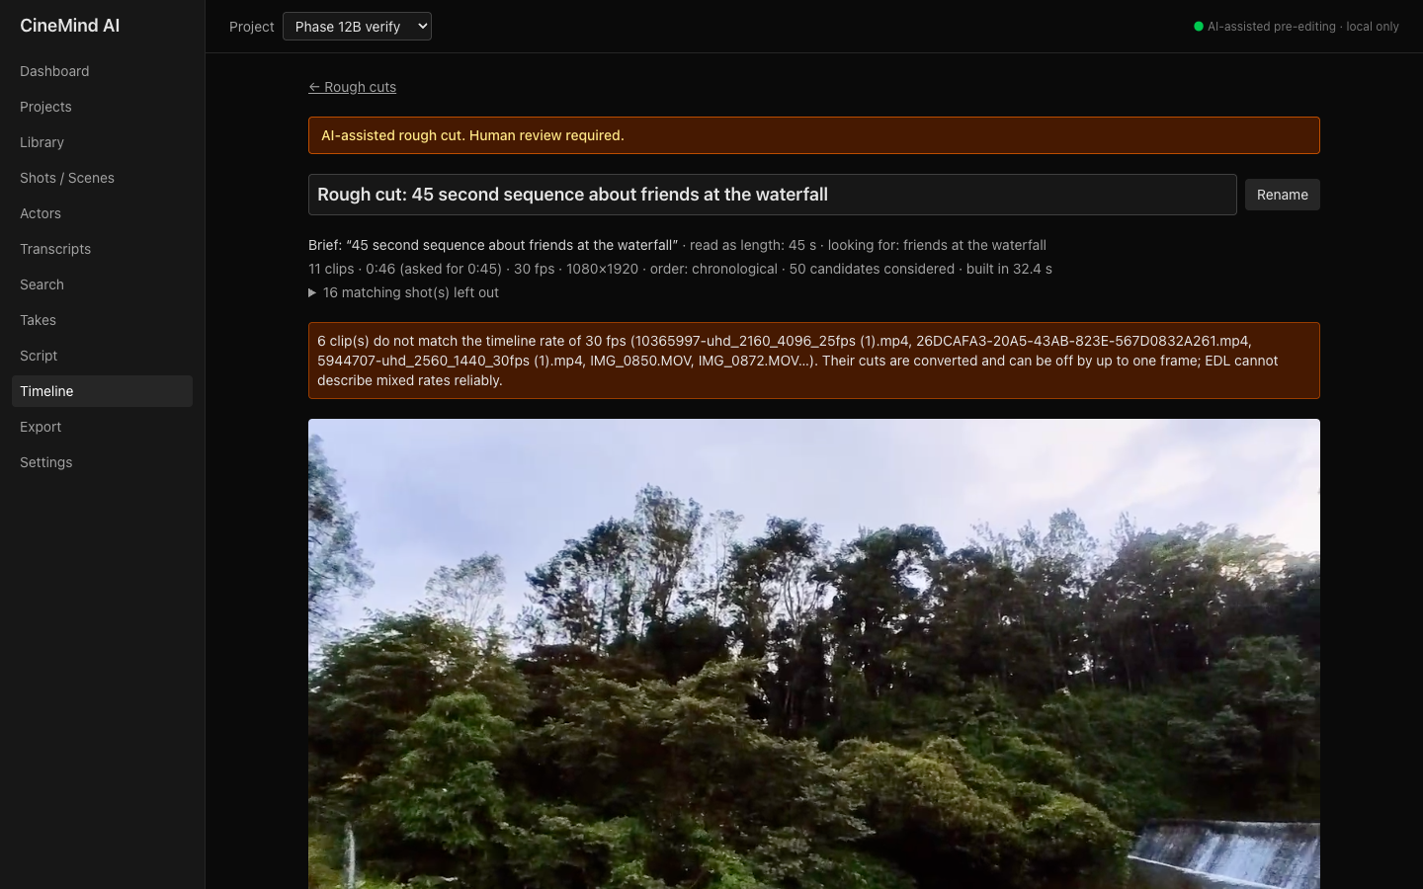
AI-assisted rough cut → DaVinci Resolve
Brief: '45 second sequence about friends at the waterfall'
Search + ranking → quality ≥ 0.5, ≥ 1.5 s → one take per group
Trim to whole sentences (+0.25 s) or 6 s around the match; fit length ±10 %
Drag, trim, swap (other takes first), preview; each clip explains why
Export FCP7 XML / EDL / OTIO / SRT with reason markers; imported in Resolve 21.1
CineMind AI · BCSE306L · 8

Slide 9
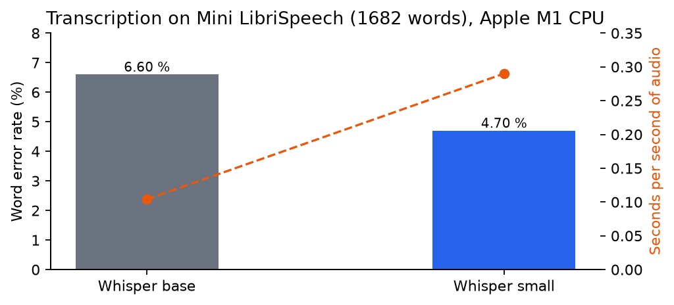
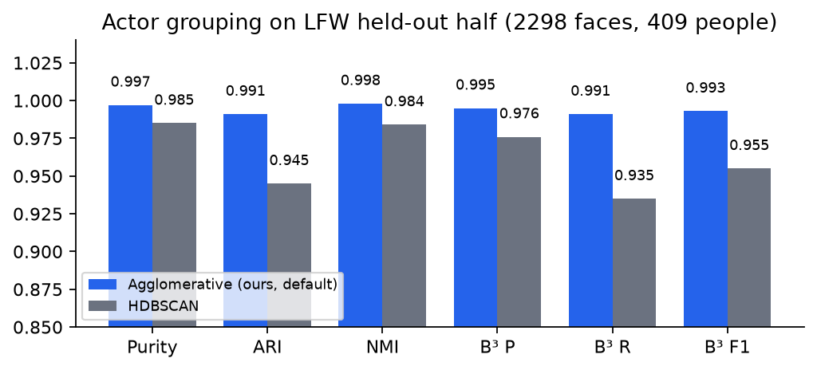
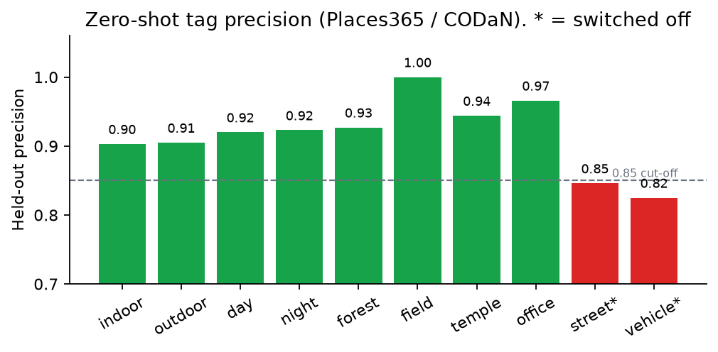
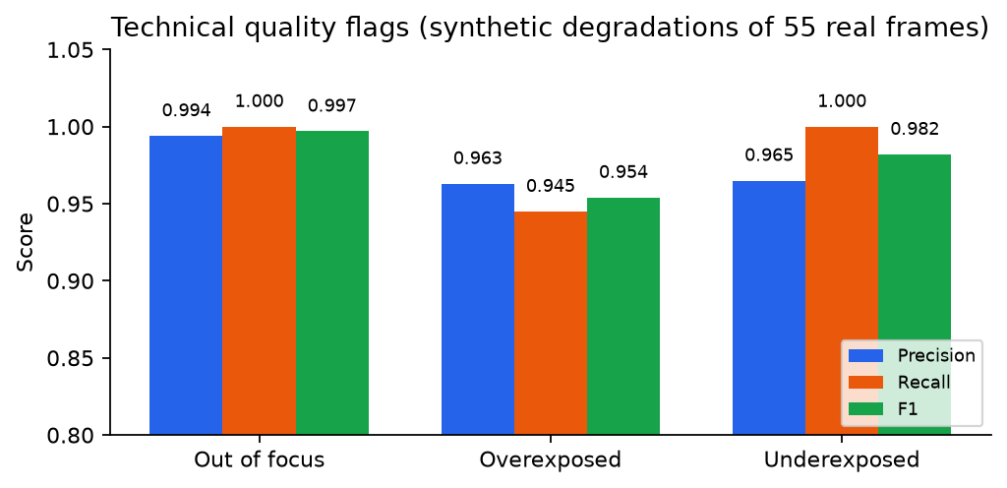
Results: component accuracy (our pipeline, public data)
CineMind AI · BCSE306L · 9

Slide 10
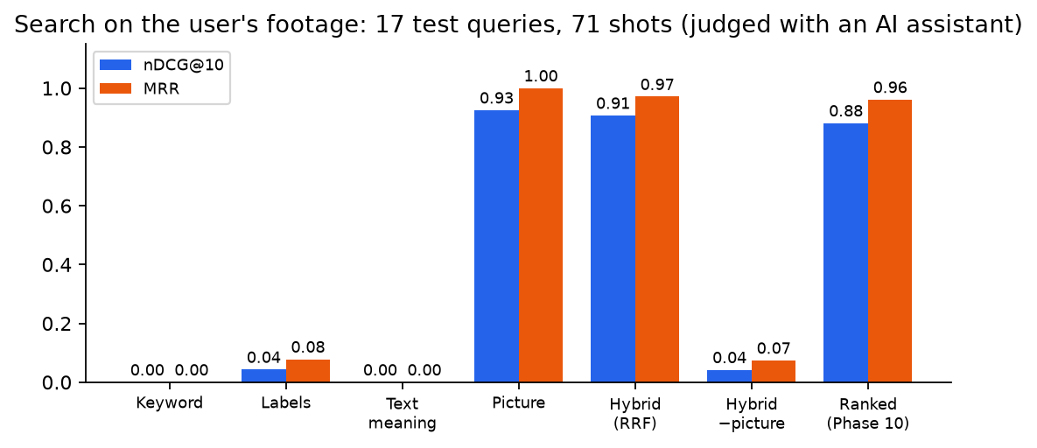
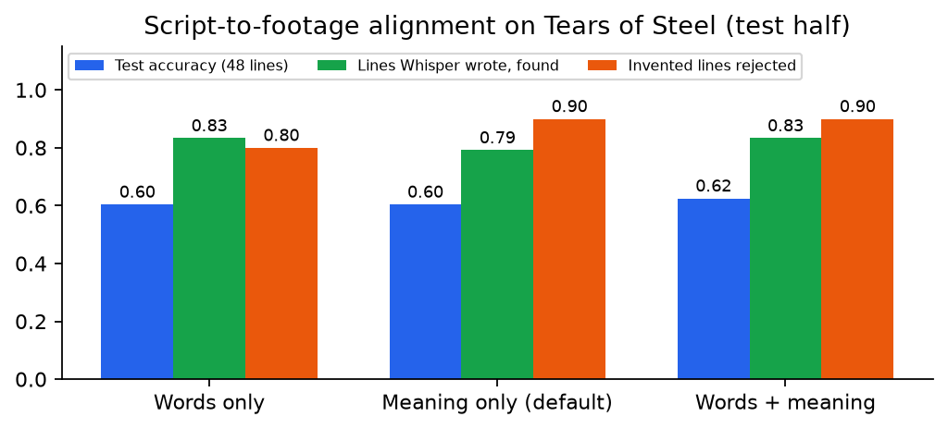
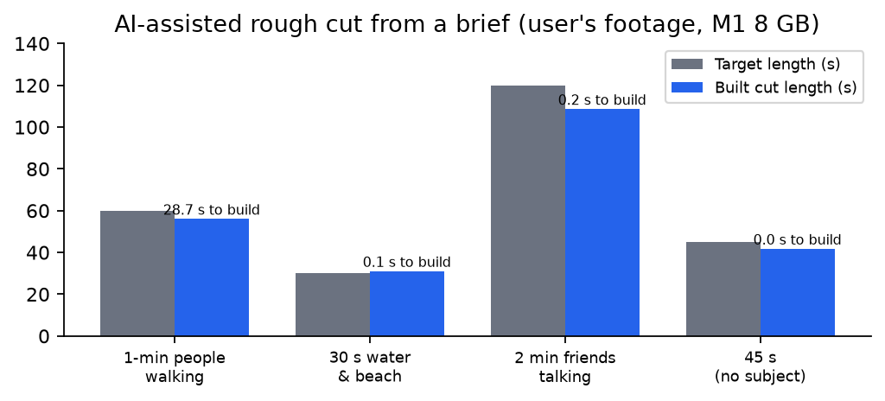
Results: search, script and rough cut
Key numbers
WER 4.70 % (Whisper small, CPU)
Actor grouping B-cubed F1 0.993 (LFW)
Search nDCG@10 0.907, MRR 0.971
Script: 83 % of transcribed lines found
Rough cut in 0.2 s, within 10 % of length
Search/take labels made with an AI assistant: indicative
CineMind AI · BCSE306L · 10

Slide 11
Comparison with existing tools and research
 | Local on CPU | Search | Rough cut | Takes / script | Explains | NLE export
CineMind AI (ours) | ✓ | ✓ | ✓ | ✓ | ✓ | XML / EDL / OTIO
Premiere Text-Based Editing | in Premiere | transcript | manual | ✗ | ✗ | native
Resolve 20 IntelliScript | Studio (paid) | limited | from script | script | ✗ | native
Jumper | ✓ | ✓ | ✗ | ✗ | partly | plug-in
CLIP4Clip / QVHighlights | GPU | text→video | ✗ | ✗ | ✗ | ✗
Learning to Cut / AVE | GPU | ✗ | cut scoring | ✗ | ✗ | ✗
We do not beat specialised GPU models on their own benchmarks. What we add is the combination: local, explained, end-to-end to an editable timeline.
CineMind AI · BCSE306L · 11

Slide 12
Limitations and future work
Dialogue features depend on speech recognition: noisy audio and Kannada are poorly transcribed by small Whisper
Search and take labels were made with an AI assistant; user studies with real editors are next
Our footage has few real retakes and no hand-marked cuts, so shot and take figures are sanity checks
Thresholds of scenes, takes and ranking weights are conventions; learned re-weighting from selects/rejects is future work
Future: word-level speech-aware trimming, speaker diarisation, multilingual models, desktop packaging
CineMind AI · BCSE306L · 12

Slide 13
Team contributions (equal effort)
Rishith Raj G (24BCE0175)
Hrishikesh Acharya (24BDS0231)
Krish Singh (24BDS0235)
Backend architecture: FastAPI, SQLite, job worker, cached stages
Ingest, proxies, shot detection, keyframes
Export to FCP7 XML / EDL / OTIO; Resolve tests
Speech: faster-whisper, script alignment
Report: intro, methodology, approach
Technical quality metrics and calibration
Faces → actors: YuNet/SFace, clustering, LFW evaluation
CLIP/SigLIP and MiniLM embeddings, calibrated tags
Scenes and take detection with best-take signals
Report: datasets, results, gaps
React + TypeScript user interface
Hybrid search, RRF, explainable ranking, evaluation
Rough-cut engine and timeline editor
Playwright / Vitest tests
Report: comparison, user manual, PPT, demo video
CineMind AI · BCSE306L · 13

Slide 14
Thank you
Not an auto-editor: an assistant that does the organising so the editor can do the editing.
Demo · Source · Report: see the Appendix of the project document

