Slide 1
Competitive Resource Allocation Game
Team Members
S. Rishitha Reddy - 2520090039
M. Thanvi Reddy - 252003054
Section - 5

Slide 2

Abstract
Competitive Resource Allocation Game
The Competitive Resource Allocation Game is an AI-based simulation in which multiple agents compete for limited resources. Each agent follows a strategy to acquire resources and maximize its score. The project demonstrates fundamental Artificial Intelligence concepts such as intelligent agents, problem formulation, decision-making, and resource optimization. By simulating competition among agents, the game helps in understanding how resources can be allocated efficiently in a constrained environment and how different strategies affect overall performance.
2

Slide 3
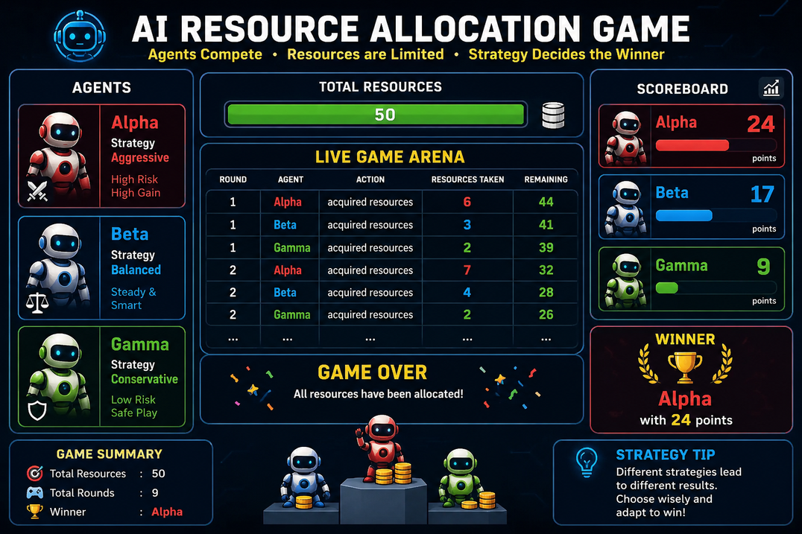
Project Overview
Project Description
AI-based resource allocation simulation.
Multiple agents compete for limited resources.
Different strategies are used by agents.
Agent with highest score wins.
AI Concepts Used
Intelligent Agents
Decision Making
Resource Optimization
Problem Solving
3

Slide 4
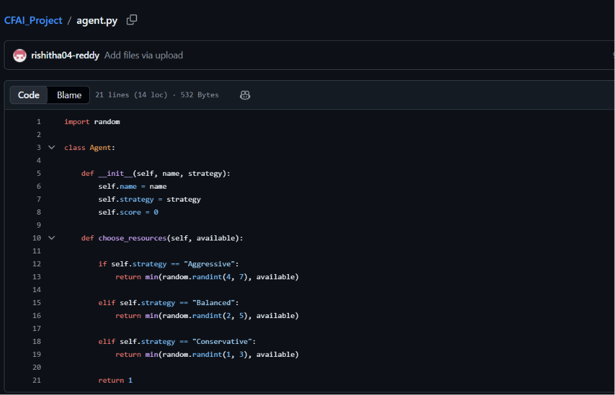
agent.py
Explaination
Defines agent behavior.
Each agent follows a strategy:
Aggressive
Balanced
Conservative
Agents decide how many resources to acquire.
4

Slide 5
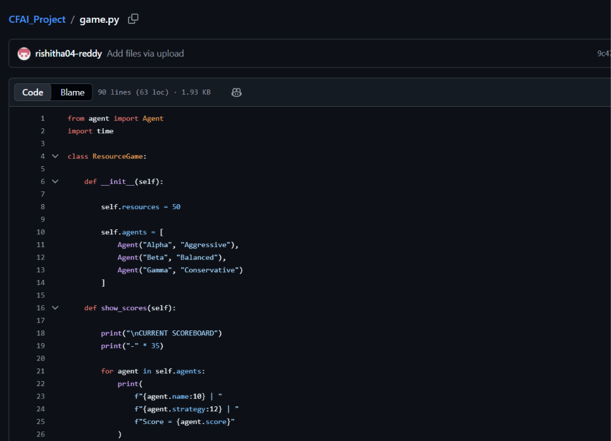
game.py
Explanation
Controls game rounds.
Allocates resources.
Updates scores.
Displays scoreboard.
Determines winner.
5

Slide 6
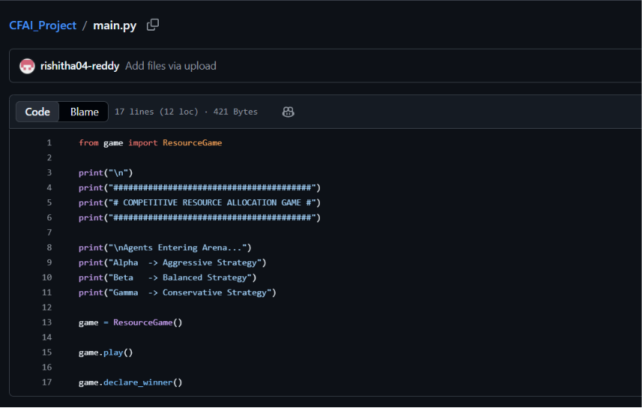
main.py
Explanation
Starts the game.
Creates agents.
Runs simulation.
Displays final results.
6

Slide 7
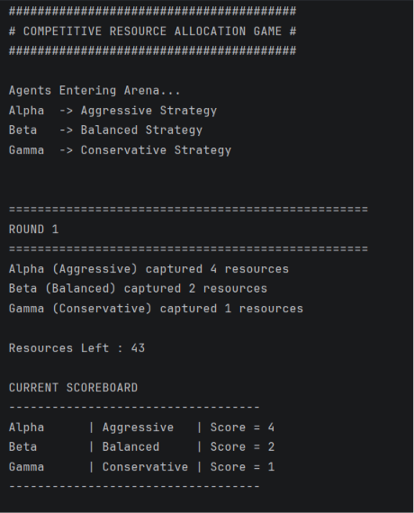
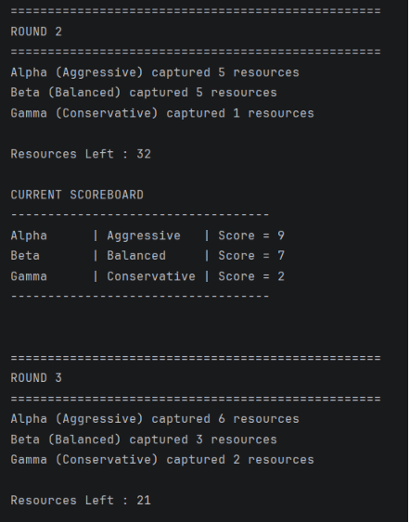
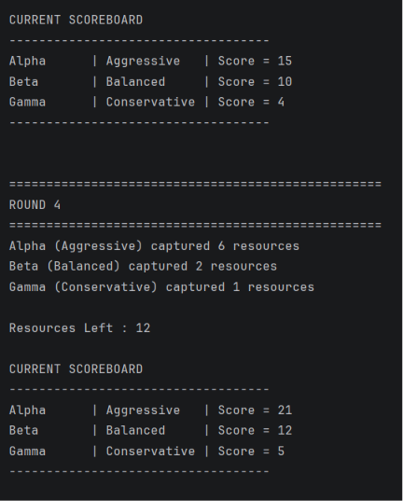
Output
6

Slide 8
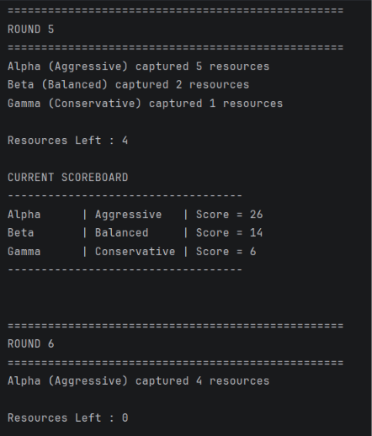
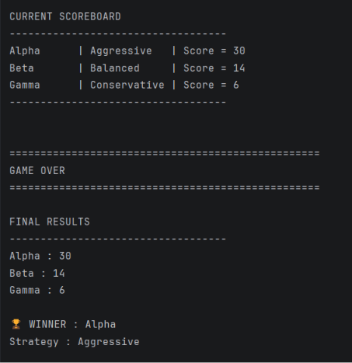
Output
6

Slide 9
Conclusion
Sample Conclusion
Successfully implemented a Competitive Resource Allocation Game.
Demonstrated AI agent behavior.
Compared different allocation strategies.
Showed efficient utilization of limited resources.
Future Enhancement
Add GUI.
Add more AI strategies.
Use Machine Learning for adaptive agents.
6

Slide 10
Thank you!

