Slide 1
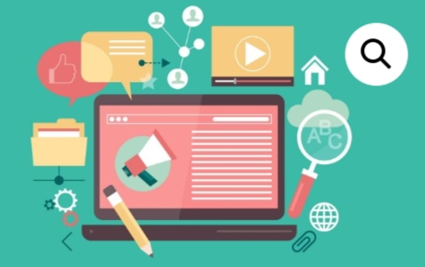
Digital portfolio
Student : rishitha
Register no : 36324u18056
Department : BSc(computer science)
College : sree abiraami arts and science College
Email ID : rishitha08112007@gmail.com

Slide 2

Project title
* Digital portfolio

Slide 3

Agenda
Problem statement
Project overview
End user
Tools And technologies
Portfolio design and layout
Features and functionality
Result and screenshot
Conclusion
Git Hub link

Slide 4
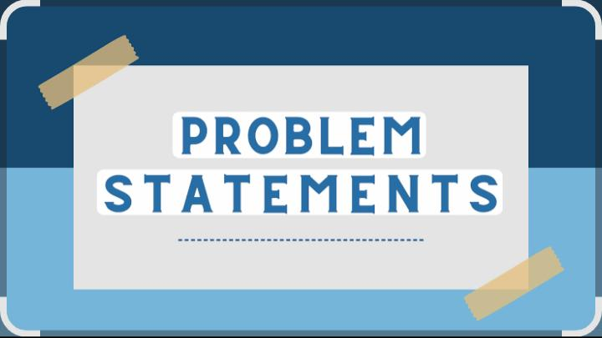
Problem statement
Many people struggle to keep track of their daily Spending and savings.
Existing Budgeting tools are often complex or require login account. This project solves that by creating a Simple, lightweight Budget tracker using html css , and javascript that allows user to add income/Expenses and see a Real-time balance – all in one page.
The goal was to redesign the navigation and interface to improve usability and retention

Slide 5
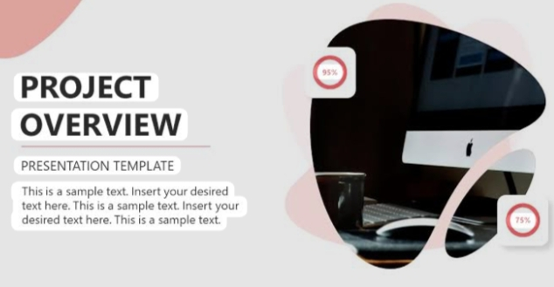
Project overview
To design and develop a digital portfolio that Showcase Personal skills achievement, project, and professional Experiences in a visually engaging and accessible format.
Serve as a tool for academic, freelance, or job opportunity.
Centralize all key the information In one digital location.
A professional, interactive, and visually appealing digital portfolio that effectively Communicates the individuals brand and capabilities
Highlights Individual Strength and Creativity.

Slide 6
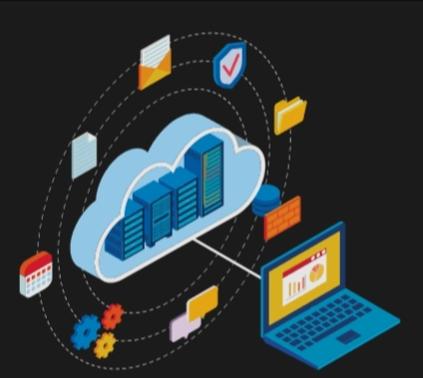
End users
A software of web Portfolio – where the end user is interacting with someone’s online portfolio(eg. Designer developer)
Student – To showcase achievement project and skills.
Employers -To evaluate Candidate through their portfolio links.
IT system - For Interval It tools employee using system are the end user.

Slide 7

Tools and technologies
Website builders : WordPress , wix , Google sites or github.
Coding language : html , css , javascript.
Version control : Git and github for managing project or version and updates.
Cloud storage : Google drive , Dropbox for storing and sharing document and media
Figma : Ui/ux design , prototyping.

Slide 8
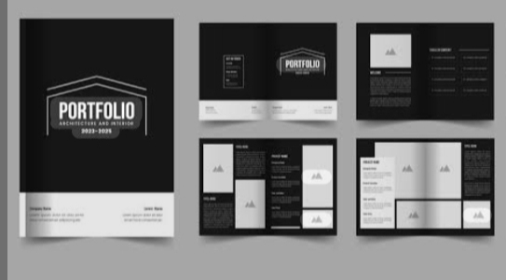
Portfolio design and layout
Home : Engaging In introduction with professional Photo and a brief tagline.
About me : Short bio detailing background, interest and career goal.
Certificate : display of earned certification with visual are downloading links.
Skills : Visual skills bar or icons for technical and soft skills.
Conference : Details of conference attend are present.
Layout : clean Grid based format.

Slide 9

Features and functionality
Home page with introduction and personal branding.
About me section (bio, skills, certificate)
Portfolio project ( images , links, description, tech used, features)
Interactive elements (eg. Animation , hover effect)
Responsive design (mobile – friendly)
Tech stack (eg. React, node.js, mongoDB)

Slide 10
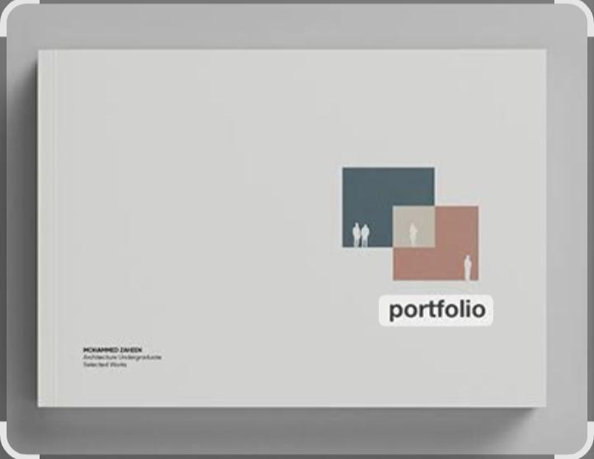
Result and screenshot
About me : hello I am sribhavnai a passionate and drive professional with a strong focus on html, python, c++. I enjoy turning complex challenge into simple.
Skills.
* Html.
* Python
* C++
* Javascript

Slide 11
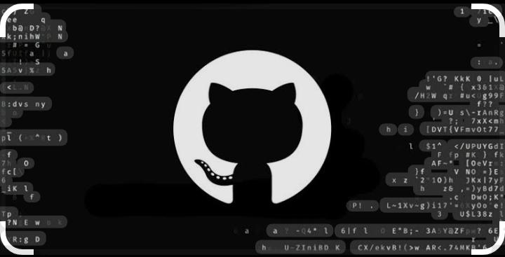
GitHub link
Github link : rishitha portfolio https://github.com/rishitha08112007

Slide 12
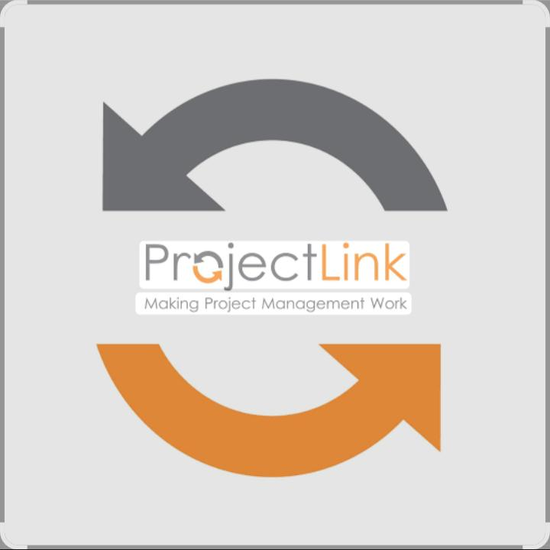
Project link
https://rishitha08112007.github.io/rishithaportfolio/

Slide 13

Conclusion
This Portfolio represents not only the range and depth of work but also the growth. I have experienced throughout this journey. Each piece included gas been thoughfully selected to showcase my skills, creativity and critical thinking. Moving forward I am to continue building on these foundations refining my abilities and emracing new challenge.
Thanks you

