Slide 1


SMART SOLAR
TRACKING SYSTEM
By
MANI
LARSHITHA
RISHITHA

Slide 2
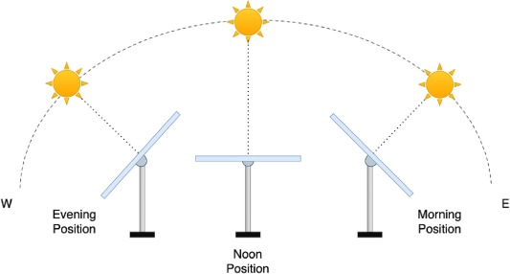
Project Overview:
Automatically tracks the sun’s movement to maximize solar energy harvesting and improve photovoltaic panel efficiency.
Developed using Arduino, LDR sensors, servo motor control, and MATLAB-based virtual instrumentation for real-time monitoring, control, and performance analysis.

Slide 3
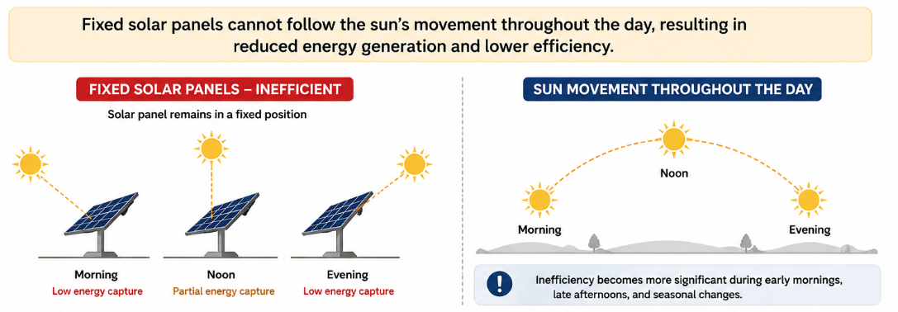
Problem Statement
Fixed solar panels cannot continuously follow the sun’s movement, reducing overall energy generation efficiency.
Energy loss becomes more significant during morning, evening, and seasonal variations.
A low-cost automated tracking system with PID-based control is required to maintain optimal panel alignment.

Slide 4
INTRODUCTION
Solar energy is one of the most widely used renewable energy sources.
Fixed solar panels cannot continuously follow the sun’s movement, reducing energy generation efficiency.
A solar tracking system improves energy capture by adjusting the panel toward maximum sunlight.
This project presents a low-cost Arduino-based solar tracking system using LDR sensors and a servo motor.
The system demonstrates concepts of automation, feedback control, and embedded system design.

Slide 5
Motivation
One evening during a power cut (which is basically normal in many Indian villages), we were discussing how some rural areas still depend on dim lights or kerosene lamps at night. Someone shared how their village has long hours of low voltage, making it hard for students to study or families to even charge a phone.
That conversation hit us.
Not because we could magically solve India’s power problems… but because one thought kept repeating in our minds:
“If sunlight is free and everywhere… why is it still underused in so many rural areas?”
We started thinking realistically.
Solar panels are useful, but fixed ones don’t capture sunlight properly throughout the day—especially in places where every bit of power matters.
We wondered if a simple, affordable, low-maintenance mechanism could help increase solar efficiency without needing technical knowledge or expensive equipment .
And that’s where our motivation began.

Slide 6
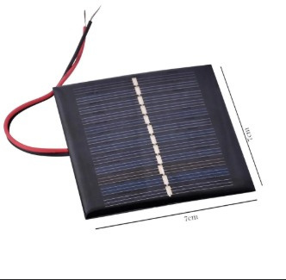
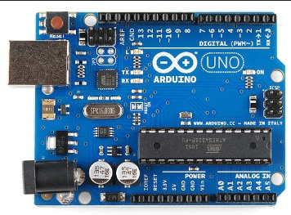
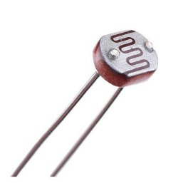
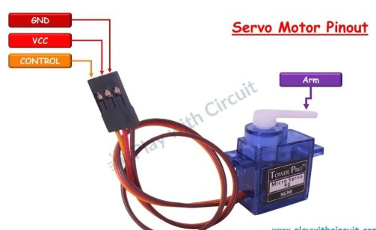
COMPONENTS
USED :
ARDUINO UNO(CONTROLLER)
SOLAR PANEL
2 PHOTO RESISTORS FOR SUNLIGHT DETECTION
1 SERVO MOTORS FOR DUAL- AXIS MOVEMENT
BREADBOARD AND JUMPER WIRES
POWER SUPPLY
MOUNTING FRAME

Slide 7
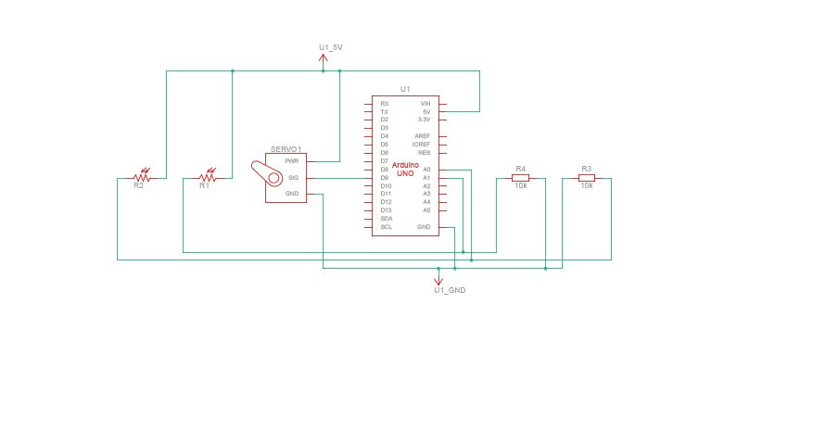
CIRCUIT ASSEMBLY :
Connect LDR sensors to the Arduino analog input pins.
Interface servo motors with PWM digital output pins.
Use push-buttons to switch between automatic and manual operating modes.
Mount the solar panel and sensors securely on the frame for stable alignment.
Ensure proper wiring connections for reliable signal transmission and safe operation.

Slide 8
Role of PID Controller in Sun-Tracking Solar System
Working Principle
PID Functions
LDR sensors detect sunlight intensity and panel position.
The PID controller calculates the alignment error between the desired and actual panel direction.
Based on this error, the controller generates control signals for the servo motor.
The servo motor continuously adjusts the solar panel for optimal sunlight alignment.
Proportional (P): Corrects immediate alignment error.
Integral (I): Eliminates accumulated steady-state error.
Derivative (D): Reduces overshoot and improves system stability.
PID tuning ensures smooth and accurate solar tracking under varying light conditions.

Slide 9
TESTING PROCEDURES:
Functional Testing
Stress & Endurance Testing
Verified LDR light detection.
Checked servo motor response.
Tested automatic tracking mode.
Validated manual control operation.
Tested under continuous operation.
Verified smooth panel movement.
Checked durability under varying conditions.
Evaluated system reliability.
Performance & Accuracy Testing
Debugging & Issue Resolution
Observed sun-tracking accuracy.
Measured panel orientation changes.
Recorded voltage/current output.
Compared efficiency with fixed panels.
Identified wiring and connection errors.
Reduced sensor noise using filtering techniques.
Calibrated the servo motor for stable movement.
Stabilized the power supply for reliable operation.

Slide 10
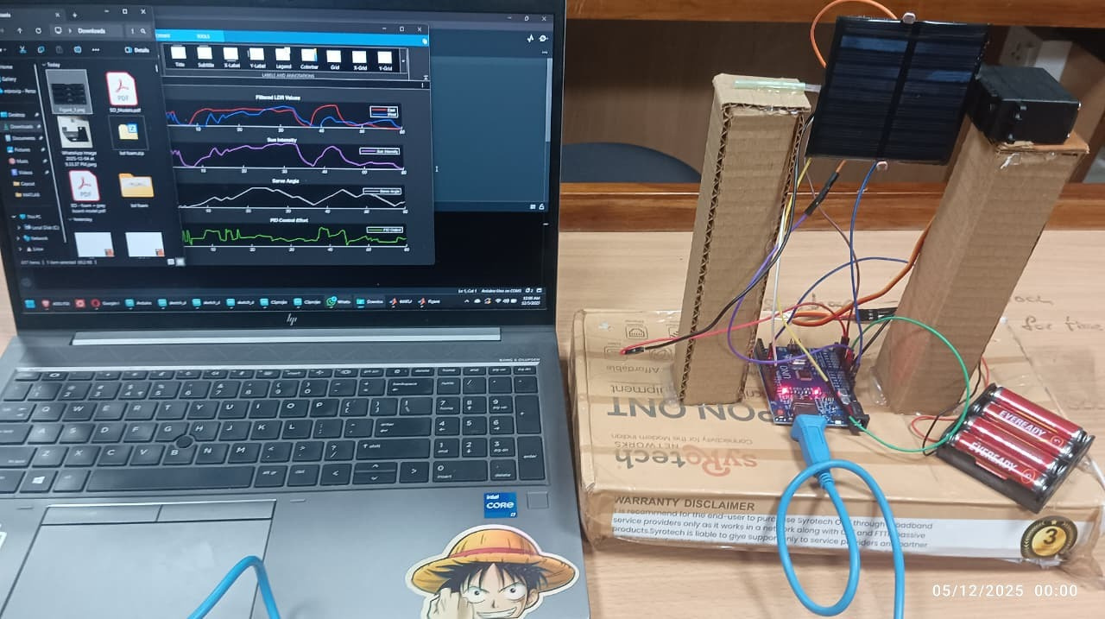

Slide 11
Conclusion
The proposed solar tracking system improves solar energy utilization through automatic panel alignment.
Integration of Arduino, LDR sensors, servo control, and PID feedback enables accurate and efficient sun tracking.
The design provides a cost-effective, reliable, and practical solution for renewable energy applications.
Real-time monitoring and testing confirm the stability and performance of the system.

Slide 12

https://www.sciencedirect.com/science/article/pii/S2352484724006164
https://www.ijert.org/dual-axis-solar-tracking-system-2
https://github.com/pratz222/Dual-Axis-Solar-Tracker-using-Arduino
https://github.com/Mohan-Balaji/Dual_Axis_Solar_Tracker
https://github.com/Tinker-Twins/Dual_Axis_Solar_Tracker
https://projecthub.arduino.cc/rinme/dual-axis-solar-tracker-system-using-arduino-d1056a
https://www.hackster.io/ElectroScopeArchive/dual-axis-solar-tracker-with-arduino-and-ldr-sensors-ee227a
https://docs.arduino.cc/resources/datasheets/A000066-datasheet.pdf
http://www.ee.ic.ac.uk/pcheung/teaching/DE1_EE/stores/sg90_datasheet.pdf
THANK YOU

