Slide 1
Water Garbage
Collector
Team Members :
Rishitha Vallika Pulaparthi - S20240020325
Larshitha Borra - S20240020276
Mani Sharan Raj Mengani - S20240020304

Slide 2
Outline
01
02
03
04
05
06
Introduction
Literature Review
Objective
Block Diagram
Results and discussion
Conclusion

Slide 3
Introduction
This project presents a floating water-cleaning robot designed to remove floating waste from ponds, lakes, and rivers. The system uses DC motors for movement and a conveyor mechanism for collecting debris from the water surface.
Key Highlights
Low-cost robotic system for cleaning floating waste
Conveyor mechanism for debris collection
Initial concept included ultrasonic and IR sensors
Current version operates through manual Bluetooth control (HC-05)
Built on a waterproof floating platform for stability
Powered through a regulated rechargeable battery

Slide 4
Literature review
Studies show that floating waste like plastics and thermocol remains on water surfaces for long periods, causing ecological and visual pollution.
Research highlights that manual cleaning methods are common but inefficient, labour-intensive, and unsafe for workers.
Existing automated or robotic cleaning systems are effective but often too costly and complex for small or rural water bodies.
Engineering literature notes that multi-hull floating structures provide better stability for water-based mechanisms.
Mechanical studies show that conveyor-style collection systems can lift lightweight floating debris effectively when used at suitable angles.
Overall, the literature points to a gap for simple, low-cost, and stable waste-collection mechanisms for small water bodies.

Slide 5
Objective
Design a floating robot capable of cleaning surface waste efficiently
Implement a conveyor system to collect and store debris
Ensure stable, waterproof operation in varying water conditions
Reduce human effort through semi-automated control
Deliver an eco-friendly, cost-effective cleaning solution

Slide 6
Block Diagram of Water Garbage Collector
9V Power Supply
Arduino UNO R3
HC-05 Bluetooth Module
Tx
Rx
Rx
Tx
5V
ENA,ENB, IN1,IN2,IN3,IN4
ENA,ENB, IN1,IN2,IN3,IN4
L298N Motor Driver
12V Power Supply
L298N Motor Driver
DC Motor
DC Motor
DC Motor
DC Motor

Slide 7
Flow Chart of Water Garbage Collector
START
Connect Via Bluetooth
(Forward/Backward/Left/Right)
Move Robot on Water
Is waste detected by user
Turn ON Conveyor
Continue Moving
Collect Waste Into Bin
STOP

Slide 8
Components &
Specifications

Slide 9
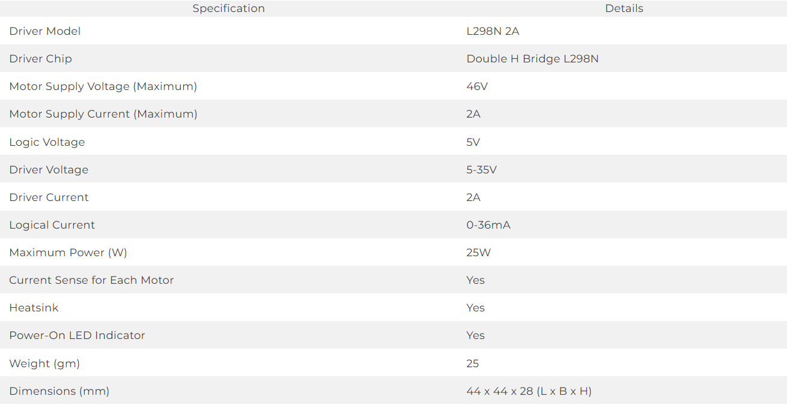
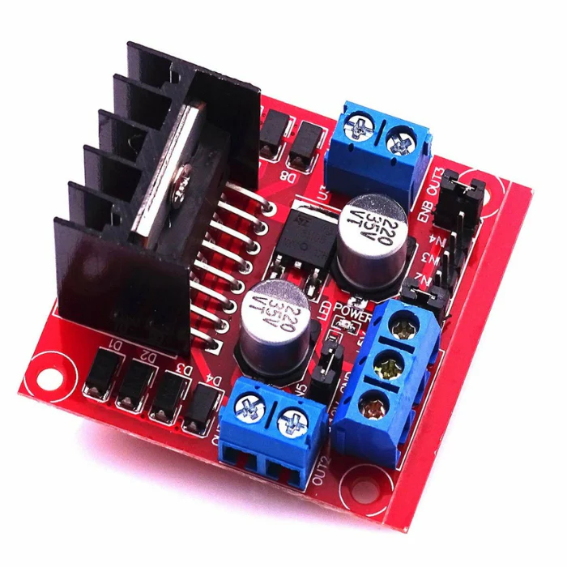
L298N Motor Driver Module

Slide 10
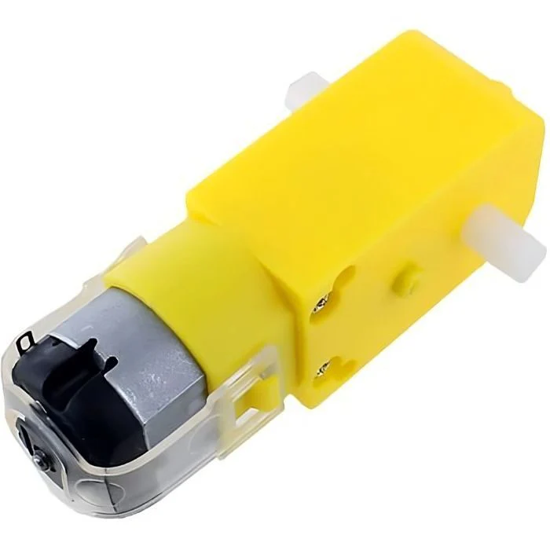
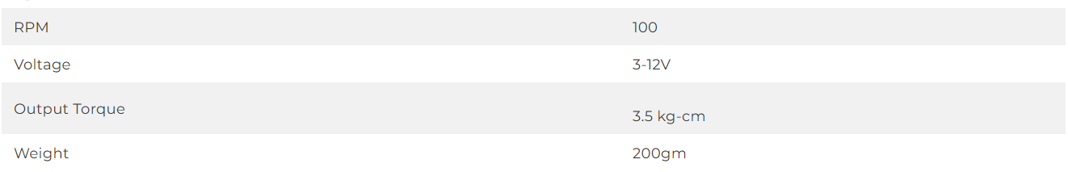
DC Motor

Slide 11
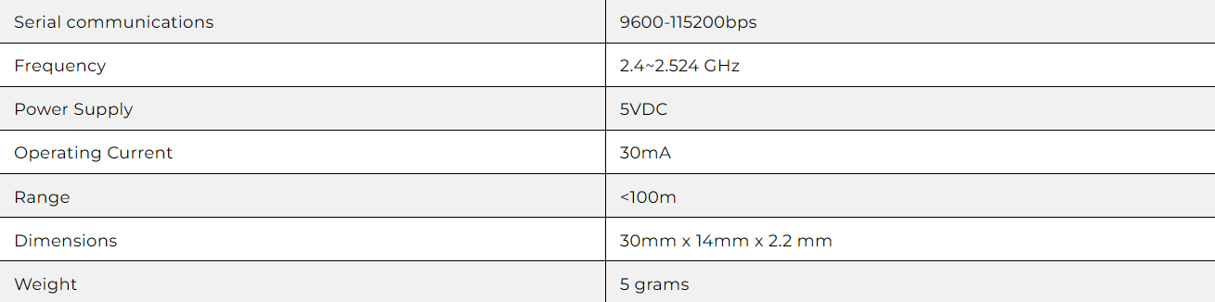
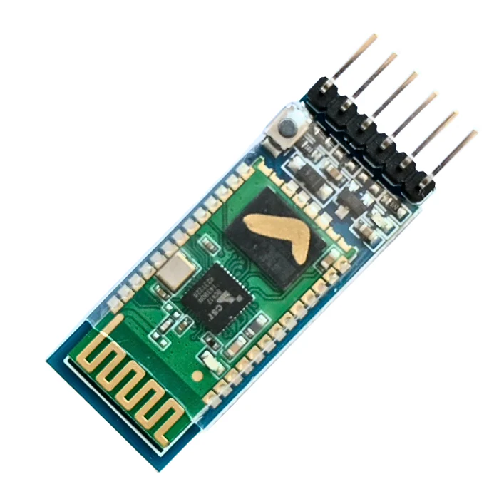
HC-05 Bluetooth Module

Slide 12
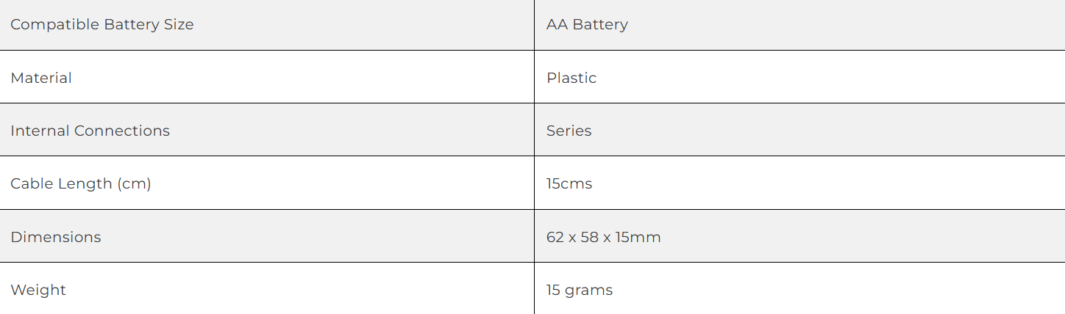
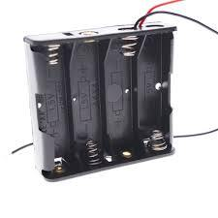
Battery Holder (Two for 12V)

Slide 13
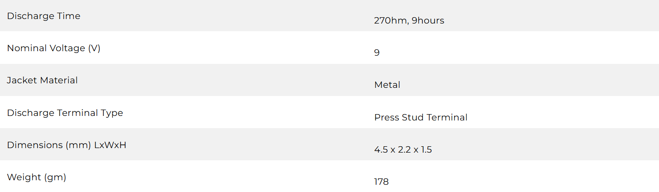
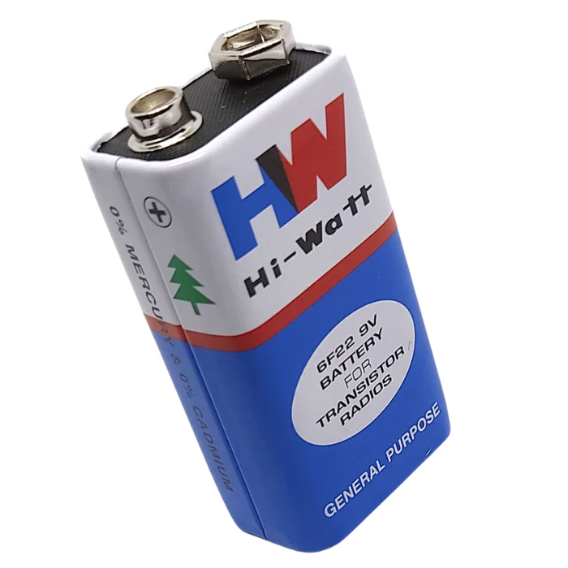
9V Battery

Slide 14
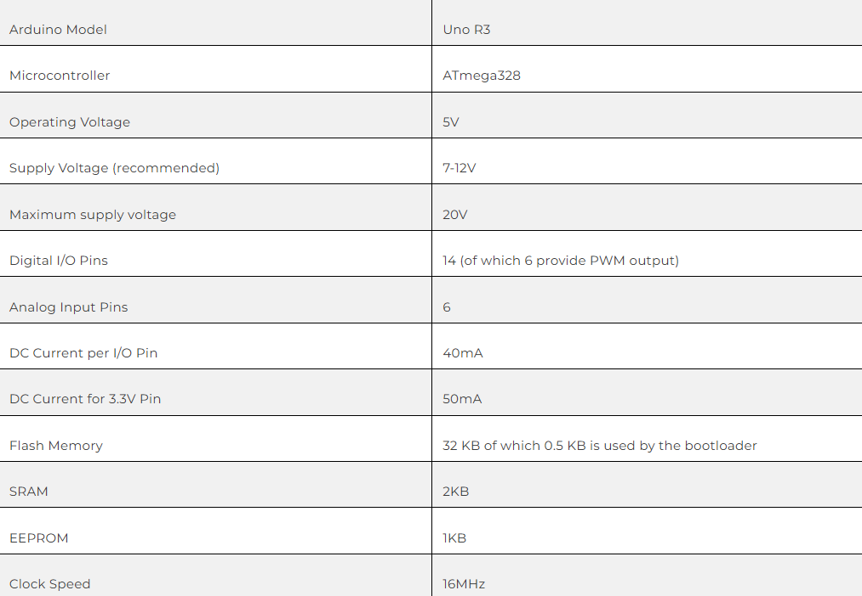
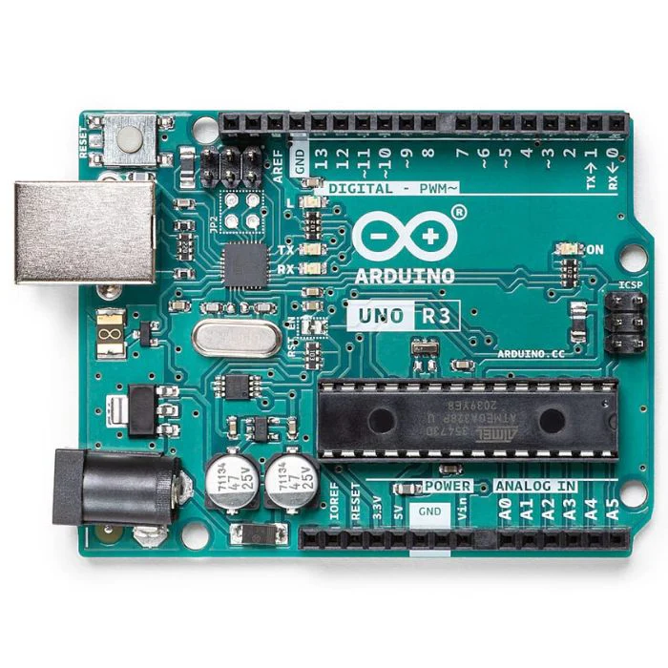
Arduino UNO R3

Slide 15
Work Done
Designed a floating waterproof body to support all components on water.
Installed DC motors for propulsion and connected them using the L298N motor driver.
Built a working conveyor mechanism to lift and collect floating waste.
Controlled the conveyor motor using the L298N motor driver.
Integrated all electronics with an Arduino Uno microcontroller.
Added HC-05 Bluetooth module for manual wireless control.
Wrote Arduino code to control movement directions and conveyor operation.

Slide 16
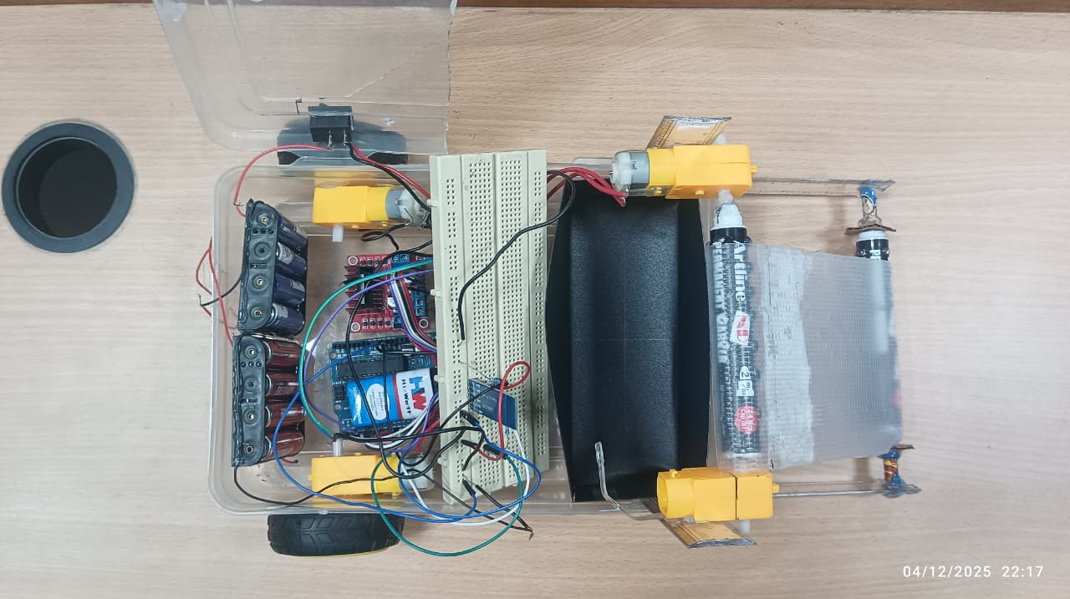
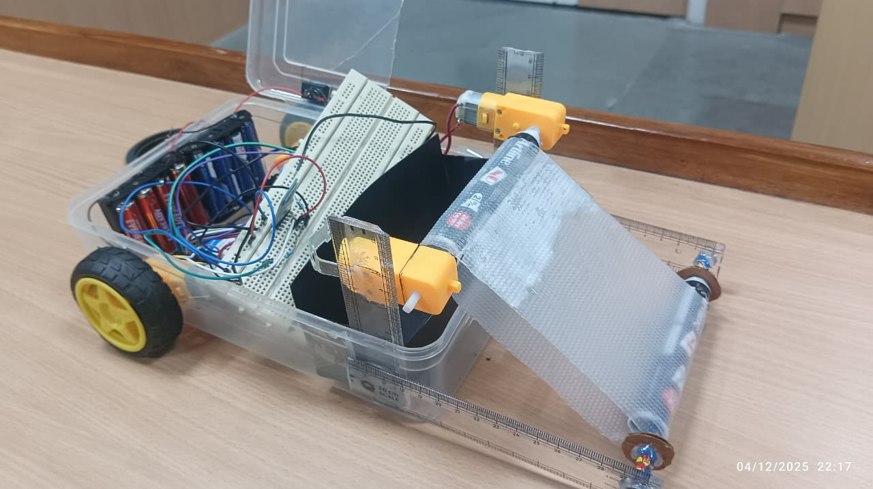
Results and Discussions
Results
The robot successfully operated using DC motors controlled through the L298N driver, with both the propeller system and the conveyor mechanism implemented effectively.
The conveyor mechanism effectively lifted small floating waste such as leaves and paper into the bin.
Bluetooth control via the HC-05 module worked smoothly, allowing manual operation from a mobile device.
Discussion
The DC motors and L298N driver provided stable control, enabling smooth movement and conveyor operation.
The conveyor effectively collected light debris but may require upgrades for heavier waste.
Bluetooth control worked reliably, though manual operation limits autonomy.
The prototype shows good potential but needs improvements in automation and load capacity.

Slide 17
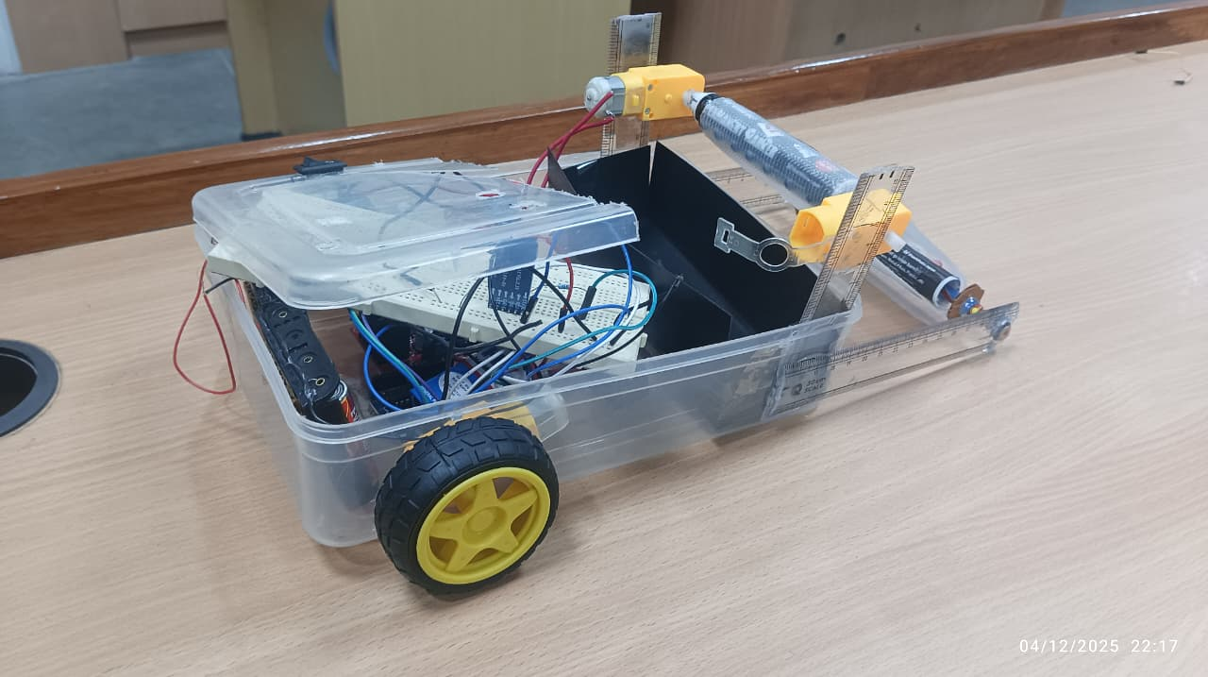
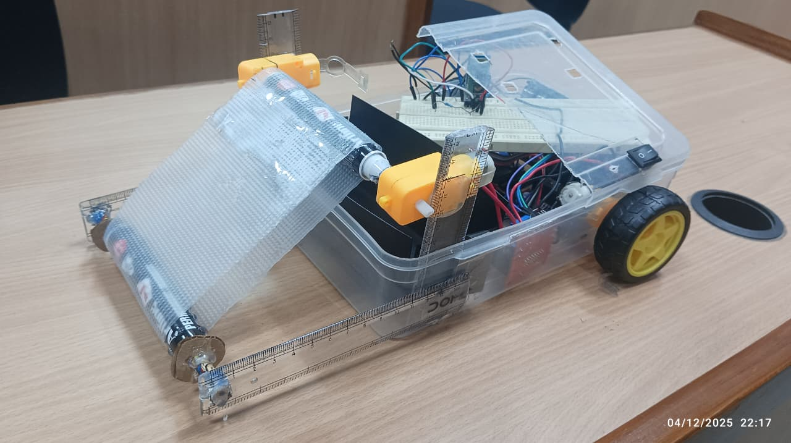
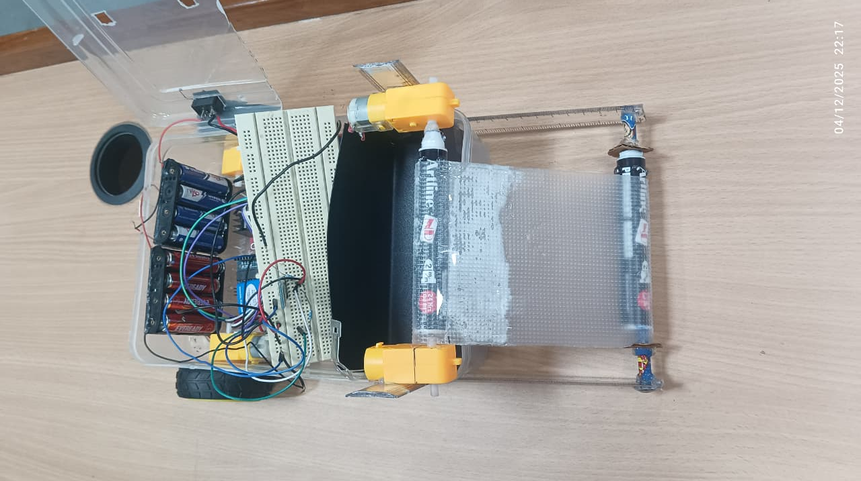
Results and Discussions

Slide 18
Conclusion
The robot successfully moves on water and collects floating waste using a conveyor mechanism.
Manual Bluetooth control (HC-05) makes it easy to operate and reduces human effort in cleaning.
Even without automatic sensors, the system works effectively as a low-cost water-cleaning prototype.
The project provides a good base for future improvements like sensor automation and solar power.

Slide 19
References
Archana, S. K., Adithya, S., Ashwini, P., & Ramya, K. R. (2024). Water cleaning RC boat. International Advanced Research Journal in Science, Engineering and Technology, 11(12), 5. https://iarjset.com/papers/water-cleaning-rc-boat
Trinadha, B., Reddy, K. M. D., Hemanth, B., HariKrishna, K., ManasaVeena, B., ReshmaDevi, B., & GeetaGayatri, B. (2024). Water surface trash collector via Bluetooth and Arduino integration. Journal of Nonlinear Analysis and Optimization, 15(1), 6.
Anilkumar, T., Abhiram, V., Sampath Kumar, K., Yashwanth Sai Ganesh, R., Bhavani Prasad, U., & Aditya Raj, P. (2024). Surface water cleaning robot (SWCR) for sustainable environmental protection. International Journal of Scientific Research & Engineering Trends, 10(5), 5.

Slide 20
Thanks!
-
-
-
-

