Slide 1
VENDING MACHINE
CONTROLLER SIMULATOR
Java Programming Project
Team No: 8
Student Name : MANNAVA NISHITHA (2620030113)
Student Name — RISHITHA GADDAM (2620030062)
VENDING MACHINE CONTROLLER SIMULATOR

Slide 2
Abstract
Project overview
A console-based Java simulation of a vending machine.
Offers Water (Rs.20), Chips (Rs.30), Juice (Rs.40) and Chocolate (Rs.50).
Accepts a product choice and payment amount, then checks whether payment is sufficient.
Calculates change for successful purchases and reports any shortfall.
Appends successful transaction details to transactions.txt.
Scope: a learning prototype; it does not connect to real payment hardware or physical dispensing equipment.
VENDING MACHINE CONTROLLER SIMULATOR

Slide 3
Understanding the Problem Statement
Problem to solve
A user needs a clear menu with fixed product prices.
The program must reject invalid menu choices safely.
It must compare the entered amount with the selected product price.
For sufficient payment, it should show success and calculate change.
For insufficient payment, it should explain how much more is required.
Successful purchases should be recorded for later review.
Expected result: a simple, repeatable purchase flow with understandable messages.
VENDING MACHINE CONTROLLER SIMULATOR

Slide 4
CO 1 Topics • Java Foundations
CO 1 • Java foundations
Variables: choice, amount, change and continueChoice store the current transaction state.
Primitive data type: int stores menu selections and whole-number rupee amounts.
Console I/O: Scanner reads keyboard input; System.out prints the menu and results.
Operators: = assigns values, == compares equality, >= checks sufficient payment, and - calculates change.
Product prices are initialized as integer values.
Example: change = amount - selected.price
VENDING MACHINE CONTROLLER SIMULATOR

Slide 5
CO 2 Topics • Control Flow
CO 2 • Selection and iteration
while (continueChoice == 1) repeats the purchase process.
for loop traverses the Product array and displays every product.
if checks whether the user selected Exit or entered an invalid choice.
if-else chooses between successful payment and insufficient payment.
break exits the purchase loop; continue returns to the next menu iteration.
These control-flow statements define the machine's decision-making.
VENDING MACHINE CONTROLLER SIMULATOR

Slide 6
CO 3 Topics • Methods & Arrays
CO 3 • Methods and arrays
Product[] p stores four Product objects in one array.
Array indexes begin at 0, so choice - 1 maps menu choices 1–4 to array positions 0–3.
The askAgain(Scanner sc) method displays the repeat-purchase question.
The method returns an int that controls whether the while loop continues.
Passing sc as a parameter lets the method reuse the same input reader.
Example: choice 3 selects p[2], which represents Juice.
VENDING MACHINE CONTROLLER SIMULATOR

Slide 7
CO 4 • OOP & Exception Handling
CO 4 • Object-oriented programming & exceptions
Product is a class that models a product using name and price fields.
The parameterized constructor Product(String name, int price) initializes each object.
new Product(...) creates objects for Water, Chips, Juice and Chocolate.
try-catch handles NumberFormatException when input is not a valid integer.
IOException is caught if saving a transaction to the file fails.
OOP benefit: each product keeps its related data together.
VENDING MACHINE CONTROLLER SIMULATOR

Slide 8
CO 5 • Strings & File I/O
CO 5 • Strings and file I/O
String concatenation builds a readable transaction record.
Path.of("transactions.txt") identifies the output file.
Files.writeString(...) writes the transaction record.
CREATE makes the file if it does not exist; APPEND preserves earlier records.
Only successful purchases reach the file-writing statement.
Example record: Water, Paid: Rs.50, Change: Rs.30
VENDING MACHINE CONTROLLER SIMULATOR

Slide 9
CO 6 • Testing & Future Scope
CO 6 • Testing and future enhancement
Test a valid product choice and sufficient payment.
Test insufficient payment and confirm the shortfall is displayed.
Test an invalid menu choice and non-numeric input.
Check that transactions.txt gains a new line after a successful purchase.
Future enhancement: use HashMap to count sales and a Stream to display a sorted sales report.
Note: collections and streams are proposed extensions; they are not implemented in the supplied code.
VENDING MACHINE CONTROLLER SIMULATOR

Slide 10
Conclusion
Conclusion
The simulator demonstrates a complete basic purchase flow in Java.
It combines console input, product objects, arrays and control-flow statements.
It validates menu selections and checks whether the payment covers the price.
It calculates change and records successful transactions in a text file.
The project can be extended with stock tracking, refunds, reports and a graphical interface.
Key learning: connecting Java fundamentals to a practical, everyday system.
VENDING MACHINE CONTROLLER SIMULATOR

Slide 11
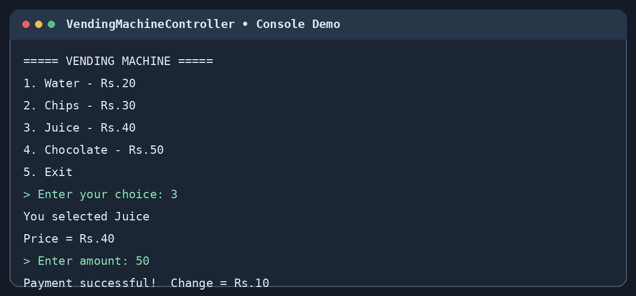
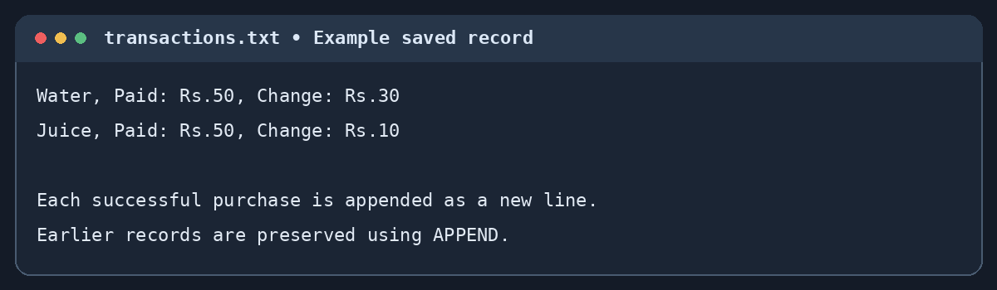
Screen Shots • Sample Program Output
2. Transaction log saved to file
1. Product selection and payment
Illustrative sample output — run the Java program to capture actual screenshots.
VENDING MACHINE CONTROLLER SIMULATOR

Slide 12
Thank you

