Slide 1
HEART DISEASE PREDICTION
TEAM:-
K.RISHITHA 2203A51L84
D.NEELA LOHITHA 2203A51L08
A.SMINU 2203A51L05
Y.SRINITHA 2203A51L68

Slide 2
1.INTRODUCTION
According to the World Health Organization, every year 12 million deaths occur worldwide due to Heart Disease. Heart disease is one of the biggest causes of morbidity and mortality among the population of the world. Prediction of cardiovascular disease is regarded as one of the most important subjects in the section of data analysis. The load of cardiovascular disease is rapidly increasing all over the world from the past few years. Many researches have been conducted in attempt to pinpoint the most influential factors of heart disease as well as accurately predict the overall risk. Heart Disease is even highlighted as a silent killer which leads to the death of the person without obvious symptoms. The early diagnosis of heart disease plays a vital role in making decisions on lifestyle changes in high-risk patients and in turn reduces the complications. Machine learning proves to be effective in assisting in making decisions and predictions from the large quantity of data produced by the health care industry. This project aims to predict future Heart Disease by analyzing data of patients which classifies whether they have heart disease or not using machine-learning algorithm. Machine Learning techniques can be a boon in this regard. Even though heart disease can occur in different forms, there is a common set of core risk factors that influence whether someone will ultimately be at risk for heart disease or not. By collecting the data from various sources, classifying them under suitable headings & finally analysing to extract the desired data we can say that this technique can be very well adapted to do the prediction of heart disease

Slide 3
1.INTRODUCTION
1.2.Existing system
Heart disease is even being highlighted as a silent killer which leads to the death of a person without obvious symptoms. The nature of the disease is the cause of growing anxiety about the disease & its consequences. Hence continued efforts are being done to predict the possibility of this deadly disease in prior. So that various tools & techniques are regularly being experimented with to suit the present-day health needs. Machine Learning techniques can be a boon in this regard. Even though heart disease can occur in different forms, there is a common set of core risk factors that influence whether someone will ultimately be at risk for heart disease or not. By collecting the data from various sources, classifying them under suitable headings & finally analysing to extract the desired data we can conclude. This technique can be very well adapted to the do the prediction of heart disease. As the well-known quote says “Prevention is better than cure”, early prediction & its control can be helpful to prevent & decrease the death rates due to heart disease.

Slide 4
1.INTRODUCTION
1.3.Problem system
The major challenge in heart disease is its detection. There are instruments available which can predict heart disease but either it are expensive or are not efficient to calculate chance of heart disease in human. Early detection of cardiac diseases can decrease the mortality rate and overall complications. However, it is not possible to monitor patients everyday in all cases accurately and consultation of a patient for 24 hours by a doctor is not available since it requires more sapience, time and expertise. Since we have a good amount of data in today’s world, we can use various machine learning algorithms to analyze the data for hidden patterns. The hidden patterns can be used for health diagnosis in medicinal data

Slide 5
1.INTRODUCTION
1.4.Object definition
The goal of our heart disease prediction project is to determine if a patient should be diagnosed with heart disease or not, which is a binary outcome, so: Positive result = 1, the patient will be diagnosed with heart disease.

Slide 6
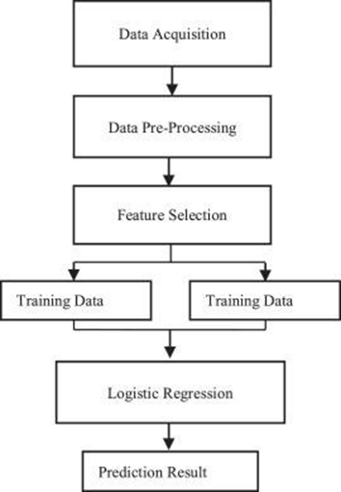
1.5.ARCHITECTURE

Slide 7
2.LITERATURE SURVEY
2.1.survey details
Machine learning is helpful for a variety of situations. The prediction of dependent variable values from independent variables is one of the uses of this methodology. Our methodology involves Linear Regression . Machine learning and statistical models have been widely used for stock price prediction. Researchers have explored various techniques and algorithms, including linear regression, Lasso regression, and logistic regression, to identify patterns and trends in historical stock prices and other relevant data sources. [1] Purushottam ,et ,al proposed a paper “Efficient Heart Disease Prediction System” using hill climbing and decision tree algorithms .They used Cleveland dataset and preprocessing of data is performed before using classification algorithms. [2] Santhana Krishnan. J ,et ,al proposed a paper “Prediction of Heart Disease Using Machine Learning Algorithms” using decision tree and Naive Bayes algorithm for prediction of heart disease. In decision tree algorithm the tree is built using certain conditions which gives True or False decisions.

Slide 8
2.LITERATURE SURVEY
2.1.survey details
[3] Sonam Nikhar et al proposed paper “ Prediction of Heart Disease Using Machine Learning Algorithms” their research gives point to point explanation of Naïve Bayes and decision tree classifier that are used especially in the prediction of Heart Disease. [4] Aditi Gavhane et al proposed a paper “Prediction of Heart Disease Using Machine Learning”, in which training and testing of dataset is performed by using neural network algorithm multilayer perceptron. In this algorithm there will be one input layer and one output layer and one or more layers are hidden layers between these two input and output layers. [5] Avinash Golande et al, proposed “Heart Disease Prediction Using Effective Machine Learning Techniques” in which few data mining techniques are used that support the doctors to differentiate the heart disease. Usually utilized methodologies are k-nearest neighbour, Decision tree and Naïve Bayes. Other unique characterization-based strategies utilized are packing calculation, Part thickness, consecutive negligible streamlining and neural systems, straight Kernel selfarranging guide and SVM (Bolster Vector Machine).

Slide 9
3. DATA PRE-PROCESSING
3.1.Data set
It's a clean, easy to understand set of data. However, the meaning of some of the column headers are not obvious. Here's what they mean,
age: The person's age in yearssex: The person's sex (1 = male, 0 = female)
cp: The chest pain experienced (Value 1: typical angina, Value 2: atypical angina, Value 3: non-anginal pain, Value 4: asymptomatic)
trestbps: The person's resting blood pressure (mm Hg on admission to the hospital)
chol: The person's cholesterol measurement in mg/dl
fbs: The person's fasting blood sugar (> 120 mg/dl, 1 = true; 0 = false)
restecg: Resting electrocardiographic measurement (0 = normal, 1 = having ST-T wave abnormality, 2 = showing probable or definite left ventricular hypertrophy by Estes' criteria)
thalach: The person's maximum heart rate achieved
exang: Exercise induced angina (1 = yes; 0 = no)
oldpeak: ST depression induced by exercise relative to rest ('ST' relates to positions on the ECG plot. See more here)

Slide 10
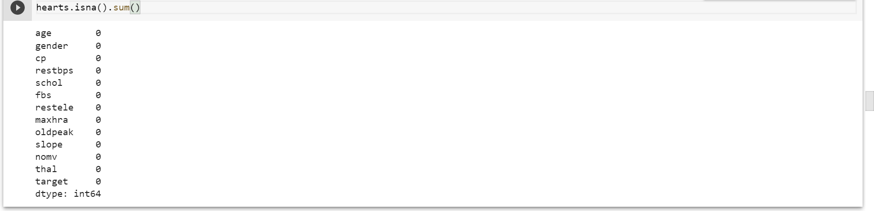
slope: the slope of the peak exercise ST segment (Value 1: upsloping, Value 2: flat, Value 3: downsloping)
ca: The number of major vessels (0-3)
thal: A blood disorder called thalassemia (3 = normal; 6 = fixed defect; 7 = reversable defect)
target: Heart disease (0 = no, 1 = yes
3.2.Data cleaning
Data cleaning is the process of fixing or removing incorrect, corrupted, in correctly formatted, duplicate, or incomplete data within a dataset. When combining multiple data sources, there are many opportunities for data to be duplicated or mislabeled.

Slide 11
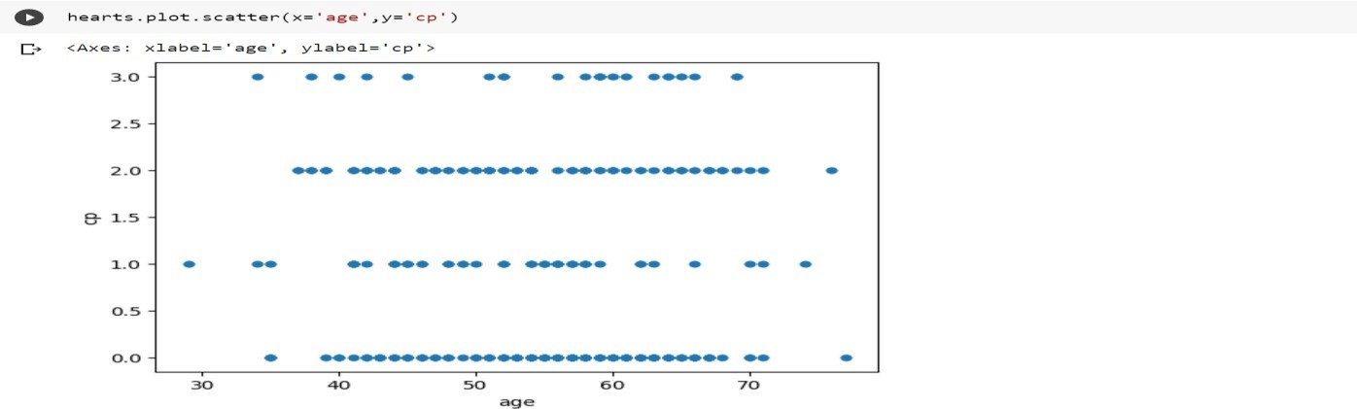
3.3 DATA VISUALIZATION
FIG 3.1:

Slide 12
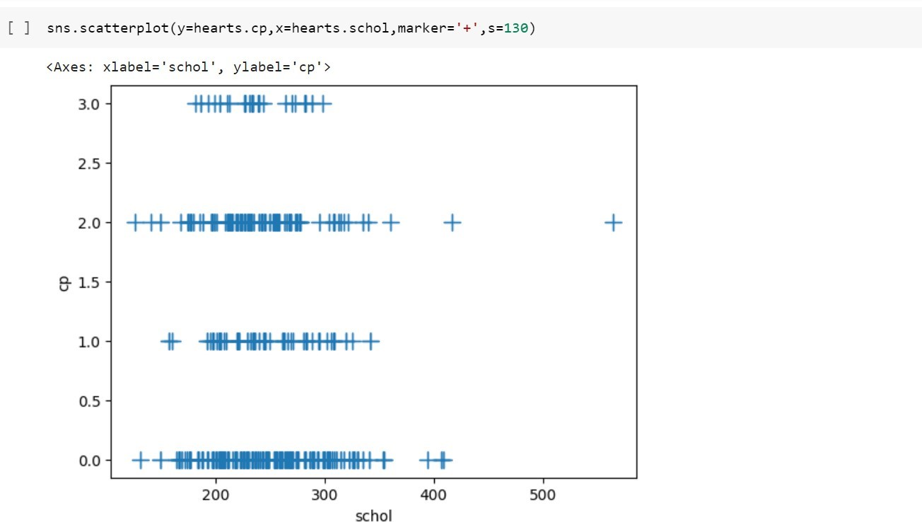
FIG 3.2 DATA VISUALIZATION

Slide 13
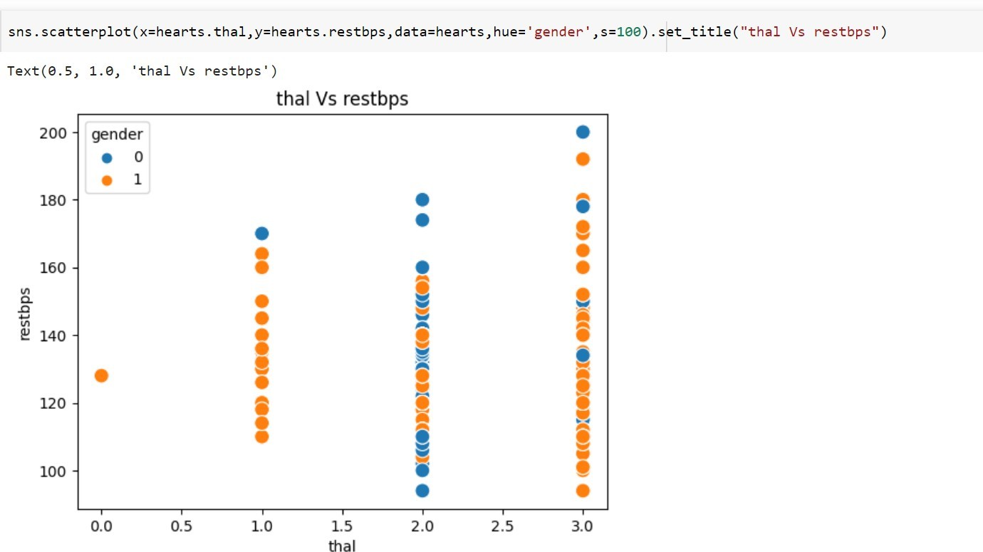
FIG 3.3

Slide 14
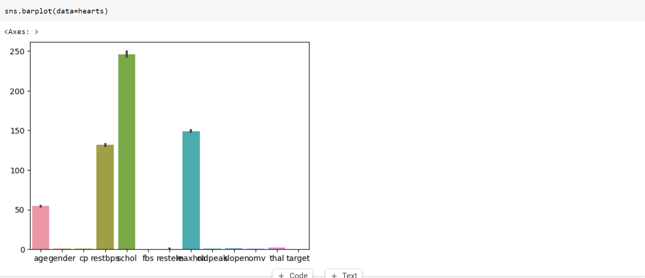
FIG 3.4

Slide 15
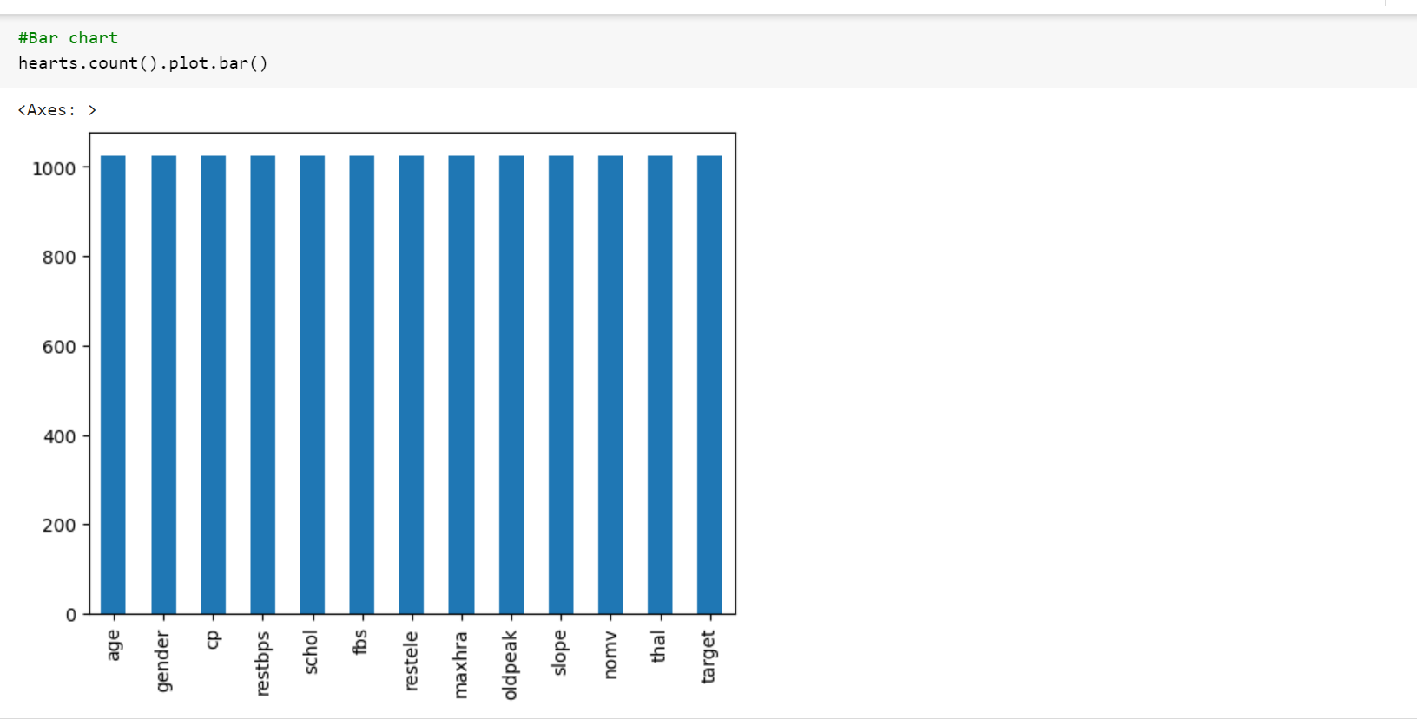
FIG 3.5

Slide 16
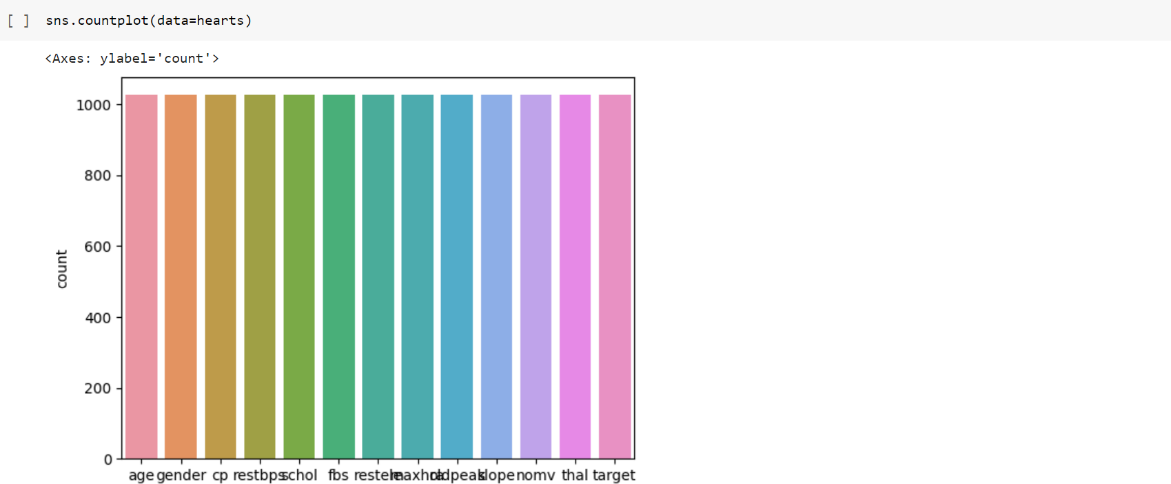
FIG 3.6

Slide 17
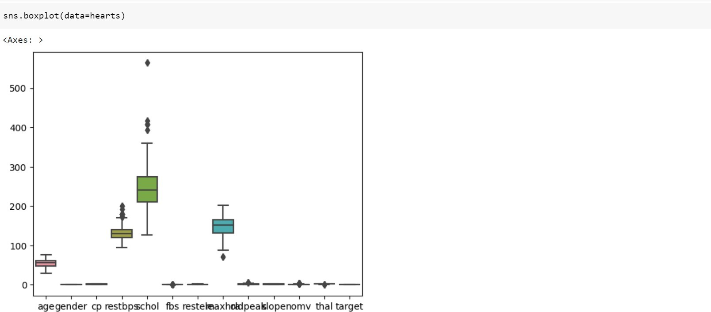
FIG 3.7

Slide 18
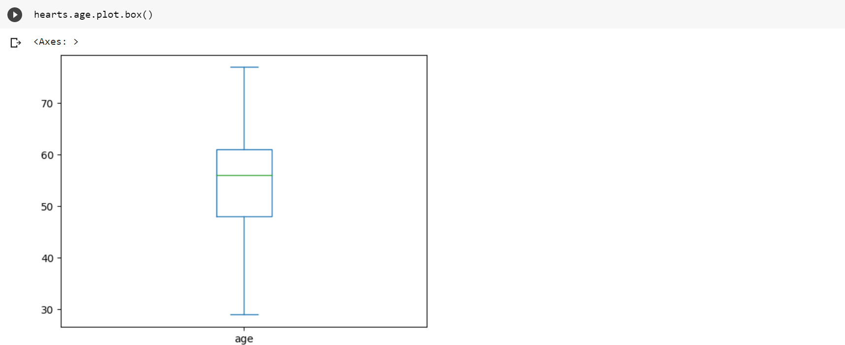
FIG 3.8

Slide 19
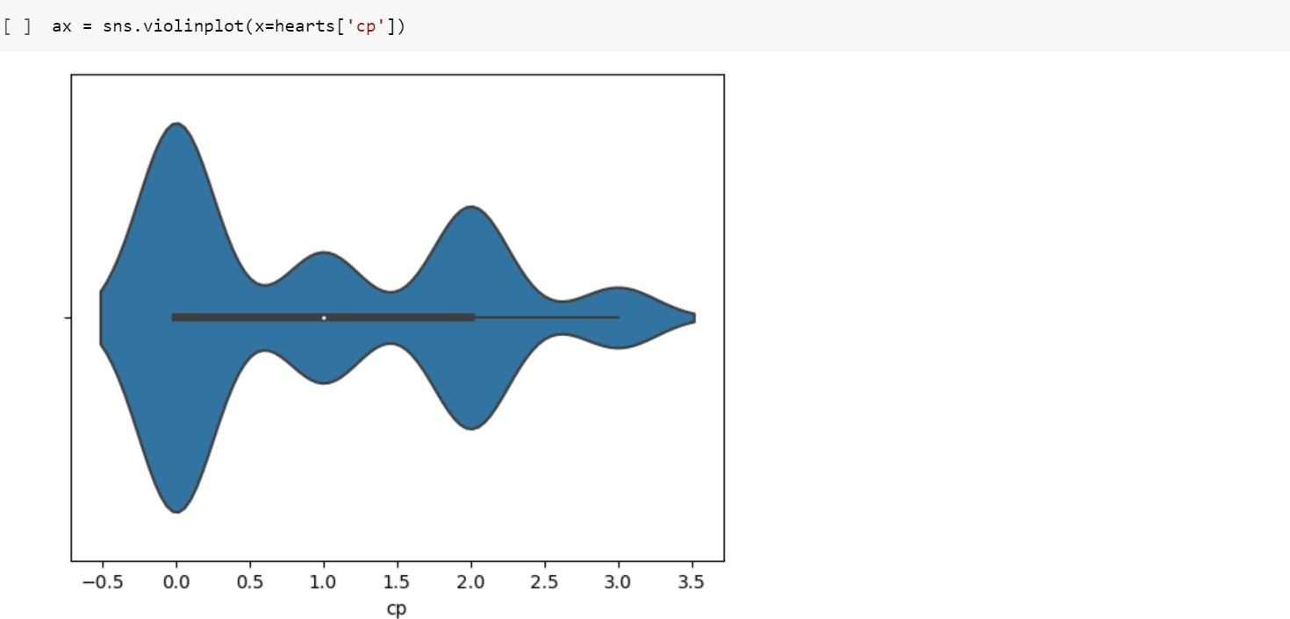
F
FIG 3.9

Slide 20
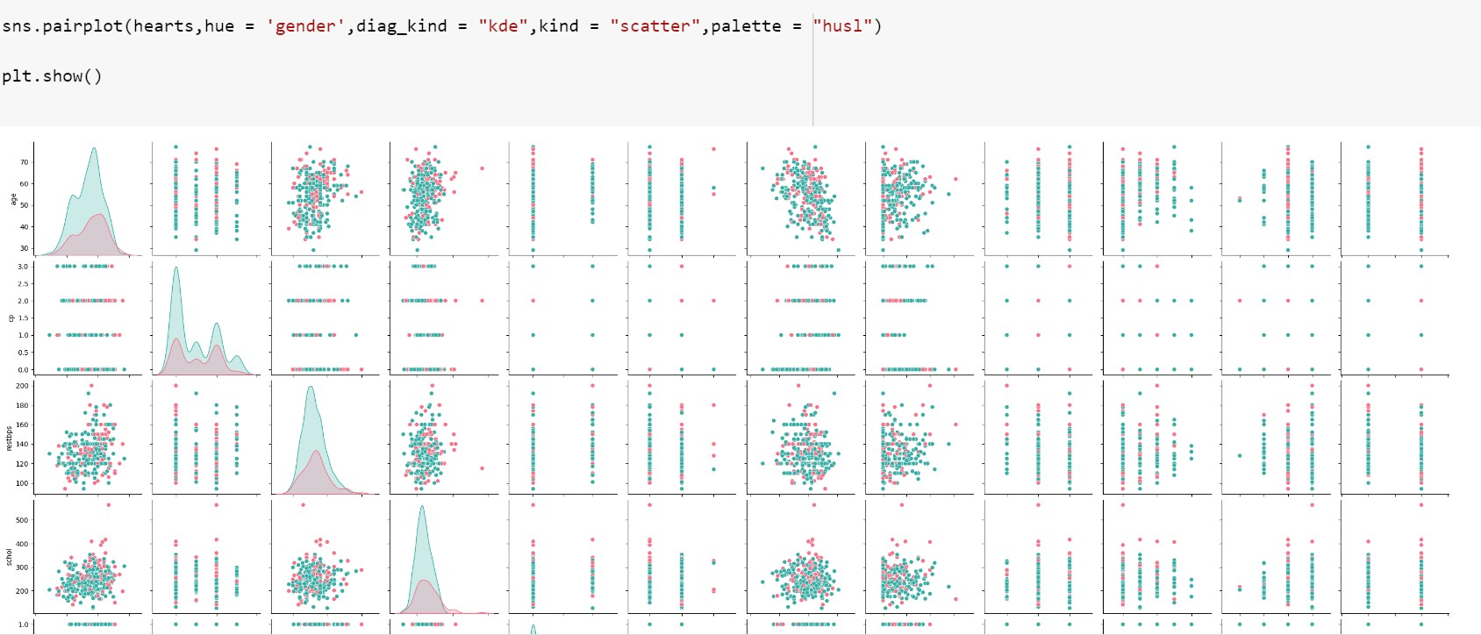
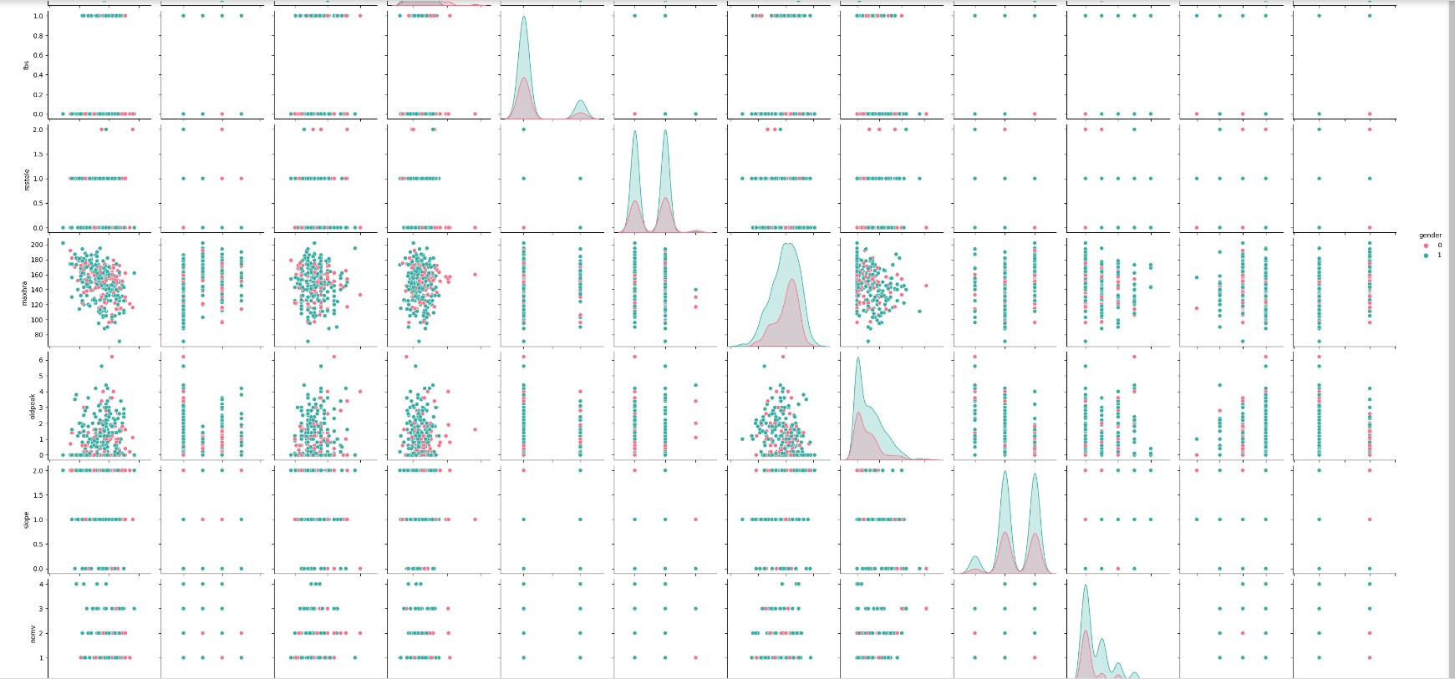
FIG 3.10

Slide 21
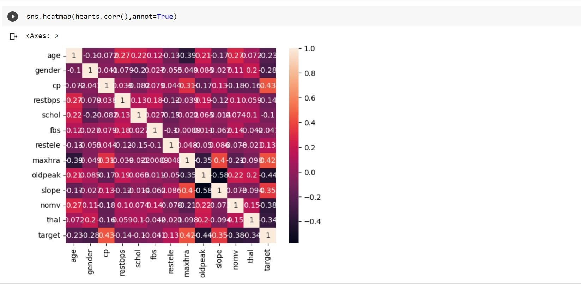
FIG 3.11

Slide 22
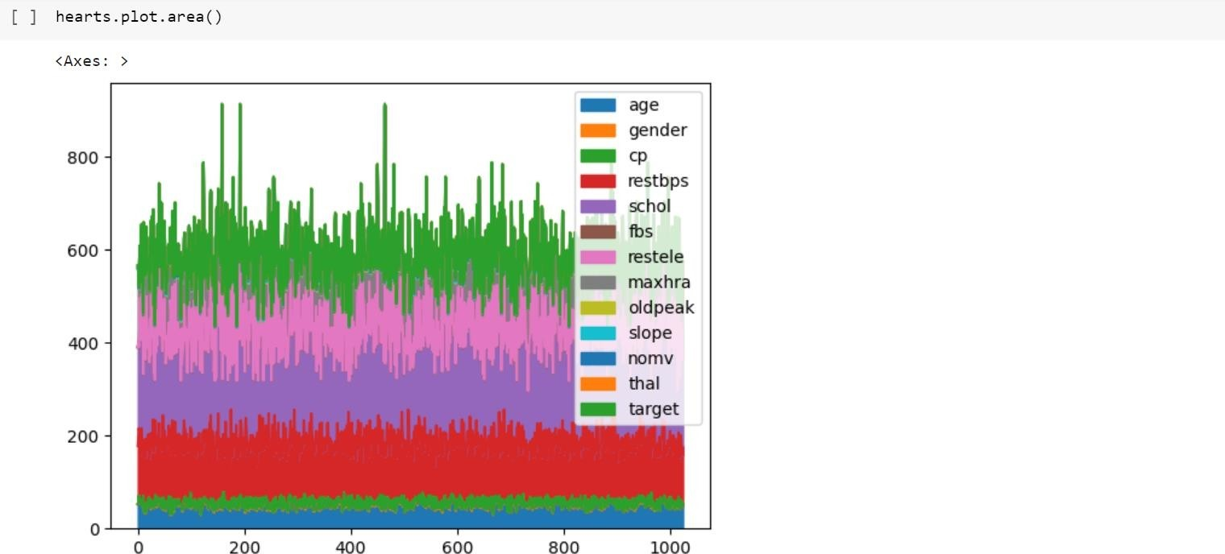
FIG 3.12

Slide 23
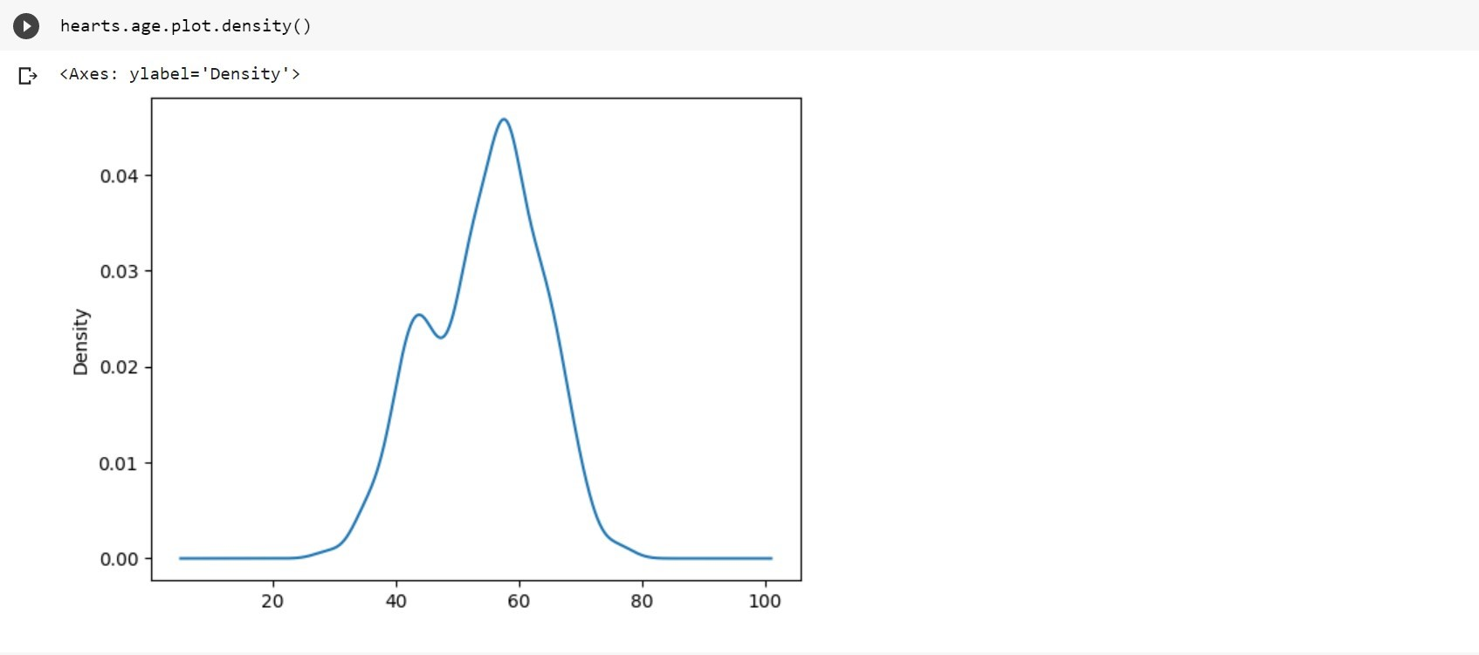
FIG 3.13

Slide 24
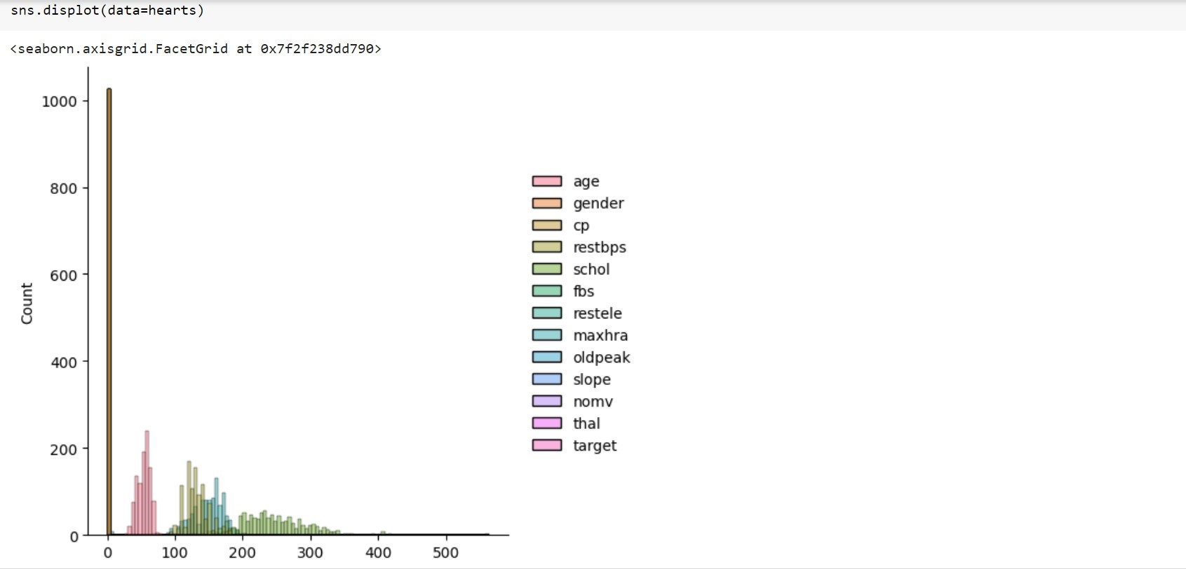
FIG 3.14

Slide 25
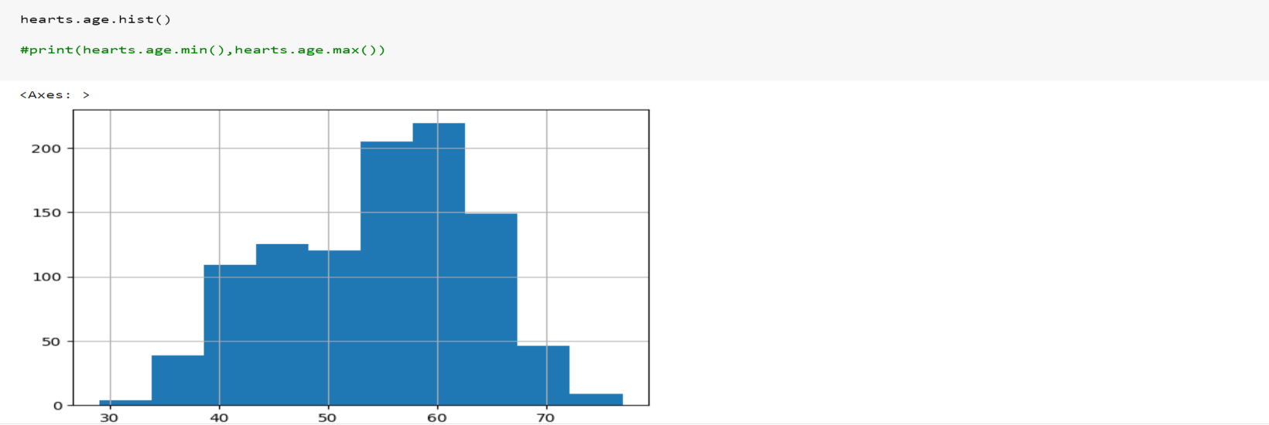
FIG 3.15

Slide 26
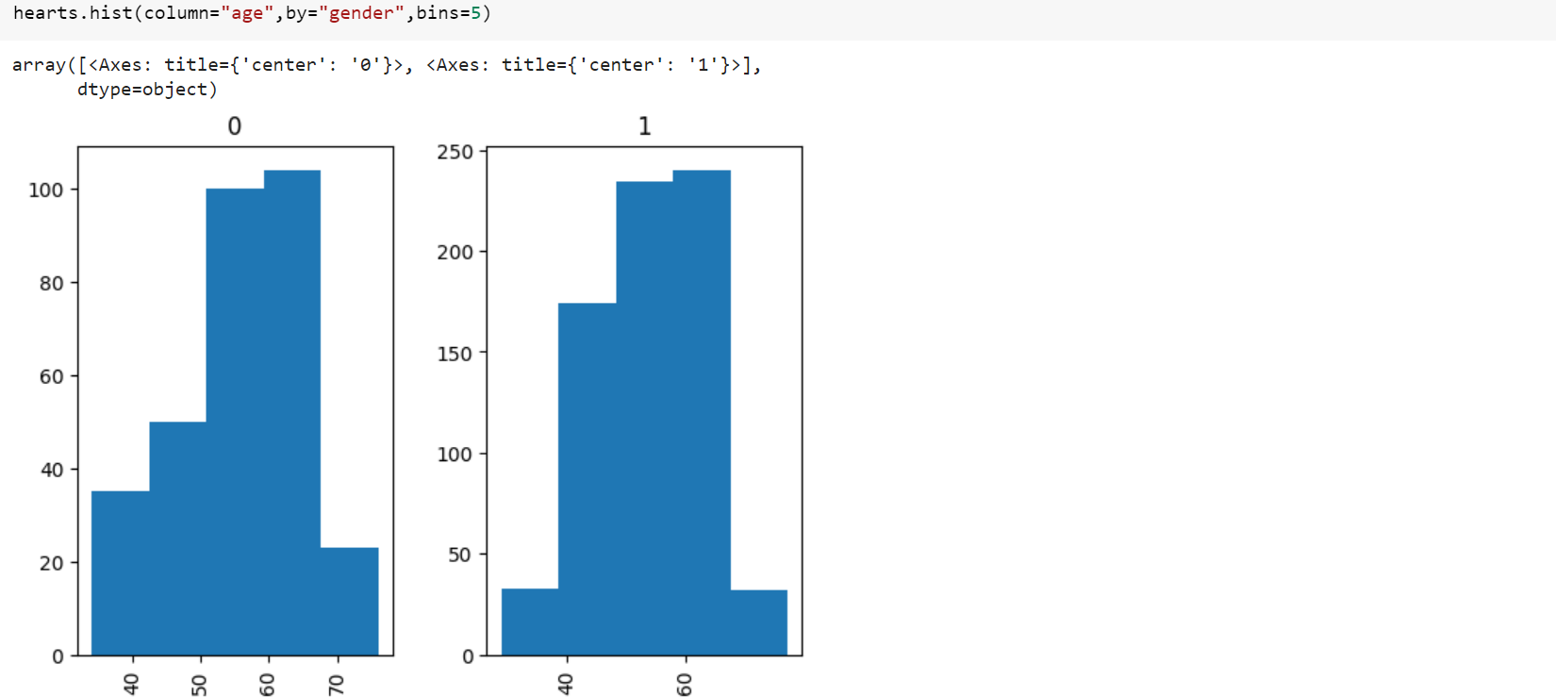
FIG 3.16

Slide 27
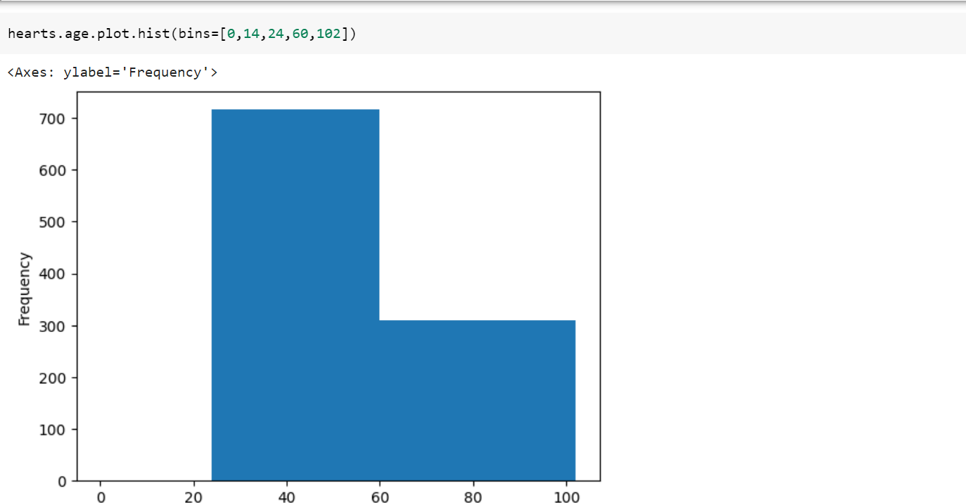
FIG 3.17

Slide 28
4.METHODOLOGY
4.1.PROCEDURE TO SOLVE THE PROBLEM
1.Download data set in CSV form.
2.Upload to Google Drive .
3.Connect Google Drive to Google colab.
4.Loading the data from CSV files to pandas data frame.
5.Understanding the data.
6.Checking missing values.
7.Checking distribution of categorical values.
8.Encoding certain columns.
9.Display linear regression model manually.
10.Set the best possible equation.
11.Obtain the main error for comparison and further study. If possible, find which feature variable is affecting the target variable This section talks about the algorithms used for the project. We are used algorithm linear regression.

Slide 29
4.METHODOLOGY
4.2.Models used
● Linear regression model
4.3.Software description
In our program we use Python 3 programming language. Python interpreted object oriented high level programming language with dynamic semantics. It’s high level built in data structures combined with dynamic typing and dynamic building make it very attractive for rapid application development as well As for use as a scripting or glue language to connect existing components together. Pythons. Simply easy to learn syntax emphasizes readability and therefore reduces the cost of program maintenance. Python support modules and packages which encourages program modularity and code review. The Python interpreter and the extensive standard library are available in source or binary form without charge for all major platforms, and can be free distributed.

Slide 30
5.RESULTS AND DISCUSSION
The proposed system is trained and tested over the dataset taken. We use a linear regression classifier model to predict heart disease. The model is very popular and we investigate in predicting very accurately. The output of the algorithm is evaluated from confusion matrix using some measures like accuracy. Accuracy- it defines how often the model predicts the correct output. It will guess the correct value of data

Slide 31
6.CONCLUSION AND FUTURE SCOPE
The overall objective of our project is to predict accurately with less number of tests and attributes the presence of heart disease. In this project, fourteen attributes are considered which form the primary basis for tests and give accurate results more or less. Many more input attributes can be taken but our goal is to predict with less number of attributes and faster efficiency to predict the risk of having heart disease at a particular age span.
This is the most effective model to predict patients with heart disease. This project could answer complex queries, each with its own strength with respect to ease of model interpretation, access to detailed information and accuracy.
This project can be further enhanced and expanded. For example, it can incorporate other medical attributes besides the 14 attributes we used. It can also incorporate other data mining techniques, e.g., Time Series, Clustering and Association Rules. Continuous data can also be used instead of just categorical data. Another area is to use Text Mining to mine the vast amount of unstructured data available.

Slide 32
6.CONCLUSION AND FUTURE SCOPE
Future scope
we are planning to introduce an efficient disease prediction system to predict the heart disease with better accuracy using Support Vector Machine (SVM). Our project aims to provide a web platform to predict the occurrences of disease based on various symptoms. The user can select various symptoms and can find the diseases with their probabilistic figures. Our project can be improved by implementing medicine suggestion to the patient along with the results. We can implement a feedback from the experienced doctors who can give their views and opinions about certain medicines /practices done by the doctor on the patient. We can implement a live chat option where the patient can chat with a doctor available regarding medication for the respective result for their symptoms. Our project could be used as a training tool for Nurses and Doctors who are freshly introduced in the field related to heart diseases. The patient can have a choice in choosing the medicines he/she should take in order to have a healthier life. Moreover, if implemented on a large scale it can be used in medical facilities like hospital, clinics where a patient wouldn’t have to wait in long queues for treatment if he is feeling symptoms related to heart disease

Slide 33
7.REFERENCES
M. K. Awang and F. Siraj, “Utilization of an artificial neural network in the prediction of heart disease,” Int. J. Bio-Science Bio-Technology, vol. 5, no. 4, pp. 159–165, 2013.
P. Selvakumar and S. P. Rajagopalan, “A survey on neural network models for heart disease prediction,” J. Theor. Appl. Inf. Technol., vol. 67, no. 2, pp. 485–497, 2014.
A. Methaila, P. Kansal, H. Arya, and P. Kumar, “Early Heart Disease Prediction Using Data Mining Techniques,” vol. 6956, no. October, pp. 53–59, 2014.
I. S. F. Dessai, “Intelligent Heart Disease Prediction System Using Probabilistic Neural Network,” no. 5, pp. 38–44, 2013.
T. Karayilan and Ö. Kiliç, “Prediction of Heart disease using neural network,” in 2nd International Conference on Computer Science and Engineering, UBMK 2017, 2017, pp. 719– 723.
M. Mardiyono, R. Suryanita, and A. Adnan, “Intelligent Monitoring System on Prediction of Building Damage Index using Neural-Network,” TELKOMNIKA (Telecommunication Comput. Electron. Control., vol. 10, no. 1, p. 155, 2015.
N. Guru, A. Dahiya, and N. Rajpal, “Decision support system for heart disease diagnosis using Neural Network,” 2007.

Slide 34
THANKYOU

