Slide 1
IBM AICTE PROJECT
RESEARCH AGENT
Presented By:
Student name : Pemmireddy Sai Rishitha
College Name :Kakinada Institute Of Engineering And Technology For Women Department : Artificial intelligence and Data science

Slide 2
OUTLINE
Problem Statement
Technology used
Wow factor
End users
Result
Conclusion
Git-hub Link
Future scope
IBM Certifications

Slide 3
PROBLEM STATEMENT
Researchers, students, and professionals often struggle to stay updated with the rapidly growing volume of academic publications, technical articles, datasets, and evolving research trends. Manually reviewing, filtering, and synthesizing information across multiple domains is time-consuming and inefficient.
Proposed Solution:
An AI Research Agent that uses Natural Language Processing (NLP), Retrieval- Augmented Generation (RAG), to assist users in conducting efficient literature reviews, generating summaries, identifying research gaps, and recommending relevant papers, datasets, or collaborators.

Slide 4
TECHNOLOGY USED
IBM cloud lite services
Natural Language Processing (NLP)
Retrieval Augmented Generation (RAG) IBM Granite model

Slide 5
IBM CLOUD SERVICES USED
IBM Cloud Watsonx AI Studio
IBM Cloud Watson.x AI runtime
IBM Cloud Agent Lab
IBM Granite foundation model

Slide 6
WOW FACTORS
This agent will significantly reduce research time, improve the quality of literature reviews, help early- stage researchers find direction, and foster interdisciplinary collaboration by making knowledge more accessible and actionable.
Unique features:
Semantic search across research papers, journals, and datasets
Auto-summarization of selected papers
Citation and reference analysis to trace influence
Recommendation of research papers based on a user’s current topic
Trend analysis over time for specific keywords or domains.
Collaboration mapping: suggests potential co-authors or institutions based on similar research interests.

Slide 7
END USERS
Academic Researchers
Research Institutions and Universities
Industry R&D Teams
Educators

Slide 8
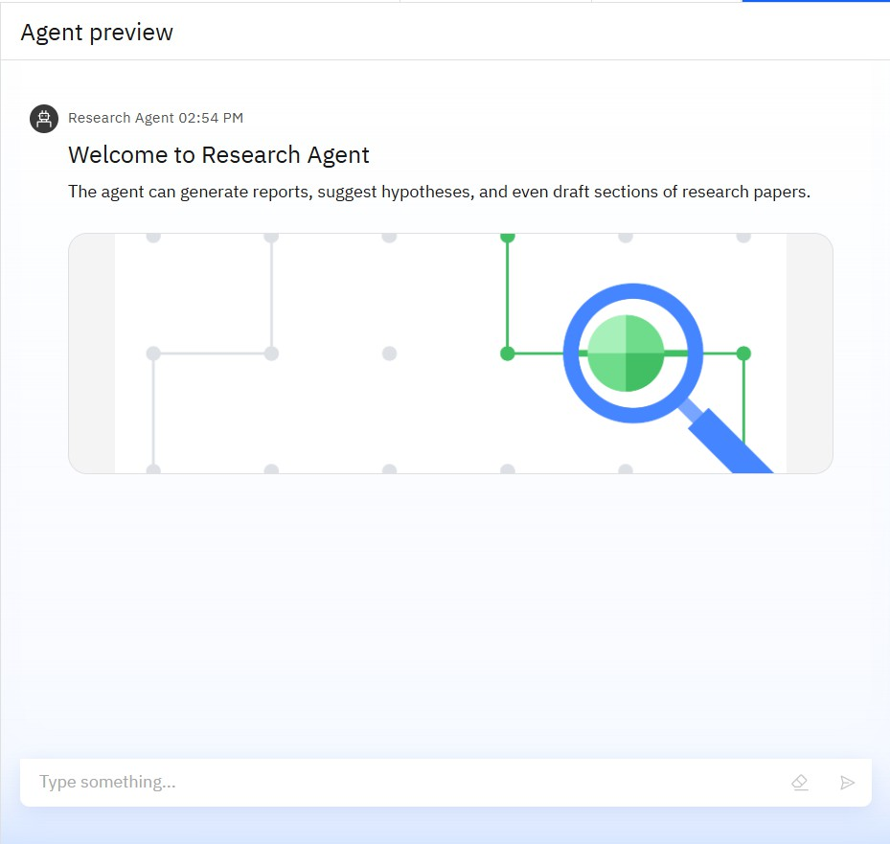
RESULTS
Topic: Introduction to the Research Agent tool.
Functionality of Research Agent:
Can generate research reports based on
queries.
Can suggest hypotheses for research work.
Can draft sections of research papers, helping in academic writing.
Purpose: Helps users streamline research tasks and document preparation.
Visual Representation: Shows an illustration symbolizing research and analysis (magnifying glass and connection nodes).

Slide 9
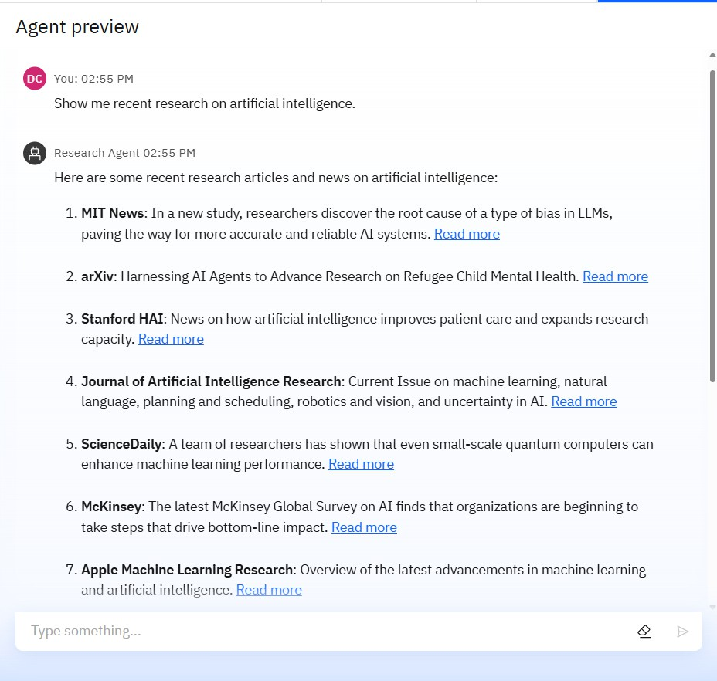
RESULTS
Topic: Recent research articles and news on Artificial Intelligence (AI).
Sources Mentioned:
MIT News: Research on identifying and addressing bias in large language models (LLMs).
arXiv: Use of AI agents in research on refugee child mental health.
Stanford HAI: AI advancements improving patient care and expanding research capacity.
Journal of Artificial Intelligence Research: Focus on machine learning, natural language processing, robotics, vision, and AI uncertainty.
ScienceDaily: Study showing quantum computers improving machine learning performance.
McKinsey: AI adoption trends in organizations for better bottom-line impact.
Apple Machine Learning Research: Overview of the
latest developments in AI and machine learning.
Result Type: A summarized list of recent research updates and publications on AI.

Slide 10
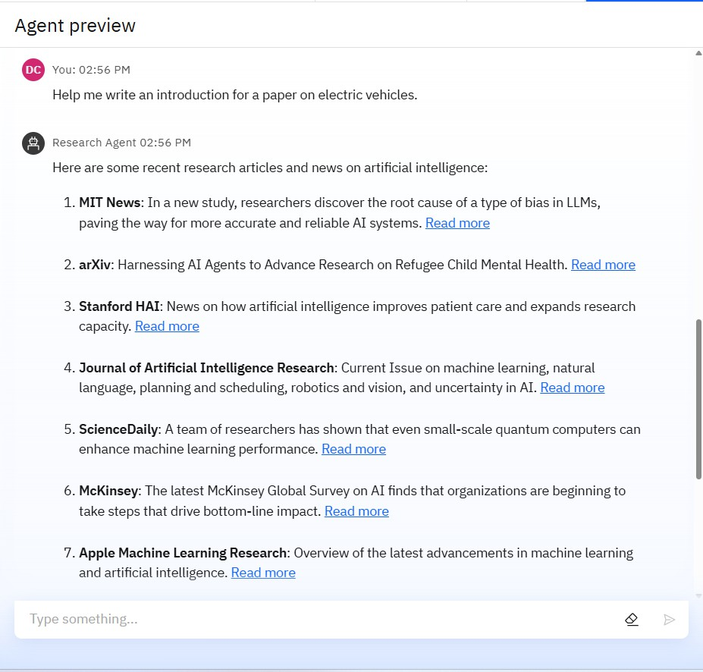
RESULTS
User Request: Asked for help in writing an introduction for a paper on electric vehicles.
Research Agent Response: Provided a list of recent research articles and news related to artificial intelligence (not electric vehicles), including:
MIT News: Discovery of the root cause of bias in large language models (LLMs).
arXiv: Use of AI agents for advancing research on refugee child mental health.
Stanford HAI: How AI improves patient care and expands research capacity.
Journal of Artificial Intelligence Research: Topics include machine learning, NLP, robotics, vision, and uncertainty in AI.
ScienceDaily: Research showing small-scale quantum computers enhancing machine learning performance.
McKinsey: Global survey on AI showing its impact on business outcomes.
Apple Machine Learning Research: Latest
advancements in machine learning and AI.
Mismatch: The research results were related to AI, not
electric vehicles, which was the user's original request.

Slide 11
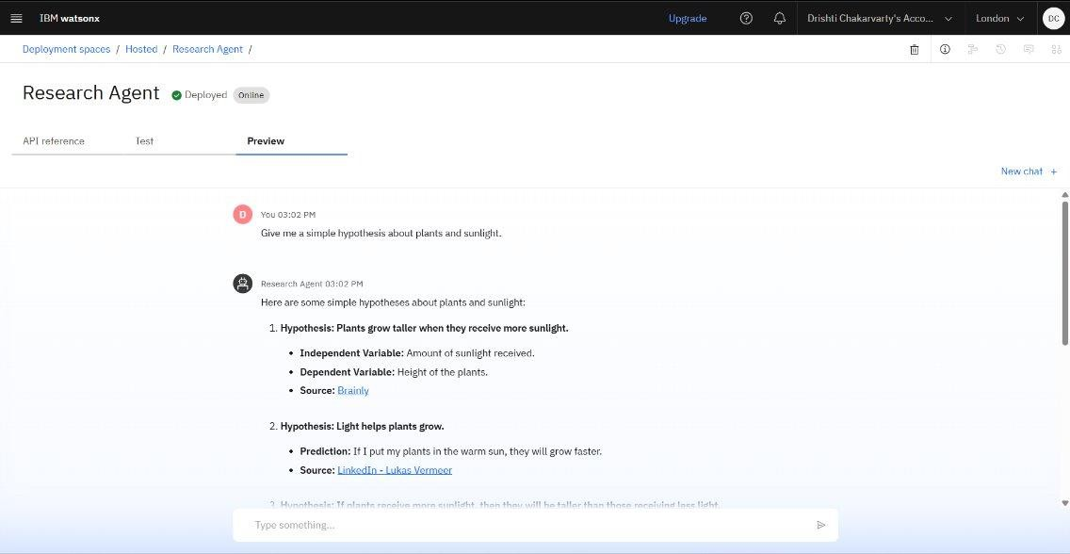
RESULTS
Deployed AI Agent

Slide 12
CONCLUSION
The agent can generate reports, suggest hypotheses, and even draft sections of research papers.
It saves time by automating repetitive tasks like citation management and data extraction.
Research Agents enhance efficiency, accuracy, and innovation in both academic and industrial R&D.

Slide 13
GITHUB LINK
https://github.com/rishithapemmireddy/Research-Agent.git

Slide 14
FUTURE SCOPE
Multilingual Research Support
Voice-Activated Research Assistant
Real-Time Collaboration Features
Research Gap and Novel Topic Identification
Integration with Publishing Platforms
AI-Assisted Paper Drafting

Slide 15
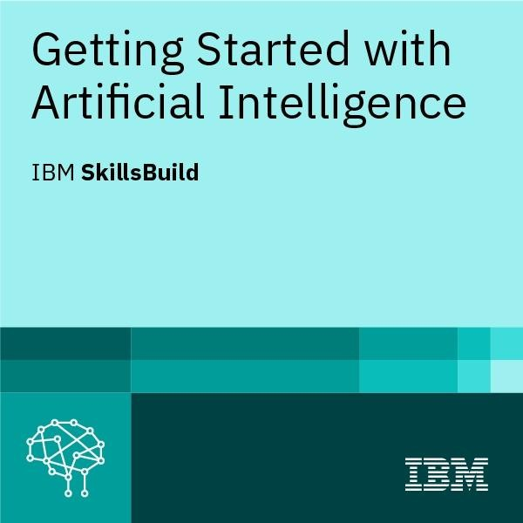
IBM CERTIFICATIONS
certificate( getting started with AI)

Slide 16
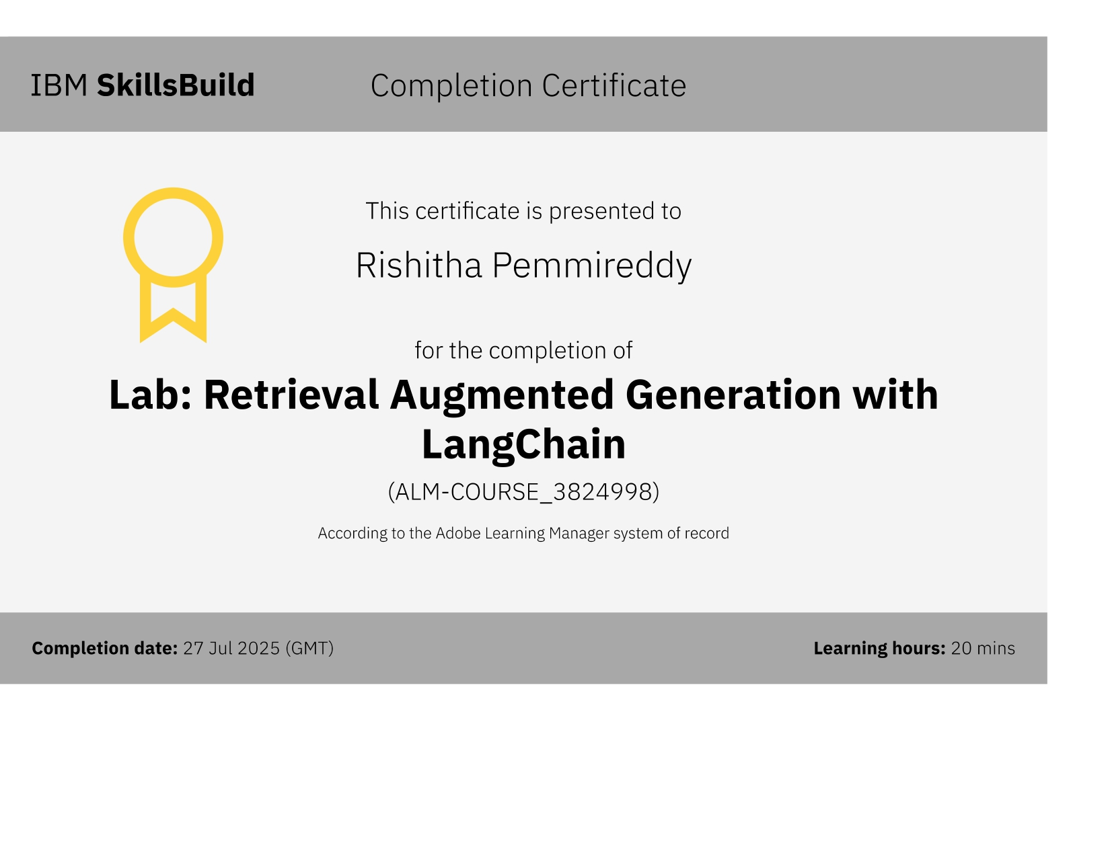
RAG LAB certificate

Slide 17
THANK YOU

