Slide 1

Predicting Life Expectancy: Insights from Health, Economic, and Social Factors across top two developing and developed nations.
Team Synergy
Rishitha Rani Pakam
Narasimha Reddy Padire
Lakshmi Reddy Bhavanam

Slide 2

Introduction
Life expectancy is a vital measure of a population’s overall health and well-being. Understanding the factors influencing life expectancy, including healthcare access, economic growth, and social conditions, can help identify key areas for improvement and intervention.
Why this topic? Life expectancy is a critical global health challenge, especially in developing nations, where disparities are significant. Exploring its predictors provides actionable insights.
Useful for which domain? This study is valuable for public health, healthcare policy, and social planning domains, offering data-driven insights to shape interventions.
Societal Benefits: Identifying key factors influencing life expectancy helps improve healthcare systems, reduce health disparities, and guide policies that promote well-being globally.

Slide 3

Research Question & Scope
Research Question:
What are the most significant factors predicting life expectancy, and how do health, economic, and social variables interact to influence life expectancy in the top two developed and developing countries?
Scope of the Study:
Dataset: Our analysis used life expectancy data from WHO, including variables such as Status, GDP, infant deaths, Adult mortality and other across 193 countries. The dataset contains 22 attributes and 2938 records.
Source: Kaggle
Methods: We applied K-Means Clustering to categorize countries based on similar features and used Multiple Linear Regression, Ridge Regression and Random Forest Regression to predict life expectancy.
Geographical Focus: The scope includes a comparative analysis of developed and developing countries, examining how different variables impact life expectancy in these contexts.
Real-World Relevance: Our project bridges data-driven insights with real-world health strategies, highlighting critical factors that impact global life expectancy trends.

Slide 4


Related Work
Source | Focus | Models Used | Limitations | Usefulness
IEEE | Health factors and life expectancy | Logistic Regression, Decision Trees | Focused only on health metrics. | Informs feature selection for health-related predictors and model selection (tree-based models).
IEEE | Social and economic factors in life expectancy | Multiple Regression | Limited interaction analysis between factors. | Supports linear modeling and feature engineering for socio-economic data.
IEEE | Economic and healthcare impacts | Linear Regression, Random Forest | Small dataset and regional focus. | Validates the use of Random Forest for capturing non-linear relationships in economic data.
IEEE | Socioeconomic determinants in developing countries | Neural Networks | Focused primarily on developing nations. | Suggests deep learning for complex patterns but supports simpler models for interpretability.
IEEE | Healthcare resource allocation | Support Vector Machines (SVM) | Did not consider non-health factors. | Highlights SVM’s role in handling high-dimensional data, useful for healthcare variables.

Slide 5
Methodology
To address the research question of predicting life expectancy, we have employed a systematic approach, outlined below:
Data Collection
Feature Selection
Preprocessing ( Handled Missing values & Outliers (Used Winsorization))
Model Implementation
Model Training and Testing
Tuning
Evaluation

Slide 6
K-Means Clustering
This model helped us to group the countries into clusters based on health, economic, and social factors.
Optimization techniques used:
GridSearchCV
RandomSearchCV
Hyperparameters:
init: Method for initializing centroids
max_iter: Maximum number of iterations for the KMeans algorithm.
n_clusters(param_grid): Number of clusters to form in KMeans.
n_init: Number of times the algorithm runs with different initializations.
random_state: Sets a fixed seed for random number generation, ensuring reproducibility of results across different runs.
tol: The tolerance for convergence
Reason for choosing these Hyperparameters: These parameters were tuned to deliver the best clustering performance, maximizing intra-cluster similarity and inter-cluster differences for optimal results.

Slide 7
Results of K-Means Clustering: Before and after tuning, the K-Means clustering model achieved 100% accuracy, precision, and F1 score, indicating optimal performance from the start.
Hyper parameter | init | max_iter | n_ clusters | n_init | random_state | tol
Best Value (GridSearchCV) | random | 300 | 10 | 10 | 50 | 0.0001
Best Value (RandomSearchCV) | random | 300 | 15 | 15 | 0 | 1e-05
Metric | Before Tuning | After GridSearchCV | After RandomSearch CV
Silhouette Score | 0.465 | 0.627 | 0.515
Davies-Bouldin Score | 0.936 | 0.488 | 0.524
Inertia | 1628.816 | 0.707 | 0.334

Slide 8
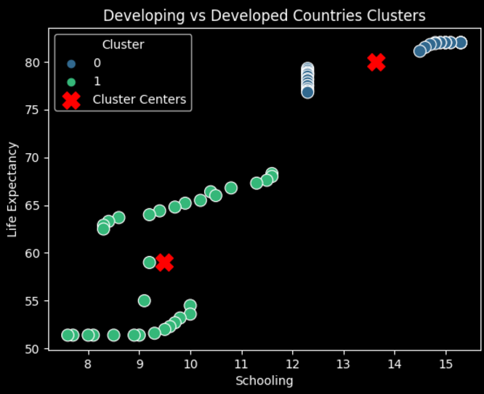
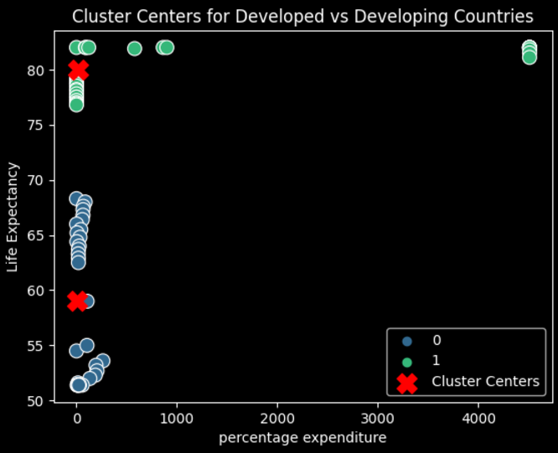
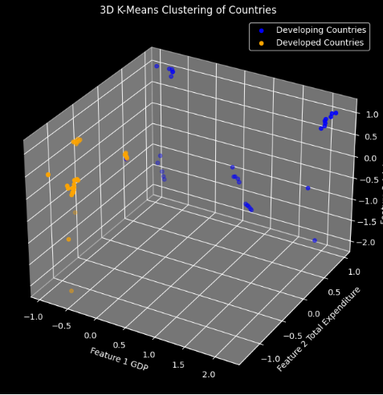
Clustering Visualizations

Slide 9
Regression Models: Split the Data: The dataset is randomly divided into two parts: Training Set (80%): Used to train the models. Testing Set (20%): Used to evaluate the model’s performance on unseen data.
Multiple Linear Regression:
Served as the baseline model for predicting life expectancy using linear relationships between features. Achieved an R-Squared score of 92%, but struggled with multicollinearity and overfitting.
Ridge Regression:
Enhanced MLR using L2 regularization to handle multicollinearity, achieved an R² of 94%.
Random Forest Regression:
Captured non-linear relationships and feature interactions, with an R² of 99.84%.

Slide 10
Hyperparameters and best values found
min_samples_leaf: Set to 1, enabling finer splits and improving prediction accuracy.
Decisions Taken:
We focused on controlling overfitting, ensuring generalization, and optimizing model performance through careful hyperparameter tuning.
Why these only(Hyperparameters)?
These choices optimized the model for achieving the best scores across, balancing accuracy and generalization.
max_depth : Limits the depth of each tree to prevent overfitting. The best value found is 5.
min_samples_split: The minimum number of samples required to split an internal node. The best value found is 2.
min_samples_leaf: The minimum number of samples required to be at a leaf node. The best value found is 1.
n_estimators: The number of trees in the forest. The best value found is 100.
These chosen parameters helped both models perform accurately and make reliable predictions, ensuring they captured important patterns and overfitting.

Slide 11
Results of Regression Models
Metric | Multiple Linear Regression | Ridge Regression (Hyperparameter Tuning) | Random Forest Regression ( Hyperparameter Tuning)
Mean Squared Error(MSE) | 11.841 | 3.01 | 0.243
Mean Absolute Error(MAE) | 2.90 | 1.66 | 0.347
R-Squared Score | 0.92 (92%) | 0.94 (94%) | 0.9984 (99.84%)
CV R-Squared Score | 0.85 | 0.95 | 0.9564

Slide 12
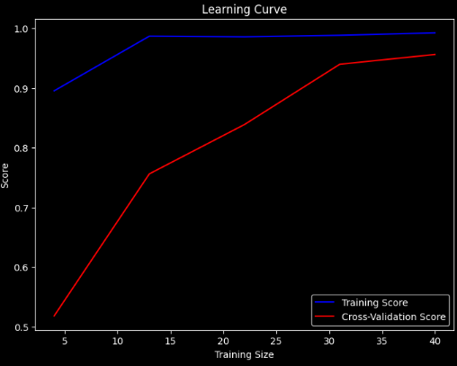
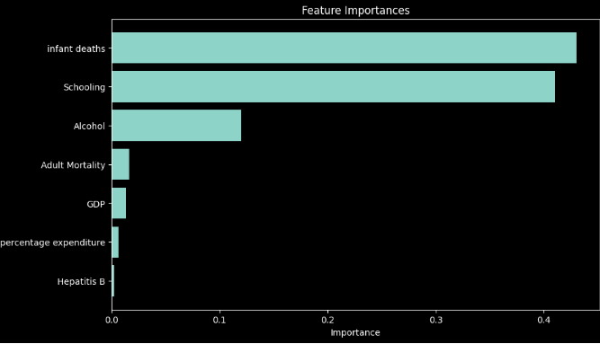
Analyzing Feature Importance and Learning Curves

Slide 13
Limitations
The dataset had some missing and imbalanced data for certain countries, which impacted model performance.
Multi-linear regression model suffered from overfitting.
Some important features, such as healthcare quality and political factors, were not included in the dataset, which could have improved the model's predictive power.
If the model had been evaluated on a larger or more diverse dataset, the results could have differed.

Slide 14

Future Work
The primary goal of future work in this field will be optimizing the results by incorporating additional variables without compromising the overall performance, complexity, or accuracy of the trained model.
Future efforts will also focus on exploring methods to gain deeper insights into the patterns detected by various models, including neural networks, decision trees, and ensemble methods, while making the determinants of specific predictions more transparent.

Slide 15
Conclusion
In conclusion, our data modeling effectively addressed the research question by identifying the most significant factors predicting life expectancy and examining how health, economic, and social variables interact in top two developed and developing countries.
The optimized Random Forest Regressor, with an R-squared value of 0.998 after hyperparameter tuning, accurately predicted life expectancy, highlighting the role of economic factors like GDP and social variables such as education. Higher life expectancy countries like Japan and the USA showed strong correlations with these factors, while lower life expectancy countries like India and Nigeria were more influenced by infant mortality and healthcare access. While Multiple Linear Regression also provided strong predictions with an R-squared value of 0.923, it’s slightly less accurate but stable, making it a solid alternative. K-Means clustering showed good cluster separation.
Overall, optimized Random Forest model proved to be a strong predictor of life expectancy based on health, economic, and social variables, with Multiple Linear Regression as a reliable backup.

Slide 16

THANK YOU!

