Slide 1

Department Of Electronics & Communication Engineering
Automatic Water Tap Using Arduino
Presented By:
S. Nandhini 235U1A04A6
Y. Rishitha 235U1A04C6
M. Mahesh 245U5A0408
S. Sai kiran 245U5A0410
Internal Guide :
Dr. G. Dhanalakshmi
Head R&D

Slide 2
ABSTRACT
Automatic Water Tap Using ArduinoWater conservation and hygiene are essential in modern facilities, and an automatic water tap system using Arduino provides an efficient solution. This system is designed to automatically control water flow using an infrared (IR) sensor and an Arduino microcontroller, reducing water wastage and promoting touchless operation.The system operates by detecting the presence of hands near the tap using an IR proximity sensor. When motion is detected, the Arduino processes the signal and activates a solenoid valve, allowing water to flow. Once the hands are removed, the valve closes, stopping the water flow. This setup significantly minimizes water wastage and enhances hygiene, making it ideal for public restrooms, hospitals, kitchens, and smart homes.Additionally, the system can be powered by a low-voltage power supply and integrated with IoT for remote monitoring. The use of Arduino makes it a cost-effective, customizable, and easy-to-implement solution. Overall, this system enhances water efficiency, reduces contamination risks, and promotes sustainable water usage.Would you like any modifications or additional details?

Slide 3
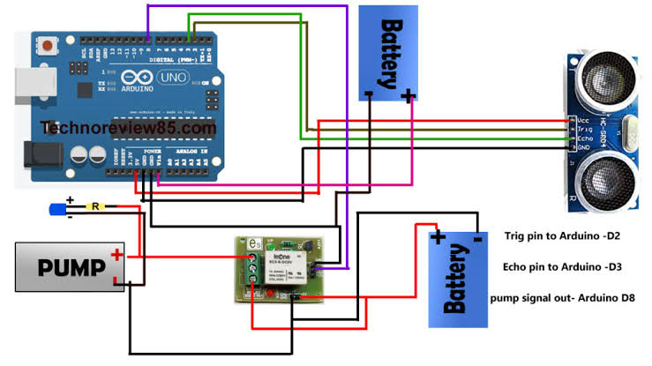
BLOCK DIAGRAM

Slide 4
Components Used :
Arduino
Solenoid Wave
IR Sensor
Relay Module
Water Pump
Power supply
Resisors
Transistors
Breadboard

Slide 5
ADVANTAGES:
Water Saving
Hygienic
Automatic
Cost Effective
Ener Efficient
Eco-friendly
Reliable
Customizable

Slide 6
APPLICATIONS :
Applications of Automatic Water Tap Using Arduino
Public Restrooms – Reduces water wastage and enhances hygiene.
Hospitals & Clinics – Prevents cross-contamination through touchless operation.
Hotels & Restaurants – Improves cleanliness and conserves water.
Smart Homes – Integrates with IoT for efficient water management.
Schools & Colleges – Promotes hygiene among students and staff.
Shopping Malls & Airports – Provides a modern, automated experience.
Factories & Industries – Ensures controlled water usage in workplaces.
Religious Places – Reduces excessive water usage during washing rituals
Gardening & Agriculture – Can be adapted for automated irrigation.
Laboratories – Ensures sterile and contamination-free environments.

Slide 7


