Slide 1

Department Of Electronics & Communication Engineering IOT-BASED GPS CHILD SAFETY AND TRACKING SYSTEM WITH GEOFENCING ALERT
Presented By:
Y. Rishitha 235U1A04C6
N. Sravani 235U1A0480
S. Sindhu Sri 235U1A04B0
P. Sai Srijan 235U1A04A0
Internal Guide :
Mr. J. Venkatesh
Assistant Professor

Slide 2
ABSTRACT
This project presents an IoT-based child safety system that uses GPS and geofencing technology to track a child’s location in real-time.
The system continuously monitors the child’s position using a GPS module and sends the data to a mobile application through Wi-Fi or GSM.
A virtual boundary called a geofence is created, and whenever the child moves outside this safe zone, an alert message is sent instantly to the parents.
This system helps improve child safety by providing real-time tracking, quick alerts, and remote monitoring through IoT technology.

Slide 3
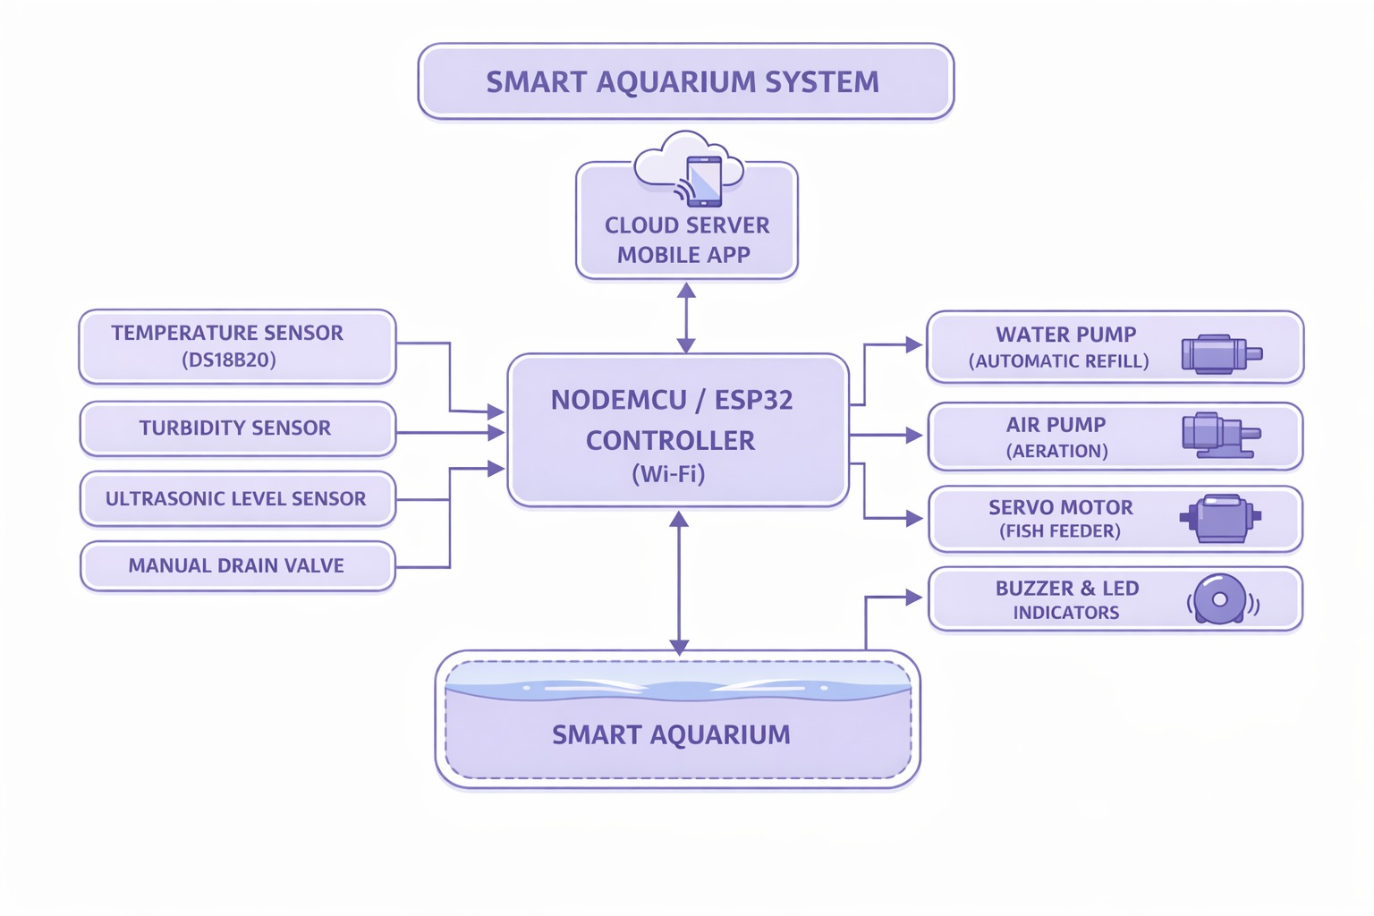
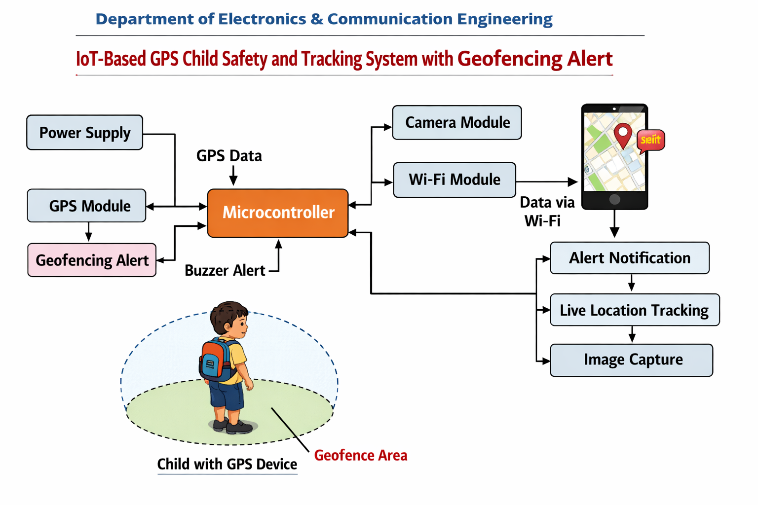
BLOCK DIAGRAM:

Slide 4
EXISTING SYSTEM:
In traditional child safety methods, parents rely on manual supervision or basic communication like phone calls.
There is no real-time tracking system available for small children.
No automatic alert system when a child moves to unsafe locations.
Parents cannot continuously monitor their child’s location remotely.
These limitations can lead to safety risks and delayed response in emergencies.

Slide 5
PROPOSED SYSTEM:
In the proposed system, GPS is used to track the child’s real-time location.
The NodeMCU (ESP8266) processes location data and sends it to the cloud server.
A geofence (safe area) is set using predefined coordinates.
If the child crosses the boundary, the system automatically sends alerts via SMS or mobile app.
Parents can monitor the child live using an IoT platform.

Slide 6
HARDWARE USED :
NodeMCU / ESP32 Controller (Wi-Fi)
GPS Module (Neo-6M)
Buzzer (for alert)
Battery / Power Supply
SOFTWARE USED:
Arduino IDE
IoT Cloud (Blynk / Thing Speak / Firebase)

Slide 7
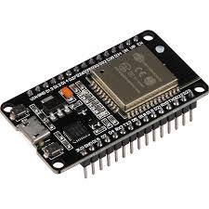
Nodemcu / ESP32 Controller (wi-fi)
NodeMCU ESP32 is a powerful, low-cost Wi-Fi and Bluetooth-enabled development board based on the dual-core ESP32-WROOM-32 chip.
It operates at 3.3V, features 4MB Flash, and supports Arduino IDE, Micro Python, and Lua scripting.
Ideal for IoT, it includes built-in antenna, 30/38 GPIO pins, and supports station/softAP modes for wireless control.

Slide 8
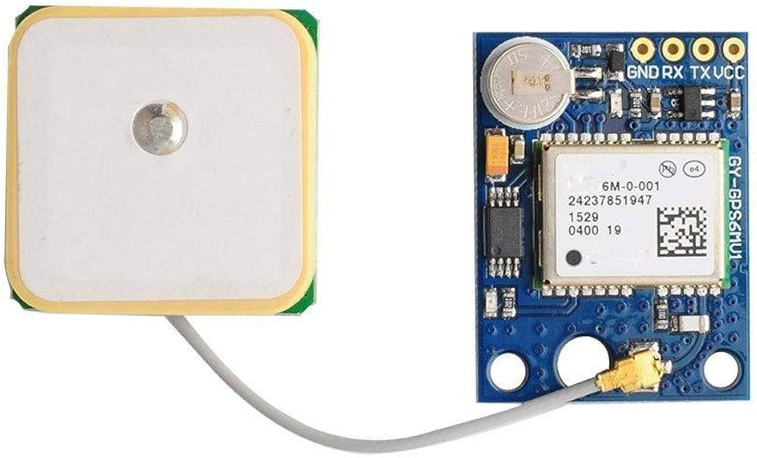
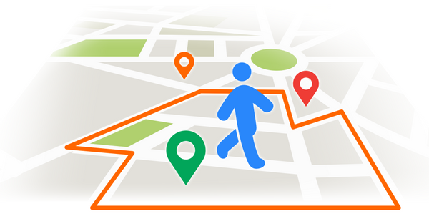
GPS MODULE
The GPS module is used to get real-time latitude and longitude coordinates.
It communicates with the microcontroller using serial communication.
Provides accurate location tracking of the child.
GEOFENCING
Geofencing is a technology that creates a virtual boundary around a location.
Safe zones like home or school are predefined.
If the child crosses this boundary, an alert is triggered automatically.

Slide 9
WORKING:
The GPS module continuously tracks the child’s location.
The NodeMCU receives this data and compares it with predefined geofence coordinates.
If the child is inside the safe zone, the system remains in normal mode.
If the child moves outside the boundary, an alert is generated.
The alert is sent to parents via SMS or mobile app.
The location can also be viewed in real-time on the IoT platform

Slide 10
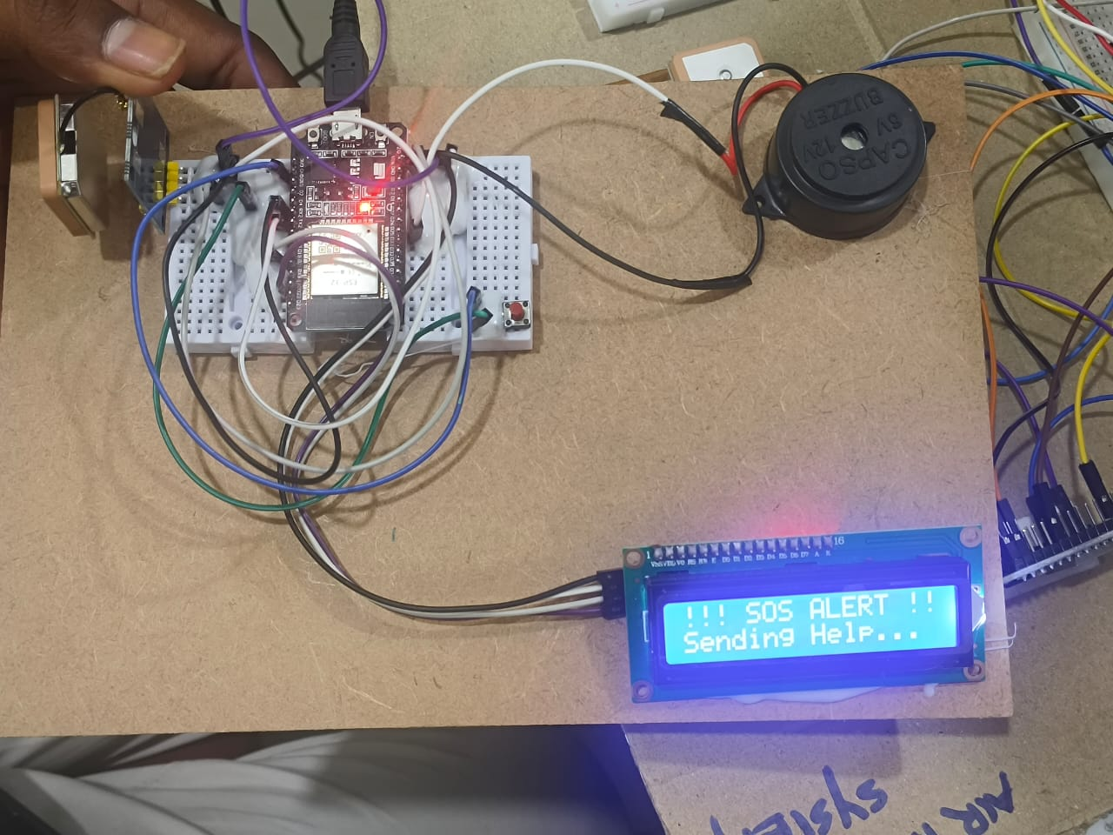
RESULT:

Slide 11
ADVANTAGES:
Real-time location tracking
Immediate alert system
Improves child safety
Low cost and efficient
Easy to use and portable
APPLICATIONS:
Child safety monitoring
School transport tracking
Elderly person tracking
Personal security system

Slide 12
FUTURE SCOPE
Integration with AI-based behavior monitoring for detecting unusual child movement.
Addition of camera module for live video monitoring.
Mobile application with real-time map navigation and voice alerts.
Cloud storage for maintaining location history and tracking records.
Integration with wearable devices like smart watches or smart bands.
Emergency SOS button for instant help during danger situations.
Improved battery backup using solar charging systems.
Support for multiple child tracking in a single application

Slide 13
THANK YOU

