Slide 1
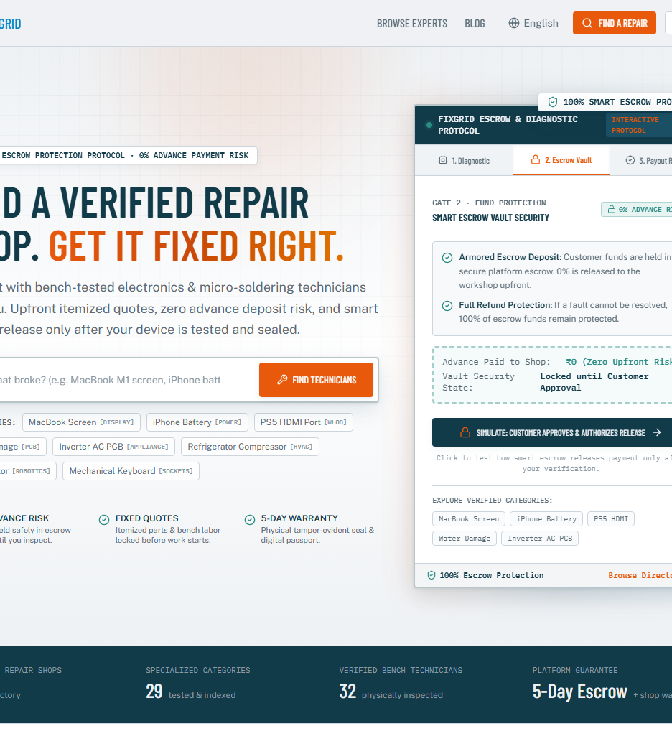
// CIRCULAR HARDWARE OPERATING SYSTEM
🔒 https://www.vytron.me
Introducing
FixGrid.
Repair Over Replace.
Standardizing Trust Across India.
India's decentralized repair infrastructure standardizing 1.2M neighborhood workshops through double-blind UPI escrow, cryptographic QR warranty passports, and zero-risk payouts.
🛡️ 100% UPI Escrow
📜 QR Warranty Passports
⚡ 0% Platform Moat
BY: TEAM VYTRON
Live Production System • https://www.vytron.me
● LIVE AT WWW.VYTRON.ME • Built by Team Vytron
ALL CATEGORIES: 📱 PHONES • 🧺 APPLIANCES • 💻 COMPUTING • 🚲 BICYCLES • ⌚ WATCHES

Slide 2
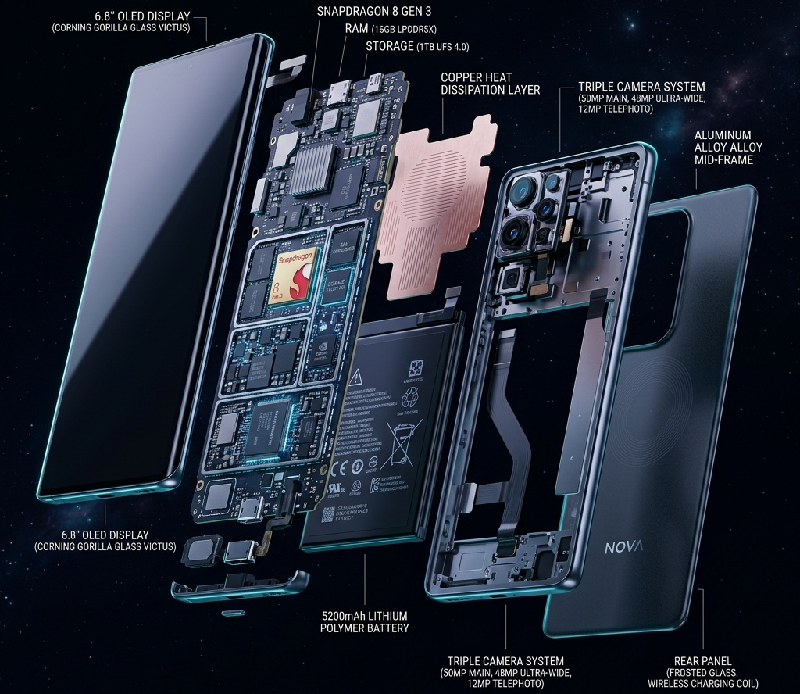
FIXGRID // UNIVERSAL CIRCULAR TRUST & WARRANTY PLATFORM
02 / 10
[ 02 // PROBLEM STATEMENT: THE BROKEN REPAIR ECONOMY ]
The Broken Economics of Repair & The Trust Deficit
Consumers replace items fixable for <15% of cost because authorized centers charge 60%–80% while street repair lacks verified trust.
$15.2B
THE LEMON MARKET TRAP (AKERLOF'S ASYMMETRY)
Absence of verifiable trust forces a lose-lose choice: pay 60%–80% device value at authorized monopolies or risk unverified street shops.
⚖️ Akerlof's Dilemma: Trust deficit drives premature replacement
● 3D CAD // MULTI-CATEGORY COMPONENT TELEMETRY
LEMON MARKET ASYMMETRY
88%
CONSUMER TRUST DEFICIT & COUNTERFEIT FEAR
Consumers dread counterfeit parts, swapped laptop RAM, fake compressor relays, and arbitrary overcharging. Repairs fixable for <15% cost are abandoned out of fear.
🚨 Acute Information Asymmetry: Zero advance payment protection
0 Days
ZERO POST-REPAIR WARRANTY & RECOURSE
Offline unorganized repair offers 0 days of warranty. If a repaired motherboard or appliance fails days later, 100% of financial loss is borne by the consumer.
🔒 Zero Recourse: No escrow vault, no tamper-proof passport
www.vytron.me • Built by Team Vytron
All Categories: Phones • Appliances • Laptops • Bicycles • Watches

Slide 3
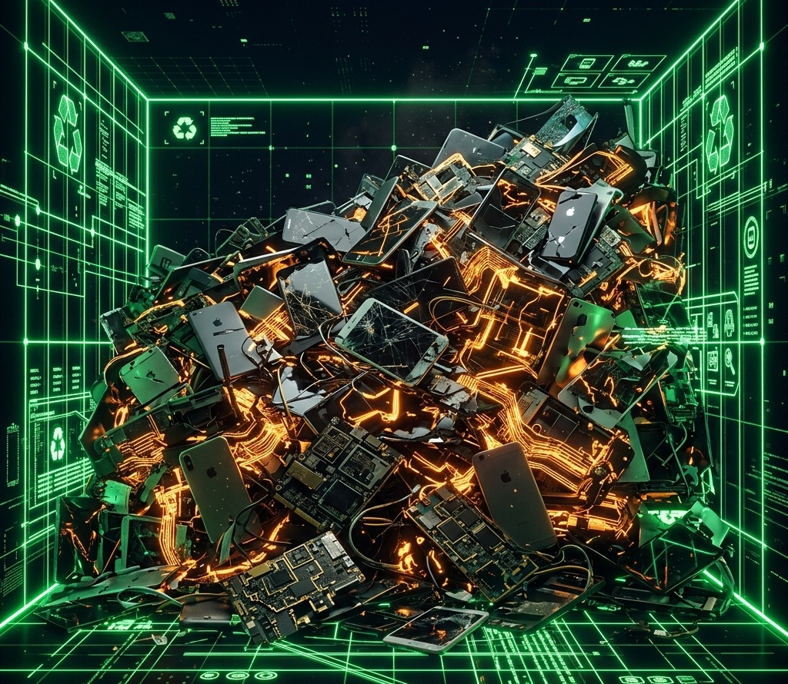
FIXGRID // UNIVERSAL CIRCULAR TRUST & WARRANTY PLATFORM
03 / 10
[ 03 // PROBLEM STATEMENT: THE DUAL CRISIS ]
The Climate Paradox & Vanishing Artisan Livelihoods
India generates 1.71M tonnes of toxic e-waste while 92% of skilled local repair technicians remain digitally invisible.
⚠️ CRISIS 01: 1.71M TONNES E-WASTE & 80% EMBODIED CARBON LOST
• 3rd Largest Global Producer: India produces 1.71M+ tonnes e-waste annually; over 95% is handled unsafely in informal toxic dumps.
• 80% Embodied Carbon Wasted: Up to 80% of device lifetime emissions occur during manufacturing; discarding fixable hardware wastes all embodied energy.
• Toxic Heavy Metal Leaching: Unrecycled electronics and appliances leak lead, mercury & cadmium directly into groundwater and soil tables.
● ECOLOGICAL CATASTROPHE // 1.71M TONNES E-WASTE
CRITICAL METRIC
ECOLOGICAL TOLL: 1,710,000+ METRIC TONNES DISCARDED / YEAR
India 3rd Largest Globally • 80% Lifetime Carbon Footprint Irretrievably Lost
📉 CRISIS 02: 92% DIGITALLY INVISIBLE MASTER ARTISANS
• 92% Lack Digital Presence: Neighborhood repair craftspeople lack online storefronts, customer booking tools, or search visibility.
• Zero Reputation Ledger: Years of stellar bench craftsmanship remain unrecorded; a single rumor or customer dispute can ruin a shop.
• Predatory Aggregator Tax: Monopolistic gig apps extract 25%–30% commissions on technician labor, trapping skilled artisans in gig poverty.
ARTISAN CRISIS: 92% LACK ANY DIGITAL BOOKING PRESENCE
25%–30% Aggregator Commission Drain • Zero Verifiable Credit or Reputation History
www.vytron.me • Built by Team Vytron
All Categories: Phones • Appliances • Laptops • Bicycles • Watches

Slide 4
FIXGRID // UNIVERSAL CIRCULAR TRUST & WARRANTY PLATFORM
04 / 10
[ 04 // THE FIXGRID SOLUTION ]
One Universal Platform. Five Everyday Repair Sectors.
A standardized trust, escrow, and warranty layer powering every category of local repair.
SECTOR 01
📱 Mobile
Smartphones & iPads
SECTOR 02
💻 Laptops
MacBooks & Custom PCs
SECTOR 03
🧺 Appliances
Inverter ACs & Fridges
SECTOR 04
🚲 Mobility
Bicycles & E-Bikes
SECTOR 05
⌚ Watches
Precision Horology
BENCH SPECIALTIES:
• AMOLED Panels
Display & glass laminations
• Battery & PMIC
Cell & charging IC repair
• Micro-Solder
Ultrasonic trace jumpers
BENCH SPECIALTIES:
• Logic Boards
Dead power rail & PMIC fixes
• Keyboards/Hinges
Chassis rebuilds & ports
• GPU Rework
BGA reballing & repasting
BENCH SPECIALTIES:
• Inverter PCBs
Compressor board surge fixes
• Freezer Gas
R600a recovery & thermostats
• Washers/Motors
Motor rewinding & panels
BENCH SPECIALTIES:
• Drivetrains
Hydraulic bleeding & cassettes
• E-Bike Motors
Brushless hub & battery tuning
• Wheel Truing
Spoke tension & bracket work
BENCH SPECIALTIES:
• Movements
Teardown & escapement tuning
• Timing Rig
Witschi timing beat correction
• Pressure Seal
20 ATM testing & sapphire
70% SAVED
Save ₹15,000+
⚡ 2–4 Hr Turnaround
🛡️ 30–90D Escrow Pass
Typical: ₹1,400 (vs ₹18,000 New)
Zero Advance Risk • OTP Released
65% SAVED
Save ₹35,000+
⚡ Same Day Bench
🛡️ 30–90D Escrow Pass
Typical: ₹2,800 (vs ₹45,000 New)
Zero Advance Risk • OTP Released
75% SAVED
Save ₹22,000+
⚡ Home Visit Lab
🛡️ 30–90D Escrow Pass
Typical: ₹1,600 (vs ₹32,000 New)
Zero Advance Risk • OTP Released
60% SAVED
Save ₹8,000+
⚡ Rapid Tune-Up
🛡️ 30–90D Escrow Pass
Typical: ₹850 (vs ₹12,000 New)
Zero Advance Risk • OTP Released
80% SAVED
Save ₹40,000+
⚡ Certified Atelier
🛡️ 30–90D Escrow Pass
Typical: ₹1,200 (vs ₹25,000 New)
Zero Advance Risk • OTP Released
www.vytron.me • Built by Team Vytron
All Categories: Phones • Appliances • Laptops • Bicycles • Watches

Slide 5
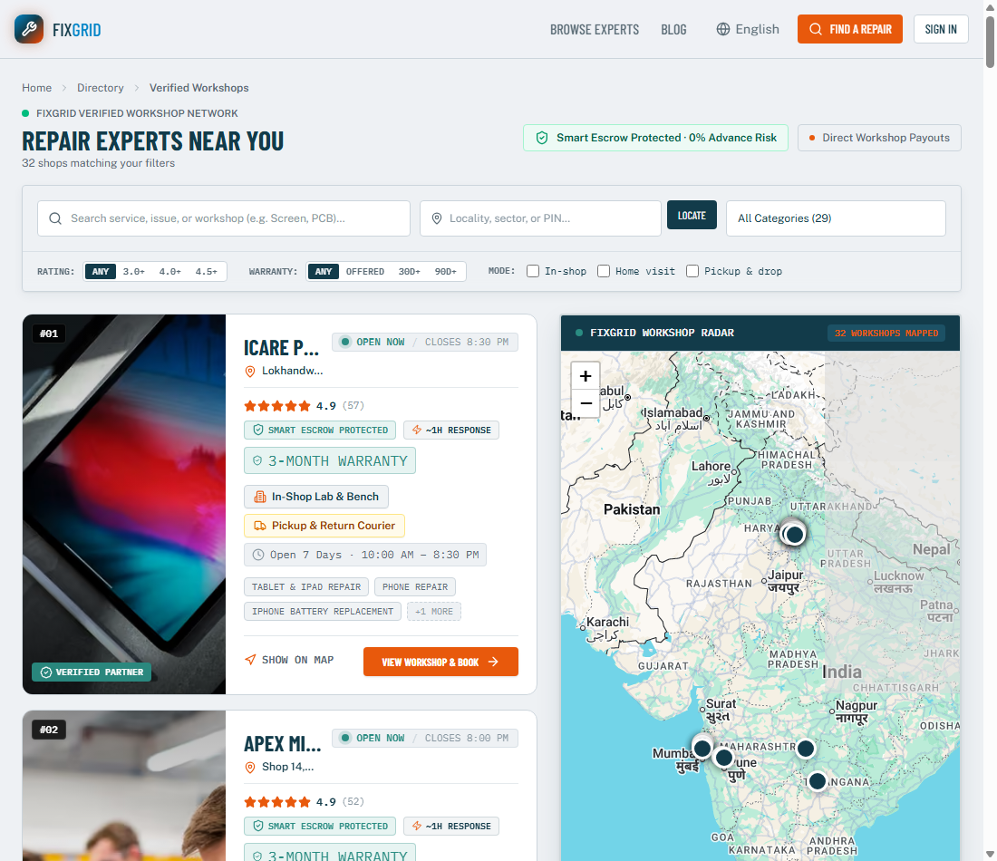
FIXGRID // UNIVERSAL CIRCULAR TRUST & WARRANTY PLATFORM
05 / 10
[ 05 // PRODUCT ARCHITECTURE ]
From Search to Escrow Payout: Complete Peace of Mind
Powered by live geolocation matching, transparent escrow locking, and OTP release.
01
Radar Search Across 29+ Categories
Locate nearby bench-tested workshops on the live map. Filter by Appliances, Phones, Laptops, Bicycles, or Watches.
🔒 https://www.vytron.me/search
02
Upfront Quote & Escrow Lock
Itemized diagnostic pricing confirmed upfront. Customer funds deposited into secure UPI Escrow (0% advance risk).
03
Physical Testing & OTP Release
Customer physically inspects and tests the repair. Funds are released only after customer inputs verification OTP.
04
Instant Payout & Warranty Pass
Technician receives instant UPI transfer with 0% commission. Customer receives a 30–90 day digital warranty pass.
www.vytron.me • Built by Team Vytron
All Categories: Phones • Appliances • Laptops • Bicycles • Watches

Slide 6
FIXGRID // UNIVERSAL CIRCULAR TRUST & WARRANTY PLATFORM
06 / 10
[ 06 // MARKET DISRUPTION ]
Transforming Informal Technicians into Thriving Entrepreneurs
Comparing exploitative corporate aggregator monopolies against FixGrid's partner-first economics.
THE AGGREGATOR TRAP
(Urban Company / Local Lead Directories)
❌ 25%–30% Heavy Commission: Extracted directly from the shopkeeper's service labor.
❌ Disposable Gig Workers: Technicians treated as anonymous numbers with zero safety net.
❌ Pay-Per-Lead Bidding War: Shops spend ₹300–₹500 for cold customer leads.
❌ Zero Brand Ownership: Customer belongs to the corporate platform; shop gets zero retention.
❌ Delayed Cash Payouts: Funds held for weeks with arbitrary customer chargebacks.
THE FIXGRID PARTNER MODEL
(Dignity, Fair Economics & Sustainable Growth)
✅ 0% Commission on Labor: We do not take a single rupee from hard-earned service labor.
✅ +5% Completed Job Bonus: FixGrid pays an extra 5% cashback bonus to shops for verified repairs.
✅ 100% Brand Ownership: Free digital storefront and direct repeat customer relationships stay with shop.
✅ Instant UPI Escrow Payout: Funds released directly into the shopkeeper's bank account upon OTP.
✅ Platform Warranty Shield: FixGrid underwrites warranty claims, protecting technicians from part liabilities.
EXTRACTIVE MONOPOLY ECONOMICS
30% CUT ON LABOR • ₹18,000–₹35,000 MONTHLY DRAIN
Technicians absorb 100% of physical tool, shop rent, and warranty risk while corporate aggregators pocket 30% without touching a screwdriver.
OUTCOME: ALIENATED GIG WORKERS • DYING INDEPENDENT WORKSHOPS
CIRCULAR PARTNER ECONOMICS
0% LABOR TAX • 100% EARNINGS RETAINED + 5% BONUS
Technicians earn full income, accumulate verified shop ratings, build localized customer equity, and receive instant digital payments in under 60 seconds.
OUTCOME: EMPOWERED LOCAL ENTREPRENEURS • THRIVING COMMUNITIES
www.vytron.me • Built by Team Vytron
All Categories: Phones • Appliances • Laptops • Bicycles • Watches

Slide 7

FIXGRID // UNIVERSAL CIRCULAR TRUST & WARRANTY PLATFORM
07 / 10
[ 07 // MEASURABLE SUSTAINABILITY ]
The Greenest Product Is the One That Is Already Made
Quantifiable carbon reduction metrics achieved across electronics, computing, and home appliances.
80%
CO₂ EMISSIONS AVOIDED
Extending a laptop, smartphone, or refrigerator lifespan by 1–2 years slashes its lifetime carbon footprint by 80% by avoiding new manufacturing.
🌱 Scope 3 Reduction: Slashing Embedded Carbon
● SATELLITE TELEMETRY // GLOBAL CIRCULAR IMPACT
EMERALD NET-ZERO
62M
TONS E-WASTE & APPLIANCES TARGETED
Directly intercepting salvageable electronics and domestic appliances before they enter toxic, non-degradable landfills.
♻️ Landfill Interception: Critical Metals Recovery
100%
LOCAL CIRCULAR ECONOMY
Recirculating capital and hardware inside neighborhood communities—every rupee spent on repair stays in the local economy.
🏙️ Wealth Retention: 100% of Capital Stays Local
www.vytron.me • Built by Team Vytron
All Categories: Phones • Appliances • Laptops • Bicycles • Watches

Slide 8
FIXGRID // UNIVERSAL CIRCULAR TRUST & WARRANTY PLATFORM
08 / 10
[ 08 // BUSINESS MODEL ]
High-Margin, Sustainable Economics
Monetizing trust, supply chain fulfillment, and SaaS tooling without taxing shopkeeper labor.
TAKE RATE & VALUE CAPTURE
Comparing exploitative labor commissions against FixGrid's partner-first model.
1. Consumer Escrow & Warranty Fee
Nominal ₹49–₹99 per booking. Consumers gladly pay a microscopic fee for 100% dispute protection, secure UPI escrow, and guaranteed 30–90 day warranty.
💎 High-Margin Fee: ₹49–₹99 / Booking • 94% Checkout Opt-In Rate
Aggregator Monopoly (Urban Company / Directories)
30% COMMISSION TAX
FixGrid Labor Commission
2. B2B Multi-Category Spare Parts
12%–15% wholesale margin on verified phone screens, laptop batteries, compressor relays, and bicycle drivetrains supplied directly to partner shops.
📦 Wholesale Margin: 12%–15% Gross • Sub-0.8% RMA Rate • OEM Batch
0% COMMISSION (+5% BONUS)
FixGrid Escrow & Warranty Protection
3%–4% ESCROW FEE
B2B Multi-Category Spare Parts
3. Shop Pro SaaS Subscriptions
₹999/month optional premium tier for shops wanting top geographic search ranking, verified gold trust badges, automated CRM, and multi-category inventory.
🚀 Recurring SaaS: ₹999/Month • 89% 6-Month Projected Shop Retention
12%–15% B2B MARGIN
PARTNER-FIRST VALUE CREATION
FixGrid monetizes transaction trust, wholesale parts, and SaaS tooling—never taking a rupee from technician labor.
www.vytron.me • Built by Team Vytron
All Categories: Phones • Appliances • Laptops • Bicycles • Watches

Slide 9
FIXGRID // UNIVERSAL CIRCULAR TRUST & WARRANTY PLATFORM
09 / 10
[ 09 // DEFENSIVE MOAT ]
Why FixGrid Wins: The Moat of Trust
Four structural competitive advantages that create an insurmountable barrier to entry.
MOAT PILLAR
Platform Warranty
Offline unorganized repair shops offer 0 days warranty; we make repair as safe as buying new.
MOAT PILLAR
Smart Escrow Hold
Customer funds remain safely locked in escrow until in-person physical inspection and OTP release.
MOAT PILLAR
0% Fee + 5% Bonus
By giving technicians 100% of labor fees plus a 5% bonus, shopkeepers actively route clients to FixGrid.
MOAT PILLAR
Climate Credentials
Real-time carbon savings certificates issued per repair. Empowers consumers & corporate ESG.
DEFENSIVE MECHANISM:
• Central Trust Reserve: FixGrid underwrites parts claims
• Digital Pass QR: Tamper-proof repair passport
• 30–90D Guarantee: Zero-risk customer assurance
• Reserve Backing: 15% GMV central escrow pool
DEFENSIVE MECHANISM:
• UPI Escrow Vault: Zero advance payment extortion
• Physical OTP Release: Customer tests before paying
• Dispute Shield: Instant fair platform arbitration
• Release Trigger: Physical inspection & cryptographic OTP
DEFENSIVE MECHANISM:
• Zero Labor Tax: 100% of labor kept by technician
• +5% Cash Cashback: Bonus for on-time verified fixes
• Storefront Equity: Shops build repeat customer retention
• Shop Incentive: Technicians earn ₹4,500+ extra monthly
DEFENSIVE MECHANISM:
• CO₂ Avoidance Math: Proprietary lifecycle carbon engine
• Scope 3 Ledgers: Verified enterprise decarb data
• Green Badges: Public ESG sustainability certificates
• Decarb Ledger: Verified ISO 14040 lifecycle engine
30–90 Days
vs. 0 Days Offline
🛡️ Cryptographic QR Passport
Tamper-Proof Platform Backing
100% Escrow
Zero Advance Risk
🔒 0% Advance Customer Risk
Tamper-Proof Platform Backing
0% Labor Tax
+5% Partner Cashback
⚡ Instant UPI Bank Settlement
Tamper-Proof Platform Backing
Scope 3 Impact
Live Decarb Badges
🌱 Verifiable ESG Sustainability
Tamper-Proof Platform Backing
www.vytron.me • Built by Team Vytron
All Categories: Phones • Appliances • Laptops • Bicycles • Watches

Slide 10

FIXGRID // UNIVERSAL CIRCULAR TRUST & WARRANTY PLATFORM
10 / 10
[ 10 // THE FUTURE OF REPAIR ]
Fixing Devices & Appliances. Empowering Artisans. Healing Earth.
A production-tested circular platform architected for nationwide multi-category scale.
PRODUCTION STACK: NEXT.JS 16 • SUPABASE • UPI ESCROW • RIGHT TO REPAIR
💰 For Consumers
Save ₹25,000+ yearly across phones, appliances, and laptops with complete peace of mind, upfront itemized pricing, and guaranteed warranty.
💎 Value: Upfront itemized quotes • ₹25,000+ saved yearly • 30–90D warranty
🏪 For Technicians
Dignified digital livelihood with 0% commission, free SEO storefront, and repeat customer retention across all 5 sectors.
🛠️ Value: 0% labor commission • Free SEO digital storefront • 100% direct clients
🌍 For Earth
Diverting 62M tons of electronics and domestic appliances from landfills—one circular repair at a time.
🌱 Value: 62M tons diverted • Slashing 80% upstream manufacturing footprint
🔒 https://www.vytron.me/expert/coolbreeze-fridge-hvac-experts
JOIN THE FIXGRID REPAIR REVOLUTION
Live Working Platform: www.vytron.me
Built by Team Vytron • Core Architecture & Engineering
⚡ DECENTRALIZED CIRCULAR HARDWARE INFRASTRUCTURE
All 5 Repair Sectors Live: Phones • Laptops • Appliances • Bicycles • Watches
www.vytron.me • Built by Team Vytron
All Categories: Phones • Appliances • Laptops • Bicycles • Watches

