Slide 1
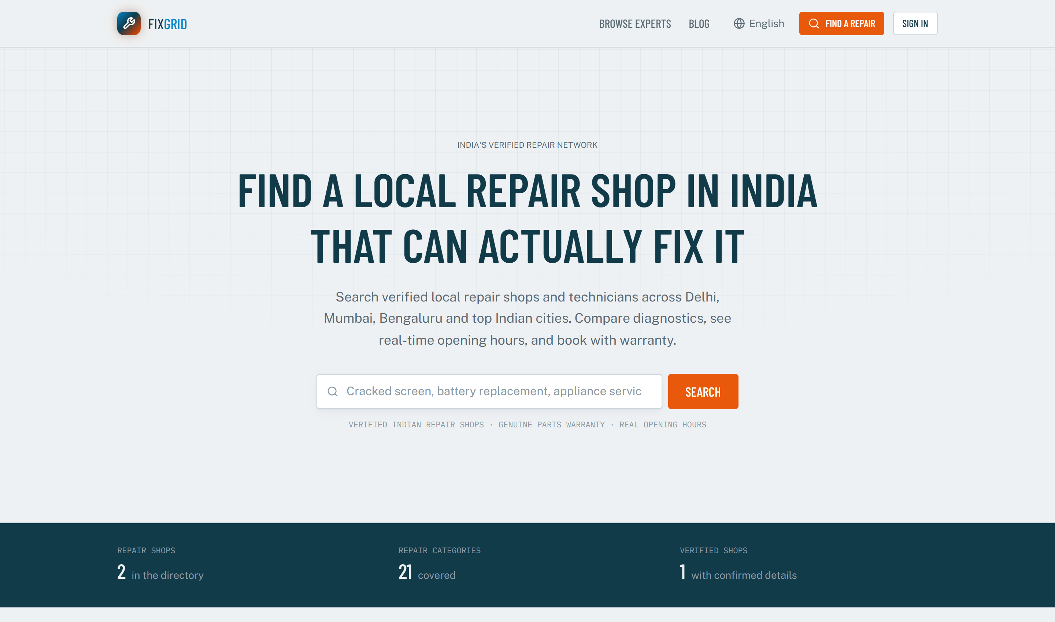
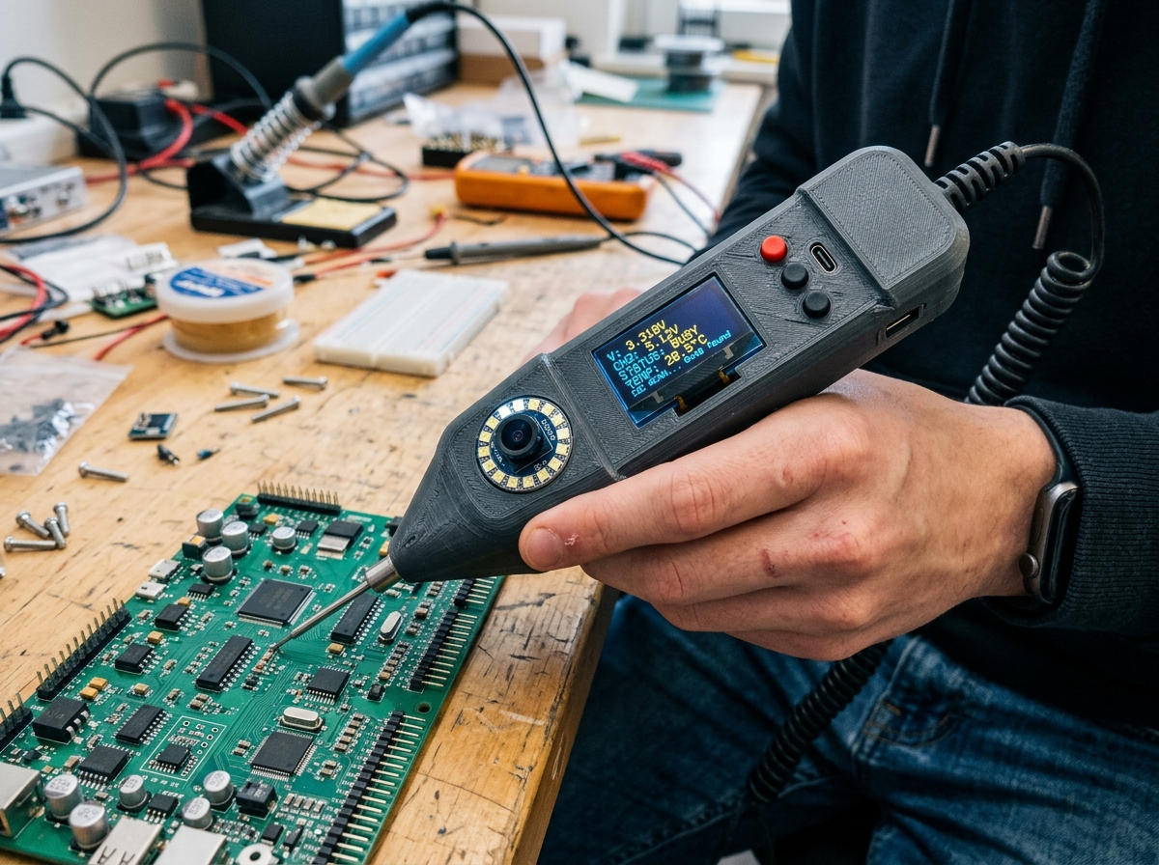
Right-to-Repair & Circular Economy Platform
FixGrid Probe™
The Complete Ecosystem: A Live Web Platform (fixgrid.vytron.me) & A Frugal Handheld Diagnostic Wand Championing Sustainable Repair Across All 21+ Categories
Live Platform: fixgrid.vytron.me
✓ Live Digital Platform: Search & escrow across 21+ categories (Appliances, Tech, EVs)
✓ Physical Innovation: Under ₹1,800 FixGrid Probe™ sub-junction diagnostic wand
✓ Dual-Loop QR Warranty: Tamper-evident seals with photo proof
FixGrid Probe™ Working Prototype
FixGrid Ecosystem • fixgrid.vytron.me
Live Web Platform + FixGrid Probe™ Diagnostics
Right-to-Repair & Circular Economy
Notes:
Welcome. FixGrid Probe unites a live web marketplace with a low-cost physical diagnostic wand, solving both the digital trust void and the technical hardware diagnostic barrier.

Slide 2
// 02 • PROBLEM STATEMENT
[ 02 / 08 ]
Problem Statement: The Throwaway Culture & Climate Paradox
1. The Trust Void Across All 21+ Categories
2. The Universal Hardware Diagnostic Void
78% of consumers discard repairable goods (appliances, consumer tech, tools) fearing arbitrary pricing & zero warranty.
Spans ALL 21+ categories: Major home appliances (ACs, fridges, washing machines), laptops, phones, TVs & EVs.
Local repair artisans across every trade remain digitally invisible, informal, and overlooked.
Lab diagnostic equipment costs ₹50,000–₹1.5L—unaffordable for neighborhood appliance & tech workshops.
Standard multimeters inject 2.5V–3.0V, risking delicate micro-controllers in modern smart appliances & boards.
Without visual proof, mechanics guess—declaring entire appliance control boards or devices "unfixable."
₹1.2L Cr
85%+
Millions
THE LOST VALUE
SKILLED HEROES OVERLOOKED
E-WASTE CATASTROPHE
Consumers waste billions replacing appliances & devices when an artisan 500m away could repair it.
Informal repair mechanics across 21+ categories lack digital tools and are trapped in unverified guesswork.
Heavy appliances & electronics flood landfills, leaching toxic metals while factories burn carbon for replacements.
FixGrid Ecosystem • fixgrid.vytron.me
Live Web Platform + FixGrid Probe™ Diagnostics
Right-to-Repair & Circular Economy
Notes:
From the synopsis: India’s $15.2B unorganized repair economy suffers a dual crisis: a trust void where 78% of consumers discard repairable electronics, and a diagnostic void where mechanics lack affordable tools, misdiagnosing a ₹10 capacitor as a dead motherboard.

Slide 3
// 03 • PROPOSED SOLUTION
[ 03 / 08 ]
Proposed Solution: The FixGrid Hardware-Software Innovation
PILLAR 1: DIGITAL PLATFORM
PILLAR 2: HARDWARE WAND
FixGrid Trust & Warranty Cloud Engine
FixGrid Probe™ Multimodal Diagnostic Tool
All 21+ Categories: Covers Home Appliances, Consumer Tech, Power Tools, EVs & Wearables.
Upfront Smart Escrow: Customer payments locked safely at booking; released on verified sign-off.
90-Day Digital Warranty: Platform-guaranteed warranty passport verifiable on any smartphone.
Artisan Empowerment: Digital storefronts, verified reviews & 5% completed-job rebate.
0.40V Sub-Junction Divider: Clamps below 0.6V P-N junction—tests in-circuit without desoldering.
16-Bit ADS1115 + Tone: Pitch-shift audio buzzer (1.2kHz → 2.4kHz) guides to shorted 0402 SMDs.
ESP32-CAM Microscope: 2.5cm macro lens & shadowless ring LEDs captures HD fault photo proof.
Hardware Trust-Gate: Transmits cryptographic VERIFIED_PASS token to release escrow funds.
₹1,795 BOM
0.40V Clamp
Dual-Loop QR
Mission LiFE
Frugal Prototype Cost
Sub-Junction In-Circuit
Digital Product Passport
E-Waste Mitigation Goal
FixGrid Ecosystem • fixgrid.vytron.me
Live Web Platform + FixGrid Probe™ Diagnostics
Right-to-Repair & Circular Economy
Notes:
From the synopsis: FixGrid Probe merges physics and digital governance. It tests in-circuit at 0.40V without desoldering, snaps macro photos of 0402 SMDs, links to a Dual-Loop QR warranty seal, and acts as a hardware trust-gate releasing escrow.

Slide 4
// 04 • HARDWARE INNOVATION
[ 04 / 08 ]
FixGrid Probe™: Lab Diagnostics in a Handheld Wand
MICRO-TOUCH SENSING
Instant Fault Chirp
Technician touches probe needle to circuit trace. Conducts rapid impedance testing in milliseconds, beeping and lighting Green (Normal) or Red (Fault) on OLED screen. Safe sub-3.3V (<5mA) sensing prevents static shock.
MAGNIFIED VISUALS
5MP Macro Photo Proof
Integrated 5MP macro camera with polarized ring LEDs captures 10x close-up photos of burned ICs or cracked solder joints, sending undeniable visual proof straight to the customer’s smartphone before soldering.
DIGITAL PASSPORT
Dual-Loop QR Warranty
Tool writes a physical tamper-evident QR void seal placed over device or appliance seam. Customer scans to review diagnostic readings, before/after photos, and activates a guaranteed 90-day digital warranty.
FixGrid Probe™ Working Prototype (₹1,795 / ~$21 BOM)
FixGrid Ecosystem • fixgrid.vytron.me
Live Web Platform + FixGrid Probe™ Diagnostics
Right-to-Repair & Circular Economy
Notes:
FixGrid Probe provides three capabilities in one wand: micro-touch fault sensing with instant beeps, macro photo proof sent to the phone, and a tamper-evident digital warranty seal.

Slide 5
// 05 • DIGITAL PLATFORM
[ 05 / 08 ]
FixGrid Web Platform (fixgrid.vytron.me)
Hyper-Local Search & Map Engine
Allows consumers to discover verified repair shops within walking distance across 21+ categories (Major Home Appliances, ACs, Microwaves, Phones, Laptops, Power Tools, EVs) with live status.
• Next.js 16 + Leaflet Map Engine
Smart Escrow & Payment Protection
Customer payments are locked securely on the platform upon booking and released to the shopkeeper only after the customer inspects and signs off on verified satisfaction.
• Supabase PostgreSQL Triggers & RLS
Artisan Storefronts & 5% Cashback
Provides informal repair mechanics with instant SEO-indexed digital profiles, verified reviews, diagnostic log uploads, and a 5% completed-bill cashback incentive.
Live Production Platform at fixgrid.vytron.me
• Shopkeeper Empowerment Engine
FixGrid Ecosystem • fixgrid.vytron.me
Live Web Platform + FixGrid Probe™ Diagnostics
Right-to-Repair & Circular Economy
Notes:
Here is our live website at fixgrid.vytron.me: featuring 21 repair categories, real-time shop hours, smart escrow, and verified local shop listings.

Slide 6
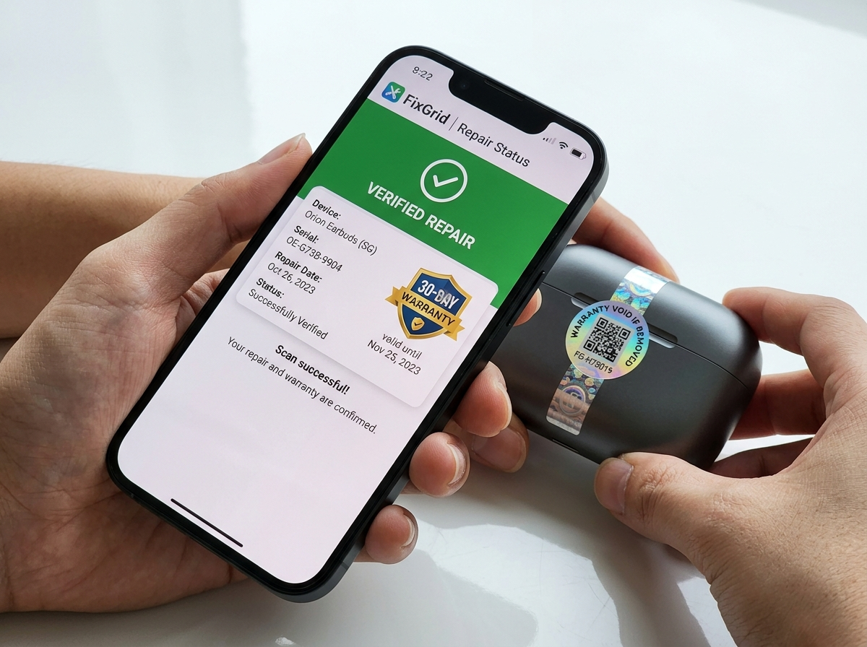
// 06 • HARDWARE-SOFTWARE BRIDGE
[ 06 / 08 ]
Dual-Loop QR Digital Product Passport
STEP 01
FixGrid Probe Diagnostics Upload
When the technician completes the repair across any category, the FixGrid Probe wand syncs the passing impedance test and high-res macro photos directly to the FixGrid cloud database via ESP32 Wi-Fi/BLE.
STEP 02
Physical Holographic Void Seal
A serialized, tamper-evident holographic QR void sticker is printed and affixed over the device or appliance seam. If anyone attempts to tamper with or reopen the unit, the physical pattern breaks.
STEP 03
Customer Scan & Warranty Activation
The customer scans the QR code with any standard smartphone camera. It displays component before/after photos, diagnostic health logs, and activates an ironclad 90-day digital warranty certificate.
Tamper-Evident Seal + Instant Smartphone Scan
FixGrid Ecosystem • fixgrid.vytron.me
Live Web Platform + FixGrid Probe™ Diagnostics
Right-to-Repair & Circular Economy
Notes:
This is where the magic happens: the FixGrid Probe hardware records the repair, generates a tamper-evident holographic QR seal, and the customer scans it on their phone to see verified before-and-after photos and activate their warranty.

Slide 7
// 07 • IMPACT & SCALABILITY
[ 07 / 08 ]
Tapping the $15.2B Repair Economy
60–80%
ECONOMIC (Consumer & Artisan)
1. Platform Take-Rate (5–8%)
Consumers save 60–80% compared to purchasing new devices. Local mechanics gain formal digital identity, repeat customers, and higher daily earnings.
Competitive transaction fee on every escrow-verified repair booking.
2. Customer Care+ Subscription (₹199/mo | ₹1,499/yr)
100%
SOCIAL (Community Dignity)
Household repair pass: free FixGrid Probe diagnostics, zero booking fees & 60-day warranty.
Brings unorganized street artisans into the formal digital economy, elevating informal mechanics with lab-grade diagnostic tools and transparent trust.
3. Shop Pro SaaS & Hardware Tier (₹999/mo)
FixGrid Probe firmware updates, warranty management, digital store CRM & analytics.
Zero
ECOLOGICAL (Planet Circularity)
Diverts hundreds of kilograms of toxic printed circuit boards and lithium batteries from municipal landfills, cutting manufacturing carbon emissions.
4. Certified Spare Parts Logistics
Curated B2B marketplace revenue for verified authentic micro-components.
FixGrid Ecosystem • fixgrid.vytron.me
Live Web Platform + FixGrid Probe™ Diagnostics
Right-to-Repair & Circular Economy
Notes:
Our model creates value for everyone: consumers save money, informal mechanics earn reliable livelihoods, and FixGrid monetizes through transaction fees and subscriptions.

Slide 8
// 08 • THE FUTURE ROADMAP
[ 08 / 08 ]
A Movement Towards a Sustainable Repair Economy
01
PHASE 1 (MONTHS 1–6)
02
PHASE 2 (MONTHS 7–12)
03
PHASE 3 (YEAR 2+)
Pilot Repair Clusters
Community Drives
Municipal Scaling
Deploy 50 FixGrid Probe units across Mumbai electronics repair markets.
Validate web escrow & before/after macro photo flow with 1,000+ customer repairs.
Partner with schools & colleges for zero-e-waste community repair clinics.
Roll out Customer Care+ subscription pass and certified technician onboarding.
Integrate with municipal e-waste boards for certified gadget triage.
Scale frugal FixGrid Probe tool manufacturing to local repairers nationwide.
FixGrid Probe™ Unified Ecosystem
Project FixGrid
A Unified Web & Hardware Solution for Right-to-Repair, Consumer Trust & Circular Sustainability
fixgrid.vytron.me
FixGrid Ecosystem • fixgrid.vytron.me
Live Web Platform + FixGrid Probe™ Diagnostics
Right-to-Repair & Circular Economy
Notes:
Thank you. FixGrid and FixGrid Probe demonstrate that with frugal engineering and digital trust, we can empower local artisans, save consumers money, and protect our environment from toxic e-waste.

