Slide 1

M.Tech Project Review
on
Deep Learning Model based Human Activity Recognition using Kinect Sensor Data
by Rishit Maurya (224ME1001)
Supervisor
Dr. Ravi Kumar Mandava
Asst. Professor
Department of Mechanical Engineering IIITDM Kurnool

Slide 2
Contents
Introduction
Applications
Literature Review
Research Gaps
Objectives
Work done so far
Dataset Collection
Deep Learning Models
Results
References

Slide 3
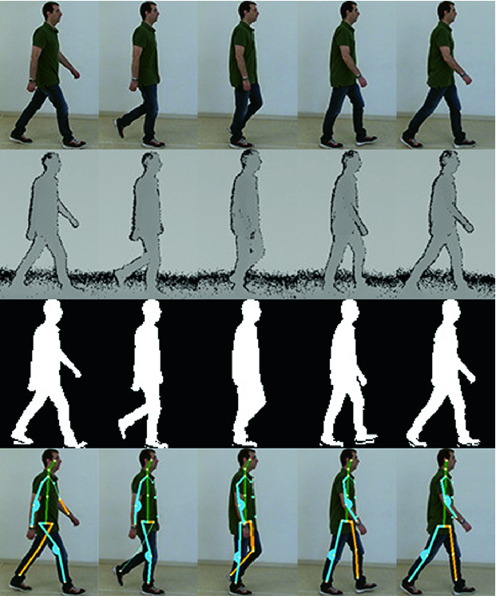
Introduction about Human Activity Recognition
Human Activity Recognition (HAR) refers to automatically identifying and classifying human actions from sensor or motion data.
HAR analyzes body movement patterns to identify activities like walking, sitting, standing, and climbing stairs.
Accurate HAR supports abnormal behavior detection, recovery monitoring, and safety for independent living.
Why HAR is needed ?
Monitor patient movements for rehabilitation and recovery progress.
Enhance surveillance systems with automatic threat detection.
Enable robots to understand and respond to human actions.
Improve interaction, navigation, and task coordination with humans.
Fig.1. HAR

Slide 4
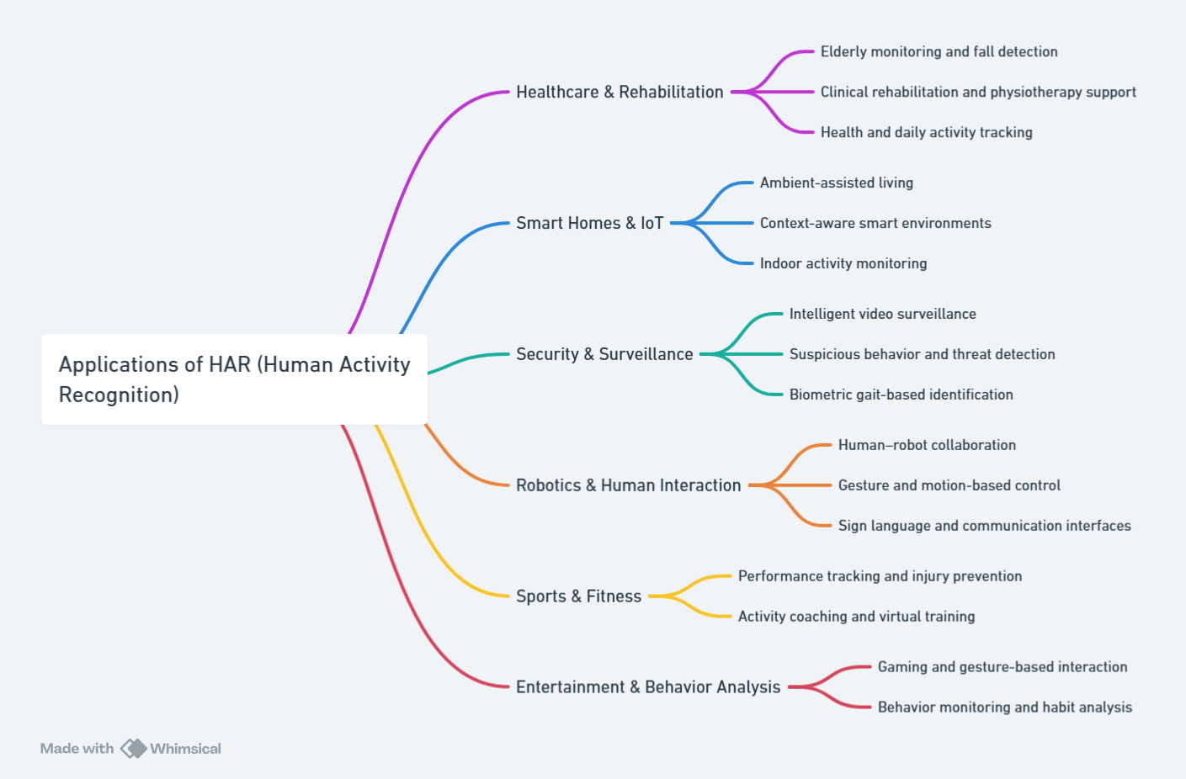
Applications of Human Activity Recognition

Slide 5
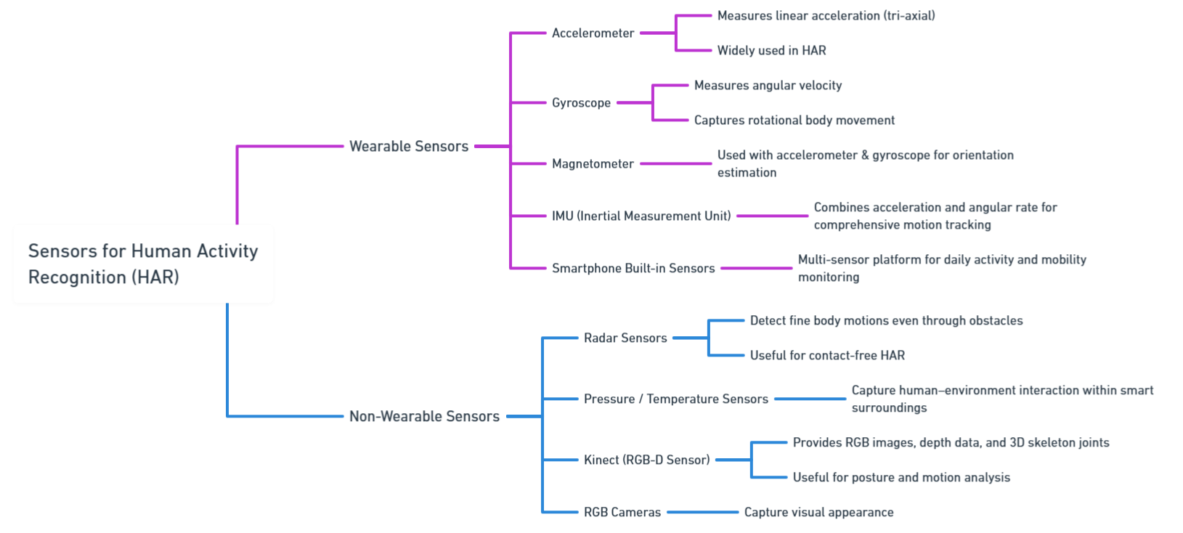
Sensor Classification for Human Activity Recognition

Slide 6
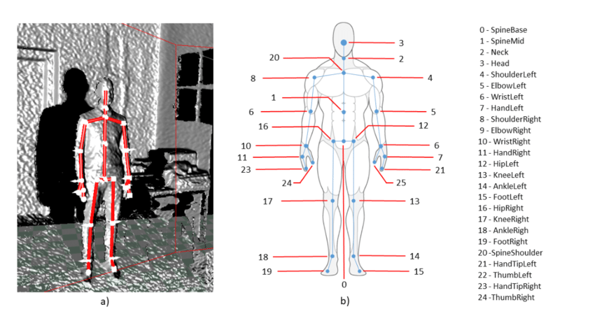
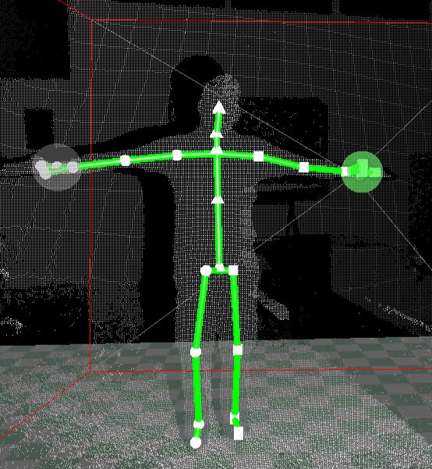
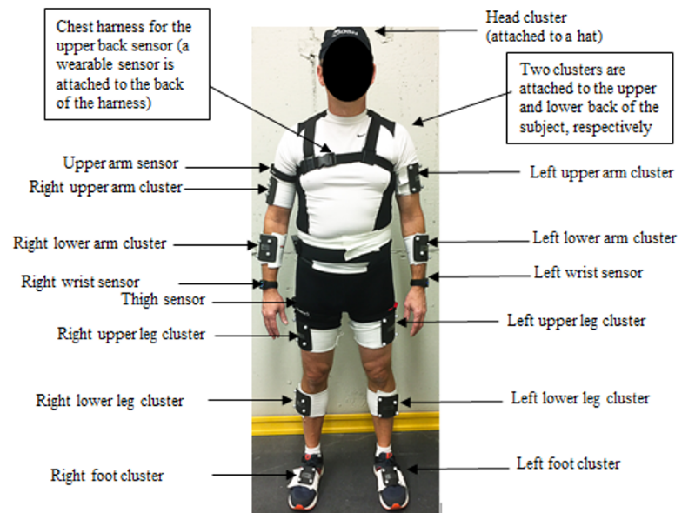
Different Approaches to Data Collection
(a)
(b)
Fig.2. Figure (a) Data collection using Kinect sensor and figure (b) Data collection using wearable sensors

Slide 7
Literature review
S. No. | Authors & Year | Title | Key Findings
1 | Lalwani et al., 2024 | A Novel CNN-BiLSTM-GRU Hybrid Deep Learning Model for Human Activity Recognition. | The proposed CNN-BiLSTM-GRU hybrid model achieved an accuracy of 99.7% on the WISDM dataset The model processes raw wearable sensor data with minimal preprocessing. The findings have implications for bipedal robotics by enhancing human–robot interaction quality.
2 | Ashwini K et al., 2020 | Skeletal Data based Activity Recognition System | The system uses statistical features derived from Kinect skeletal data. The Support Vector Machine (SVM) classifier performed better than the KNN classifier.
3 | Rahul Kala et al., 2016 | Human Activity Recognition in Real-Times Environments using Skeleton Joints | The Artificial Neural Network (ANN) classifier achieved the highest aggregate accuracy result of 95.1%. Principal Component Analysis (PCA) was used for dimension reduction of 3D joint coordinates captured by the Kinect camera.
4 | Komang Mandira et al., 2019 | Human activity recognition using skeleton data and support vector machine | The study proposed using Support Vector Machine (SVM) classification on skeleton data captured by a Kinect device with accuracy of 93.75%.
5 | Khatun et al., 2022 | Deep CNN-LSTM With Self-Attention Model for Human Activity Recognition Using Wearable Sensor | A hybrid deep learning model combining CNN-LSTM and a self-attention algorithm was proposed to enhance predictive capabilities. The model uses raw smartphone sensor data (accelerometer, gyroscope, and linear acceleration) It achieved an accuracy of 99.93% on the collected H-Activity dataset.

Slide 8
Literature review
S. No. | Authors & Year | Title | Key Findings
6 | Açış & Güney., 2023 | Classification of human movements by using Kinect sensor | The maximum average classification success achieved was 98.85%. This maximum success utilized LSTM for feature extraction combined with a machine learning classifier (SVM Kernel/Logistic Regression/Medium Neural Network). The study concluded that joint data provided much more successful results for classification than image data.
7 | Challa et al., 2022 | A multibranch CNN-BiLSTM model for human activity recognition using wearable sensor data | A multibranch CNN-BiLSTM network was proposed for automatic feature extraction from raw sensor data. The model uses different convolutional filter sizes (3, 7, and 11) to capture various temporal local dependencies. It achieved accuracies of 96.37% (UCI-HAR), 96.05% (WISDM), and 94.29% (PAMAP2) datasets.
8 | Kaseris et al., 2024 | A Comprehensive Survey on Deep Learning Methods in Human Activity Recognition | It investigates approaches utilizing diverse input modalities like accelerometer data, video sequences, and audio signals
9 | Sarveshwaran, 2022 | Investigation on Human Activity Recognition using Deep Learning | Discussion about the deep learning model, merits, demerits and dataset used in human activity recognition.
10 | Morana et al., 2017 | KARD - Kinect Activity Recognition Dataset | KARD contains 18 Activities. Each activity is performed 3 times by 10 different subjects.

Slide 9
Research Gaps
A. Data and Annotation Challenges :
Limited annotated datasets.
Low subject diversity.
Noisy, imbalanced real-world data.
High-cost vision data processing.
Reliance on handcrafted features.
Deep models lack interpretability.
B. Activity and Complexity Modeling :
Complex multi-sensor fusion required.
Subtle/overlapping motions cause difficulty.
Hard postural transition detection.
Vision suffers occlusion/clutter.
C. Architectural and Methodological Limitations :
Heavy preprocessing overhead.
No multi-resolution encoding.
High computational complexity.
RNNs are slow, and provide limited context.
CNN/RNN spatial–temporal mismatch.
D. Deployment and Real-World Challenges :
Severe domain shift issues.
Low wearable adoption.
No adaptive recalibration.
Embedded systems constraints.
Vision-based privacy concerns.

Slide 10
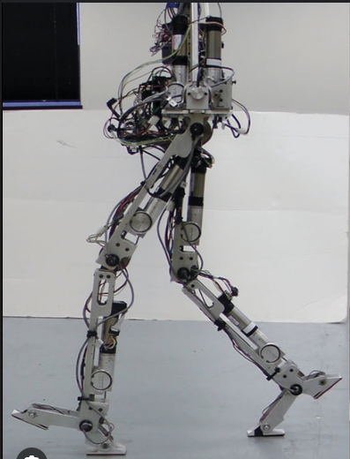
Objective
Develop a unified, efficient HAR model capable of handling data scarcity, multi-sensor complexity, and real-world deployment challenges using both wearable and non-wearable Kinect data.
Integrate and compare activity recognition performance across wearable and non-wearable sensing modalities.
Transfer recognized motion patterns to a bipedal robot, enabling accurate, real-time imitation and reproduction of human activities.
Fig.3. Bipedal Robot

Slide 11
Work done so far
Created a Skeletal Joints Dataset using Microsoft Kinect Sensor for Human Activity Recognition.
Studied skeletal joint movement patterns specific to each activity to enhance accurate feature capture for the model.
Used a multi-scale feature extraction approach to capture slow, medium, and fast skeletal joint movements during activities for dataset creation.
Developed a hybrid deep learning architecture Multi-Scale Gated Residual Skip BiLSTM model.
Achieved a classification accuracy of 97.97% using the MS-GRS-BiLSTM model on the skeletal joints dataset for Human Activity Recognition.
Evaluated the MS-GRS-BiLSTM model on the KARD - Kinect Activity Recognition dataset and achieved an accuracy of 98.77%.

Slide 12
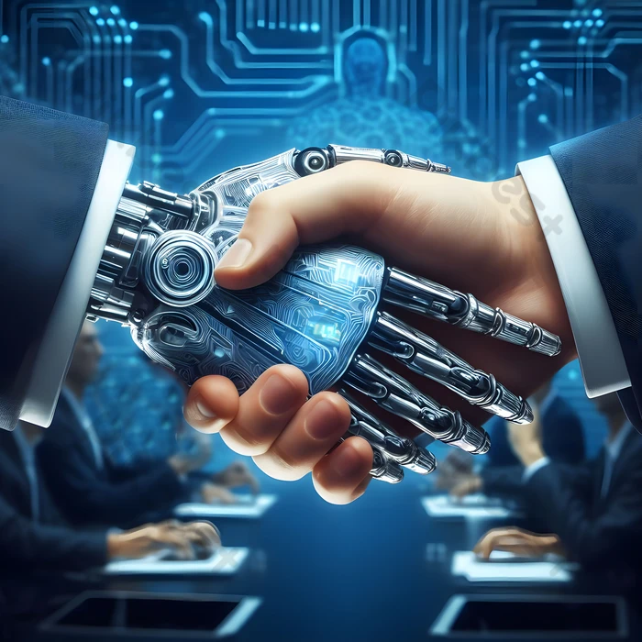
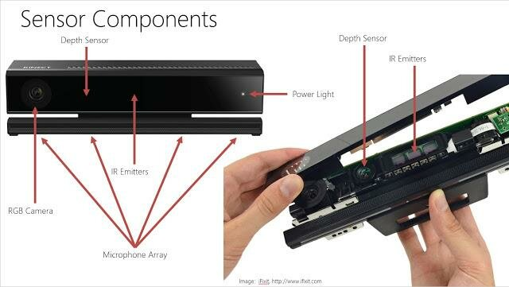
Sensor Selection – Kinect Sensor
Kinect provides 3D skeletal coordinates (x, y, z) for 25 joints, supporting detailed posture and gait analysis.
It captures motion contact-free, avoiding discomfort and ensuring user independence.
Kinect records full-body movement in global coordinates, whereas wearables capture only local motion signals.
Kinect tracks multiple joints simultaneously for coordinated movement detection; wearables typically monitor only one or few points, limiting context.
Fig.4. Kinect Sensor

Slide 13
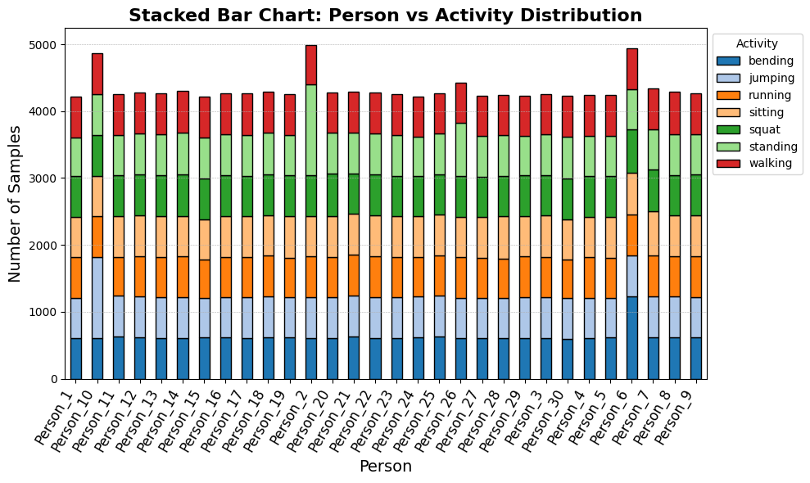
My Dataset - Using Kinect Sensor
Data captured using Microsoft Kinect with RGB, depth, and 3D skeletal data.
Kinect uses a 25-joint skeleton model with x, y, z coordinates tracked over time.
Dataset includes 30 individuals for variability in movement and posture.
Each person performs 7 activities: bending, jumping, running, sitting, squat, standing, walking.
Each activity is stored as a time-series CSV with timestamp, body ID, and joint coordinates.
Dataset Size : 1,29,982 samples
Fig.5. Person vs Activity Distribution

Slide 14
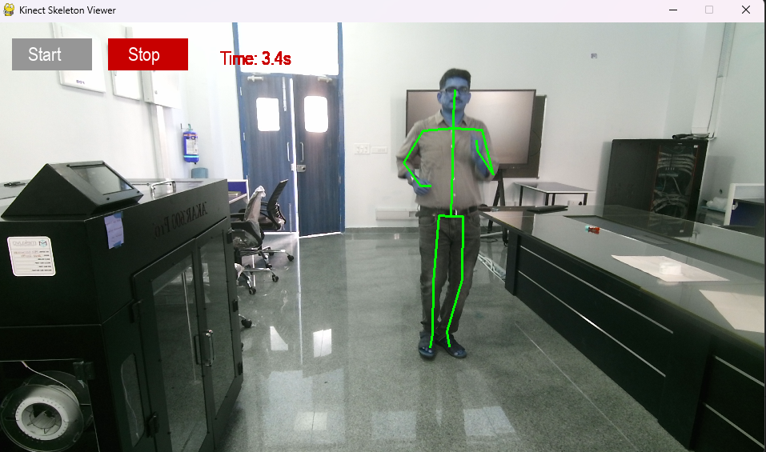
Dataset Collection
Fig.6. Person performing Activity for Dataset Collection
Fig.7. Skeletal representation of Activity

Slide 15
Models Used
Model | Key Idea | Architecture | Strengths | Limitations | Best Use Cases
Long Short Term Memory (LSTM) | Learns long-term dependencies in sequential data | Single-direction recurrent unit with input, forget, and output gates | - Handles vanishing gradient problem- Good for time-series / sequential classification. - Captures temporal memory effectively. | - Loses information from future context. - May underperform on complex motion patterns. | Basic sequence forecasting, simple activity recognition, speech modeling
Bidirectional LSTM (BiLSTM) | Uses past + future context for each time step | Two LSTM layers: one forward, one backward, outputs concatenated | - Strong contextual understanding- Captures bidirectional motion patterns. - Good for overlapping / subtle movements. | - Increased computational load. - More memory usage due to dual processing. | Human activity recognition, NLP tasks, gesture recognition
Gated Residual Skip BiLSTM (GRS-BiLSTM) | Enhances BiLSTM with Gated Residual Skip (GRS) connections | BiLSTM backbone + gating layer + residual skip pathways + optional multi-scale inputs | - Improved gradient flow and training stability- Better multi-resolution temporal modeling. - Handles subtle transitions and long motion dependencies- Reduces over-smoothing and information loss. | - Complex architecture requiring careful tuning . - Higher training time and model size. | High-precision activity recognition, multi-sensor fusion, real-world motion environments

Slide 16
Proposed Model – MS-GRS-BiLSTM
Name : Multi-Scale Gated Residual Skip Bidirectional Long Short Term Memory (MS-GRS-BiLSTM).
Goal : classify short time-windows of sensor / joint data into activity classes.
Key ideas : multi-scale temporal representation, learned gates to fuse scales, residual skip from raw input, BiLSTM temporal modeling.
The MS-GRS-BiLSTM is not just detecting momentary movement, but is:
Understanding the shape of motion over time, at multiple speeds, while carefully preserving useful information and filtering noise.

Slide 17
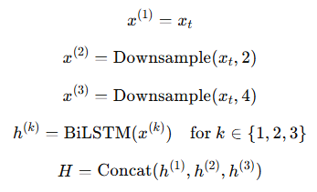
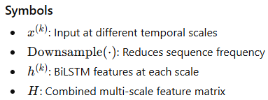
MS-GRS-BiLSTM
Why Multi-Scale (MS) is Needed ?
Different activities show patterns at different time speeds:
Formula :
Activity Type | Activity Speed | Example
Quick & Repetitive | Fast | Running, Jumping
Moderate Movement | Medium | Walking
Postural & Stable | Slow | Standing, Sitting
To capture these differences, the model creates 3 versions of each input window:
Full detail (original resolution)
Medium-scaled (every 2nd time step)
Coarse-scaled (every 4th time step)
This allows the network to understand both short, rapid motions and longer, slower movement trends.

Slide 18
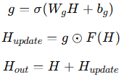
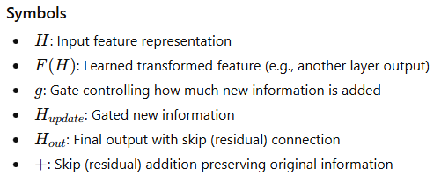
MS-GRS-BiLSTM
Gated Residual Skip (GRS) Blocks contains :
Projection Layer : Simplifies the signal and extracts essential structure.
BiLSTM Layer : Reads the movement pattern forward and backward in time.
This is important because what happened just before and just after each moment helps define the action (e.g., lowering before a jump).
Gating Mechanism : A learned filter that decides:
i) How much new information to use
ii) How much previous information to keep
Residual Skip Connection : Passes earlier information forward without loss, preventing the model from forgetting important details.
Formula :

Slide 19
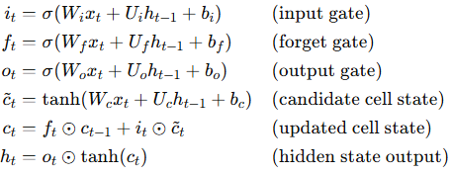
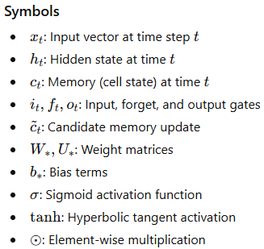
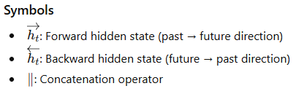


MS-GRS-BiLSTM
LSTM is a type of neural network used for time-series or sequential data.
It has memory cells that allow it to retain important past information.
It uses gates to decide what to keep, what to update, and what to forget.
A BiLSTM processes the sequence in two directions:
Forward: earlier → later time steps
Backward: later → earlier time steps
This gives it context from both past and future time steps,
Formula :
Formula :

Slide 20
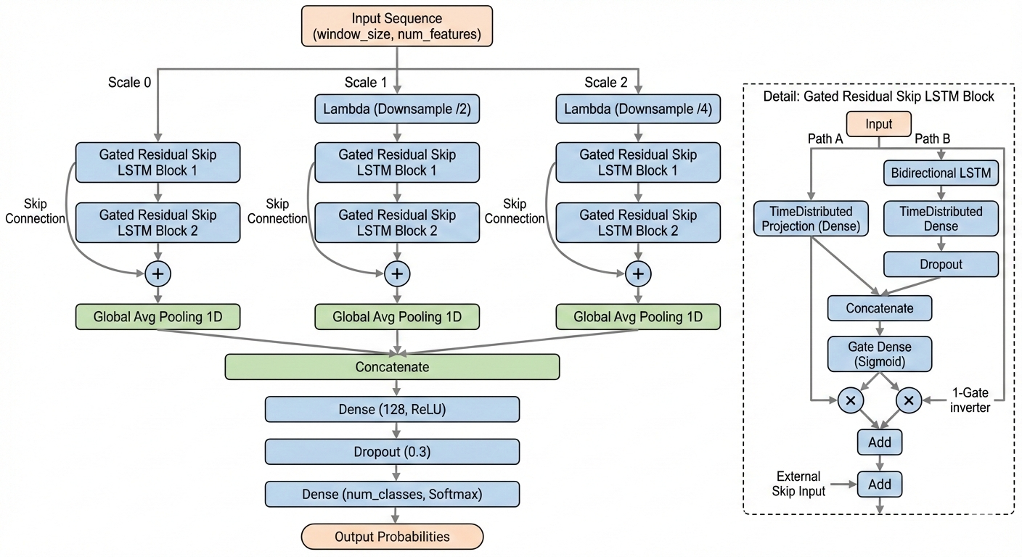
MS-GRS-BiLSTM Architecture
Fig.8. MS-GRS-BiLSTM Architecture

Slide 21
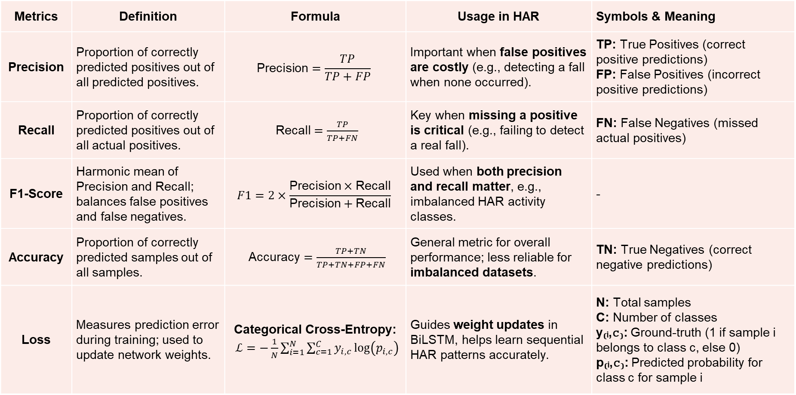
Metrics Used in HAR
Metrics | Definition | Formula | Usage in HAR | Symbols & Meaning
Precision | Proportion of correctly predicted positives out of all predicted positives. | $$\text{Precision}=\frac{TP}{TP+FP}$$ | Important when false positives are costly (e.g., detecting a fall when none occurred). | TP: True Positives (correct positive predictions) FP: False Positives (incorrect positive predictions)
Recall | Proportion of correctly predicted positives out of all actual positives. | $\text{Recall}=\frac{TP}{TP+FN}$ | Key when missing a positive is critical (e.g., failing to detect a real fall). | FN: False Negatives (missed actual positives)
F1-Score | Harmonic mean of Precision and Recall; balances false positives and false negatives. | $$F1=2×\frac{\text{Precision}×\text{Recall}}{\text{Precision}+\text{Recall}}$$ | Used when both precision and recall matter, e.g., imbalanced HAR activity classes. | -
Accuracy | Proportion of correctly predicted samples out of all samples. | $\text{Accuracy}=\frac{TP+TN}{TP+TN+FP+FN}$ | General metric for overall performance; less reliable for imbalanced datasets. | TN: True Negatives (correct negative predictions)
Loss | Measures prediction error during training; used to update network weights. | Categorical Cross-Entropy: $ℒ=−\frac{1}{N}\sum_{i=1}^{N}{\sum_{c=1}^{C}{y_{i,c}}\log\left(p_{i,c}\right)}$ | Guides weight updates in BiLSTM, helps learn sequential HAR patterns accurately. | N: Total samples C: Number of classes y₍ᵢ,𝚌₎: Ground-truth (1 if sample i belongs to class c, else 0) p₍ᵢ,𝚌₎: Predicted probability for class c for sample i

Slide 22
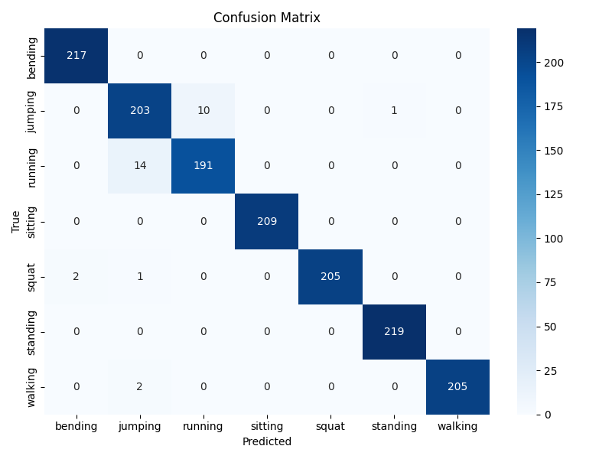
Results on My Dataset using the Proposed Model
Class | Precision | Recall | F1-Score
Bending | 0.9982 | 0.9972 | 0.9977
Jumping | 0.9344 | 0.9597 | 0.9469
Running | 0.9571 | 0.9365 | 0.9467
Sitting | 1.0000 | 1.0000 | 1.0000
Squat | 1.0000 | 0.9952 | 0.9976
Standing | 0.9955 | 1.0000 | 0.9977
Walking | 1.0000 | 0.9942 | 0.9971
Overall Metric | Precision | Recall | F1-Score
Accuracy | - | - | 0.9835
Macro Avg | 0.9836 | 0.9833 | 0.9834
Weighted Avg | 0.9836 | 0.9835 | 0.9835
Fig.9. Confusion Matrix on Skeletal Dataset

Slide 23
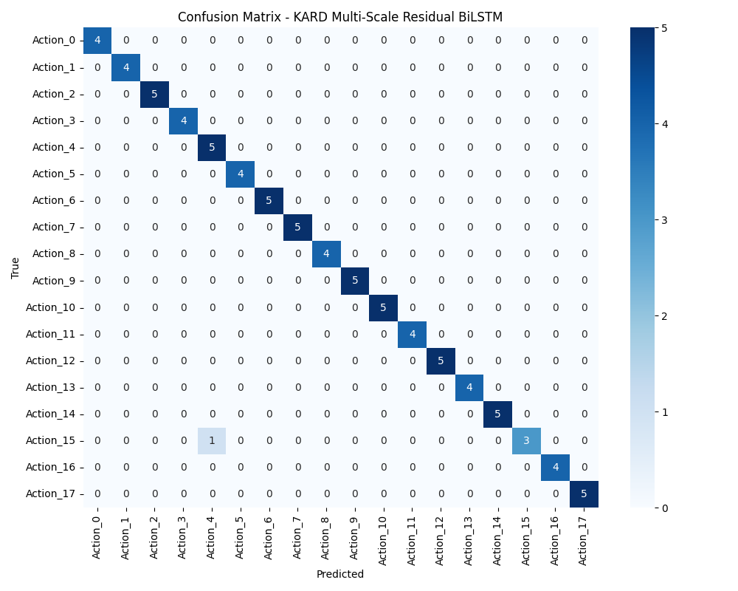
Results on Online Dataset (KARD) using the Proposed Model
Class | Precision | Recall | F1-Score
Action_0 | 1.0000 | 1.0000 | 1.0000
Action_1 | 1.0000 | 1.0000 | 1.0000
Action_2 | 1.0000 | 1.0000 | 1.0000
Action_3 | 1.0000 | 1.0000 | 1.0000
Action_4 | 0.8333 | 1.0000 | 0.9091
Action_5 | 1.0000 | 1.0000 | 1.0000
Action_6 | 1.0000 | 1.0000 | 1.0000
Action_7 | 1.0000 | 1.0000 | 1.0000
Action_8 | 1.0000 | 1.0000 | 1.0000
Action_9 | 1.0000 | 1.0000 | 1.0000
Action_10 | 1.0000 | 1.0000 | 1.0000
Action_11 | 1.0000 | 1.0000 | 1.0000
Action_12 | 1.0000 | 1.0000 | 1.0000
Action_13 | 1.0000 | 1.0000 | 1.0000
Action_14 | 1.0000 | 1.0000 | 1.0000
Action_15 | 1.0000 | 0.7500 | 0.8571
Action_16 | 1.0000 | 1.0000 | 1.0000
Action_17 | 1.0000 | 1.0000 | 1.0000
Overall Metric | Precision | Recall | F1-Score
Macro Avg | 0.9907 | 0.9861 | 0.9870
Weighted Avg | 0.9897 | 0.9877 | 0.9833
Fig.10. Confusion Matrix on KARD Dataset

Slide 24
Comparison of Accuracies of Models on My Dataset
Activities / Models | LSTM | BiLSTM | GRS-BiLSTM | Proposed Model
Bending | 0.9091 | 0.9800 | 1.0000 | 0.9977
Jumping | 0.8571 | 0.4900 | 0.7300 | 0.9469
Running | 0.7692 | 0.7400 | 0.8200 | 0.9467
Sitting | 0.4000 | 1.0000 | 0.9800 | 1.0000
Squat | 1.0000 | 1.0000 | 1.0000 | 0.9976
Standing | 0.5000 | 0.9200 | 0.9800 | 0.9977
Walking | 0.8333 | 0.9700 | 1.0000 | 0.9971
Fig.11. Accuracy amongst different Activity and Models

Slide 25
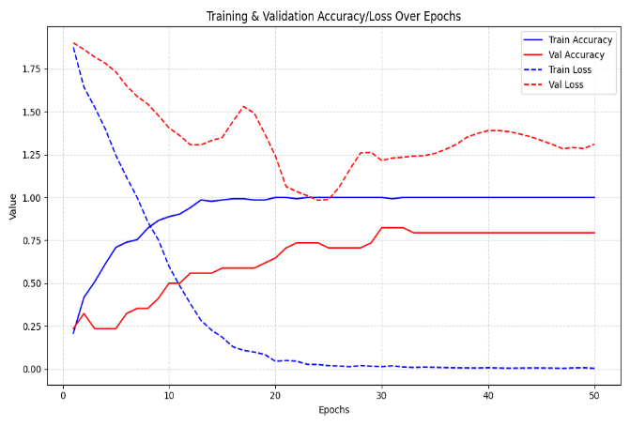
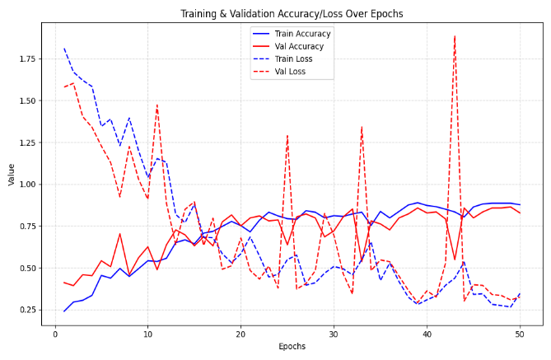
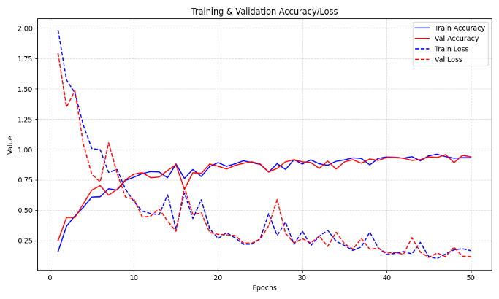
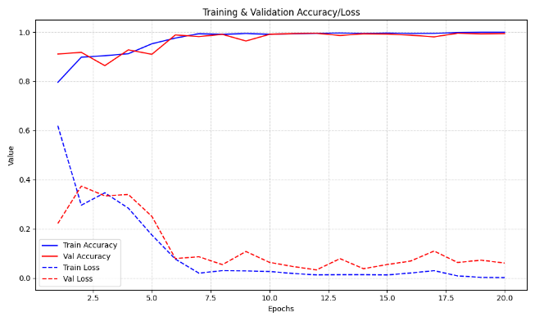
Comparison of Accuracy/Loss over Epochs of Models on My Dataset
LSTM | BiLSTM
GRS-BiLSTM | MS-GRS-BiLSTM

Slide 26
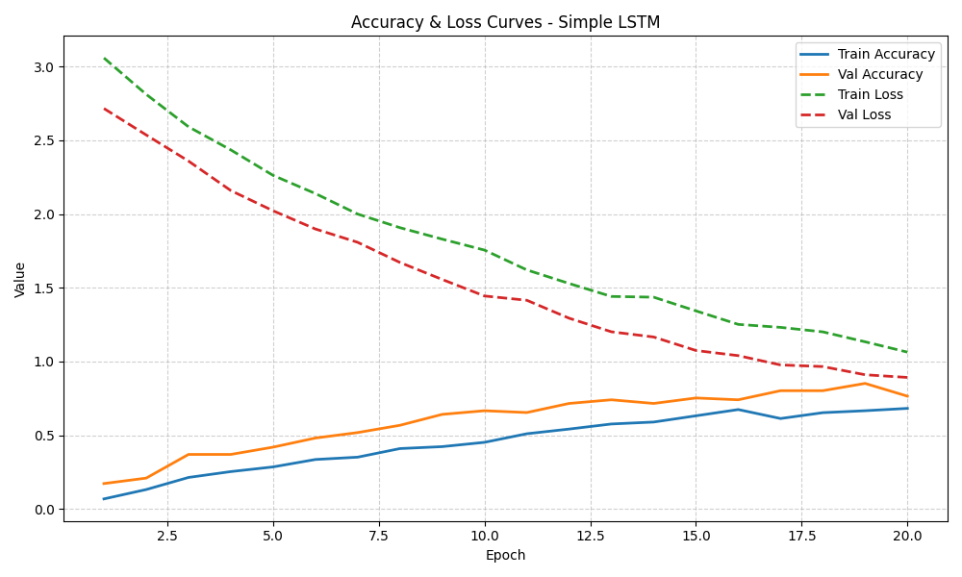
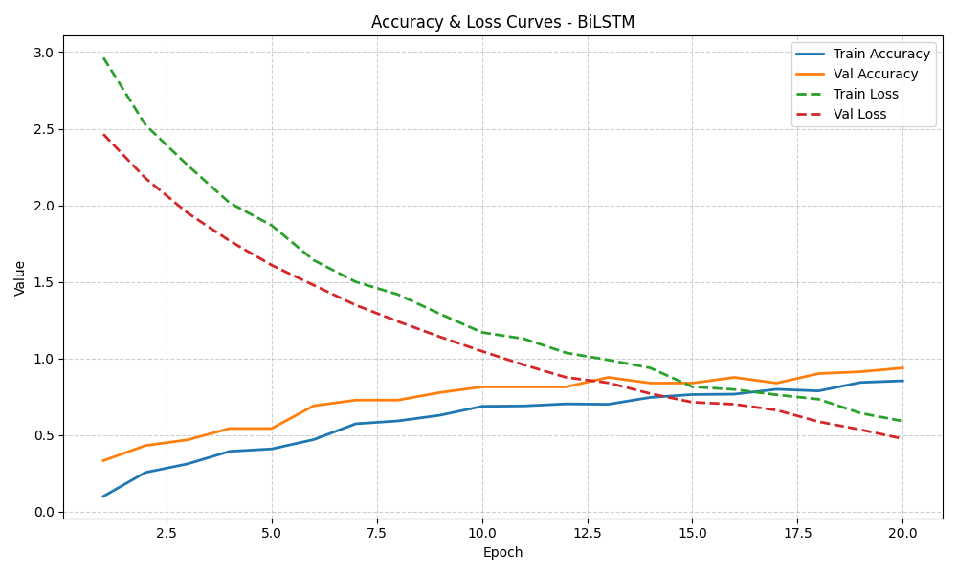
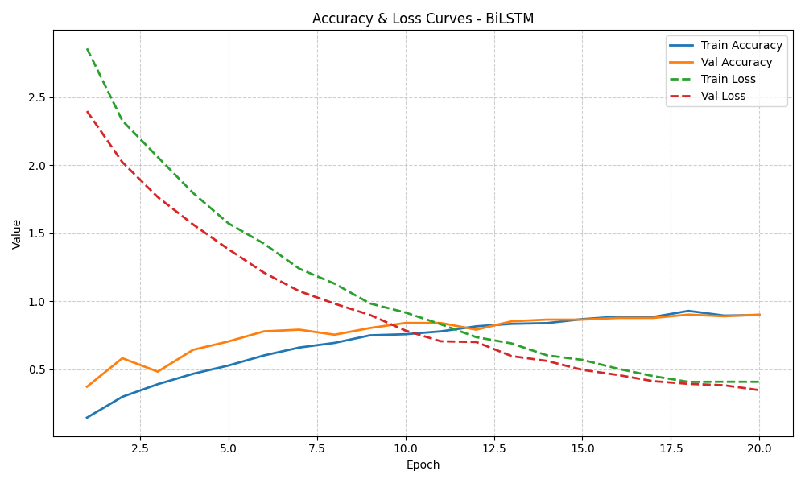
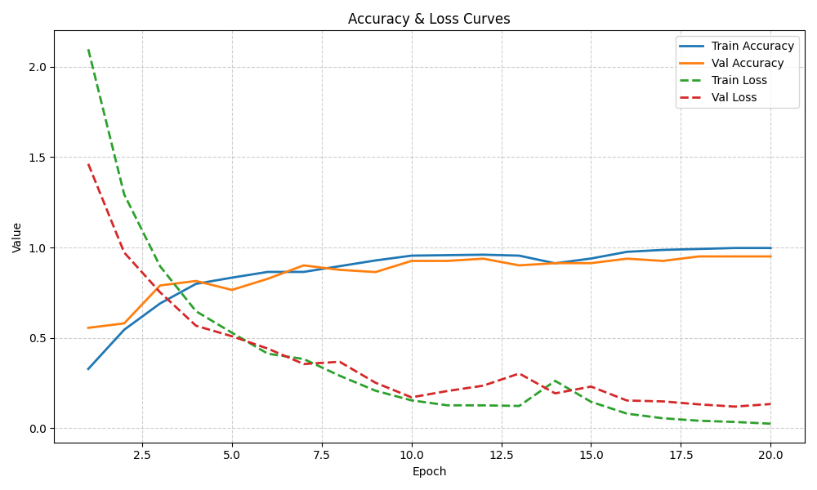
Comparison of Accuracy/Loss over Epochs of Models on KARD Dataset
LSTM | BiLSTM
GRS-BiLSTM | MS-GRS-BiLSTM

Slide 27
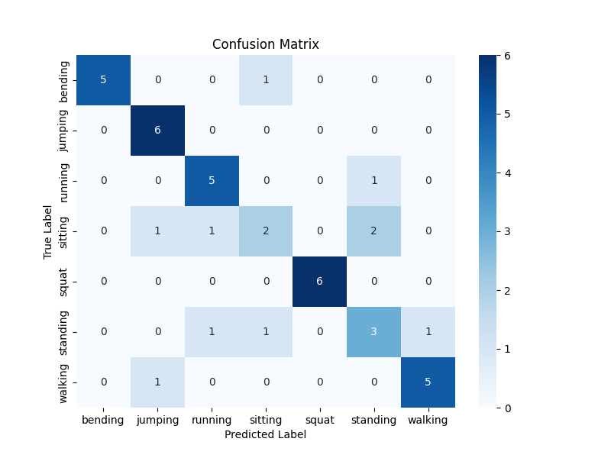
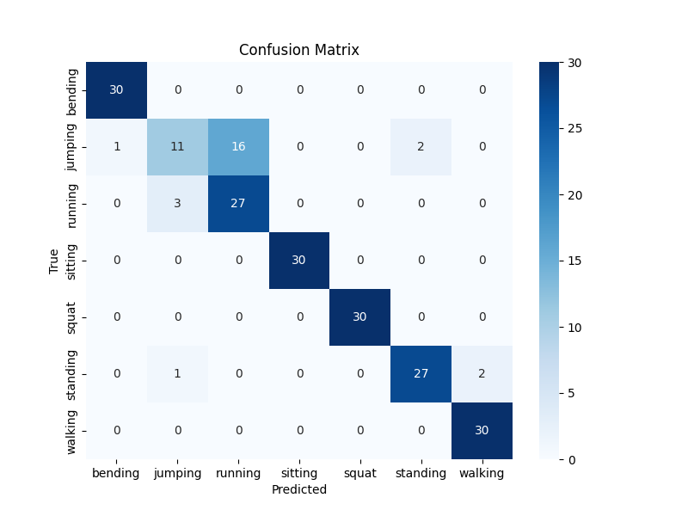
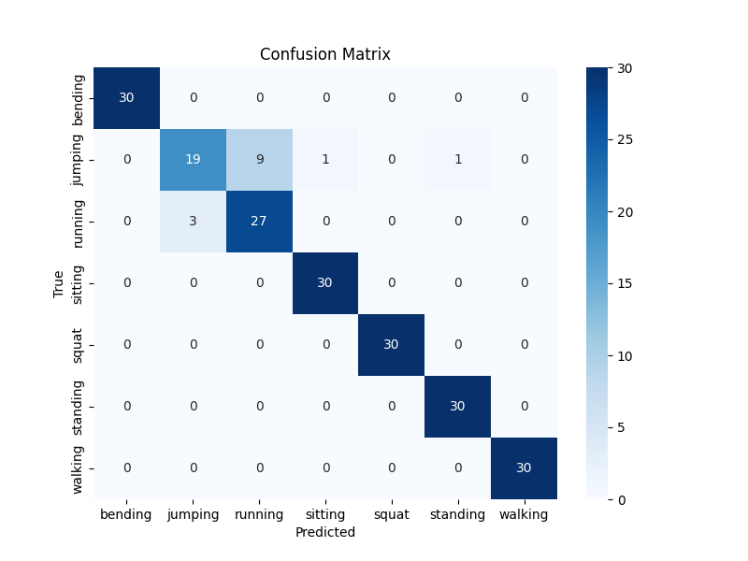
Comparison of Confusion Metrics of Models on My Dataset
LSTM | BiLSTM
GRS-BiLSTM | MS-GRS-BiLSTM

Slide 28
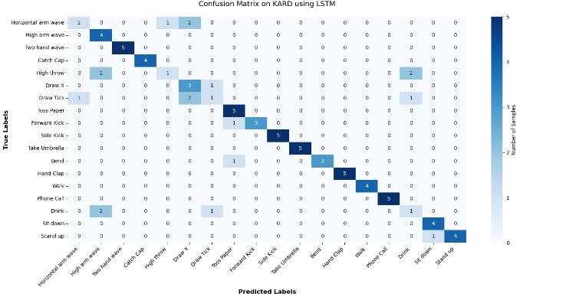
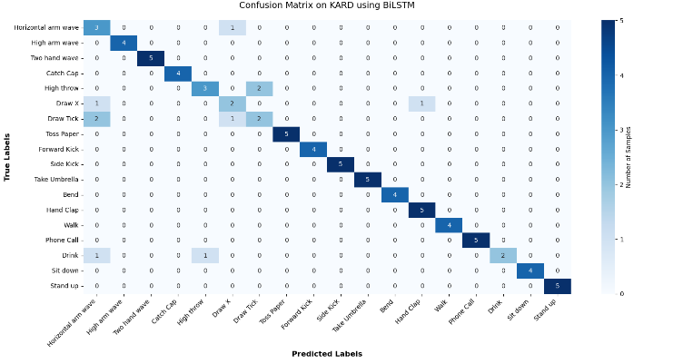
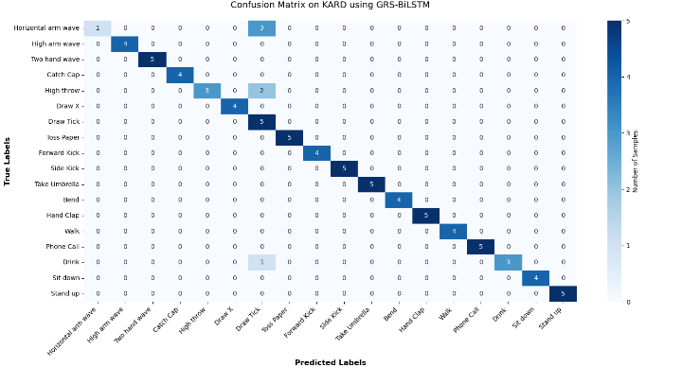
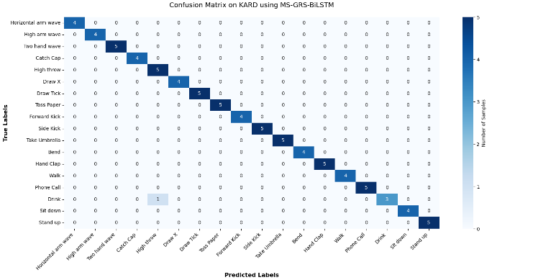
Comparison of Confusion Metrics of Models on My Dataset
LSTM | BiLSTM
GRS-BiLSTM | MS-GRS-BiLSTM

Slide 29
Comparison of Models Performance between Dataset
Skeletal Joint Dataset (My Dataset) :
Model | Test Loss | Test Accuracy | Precision | Recall | F1-Score | Model Size | Avg Inference Time per Sample
LSTM | 1.3108 | 76.19% | 0.7568 | 0.7619 | 0.7527 | 1.86 MB | 31.01 ms
BiLSTM | 0.3456 | 88.10% | 0.8900 | 0.8800 | 0.8700 | 1.43 MB | 27.03 ms
GRS-BiLSTM | 0.1671 | 93.33% | 0.9400 | 0.9300 | 0.9300 | 22.56 MB | 31.86 ms
MS-GRS-BiLSTM | 0.0516 | 98.35% | 0.9836 | 0.9833 | 0.9834 | 6.82 MB | 1.857 ms
KARD Dataset :
Model | Test Loss | Test Accuracy | Precision | Recall | F1-Score | Model Size | Inference Time per Sample
LSTM | 0.9281 | 77.78% | 0.7792 | 0.7750 | 0.7587 | 0.04 MB | 0.015 ms
BiLSTM | 0.5001 | 87.65% | 0.8896 | 0.8750 | 0.8740 | 0.09 MB | 0.077 ms
GRS-BiLSTM | 0.3790 | 92.59% | 0.9697 | 0.9222 | 0.9240 | 0.29 MB | 0.037 ms
MS-GRS-BiLSTM | 0.0573 | 98.77% | 0.9907 | 0.9861 | 0.9870 | 3.58 MB | 0.020 ms

Slide 30
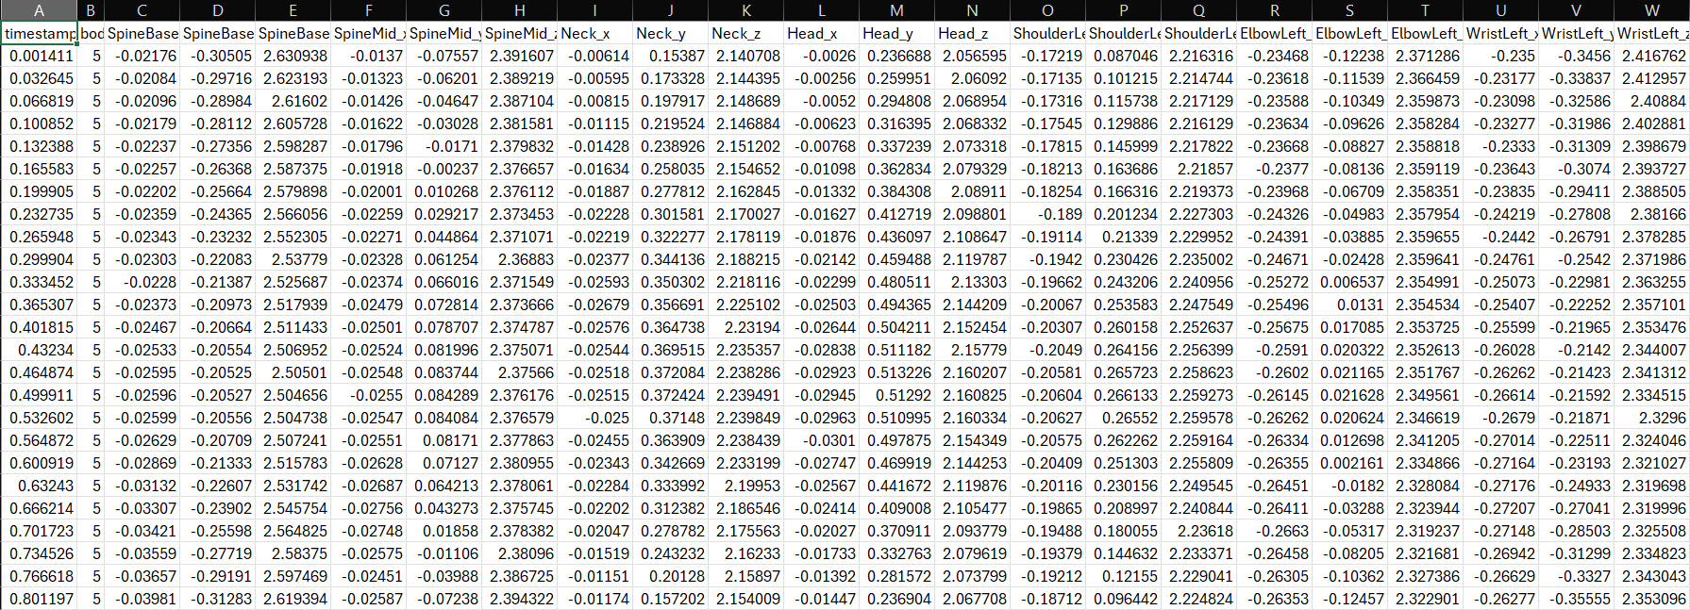
Sample Dataset : (a) Custom Dataset

Slide 31
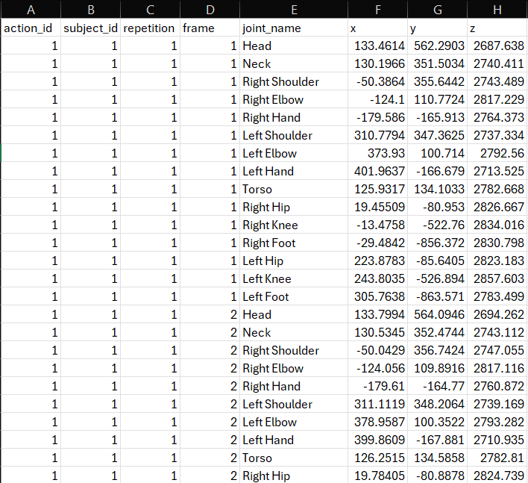
Sample Dataset : (b) KARD Dataset

Slide 32
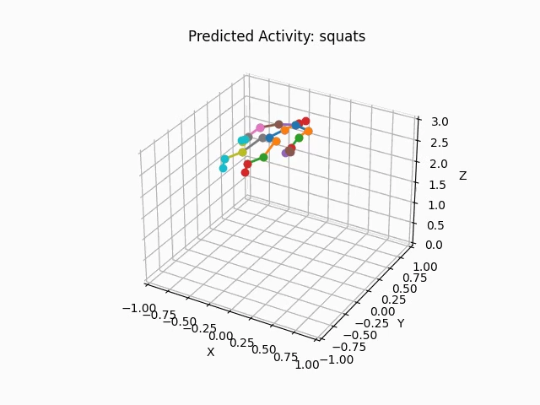
Prediction of Activity using Proposed Model
Fig.12. Prediction on different activities

Slide 33
References
Gupta, S. Deep learning based human activity recognition (HAR) using wearable sensor data. Int. J. Inf. Manag. Data Insights 2021, 1, 100046.
Diraco, G.; Rescio, G.; Caroppo, A.; Manni, A.; Leone, A. Human Action Recognition in Smart Living Services and Applications: Context Awareness, Data Availability, Personalization, and Privacy. Sensors 2023, 23, 6040.
Shuvo, M.M.H.; Ahmed, N.; Nouduri, K.; Palaniappan, K. A Hybrid Approach for Human Activity Recognition with Support Vector Machine and 1D Convolutional Neural Network. In Proceedings of the 2020 IEEE Applied Imagery Pattern Recognition Workshop (AIPR), Washington, DC, USA, 13–15 October 2020; pp. 1–5.
Rojanavasu, P.; Jantawong, P.; Jitpattanakul, A.; Mekruksavanich, S. Improving Inertial Sensor-based Human Activity Recognition using Ensemble Deep Learning. In Proceedings of the 2023 Joint International Conference on Digital Arts, Media and Technology with ECTI Northern Section Conference on Electrical, Electronics, Computer and Telecommunications Engineering (ECTI DAMT & NCON), Phuket, Thailand, 22–25 March 2023; pp. 488–492.
Muhoza, A.C.; Bergeret, E.; Brdys, C.; Gary, F. Multi-Position Human Activity Recognition using a Multi-Modal Deep Convolutional Neural Network. In Proceedings of the 2023 8th International Conference on Smart and Sustainable Technologies (SpliTech), Split, Croatia, 20–23 June 2023; pp. 1–5.
Tao, S.; Goh, W.L.; Gao, Y. A Convolved Self-Attention Model for IMU-based Gait Detection and Human Activity Recognition. In Proceedings of the 2023 IEEE 5th International Conference on Artificial Intelligence Circuits and Systems (AICAS), Hangzhou, China, 11–13 June 2023; pp. 1–5.

Slide 34
References
Hassler, A.P.; Menasalvas, E.; García-García, F.J.; Rodríguez-Mañas, L.; Holzinger, A. Importance of medical data preprocessing in predictive modeling and risk factor discovery for the frailty syndrome. BMC Med. Inform. Decis. Mak. 2019, 19, 33.
Xu, S.; Zhang, L.; Huang, W.; Wu, H.; Song, A. Deformable convolutional networks for multimodal human activity recognition using wearable sensors. IEEE Trans. Instrum. Meas. 2022, 71, 2505414.
Beddiar, D.R.; Nini, B.; Sabokrou, M.; Hadid, A. Vision-based human activity recognition: A survey. Multimed. Tools Appl. 2020, 79, 30509–30555.
Lara, O.D.; Labrador, M.A. A survey on human activity recognition using wearable sensors. IEEE Commun. Surv. Tutorials 2012, 15, 1192–1209.
Ke, S.R.; Thuc, H.L.U.; Lee, Y.J.; Hwang, J.N.; Yoo, J.H.; Choi, K.H. A review on video-based human activity recognition. Computers 2013, 2, 88–131.
Ray, A.; Kolekar, M.H.; Balasubramanian, R.; Hafiane, A. Transfer learning enhanced vision-based human activity recognition: A decade-long analysis. Int. J. Inf. Manag. Data Insights 2023, 3, 100142. [CrossRef]
Singh, R.; Kushwaha, A.K.S.; Srivastava, R. Recent trends in human activity recognition–A comparative study. Cogn. Syst. Res. 2023, 77, 30–44.

Slide 35
THANK YOU

