Slide 1

M.Tech Project Review
on
Deep Learning Model based Human Activity Recognition using Mobile Sensor Data
by Rishit Maurya (224ME1001)
Supervisor
Dr. Ravi Kumar Mandava
Asst. Professor
Department of Mechanical Engineering IIITDM Kurnool

Slide 2
Contents
Introduction
Applications
Literature Review
Research Gaps
Objectives
Work done so far
Dataset Collection
Deep Learning Models
Results
References

Slide 3
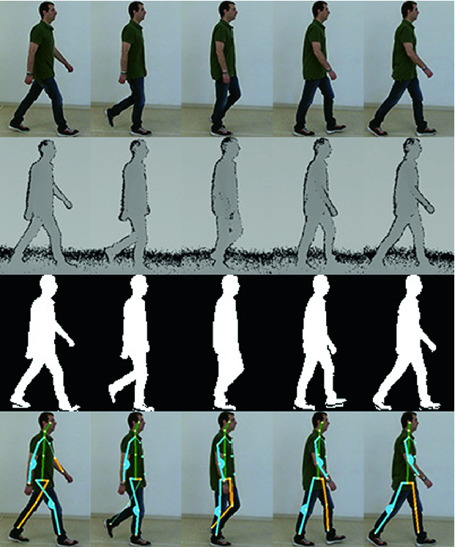
Introduction about Human Activity Recognition
Human Activity Recognition (HAR) refers to automatically identifying and classifying human actions from sensor or motion data.
HAR analyzes body movement patterns to identify activities like walking, sitting, standing, and climbing stairs.
Accurate HAR supports abnormal behavior detection, recovery monitoring, and safety for independent living.
Why HAR is needed ?
Monitor patient movements for rehabilitation and recovery progress.
Enhance surveillance systems with automatic threat detection.
Enable robots to understand and respond to human actions.
Improve interaction, navigation, and task coordination with humans.
Fig.1. HAR

Slide 4
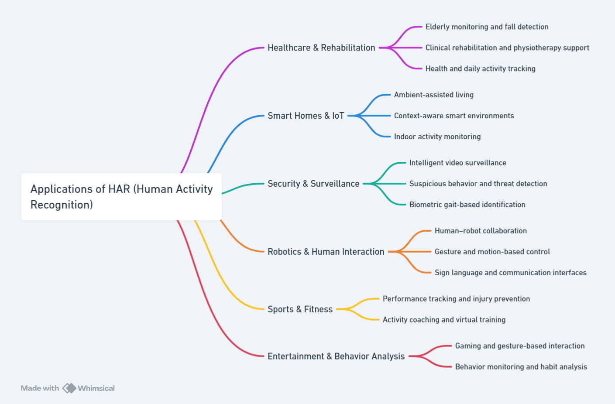
Applications of Human Activity Recognition

Slide 5
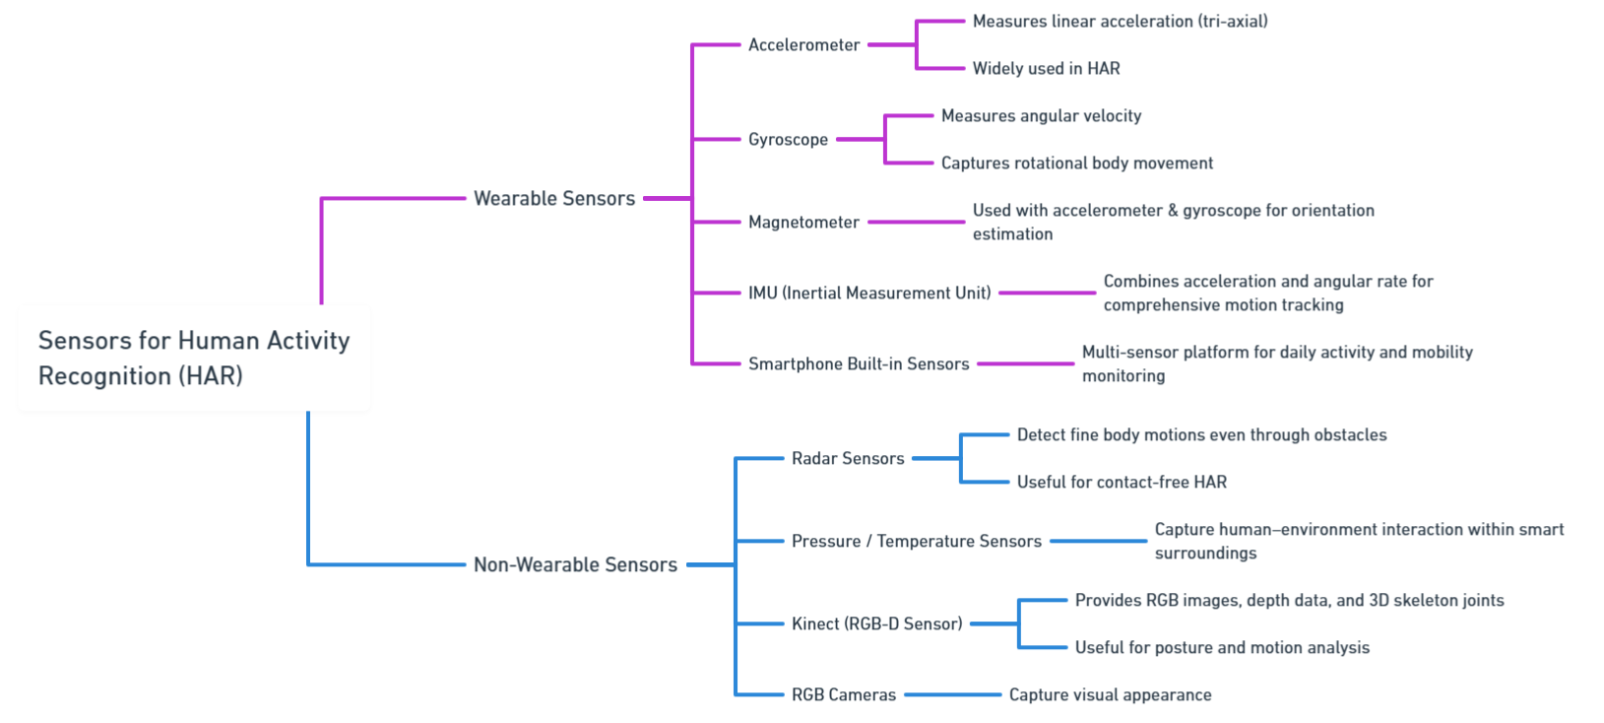
Sensor Classification for Human Activity Recognition

Slide 6
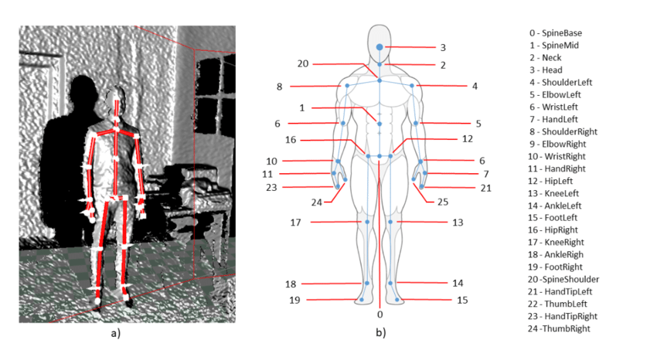
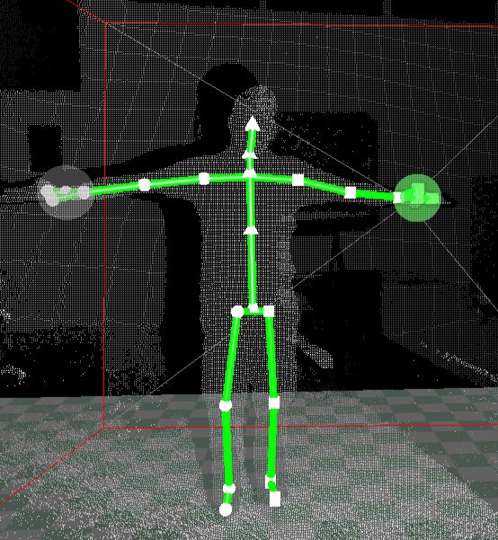
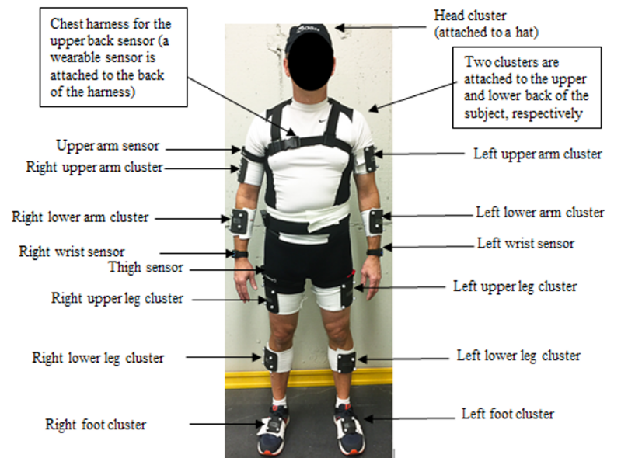
Different Approaches to Data Collection
(a)
(b)
Fig.2. Figure (a) Data collection using Kinect sensor and figure (b) Data collection using wearable sensors

Slide 7
Literature review
S. No. | Authors & Year | Title | Key Findings
1 | Lalwani et al., 2024 | A Novel CNN-BiLSTM-GRU Hybrid Deep Learning Model for Human Activity Recognition. | The proposed CNN-BiLSTM-GRU hybrid model achieved an accuracy of 99.7% on the WISDM dataset The model processes raw wearable sensor data with minimal preprocessing. The findings have implications for bipedal robotics by enhancing human–robot interaction quality.
2 | Tokas et al., 2025 | A Real-Time Deployable Attention-Driven CNN–LSTM Framework for Human Activity Recognition using Wearable Sensor | Introduces a lightweight architecture combining multi-resolution kernels and Convolutional Block Attention Modules (CBAM) to highlight salient features while suppressing sensor noise. Achieves high accuracy (e.g., 99.7% on mHealth) while remaining optimized for edge devices through structured pruning and quantization, resulting in a compact 130.8 KB model size.
3 | Hossen et al., 2025 | Machine Learning for Human Activity Recognition: State-of-the-Art Techniques and Emerging Trends | Provides a comprehensive review focusing on the integration of sensor-based, vision-based, and hybrid methodologies using modalities like RGB, depth, and Wi-Fi. Discusses recent breakthroughs in deep learning (CNNs, RNNs, attention mechanisms, and reinforcement learning) and evaluates their implications for future tech development.
4 | Khatun et al., 2022 | Deep CNN-LSTM With Self-Attention Model for Human Activity Recognition Using Wearable Sensor | A hybrid deep learning model combining CNN-LSTM and a self-attention algorithm was proposed to enhance predictive capabilities. The model uses raw smartphone sensor data (accelerometer, gyroscope, and linear acceleration) It achieved an accuracy of 99.93% on the collected H-Activity dataset.

Slide 8
Literature review
S. No. | Authors & Year | Title | Key Findings
6 | Sain et al., 2023 | Hybrid deep learning model-based human action recognition in indoor environment | Introduces the LNMIIT-KHAD dataset, consisting of seven indoor activities collected from 20 individuals using a Kinect V2 sensor. Develops a novel hybrid model (CNN + BiLSTM) that uses skeleton coordinates and kinematic features to identify actions while specifically protecting user privacy. Achieves a high accuracy of 99.5%, outperforming standard stand-alone CNN, LSTM, and ConvLSTM architectures
7 | Challa et al., 2022 | A multibranch CNN-BiLSTM model for human activity recognition using wearable sensor data | A multibranch CNN-BiLSTM network was proposed for automatic feature extraction from raw sensor data. The model uses different convolutional filter sizes (3, 7, and 11) to capture various temporal local dependencies. It achieved accuracies of 96.37% (UCI-HAR), 96.05% (WISDM), and 94.29% (PAMAP2) datasets.
8 | Kaseris et al., 2024 | A Comprehensive Survey on Deep Learning Methods in Human Activity Recognition | It investigates approaches utilizing diverse input modalities like accelerometer data, video sequences, and audio signals
9 | Sarveshwaran, 2022 | Investigation on Human Activity Recognition using Deep Learning | Discussion about the deep learning model, merits, demerits and dataset used in human activity recognition.

Slide 9
Research Gaps
A. Data and Annotation Challenges :
Limited annotated datasets.
Low subject diversity.
Noisy, imbalanced real-world data.
High-cost vision data processing.
Reliance on handcrafted features.
Deep models lack interpretability.
B. Activity and Complexity Modeling :
Complex multi-sensor fusion required.
Subtle/overlapping motions cause difficulty.
Hard postural transition detection.
Vision suffers occlusion/clutter.
C. Architectural and Methodological Limitations :
Heavy preprocessing overhead.
No multi-resolution encoding.
High computational complexity.
RNNs are slow, and provide limited context.
CNN/RNN spatial–temporal mismatch.
D. Deployment and Real-World Challenges :
Severe domain shift issues.
Low wearable adoption.
No adaptive recalibration.
Embedded systems constraints.
Vision-based privacy concerns.

Slide 10
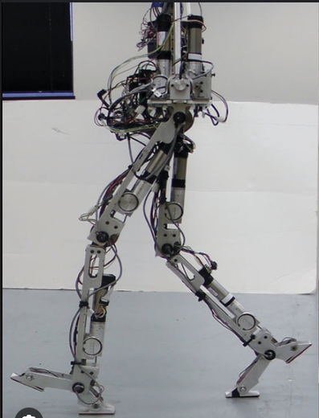
Objective
Develop a unified, efficient HAR model capable of handling data scarcity, multi-sensor complexity, and real-world deployment challenges using wearable.
Integrate and compare activity recognition performance across wearable sensing modalities.
Transfer recognized motion patterns to a bipedal robot, enabling accurate, real-time imitation and reproduction of human activities.
Fig.3. Bipedal Robot

Slide 11
Work done so far
Created a Mobile HAR Dataset using Samsung M34 mobile and Sensor Logger application for Human Activity Recognition.
Studied sensory joint movement patterns specific to each activity to enhance accurate feature capture for the model.
Used a multi-scale feature extraction approach to capture slow, medium, and fast movements during activities for dataset creation.
Developed a hybrid deep learning architecture Multi-Scale Gated Residual Skip BiLSTM model.
Achieved a classification accuracy of 96.8937% using the MS-GRS-BiLSTM model on the Mobile HAR dataset for Human Activity Recognition.

Slide 12

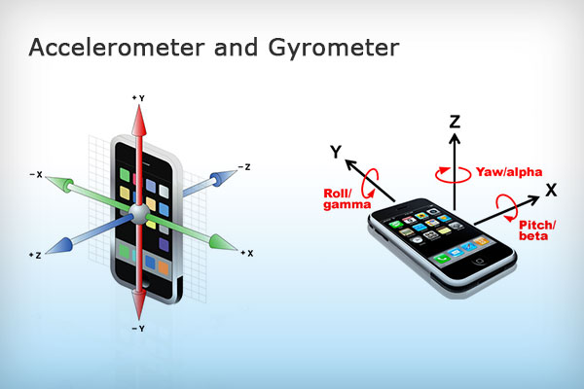
Sensor Selection – Kinect Sensor
Mobile accelerometer and gyroscope sensors provide multi-axis motion data (x, y, z and angular velocity), enabling effective analysis of posture, orientation, and gait patterns.
Motion is captured using a smartphone without external hardware, ensuring user comfort, portability, and independent usage.
Unlike vision-based systems that track full-body movement in global coordinates, mobile sensors measure localized body motion relative to the device’s position.
While smartphones typically capture movement from a single body location, sensor fusion techniques can still infer coordinated motion patterns.
Fig.4. Accelerometer and Gyroscope Sensor

Slide 13
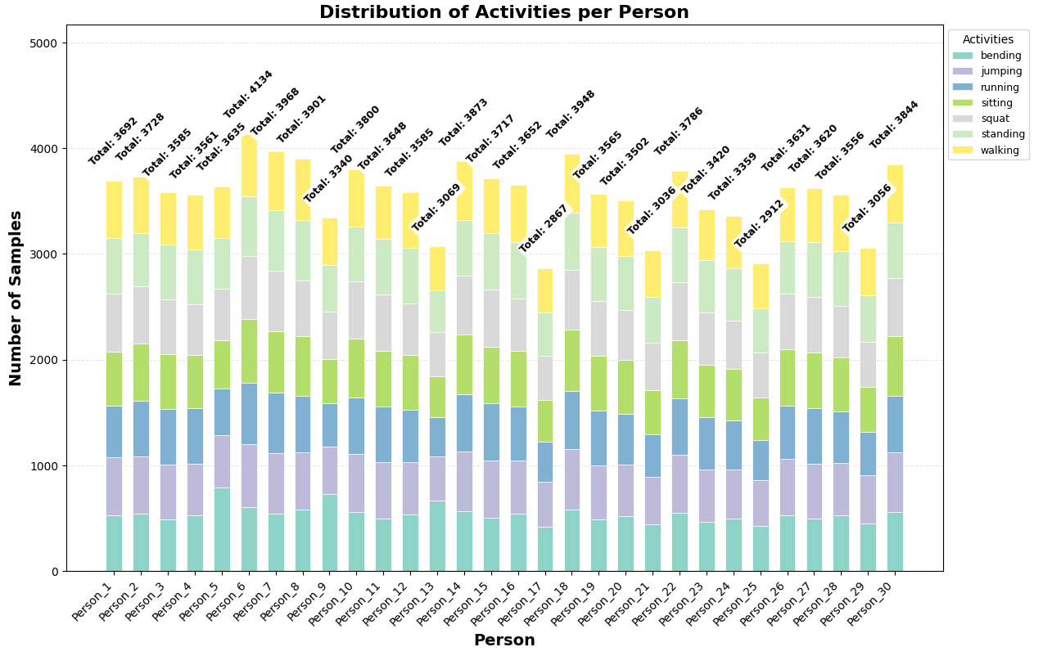
My Dataset - Using Mobile
Data captured using Samsung M34 mobile with Sensor Logger application.
The mobile was mounted on the chest area to track x, y, z coordinates over time.
Dataset includes 30 individuals for variability in movement and posture.
Each person performs 7 activities: bending, jumping, running, sitting, squat, standing, walking.
Each activity is stored as a time-series CSV with timestamp, body ID, and joint coordinates.
Dataset size : 1,06,991 samples.
Fig.5. Person vs Activity Distribution

Slide 14

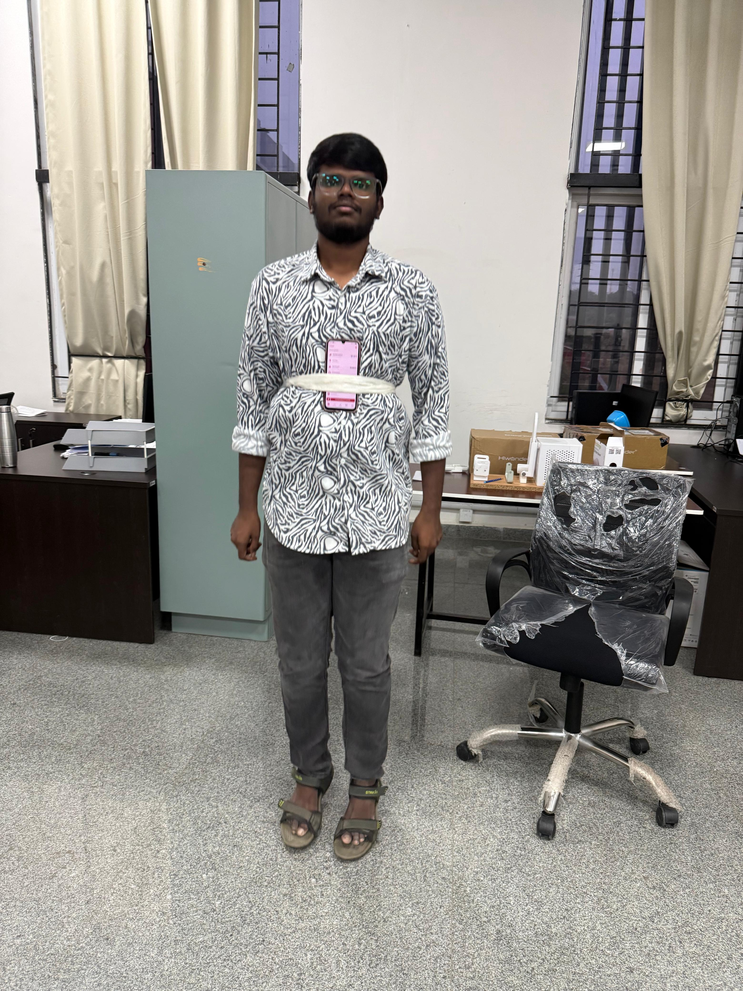
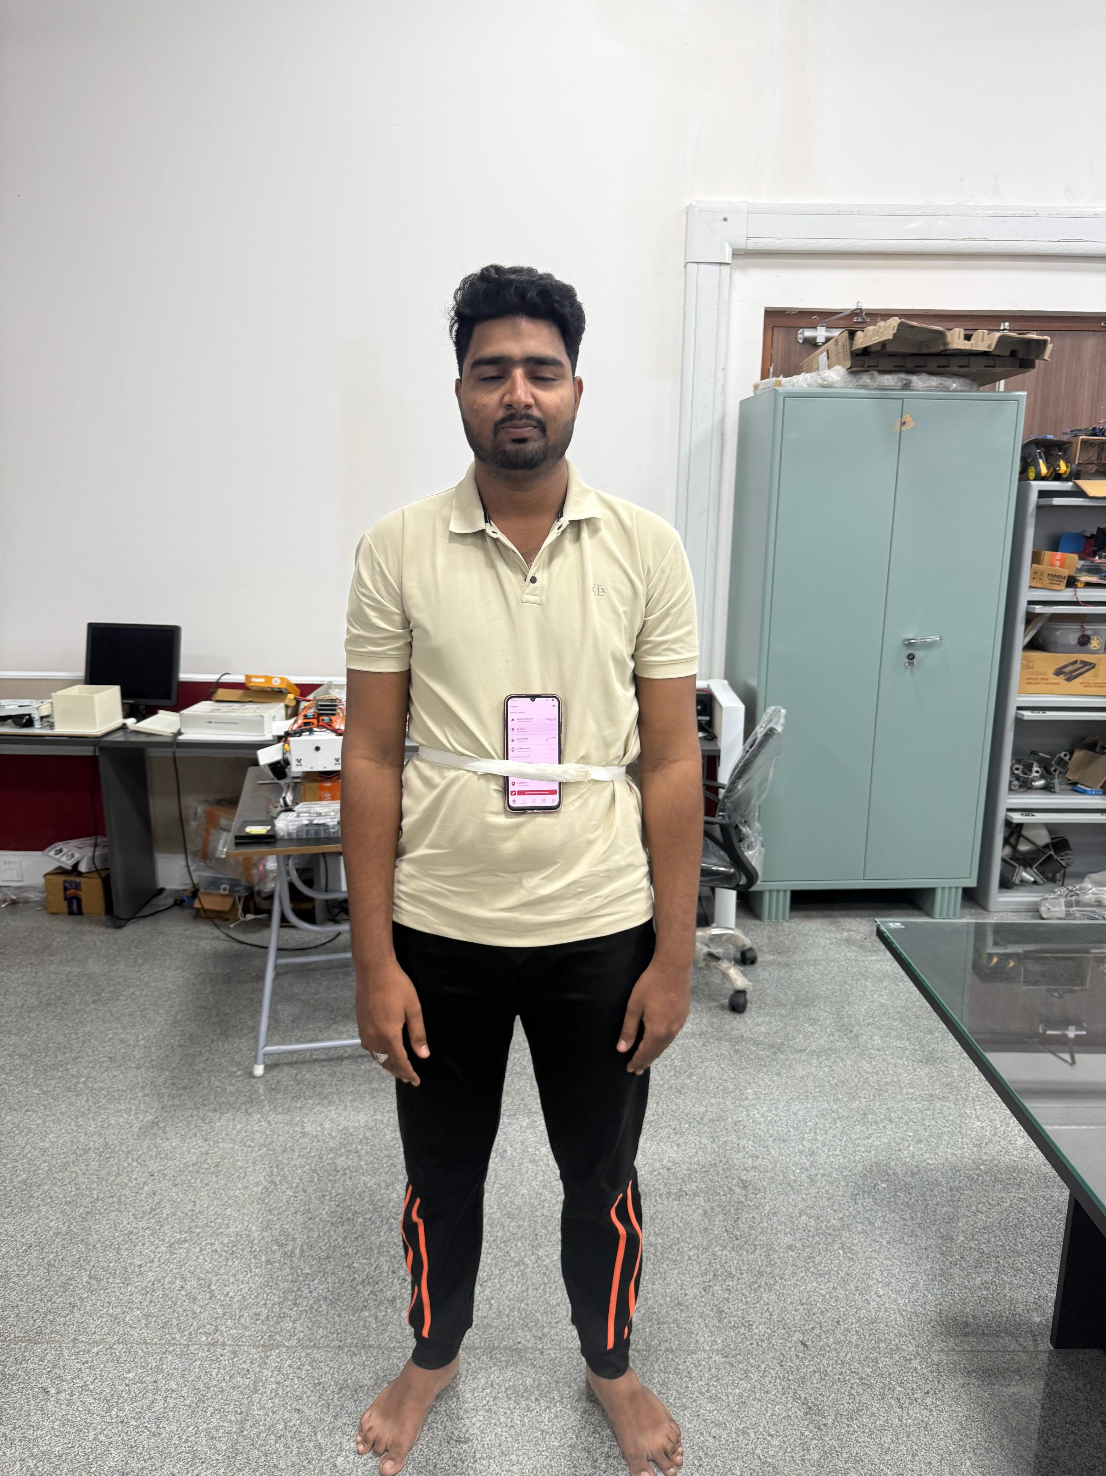
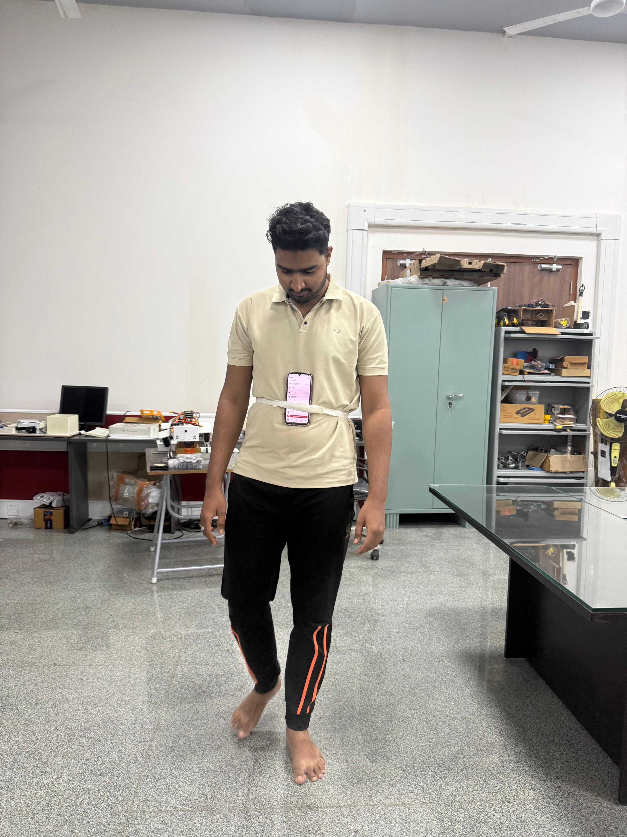
Dataset Collection
(a) sitting
(b) standing
(c) standing
(d) walking
Fig.6. Volunteers performing Activity for Dataset Collection

Slide 15
Models Used
Model | Key Idea | Architecture | Strengths | Limitations | Best Use Cases
Long Short Term Memory (LSTM) | Learns long-term dependencies in sequential data | Single-direction recurrent unit with input, forget, and output gates | - Handles vanishing gradient problem- Good for time-series / sequential classification. - Captures temporal memory effectively. | - Loses information from future context. - May underperform on complex motion patterns. | Basic sequence forecasting, simple activity recognition, speech modeling
Bidirectional LSTM (BiLSTM) | Uses past + future context for each time step | Two LSTM layers: one forward, one backward, outputs concatenated | - Strong contextual understanding- Captures bidirectional motion patterns. - Good for overlapping / subtle movements. | - Increased computational load. - More memory usage due to dual processing. | Human activity recognition, NLP tasks, gesture recognition
Gated Residual Skip BiLSTM (GRS-BiLSTM) | Enhances BiLSTM with Gated Residual Skip (GRS) connections | BiLSTM backbone + gating layer + residual skip pathways + optional multi-scale inputs | - Improved gradient flow and training stability- Better multi-resolution temporal modeling. - Handles subtle transitions and long motion dependencies- Reduces over-smoothing and information loss. | - Complex architecture requiring careful tuning . - Higher training time and model size. | High-precision activity recognition, multi-sensor fusion, real-world motion environments

Slide 16
Proposed Model – MS-GRS-BiLSTM
Name : Multi-Scale Gated Residual Skip Bidirectional Long Short Term Memory (MS-GRS-BiLSTM).
Goal : classify short time-windows of sensor / joint data into activity classes.
Key ideas : multi-scale temporal representation, learned gates to fuse scales, residual skip from raw input, BiLSTM temporal modeling.
The MS-GRS-BiLSTM is not just detecting momentary movement, but is:
Understanding the shape of motion over time, at multiple speeds, while carefully preserving useful information and filtering noise.

Slide 17
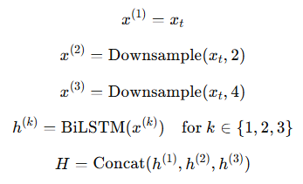
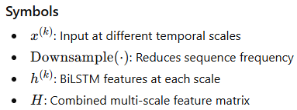
MS-GRS-BiLSTM
Why Multi-Scale (MS) is Needed ?
Different activities show patterns at different time speeds:
Formula :
Activity Type | Activity Speed | Example
Quick & Repetitive | Fast | Running, Jumping
Moderate Movement | Medium | Walking
Postural & Stable | Slow | Standing, Sitting
To capture these differences, the model creates 3 versions of each input window:
Full detail (original resolution)
Medium-scaled (every 2nd time step)
Coarse-scaled (every 4th time step)
This allows the network to understand both short, rapid motions and longer, slower movement trends.

Slide 18
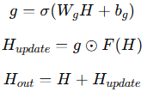
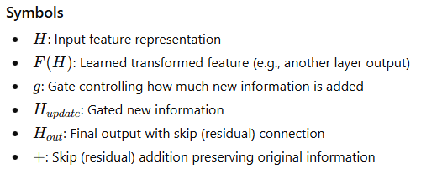
MS-GRS-BiLSTM
Gated Residual Skip (GRS) Blocks contains :
Projection Layer : Simplifies the signal and extracts essential structure.
BiLSTM Layer : Reads the movement pattern forward and backward in time.
This is important because what happened just before and just after each moment helps define the action (e.g., lowering before a jump).
Gating Mechanism : A learned filter that decides:
i) How much new information to use
ii) How much previous information to keep
Residual Skip Connection : Passes earlier information forward without loss, preventing the model from forgetting important details.
Formula :

Slide 19
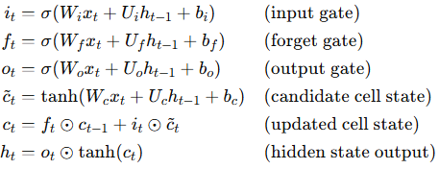
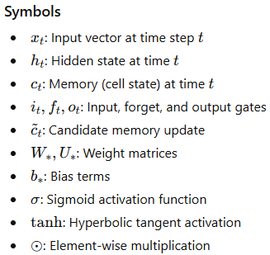
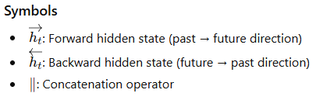


MS-GRS-BiLSTM
LSTM is a type of neural network used for time-series or sequential data.
It has memory cells that allow it to retain important past information.
It uses gates to decide what to keep, what to update, and what to forget.
A BiLSTM processes the sequence in two directions:
Forward: earlier → later time steps
Backward: later → earlier time steps
This gives it context from both past and future time steps,
Formula :
Formula :

Slide 20
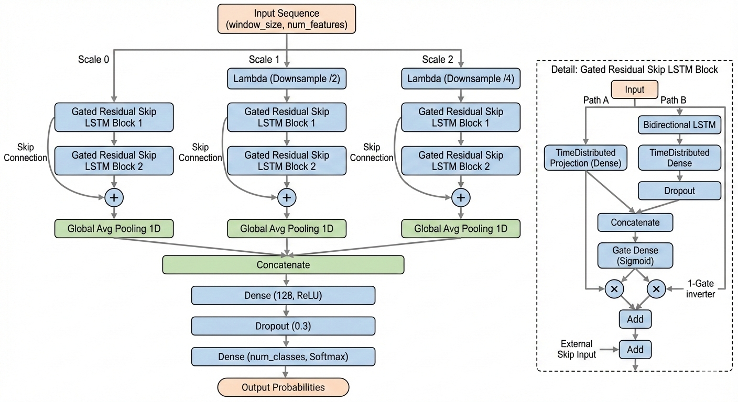
MS-GRS-BiLSTM Architecture
Fig.8. MS-GRS-BiLSTM Architecture

Slide 21
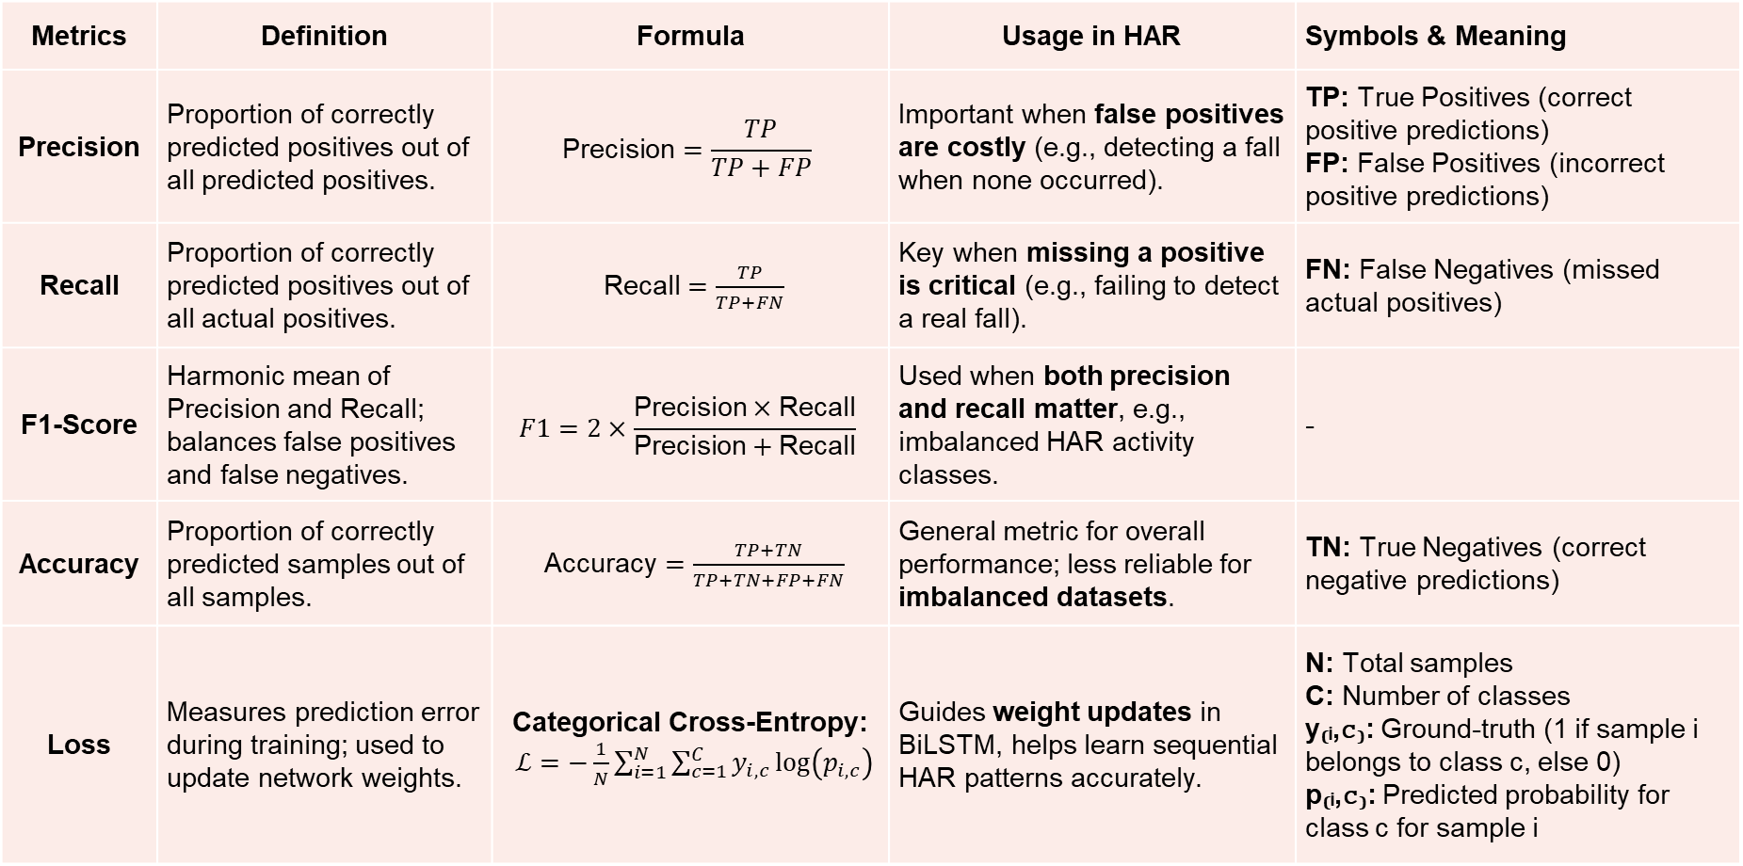
Metrics Used in HAR
Metrics | Definition | Formula | Usage in HAR | Symbols & Meaning
Precision | Proportion of correctly predicted positives out of all predicted positives. | $$\text{Precision}=\frac{TP}{TP+FP}$$ | Important when false positives are costly (e.g., detecting a fall when none occurred). | TP: True Positives (correct positive predictions) FP: False Positives (incorrect positive predictions)
Recall | Proportion of correctly predicted positives out of all actual positives. | $\text{Recall}=\frac{TP}{TP+FN}$ | Key when missing a positive is critical (e.g., failing to detect a real fall). | FN: False Negatives (missed actual positives)
F1-Score | Harmonic mean of Precision and Recall; balances false positives and false negatives. | $$F1=2×\frac{\text{Precision}×\text{Recall}}{\text{Precision}+\text{Recall}}$$ | Used when both precision and recall matter, e.g., imbalanced HAR activity classes. | -
Accuracy | Proportion of correctly predicted samples out of all samples. | $\text{Accuracy}=\frac{TP+TN}{TP+TN+FP+FN}$ | General metric for overall performance; less reliable for imbalanced datasets. | TN: True Negatives (correct negative predictions)
Loss | Measures prediction error during training; used to update network weights. | Categorical Cross-Entropy: $ℒ=−\frac{1}{N}\sum_{i=1}^{N}{\sum_{c=1}^{C}{y_{i,c}}\log\left(p_{i,c}\right)}$ | Guides weight updates in BiLSTM, helps learn sequential HAR patterns accurately. | N: Total samples C: Number of classes y₍ᵢ,𝚌₎: Ground-truth (1 if sample i belongs to class c, else 0) p₍ᵢ,𝚌₎: Predicted probability for class c for sample i

Slide 22
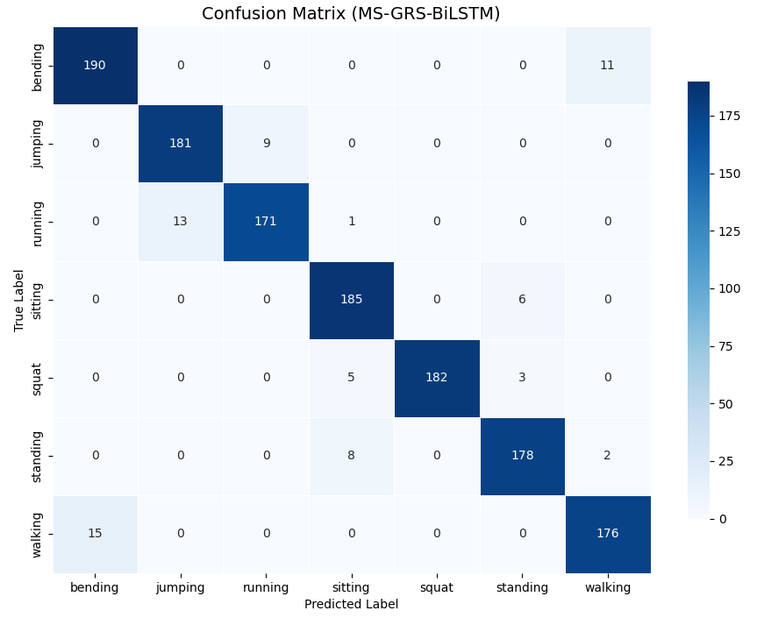
Results on My Dataset using the Proposed Model
Class | Precision | Recall | F1-Score
Bending | 0.9642 | 0.9193 | 0.9371
Jumping | 0.9782 | 0.9635 | 0.9795
Running | 0.9652 | 0.9743 | 0.9771
Sitting | 0.9031 | 0.9702 | 0.9432
Squat | 1.0000 | 0.9652 | 0.9866
Standing | 0.9854 | 0.9267 | 0.9557
Walking | 1.0000 | 0.9942 | 0.9971
Overall Metric | Precision | Recall | F1-Score
Accuracy | - | - | 0.9689
Macro Avg | 0.9679 | 0.9684 | 0.9687
Weighted Avg | 0.9678 | 0.9684 | 0.9681
Fig.9. Confusion Matrix on Mobile Dataset

Slide 23
Comparison of Accuracies of Models on My Dataset
Activities / Models | LSTM | BiLSTM | GRS-BiLSTM | Proposed Model
Bending | 0.8052 | 0.8435 | 0.9160 | 0.9371
Jumping | 0.7850 | 0.8340 | 0.8855 | 0.9795
Running | 0.7592 | 0.7441 | 0.8806 | 0.9771
Sitting | 0.7643 | 0.9035 | 0.9430 | 0.9432
Squat | 0.9344 | 0.9729 | 0.9839 | 0.9866
Standing | 0.7902 | 0.8759 | 0.9576 | 0.9557
Walking | 0.8078 | 0.8465 | 0.9250 | 0.9971
Fig.11. Accuracy amongst different Activity and Models

Slide 24
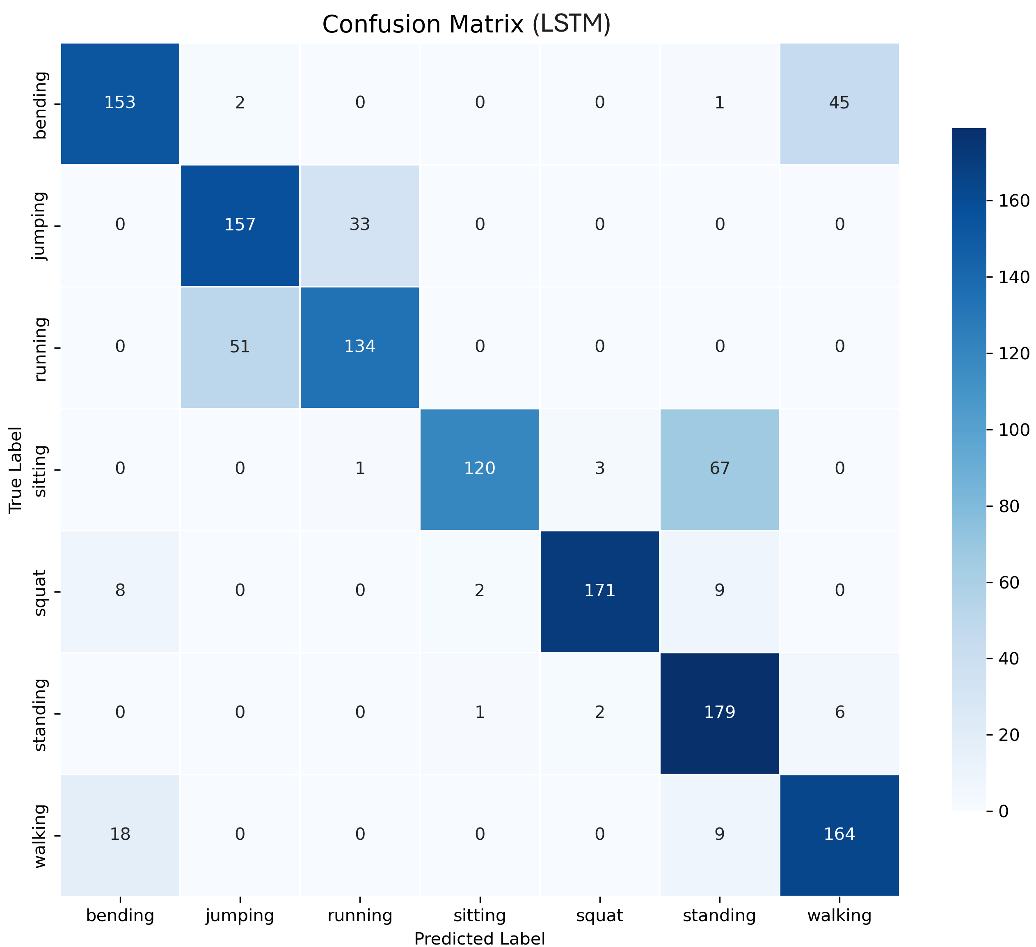
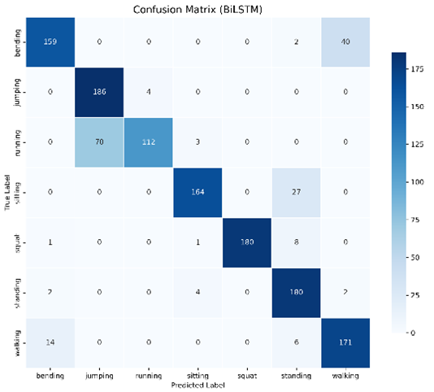
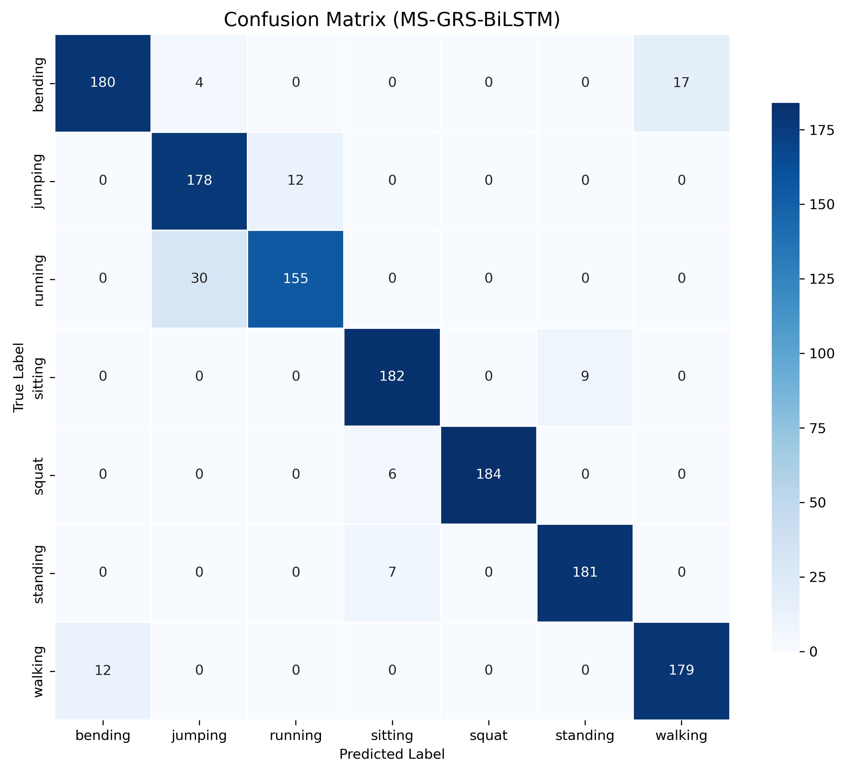
Comparison of Confusion Matrics over Epochs of Models on My Dataset
LSTM | BiLSTM
GRS-BiLSTM | MS-GRS-BiLSTM

Slide 25
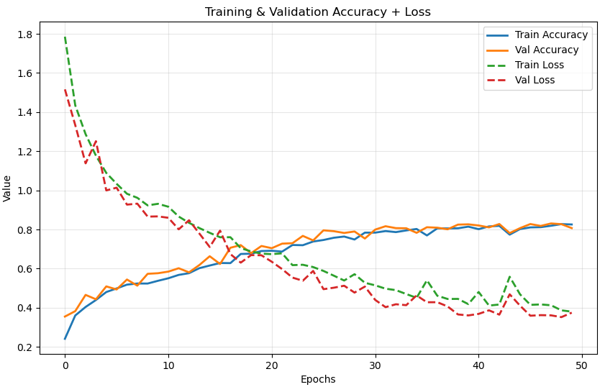
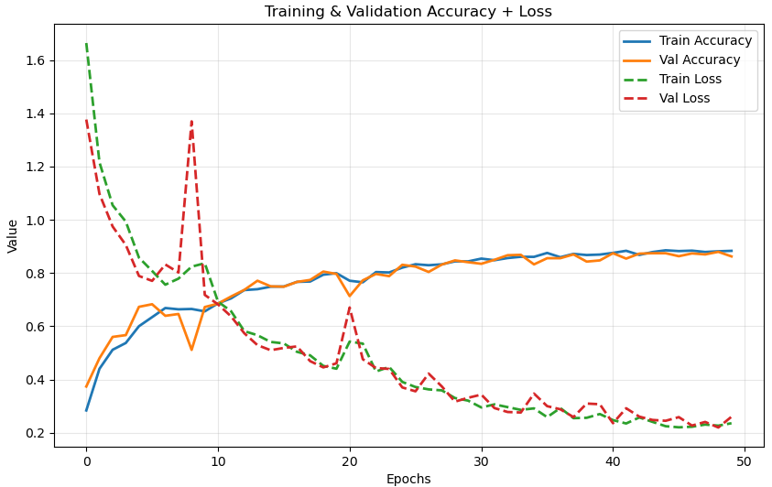
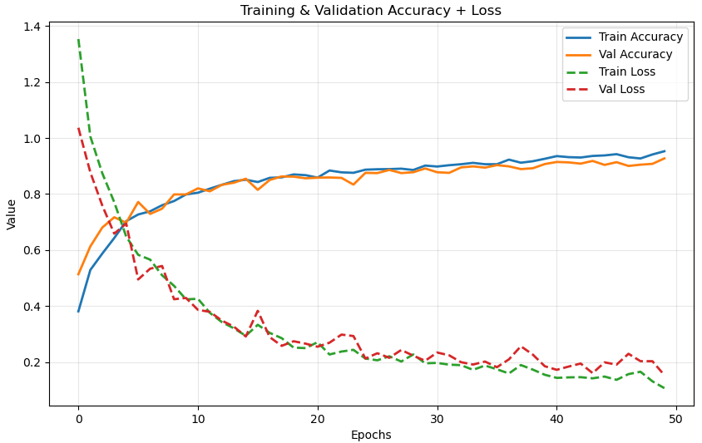
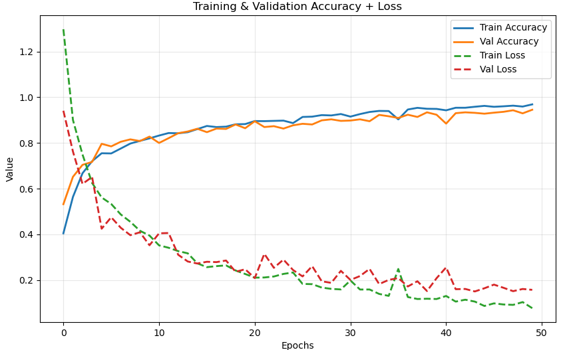
Comparison of Accuracy/Loss over Epochs of Models on My Dataset
LSTM | BiLSTM
GRS-BiLSTM | MS-GRS-BiLSTM
25

Slide 26
Comparison of Models Performance on Mobile Dataset
Mobile Dataset (My Dataset) :
METRICS | LSTM | BiLSTM | GRS-BiLSTM | MS-GRS-BiLSTM
Precision | 0.826493 | 0.879853 | 0.929214 | 0.967921
Recall | 0.807268 | 0.862020 | 0.927349 | 0.968486
F1-score | 0.806628 | 0.860110 | 0.927426 | 0.968763
Test Accuracy | 0.806886 | 0.862275 | 0.927395 | 0.968937
Test Loss | 0.3746 | 0.2357 | 0.106525 | 0.077365
Model Parameters | 32,775 | 84,040 | 556,104 | 559,176
Model Size | 0.1250 MB | 0.3206 MB | 2.1214 MB | 2.1373 MB
Avg Batch Inference Time | 0.008822 sec | 0.014246 sec | 0.017332 sec | 0.017672 sec
Single Sample Inference Time | 0.004555 sec | 0.002505 sec | 0.008718 sec | 0.009988 sec

Slide 27
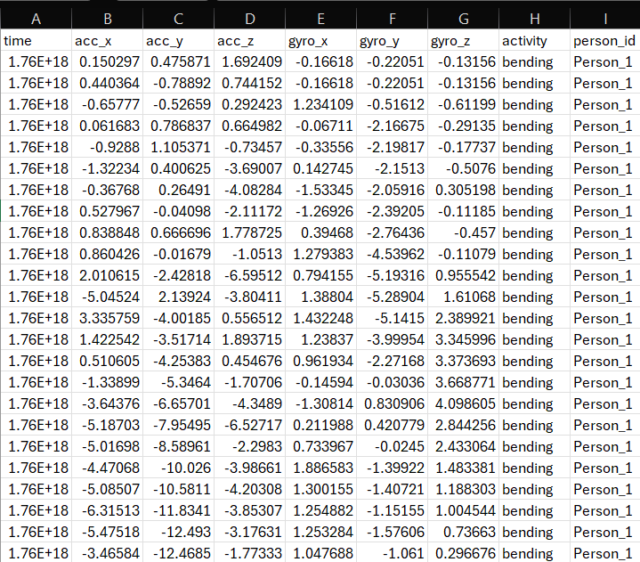
Sample Dataset

Slide 28
References
Gupta, S. Deep learning based human activity recognition (HAR) using wearable sensor data. Int. J. Inf. Manag. Data Insights 2021, 1, 100046.
M. Kaseris, I. Kostavelis, and S. Malassiotis, "A Comprehensive Survey on Deep Learning Methods in Human Activity Recognition," Mach. Learn. Knowl. Extr., vol. 6, pp. 842–876, Apr. 2024.
P. Lalwani and R. Ganeshan, "A Novel CNN-BiLSTM-GRU Hybrid Deep Learning Model for Human Activity Recognition," Int. J. Comput. Intell. Syst., vol. 17, no. 278, Nov. 2024.
S. K. Challa, A. Kumar, and V. B. Semwal, "A multibranch CNN-BiLSTM model for human activity recognition using wearable sensor data," The Visual Computer, vol. 38, pp. 4095–4109, Aug. 2021.
P. Tokas, V. B. Semwal, and S. Verma, "A Real-Time Deployable Attention-Driven CNN–LSTM Framework for Human Activity Recognition using Wearable Sensor," Dehradun, India: IEEE Sensors Council, 2025.
M. A. Khatun et al., "Deep CNN-LSTM With Self-Attention Model for Human Activity Recognition Using Wearable Sensor," IEEE J. Transl. Eng. Health Med., vol. 10, pp. 1–16, May 2022.

Slide 29
References
Xu, S.; Zhang, L.; Huang, W.; Wu, H.; Song, A. Deformable convolutional networks for multimodal human activity recognition using wearable sensors. IEEE Trans. Instrum. Meas. 2022, 71, 2505414.
Beddiar, D.R.; Nini, B.; Sabokrou, M.; Hadid, A. Vision-based human activity recognition: A survey. Multimed. Tools Appl. 2020, 79, 30509–30555.
Lara, O.D.; Labrador, M.A. A survey on human activity recognition using wearable sensors. IEEE Commun. Surv. Tutorials 2012, 15, 1192–1209.
Ke, S.R.; Thuc, H.L.U.; Lee, Y.J.; Hwang, J.N.; Yoo, J.H.; Choi, K.H. A review on video-based human activity recognition. Computers 2013, 2, 88–131.
Ray, A.; Kolekar, M.H.; Balasubramanian, R.; Hafiane, A. Transfer learning enhanced vision-based human activity recognition: A decade-long analysis. Int. J. Inf. Manag. Data Insights 2023, 3, 100142. [CrossRef]
Singh, R.; Kushwaha, A.K.S.; Srivastava, R. Recent trends in human activity recognition–A comparative study. Cogn. Syst. Res. 2023, 77, 30–44.

Slide 30
THANK YOU

