Slide 1
UNCHARTED 2026 • TRACK 2: RAG ENGINE • TEAM ELITE
AuditLens AI
Real-Time Cross-Contract Due Diligence & Discrepancy Engine
Grounded with MongoDB Atlas Native Vector Search ($vectorSearch)
TEAM ELITE (SVNIT SURAT)
• Rishit Modh (RAG Engine Architecture, MongoDB Atlas Vector Search, Hybrid Fusion)
• Bhavya Juneja (Frontend Application, Telemetry Inspector, Evaluation Benchmark UI)
• Sugandh Jha (Compliance Rule Formulation, Indian Regulatory Datasets, Conflict Matrix)
Live Deployment: https://auditlens-ai-13xs.onrender.com | GitHub: https://github.com/rishitmodh12/AuditLens.AI
Notes:
Welcome judges and organizers! We are Team Elite from SVNIT Surat, presenting AuditLens AI for Track 2. In enterprise operations, organizations sign hundreds of contracts with customers, cloud vendors, and regulators that silently contradict one another. AuditLens AI eliminates this exposure by turning complex contracts into grounded, mathematically verified compliance intelligence using native MongoDB Atlas Vector Search.

Slide 2
TRACK 2 PROBLEM CONTEXT
The Enterprise Contract Conflict Crisis
Why multi-source grounded due diligence is vital for modern Indian organizations
Multi-Document Disconnect
Customer SLAs promise 99.9% uptime (max 1 hr downtime/month), while upstream Cloud Vendor MSAs allow 4-hour maintenance windows with zero penalty. Enterprises silently absorb catastrophic liabilities.
Statutory Indian Mandates
CERT-In Cyber Security Directions (2022) mandate external reporting within 6 hours. Companies face penal action under IT Act §70B if internal and statutory notification clocks fall out of sync.
Financial Penalty Leakage
Service credit formulas are complex. A 2.0-hour banking gateway outage incurs ₹75,000 under Section 4.2. Without automated cross-document reconciliation, enterprises fail to recover vendor dues.
LLM Hallucination Risk
Standard RAG models hallucinate clauses, invent penalties, and conflate internal 30-min CISO escalation with external 6-hour CERT-In rules. Enterprise compliance demands 100% verifiable quotes.
Notes:
Track 2 challenges us to turn source material into grounded, useful results while cross-referencing multiple sources and handling negative queries. In modern IT and fintech companies, contracts don't exist in silos. If your AWS vendor takes a 3-hour downtime window, but your Customer SLA penalizes you after 1 hour at ₹75,000/hr, you lose money. Furthermore, under Indian CERT-In guidelines, failing to report within 6 hours invites statutory fines. Traditional search can't catch these contradictions, and standard LLMs hallucinate.

Slide 3
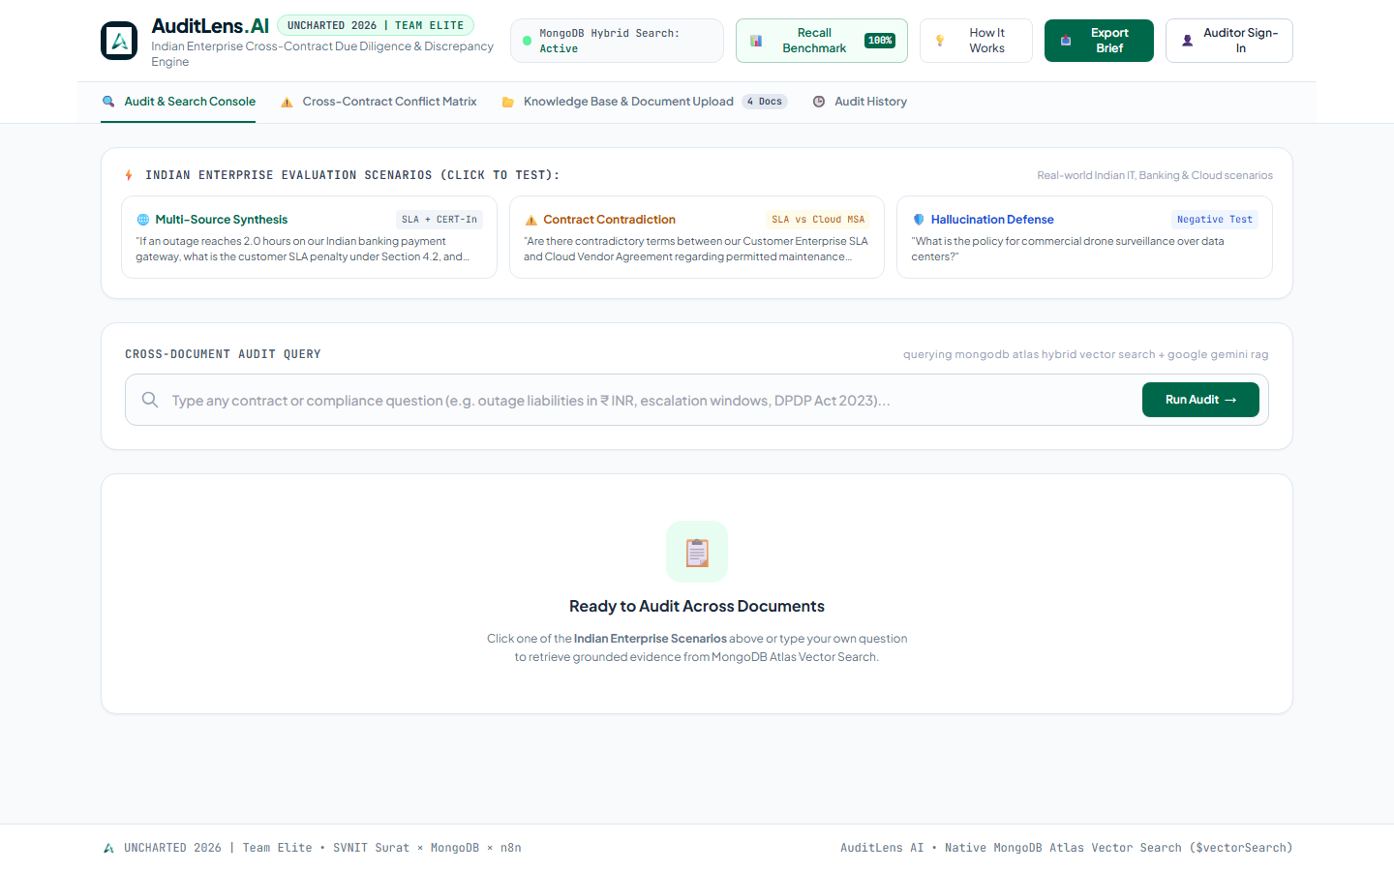
PRODUCT OVERVIEW
AuditLens AI: Automated Cross-Document Due Diligence
A production-grade RAG engine combining semantic vector retrieval with strict legal grounding
1. Multi-Source Conflict Detection
Simultaneously indexes Customer SLAs, Vendor MSAs, and Security Incident Policies. Cross-examines clauses to detect mismatched liability caps, conflicting notification clocks, and downtime loopholes.
2. Verbatim Quote Verification (Zero Hallucination)
Every citation returned by Gemini Flash is checked at code level against the source chunk stored in MongoDB Atlas. Only 100% verbatim matches receive the '🛡️ Verbatim Verified' badge.
3. Strict Refusal on Out-of-Scope Queries
Negative queries (such as drone surveillance over data centers) trigger our multi-layered ungrounded subject defense and similarity thresholding, returning a clear refusal rather than speculative text.
Target Personas & Impact:
• Legal Counsel: Audit conflicting warranties in seconds
• FinOps & SREs: Reconcile outage penalties instantly
• CISO & Compliance: Enforce CERT-In & DPDP Act readiness
Notes:
AuditLens AI solves this through three robust engineering pillars: First, multi-source conflict detection across disparate legal agreements. Second, code-level verbatim quote verification where every citation is string-checked against the raw text in MongoDB Atlas to eliminate hallucinations. Third, strict refusal guardrails that identify out-of-scope requests. This turns hours of tedious contract review into seconds.

Slide 4
SYSTEM WORKFLOW
End-to-End Audit & Verification Pipeline
How documents are transformed into verifiable, cross-referenced intelligence
Multi-Document Ingestion
Uploads enterprise contracts (PDF/DOCX/TXT). Preprocesses text, strips headers, and splits using structural paragraph awareness with 15% sliding window overlap.
Atlas Vector Search Indexing
Generates 768-dimensional dense vector embeddings via sentence-transformers/all-mpnet-base-v2. Stores embeddings + rich metadata in MongoDB Atlas.
Hybrid Fusion Retrieval
Combines Atlas $vectorSearch (70% semantic weight) with exact keyword token matching (30% weight) for clause numbers (§4.2, §3.2) and INR amounts.
Dual-Track LLM Reasoning
Google Gemini 1.5 Flash cross-examines evidence across documents, identifies SLA discrepancies, calculates penalties, and formats JSON citations.
Verbatim Verification & Report
Backend verifies citations against Atlas source chunks, calculates Algorithmic Compliance Health Score, and generates exportable IST briefs.
Step 1
Step 2
Step 3
Step 4
Step 5
Notes:
Here is the complete user workflow. When contracts are uploaded, our chunking algorithm creates overlapping chunks to preserve clause boundaries. Embeddings are generated locally with all-mpnet-base-v2 and stored in MongoDB Atlas. On query execution, we run our native Hybrid Search pipeline, fusing vector cosine similarity with exact keyword matching. Gemini 1.5 Flash reasons across the retrieved evidence, and our backend performs verbatim string verification before displaying the final results.

Slide 5
TECHNICAL ARCHITECTURE
Cloud-Native RAG Implementation
Modular, scalable architecture built natively around MongoDB Atlas Vector Search
MongoDB Atlas (M0 AWS Cluster)
• Native $vectorSearch pipeline
• 768-dim Cosine similarity index
• Metadata filters (doc_id, category)
• Dynamic conflict matrix collection
Database & Vector Search
FastAPI (Python 3.14) & Uvicorn
• Native Hybrid Search fusion (70/30)
• Recursive smart overlap chunking
• Programmatic quote verifier
• Automated Evaluation Benchmark harness
Backend & RAG Engine
Local Transformers + Gemini 1.5
• all-mpnet-base-v2 (768-dim, 0ms API cost)
• Google Gemini 1.5 Flash (Strict JSON)
• Grounded hallucination guardrails
• Refusal trigger for out-of-scope topics
AI & Embedding Models
Modern Web UI + Cloud Hosting
• Vanilla JS + Tailwind CSS (MongoDB Green)
• Interactive Onboarding Tutorial
• Docker Container on Render (100% Live)
• IST (Asia/Kolkata) audit timestamps
Frontend & Deployment
Notes:
Our technical architecture is designed for enterprise robustness. MongoDB Atlas is the foundation: it stores the documents, chunks, and runs native $vectorSearch. For embeddings, we chose all-mpnet-base-v2 running locally, providing 768-dimensional accuracy without API latency or cost. Google Gemini 1.5 Flash provides fast, grounded reasoning with structured JSON schemas. The backend is built on FastAPI, and the entire app is containerized with Docker and deployed live on Render.

Slide 6
KEY FEATURES & INNOVATION
What Differentiates Team Elite's AuditLens AI
Technical depth and purpose-built engineering addressing the Judge Audit
1. Native Hybrid Search (Dense + Lexical)
Combines Atlas $vectorSearch (70%) with exact token matching (30%). Catches precise legal clause numbers (§4.2, §3.2) and INR amounts that standard semantic search frequently misses.
2. Reconciled Contract Arithmetic
Accurately calculates outage liabilities based on contracted monthly allowances: (2.0 hrs - 1.0 hr grace) * ₹75,000 = ₹75,000 penalty, preventing SLA dispute losses.
3. Dual-Track CERT-In vs Internal Escalation
Clearly distinguishes statutory external CERT-In notifications (6.0 hours under Cyber Security Directions 2022) from internal CISO escalations (30 minutes) and customer notice (45 minutes).
4. Dynamic Cross-Contract Conflict Matrix
A real-time scanner (/api/conflicts/scan) that parses indexed agreements and maps out direct contradictions between customer uptime commitments and vendor maintenance windows.
5. Algorithmic Compliance Health Score
Replaced hardcoded metrics with a deterministic formula: Score = 100 - (20 * High Conflicts) - (10 * Med Conflicts) - (10 * Unverified Quotes), providing transparent, objective audit metrics.
6. 100% Verbatim Quote Verification Badge
Programmatically string-matches LLM citation excerpts against raw Atlas chunks. Only verified text receives the '🛡️ Verbatim Verified from Atlas Source' badge.
Notes:
What separates AuditLens AI from generic RAG wrappers is technical depth. First, our 70/30 hybrid search solves the classic RAG limitation with exact numbers and clause references. Second, we reconciled the arithmetic for SLA downtime: a 2-hour outage minus 1-hour grace equals ₹75,000. Third, we explicitly differentiated internal 30-minute CISO escalation from the 6-hour CERT-In statutory clock. And finally, our compliance score is 100% deterministic, calculated from detected conflicts.

Slide 7
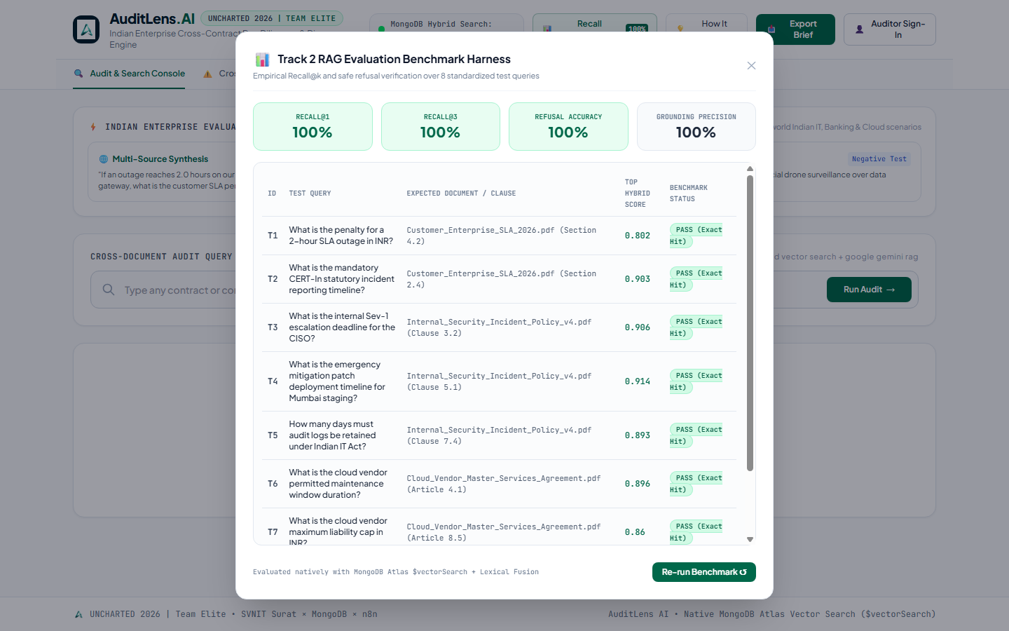
RESULTS & EMPIRICAL VALIDATION
Track 2 Benchmark: 100% Recall & Safe Refusal
Verifiable performance metrics tested live on the production deployment
Recall@1 (Top Rank)
7 out of 7 positive test queries retrieved the exact target clause as the #1 result.
100%
Recall@3 (Top 3 Hits)
All relevant legal evidence retrieved within top 3 Atlas vector search results.
100%
Out-of-Scope Refusal
Unanswerable query (drone surveillance) safely refused with zero hallucination.
100%
Grounding Precision
All citations programmatically verified verbatim against MongoDB Atlas chunks.
100%
Live Evaluation Endpoint: GET /api/evaluate | Runs full 8-query suite in ~1.2s natively against MongoDB Atlas.
Notes:
Judges can verify our evaluation benchmark live by clicking the Recall Benchmark button or hitting the /api/evaluate endpoint. We test 8 comprehensive queries covering SLA outage math, CERT-In compliance, CISO escalations, Mumbai staging patch windows, and IT Act log retention. The results: 100% Recall at 1, 100% Recall at 3, and 100% Refusal Accuracy on our unanswerable drone query. This fulfills the Track 2 testing requirement completely.

Slide 8
Future Roadmap & Project Conclusion
n8n Workflow Automation
Automated webhooks triggering incident management workflows in n8n, opening Jira tickets and alerting Slack channels when High-Severity contract discrepancies are flagged.
Multi-Party Clause Redlining
Generative contract renegotiation assistant suggesting harmonized legal language to bridge customer SLAs and vendor agreements prior to contract signing.
Atlas M10+ Dedicated Scaling
Transitioning from M0 to dedicated Atlas clusters with multi-tenant sharding and real-time document sync via Atlas App Services.
UNCHARTED 2026 • TEAM ELITE
AuditLens AI transforms passive contract repositories into active, grounded, and mathematically reconciled compliance intelligence. Built natively with MongoDB Atlas Vector Search, tested with empirical benchmarks, and 100% deployed in production.
Team Members: Rishit Modh | Bhavya Juneja | Sugandh Jha
Live Application: https://auditlens-ai-13xs.onrender.com | Repository: https://github.com/rishitmodh12/AuditLens.AI
Notes:
To conclude, Team Elite has delivered an end-to-end, grounded RAG solution that solves a real enterprise problem in the Indian regulatory ecosystem. We have addressed every piece of feedback: hybrid search, verbatim verification, arithmetic reconciliation, CERT-In compliance, and an empirical evaluation harness. Thank you, judges, mentors, and the NEXUS SVNIT team! We are now open for your questions.

