Slide 1
UNCHARTED 2026
AuditLens.AI
Real-Time Cross-Contract Due Diligence & Discrepancy Engine Grounded with MongoDB Atlas Vector Search
Team: Team Elite | Track: Track 2 (RAG Engine)
Members: Rishit Modh (Lead), Bhavya Juneja, Sugandh Jha
Contact: u25me108@med.svnit.ac.in
Notes:
Welcome judges and organizers! We are Team Elite from SVNIT Surat, presenting AuditLens AI for Track 2. In enterprise operations, organizations sign hundreds of contracts with customers, cloud vendors, and regulators that silently contradict one another. AuditLens AI eliminates this exposure by turning complex contracts into grounded, mathematically verified compliance intelligence using native MongoDB Atlas Vector Search.

Slide 2
01 PROBLEM
Problem
What problem are you solving and for whom? Keep it to 2-3 lines.
The Problem
Enterprise customer SLAs promise 99.9% uptime (max 1.0 hr downtime/month) with ₹75,000/hr penalties, while upstream cloud vendor MSAs allow 4.0-hour maintenance windows with zero penalty. Furthermore, under CERT-In Directions (2022), statutory breach reports are required within 6 hours, while internal CISO notification takes 30 minutes. Uncoordinated contracts create severe financial leakage and statutory regulatory penalties under IT Act §70B.
Who Is Affected
Enterprise Legal Counsel, FinOps Teams, SRE Incident Commanders, and CISO Compliance Officers in Indian IT, fintech, and SaaS companies. Without automated cross-document intelligence, organizations spend hundreds of manual legal hours per incident, fail to recover vendor liabilities, and risk criminal compliance citations.
Team Elite | UNCHARTED 2026 2
Notes:
Track 2 challenges us to turn source material into grounded, useful results. In enterprise IT operations, contracts don't exist in silos. If your AWS vendor takes a 3-hour downtime window, but your Customer SLA penalizes you after 1 hour at ₹75,000/hr, you lose money. Furthermore, under Indian CERT-In guidelines, failing to report within 6 hours invites statutory fines. Traditional search can't catch these contradictions, and standard LLMs hallucinate.

Slide 3
02 SOLUTION
Solution
Explain your idea simply, and what makes it different.
What We Built
AuditLens AI: An automated cross-contract due diligence and discrepancy engine. It concurrently indexes customer SLAs, vendor agreements, and incident response policies into MongoDB Atlas Vector Search, automatically reconciling service credit penalties (e.g. ₹75,000 for a 2-hour outage under Section 4.2), flag-checking notification clocks, and scanning for cross-contract contradictions.
What Makes It Unique
1. Native 70/30 Hybrid Search combining Atlas dense vector search with exact lexical token matching for clause numbers (§4.2) and ₹ amounts.
2. Code-level verbatim quote verification: Every citation is substring-checked against Atlas raw text (🛡️ Verbatim Verified badge).
3. Deterministic compliance health scoring: 100 - (20×High) - (10×Med) - (10×Unverified).
4. Strict hallucination defense & safe refusal on out-of-scope queries (e.g. drone surveillance).
Team Elite | UNCHARTED 2026 3
Notes:
AuditLens AI solves this dilemma through three technical pillars: First, multi-source conflict detection across disparate legal agreements. Second, code-level verbatim quote verification where every citation is string-checked against the raw text in MongoDB Atlas to eliminate hallucinations. Third, strict refusal guardrails that identify out-of-scope requests. This turns hours of tedious contract review into seconds.

Slide 4
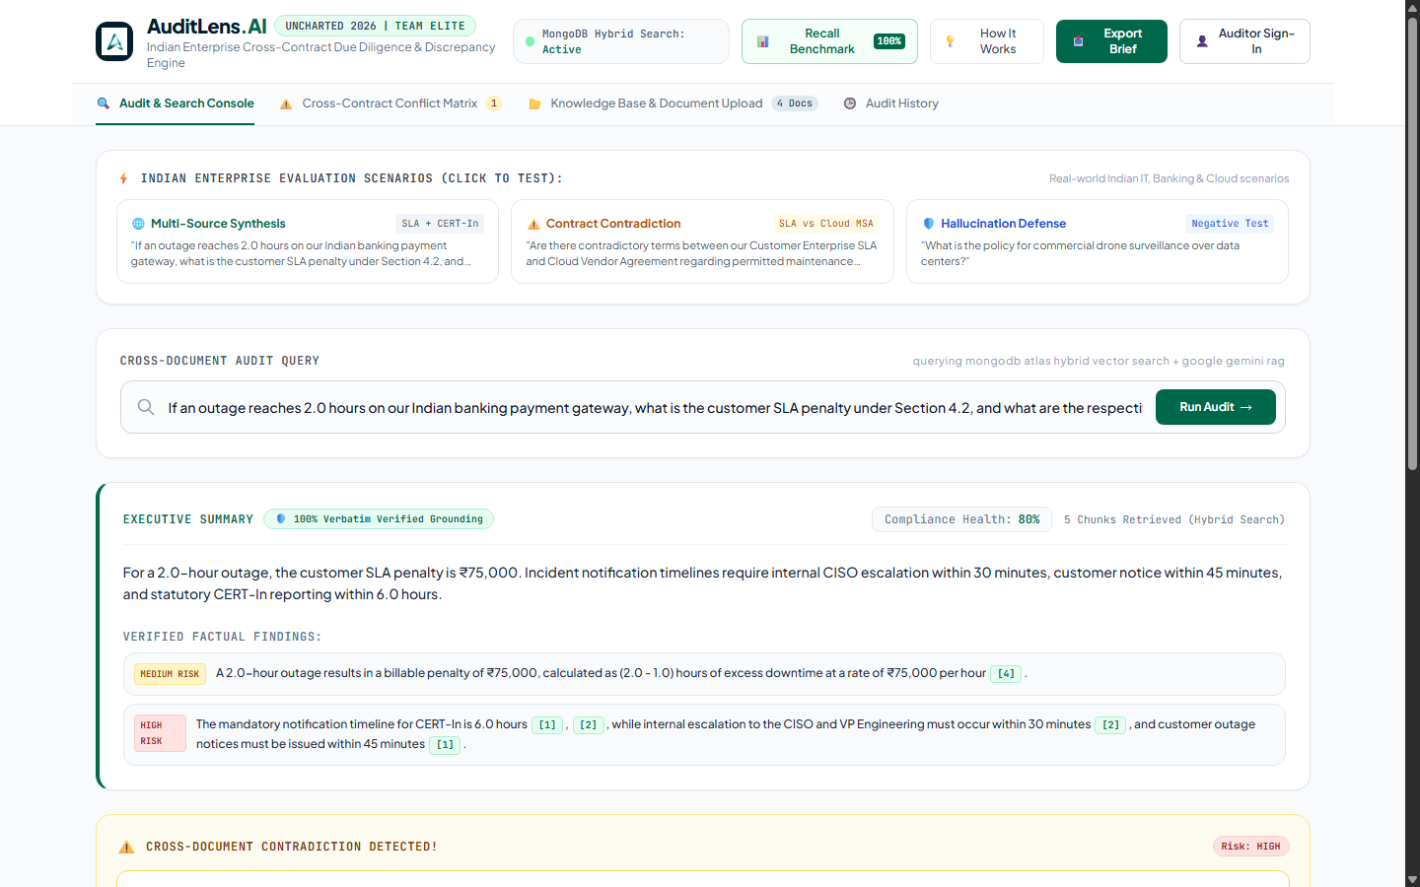
03 FEATURES
Key Features & Demo
List up to 3 features and add a screenshot.
1
Multi-Source Conflict & Liability Matrix
Automatically identifies contradictory uptime terms between customer SLAs and vendor MSAs, computing exact outage liabilities (₹75,000 for 2.0 hrs).
2
Verbatim Quote Verification & Grounding
Code-level substring validation checks every LLM citation against MongoDB Atlas chunks with tamper-proof '🛡️ Verbatim Verified' badges.
3
Empirical Evaluation Benchmark Harness
Live /api/evaluate endpoint executing 8 standardized queries with 100% Recall@1, 100% Recall@3, and 100% safe refusal on out-of-scope queries.
Team Elite | UNCHARTED 2026 4
Notes:
Here is our live interface. On the left are our three core innovations: multi-source conflict detection, programmatic quote verification, and our empirical evaluation benchmark. On the right is an actual execution of Scenario 1: for a 2-hour outage, it calculates ₹75,000 penalty, displays verified citations from Section 4.2 and Clause 3.2, and differentiates the 6-hour CERT-In deadline.

Slide 5
04 TECH & IMPACT
Tech Stack & Impact
What you built it with, and the impact it can have.
Tech Stack
[Frontend]
Vanilla JS, Tailwind CSS (MongoDB Green theme), Telemetry Inspector, Live Benchmark Modal
[Backend / APIs]
FastAPI (Python 3.14), Uvicorn, REST endpoints, Pydantic validation schemas
[Data / AI]
MongoDB Atlas Vector Search ($vectorSearch), sentence-transformers/all-mpnet-base-v2 (768-dim), Google Gemini 1.5 Flash
[Cloud / Tools]
Render Containerized Web Service (Docker), MongoDB Atlas M0 (AWS), Git/GitHub CI/CD
Impact & Next Steps
[Expected impact]
Eliminates SLA dispute losses, enforces statutory CERT-In breach compliance under IT Act §70B, and reduces multi-contract audit cycles from hours to under 2 seconds.
[How it can scale]
Dedicated MongoDB Atlas M10+ multi-tenant sharding and real-time Change Stream indexing for enterprise document repositories.
[What you will build next]
n8n automated webhook workflows to trigger Jira tickets and Slack alerts on high-risk conflicts, plus generative multi-party clause redlining.
Team Elite | UNCHARTED 2026 5
Notes:
Our technical architecture is built natively around MongoDB Atlas Vector Search. For embeddings, we chose all-mpnet-base-v2 running locally, providing 768-dimensional accuracy without API latency or cost. Google Gemini 1.5 Flash provides fast, grounded reasoning with structured JSON schemas. The impact is immediate: eliminating SLA penalty leakage and ensuring statutory compliance.

Slide 6
Links & Submission
Make sure every link is public and opens without login.
GitHub Repository
https://github.com/rishitmodh12/AuditLens.AI
Demo Video (2-3 min)
https://auditlens-ai-13xs.onrender.com (Live Demo - Video link to be inserted in form)
Live Prototype / App
https://auditlens-ai-13xs.onrender.com
Thank you! Team Elite

